Slide 1
Artificial Intelligence for Health Metricians, Week 8: Unsupervised Learning
Abraham D Flaxman
Feb 23 & 25, 2015

Slide 2
Any questions?

Slide 3
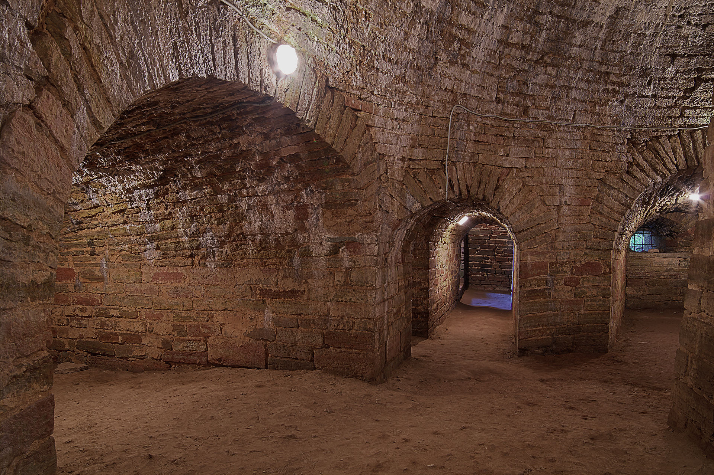
Back to HSL for rest of the quarter
Notes:
http://commons.wikimedia.org/wiki/File:Fortress_%22Oreshek%22._King_tower_(Korolevskaya)._Interior_of_the_dungeon..jpg

Slide 4
Projects
Baseline model?
Notes:
Starting with decision trees. DM focuses on pruning methods, while ISL focuses on ensembles of trees. I’m saving ensembles for later, so the focus here is on trees, greedy construction, and pruning

Slide 5
Baseline Model
Data prepped from Week 6 HW
What is the simplest approach?
How will you measure its success?
Try it out, how does it do?
The results will be an annotated IPython notebook describing the baseline method, metric(s) of success, and performance.

Slide 6
Before, during, and after this week
Before this week: Read DM 6.8 and ISL 10, implement and evaluation baseline model
During class: Grapple with the challenge of unsupervised learning. Run k-means, affinity propagation, single linkage, Gaussian mixture model, and compared the results visually
Outside of classes:
Read (DM 7), finish Clustering exercise, implement and evaluate improved model 1 for class project.

Slide 7
Lecture 8 Outline
Homework solutions
Project check-ins
Unsupervised Learning (PCA & Clustering)
Exercise 8: PCA & Clustering

Slide 8
Any (more) questions?

Slide 9
Lecture 8 Outline
Homework solutions
Project check-ins
Unsupervised Learning (PCA & Clustering)
Exercise 8: PCA & Clustering

Slide 10
Lecture 8 Outline
Homework solutions
Project check-ins
Unsupervised Learning (PCA & Clustering)
Exercise 8: PCA & Clustering

Slide 11
Improved Model One
Make most important changes/additions to data and/or model
How does it compare to baseline approach?
The results will be an annotated IPython notebook describing the improved model and how it compares to the baseline method.

Slide 12
Check-in (~5 min each)
What did you do in last week?
What will you do in next week?
What are you stuck on?

Slide 13
Lecture 8 Outline
Homework solutions
Project check-ins
Unsupervised Learning (PCA & Clustering)
Exercise 8: PCA & Clustering

Slide 14
PCA
Principle Component Analysis
Kernalized PCA
Factor Analysis?
Multidimensional Scaling?
Random Trees Embedding?

Slide 15
Distances
Assumption of shifting in PCA
Importance of scaling to PCA
Reiterate kernel stuff

Slide 16
Clustering
K-means
Hierarchical Clustering
Affinity Propagation?
DBSCAN?
Gaussian Mixture Models?
Kleinberg’s argument on why there are so many clustering methods: https://www.cs.cornell.edu/home/kleinber/nips15.pdf

Slide 17
Distances revisited
Even more important now
Some options available in sklearn: [‘cityblock’, ‘cosine’, ‘euclidean’, ‘l1’, ‘l2’, ‘manhattan’, ‘braycurtis’, ‘canberra’, ‘chebyshev’, ‘correlation’, ‘dice’, ‘hamming’, ‘jaccard’, ‘kulsinski’, ‘mahalanobis’, ‘matching’, ‘minkowski’, ‘rogerstanimoto’, ‘russellrao’, ‘seuclidean’, ‘sokalmichener’, ‘sokalsneath’, ‘sqeuclidean’, ‘yule’]

Slide 18
Lecture 8 Outline
Homework solutions
Project check-ins
Unsupervised Learning (aka Clustering)
Exercise 8: PCA & Clustering

