Slide 1
Intro to PCB Design
A primer to designing you own hacking tools.

Slide 2
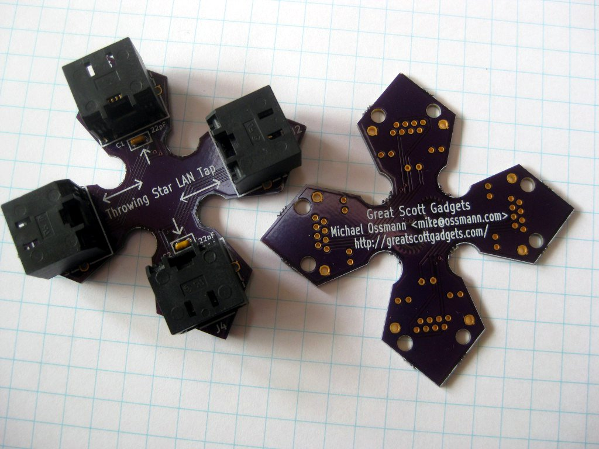
Objective:
Design a LAN Tap

Slide 3
Required tools:
Eagle CAD: http://bit.ly/1LnGIO4
Course Files: https://github.com/osteth/Intro_to_pcb

Slide 4
Getting started:
Install Eagle CAD and Part Libraries.
--Place the contents of the libraries folder into <install-path>/Eagle-7.4.0/lbr
Run the Eagle CAD Program.
Run as freeware. (find your own crack later)
--If prompted about a directory not existing click yes to create the directory.

Slide 5
Instruction time :)
Follow along with me!

Slide 6
Production Resources
Boards: http://www.oshpark.com
Stencils: http://www.oshstencils.com
Components: http://www.Digikey.com

Slide 7
Additional Educational Resources:
https://learn.sparkfun.com/tutorials/using-eagle-schematic
https://www.youtube.com/watch?v=1AXwjZoyNno
http://www.eevblog.com/
https://learn.sparkfun.com/tutorials/where-do-i-start

