Slide 1

NONHOLONOMIC WHEELED MOBILE ROBOT CONTROL
Presented by:
Karam, Carlo B.
Khairallah, Nadim F.
Rayess, Ralph C.

Slide 2
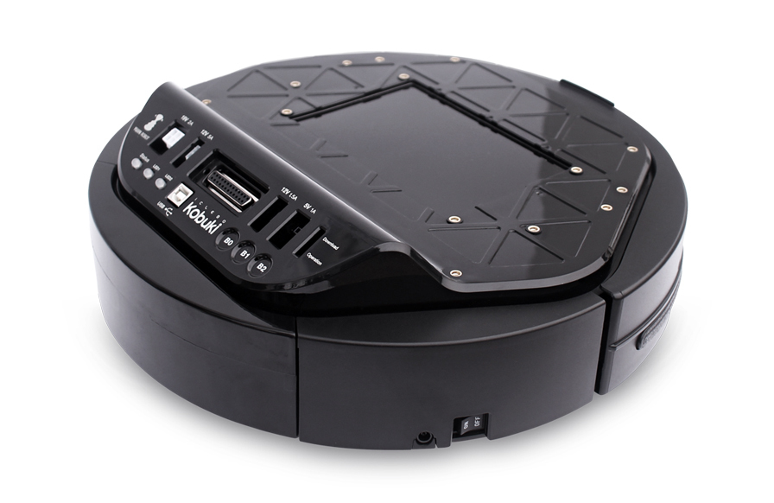
Ralph Rayess
Introduction
Low cost research platform for advancement in robotics and control
Differential drive wheeled mobile robot with a built it PID to track input reference velocities.
Goal
Implement a controller combining kinematic control and a MRAC for dynamic compensation, to track a predefined trajectory

Slide 3
Ralph Rayess
Literature Review
As wheeled mobile robots are subjected to both holonomic and nonholonomic constraints and exhibit highly nonlinear dynamics, it has been shown that these platforms are not properly stabilizable by standard linear controllers. We have two major categories:
Pure Kinematic Controllers
Nonlinear controllers
Controllers via dynamic feedback linearization (most common)
Combined Action Controllers
Dynamic feedback input-output linearization
MRAC via standard or neural network methods
“High-level” velocity controllers, or “low-level” motor torque controllers

Slide 4
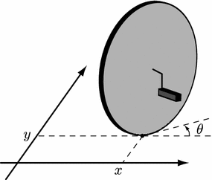
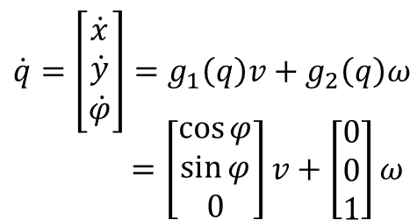



Carlo Karam
Modelling
Kinematic Model
Generalized Coordinates:
$$q= {\left[\begin{matrix}x & y & φ\end{matrix}\right]}^{T}$$
$$A\left(q\right) \dot{q}=\dot{x} \sin{θ}− \dot{y}\cos{θ}$$
Rolling without slipping constraint
$$φ$$
1st Order Kinematics
Unicycle Kinematic Diagram

Slide 5
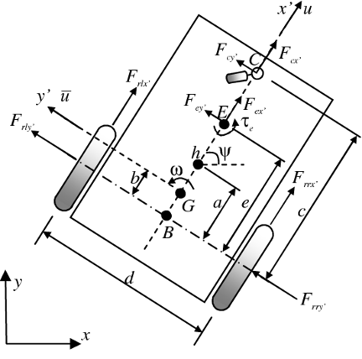
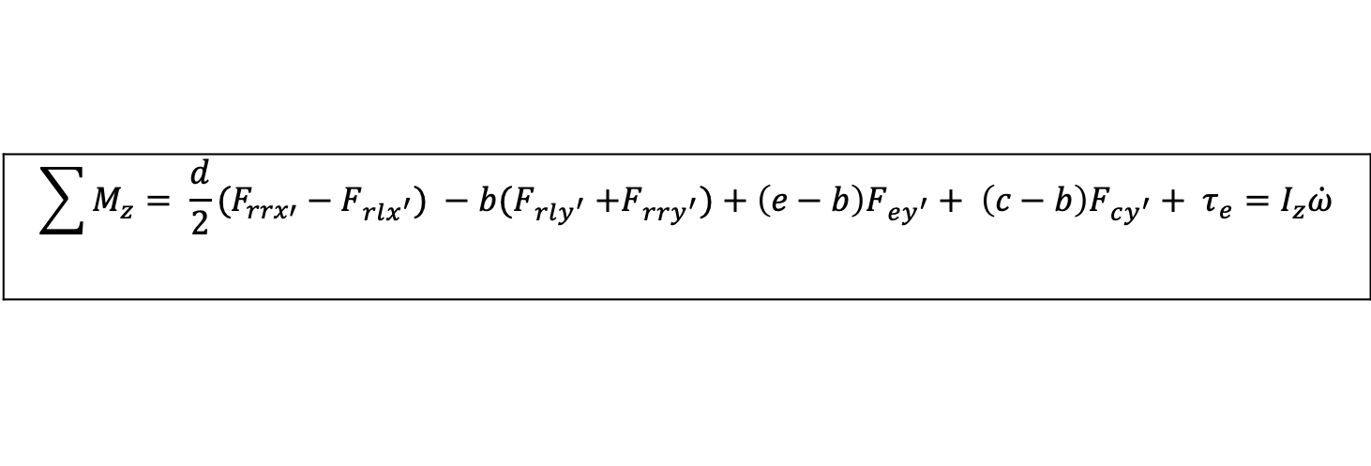
Ralph Rayess
Modelling
Dynamic Model (1/3)
$$\sum{F_{x′}= F_{rlx′}+F_{rrx′}+F_{ex^{′}}+ F_{cx′}}=m(\dot{u}−\overline{u}ω)$$
$$\sum{F_{y′}= F_{rly′}+F_{rry′}+F_{ey^{′}}+ F_{cy′}}=m(\dot{\overline{u}}+uω)$$
$$\sum{M_{z}= {\frac{d}{2}(F}_{rrx′}−F_{rlx^{′}}) {− b(F}_{rly^{′}}+F_{rry^{′}})+{\left(e−b\right)F}_{ey^{′}}+ {\left(c−b\right)F}_{cy^{′}}+ τ_{e}}=I_{z}\dot{ω}$$

Slide 6
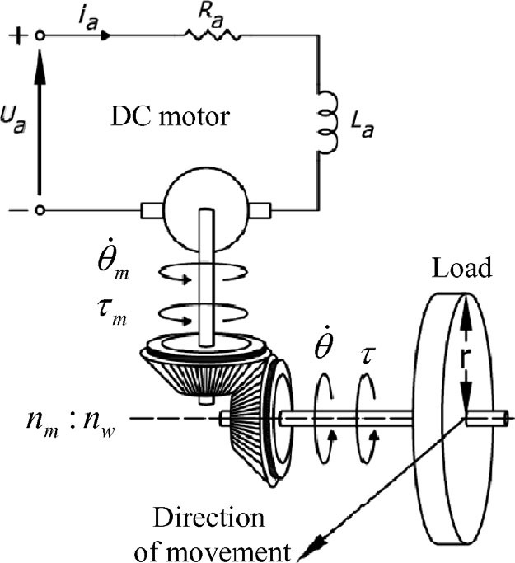


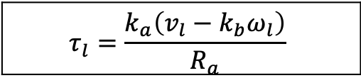
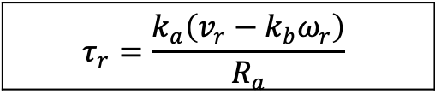
Ralph Rayess
Modelling
Dynamic Model (2/3)
Motor to Wheel Dynamics:
$$τ_{r}=\frac{k_{a}\left(v_{r}−k_{b}ω_{r}\right)}{R_{a}}$$
$$τ_{l}=\frac{k_{a}\left(v_{l}−k_{b}ω_{l}\right)}{R_{a}}$$
$$I_{e}{\dot{ω}}_{r}+B_{e}w_{r}=τ_{r}−F_{rrx}R_{t}$$
$$I_{e}{\dot{ω}}_{l}+B_{e}w_{l}=τ_{l}−F_{rlx}R_{t}$$

Slide 7
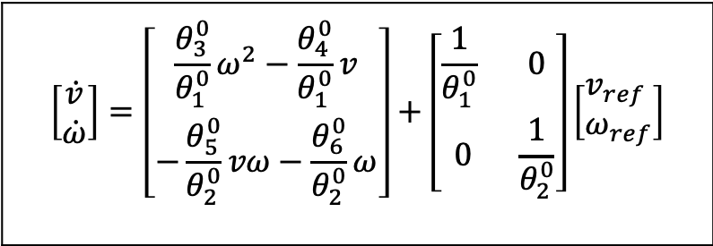
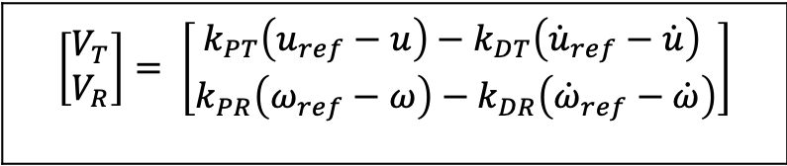
Ralph Rayess
Modelling
Dynamic Model (3/3)
$\left[\begin{aligned}V_{T} \\ V_{R}\end{aligned}\right]= \left[\begin{aligned}k_{PT}\left(u_{ref}−u\right)−k_{DT}\left({\dot{u}}_{ref}−\dot{u}\right) \\ k_{PR}\left(ω_{ref}−ω\right)−k_{DR}\left({\dot{ω}}_{ref}−\dot{ω}\right)\end{aligned}\right]$
Integrated PD controller to track reference input velocities:
$$\left[\begin{matrix}\dot{v} \\ \dot{ω}\end{matrix}\right]=\left[\begin{matrix}\frac{θ_{3}^{0}}{θ_{1}^{0}}ω^{2}−\frac{θ_{4}^{0}}{θ_{1}^{0}}v \\ −\frac{θ_{5}^{0}}{θ_{2}^{0}}vω−\frac{θ_{6}^{0}}{θ_{2}^{0}}ω\end{matrix}\right]+\left[\begin{matrix}\frac{1}{θ_{1}^{0}} & 0 \\ 0 & \frac{1}{θ_{2}^{0}}\end{matrix}\right]\left[\begin{aligned}&v_{ref} \\ &ω_{ref}\end{aligned}\right]$$
Reference input velocities to actual velocities dynamics for a unicycle-like WMR:

Slide 8
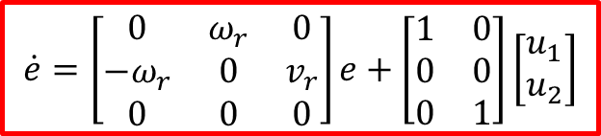


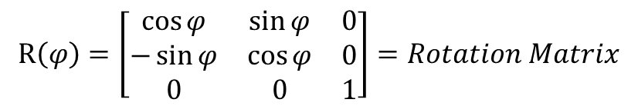
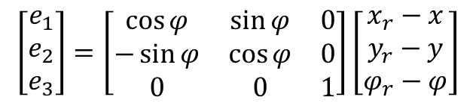
Carlo Karam
Control System Design
Kinematic Controller (1/2)
We wish to track a reference trajectory $q_{r}= {\left[\begin{matrix}x_{r}\left(t\right) & y_{r}\left(t\right) & φ_{r}\left(t\right)\end{matrix}\right]}^{T}$
We define our tracking errors as:
$$\left[\begin{matrix}e_{1} \\ e_{2} \\ e_{3}\end{matrix}\right]=\left[\begin{matrix}\cos{φ} & \sin{φ} & 0 \\ −\sin{φ} & \cos{φ} & 0 \\ 0 & 0 & 1\end{matrix}\right]\left[\begin{matrix}x_{r}−x \\ y_{r}−y \\ φ_{r}−φ\end{matrix}\right]$$
$$R\left(φ\right)=\left[\begin{matrix}\cos{φ} & \sin{φ} & 0 \\ −\sin{φ} & \cos{φ} & 0 \\ 0 & 0 & 1\end{matrix}\right]=Rotation Matrix$$
where
$$v=v_{r}\cos{e_{3}}−u_{r1}$$
$$ω= ω_{r}−u_{r2}$$
$$\dot{e}=\left[\begin{matrix}0 & ω_{r} & 0 \\ −ω_{r} & 0 & v_{r} \\ 0 & 0 & 0\end{matrix}\right]e+\left[\begin{matrix}1 & 0 \\ 0 & 0 \\ 0 & 1\end{matrix}\right]\left[\begin{matrix}u_{1} \\ u_{2}\end{matrix}\right]$$
Linearized Error Dynamics

Slide 9

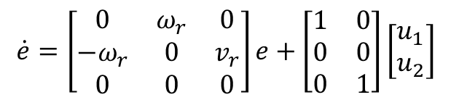
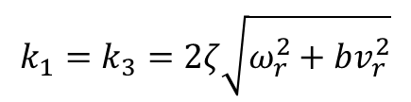
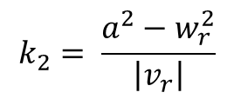



Carlo Karam
Control System Design
Kinematic Controller (2/2)
$$\dot{e}=\left[\begin{matrix}0 & ω_{r} & 0 \\ −ω_{r} & 0 & v_{r} \\ 0 & 0 & 0\end{matrix}\right]e+\left[\begin{matrix}1 & 0 \\ 0 & 0 \\ 0 & 1\end{matrix}\right]\left[\begin{matrix}u_{1} \\ u_{2}\end{matrix}\right]$$
$$k_{1}=k_{3}=2ζ\sqrt{ω_{r}^{2}+bv_{r}^{2}}$$
Gain Scheduling:
$$k_{2}=b\left|v_{r}\right|$$
Where $a= \sqrt{ω_{r}^{2}+bv_{r}^{2}}$, $ζ=0.707$ and $b=10$
$$u_{1}= −k_{1}e_{1}$$
$$u_{2}= −k_{2}v_{r}e_{2}−k_{3}e_{3}$$
For our initial CLCE: $\left(s+2ζa)(s^{2}+2ζas+a^{2}\right)$
$$k_{2}= \frac{a^{2}−w_{r}^{2}}{\left|v_{r}\right|}$$

Slide 10
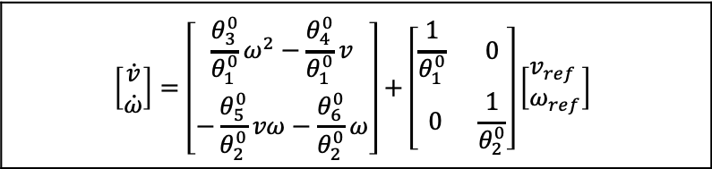
Nadim Khairallah
Control System Design
Dynamic Controller (1/5)
Motivation: Dynamic Compensation
Nonlinear Dynamic Model:
$$\left[\begin{matrix}\dot{v} \\ \dot{ω}\end{matrix}\right]=\left[\begin{matrix}\frac{θ_{3}^{0}}{θ_{1}^{0}}ω^{2}−\frac{θ_{4}^{0}}{θ_{1}^{0}}v \\ −\frac{θ_{5}^{0}}{θ_{2}^{0}}vω−\frac{θ_{6}^{0}}{θ_{2}^{0}}ω\end{matrix}\right]+\left[\begin{matrix}\frac{1}{θ_{1}^{0}} & 0 \\ 0 & \frac{1}{θ_{2}^{0}}\end{matrix}\right]\left[\begin{aligned}&v_{ref} \\ &ω_{ref}\end{aligned}\right]$$
$$\dot{x}=f\left(x,θ^{0}\right)+g(θ^{0}) u_{ref}$$
→ Need to linearize it to perform MRAC full state feedback

Slide 11
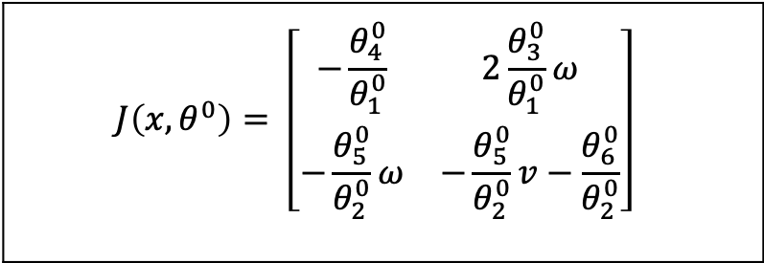
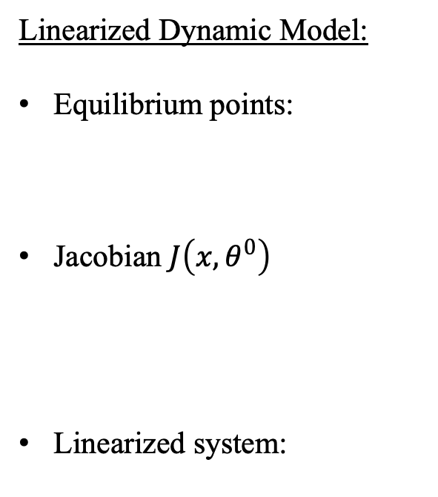
Nadim Khairallah
Control System Design
Dynamic Controller (2/5)
Linearized Dynamic Model:
Equilibrium points:
Jacobian $J\left(x,θ^{0}\right)$
Linearized system:
$\dot{x}=f\left(x,θ^{0}\right)=0$
$$J\left(x,θ^{0}\right)= \left[\begin{matrix}−\frac{θ_{4}^{0}}{θ_{1}^{0}} & 2\frac{θ_{3}^{0}}{θ_{1}^{0}}ω \\ −\frac{θ_{5}^{0}}{θ_{2}^{0}}ω & −\frac{θ_{5}^{0}}{θ_{2}^{0}}v−\frac{θ_{6}^{0}}{θ_{2}^{0}}\end{matrix}\right]$$
$$\dot{x}=Ax+Bu_{ref}$$

Slide 12

Nadim Khairallah
Control System Design
Dynamic Controller (3/5)
MRAC Full State Feedback:
Reference Model:
Linearized system:
Controller structure:
Controller parameters:
$${ \dot{x}}_{m}=A_{m}x_{m}+B_{m}u_{c}$$
$${\dot{v}}_{m}={−a}_{m1}v_{m}+ b_{m1}v_{c}$$ $${\dot{ω}}_{m}={−a}_{m2}ω_{m}+ b_{m2}ω_{c}$$
$$\dot{x}=Ax+Bu_{ref}$$
$$u_{ref}=Mu_{c}−Lx$$
$$θ_{c}={\left[m_{1}{ m}_{2} m_{3}{ m}_{4} l_{1} l_{2 }l_{3} l_{4} \right]}^{T}$$

Slide 13


Nadim Khairallah
Control System Design
Dynamic Controller (3/5)
MRAC Full State Feedback:
Closed loop system:
Perfect model-following conditions:
Error equation:
$$\dot{x}=\left(A−BL\right)x+BMu_{c}$$
$$A_{CL}=A−BL= A_{m}$$ $$B_{CL}=BM= B_{m}$$
$${θ_{c}}^{0}$$
$$e=x−x_{m}$$

Slide 14
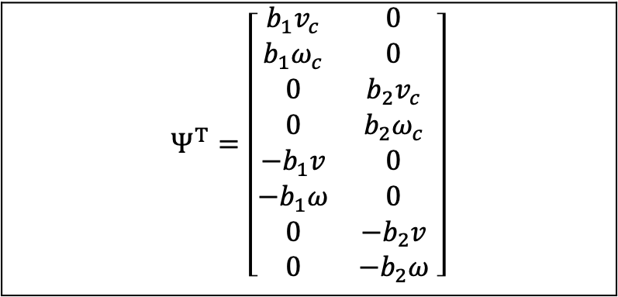
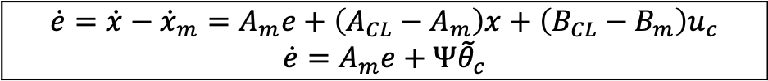
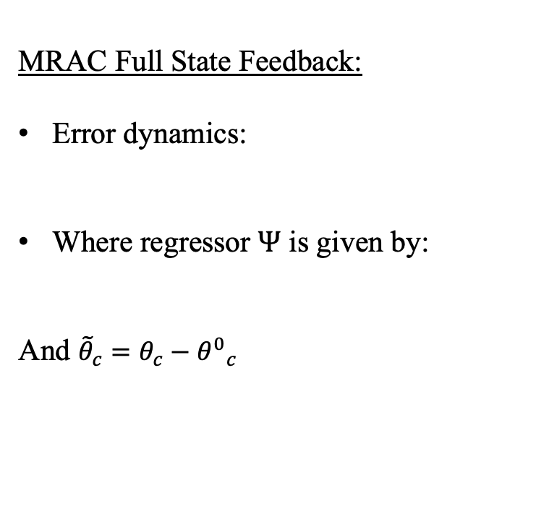
Nadim Khairallah
Control System Design
Dynamic Controller (4/5)
MRAC Full State Feedback:
Error dynamics:
Where regressor $Ψ$ is given by:
And ${\tilde{θ}}_{c}=θ_{c}−{θ^{0}}_{c}$
$$\dot{e}=\dot{x}−{\dot{x}}_{m}=A_{m}e+\left(A_{CL}−A_{m}\right)x+\left(B_{CL}−B_{m}\right)u_{c}$$ $$\dot{e}=A_{m}e+Ψ{\tilde{θ}}_{c}$$
$$Ψ^{T}=\left[\begin{matrix}b_{1}v_{c} & 0 \\ b_{1}ω_{c} & 0 \\ 0 & b_{2}v_{c} \\ 0 & b_{2}ω_{c} \\ −b_{1}v & 0 \\ −b_{1}ω & 0 \\ 0 & −b_{2}v \\ 0 & −b_{2}ω\end{matrix} \right]$$

Slide 15
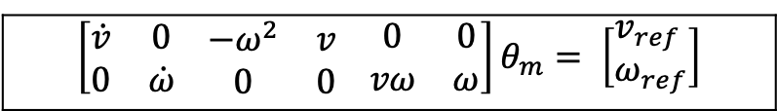

Nadim Khairallah
Control System Design
Dynamic Controller (5/5)
MRAC Full State Feedback:
Lyapunov candidate function:
Controller parameters adaptation law:
RLS for model parameter estimation:
$$V=\frac{1}{2}{(e}^{T}Pe+{{\tilde{θ}}_{c}}^{T}Γ^{−1}{\tilde{θ}}_{c})$$
$${\dot{\tilde{θ}}}_{c}=−ΓΨ^{T}Pe$$
$$\left[\begin{matrix}\dot{v} & 0 \\ 0 & \dot{ω}\end{matrix} \begin{matrix}−ω^{2} & v \\ 0 & 0\end{matrix} \begin{matrix}0 & 0 \\ vω & ω\end{matrix}\right]θ_{m}= \left[\begin{aligned}&v_{ref} \\ &ω_{ref}\end{aligned}\right]$$
$$φ^{T}θ_{m}=u_{ref}$$

Slide 16
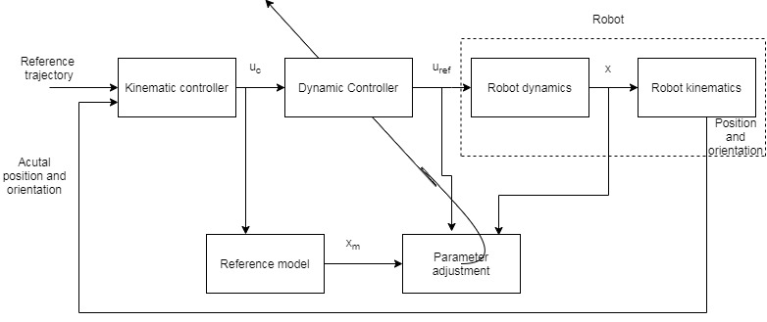
Nadim Khairallah
Control System Design
Our proposed controller is thus represented by the block diagram:

Slide 17
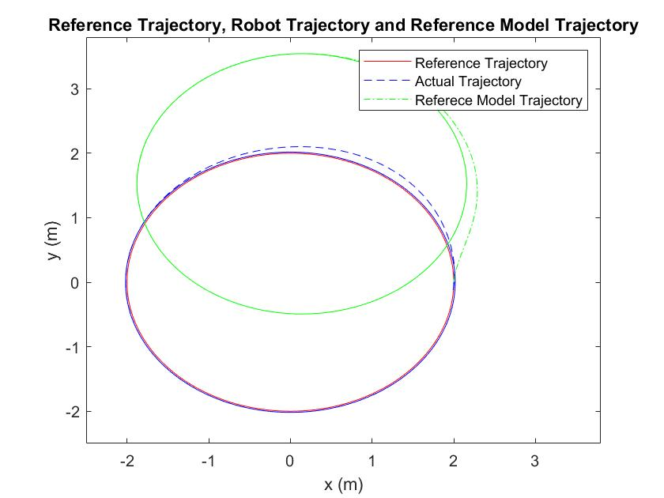
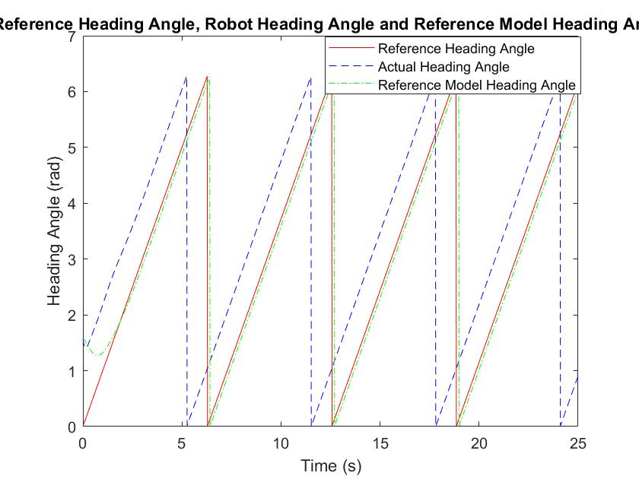
Nadim Khairallah
Simulation Results (No Disturbance)

Slide 18
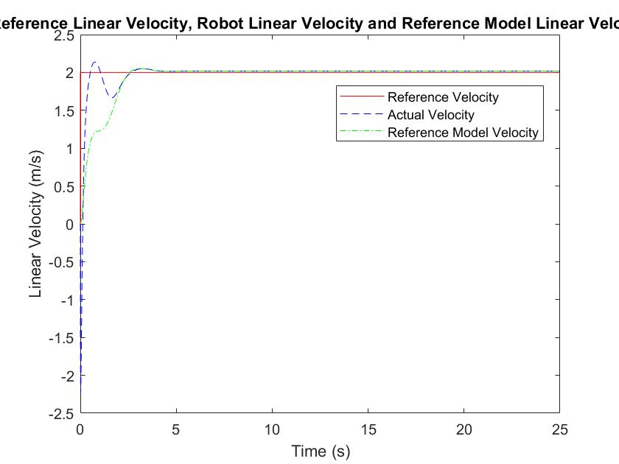
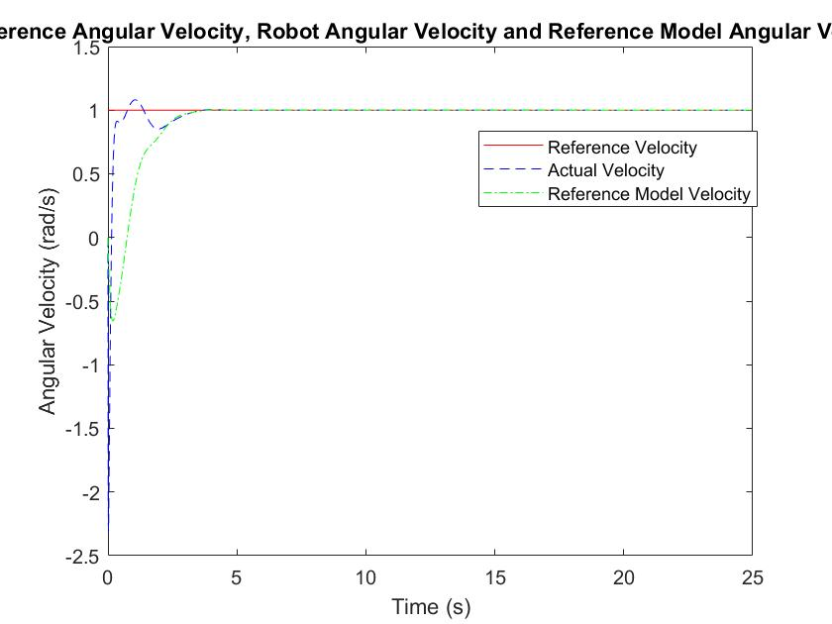
Nadim Khairallah
Simulation Results (No Disturbance)

Slide 19
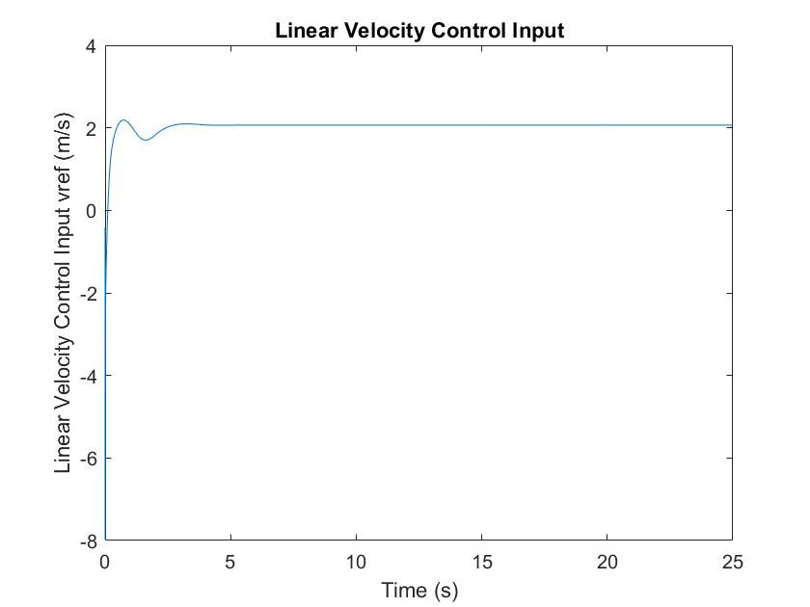
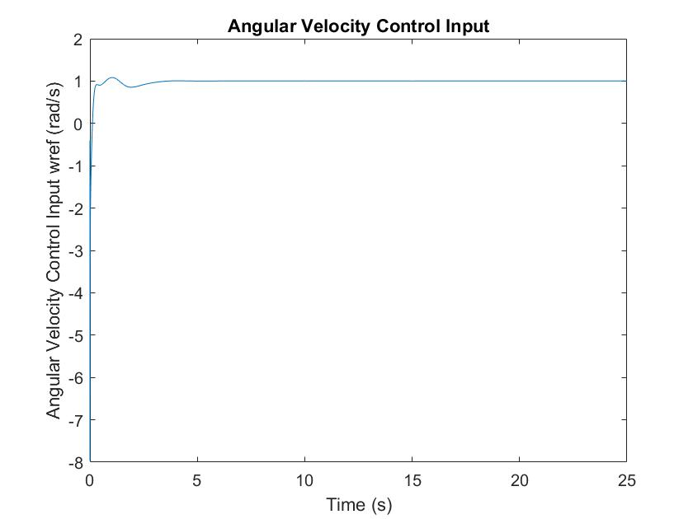
Nadim Khairallah
Simulation Results (No Disturbance)

Slide 20
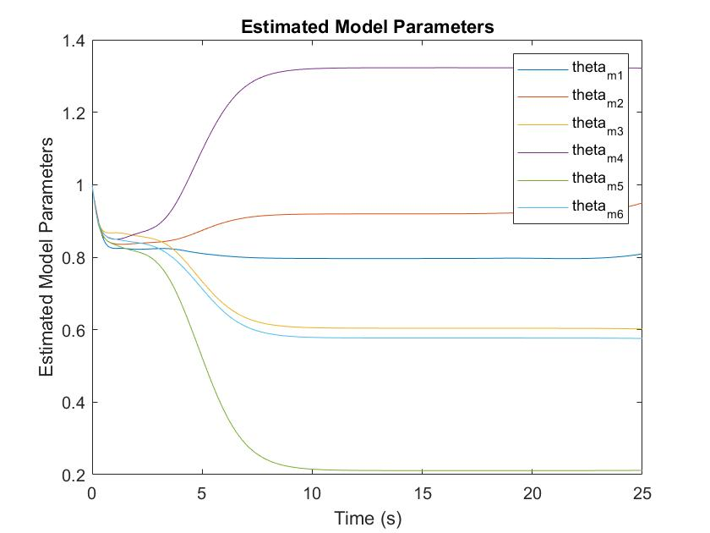
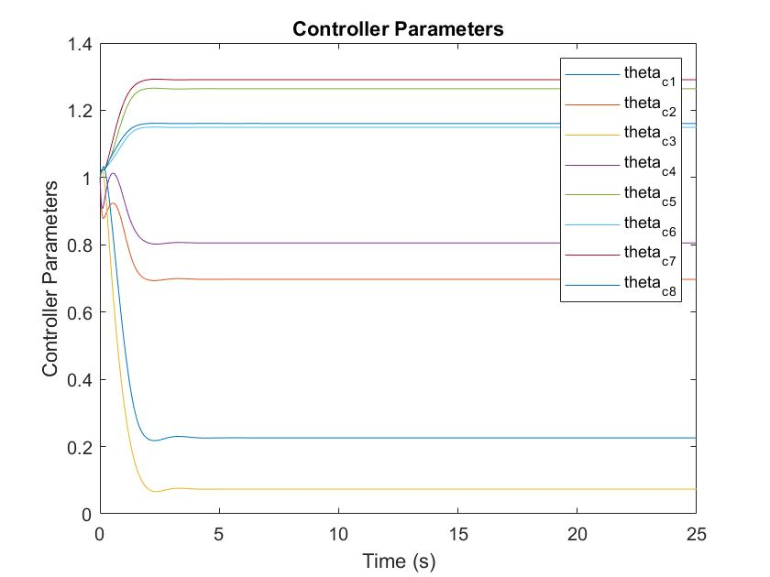
Nadim Khairallah
Simulation Results (No Disturbance)

Slide 21
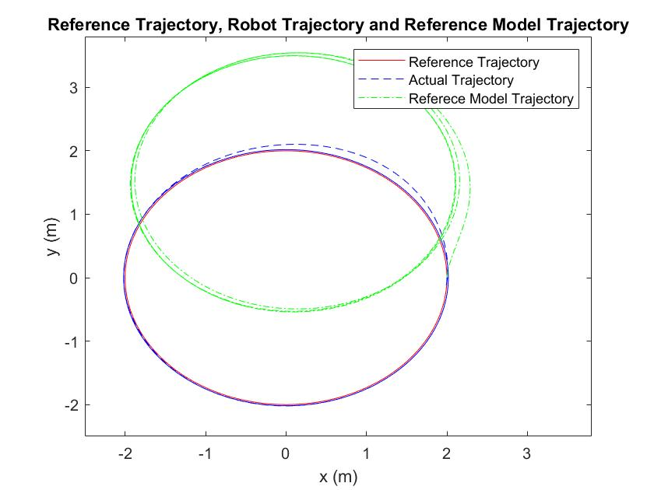
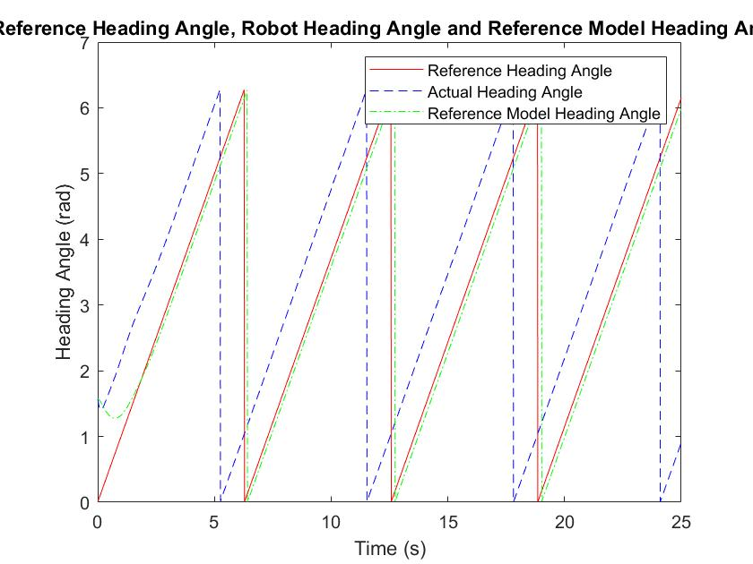
Carlo Karam
Simulation Results (w/ Disturbance)

Slide 22
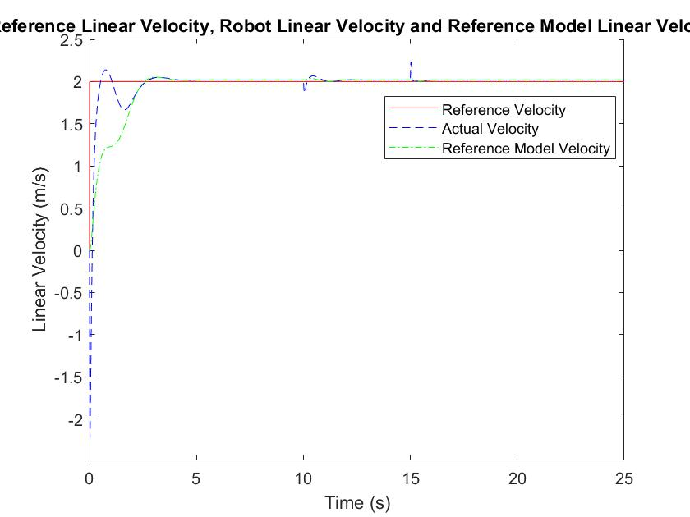
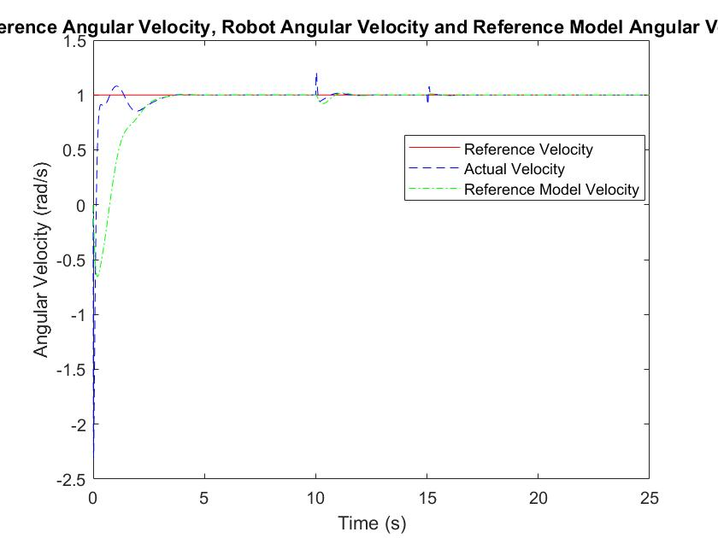
Carlo Karam
Simulation Results (w/ Disturbance)

Slide 23
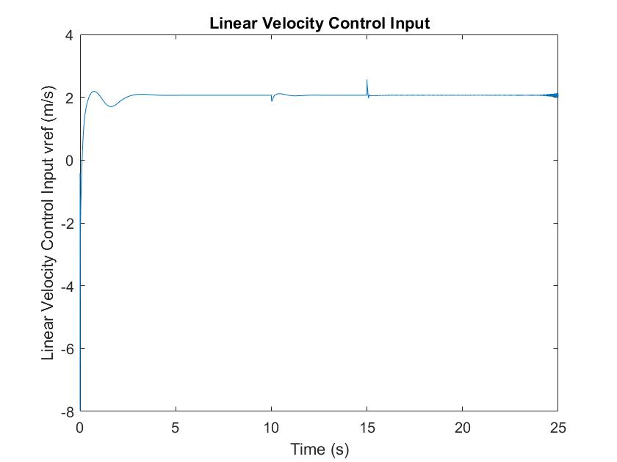
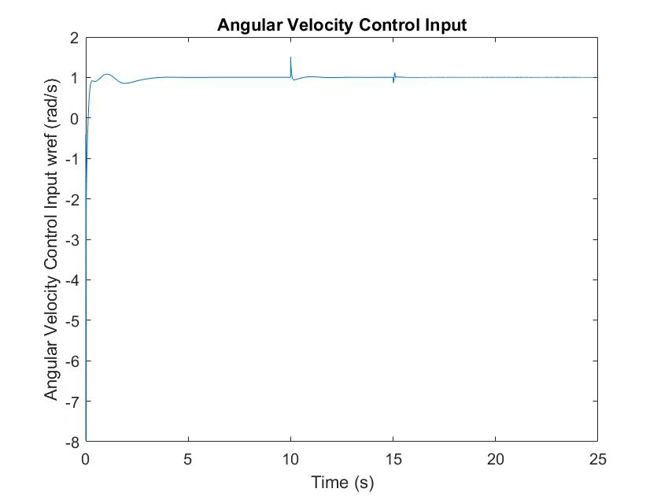
Carlo Karam
Simulation Results (w/ Disturbance)

Slide 24
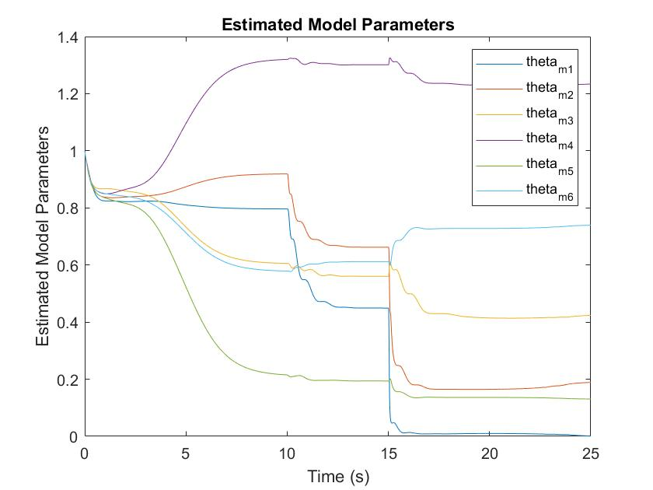
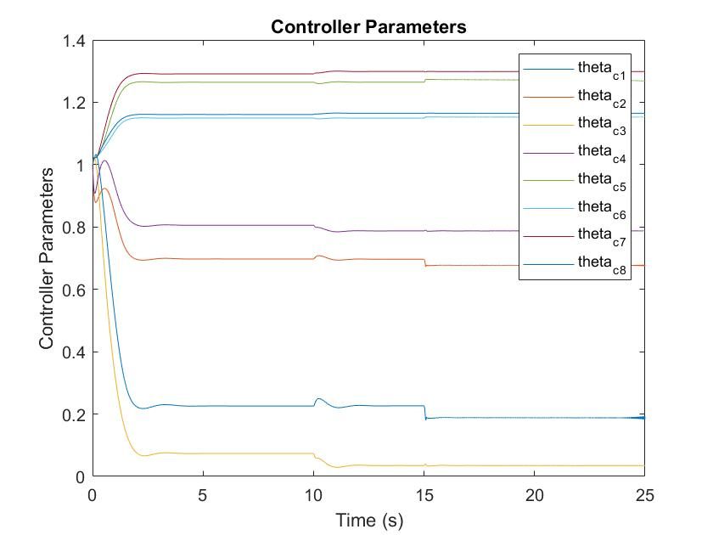
Carlo Karam
Simulation Results (w/ Disturbance)

Slide 25
Ralph Rayess
Conclusions
Successful tracking of predefined trajectory achieved by the combined kinematic and adaptive controllers.
Disturbances don’t affect the performance significantly. The controller successfully rejects these.
Such a controller can be implemented in industrial robot solutions where dynamical parameters are unknown or subject to variation.

