Slide 1


COMPUTER ENGINEERING
MASTER’S DEGREE
PROTOTYPE PRESENTATION
GUARDIAN
Child & Pet Safety
CARLO PIO PACE
PRASHANT GAUTAM

Slide 2
ABSTRACT
Preventable fatalities from vehicular heatstroke continue to occur globally, resulting from instances where children or pets are inadvertently left by themselves or where children gain unsupervised access to vehicles. To address this safety challenge, this paper proposes a Child and Pet Presence Detection (CPPD) system, covering its architecture, deployment, and performance assessment.
This system employs visual and acoustic sensors, to acquire data processed by a Raspberry Pi 3B+ to actively monitor the cabin environment immediately after vehicle closure. Upon detecting a living occupant, the system sends alerts to a designated caregiver.

Slide 3
INTRODUCTION
The phenomenon of vehicular heatstroke, often referred to as "Hot Car Death“, is a critical safety issue that continues to claim the lives of vulnerable occupants, particularly young children and pets. When a vehicle is parked in direct sunlight, the interior temperature can rise rapidly due to the greenhouse effect.
Despite public awareness campaigns, these incidents frequently occur due to "Forgotten Baby Syndrome," a psychological phenomenon where a parent or a caregiver inadvertently leaves a quiet in the rear seat due to a disruption in routine, fatigue, or distraction. As modern vehicles become increasingly soundproof and tinted, manual detection by passersby becomes difficult, necessitating an automated technological solution, which could totally prevent those fatalities.

Slide 4
STATE OF THE ART
[1] C.-H. Choi, S. Hong, E. J. Jeong, and J. Han, “Infrared thermal imaging for embedded child presence detection system: Feasibility and performanceevaluation,” in Proceedings of the IEEE International Conference on ConsumerElectronics Asia (ICCE-Asia), Danang, Vietnam, 2024.
[2] C. -H. Choi, S. Hong, E. J. Jeong and J. Han, "Infrared Thermal Imaging for Embedded Child Presence Detection System: Feasibility and Performance Evaluation," 2024 IEEE International Conference on Consumer Electronics-Asia (ICCE-Asia), Danang, Vietnam, 2024
[3] J. Gillner, R. Taylor, and K. Thelen, “Radar-based breathing sensor for child presence detection in automotive applications,” in 2024 IEEE 67th International Midwest Symposium on Circuits and Systems (MWSCAS). IEEE, 2024,pp. 104–107.
[4] M. A. H. M. Nazri, S. A. B. C. Abdullah, A. Ahmad, F. H. K. Zaman, N. K.Mun, and M. F. M. Salleh, “In vehicle child presence detection using 60ghz radar,” in 2025 IEEE 8th International Conference on Electrical, Electronics,and System Engineering (ICEESE). IEEE, 2025, pp. 42–47.
[4] Y. Su, F. Zhang, K. Niu, T. Wang, B. Jin, Z. Wang, Y. Jiang, D. Zhang,L. Qiu, and J. Xiong, “Embracing distributed acoustic sensing in car cabin forchildren presence detection,” Proceedings of the ACM on Interactive, Mobile,Wearable and Ubiquitous Technologies, vol. 8, no. 1, Mar. 2024.

Slide 5
SYSTEM FUNCTIONALITIES
THE SYSTEM USE A COMBINATION OF SENSORS AND AI MODELS TO DETECT THE PRESENCE OF A CHILD OR PET , UNACOMPAINED INSIDE A CAR.
IN SUCH CASE SEND AN ALERT TO THE USER.

Slide 6






PROTOTYPE ARCHITECTURE
IMAGE CLASSIFICATION MODULE
Detects the cabin occupants and sends
the result to the brain module.
EYE MODULE
COMMUNICATIONS MODULE
Acquires images from the camera,
pre-process them, then send the result
to the image classification module.
Once triggered, sends the alert to a designated caregiver, leveraging the Telegram APIs.
BRAIN MODULE
Coordinates eye and ear, and classification modules, process their output, evaluate the state and if necessary trigger the communications module.
EAR MODULE
Acquire the sound, and the pre-process it, provide the output to the audio classification module
AUDIO CLASSIFICATION MODULE
Classify the audio and sends the result to the brain module.

Slide 7
PROTOTYPE ARCHITECTURE
IMAGE BASED DETECTION MODEL
SOUND BASED DETECTION MODEL
DETECTS :
ADULTS
CHILDS
PETS
DETECTS :
ADULTS SOUNDS (SPEAKING)
CHILDS SOUNDS
PET SOUNDS (BARKING)
NOISE
SILENCE

Slide 8
STATE OF THE ART
[1] Van Thanh, Hoang, et al. "An Efficient Object Detection Model Based on NanoDet." 2025 International Workshop on Intelligent Systems (IWIS). IEEE, 2025
[2] Yerulan, Turganbek, and Duisebekov Zhasdauren. "COMPARATIVE STUDY OF LIGHTWEIGHT OBJECT DETECTION MODELS FOR MOBILE PEDESTRIAN DETECTION." Universum: технические науки 10.5 (134) (2025): 4-8.
[3] Sapkota, R., Cheppally, R. H., Sharda, A., & Karkee, M. (2026). YOLO26: Key Architectural Enhancements and Performance Benchmarking for Real-Time Object Detection. arXiv:2509.25164.
[4] Cao, J., Peng, B., Gao, M., Hao, H., Li, X. and Mou, H. (2025), Object Detection Based on CNN and Vision-Transformer: A Survey. IET Comput. Vis, 19: e70028. https://doi.org/10.1049/cvi2.70028
[5] Ali, M. L., & Zhang, Z. (2024). The YOLO Framework: A Comprehensive Review. Computers, 13(12), 336. https://doi.org/10.3390/computers13120336

Slide 9
STATE OF THE ART
[6] Gourisaria, Mahendra Kumar, et al. "Comparative analysis of audio classification with MFCC and STFT features using machine learning techniques." Discover Internet of Things 4.1 (2024): 1.
[7] Podda, Alessandro Sebastian, et al. "CARgram: CNN-based accident recognition from road sounds through intensity-projected spectrogram analysis." Digital Signal Processing 147 (2024): 104431.
[8] Valliappan, N. Harihara, Sagar Dhanraj Pande, and Surendra Reddy Vinta. "Enhancing gun detection with transfer learning and YAMNet audio classification." IEEE Access 12 (2024): 58940-58949.
[9] Liu, LiFeng, et al. "YAMNet-based transfer learning for compact noise classification in urban and wireless systems." EURASIP Journal on Wireless Communications and Networking 2025.1 (2025): 74.
[10] Sakaki, Haruka, et al. "Comparative Evaluation of CNN, VGG16, Conformer, and YAMNet Models for Skateboard Riding Sound Detection." 2025 International Symposium on Multimedia and Communications Technology (ISMAC). IEEE, 2025.

Slide 10
AI MODELS : COMPARISON
IMAGE BASED DETECTION MODELS
MODEL | PARAMETERS [millions] | RESOLUTION | mAP50
picoDET | 2.15 | 416 | 0.86
nanoDET | 6.1 | 480 | 0.89
Yolo v5 NU | 2.6 | 640 | 0.924
Yolo v11 N | 2.6 | 640 | 0.917
Yolo v12 N | 2.6 | 640 | 0.922
Yolo v26 N | 2.4 | 480 | 0.905
Yolo v26 N | 2.4 | 640 | 0.928
Yolo v26 S | 9.5 | 640 | 0.947

Slide 11
AI MODELS : COMPARISON
SOUND BASED DETECTION MODEL
MODEL | PARAMETERS [millions] | Accuracy
SPECTROGRAM+CNN | 0.024 | 0.72
MFCC + SVM | 0.05 | 0.86
YAMNet+FFN | 0.66 | 0.88

Slide 12

HARDWARE SETUP

Slide 13
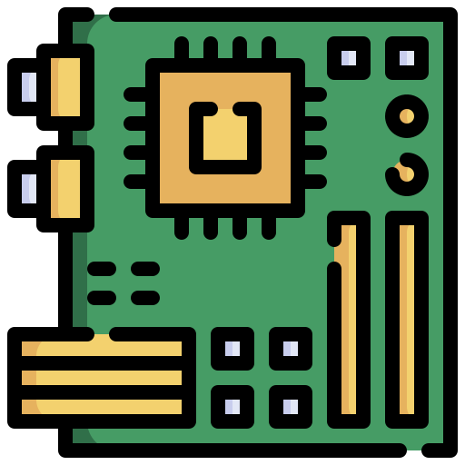
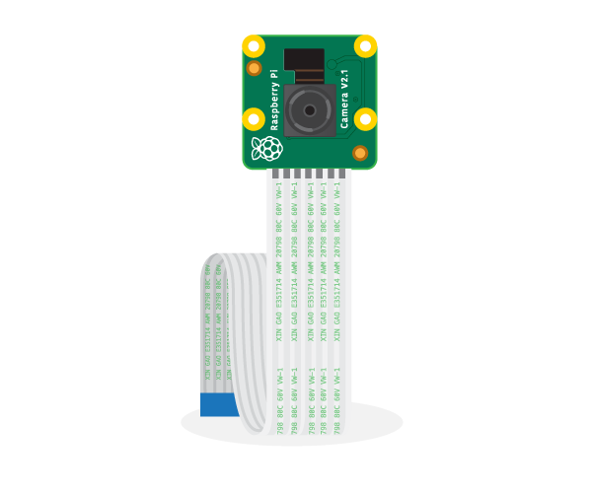
HARDWARE SETUP
RASPBERRY PI 3 MODEL B+
Processor: 1.4GHz 64-bit quad-core Broadcom BCM2837B0, Cortex-A53 (ARMv8) SoC.
Memory: 1GB LPDDR2 SDRAM.
Wireless Connectivity: Dual-band 2.4GHz and 5GHz IEEE 802.11.b/g/n/ac wireless LAN, Bluetooth 4.2/BLE.
GPIO: Extended 40-pin GPIO header.
Camera Support: CSI camera port for connecting a Raspberry Pi camera.
Power Input: 5V/2.5A DC power input.
RASPBERRY PI CAMERA MODULE (V2.1)
Sensor: Sony IMX219, 8-megapixel sensor.
Capabilities:
High-definition video recording: 1080p30, 720p60, VGA90 video modes.
Still image capture.
Connection: Attaches via a 15cm ribbon cable to the CSI port on the Raspberry Pi.
Software Support: Numerous third-party libraries are available, including the Picamera Python library.

Slide 14

HARDWARE SETUP
C MEDIA ELECTRONICS USB SOUND DEVICE
Processor : insert specs.
USB Version : 1.1
Channels : 1.
Sample Rate : 44100 Hz.
Audio Format : PCM.
Bit Resolution : 16 bits.

Slide 15



CAMERA INTEGRATION
Raspberry Pi
Camera
Raspberry Pi 3 +
OpenCV
Image

Slide 16





EYE MODULE
Acquired frame
Frame
pre-processing Pipeline
Bounding Boxes
&
Labels
Processed
frame
Image with detections

Slide 17

MICROPHONE INTEGRATION
Python
Sounddevice
Microphone
Raw audio signal

Slide 18


EAR MODULE
YAMNet
Audio
Embeddings
Raw
Audio
Processed
Audio
FFN
Audio
pre-processing Pipeline
Classifications

Slide 19
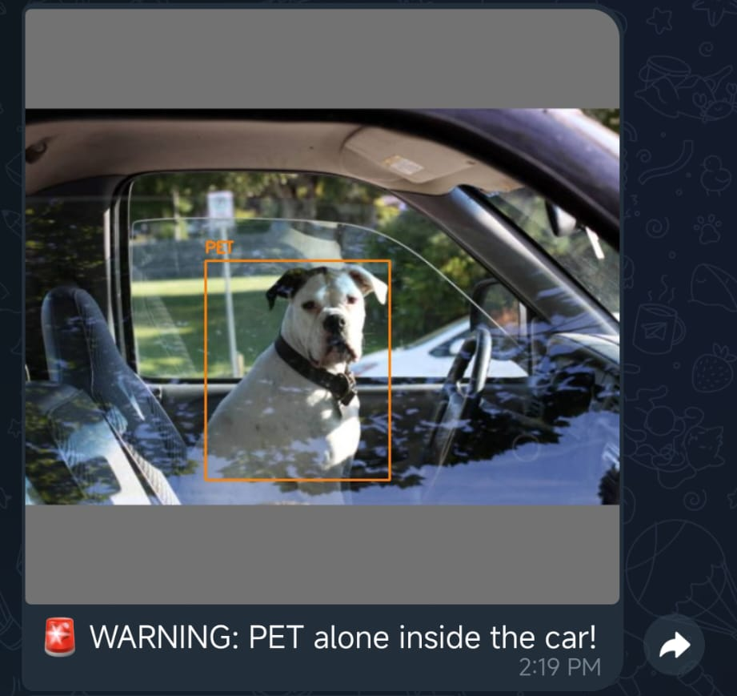
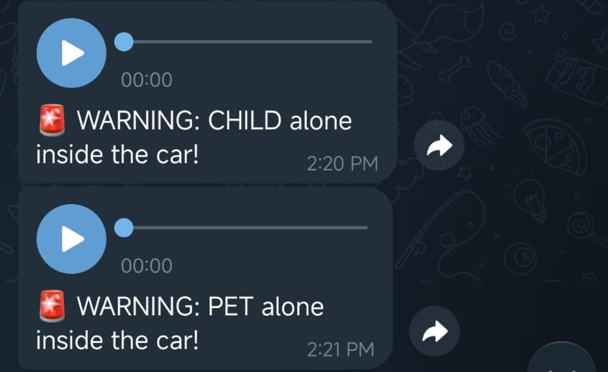
COMMUNICATIONS MODULE
LEVERAGES TELEGRAM APIs TO SEND 2 TYPES OF ALERT :
Visual Alert :
when a vulnerable occupant is detected through image, it sends a message and the image containing the ROI.
Sound Alert :
When the occupant is detected through sound, it send a message and the audio containing the sound.

Slide 20


DECISION LOGIC

Slide 21
GUARDIAN : FIRST VERSION
CHARACTERISICS :
Sequential approach
Yolo 26 Nano 480 (Image Model)
Inference on audio (Spectrogram on 5s audio)
SEQUENTIAL APPROACH :
Acquire image
Record audio
Inference on image
Inference on audio
Compute output, and if
needeed send the alert
PROBLEMS:
Recording the audio was the main bottleneck (waiting 5 seconds)
Output each 6 seconds on average

Slide 22

INFERENCE TIME
COMPARISON

Slide 23
INFERENCE TIME
COMPARISON
IMAGE MODELS
SOUND MODELS

Slide 24

OPTIMIZATION

Slide 25
OPTIMIZATION
IMPROVEMENTS:
Parallel approach (Exploiting Multiprocessing library and IPC)
Audio model improvements, dataset optimizations, needs shorter audio (3 seconds)
Switch to YOLO 26 Nano 640

Slide 26
GUARDIAN : OPTIMIZED VERSION
BRAIN PROCESS : MAIN PROCESS, STARTS EYE AND EAR PROCESS, WAITS THEIR OUTPUT, EVALUTE THE STATE, SEND ALERT MESSAGES
EYE PROCESS : STANDALONE PROCESS , INITIALIZE CAMERA, ACQUIRE THE IMAGE, PROCESS IT, MAKE INFERENCE , PROVIDE DETECTIONS AS OUTPUT
EAR PROCESS : STANDALONE PROCESS , INITIALIZE MICROPHONE, RECORD AN AUDIO, PROCESS IT, MAKE INFERENCE , PROVIDE DETECTIONS AS OUTPUT

Slide 27

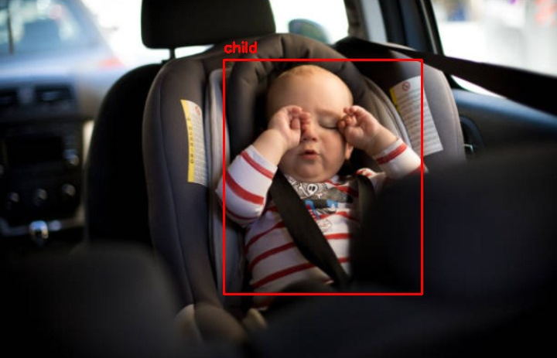
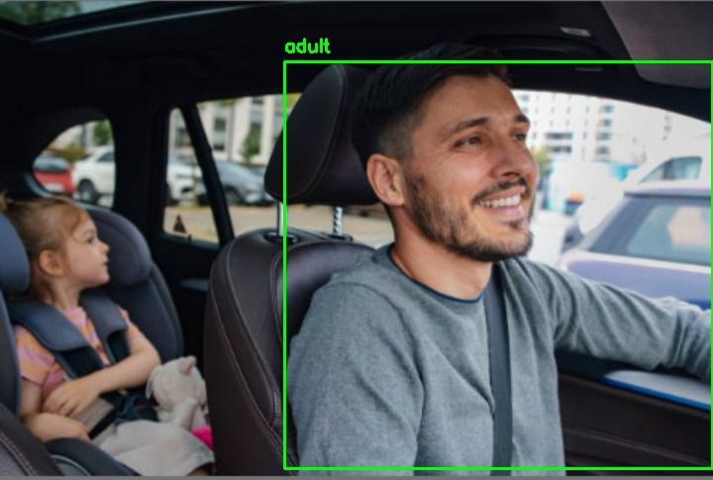
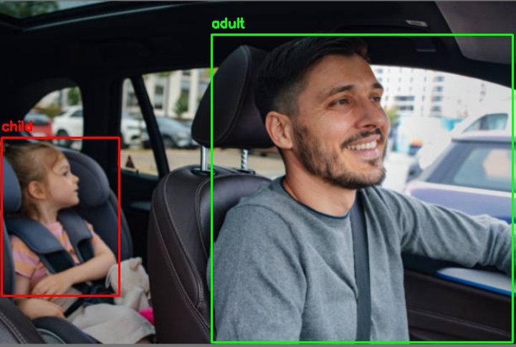
GUARDIAN : OPTIMIZED VERSION
480 X 480
640 X 640

Slide 28

LIVE DEMO

Slide 29
LIVE DEMO
POSSIBLE SCENARIOS :
ADULT IN FOV (FIELD OF VIEW)
ADULT + BABY IN FOV
ADULT + PET IN FOV
BABY ALONE IN FOV
DOG ALONE IN FOV
ADULT IN FOV + CHILD CRYING
CHILD CRYING
PET SOUNDS
ADULT SOUNDS
SILENCE
IMAGES READ FROM FILE
EAR MODULE IN STANDY (NO SOUND)
LIVE IMAGES
NOTHING IN FOV
EAR MODULE ACTIVE

Slide 30

PERFORMANCES

Slide 31
PERFORMANCES
METRICS USED
Mean Cycle Time [s]
Average time elapsed from data acquisition to system output.
Jitter [s]
Standard deviation of${\overline{ T}}_{cyc}$, indicating timing consistency
Throughput [dps/dpm]
Frequency of decision-making (system decisions per second and decision per minute)
CPU Load [%]
Represents the computational demand of the system’s processes relative to the Raspberry Pi’s processing capacity
RAM Usage [Mb]
Indicates the RAM memory usage of system’s processes
CPU Temperature [°C]
Monitors thermal stability to ensure the system avoids frequency throttling during extended operation

Slide 32
PERFORMANCES
Average Metric | V1 (Sequential) | V2(Optimized)
Mean Cycle Time [s] | 5.9875 ± 0.0084 | 3.3259 ± 0.003
Jitter [s] | 0.037 | 0.199
Throughput [dps] | 0.167 ± 0.0002 | 0.3007 ± 0.0003
Throughput [dpm] | 10.02 ± 0.01 | 18.04 ± 0.002
CPU Load [%] | 16 ± 6.77 | 24.31 ± 4.53
RAM Usage [Mb] | 379.75 ± 0.3294 | 396.8125 ± 2.5408
CPU Temperature [°C] | 55 ± 0.2505 | 57.7647 ± 1.7267
CI 99% (EXCLUDED JITTER)

Slide 33
PERFORMANCES
Yolo V26 (Converted to TFLite Model)
Size : Nano
mAP50 : 0.923 %
Recall : 0.893 %
Resolution : 640 X 640
mAP50-95 : 0.675 %
INFERENCE TIME : [1.4287,1,44] [s] (CI 99%)

Slide 34
PERFORMANCES
YAMNet+FFN (Converted to TFLite Model)
Accuracy : 0.88 %
INFERENCE TIME : [0.0187,0,0021] [s] (CI 99%)

Slide 35
CONCLUSION
A multimodal Child and Pet Presence Detection (CPPD) prototype was successfully developed and validated to prevent vehicular heatstroke caused by Forgotten Baby Syndrome.
The system combines vision and audio processing on a Raspberry Pi 3B+ to overcome limitations of camera-only solutions (e.g., low light, occlusion, blind spots).
Optimizing the architecture from sequential to parallel processing reduced detection time from 6s to 3.32s, enhancing real-time responsiveness.
Decision-level fusion allows the system to distinguish between safe (adult present) and critical (unattended child/pet) scenarios and send immediate alerts.
Results confirm that a low-cost edge-computing solution can deliver reasonable accuracy and fast response, making it a practical automotive safety enhancement.

Slide 36
THANKS FOR YOUR ATTENTION

