Slide 1
Discrete Cosine Transform
Metodi del calcolo scientifico
A.A. 2018/2019
Carlo Radice 807159

Slide 2
Outline
Hardware and Software specifications
About Project Nayuki
Naive DCT2 vs Fast DCT2 (FFT)
Time comparison
Design choices for the interface
Demo
Examples

Slide 3
Outline
Hardware and Software specifications
About Project Nayuki
Naive DCT2 vs Fast DCT2 (FFT)
Time comparison
Design choices for the interface
Demo
Examples

Slide 4
Hardware and Sofware specifications
Hardware Lenovo Thinkpad T480
Processor : Intel(R) Core(TM) i7-8550U CPU @ 1.80GHz, 1992 Mhz, 4 Core(s), 8 Logical Processor(s)
Installed Physical Memory (RAM): 8.00 GB
O.S.
Gnu/Linux Ubuntu 18.04 LTS
Programming language
C++

Slide 5
Outline
Hardware and Software specifications
About Project Nayuki
Naive DCT2 vs Fast DCT2 (FFT)
Time comparison
Design choices for the interface
Demo
Examples

Slide 6
About Project Nayuki
Nayuki is a software developer who lives in Canada
His web site (Project Nayuki¹) contains a lot of projects involving mathematics and programming
The projects are developed in multiple languages like Java, JavaScript, C, C++, C#, Python.
The provided fast DCT algorithm is implemented from papers linked in the site page
¹Project Nayuki: https://www.nayuki.io/
Notes:
Spiegare all’orale che lo scaling era diverso per cui è stato fatto a mano

Slide 7
Outline
Hardware and Software specifications
About Project Nayuki
Naive DCT2 vs Fast DCT2 (FFT)
Time comparison
Design choices for the interface
Demo
Examples

Slide 8
Naive DCT2 vs Fast DCT2 (FFT)
Time comparison:
Time expressed in seconds
20 samples
From an 8x8 to a 457x457 random quadratic matrix
Dimension | My DCT2 | Library DCT2
8 | 6.59e-4 | 7.8e-5
10 | 1.84e-3 | 9.46e-4
12 | 3.74e-3 | 1.12e-4
. | . | .
. | . | .
. | . | .
293 | 5.23e+2 | 4.85e-1
366 | 1.29e+3 | 6.22e-1
457 | 3.15e+3 | 7.82e-1

Slide 9
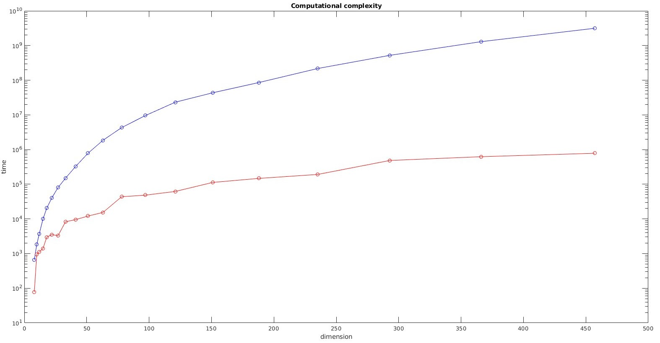


Slide 10
Outline
Hardware and Software specifications
About Project Nayuki
Naive DCT2 vs Fast DCT2 (FFT)
Time comparison
Design choices for the interface
Demo
Examples

Slide 11

Design choices for the interface
Use of QtCreator¹ ide to design the interface
Selection of the image, F and b through a pop up window
Opencv² library functions for:
Loading image
Get pixel values
Display images
¹QtCreator: https://www.qt.io/ ²Opencv: https://opencv.org/

Slide 12
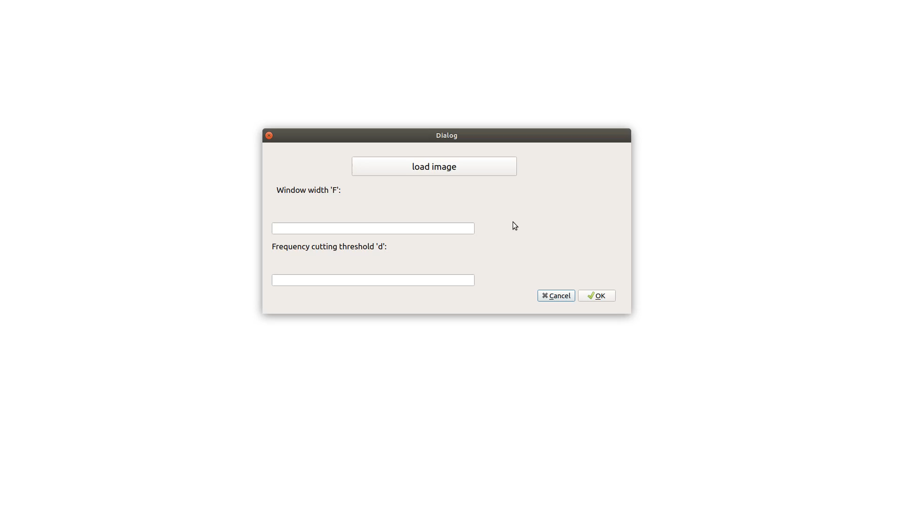
Demo

Slide 13
Outline
Hardware and Software specifications
About Project Nayuki
Naive DCT2 vs Fast DCT2 (FFT)
Time comparison
Design choices for the interface
Demo
Examples

Slide 14
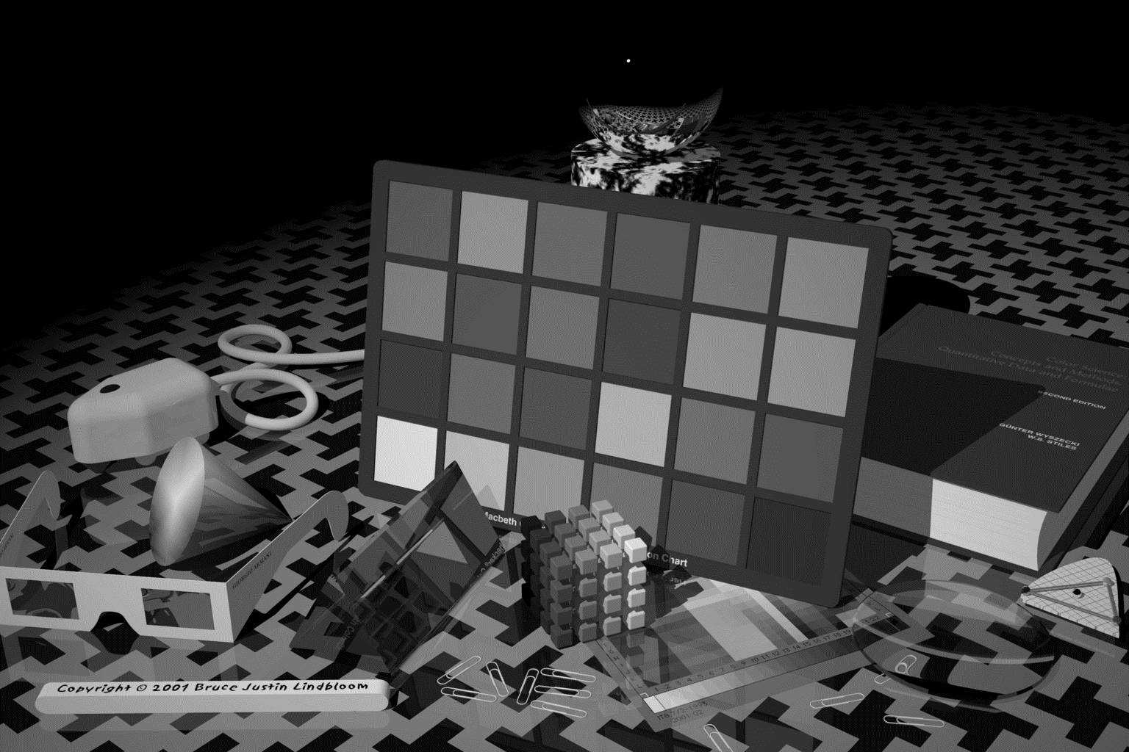
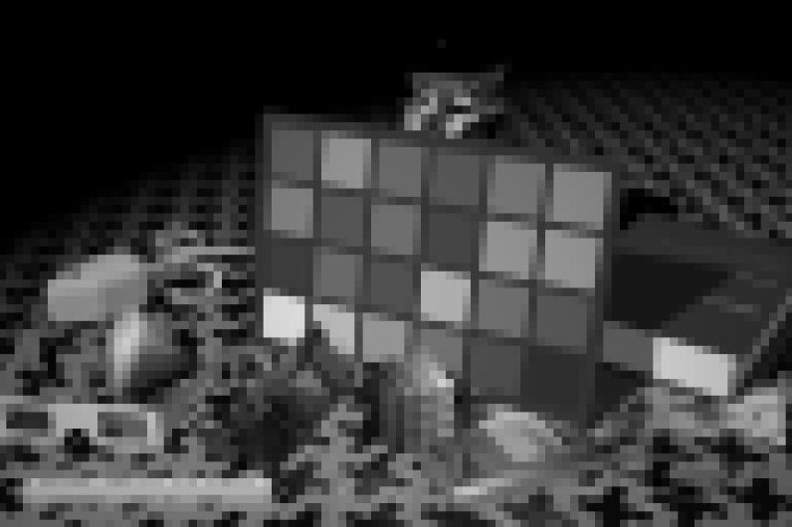


Image: artificial.bmp
Original dimension: 768 x 512 pixels
F = 8, d = 1
Original dimension: 768 x 512 pixels
F = 8, d = 7
Original dimension: 768 x 512 pixels
F = 8, d = 14
Original dimension: 768 x 512 pixels

Slide 15
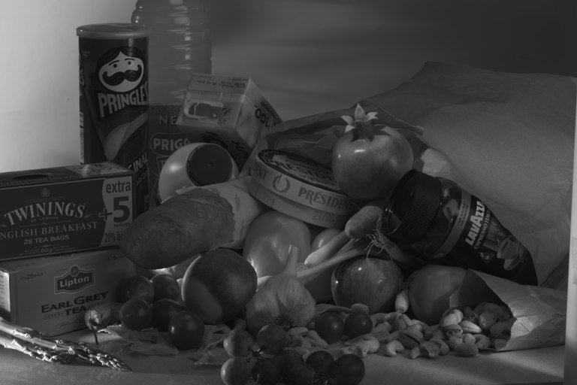
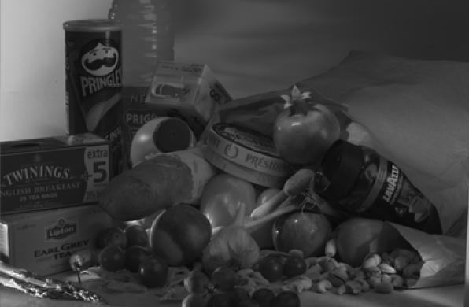
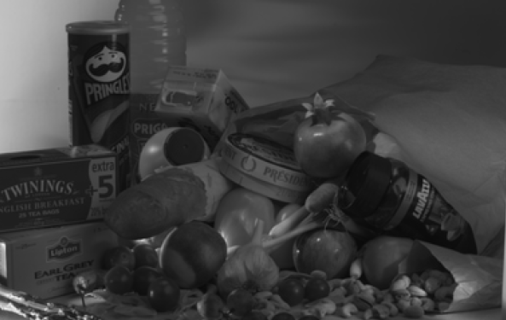
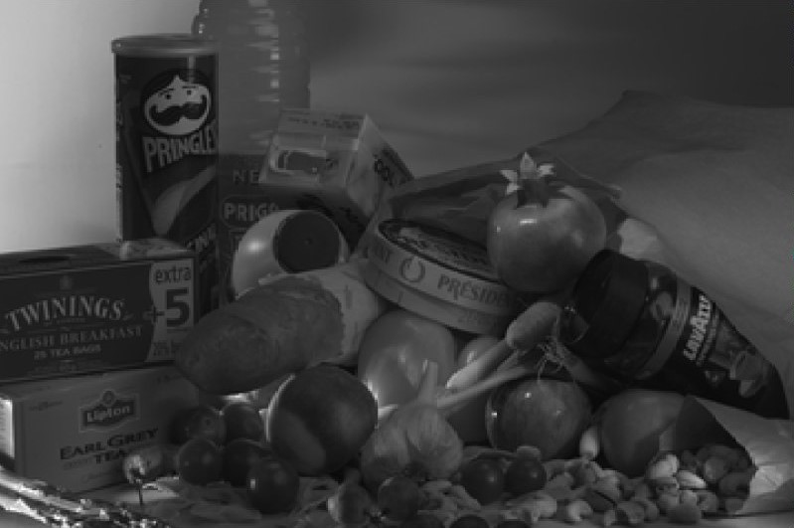
Image: hdr.bmp
Original dimension: 384 x 256 pixels
F = 10, d = 17
Original dimension: 380 x 250 pixels
F = 20, d = 30
Original dimension: 380 x 240 pixels
F = 30, d = 50
Original dimension: 360 x 240 pixels

Slide 16
Grazie per l’attenzione!

Slide 17
Dimension | My DCT2 | Library DCT2
8 | 6.59e-4 | 7.8e-5
10 | 1.84e-3 | 9.46e-4
12 | 3.74e-3 | 1.12e-4
15 | 1.01e-2 | 1.41e-3
18 | 2.04e-2 | 2.97e-3
22 | 4.02e-2 | 3.53e-3
27 | 8.02e-2 | 3.27e-3
33 | 1.50e-1 | 8.24e-3
41 | 3.22e-1 | 9.53e-3
51 | 7.81e-1 | 1.21e-2
63 | 1.85 e+0 | 1.54e-2
78 | 4.30e+0 | 4.35e-2
97 | 9.56e+0 | 4.84e-2
121 | 2.32e+1 | 4.83e-2
151 | 4.35e+1 | 1.13e-1
188 | 8.59e+1 | 1.47e-1
235 | 2.17e+2 | 1.91e-1
293 | 5.23e+2 | 4.85e-1
366 | 1.29e+3 | 6.22e-1
457 | 3.15e+3 | 7.82e-1
Full table of samples

