Slide 1
Linear System Solver
Metodi del calcolo scientifico
A.A. 2018/2019
Carlo Radice 807159

Slide 2
Outline
Hardware and Software specifications
About Matlab
About Eigen
Windows VS Ubuntu
Time, Memory, Relative Error, Results
Matlab VS Eigen
Time, Memory, Relative Error, Results
Conclusions

Slide 3
Outline
Hardware and Software specifications
About Matlab
About Eigen
Windows VS Ubuntu
Time, Memory, Relative Error, Results
Matlab VS Eigen
Time, Memory, Relative Error, Results
Conclusions

Slide 4
Hardware and Sofware specifications
Hardware Lenovo Thinkpad T480
Processor : Intel(R) Core(TM) i7-8550U CPU @ 1.80GHz, 1992 Mhz, 4 Core(s), 8 Logical Processor(s)
Installed Physical Memory (RAM): 8.00 GB
O.S.
Microsoft Windows 10 Home
Gnu/Linux Ubuntu 18.04 LTS
Other software
Psrecord to record CPU and memory activity of a process
psrecord: https://github.com/astrofrog/psrecord

Slide 5
Outline
Hardware and Software specifications
About Matlab
About Eigen
Windows VS Ubuntu
Time, Memory, Relative Error
Matlab VS Eigen
Time, Memory, Relative Error
Conclusions

Slide 6
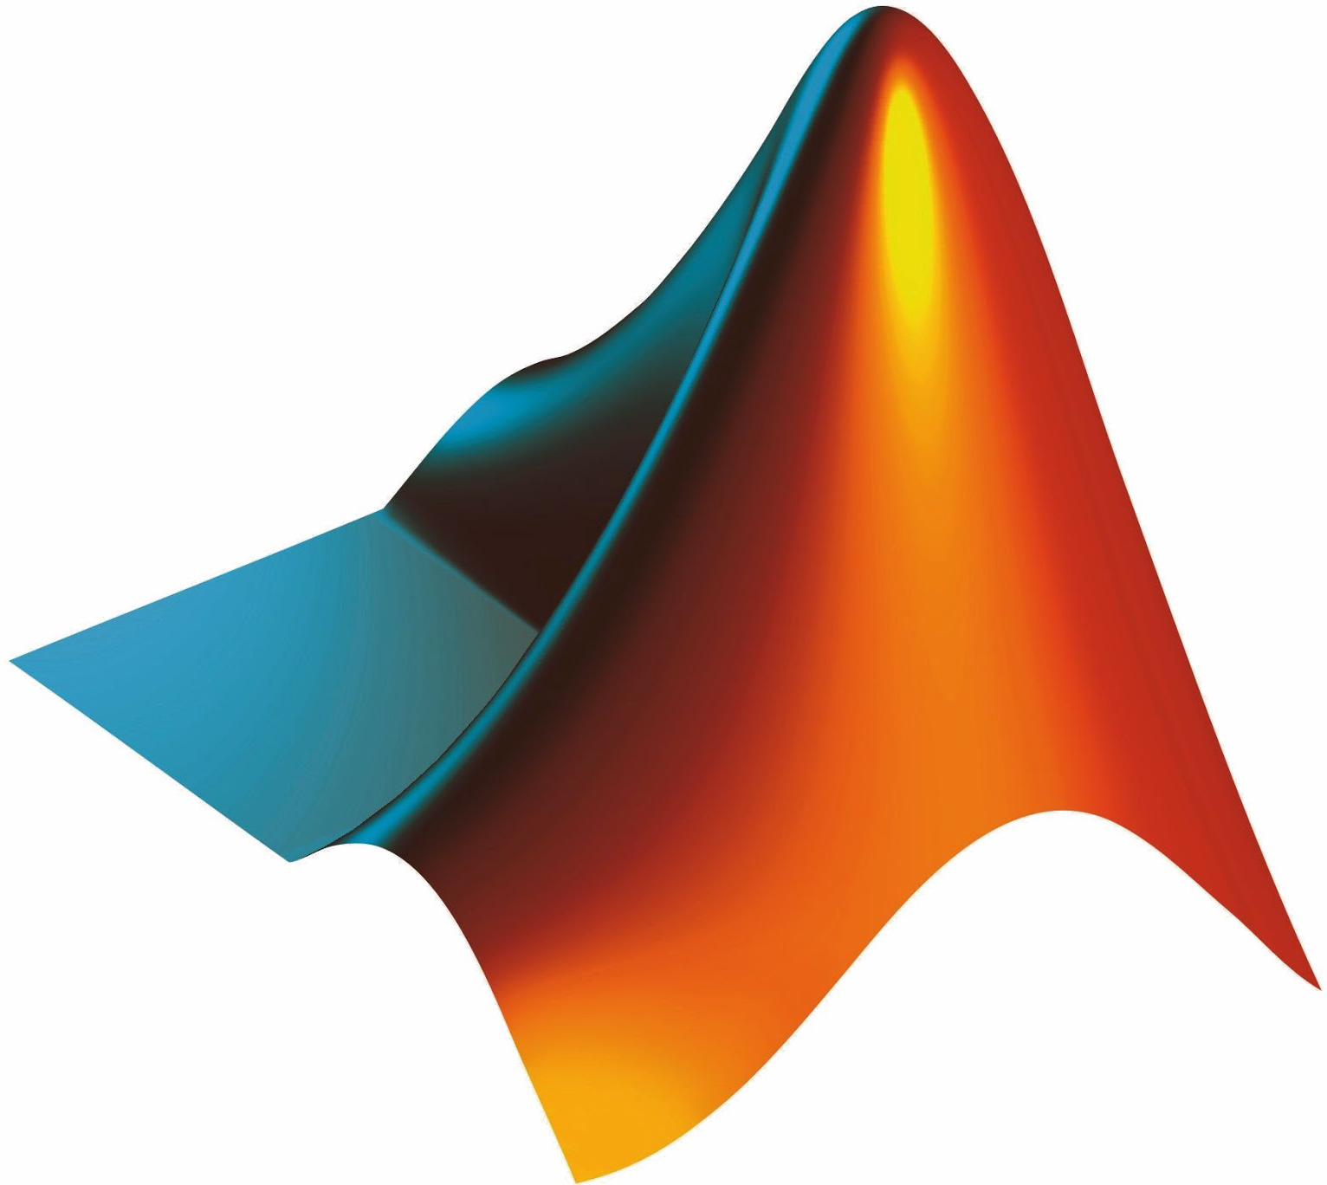
About Matlab
Features:
Matlab is a multi-paradigm numerical computing enviroment
Uses its own programming language
Allows matrix manipulation with fast and optimized algorithms
Allows implementation of algorithms and creation of user interfaces
Matlab is proprietary programming language developed by MathWorks
Matlab is documented and supported, with two software releases every year
Additional toolboxes and packages allow to extend the basics functionalities
Matlab main page: https://it.mathworks.com/products/matlab.html

Slide 7
Outline
Hardware and Software specifications
About Matlab
About Eigen
Windows VS Ubuntu
Time, Memory, Relative Error, Results
Matlab VS Eigen
Time, Memory, Relative Error, Results
Conclusions

Slide 8

About Eigen
Features:
Eigen is a linear algebra library written in C++
It supports all matrix sizes
Provides many specialized features such as non-linear optimization and matrix functions
Algorithms are carefully selected for reliability
For large matrices, special attention is paid to cache-friendliness
Eigen is free software licensed under the MPL2
Eigen is standard C++98
Eigen is documented and supported. Its current version is 3.3.7 released on 11.12.2018.
Eigen main page: http://eigen.tuxfamily.org/index.php?title=Main_Page

Slide 9
About Eigen
Features:
Eigen is a linear algebra library written in C++.
It supports all matrix sizes, from small fixed-size matrices to arbitrarily large dense matrices, and even sparse matrices.
Its ecosystem of unsupported modules provides many specialized features such as non-linear optimization and matrix functions.
Algorithms are carefully selected for reliability.
For large matrices, special attention is paid to cache-friendliness.
Eigen is free software licensed under the MPL2.
Eigen doesn't have any dependencies other than the C++ standard library.
Eigen is standard C++98 and so should theoretically be compatible with any compliant compiler. It guarantees reliability and work around any compiler bugs.
Eigen is documented and supported. Its current version is 3.3.7 released on 11.12.2018. The unsupported modules which are contributions from various users are provided "as is", without any support.
Eigen main page: http://eigen.tuxfamily.org/index.php?title=Main_Page

Slide 10
Outline
Hardware and Software specifications
About Matlab
About Eigen
Windows VS Ubuntu
Time, Memory, Relative Error, Results
Matlab VS Eigen
Time, Memory, Relative Error, Results
Conclusions

Slide 11
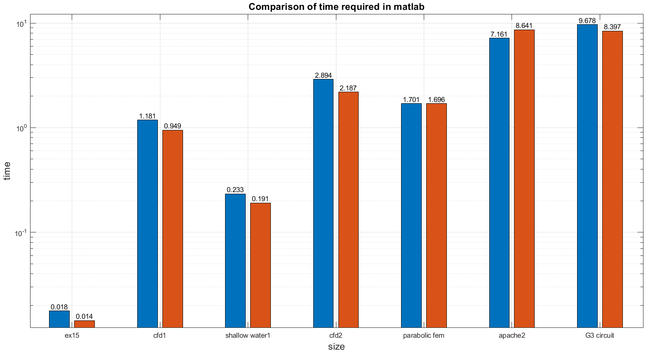

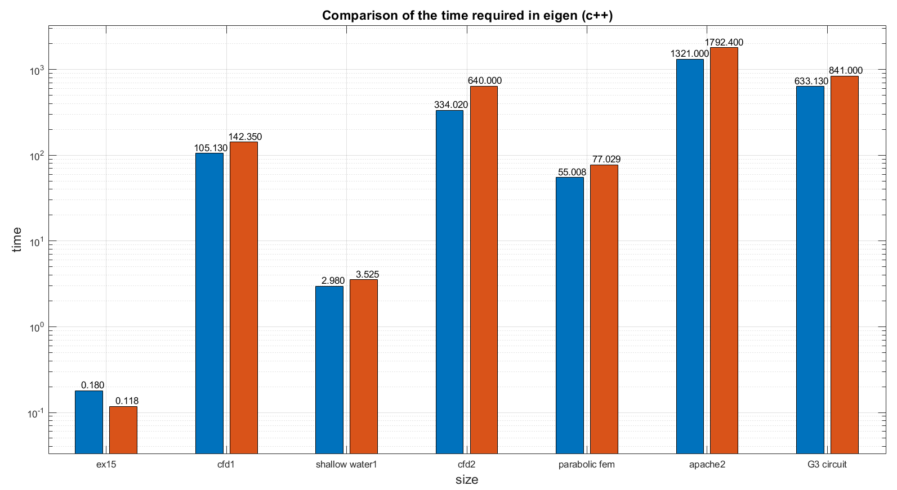

Slide 12
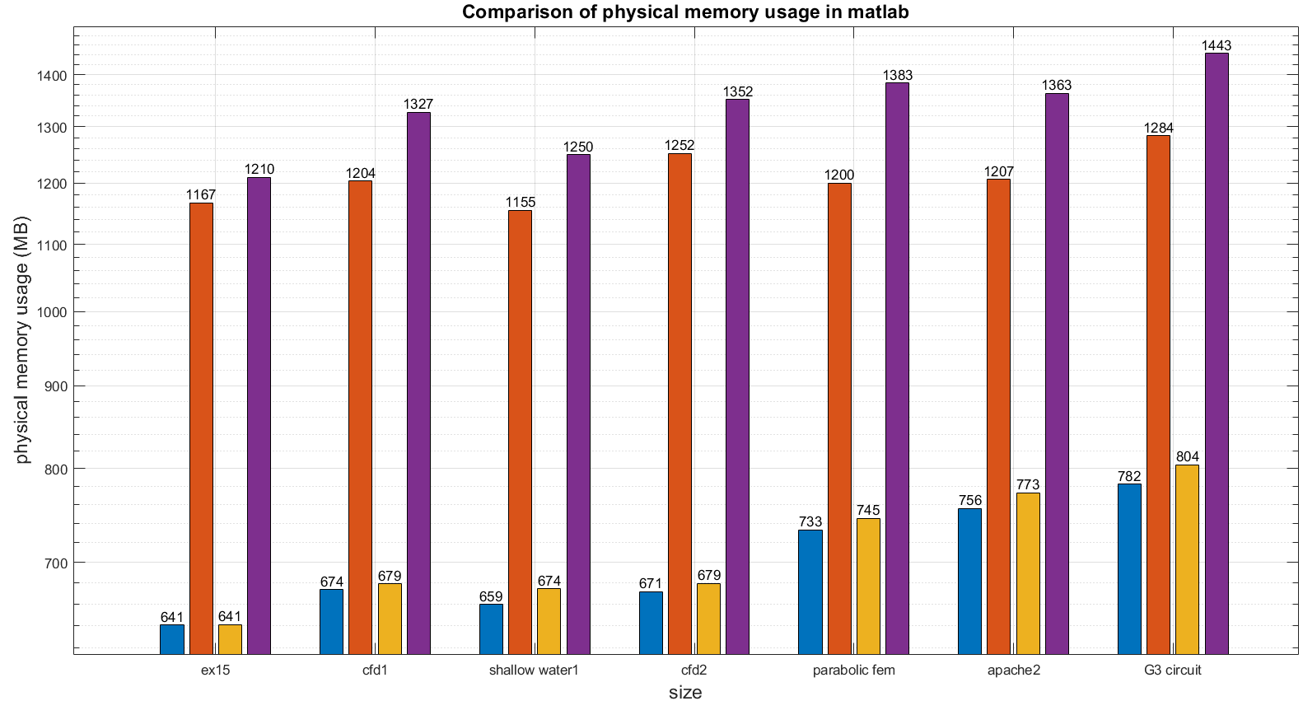

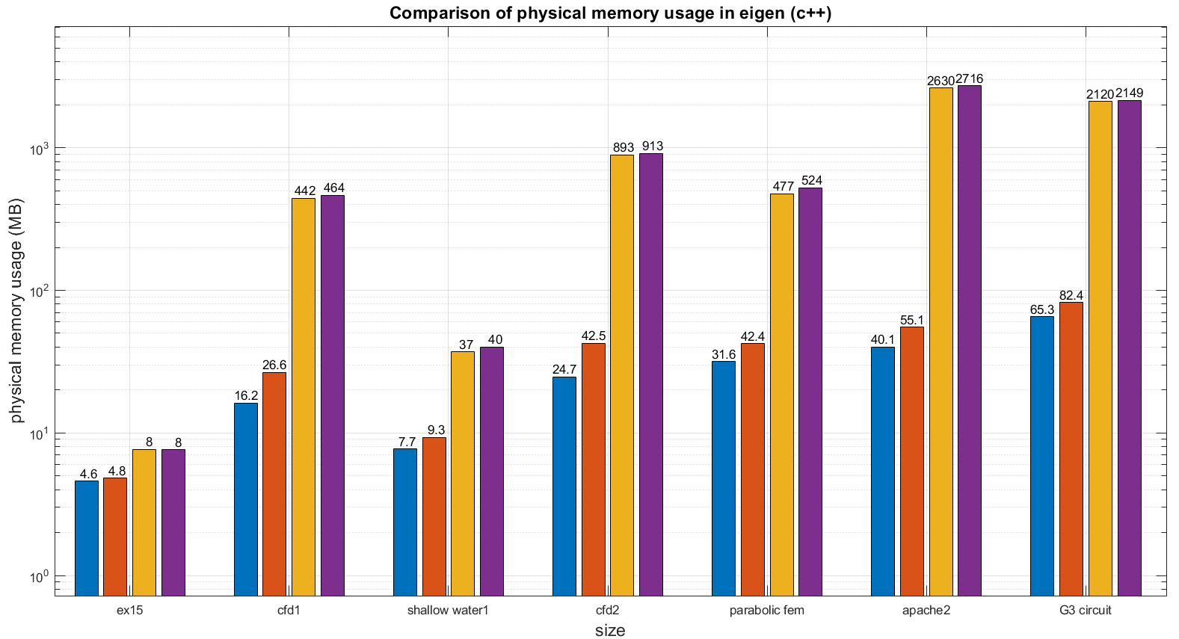

Slide 13
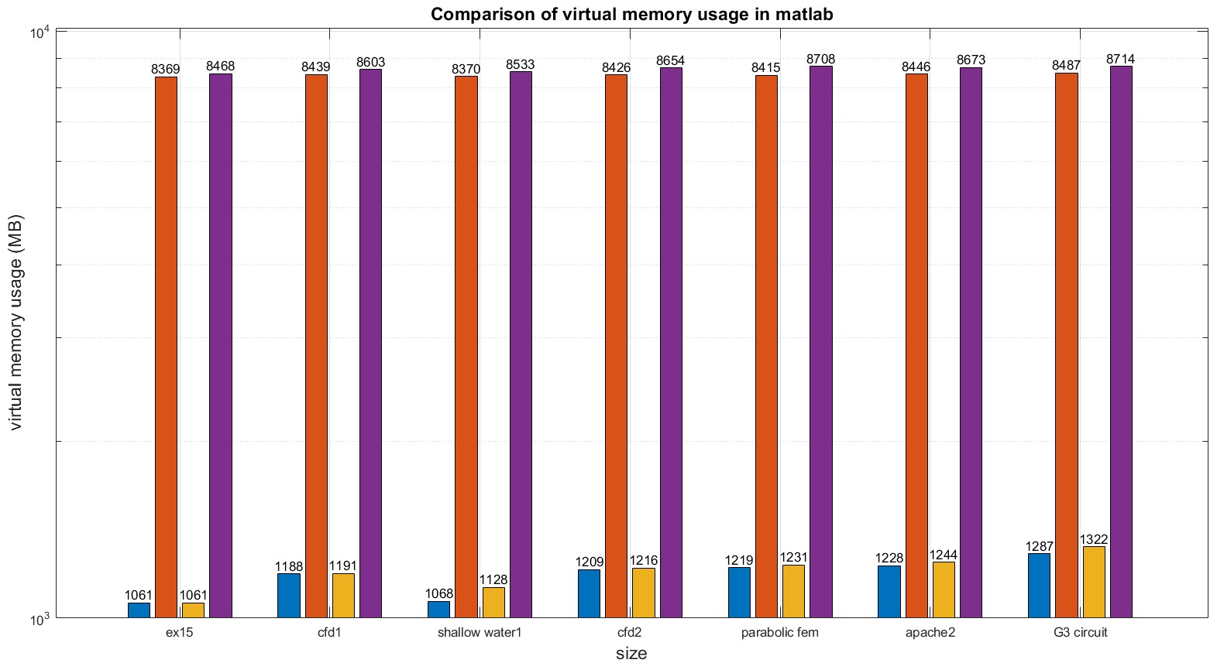
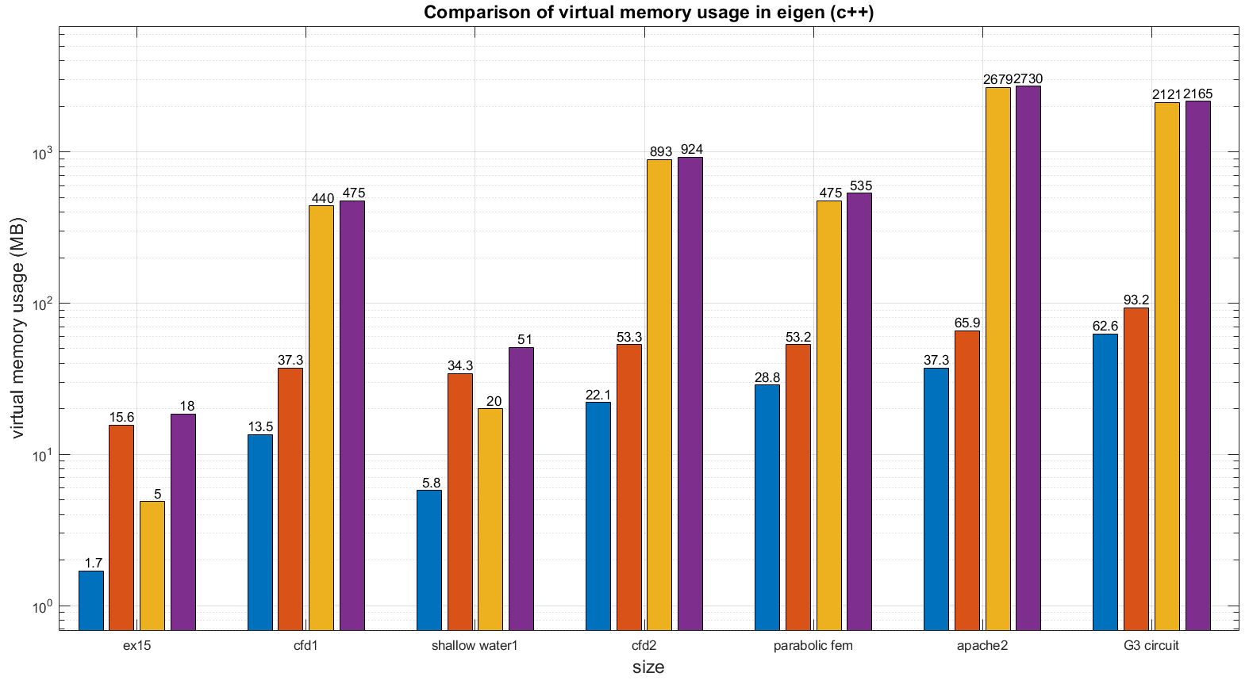

Slide 14
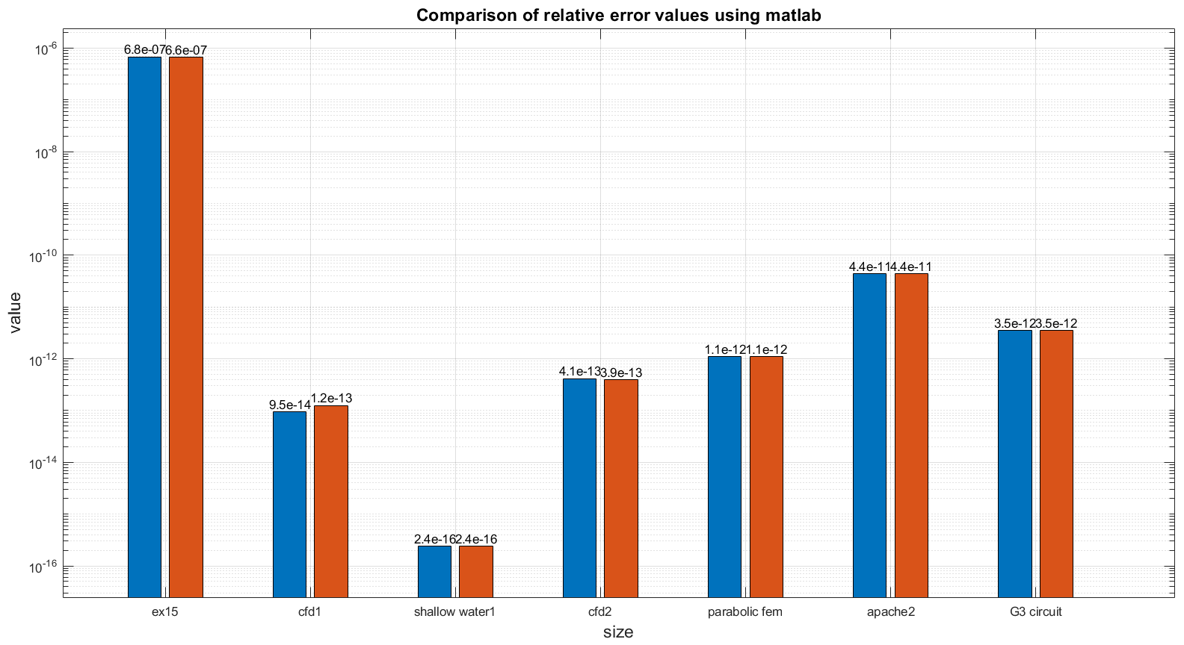

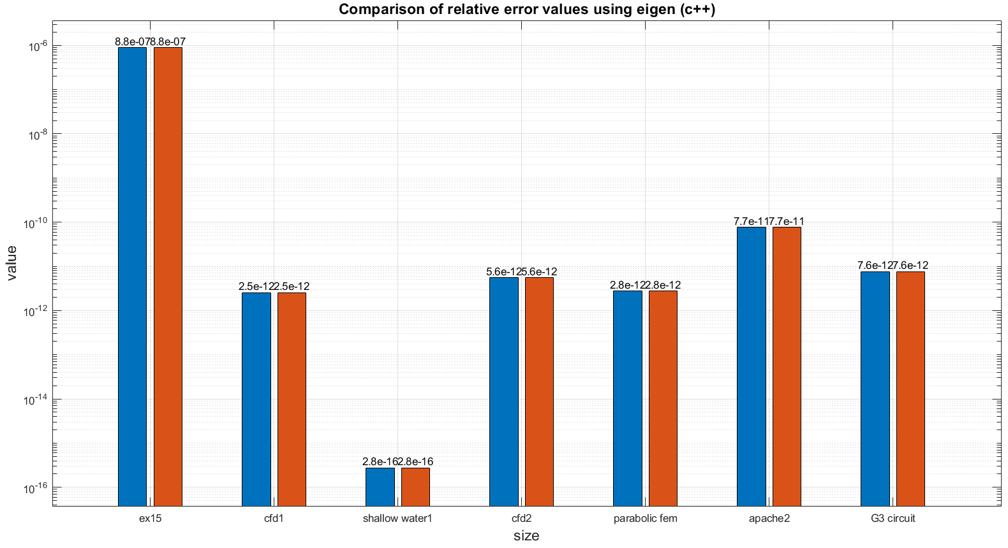
Notes:
Qui errore relativo

Slide 15



Results
 | Time Matlab | Time Eigen | PM Matlab | PM Eigen | VM Matlab | VM Eigen | RE Matlab | RE Eigen
Windows
Ubuntu
Notes:
Conclusions windows vs ubuntu ✓, ✗

Slide 16
Results
Time
Similar computational times in Matlab
Eigen is faster in Windows
Memory
Less physical memory used by Windows in Matlab
Similar physical memory used in Eigen
Similar physical memory used both in Matlab and Eigen
Relative Error
Same degree of precision both in Matlab and Eigen
Notes:
Conclusions windows vs ubuntu

Slide 17
Outline
Hardware and Software specifications
About Matlab
About Eigen
Windows VS Ubuntu
Time, Memory, Relative Error, Results
Matlab VS Eigen
Time, Memory, Relative Error, Results
Conclusions

Slide 18
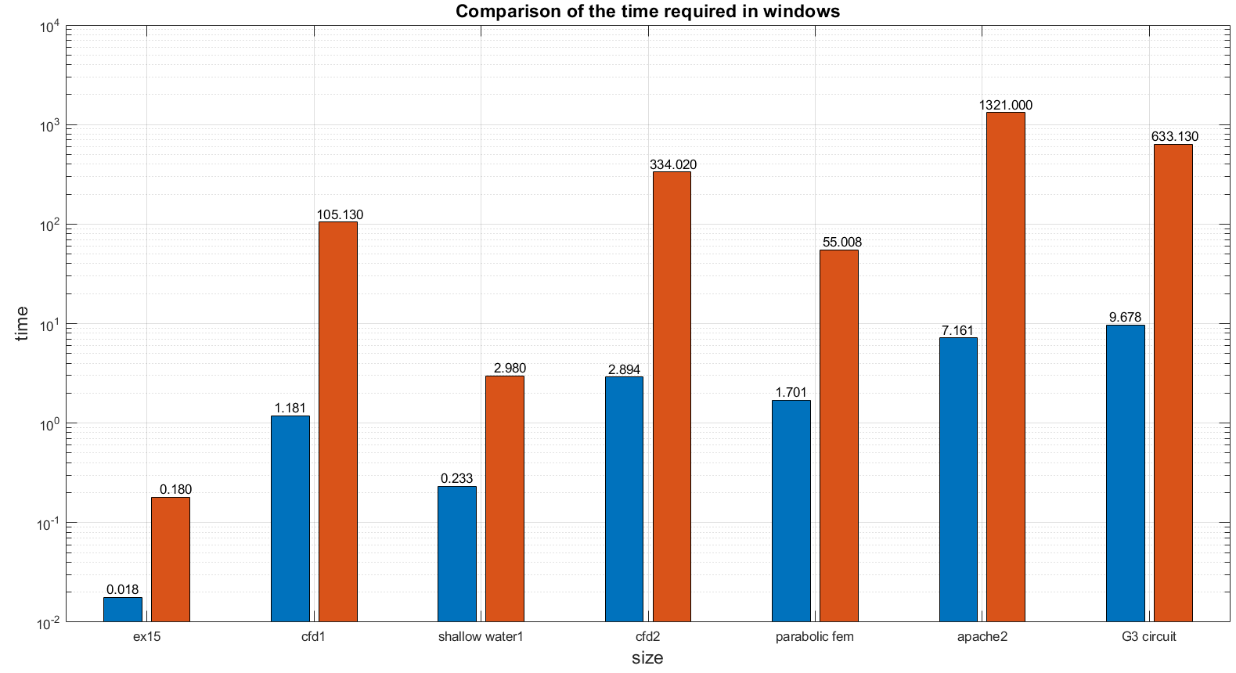

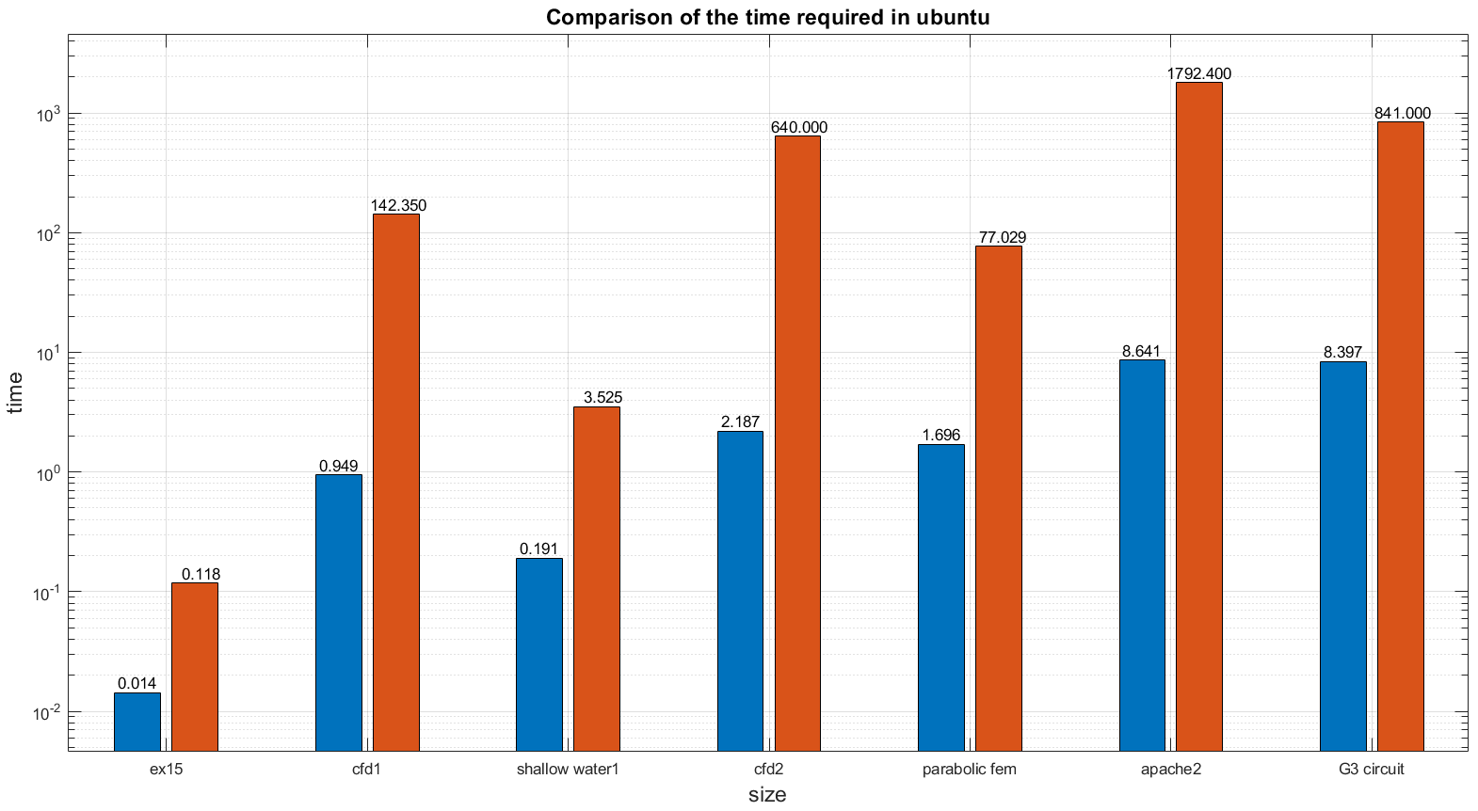
Notes:
Time matlab vs eigen

Slide 19
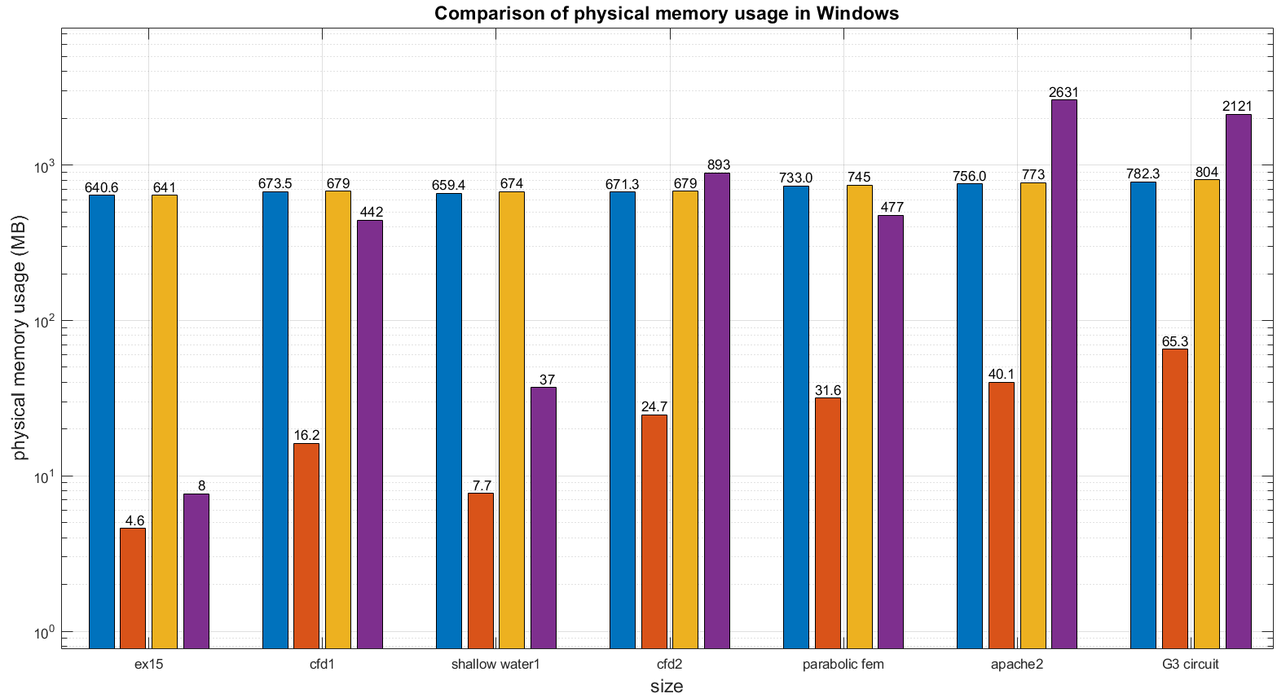

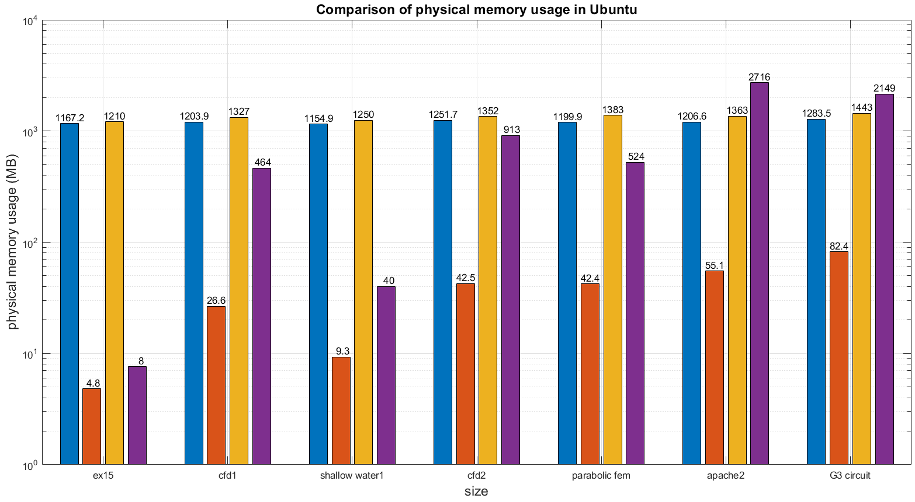
Notes:
Phyisical memory matlab vs eigen

Slide 20
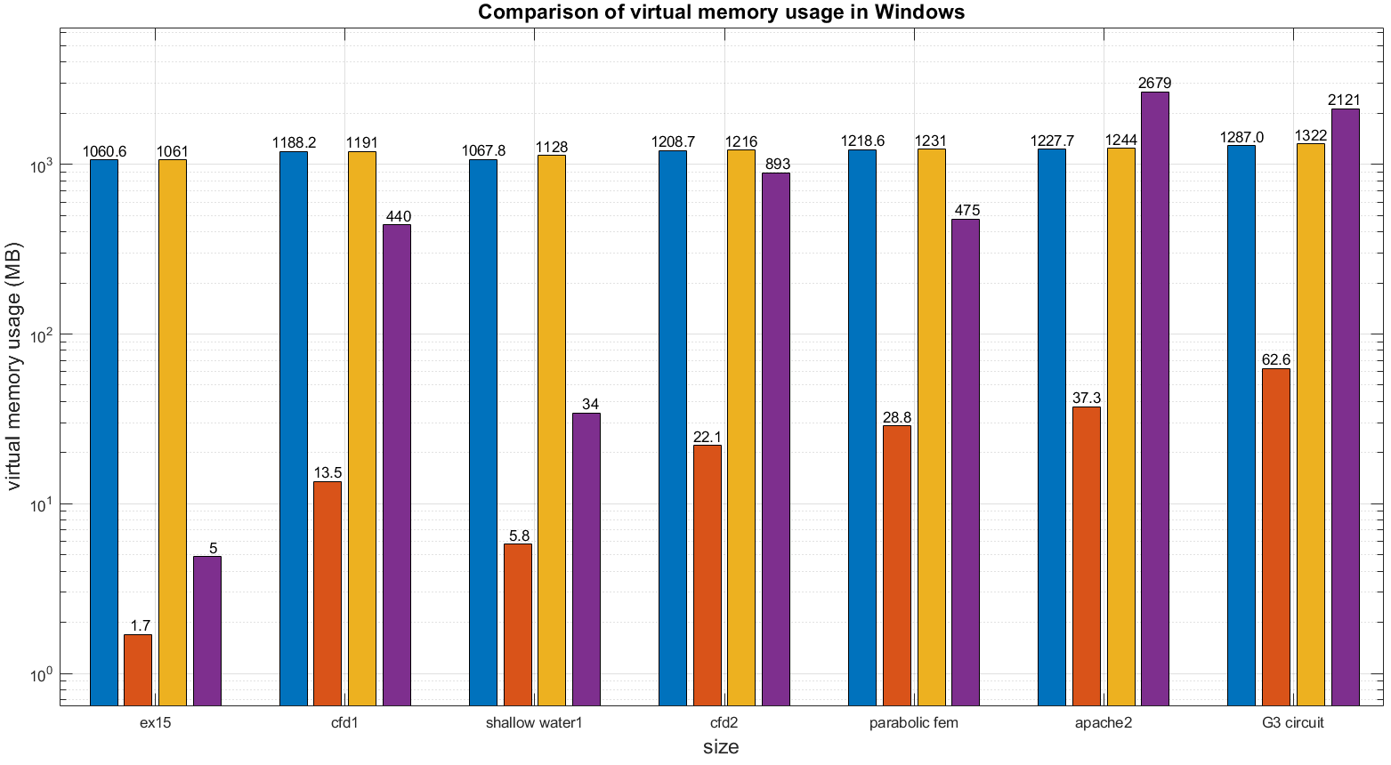
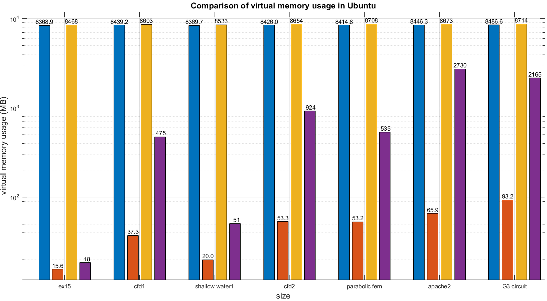
Notes:
Virtual memory matlab vs eigen

Slide 21
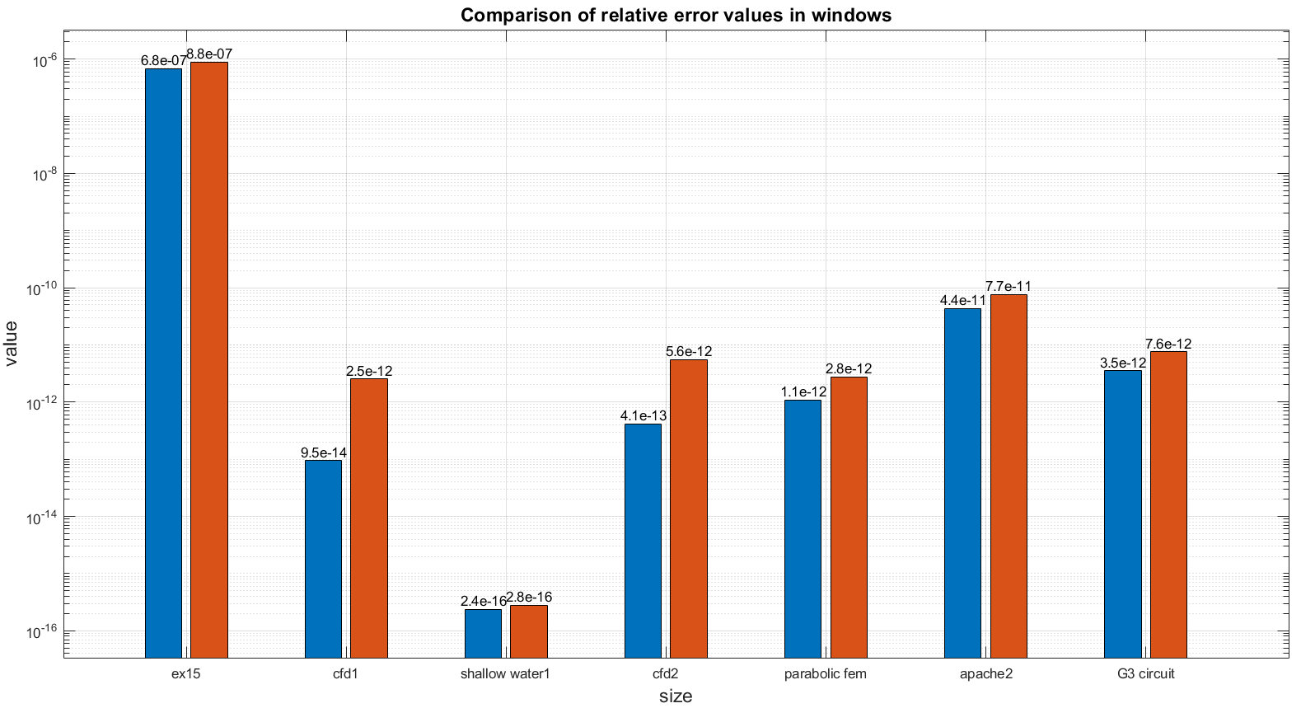

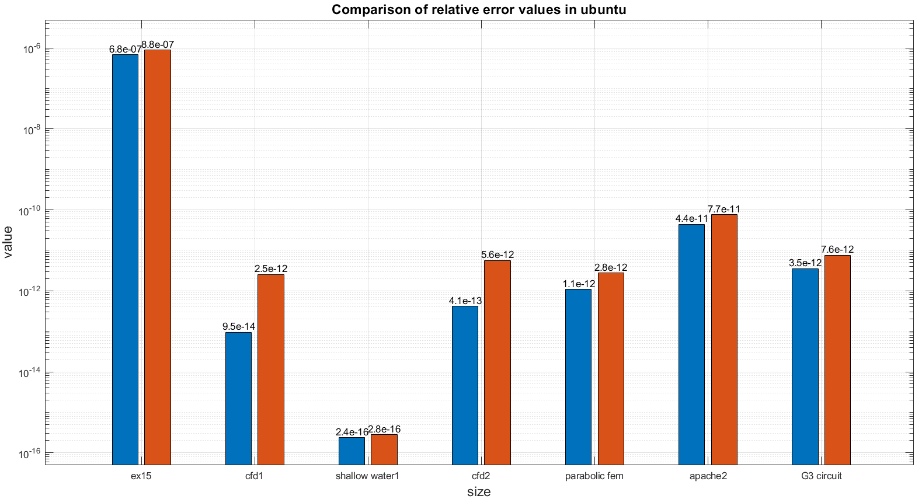
Notes:
Error matlab vs eigen

Slide 22
Results
 | Time Windows | Time Ubuntu | PM Windows | PM Ubuntu | VM Windows | VM Ubuntu | RE Windows | RE Ubuntu
Matlab
Eigen
Notes:
Conclusions windows vs ubuntu

Slide 23
Results
Time
Matlab is much faster that Eigen both in Windows and Ubuntu
Memory
Less physical memory used by Matlab in Matlab only with large matrices
Similar physical memory used in Eigen
Similar physical memory used both in Matlab and Eigen
Relative Error
Same degree of precision both in Matlab and Eigen
Notes:
Conclusions windows vs ubuntu

Slide 24
Outline
Hardware and Software specifications
About Matlab
About Eigen
Windows VS Ubuntu
Time, Memory, Relative Error, Results
Matlab VS Eigen
Time, Memory, Relative Error, Results
Conclusions

Slide 25
Conclusions
Overall:
Windows performs better than Ubuntu in Eigen computation time and Matlab memory
In the other cases the two o.s. have considerable similar performance
Matlab outclasses Eigen in the computation time
With big matrices Matlab performs better in memory both in Windows and Ubuntu
With small matrices Eigen has lower memory usage
Matlab and Eigen have similar relative error values
Notes:
Conclusions windows vs ubuntu ✓, ✗

