Slide 1
Lab 2, presentation
Carlo Saccardi
Filip Zawadka

Slide 2
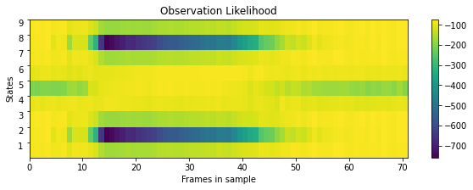
QUESTION 4.1: Gaussian emission probabilities
In this figure we are plotting the probabilities of each state, given a time instance in the utterance of the sound. The word 'o' is made of 3 phoneme (each of them modeled with 3 states), one of them corresponds to O(ow), and the other two are 'sil' (silence) and they are placed at the start and end of the utterance. In other words, the first and last frames of the sample are mostly silent and the middle frames correspond to the word ‘o’.
From the color bar, blue indicates that the probability that the model is in that state, given the corresponding time frame, is low. Yellow indicates a higher probability. Thus, as expected, towards the start and the end of the utterance (time frames) we have a higher probability in states 1,2,3 and 7,8,9 (silence 'sil'), and blue in states 4,5,6 (o wird 'ow'). On the other hand, we have a higher probability in states 4,5,6 in the middle of the utterance, between time frames 15 and 45, which correspond to the word 'o'

Slide 3
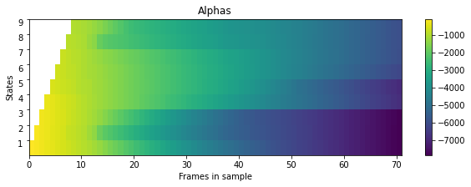
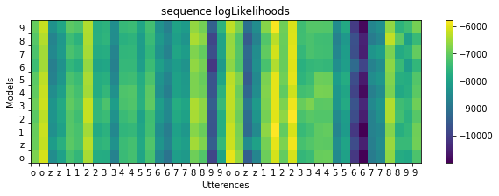
QUESTION 5.2: Forward Algorithm
Alpha represent the probability of observing a given sequence o_1,o_2,...,o_n and ending up in state j.
From the observation likelihood calculated in the previous section, we know that the utterance 'ow' lies in the frames 15-45, right in the middle of two silence phones. This alpha pass shows a similar behavior: between time step 15-45 we get higher values in states 4,5,6, whereas for time step 0 to 15 and 50 to 71 we get higher probabilities in states 1,2,3 and 7,8,9 respectively. Notice that as the frames move to end, the probabilities of states tend to increase as we move from state 1 to 9.
Since alpha is the probability of observing a given sequence and ending up in a particular state, the probability of observing the entire sequence regardless of where we might end up is obtained by marginalizing out the 'state variable', once the sequence of observations is completed.

Slide 4
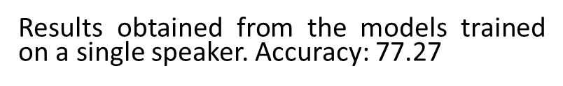
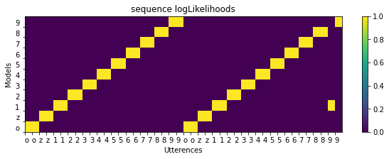
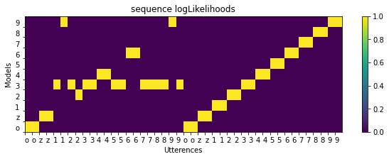
QUESTION 5.2: Forward Algorithm
Results obtained from the models trained on every speaker. Accuracy: 97.72

Slide 5
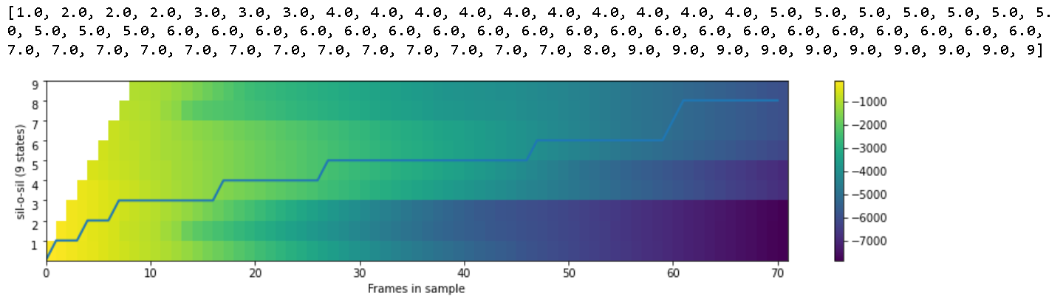
QUESTION 5.3: Viterbi Algorithm
Forward algorithm: what is the probability that the model has generated the sequence of observations? (isolated word recognition)
Viterbi algorithm: what is the most likely state sequence given the observation sequence? (continuous speech recognition
The main difference in these algorithms is that the forward algorithm considers all possible paths and marginalizes over them, while the Viterbi algorithm finds the best path given the observation sequence. Viterbi approximation was faster computationally (CPU times: user 7.51 sec vs 21.9 s), and thus is usually a more preferred method when dealing with long sequences.

Slide 6
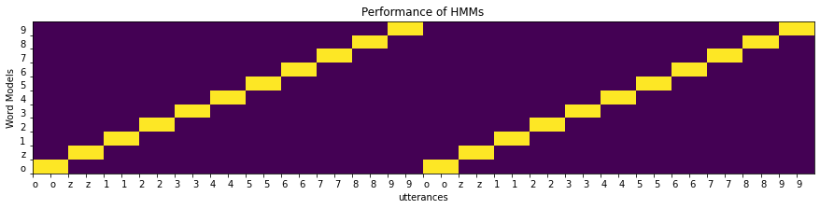
QUESTION 5.3: Viterbi Algorithm
Results obtained from the models trained on every speaker. Accuracy: 100.
Results obtained from the models trained on a single speaker. Accuracy: 77.27. The errors are the same as those obtained in the forward algorithm

