Slide 1
Obfuscation: Week 7
Caleb Parten and Carlo Velarde

Slide 2
Overview
Transition to Llama
Llama Pros and Cons
Graphs

Slide 3
Transition to Llama
Gemini -> Llama
Generated new Llama dataset
500 obfuscated code snippets
Obfuscated output
Embeddings
Cosine Similarity
Tested different embedding input prompts

Slide 4
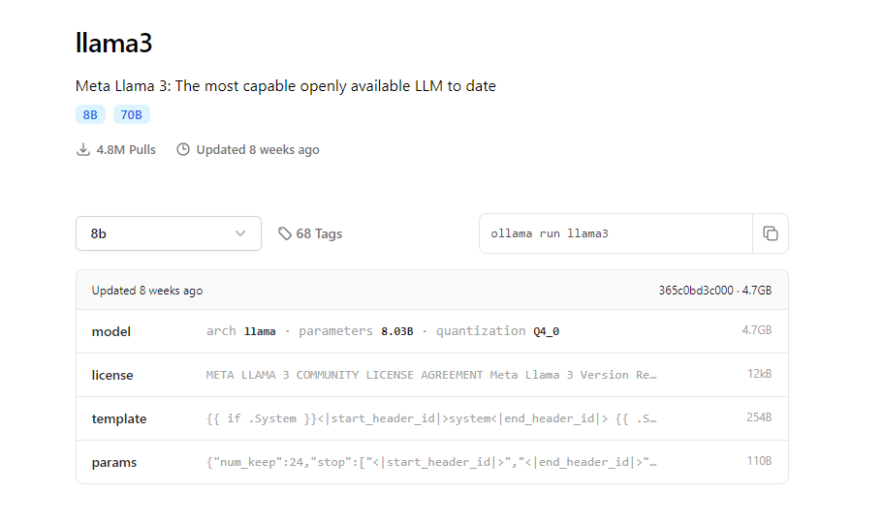
Llama Pros
Open source
Free to use
Runs locally
No rate limits
Privacy and Security
https://github.com/ollama/ollama

Slide 5
Llama Cons
Ease of use and integration
Poor documentation compared to GPT or Gemini
Gemini and GPT have better libraries & APIs
Takes up storage on local machine
Less performance and capabilities

Slide 6
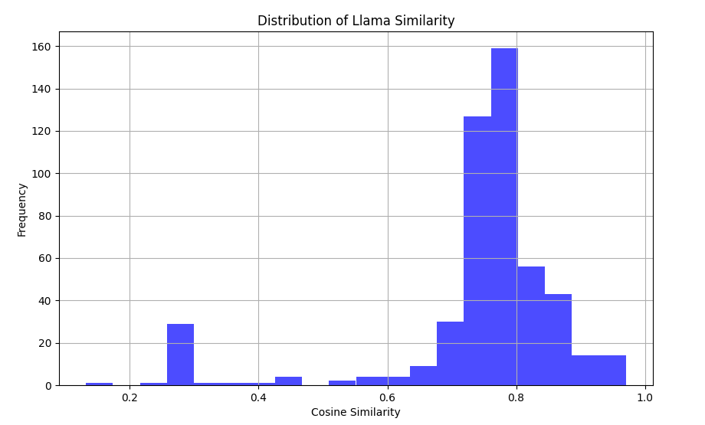
Graphs: Llama Cosine Distribution

Slide 7
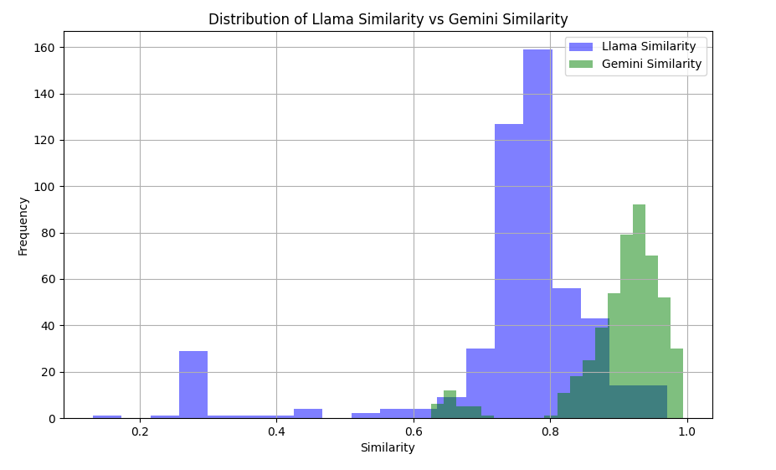
Graphs: Llama vs Gemini

Slide 8
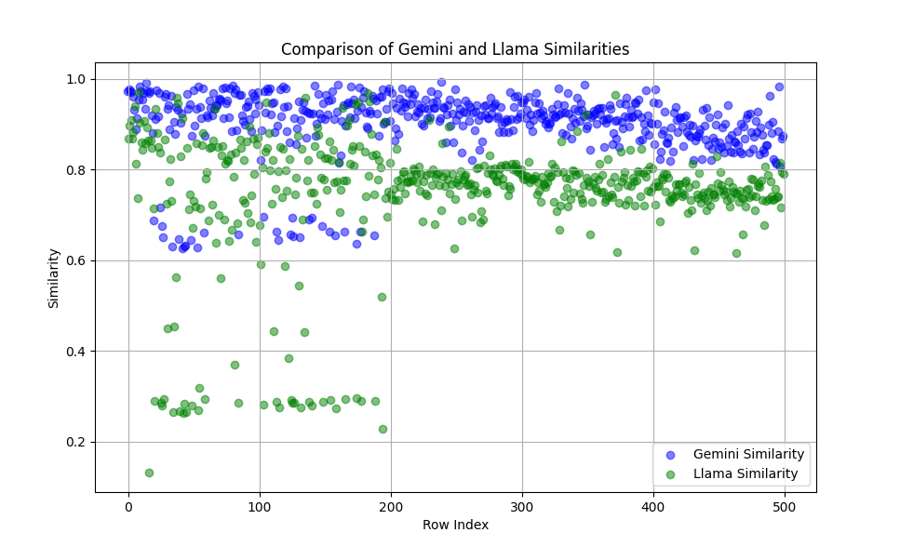
Graphs: Llama vs Gemini

