Slide 1
Obfuscation: Week 5
Caleb Parten and Carlo Velarde

Slide 2
Overview
New dataset
Latent space measurements
Analysis

Slide 3
New Dataset
600 clean and working JS snippets
First 200 are control flow
Second 200 are loops
Last 200 are basic
600 working obfuscated outputs
Runtime 24 hours

Slide 4
Latent Space Measurements
Embedded corresponding code snippets
Embedded and non embedded version
Used Cosine similarity to measure latent space
Returns x where x is: -1 <= x <= 1
-1 ≈ not similar 1 ≈ very similar

Slide 5
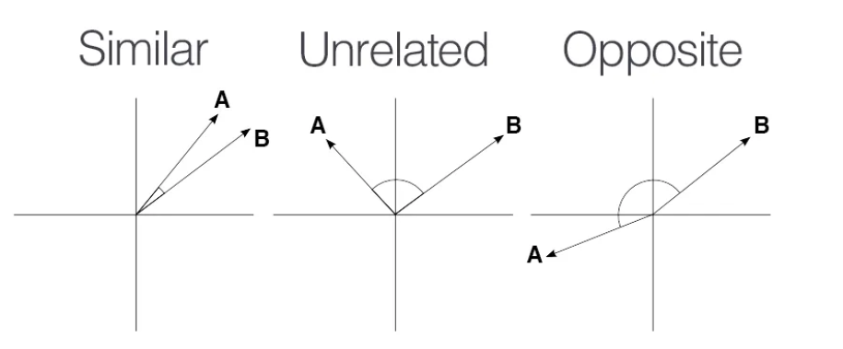
Cosine Similarity Visual

Slide 6
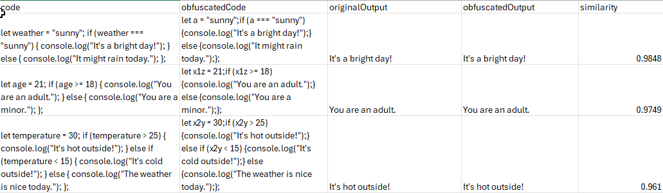
Completed Table

Slide 7
Analysis
Still analyzing data
Finding similarity in text(tokens) but not functionality
View previous slide

