Slide 1
Obfuscation: Week One
Caleb Parten and Carlo Velarde

Slide 2
Overview
What we learned about obfuscation
Our current goal
What we have done

Slide 3
What We Learned About Obfuscation…
Definition/meaning
To make code difficult to follow
Purpose
Prevent/slow down reverse engineering
Slows attacks
Protects sensitive data
Protects property
https://www.appsealing.com/code-obfuscation/

Slide 4
What We Learned About Obfuscation…
Techniques
Naming
Control flow
Dead code
String encryption
Root
Root
Output
Output
Code
Obfuscated Code
https://www.appsealing.com/code-obfuscation/

Slide 5

Current Goal
let name = “Carlo”;
console.log(name);
Create and store simple snippets
Store their outputs
Ask a LLM to obfuscate
Check if LLM implemented the correct obfuscation
Check if output is the same
var wdkhawd=“Carlo”;
var awdhawk = wdkhawd;
console.log(awdhawk)

Slide 6
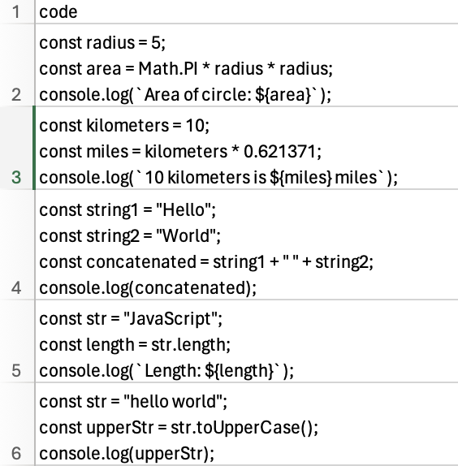
What we have done…
Generated over 350 JS code snippets

Slide 7
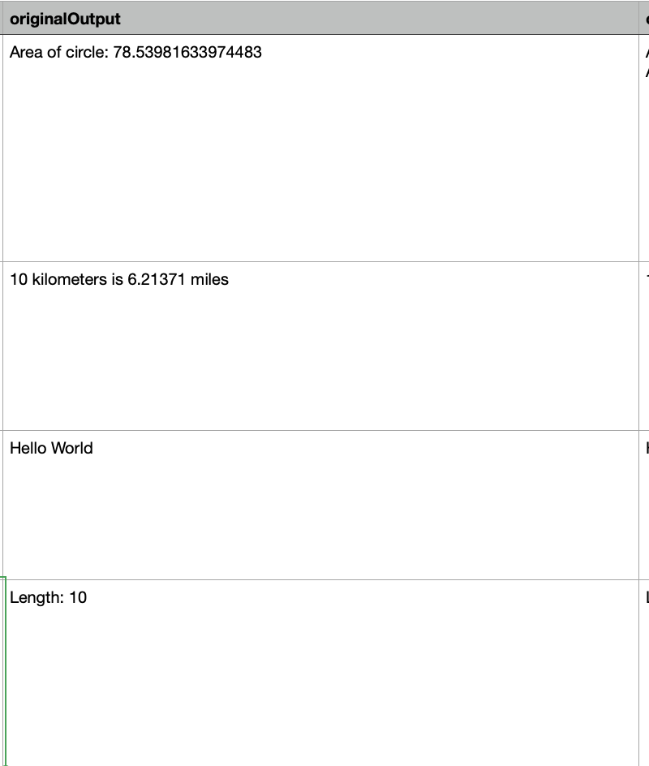
What we have done…
Executed all 350 snippets
Stored output

Slide 8
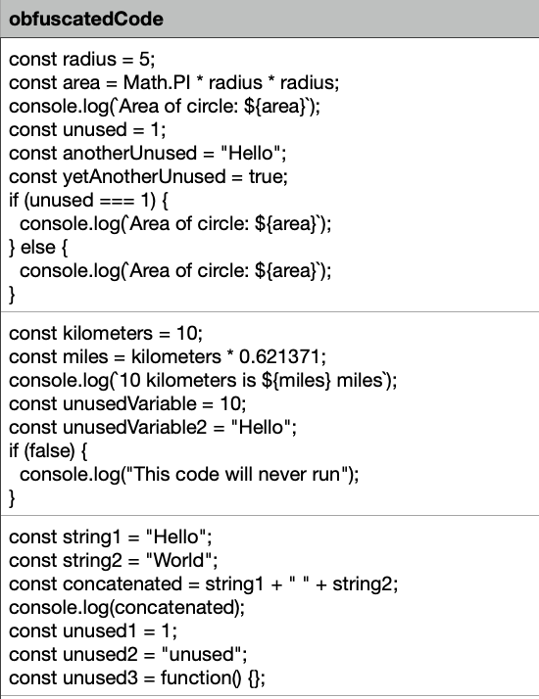
What we have done…
Asked Gemini to obfuscate code snippets

Slide 9
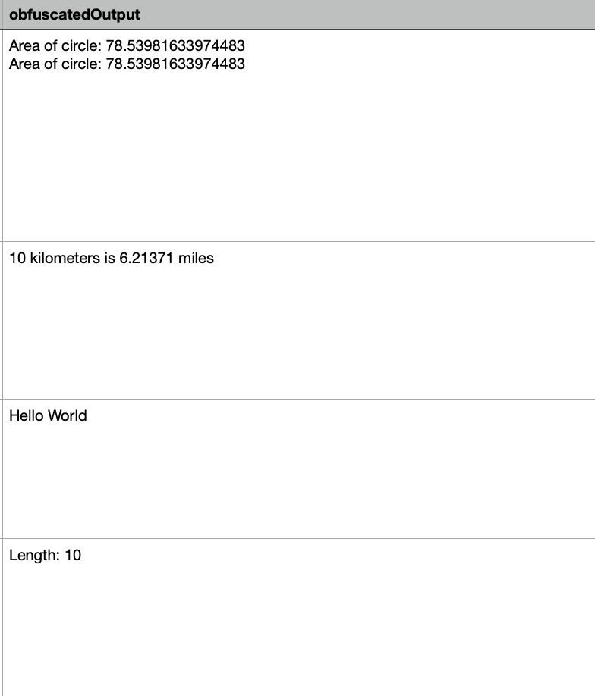
What we have done…
Executed obfuscated code
Stored in csv

Slide 10
Next Plan
Ask for different obfuscations techniques
Check if correct obfuscation was implemented
Analyze results

