Slide 1
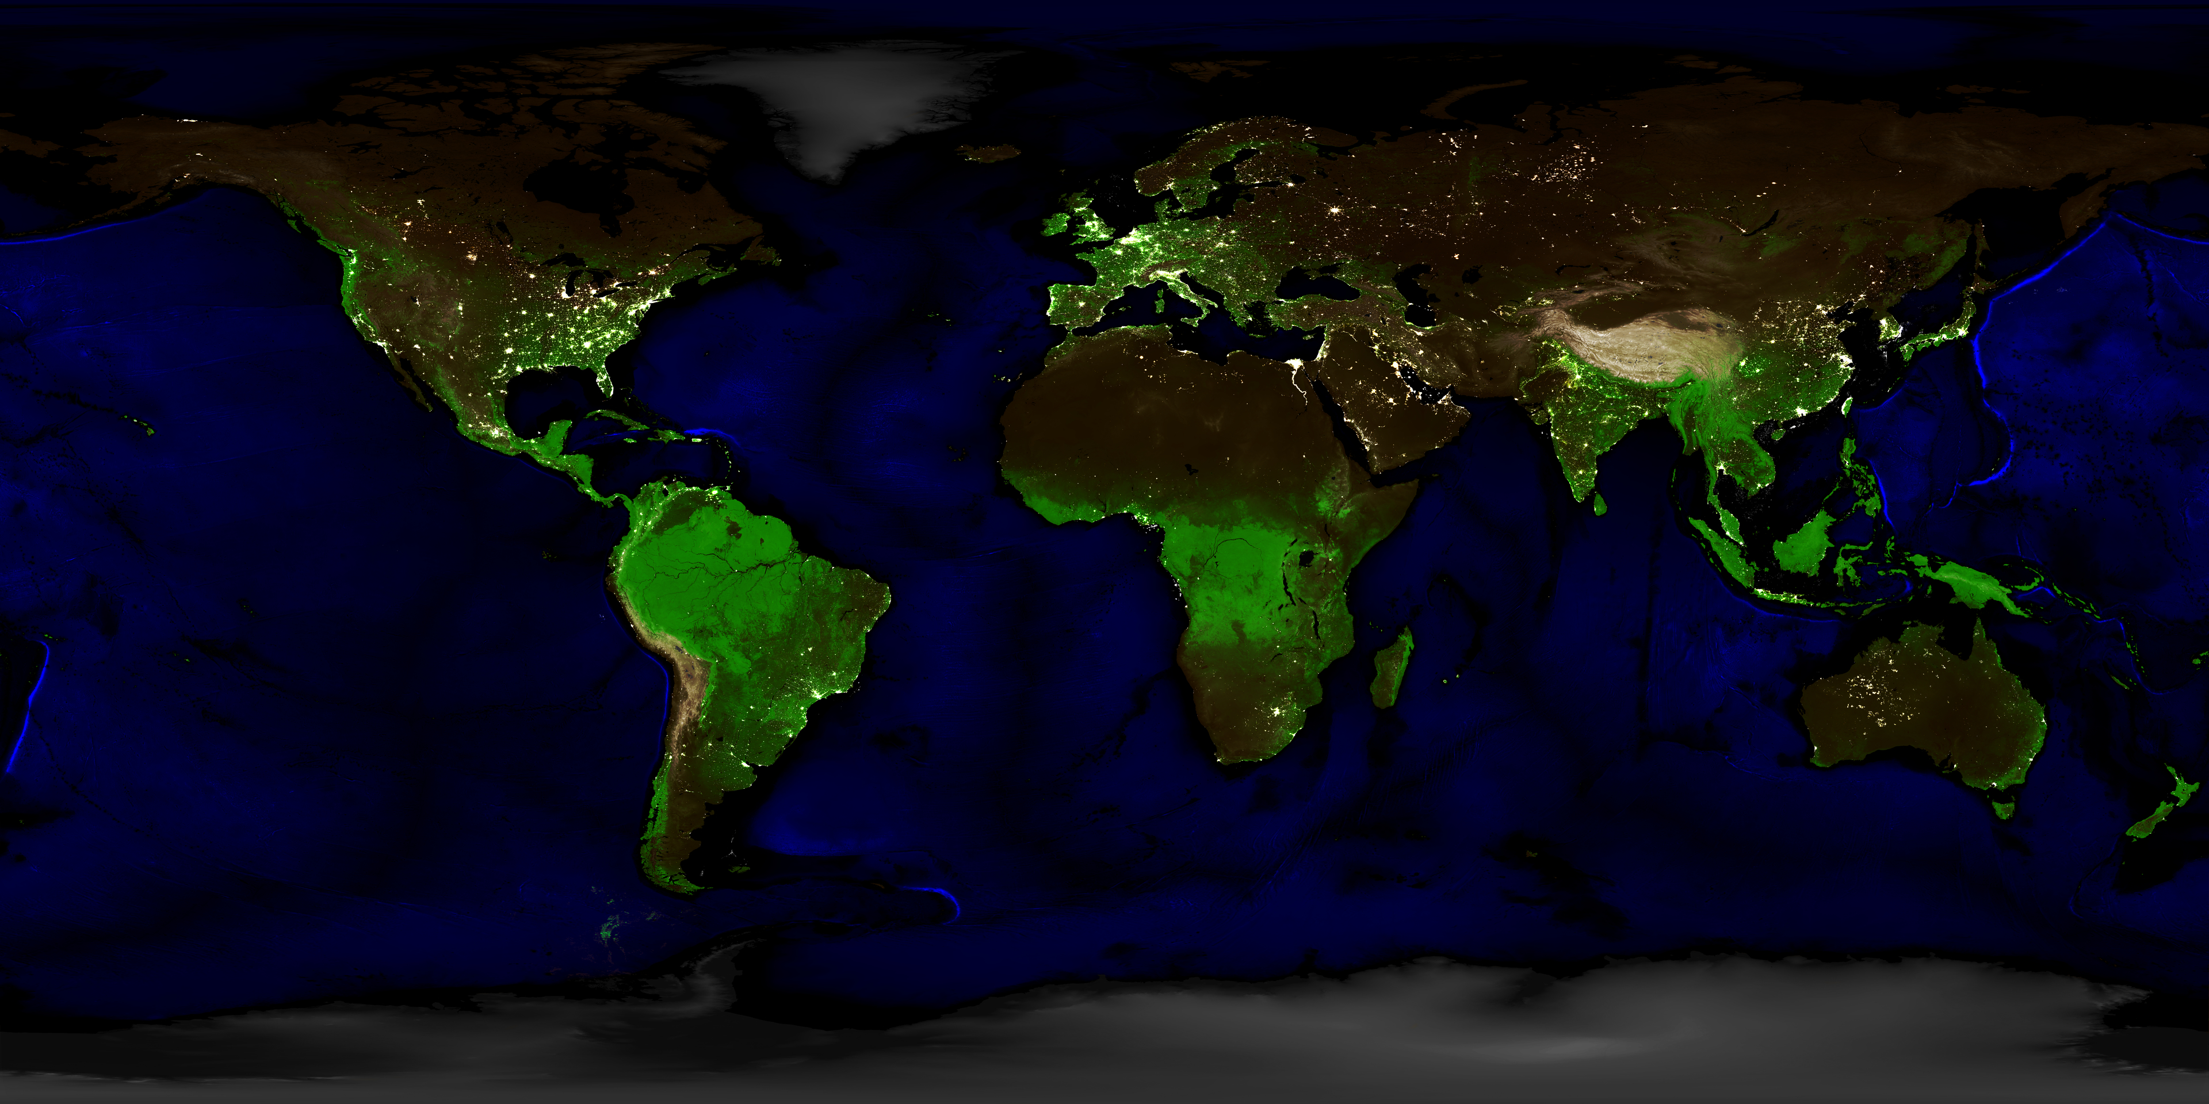

A bridge between ESRI and QGIS
Brett Edmond Carlock
2020-07-17

Slide 2
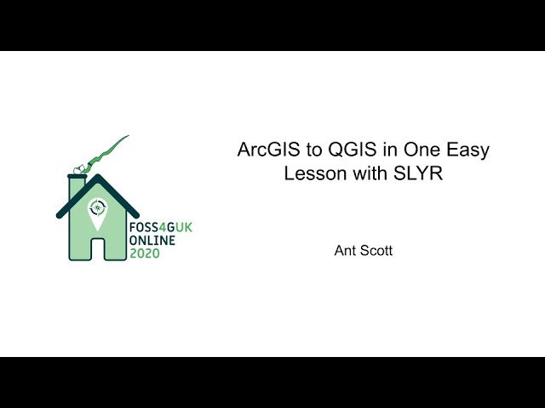
https://youtu.be/h4fC7ryyyTw
Excellent demonstration of side-by-side testing of QGIS+SLYR conversions of ArcGIS projects

Slide 3
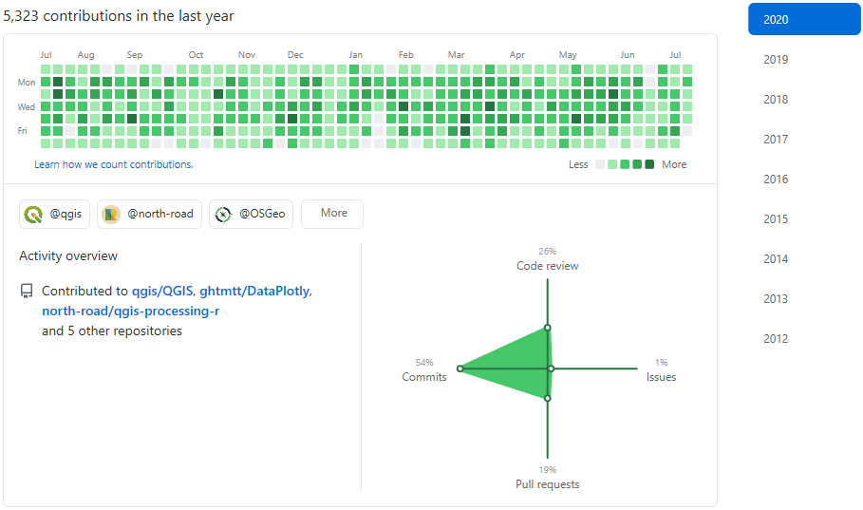
North Road & Nyall Dawson
North Road
  https://north-road.com/
    Cartography
    Development
    Analysis
Nyall Dawson
  https://github.com/nyalldawson

Slide 4
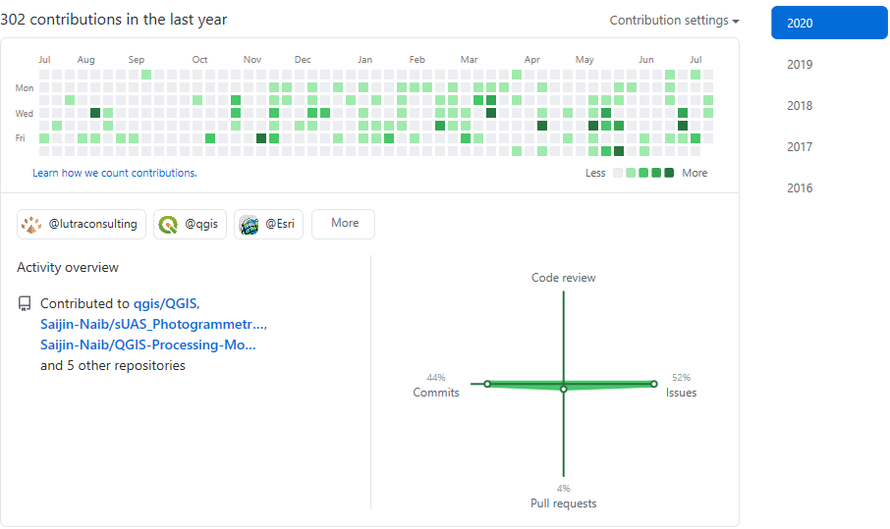
Brett Edmond Carlock
https://github.com/Saijin-Naib
  Issues, Feature Requests, Sample Data
Education & History

Slide 5
SLYR – Open Source Snapshot
https://github.com/nyalldawson/slyr
Features:
  ESRI ArcDesktop .STYLE parsing
    Color Swatches
    Symbology
      Line
      Marker
      Fill
    Color Ramps
Example Usage
  https://github.com/StephSaephan/QGIS-ESRI-Converted-Styles
    https://opengislab.com/blog/2019/3/16/converting-esri-styles-to-qgis-styles-using-slyr
  https://github.com/Saijin-Naib/QGIS-ESRI-Converted-Palettes

Slide 6
SLYR – Donationware?
FOSS release
  Limited functionality
  Fairly static (+1yr since last update)
Donation release
  Funding of continual improvements
    SLYR, QGIS core, GDAL, etc.
  Open Source Pledge
    https://north-road.com/slyr/#open_source_pledge

Slide 7
SLYR-funded Improvements
https://github.com/qgis/QGIS/pulls?q=is:pr+SLYR
  Over 30 improvements to QGIS funded directly by SLYR donations
  Improvements to GDAL also as a result of SLYR development efforts

Slide 8
SLYR – Revision History
Changelog
Version 3.10.1 (2020-05-07) - Much improved legend conversion. Lots of QGIS 3.14 related goodies!
Version 3.10.0 (2020-04-09) - Legend, North Arrow conversion. Much improved layout conversion (especially for QGIS 3.14). Relationship conversion support.
Version 3.9.0 (2020-03-12) - Much more support for page layout conversion, including data driven pages conversion
Version 3.8.4 (2020-02-05) - More beta page layout conversion support, gracefully handle renderers provided by known 3rd party ArcGIS extensions
Version 3.8.3 (2020-01-22) - Convert Maplex label rotation by attribute, add algorithm to export MXD/LYR structure as JSON
Version 3.8.2 (2020-01-21) - Fix loss of vbscript expressions during conversion, fix invalid default shapefile encoding
Version 3.8.1 (2020-01-20) - Convert layer joins, allow conversion of XLS layer sources, improved conversion of expressions with non-latin field names
Version 3.8.0 (2020-01-17) - Huge compatibility improvements, conversion of 3D Texture Fill symbols, 3D Character Marker symbols, conversion of bar charts, warn on encountering more types of corrupt layer nodes, warn on encountering compressed GDB layer sources, fixes for very old MXD document conversion, convert Biunique Value renderers, raise warnings instead of aborting when corrupt picture data is found, CRS conversion improvements, convert legend group expanded states
Version 3.7.2 (2019-11-20) - General compatibility improvements
Version 3.7.1 (2019-11-19) - Fixed loss of original vector layer paths, correctly set project CRS, handle attribute based marker rotation, add support for converting Proportional Symbol renderers, general MXD and LYR compatibility improvements
Version 3.7.0 (2019-11-06) - MXD support is no longer beta, and is available for all users. Also more huge compatibility improvements for MXD documents and general all round improvements.
Version 3.6.2 (2019-10-25) - Huge compatibility improvements for MXD documents (again!), basic support for ImageServer layers, add support for PMF and SXD files, convert all data frames from MXD documents
Version 3.6.1 (2019-10-09) - Huge compatibility improvements and support for converting more objects. Beta annotation conversion functionality. Nicer error reporting. Convert bing/osm layers. dat bookmark conversion.
Version 3.5.1 (2019-09-26) - Further improvements in MXD conversion capabilities. Fix embedded picture conversion in styles, multiple decoration layers, scale range fixes, color map conversion
Version 3.5.0 (2019-09-17) - Huge improvements in raster and MXD conversion capabilities. Add algorithms for batch MXD conversion.
Version 3.4.1 (2019-09-13) - Raise a warning if an invalid license key is entered
Version 3.4.0 (2019-09-13) - Properly fix errors on plugin updates
Version 3.3.6 (2019-09-12) - Handle date values, beta drawing conversion, greater class breaks renderer, map server layer, color ramp symbol compatibility, handle raster band names. Fix error on plugin update.
Version 3.2.0 (2019-09-09) - Conversion of raster RGB and unique value renderers, raster alpha bands and settings, mxd bookmark conversion (requires QGIS 3.10), much better labeling conversion (including multi-class labels), compatibility with very old symbol versions, conversion of gradient fills, allow users to set path to Inkscape binary, fix default symbols returned instead of completely empty symbols, allow conversions of some forms of multi-part color ramps
Version 3.1.2 (2019-08-26) - Improved handling of relative file paths in LYR/MXD documents, more robust MXD document conversion
Version 3.1.1 (2019-08-22) - Improve conversion of lines with decorations, center markers, offset cartographic lines and other edge cases
Version 3.1.0 (2019-08-09) - Initial beta support for raster conversion (stretch color ramp only for now), add conversion support for multi-part color ramps, support direct drag and drop of layers ArcMap/ArcCatalog to QGIS (requires QGIS master/3.10)
Version 3.0.4 (2019-07-19) - Much improved symbol conversion quality, improved label conversions
Version 3.0.3 (2019-06-17) - Improved conversion capabilities
Version 3.0.1 (2019-05-20) - Improve Win install process
Version 3.0 (2019-05-17) - Experimental MXD support
Version 2.0 (2018-10-16) - Convert almost all symbol types, pictures
Version 0.0.1 (2018-08-29) - Initial kick off

Slide 9
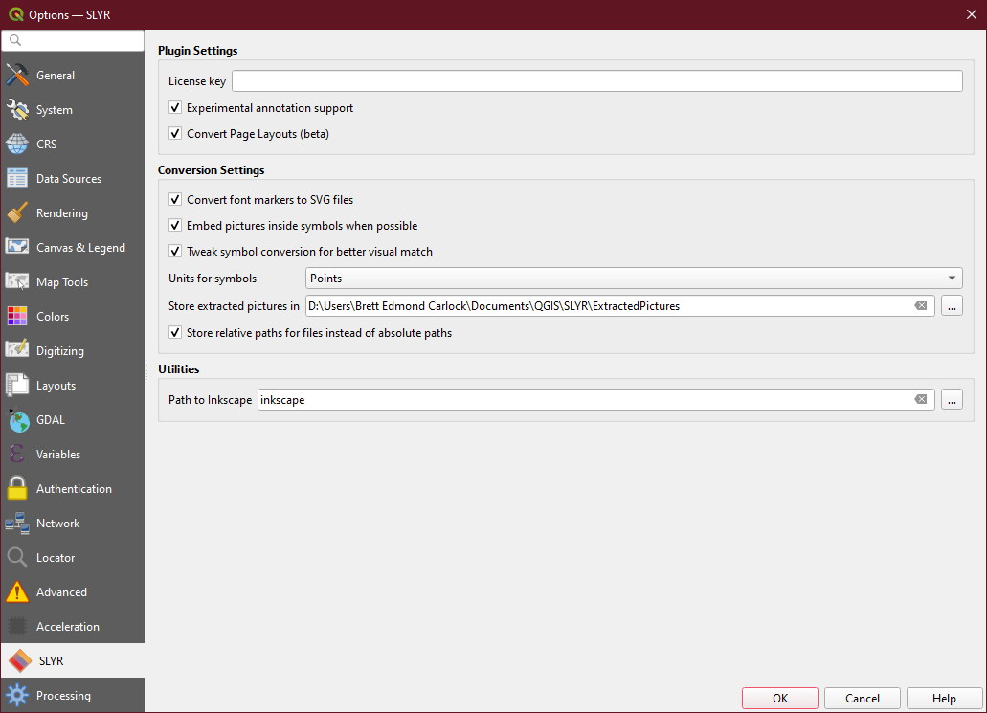
SLYR – Settings Panel

Slide 10
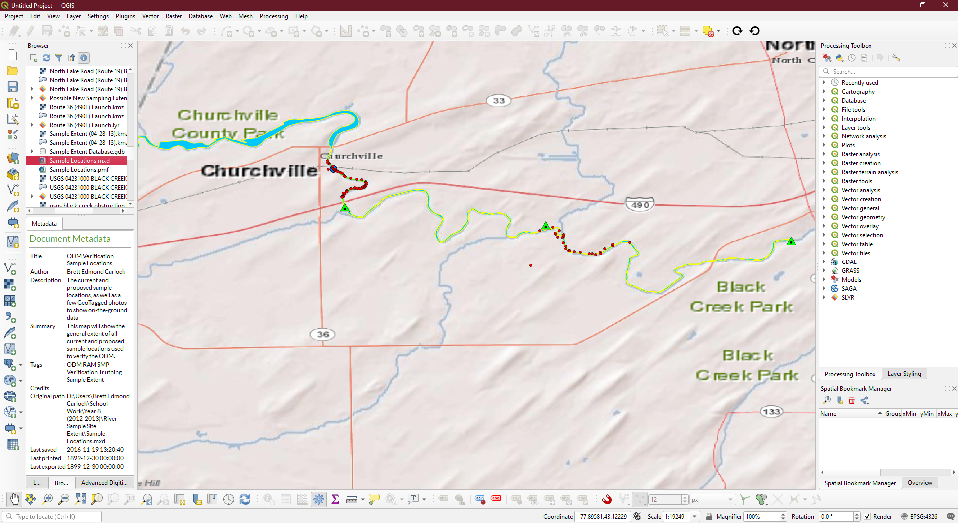
SLYR – Browser & Metadata

Slide 11
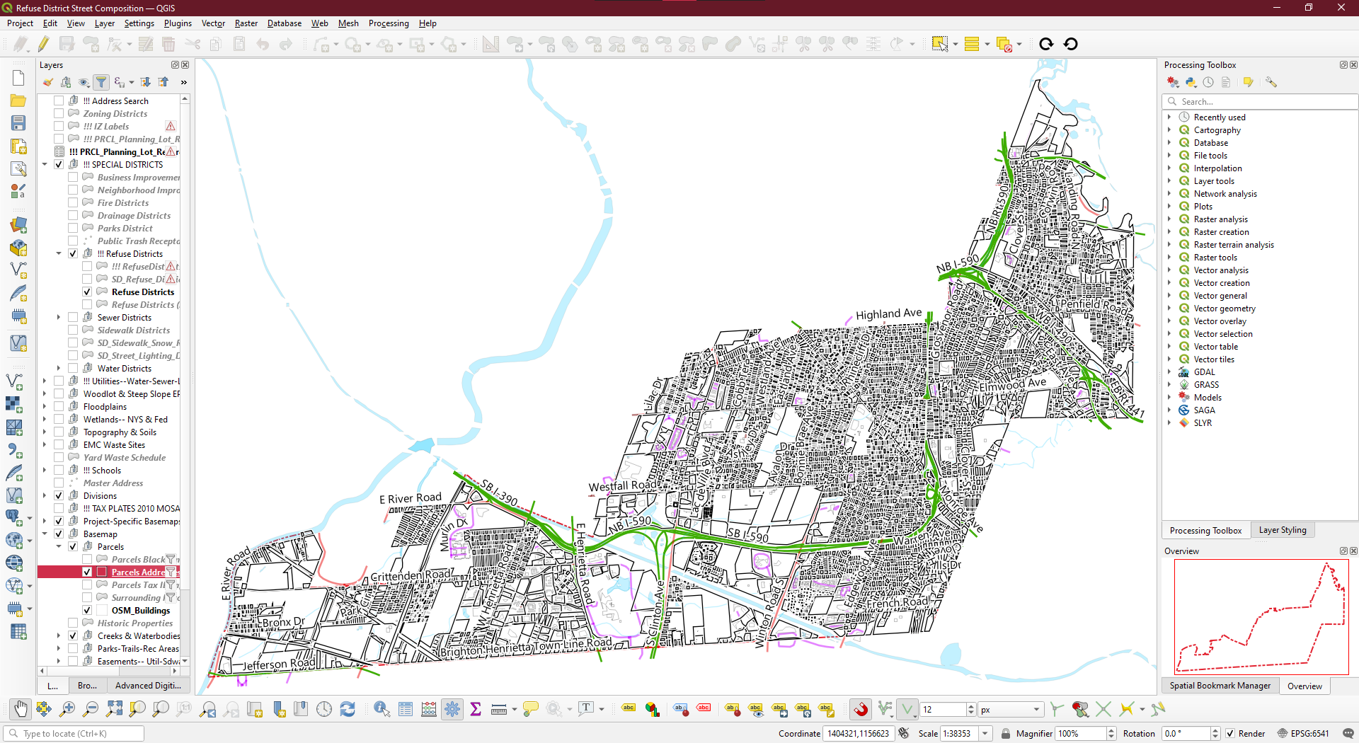

Slide 12
Limitations
Annotations
  QGIS 3.16+
ArcGIS Pro
  Mapx
  Layerx
  Stylex
ESRI TIN
  QGIS 3.18+

Slide 13
Limitations, cont.
ArcScene
  2D
  3D
Editing of hosted features
  ArcGIS Online
  ArcGIS Portal

Slide 14
Limitations, cont.
Mixed Deployments
  ESRI FGDB
    Raster
      https://github.com/qgis/QGIS-Enhancement-Proposals/issues/173
      Read/Write
      RAT
      Colormap
    Vector
      https://github.com/qgis/QGIS-Enhancement-Proposals/issues/172
        Spatial Index Support
        Read/Write
        Compression
        Domains & Relations

Slide 15
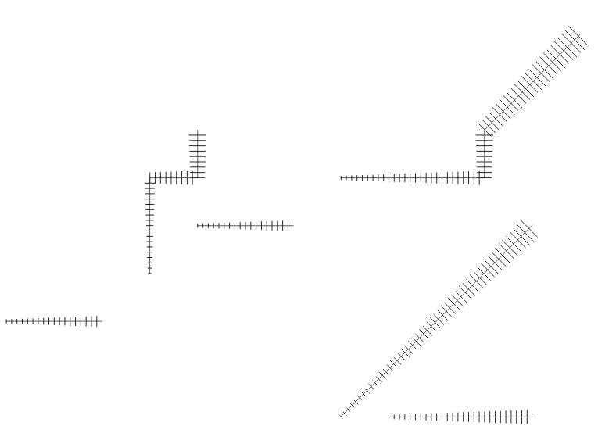
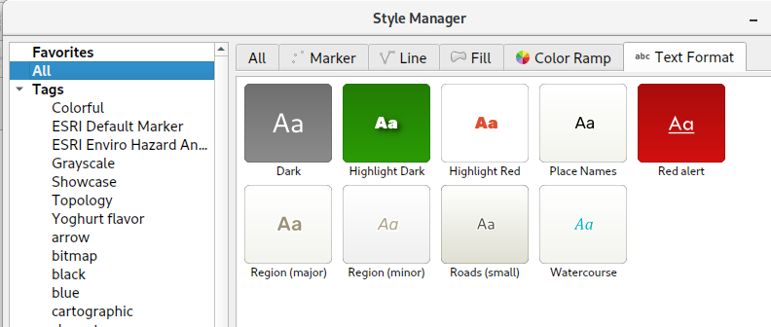
Pull Requests
[FEATURE] New line symbol type: Hash line #9644
Handle text formats in style manager #30281

Slide 16
Pull Requests, cont.
New algorithm "Combine style databases" #30608
This algorithm combines multiple QGIS style databases into a single style database. If any symbols exist with duplicate names between the different source databases these will be renamed to have unique names in the output combined database.
"Center of segment" placement mode for marker and hash line symbol layers #31315
Adds a new placement option to place markers/hash lines at the center point of individual line segments

Slide 17
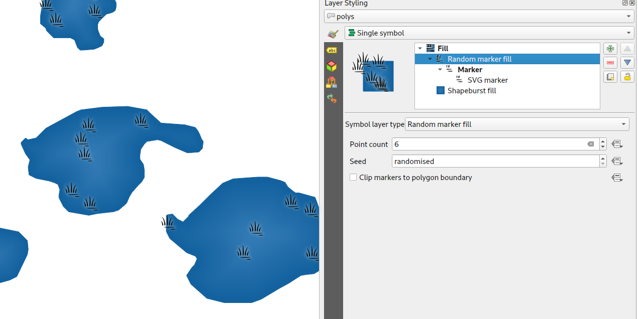
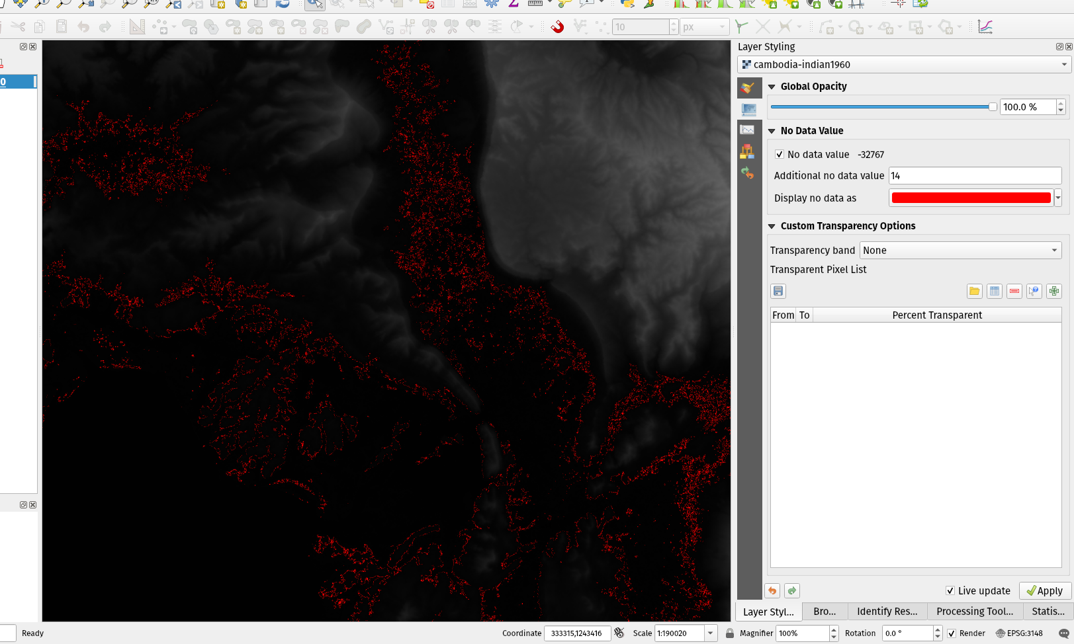
Pull Requests, cont.
Random marker fill symbol layer type #32241
Add option to set color for rendering nodata pixels in raster layers #31728

Slide 18
Pull Requests, cont.
New class QgsBookmarkManager #31524
Attached to QgsProject, this provides a stable, supported method of managing project bookmarks (vs the old undocumented, not stable approach of directly manipulating project keys)
[FEATURE][diagrams] Add option to control pie diagram angular direction #32986
I.e. control whether the sections are rendered in a clockwise or anticlockwise direction

Slide 19
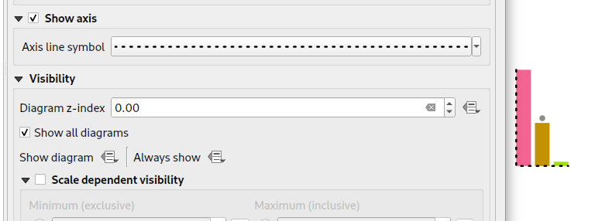
Pull Requests, cont.
[FEATURE] Add spacing option for vector layer bar chart diagrams #32984
Allows for user-controlled spacing between each bar in the chart.
Diagrams - add option to show axis for histogram plots, many fixes #33029

Slide 20
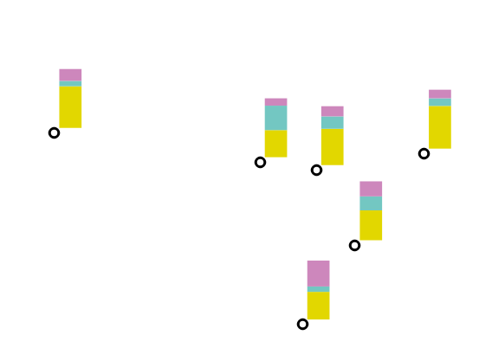
Pull Requests, cont.
[diagrams] Paint effect support for diagram renderer #33044
Allows for diagrams to use paint effects, including drop shadows, outer glows, etc...
[FEATURE][diagrams] New diagram type "stacked bars" #33043

Slide 21
Pull Requests, cont.
Allow scalebar line style to be set using standard QGIS line symbols #35225
We now expose the option as a full line symbol for more advanced styling
Rework picture item UI and behavior #35160
Adds an explicit choice between SVG or raster image sources, which allows us to clean up the configuration panel for layout pictures by hiding options which don't apply to a certain picture source. Also permits us to:
Reuse the standard svg selector tree widget, which loads images in a background thread and fixes #17061
Uses the standard SVG and image selector line edit, which permit drag and drop of images and expose options to embed images and link to online sources
Ultimately this is motivated by a desire to allow users to embed images in layouts and layout templates

Slide 22
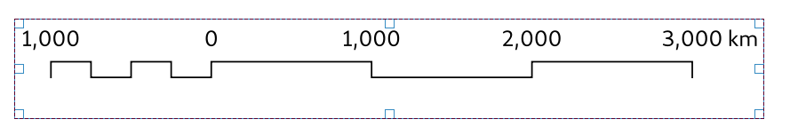
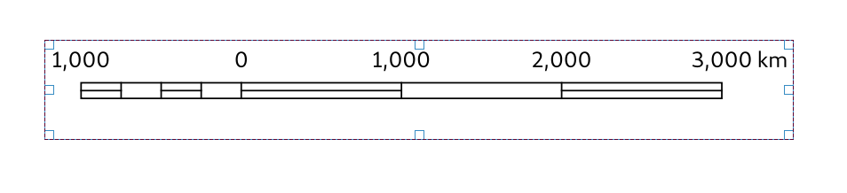
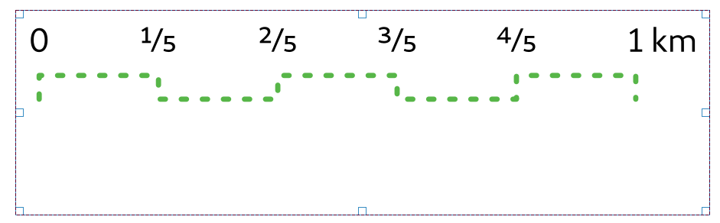
Pull Requests, cont.
Add "stepped line" and "hollow" scalebar styles #35238
Add numeric formatter "fraction" style #35244
This style represents decimal numbers as vulgar fractions, e.g. "3/4" instead of 0.75.
Options include using Unicode superscript and subscript characters for nicer typography, e.g. ¹⁷/₂₃. An option also exists forusing dedicated unicode characters for specific fractions (where a unicode character exists), e.g. ½ or ¾

Slide 23
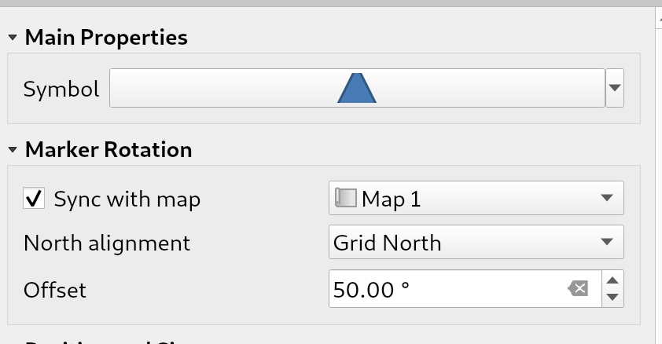
Pull Requests, cont.
Allow marker items to sync rotation with maps #35591
[FEATURE][layouts] New item type for marker symbols #35576
Allows marker symbols to be placed directly on layouts, eg. for manually placing markers over a map item or for creation of advanced custom legends.

Slide 24
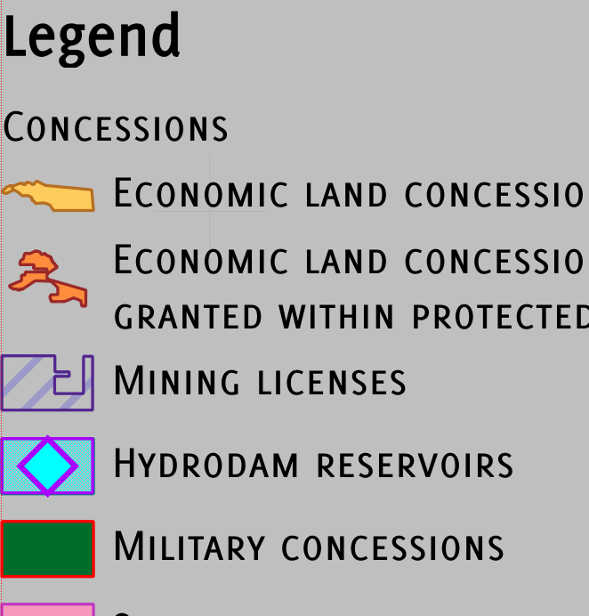

Pull Requests, cont.
Allow configuring legend patch shapes by double-clicking on legend items #35863
Allow plugins to register custom "Project Open" handlers #35606
These allow plugins to extend the "Open Project" dialog by adding in support for new file filters, which appear in the formats drop down list alongside the existing "QGS Projects" entry.
Custom project open handlers then get first chance at loading project files.
This allows plugins to extend QGIS support by adding integrated support for opening projects from non QGS/QGZ formats, e.g. allowing users to open ArcGIS MXD documents or MapInfo WOR Workspaces direct from the project open dialog.
These non-native projects are also added to the recent projects list and welcome screen, giving them a truly first-class experience within QGIS.

Slide 25
Pull Requests, cont.
Allow overriding the legend patch size on a per-item basis #36013
Allows users to override the symbol patch size for individual legend nodes, by double clicking the node
Width and height can be individually overridden, with the node falling back to the default width or height when the override isn't set.
Allow control over the horizontal spacing before legend group/subgroup/symbols #35974
Gives flexibility to allow "nesting" legend groups/subgroups/symbols and much greater control over legend item placement

Slide 26
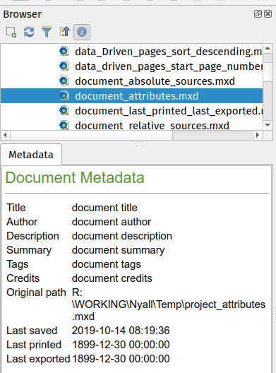
Pull Requests, cont.
Allow customisation of division and subdivision symbols as distinct from scalebar tick horizontal symbol #36222
Allows for styling division and subdivision symbols in a different way compared with the horizontal line symbol in a tick scalebar
Allow custom QgsDataItem types a chance to create a info widget #36014

Slide 27
Pull Requests, cont.
Add support for field aliases to OGRFieldDefn, read alias in openfilegdb driver #2729
This PR adds support for setting/retrieving field aliases to OGRFieldDefn. It also adds support for reading the embedded field alias information stored in .gdb tables
Expose control over layer legend splitting behavior on a layer-by-layer basis #36224
This allows users to manually override the legend's default setting for "split layers" on a layer-by-layer basis, by double clicking a layer in the layout legend panel and choosing whether that layer:
  follows the default legend setting for splitting
  can ALWAYS be split over multiple columns (regardless of the legend's setting)
  can NEVER be split over multiple columns (regardless of the legend's setting)

Slide 28
Pull Requests, cont.
Embedded Images in QGIS Layouts
it’s now possible to create completely self contained print layout templates for QGIS — you no longer have to separately distribute any required images (such as company logos) along with your QPT templates!
Scalebar numeric formats
Thousands separator
Decimal places
Rounding
Significant Figures
Plus/Minus
Padding

