Slide 1

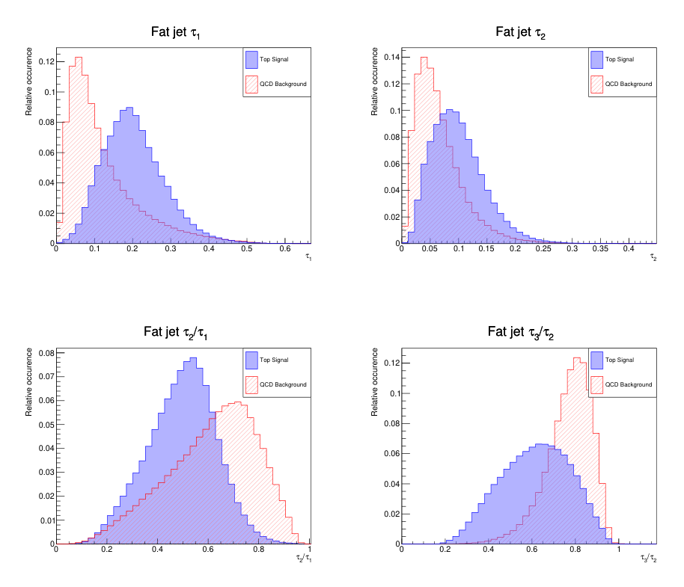
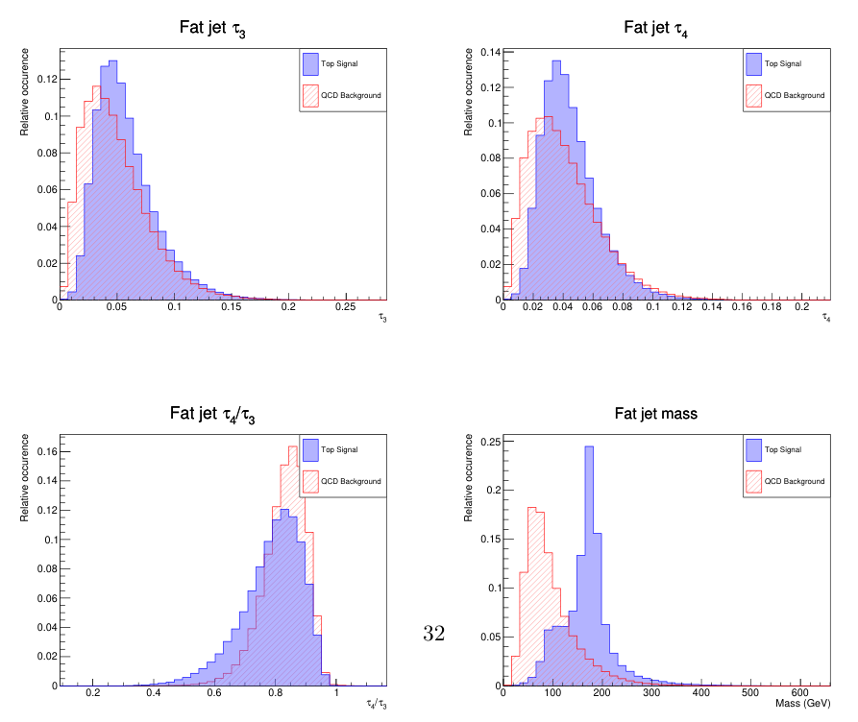

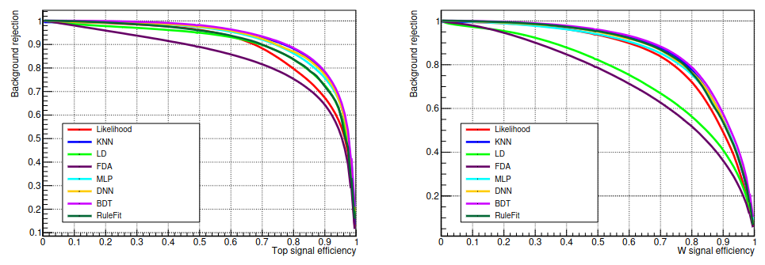
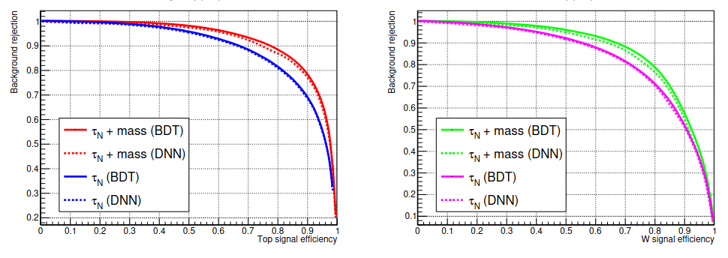
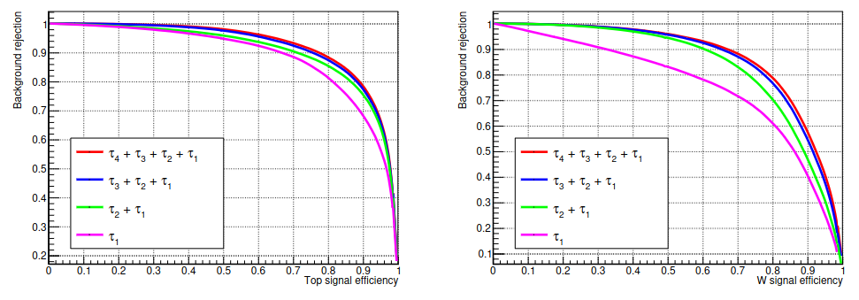
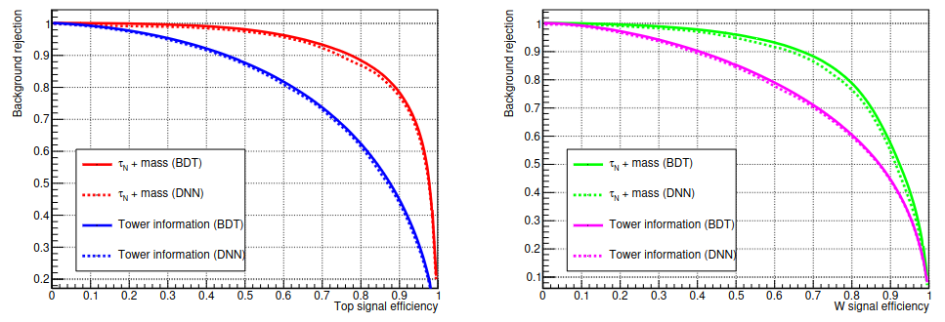
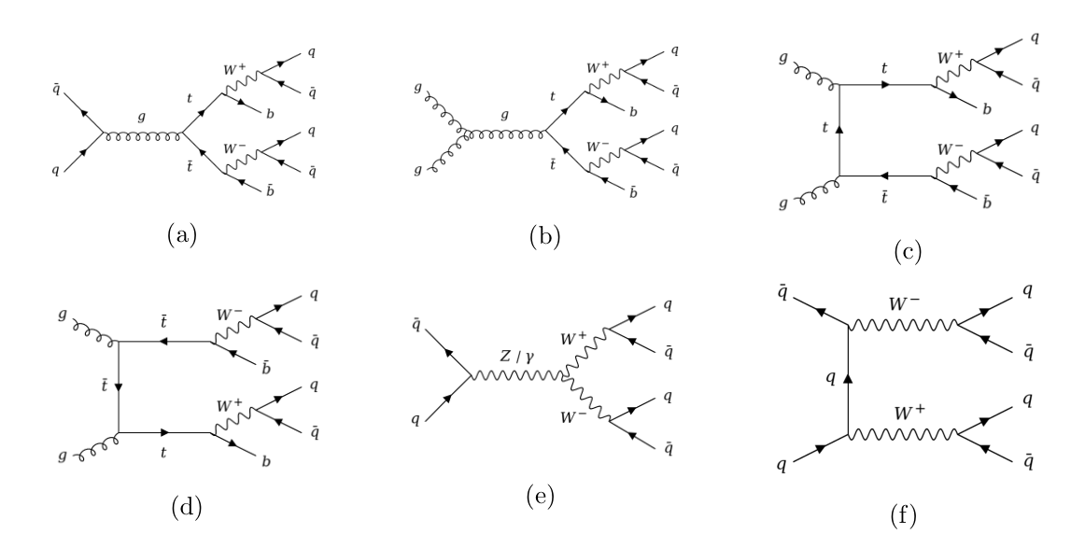
Boosted particle tagging at the LHC based on large R jet substructure using machine learning techniques
Author: Carlos Buitrago Cárdenas. cabuitrago@unal.edul.co
Director: Carlos Sandoval Usme. cesandovalu@unal.edu.co
FENYX-UN
Physics Bachelor Thesis
Abstract
As the searches for new physics at the LHC continue to look into previously unexplored kinematic regimes, the importance of boosted particles constantly increases. These particles, whose transverse momentum is far greater than their rest mass, need to be efficiently reconstructed and identified (”tagged”). When decaying hadronically, these kind of objects have a unique detector signature. As their decay products are highly collimated, they are reconstructed as a single large R jet. In this work, a tagging mechanism for boosted particles based on the substructure information of these large R jets is explored. Specifically, the fat jet N-subjettiness shape and the fat jet mass are used to train different multivariate classifiers. The performance of the resulting algorithm is examined for the tagging of boosted top quarks and W bosons. The algorithm’s response to various inputs is also analysed.
Introduction
Boosted particles decaying hadronically result in multiple collimated (and unresolved) jets which will merge into a single large R jet, usually called fat jet [1]. The key to identifying and measuring boosted particles lies in the internal structure of the reconstructed fat jets, whose discriminating power is the object of this study.
The energy pattern of boosted hadronically decaying particles is fundamentally different from that of QCD jets of a similar invariant mass. N-subjettiness [2] is a jet shape which exploits said difference. It is denoted by and it is defined using N candidate subjets identified during the clustering process as follows:
Results
Initial assessment of the discriminant capabilities of the substructure variables:
Where runs over the constituent particles and is a normalization factor which depends on the radius parameter used in the jet algorithm. The variables give us information about how well the jet substructure is defined by N subjets, effectively working as discriminant variables which can be employed to develop a tagging mechanism by making use of machine learning algorithms.
Figure 2: Distribution of variables, their ratios and the mass for the fat jets in the signal and background training samples (only shown for the top signal).
Classifier training results, performance measured by the area under the ROC curve (background rejection vs. signal efficiency):
Methodology
The generation of the Monte Carlo samples for signal and background events consists of the same simulation chain. Initially, matrix elements for the signal processes are produced at LO using MadGraph 5, after which datasets of 500000 tree-level events are generated via MadEvent at = 14 TeV with a generator-level cut of > 35‏‏0 GeV on all partons. Afterwards, the events are showered using Pythia 8 and the response of the ATLAS detector is simulated via Delphes 3.
The signal processes being considered correspond to the production of top quarks and W bosons, both decaying in the fully hadronic channel (see figure 1). On the other hand, for the background sample the process consists of QCD dijet production (top jets excluded).
Figure 3: Performance of the different multivariate algorithms trained.
Figure 4: Effect of not including the mass as an input during the training.
Figure 5: Effect of using different number of variables as input for the algorithm training (BDT).
Figure 6: Performance obtained using substructure variables vs. using kinematic variables.
Conclusions
The discriminant capabilities of the ratios were noticeable from the signal and background distributions of the training set. The boosted top and W tagging method proposed was carried out using the first four variables and the mass of the resulting fat jets. The best performance was achieved using the BDT classifier. The relevance of the mass in the tagging method was addressed and the potential of the variables by themselves was notorious. The gain in performance decreased noticeably with the increase of inputs being used, indicating a saturation of the model being trained. Finally, a clear difference in the performance achieved using substructure and kinematic variables was observed.
Figure 1: Signal processes used for the simulation of (a) - (d) boosted top production and (e) - (f) boosted W production.
The jets are reconstructed using the anti- algorithm with R = 1. After their … values and mass are computed using FastJet, they are used to train multiple multivariate algorithms via TMVA 4. The performance of the resulting tagging mechanism is evaluated when different inputs are used during the training. For both the signal and background datasets, half of the events (randomly selected) are used as the training sample and the other half as the testing sample.
References
Altheimer, Andrew, et al. (2014). Boosted objects and jet substructure at the LHC. Report of BOOST2012, held at IFIC Valencia, 23rd–27th of July 2012. The European Physical Journal C, 74, 1-24.
Thaler, J., & Van Tilburg, K. (2011). Identifying boosted objects with N-subjettiness. Journal of High Energy Physics, 2011(3), 1-28.

