Slide 1
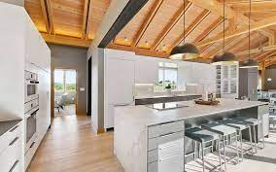
Painting Quality Control
Carlos Verdugo
MAP 3305
Dr. Hahn

Slide 2
Painting Quality Control
According to Statistica.com, The global market volume of paint and coatings amounted to nearly ten billion gallons in 2019. In 2020, the global paint and coatings industry was estimated to be valued at some 158 billion dollars.
State with most paint and coatings establishments
In the painting industry, one of the biggest concerns for contractors and for customers is painting quality. Not only the quality of the paint itself but also the surface quality. In most painting projects, most customers expect the highest paint quality, especially in New Construction.

Slide 3
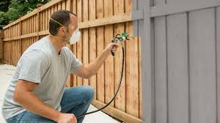
Comparing paint samples with Defects versus Smooth samples
I will use an AlexNet model to help me compare defective paint samples versus smooth samples.
I know that in the future many dangerous jobs such as spraying paint will be automated. With the continuous study of AI and Machine Learning this will be possible.

