Slide 1
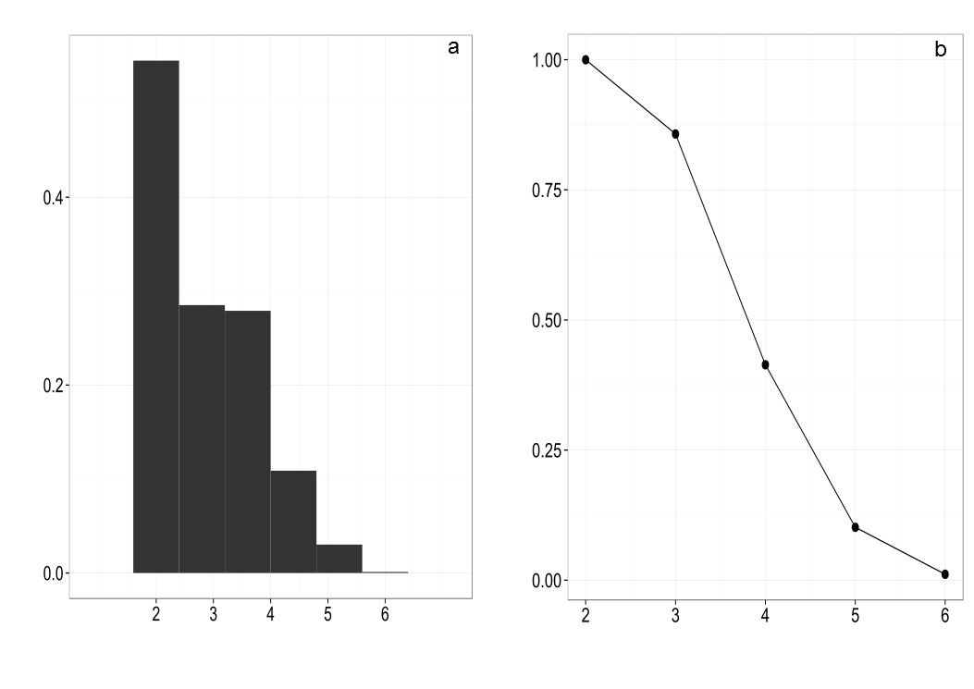
Figure 1
QUASI SIGN-STABILITY
DENSITY
NUMBER OF TROPHIC LEVELS

Slide 2
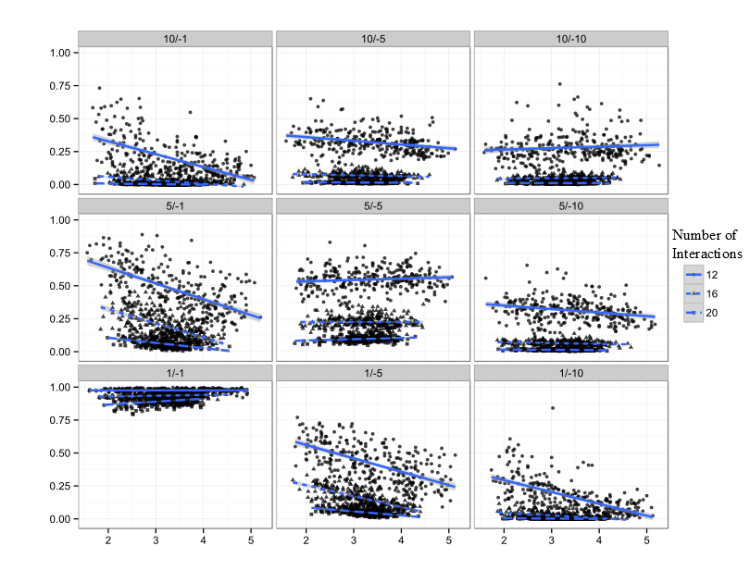
Figure 2
QUASI SIGN-STABILITY
MEAN TROPHIC POSITION

