Slide 1
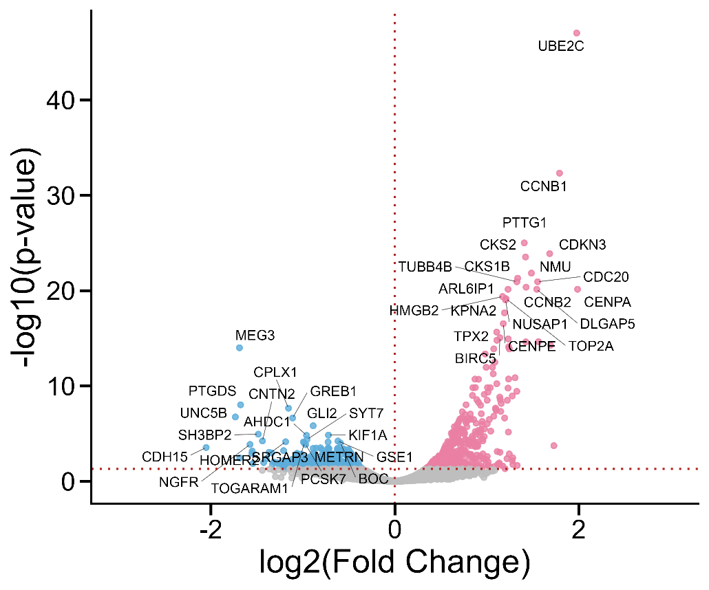
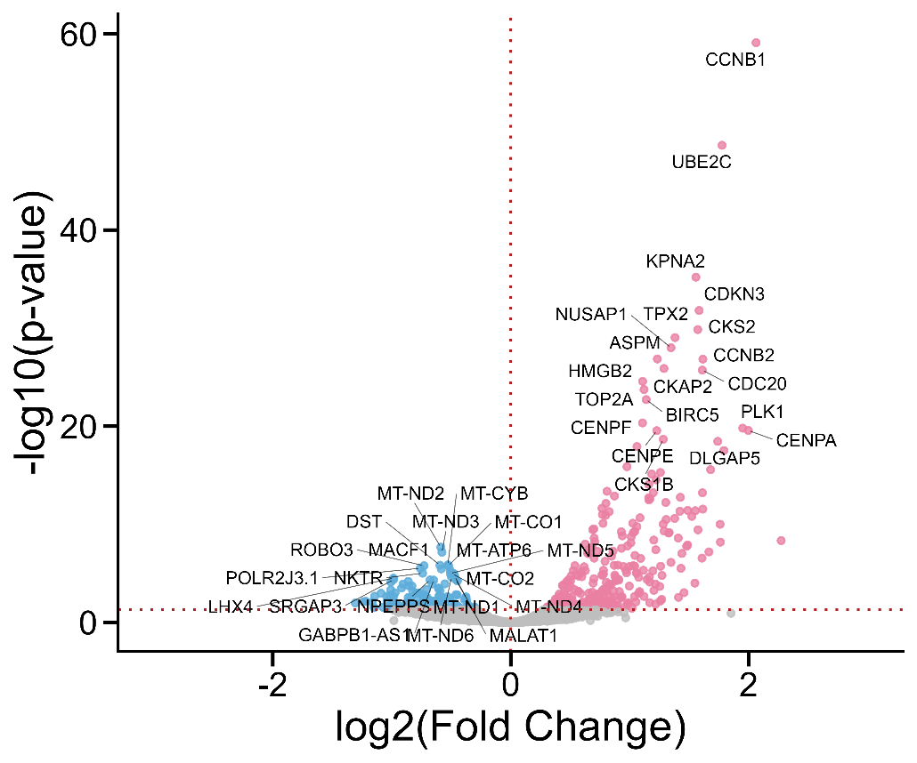
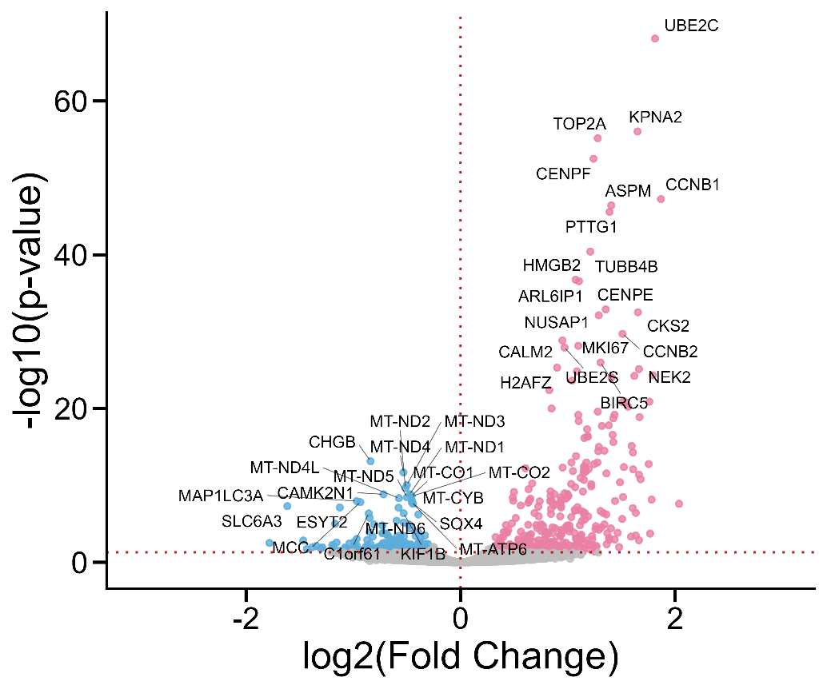
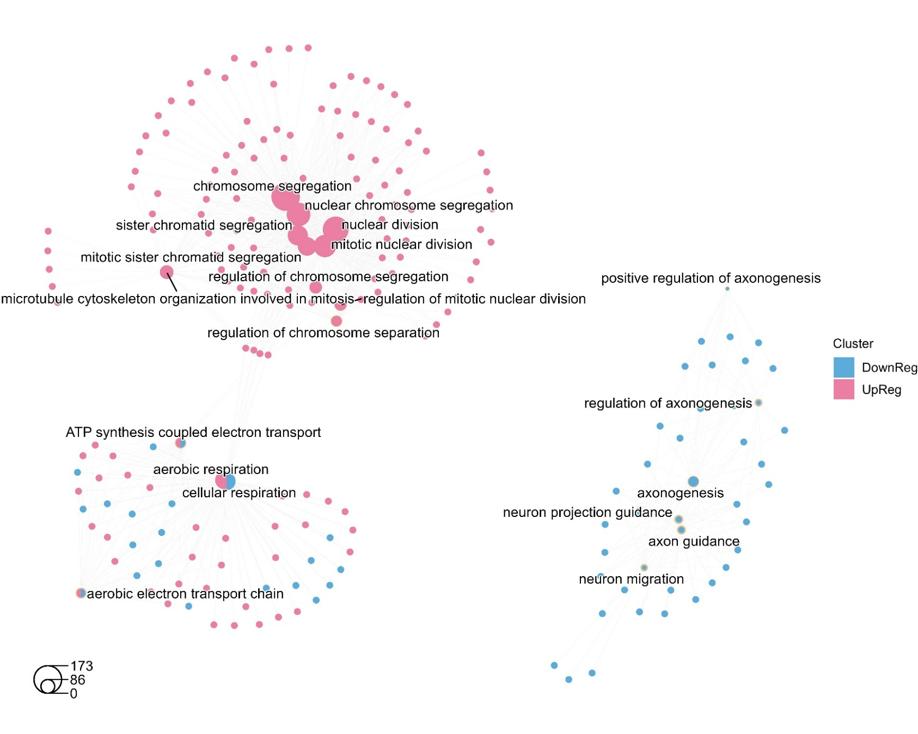
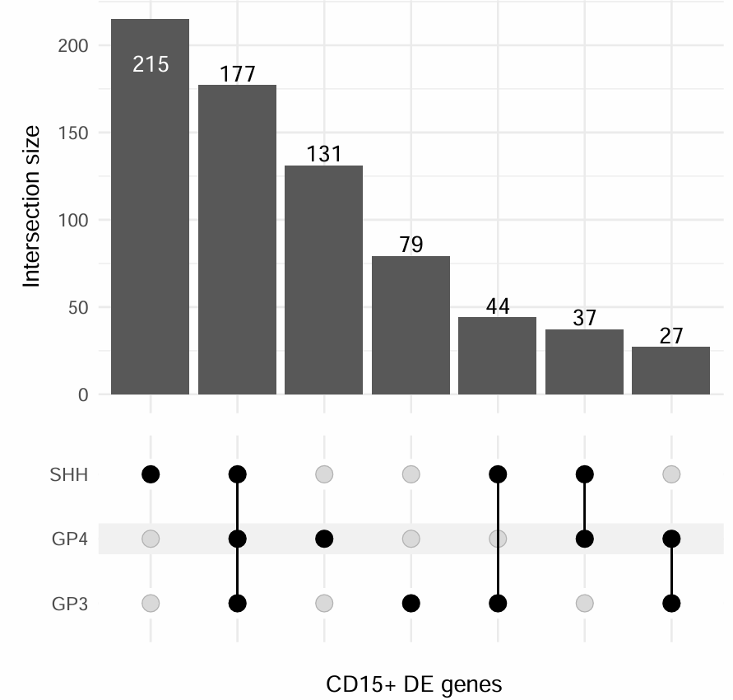
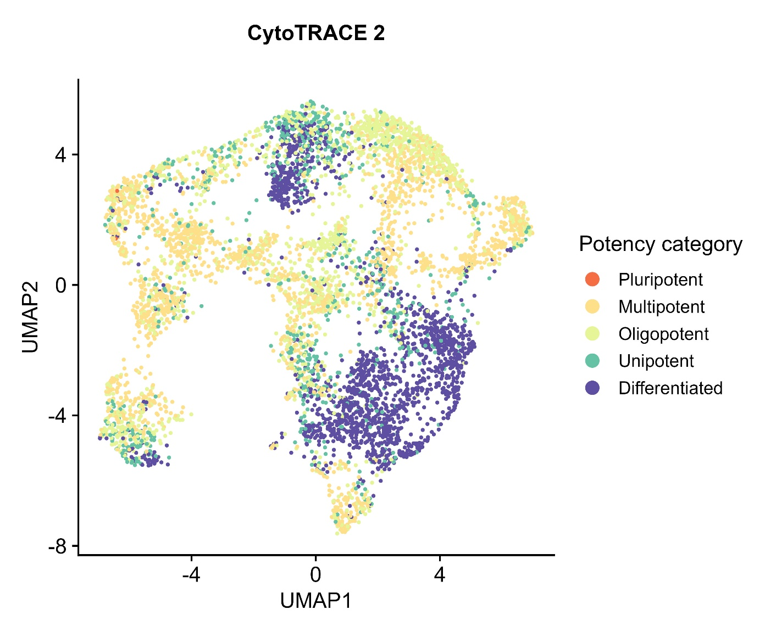
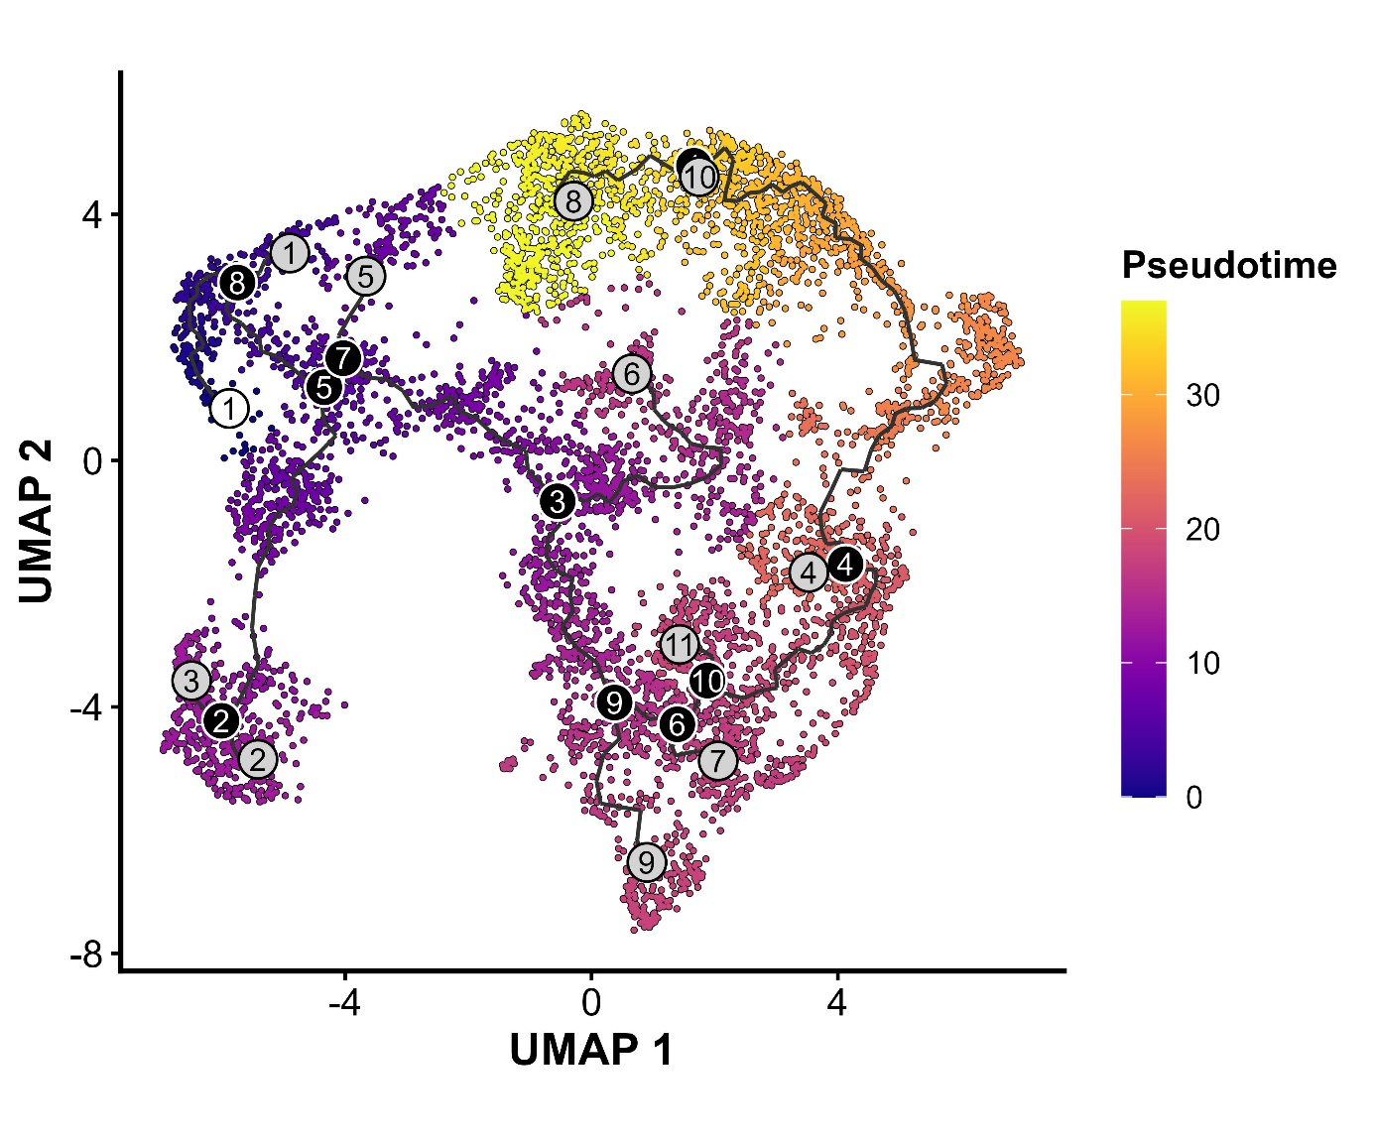
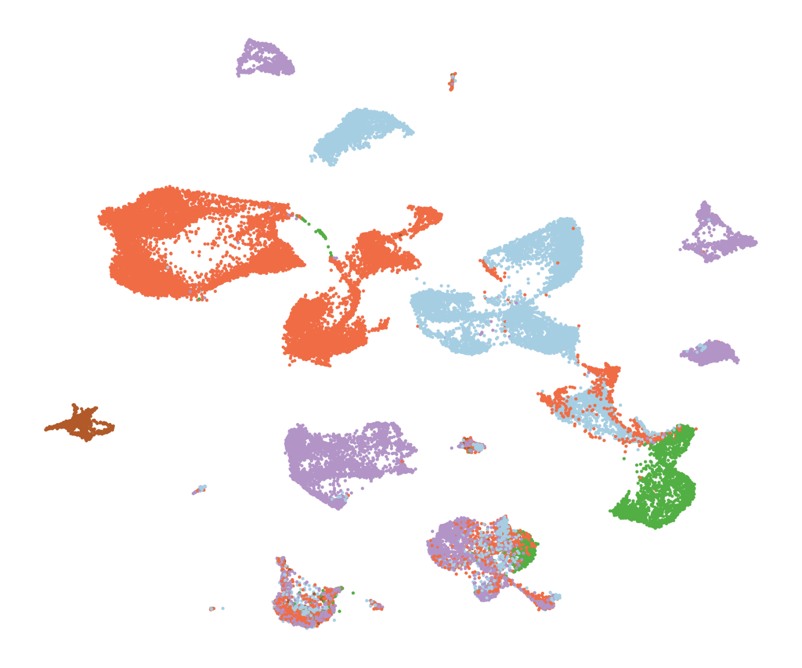
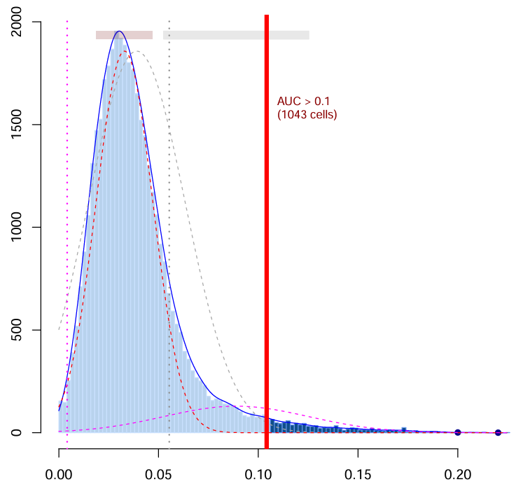
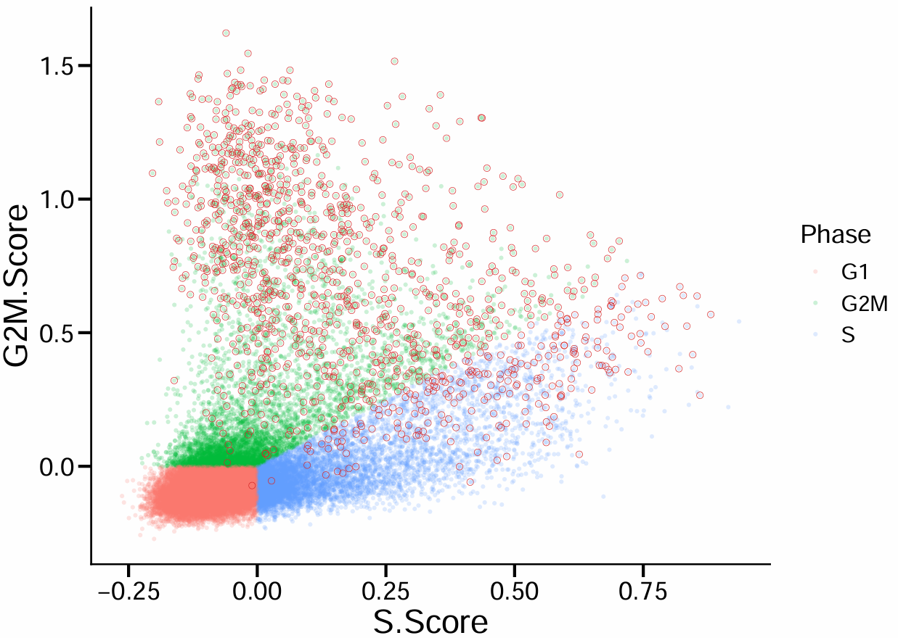
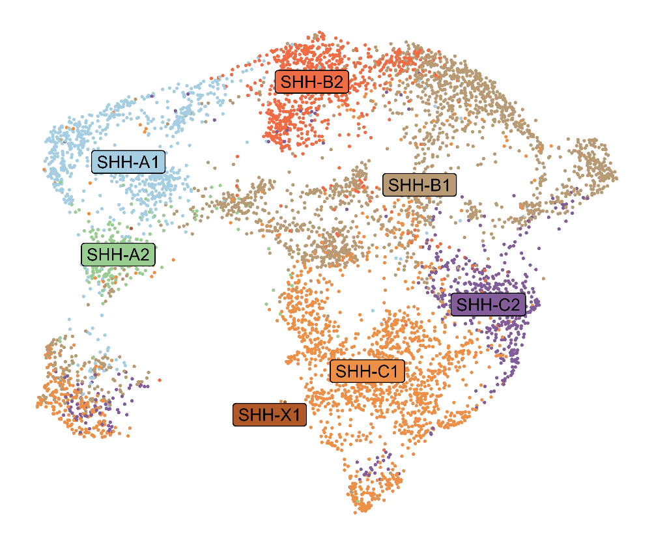
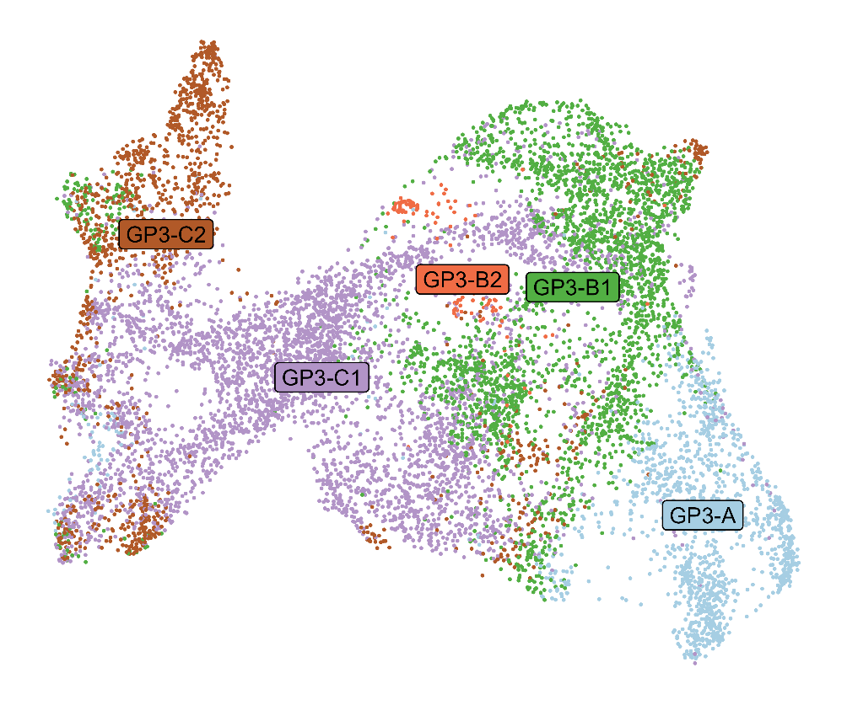
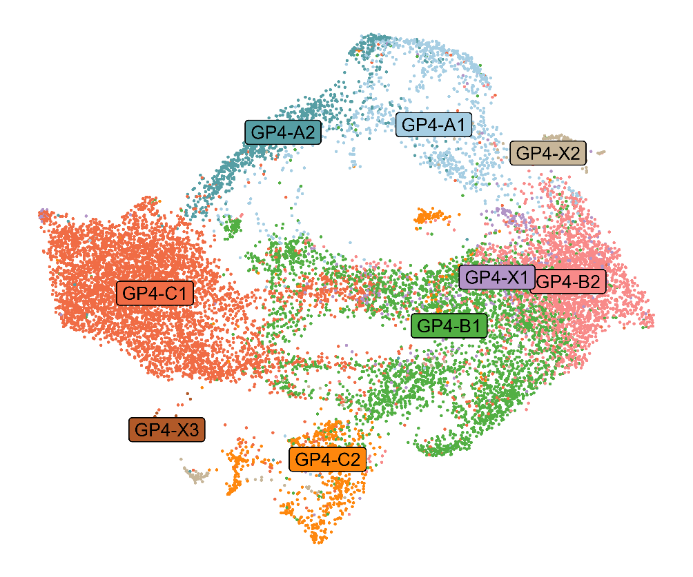
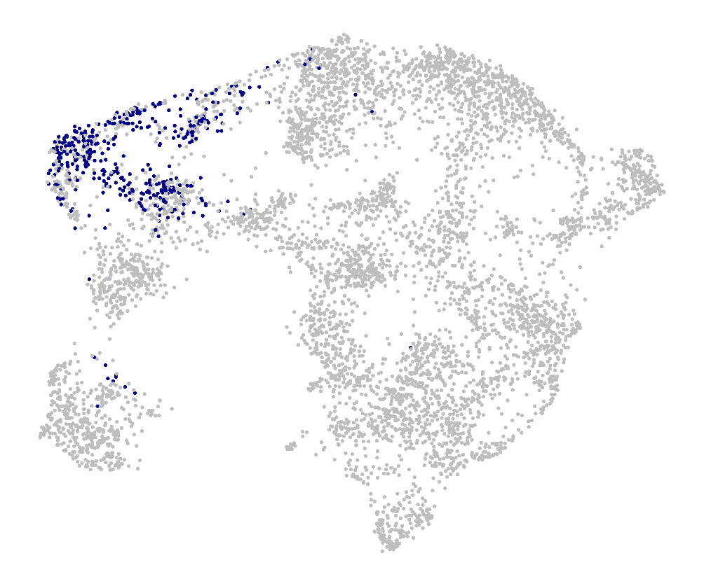
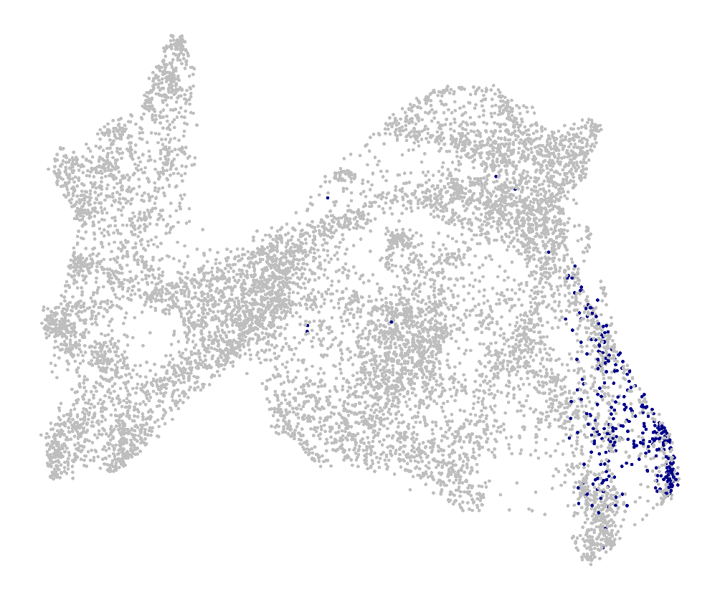
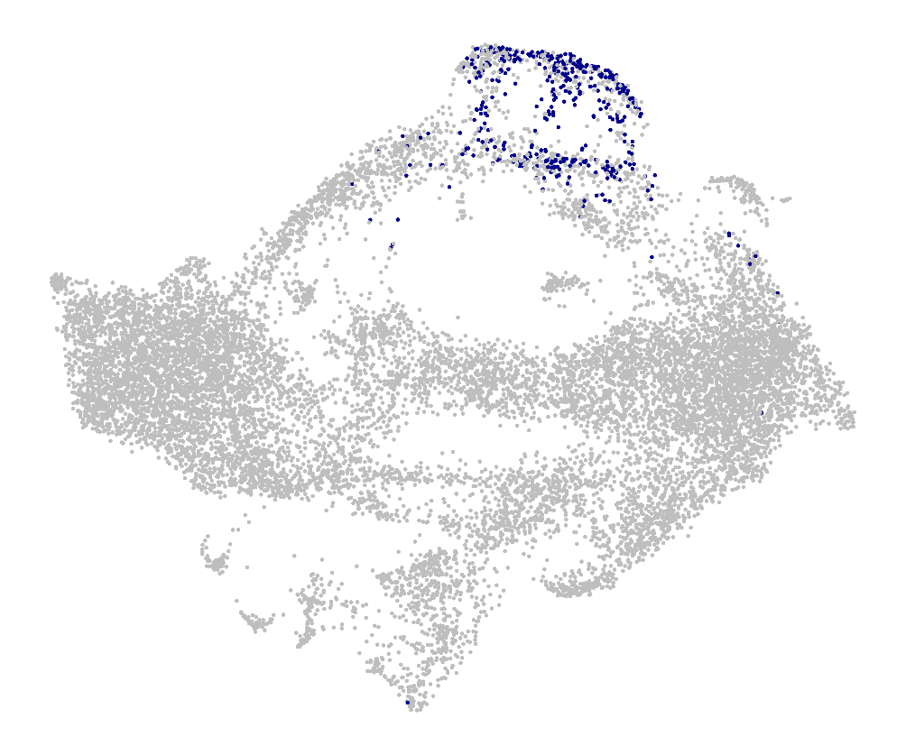
Transcriptional footprint of CD15⁺ medulloblastoma cells reveals a mitotic and multipotent phenotype.
Carlos Alfaro-Quinde¹, Pritika Shahani¹, Valentin Kliebe¹, April D. Salvador¹, Jezabel Rodriguez-Blanco^{1,2}.
¹ Department of Pediatrics, Medical University of South Carolina, Charleston, SC.
² Hollings Cancer Center, Medical University of South Carolina, Charleston, SC.
Abstract
CD15⁺ CELLS DEFINE A MITOTICALLY ACTIVE, MULTIPOTENT STATE
Background:
Brain tumors are a leading cause of cancer-related mortality in children, with medulloblastoma (MB) being the most common malignant one. Despite advances in treatment, approximately 30% of MB patients experience relapse. Unfortunately, recurrent MB is almost uniformly lethal. Thus, therapies that prevent MB relapse are urgently needed. Recent studies from our lab have shown that MB cells expressing the stemness marker Cluster of Differentiation 15 (CD15) contribute to MB relapse (Cell Death and Dis, 2026). However, the transcriptional program of CD15⁺ cells across MB subgroups and their potential therapeutic vulnerabilities remain largely underexplored.
Specific aims:
Obtain 28 human MB patient samples from Riemondy et al.2021, comprising SHH, Group 3 and 4.
Characterized the transcriptomic profile of CD15⁺ cells in SHH, Group 3 and 4 MB patient samples.
Calculate pseudo trajectory analysis of SHH CD15⁺ cells to reconstruct dynamic progression of theoretical differentiation.
Design/Methods:
Integrative analysis of single cell-RNA seq samples was performed obtaining a spectrum of cellular populations and states across SHH, Group 3 and 4 MB.
CD15⁺ signature was derived from Read et al., 2010; and signature was mapped onto the single-cell object.
Pseudobulk differential expression analysis of CD15⁺ vs CD15⁻ cells was computed to define their transcriptional profile. Functional enrichment analysis was performed on the differential expressed genes.
Pseudo trajectory analysis was also computed using Monocle3, following the estimation of cellular potency with CytoTRACE2.
A
SHH
Group 3
Group 4
B
C
Pseudobulk differentially expression analysis comparing CD15 ⁺ vs CD15⁻ cells within the A-program (G2/M cells) across SHH, Group 3 and 4 shows similar set of upregulated genes across subtypes, suggesting a consistent/conserved cellular state.
Representative functional enrichment analysis highlights significant upregulation of pathways related to chromosome segregation, mitotic processes, and nuclear division-consistent with the CD15⁺ proliferative signature, alongside downregulation of differentiation-associated programs.
UpSet plot showing the distribution of DEGs (CD15 ⁺ vs CD15⁻) across subtypes, displays 177 DEGs in common across subtypes . SHH exhibits the highest number of unique DEGs (215), followed by Group 4 (131) and Group 3 (79).
D
E
Discussion
CD15⁺ cells exhibit a predominantly mitotic phenotype, with the highest enrichment observed in SHH MB.
Integrative analysis on single-cell RNA seq combined with AUCell scoring displays CD15⁺ cells as mitotic cells mainly located in the cell cycling program, with SHH showing the highest proportion of CD15⁺ cells.
Pseudobulk and pseudo trajectory analysis shows CD15⁺ as mitotic-addict cells with multipotency capability of potential of differentiation.
CytoTRACE2 analysis reveals that the CD15⁺ cell compartment comprises predominantly multipotent and oligopotent cells, with a subset exhibiting pluripotent-like features.
Pseudotime trajectory analysis further supports this, showing multiple branching differentiation paths, highlighting the differentiation potential of CD15⁺ cells and warranting further investigation.
Characterization of cd15⁺ cells in patient samples
A
B
C
GP4
GP3
WNT
SHH
Integrative analysis of 28 single-cell RNA-seq MB patient samples reveals a broad range of cellular states.
Cells with AUCell scores > 0.1 were classified as CD15⁺ signature–positive, yielding 1,043 cells.
Cell Cycle analysis on the CD15⁺ cells indicates a predominant enrichment in the G2/M phase, consistent with highly mitotic/proliferative cells.
Conclusions
UMAP 2
n = 28
39946 cells
GP3/4
Using fully bioinformatic analysis on human samples, we were able to determine the transcriptional profile of CD15⁺ cells in SHH, Group 3 and Group 4 MB.
Pseudobulk differential expression and pseudotime trajectory analyses identify CD15⁺ cells as a subset of cycling cells with a highly mitotic phenotype and multipotent differentiation capacity, suggesting a potential role in MB development and maintenance.
UMAP 1
SHH
Group 3
Group 4
D
Future Directions
Elucidate the regulatory landscape of CD15⁺ cells by identifying key transcription factors and upstream regulators using SCENIC and decoupleR.
Experimentally confirmed CD15⁺ cells-potential in mice models for further studies
CD15⁺ cells are predominantly enriched within the A-program across SHH, Group 3, and 4 MB subtypes.
~48% of A-program cells in SHH are CD15⁺, compared to ~21% in Group 3 and ~31% in Group 4.
A-program: cycling cells; B-program: progenitor-like cells; C-program: differentiated-like cells; X-program: patient-specific populations/clusters.
Contact Information
Contact Carlos Alfaro for further information. Contact by email at alfaroqu@musc.edu or by phone at 803-404-4585

