Slide 1

FIT & HEALTHY
Author: Carlos Arenas Carretero

Slide 2

What is Fit & healthy?
The project consists of the creation and management of a gym in Córdoba.
It is a place that allows you to practice different types of activities and exercise indoors.

Slide 3

Why did I choose this idea?
The idea of creating this type of business arises from the growing interest of society to improve both health and physical appearance.
Today, the population is increasingly concerned about their physical condition and image.

Slide 4
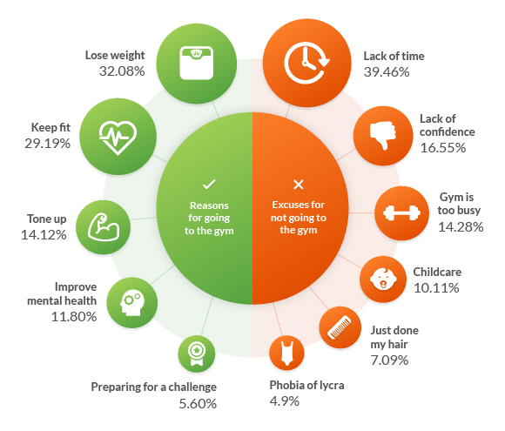
The reasons that promote the opening of the gym are diverse.
First of all, in Spain there are a large number of people who regularly attend sports clubs and gyms.

Slide 5

The reasons that promote the opening of the gym are diverse.
Second, the gym will be located in Córdoba, a city that is gradually increasing in number of inhabitants after the creation of new neighborhoods.
Finally, the gym sector is in full expansion due to the increase in its demand in recent decades and therefore has market niches to cover.

Slide 6

Technologies used :FRONT
Since the beginning of my internship in the company Atmira, I have taken training courses for Angular, so I decided that the best way to improve on this technology was to base the project on it.
Angular is a development framework for JavaScript created by Google.

Slide 7
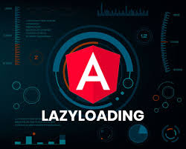
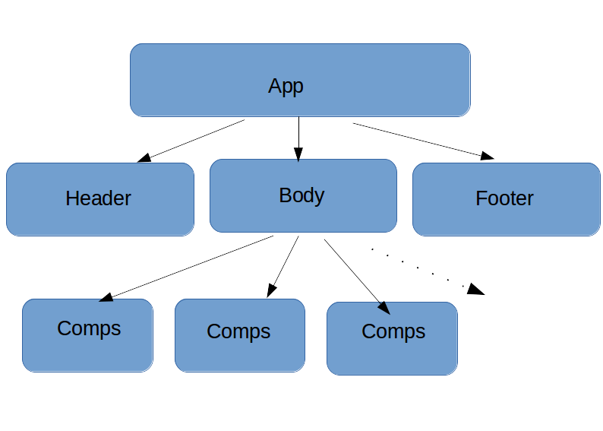
ANGULAR
The application has implemented the technique called lazy loading ,that is a technique used in Angular and consists of delaying the loading or initialization of objects at the time of use.
Angular's component model offers strong encapsulation and an intuitive application structure.
Use of component libraries like prime ng and angular material

Slide 8
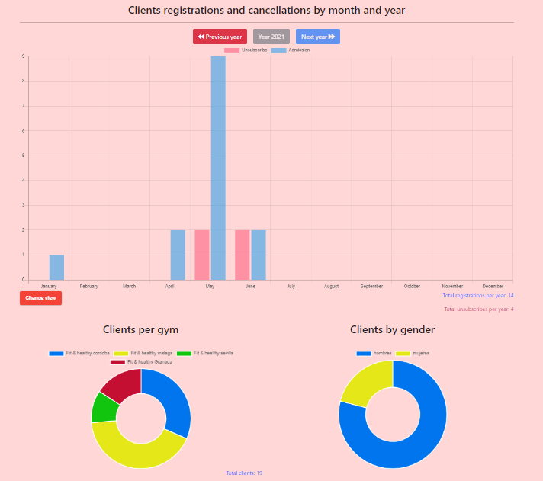
Some libraries used :FRONT
Graphics: Ng2-charts

Slide 9
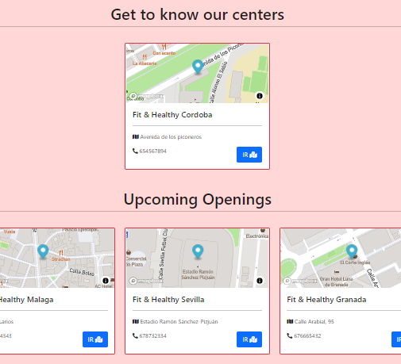
Some libraries used :FRONT
Maps: mapbox-gl

Slide 10
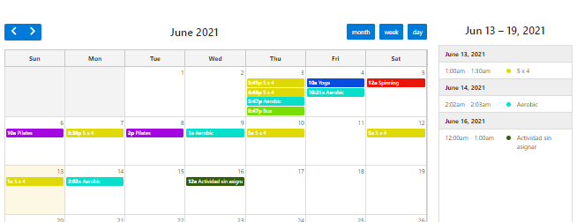
Some libraries used :FRONT
Full-calendar

Slide 11

WEB DESIGN: BOOTSTRAP
This framework is one of the most popular in the market, having been developed by the Twitter team.
Bootstrap is present throughout the application, whether in the management of rows and columns, forms, buttons…

Slide 12

Technologies used :MIDDLE
PHP is a very popular open source language suitable for web development and can be embedded in HTML.
I have used php for my project due to the ease of integrating it with angular to make calls to php files through services and the ease of making the necessary requests to the database.

Slide 13


Technologies used :MIDDLE
Composer: It is a dependency manager for PHP that allows us to download packages from a repository to add them to our project.
PHPMailer is a class created specifically to make it easy to send emails that have complex characteristics.

Slide 14

Technologies used :BACK
MySQL is a database management system. It is currently the most famous and widely used open source database in the world.
MySQL is used to store all the information you want in relational databases, as well as to manage all this data with little complications.

Slide 15
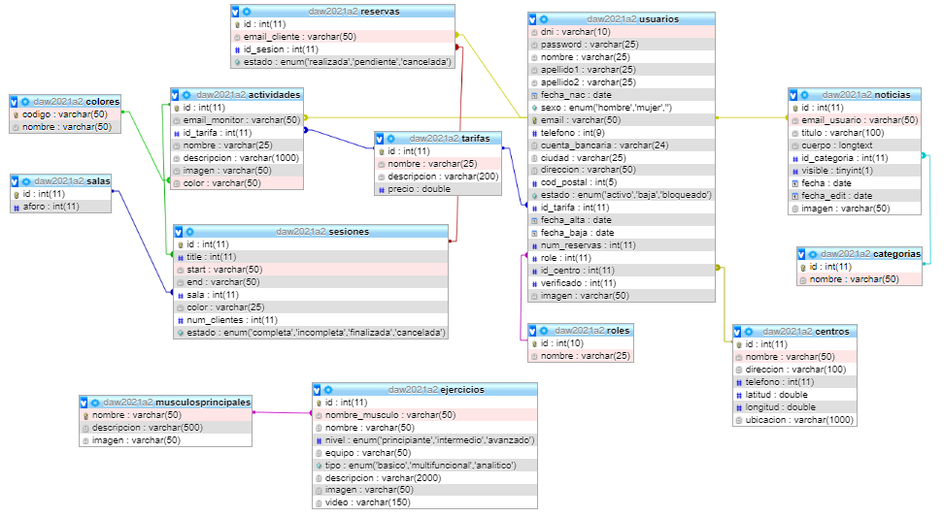
Database tables

Slide 16

Difficulties in carrying out the project
1º The creation and the relationships needed for the different tables.
2º The connection between angular and php.
3º The division of the modules for the lazy load.
4º Compatibility between libraries.
5º The adaptation of the libraries to the project code.
6º The work with times and dates and the different casuistics for the management of the sessions

Slide 17
ROLES
The following roles have been implemented in the application:
Administrator
Monitor
Client
Now, if there are no questions let's see the application….

