Slide 1


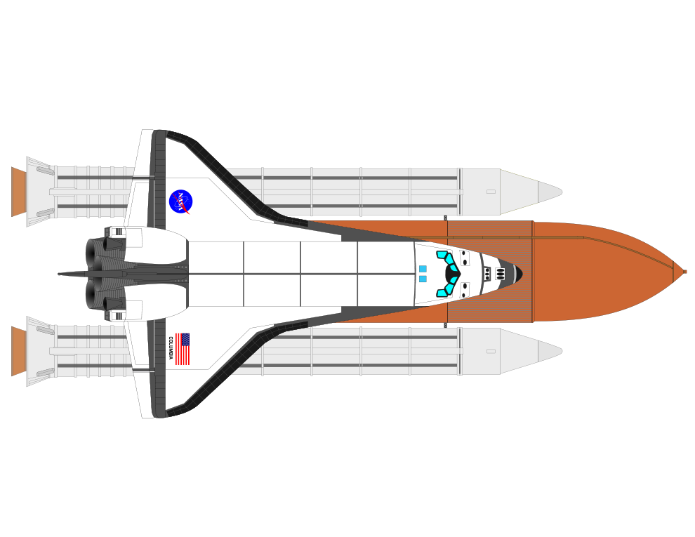
Welcome! I’m
Carlos
Carrasquillo
<Icon>Robotics PhD Student @ Georgia Tech
<Icon>BS Mechanical Engineering @ UF
<Icon>BS Computer Engineering @ UF

Slide 2





