Slide 1
Testing Java applications using JUnit framework
Carlos Sá

Slide 2
Agenda
What is JUnit Framework ?
Creating a Unit Test
Creating test methods
JUnit conventions
JUnit API
Annotation Types
Testing Exceptions
Performance Concerns: Using JUnit for performance evaluation
Parameterized Tests
Grouping tests using Suites
Good Practices in Unit Testing

Slide 3
1) What is JUnit framework?
A framework for testing “units” in Java applications.
It is part of a family of unit testing frameworks called xUnit frameworks.
Became an important part on test-driven development in software.
Requirements are translated in small specific test cases.
The tests grants reliability and confidence of software designs and helps to detect parts of the code that does not meet the requirements.
The tests can be also used for debugging purposes

Slide 4
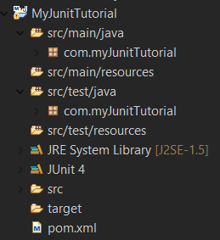
2) How to create an Unit test?
Unit test needs a special project structure (automatically created with Maven)
Create a Maven project in Eclipse (File -> New -> Other -> Maven Project)
Activate “Create a simple project”
For Group id choose a “com.myJunitTutorial” and in Artifact id “MyJunitTutorial”

Slide 5
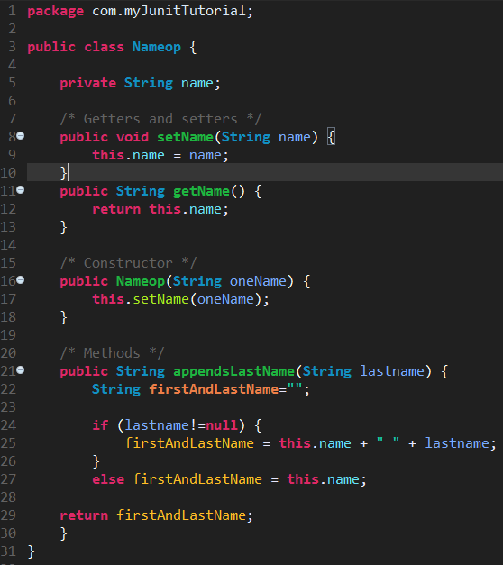
2) How to create an Unit test?
Nameop.java

Slide 6
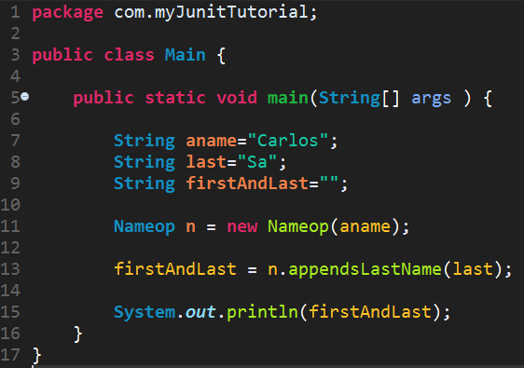
2) How to create an Unit test?
Main.java

Slide 7
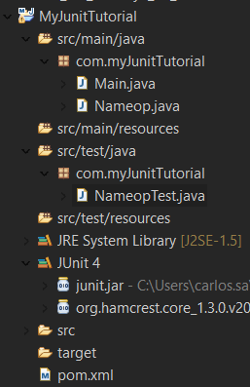
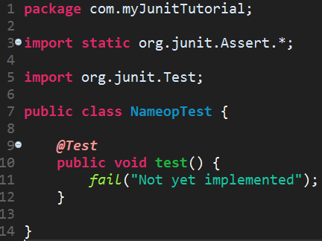
2) How to create an Unit test?
src/test/java/com.myJunitTutorial (right click) -> New -> “JUnit Test Case”
Use “Test” after name of the tested class (convention)
NameopTest.java

Slide 8
Notes
You can add manually a more recent version of JUnit in Build Path.
We are going to use:
J2SE – 1.5 (JRE 1.8)
JUnit 4.12
Some older versions of JUnit does not use @Test annotation by default to specify a test. An extension of TestCase class is used instead.
Be aware of some conventions used when creating tests.
Unit testing is based on the logic: “If no failure occurs, the test succeed”

Slide 9
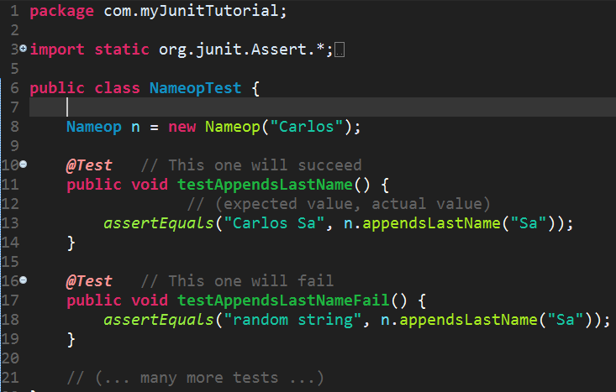
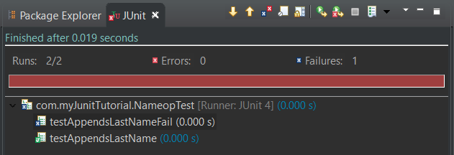

3) Creating test methods: the first test
Testing methods for Nameop class
appendsLastName
Righ Click -> Run As -> JUnit Test Case
The test appendsLastNameTestFail failed because the returned value of n.appendsLastName(“Sa”) does not match the expected result.

Slide 10
4) JUnit conventions
The annotation @Test specifies a test method. The name of test methods should have the same name of original tested method preceded by “test” and followed by an “_” to specify the condition that is being made within a test.
The source code is not mixed with test code:
In /src/main/java you maintain your code to be tested
In /src/test/java you maintain the created tests
This will allow to compile the JAR with source code only, without unnecessary code used for testing included.
Use inline expressions in test methods arguments (assert methods of JUnit API for example) instead of passing variables.
Each test method should be public void and do not use multiple assert or other test methods within a test.

Slide 11
5) JUnit API: Available test methods
Some methods of Assert Class (org.junit.Assert)
Test method | Description
assertArrayEquals(Object[] expecteds, Object[] actuals) | Asserts that two object arrays are equal.
assertEquals(double expected, double actual, double delta) | Asserts that two doubles or floats are equal to within a positive delta. The “delta” can be omitted.
assertFalse(String message, boolean condition) | Asserts that a condition is false. The “message” can be omitted.
assertNotNull(Object object) | Asserts that an object isn't null.
assertNotSame(String message, Object unexpected, Object actual) | Asserts that two objects do not refer to the same object. The String “message” can be omitted.
assertSame(String message, Object expected, Object actual) | Asserts that two objects refer to the same object. String “message” can be omitted.
fail(String message) | Fails a test with the given message.
Source: http://junit.sourceforge.net/javadoc/org/junit/Assert.html

Slide 12
Other JUnit classes
org.hamcrest.core.IsIntanceOf
org.hamcrest.core.AnyOf<T>
org.hamcrest.core.IsAnything<T>
org.hamcrest.core.IsNull<T>
JavaDoc: http://junit.sourceforge.net/javadoc/

Slide 13
6) Annotation Types
JUnit provides annotation types that allows to inject methods that should be executed in specific points of the execution test environment.
The annotation types was introduced in JUnit 4
The core classes and annotations types on JUnit 4 corresponds to junit.framework in 3.x versions.
Annotations:
@Test
@Before
@After
@BeforeClass
@AfterClass
@Ignore

Slide 14
The @Before and @After annotations
The annotation @Before is useful for setting up necessary conditions or performing actions that should be done before executing the tests marked with @Test.
Methods and other type of instructions marked with @Before annotation will be executed before each @Test.
The @After annotation follows the same logic of @Before but execution occurs after each @Test.
The actions that should be performed after the execution of each test should be followed by @After annotation. For example, closing connections to a DB, closing sockets, input readers etc.

Slide 15
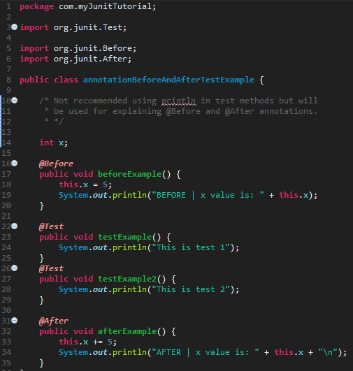
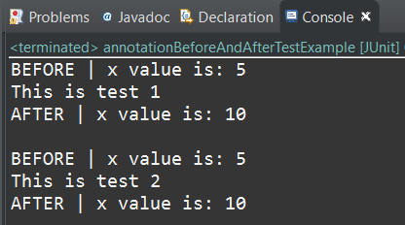
Example
Create a new JUnit Test Case
annotationBeforeAndAfterTestExample
Necessary imports
(Right Click) -> Run As -> JUnit Test

Slide 16
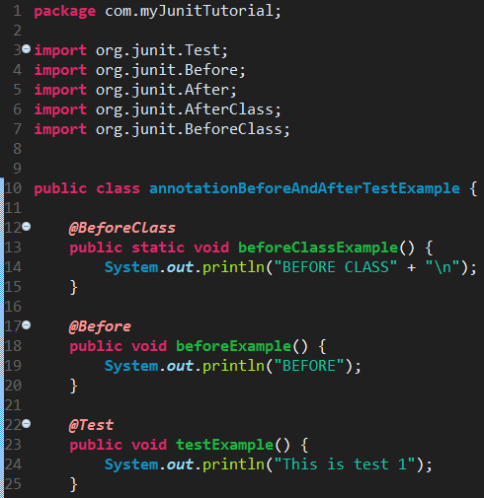
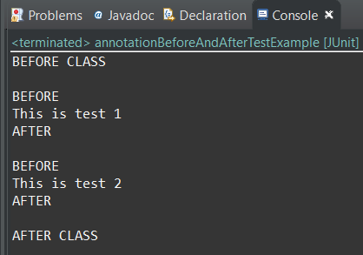
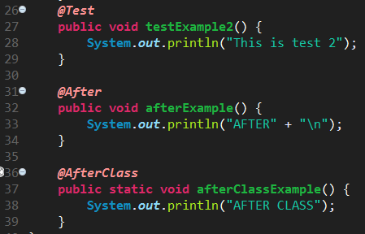
The @BeforeClass and @AfterClass
The actions that should be performed only once (not always) before or after a test, @BeforeClass and @AfterClass should be used instead of @Before and @After respectively.
Every method at BeforeClass and AfterClass should be a static.

Slide 17
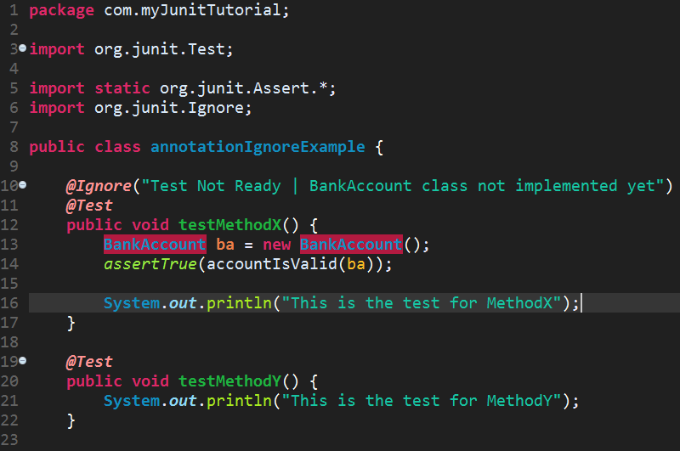
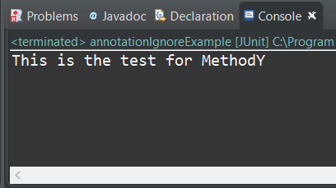
The @ignore annotation
A test method can be marked as “ignored”.
This annotation can be used if you start to develop a test, but for some reason the test is not ready to run and needs to be ignored by the compiler.
An additional parameter can be used to specify why the test is being ignored.
There is also a @Disable annotation also that makes JUnit skipping the test.

Slide 18
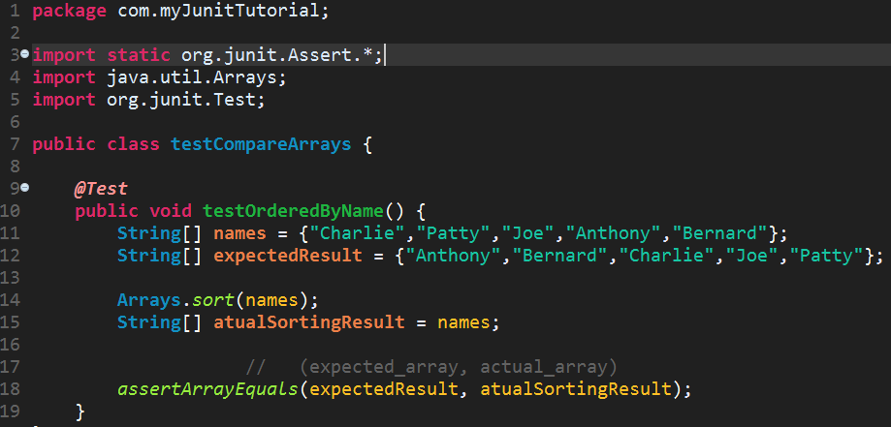
Asserts over array objects
The assertArrayEquals can be used to assert if two arrays has the same values.
This test will succeed.

Slide 19
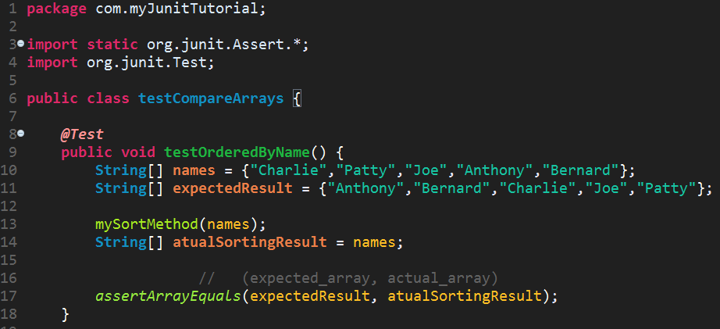

Asserts over array objects
In this case, if the arrays are not equals after assert test, JUnit will allows to detect a situation where an sorted array was expected, but does not match the array after calling the sort method.
Replaced Arrays.sort by mySortMethod
Know is known the codification of mySortMethod does not meet the requirements (does not sort the array correctly).
This test will fail.

Slide 20
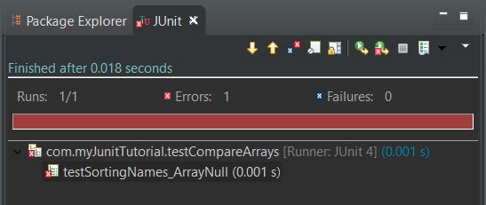
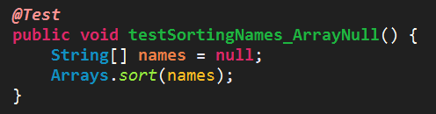
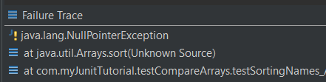
7) Testing Exceptions
Usually when an exception occurs in a program, the normal execution is suspended and the program terminates abnormally.
In Java, those exceptions are usually handled using a try/catch expressions so the programmer can detect the reasons why the execution went wrong.
This is not an incorrection in the program. It’s a predicted scenario by the method (but not well tested).

Slide 21
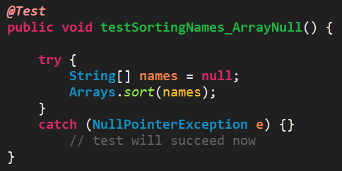
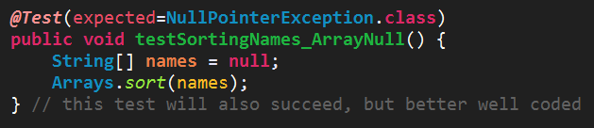
How to correctly test Exceptions
It is necessary to specify that a given method that are being tested expects an exception.
Possible approaches:
Using try/catch for catching the exceptions. (Not the most elegant way)
Using JUnit mechanisms
Passing the expected exception as a parameter to @Test annotation.

Slide 22
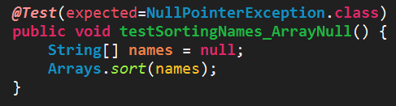
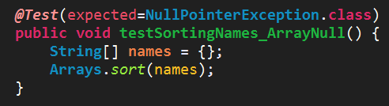
How to correctly test Exceptions
Important note:
When an exception test is made, is supposed that the execution of the test actually throws the expected Exception so the test can succeed. Otherwise, it will fail.
This succeeds
This fails

Slide 23
8) Performance concerns
Some test methods can became computationally heavy.
Executing heavier code sections using @Before and @After can make whole test environment running slow.
Be aware of using @BeforeClass and @AfterClass annotations instead, if you do not need to perform those tests every time a test (marked with @Test) runs.
This is a concern that may appear in a long-term since @After and @Before are more commonly used.

Slide 24
Using JUnit for Performance evaluation
In most different scenarios, is important to know if certain methods runs less than a certain period of time.
In JUnit this is possible using timeout as a performance metric parameter for @Test.
The tests created to evaluate the performance of certain methods do not evaluate other conditions simultaneously.

Slide 25
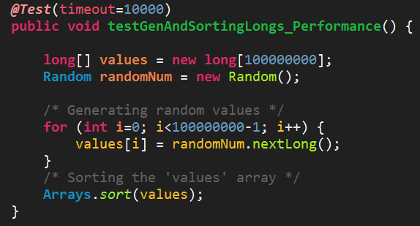
Using JUnit for Performance evaluation
Consider a test of the performance generating one hundred million longs and sort them with Arrays.sort method.
Lets assume the requirements establish this task should be performed in less than 10 seconds.

Slide 26
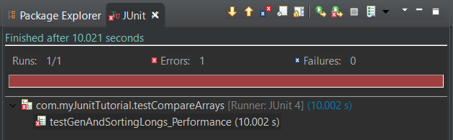
Using JUnit for Performance evaluation
Result:
The program was interrupted after 10 seconds as established by the requirements.
The red bar shows the test have failed so this task takes more than the time expected by the requirements.
Failure trace will throw a JUnit exception:
“org.junit.runners.model.TestTimedOutException: test timed out after 10000 milliseconds”
Two solutions:
Changing the requirements and increase the time tolerance for the task.
Alert the programmer this task takes too long and the algorithms/methods or data structures should be replaced.

Slide 27
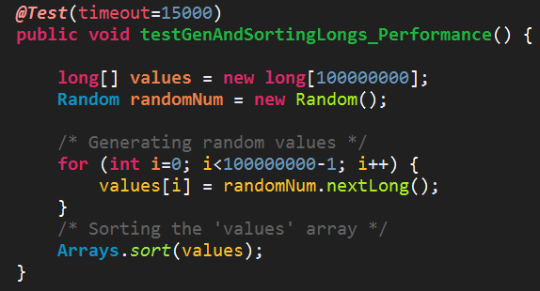
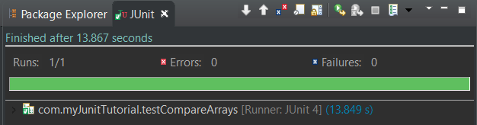
Using JUnit for Performance evaluation
First solution:
Performing a change in the requirements and increase the time tolerance for the task.
Considering now 15 seconds.
The test was successful because it was possible to complete the execution of the test before the established time for timeout

Slide 28
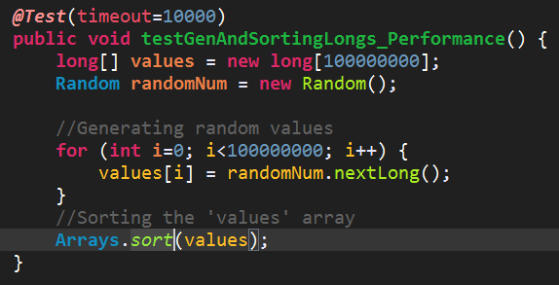
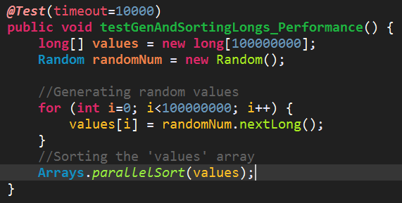
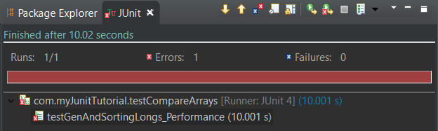
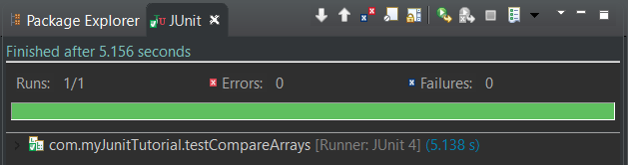
Using JUnit for performance evaluation
Second solution:
Alert the programmer this task takes too long and the algorithms/methods should be replaced.

Slide 29
Using JUnit for performance evaluation
Defining performance requirements for timeout of methods using JUnit is not trivial.
If the performance requirements are too picky, the tests will always fail.
If the performance requirements are too liberal, the application will have a wide margin to improve in execution time. In consequence, the timeout based tests loses their goal.
Performance evaluation in Test-driven development (TDD) is a commitment between fast delivery (important in extreme programming projects), and fast software.
Choosing a smart value for timeout takes in consideration the platform where the tests will run. For example, if the tests were built to test a web application running with a server (as TomCat).

Slide 30
9) Parameterized Tests
As a project grows, more input and output test scenarios are needed, sometimes implying a crescent number of (unnecessary) tests with same test logic behind.
This crescent number of tests leads to a repetition pattern which can be captured by parameterized tests reducing the number of @Test methods.

Slide 31
9) Parameterized Tests
Parameterized tests are different than normal tests, and should be logically separated from other Junit Test Case classes.
It is necessary to add the annotation @RunWith(Parameterized.class) for explicitly define the test class as a Parameterized class.
Also needs the import of:
org.junit.runners.Parameterized
org.junit.runner.RunWith;
java.util.Collection;
org.junit.runners.Parameterized.Parameters;

Slide 32
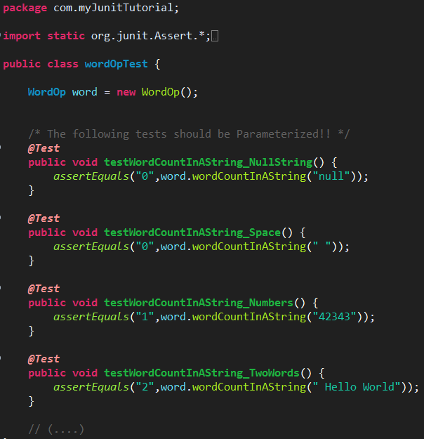
9) Parameterized Tests: Use case example
Consider a method that counts the number of space-separated words in a given string and a JUnit Test Case.
Too much tests with same semantics:
The same assert method tests different inputs with their correspondent expected output.
This can be parameterized in an array of inputs and an array of outputs after applying the assert method for each case (similar to a high-order map function).

Slide 33
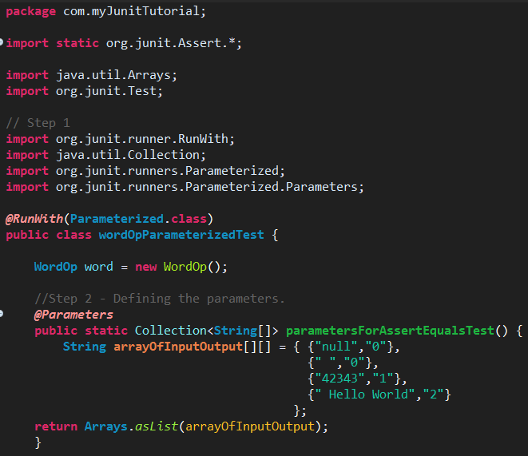
9) Parameterized Tests: Example
Step 1: Detects a couple of tests with same semantic and create a new JUnit Test Case class. Collect the input/output values used in each test and prepare the setup (previous slide).
Step 2: Defining the parameters. This is done by creating a public static method which returns a collection with arrays of input values and their expected results.

Slide 34
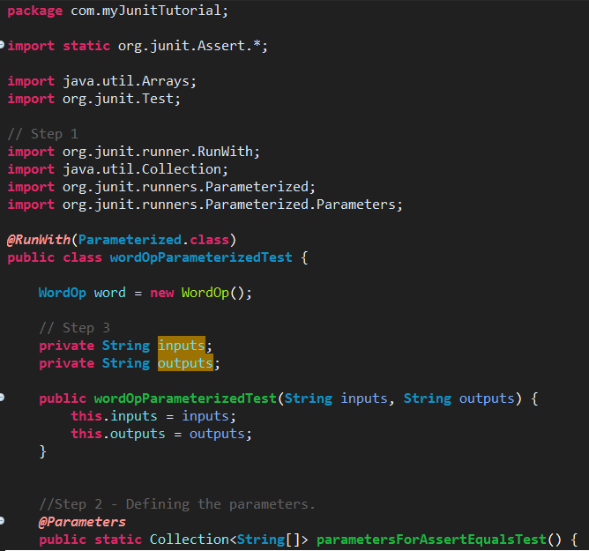
9) Parameterized Tests: Example
Step 3: Create the necessary Constructors (they can be automatically generated in Eclipse).

Slide 35
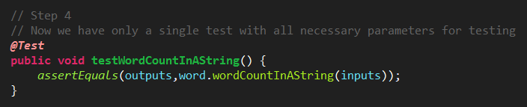
9) Parameterized Tests: Example
Step 4: Pass the parameters variables into the test and delete the rest of similar tests.
Only a test now (instead of four) that performs the same assertEquals for different test cases.

Slide 36
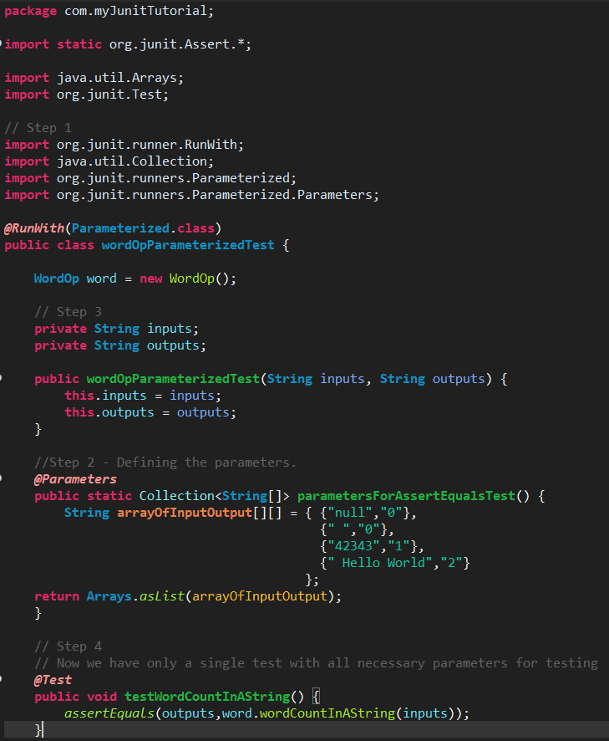
9) Parameterized Tests: The Big Picture
Before (WordOpTest)
After (WordOpParameterizedTest)

Slide 37
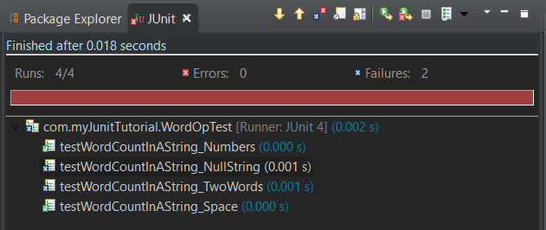
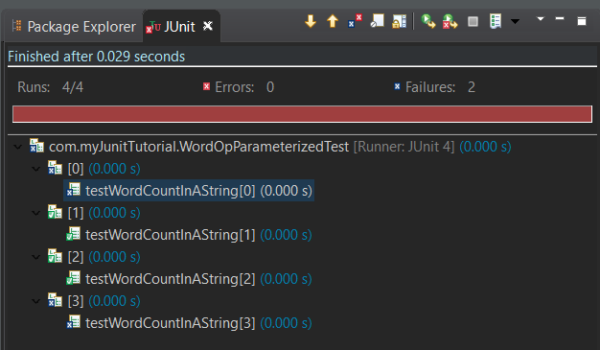
9) Parameterized Tests: The Big Picture
Before (WordOpTest)
After (WordOpParameterizedTest)
Same conditions succeed and same conditions failed. Each index corresponds to a different test in arrayOfInputOutput.

Slide 38
9) Parameterized Tests: Notes
Using parameterized tests reduces significantly the quantity of @Tests
Multiple test inputs can be concentrated in one place instead of spreading them across multiple test methods.
However, introduces additional overhead in the code as well:
Building the Collection of parameters
Additional imports for using parameterized class test
Additional constructors

Slide 39
10) Grouping tests into Suites
A project can have a huge number of test case classes.
Some of the tests can be logically grouped.
Test Suites are a way of grouping tests by some logic:
Divide tests taking in account their specificity. Allows a logic separation.
Detach heavier tests from others. Allows to perform the execution of the test environment restricted to lightest tests or heaviest ones.
Instead of executing all tests, is possible to execute only the tests included in a Test Suite.
If a group of tests are not so important to execute among others, is possible to create a Test Suite for them and exclude they from test execution environment.

Slide 40
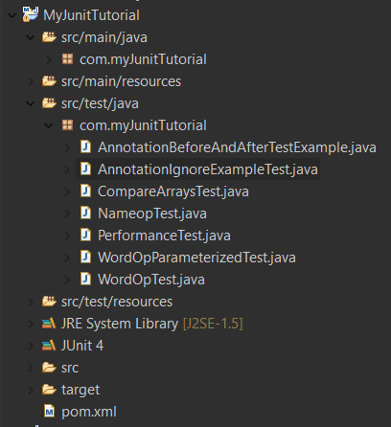
10) Grouping tests into Suites
Whenever Run As -> JUnit Test in com.myJunitTutorial, all tests inside the package will run.
It is possible to limit the test execution to only some of the specific tests in a Test Suite.
Create a Test Suite:
Right click over com.myJunitTutorial -> New -> Other -> JUnit Test Suite.
Choose the Test Cases classes to include in the suite in the window.
A new Test Suite (java file) will be created.

Slide 41
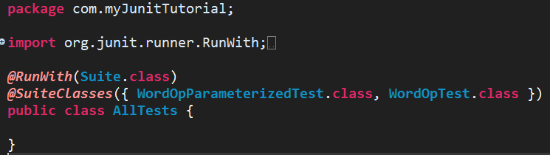
Test Suite Example
In the following example, the tests related to WordOp class were included in the created Test Suite.
More can be added manually in @SuiteClasses parameter.
Running the following code will only execute the tests inside the annotation.

Slide 42
11) Good Practices in Unit Testing
One @Test should only have one purpose (one condition per test). Do not test multiple aspects in the same test.
Follow the conventions about test class naming;
Always separate your source code from testing code.
Make sure that a test only fails when there is a failure. Abstract the dependencies from external sources. If a test fails because of an external source changed his behavior, the test is not useful in fact.
Cover all possible scenarios in each test to assure the correctness of the methods.
When using JUnit for performance evaluation, take in consideration the platforms where the tests will run for choosing timeout wisely.

Slide 43
References
Jeff Langr, Andy Hunt, and Dave Thomas. 2015. Pragmatic Unit Testing in Java 8 with Junit (1st ed.). Pragmatic Bookshelf.
Andrew Patterson, Michael Kölling, and John Rosenberg. 2003. Introducing Unit testing with BlueJ. 8th annual conference on Innovation and technology in computer science education (ITiCSE ‘03)
http://junit.org/junit4/faq.html
http://www.in28minutes.com/

Slide 44
Testing Java applications using JUnit framework
Carlos Sá

