Slide 1
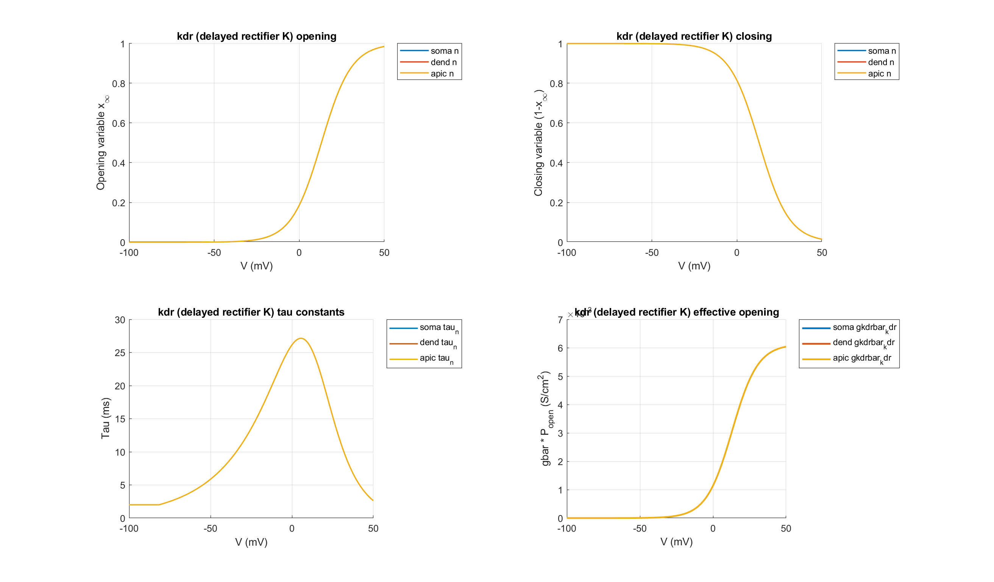
PC: kdr (delayed rectifier K)

Slide 2
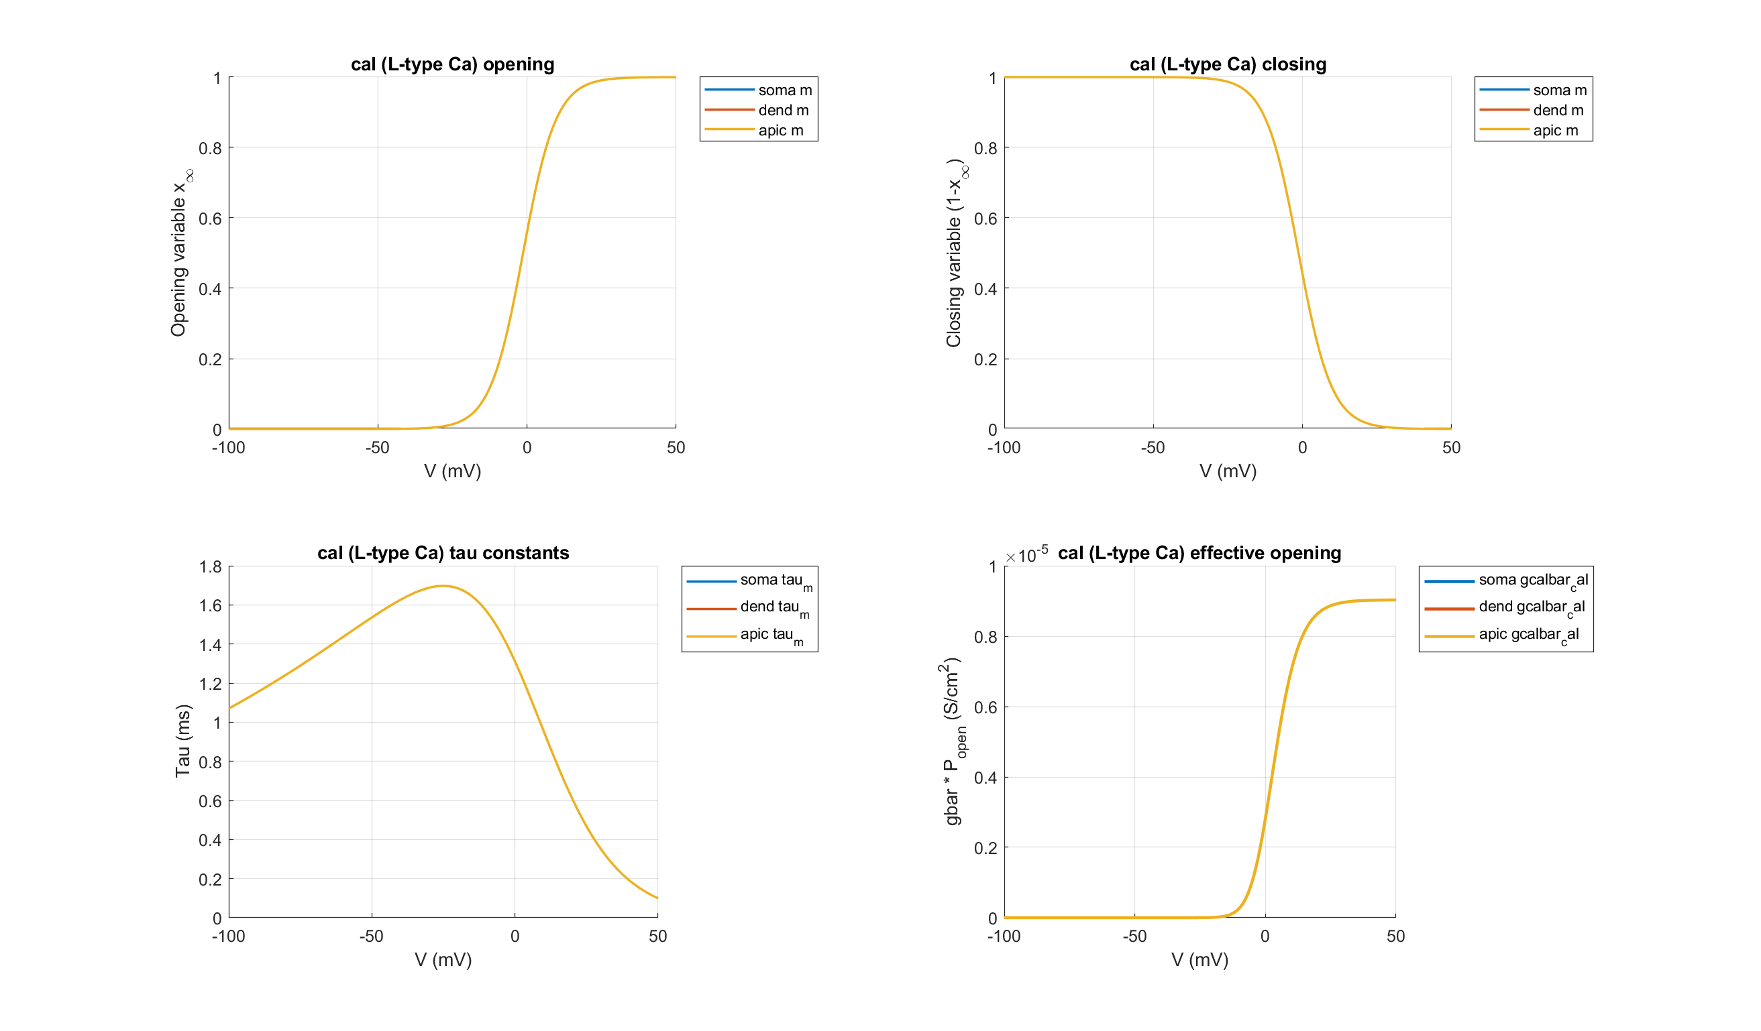
PC: cal (L-type Ca)

Slide 3
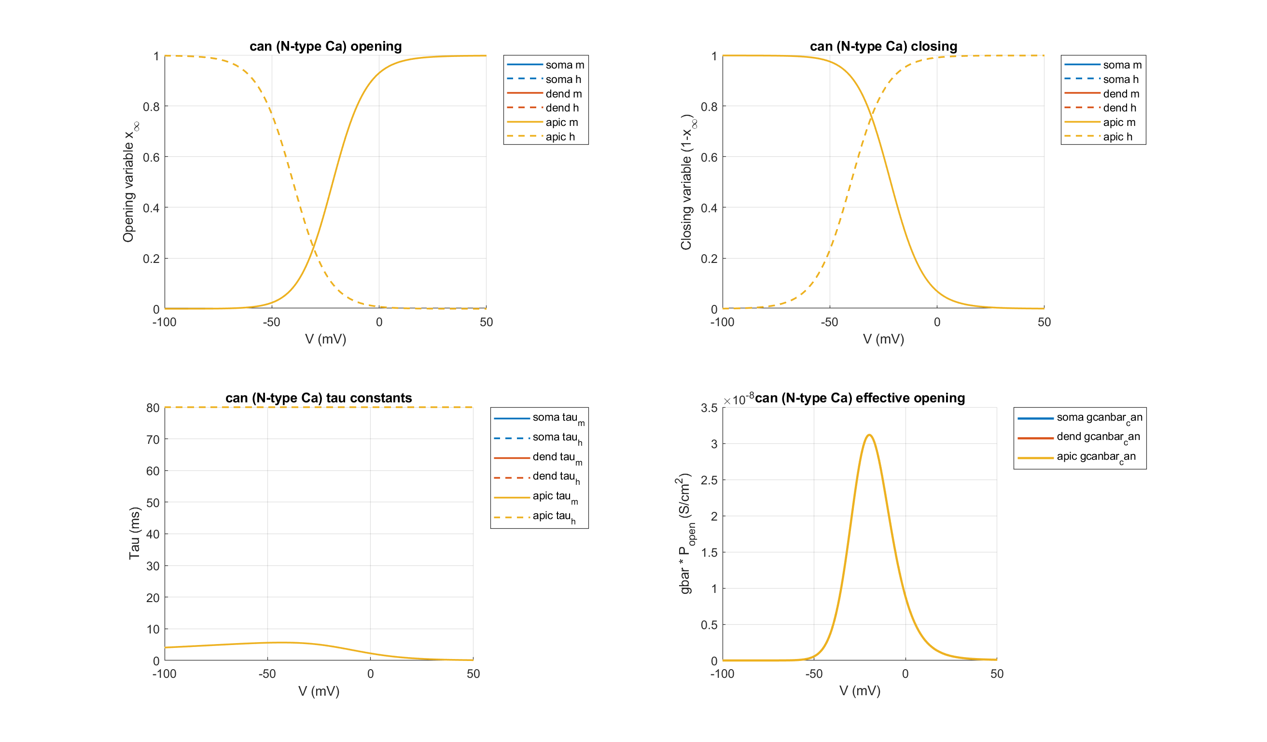
PC: can (N-type Ca)

Slide 4
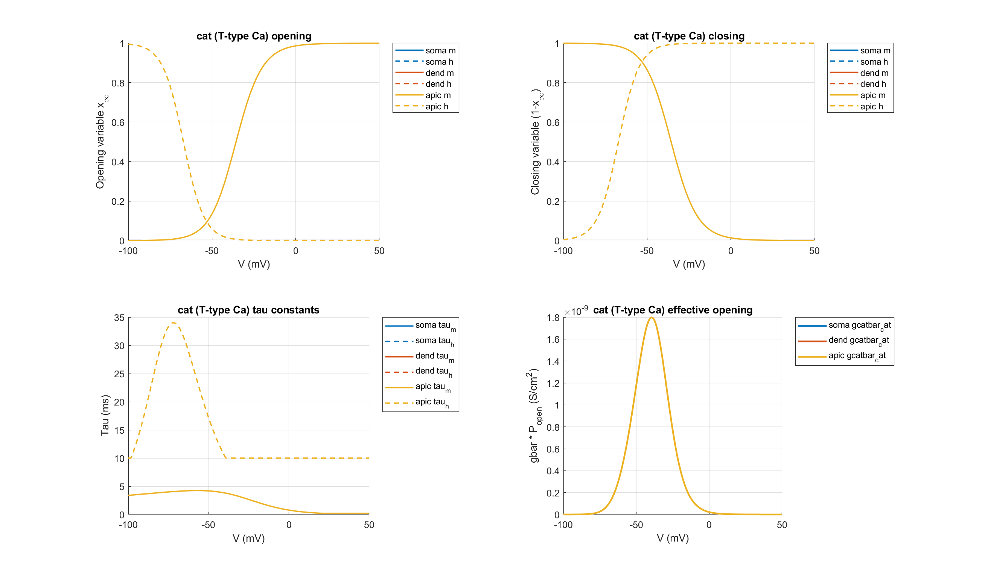
PC: cat (T-type Ca)

Slide 5
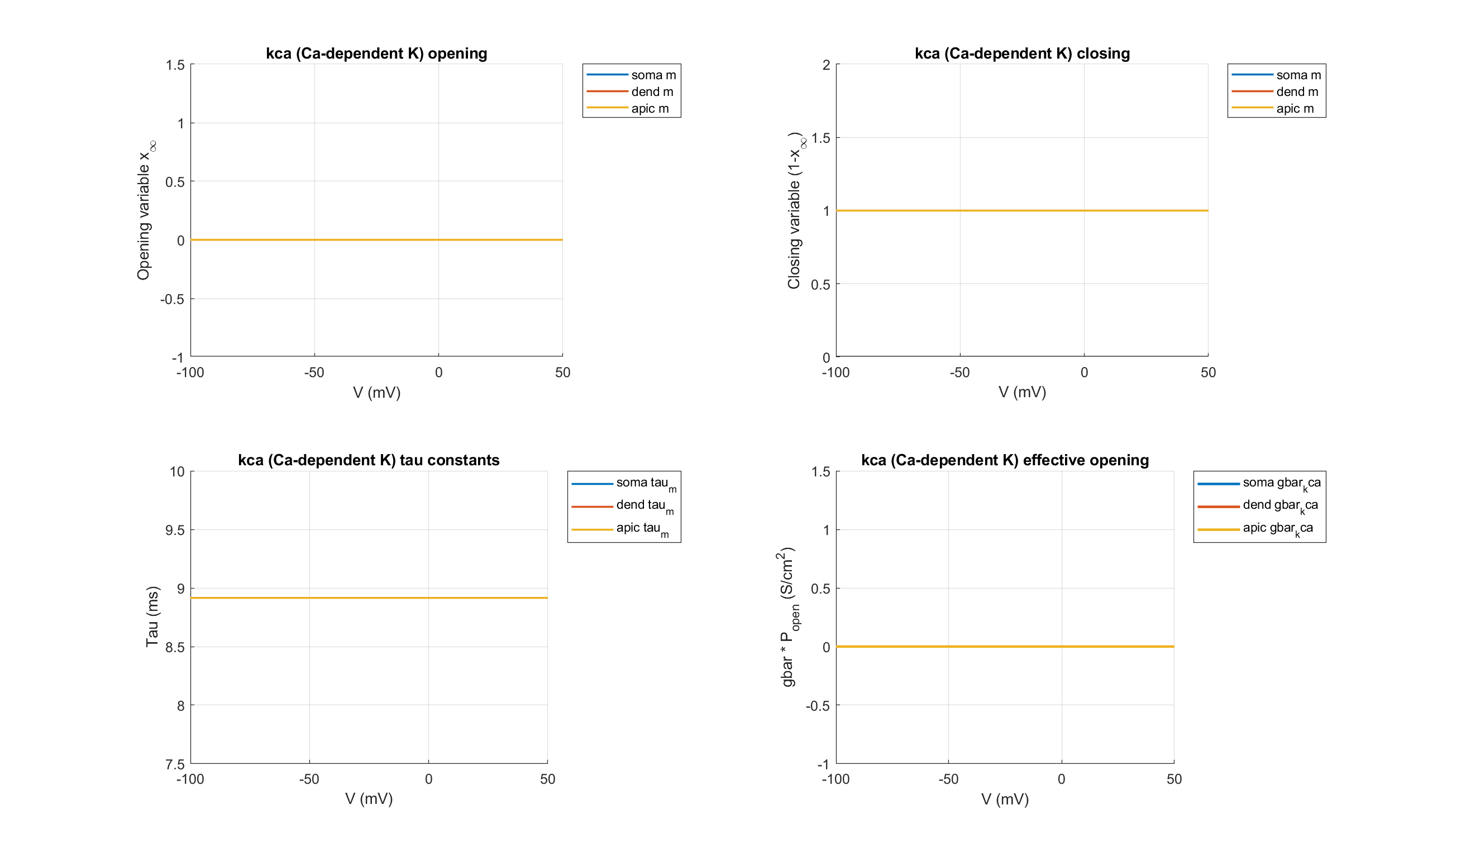
PC: kca (Ca-dependent K)

Slide 6
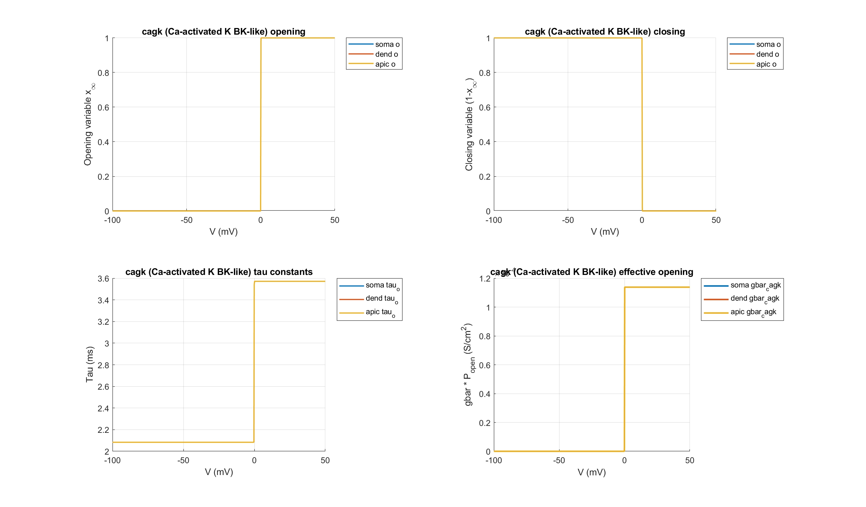
PC: cagk (Ca-activated K BK-like)

Slide 7
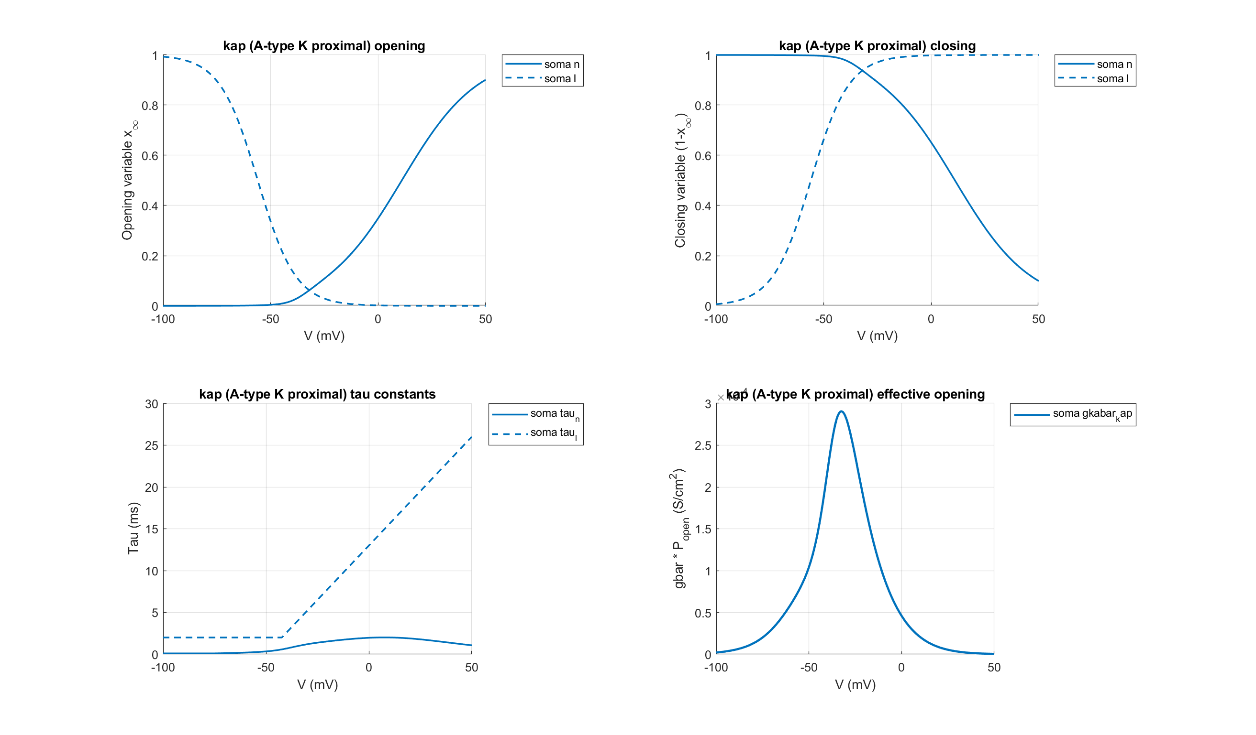
PC: kap (A-type K proximal)

Slide 8
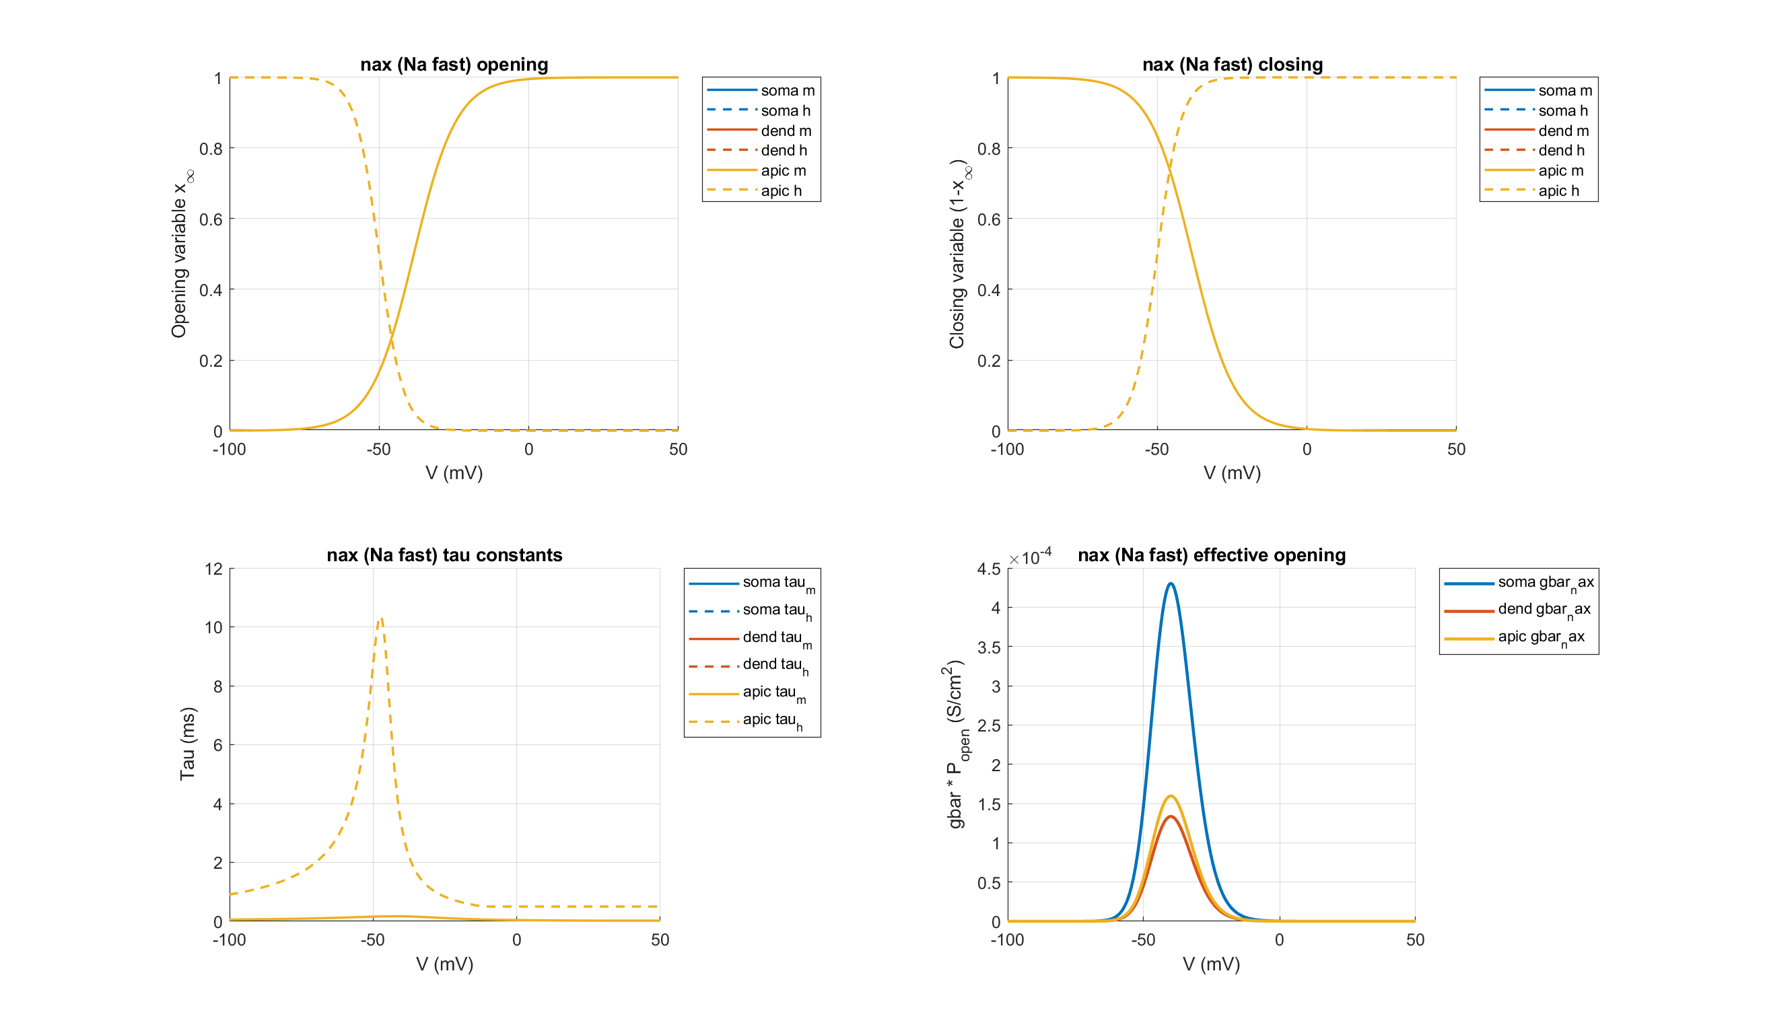
PC: nax (Na fast)

Slide 9
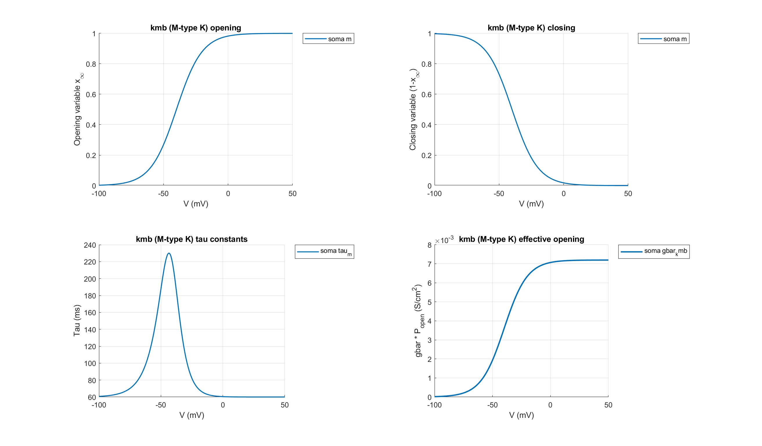
PC: kmb (M-type K)

Slide 10
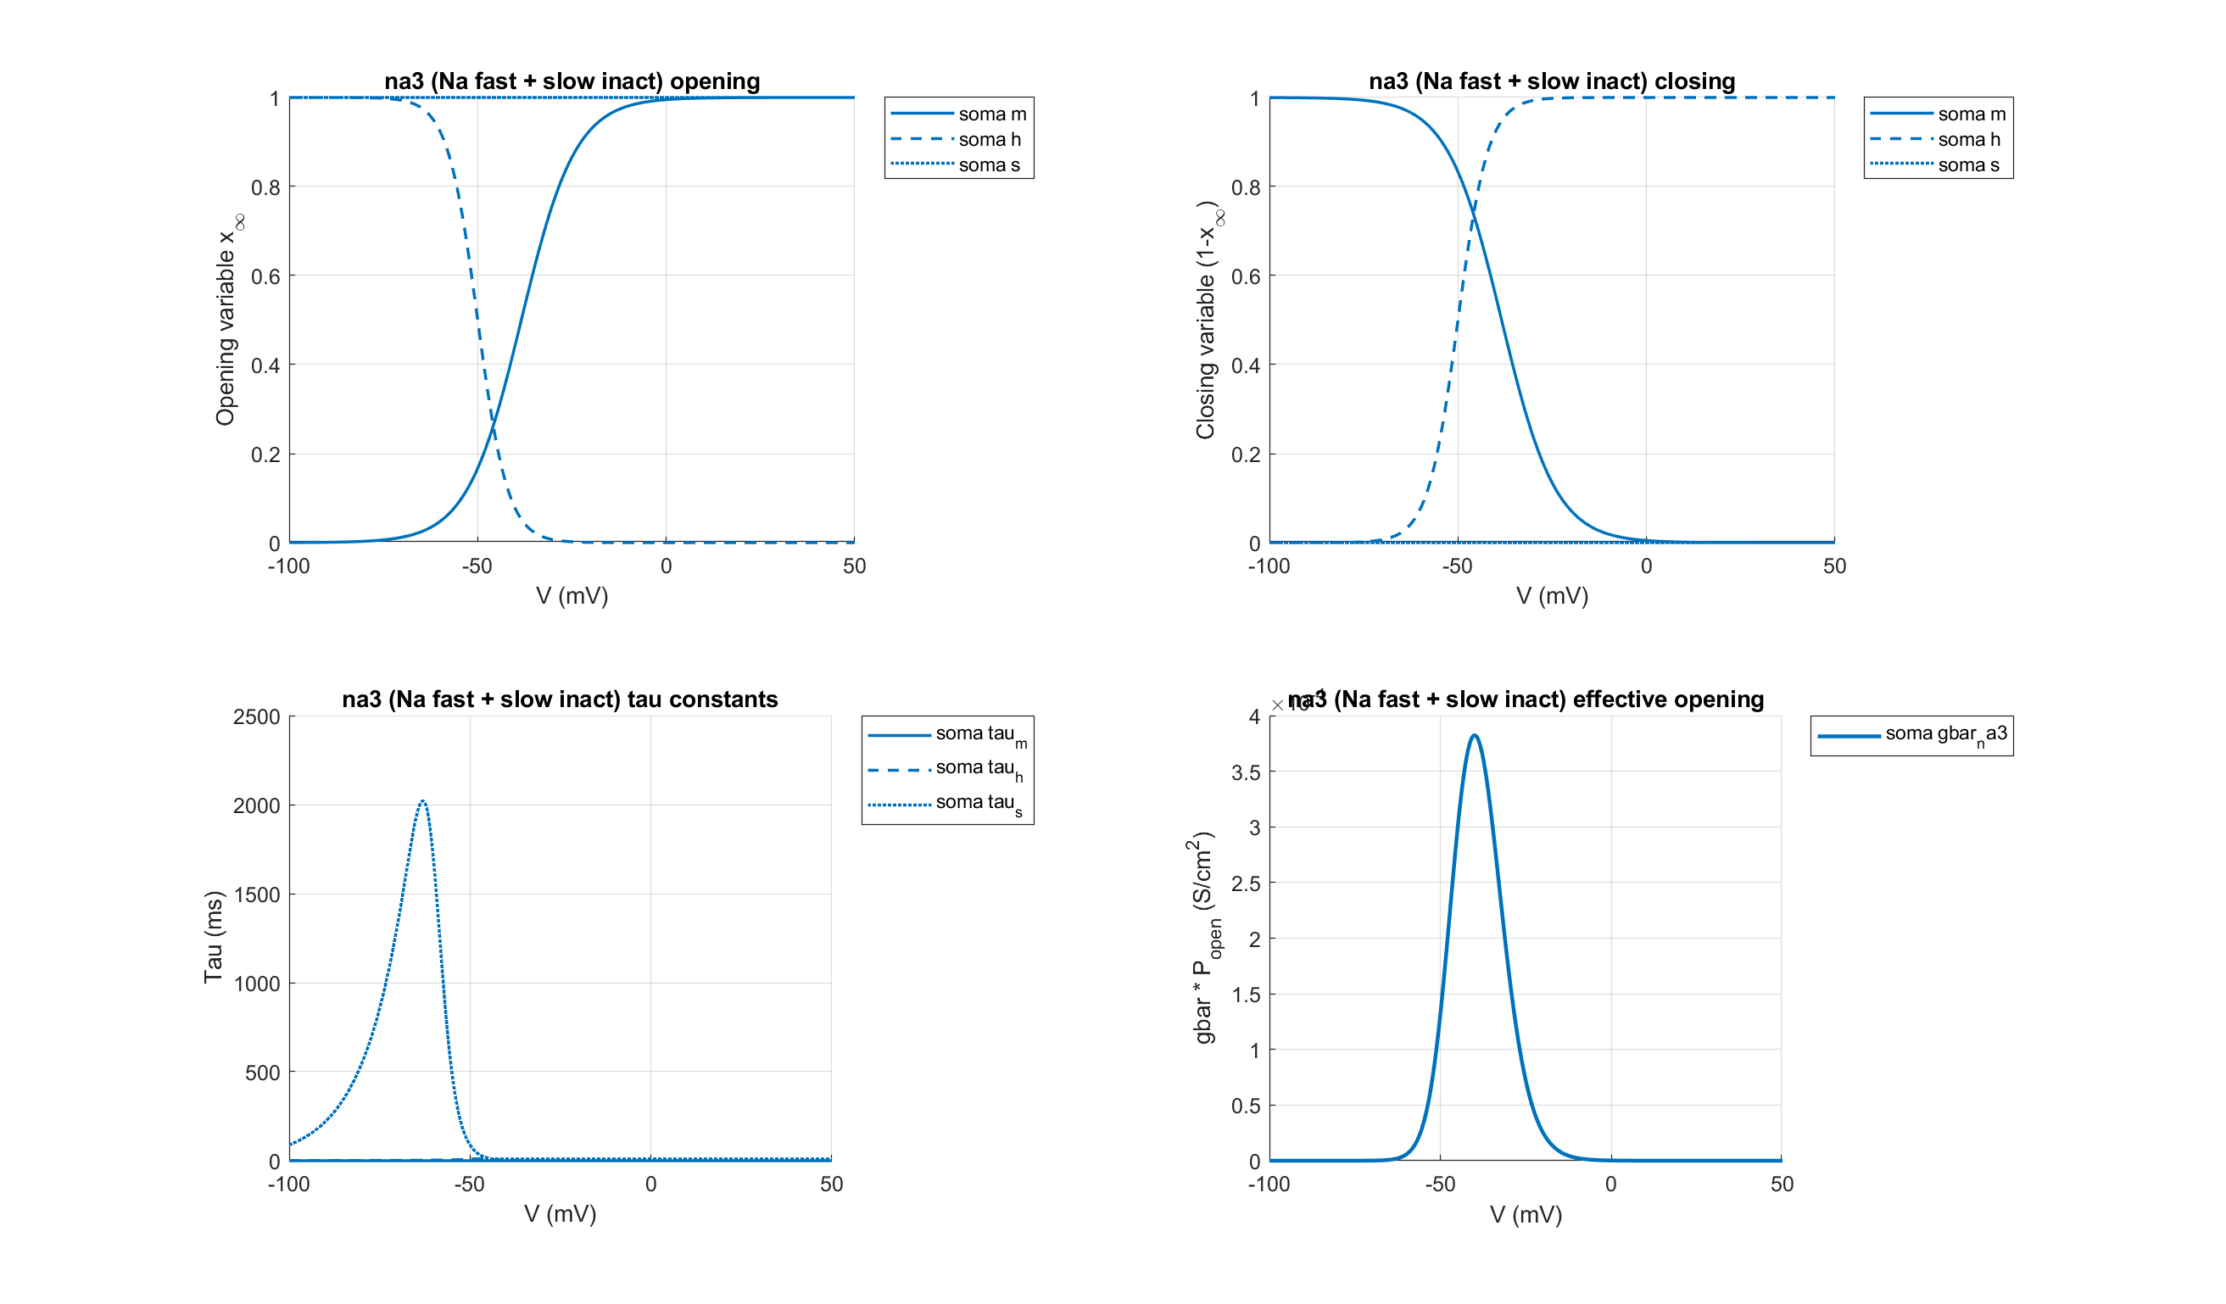
PVBC: na3 (Na fast + slow inact)

Slide 11
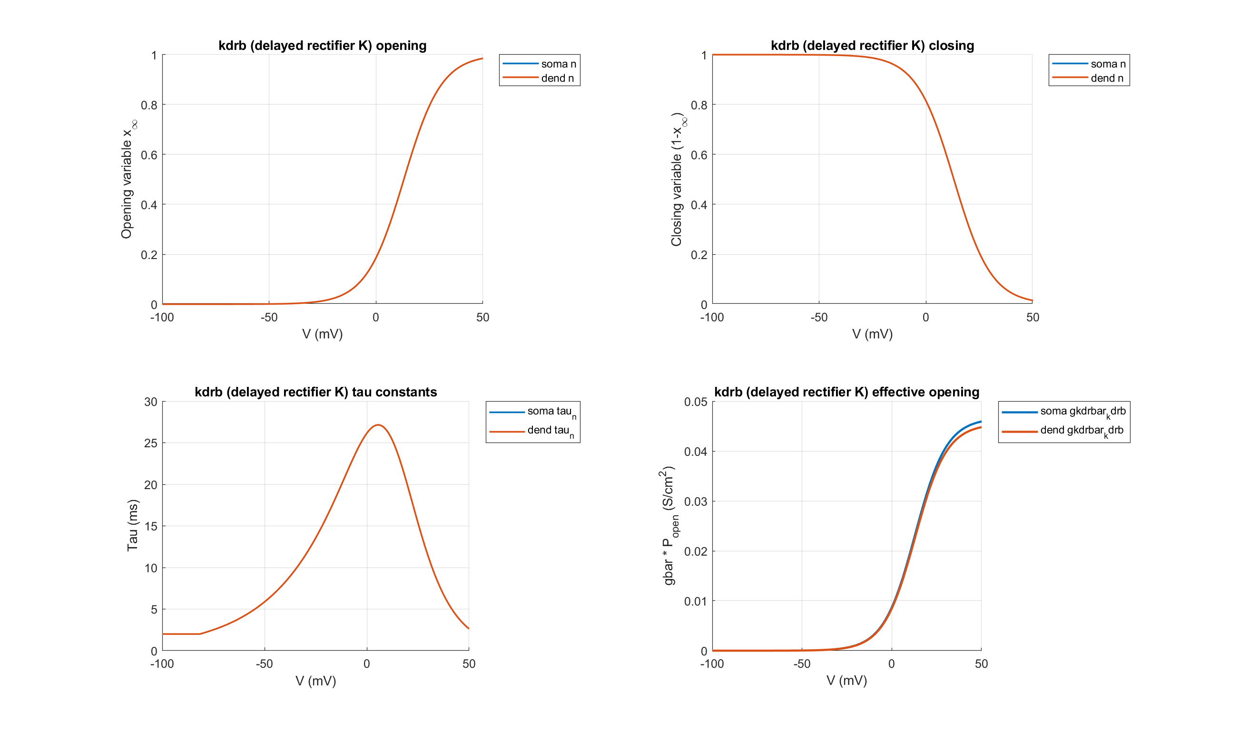
PVBC: kdrb (delayed rectifier K)

Slide 12
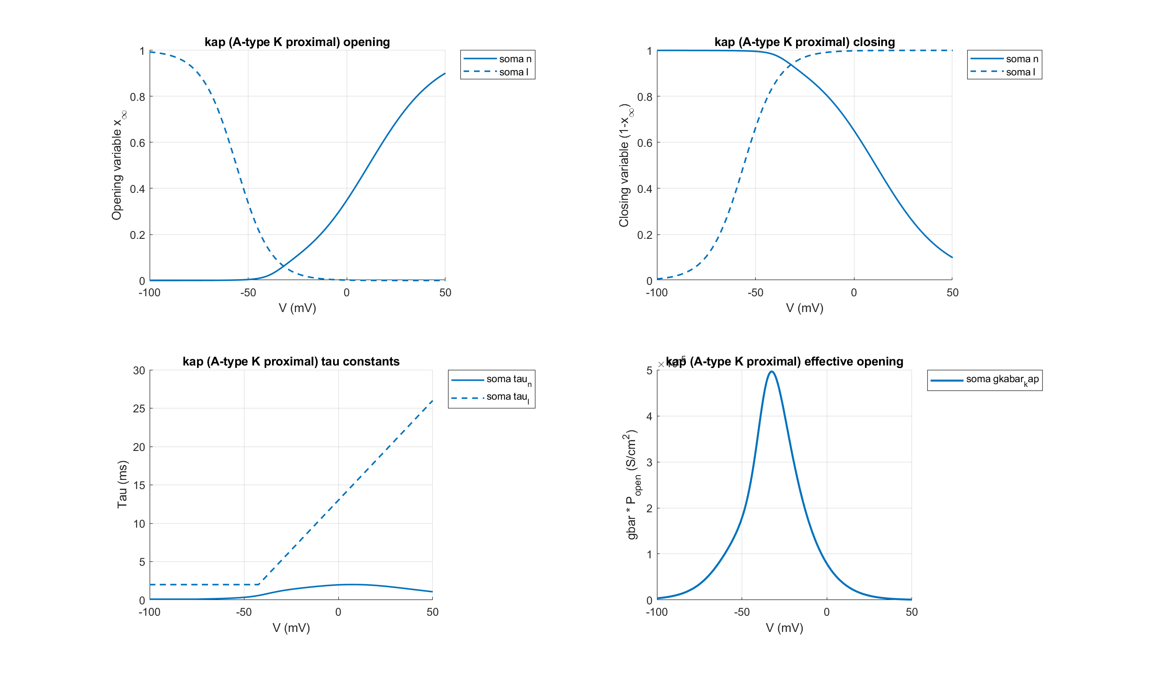
PVBC: kap (A-type K proximal)

Slide 13
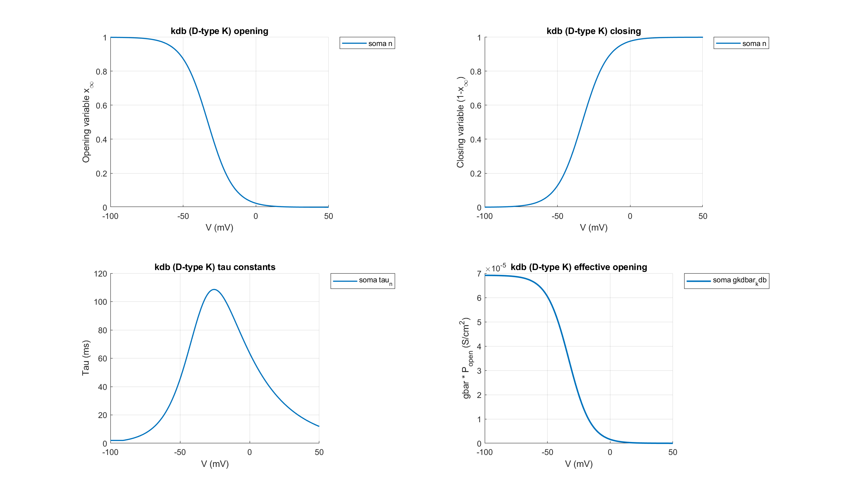
PVBC: kdb (D-type K)

Slide 14

PVBC: kmb (M-type K)

Slide 15
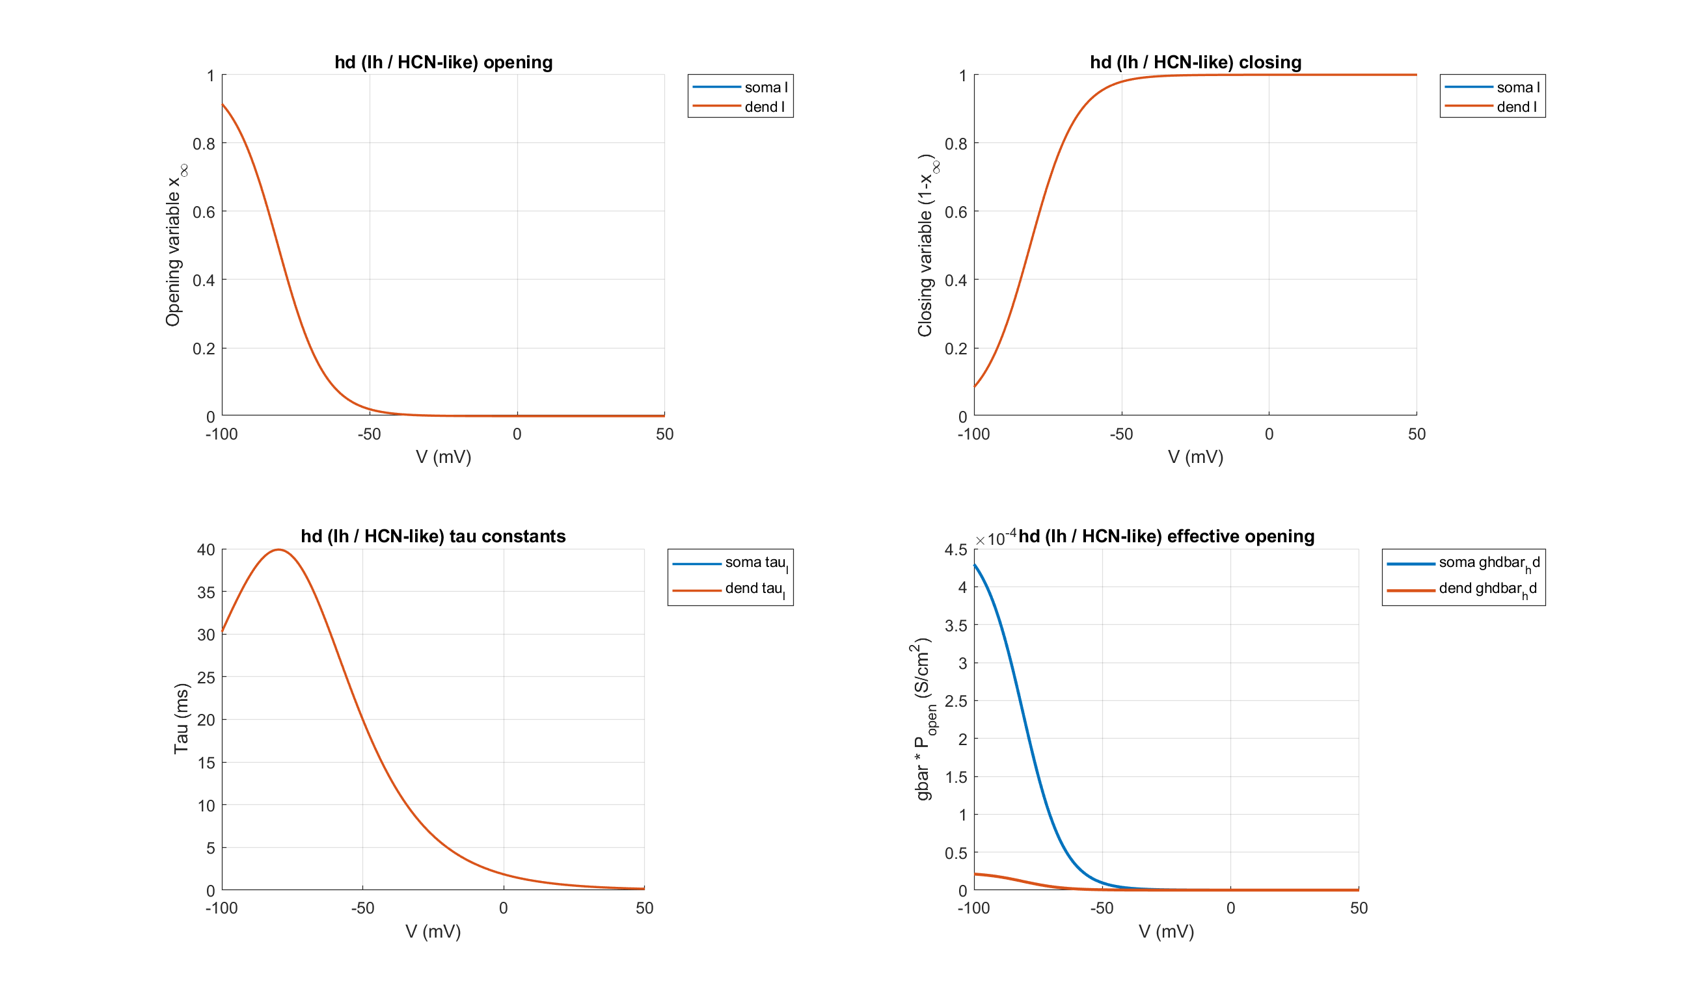
PVBC: hd (Ih / HCN-like)

Slide 16
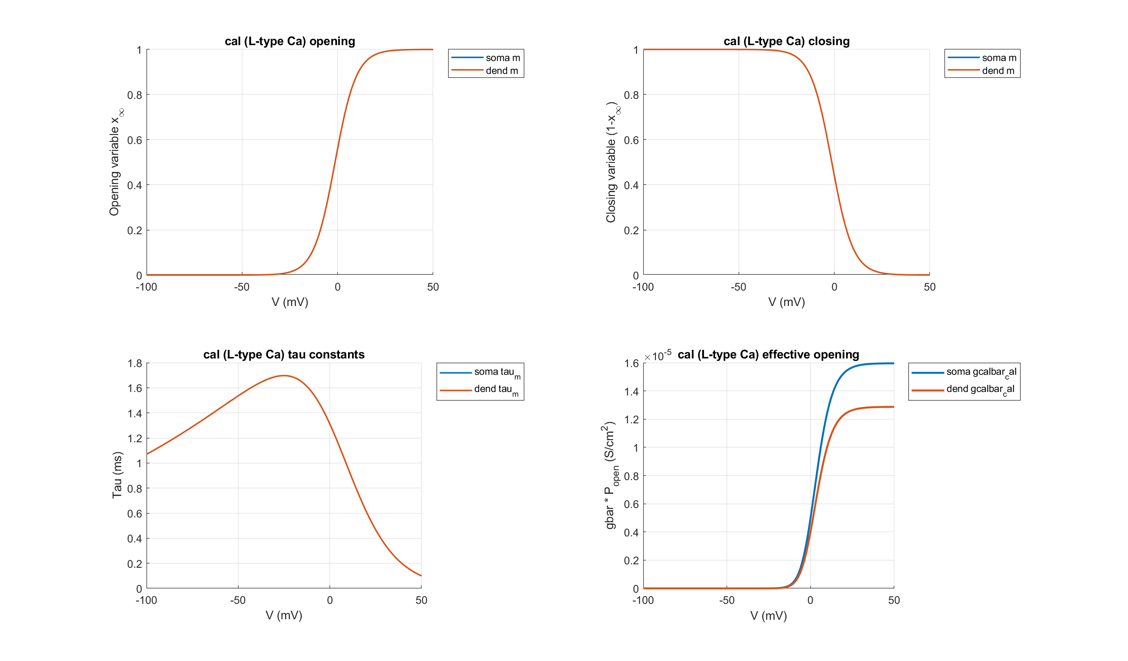
PVBC: cal (L-type Ca)

Slide 17
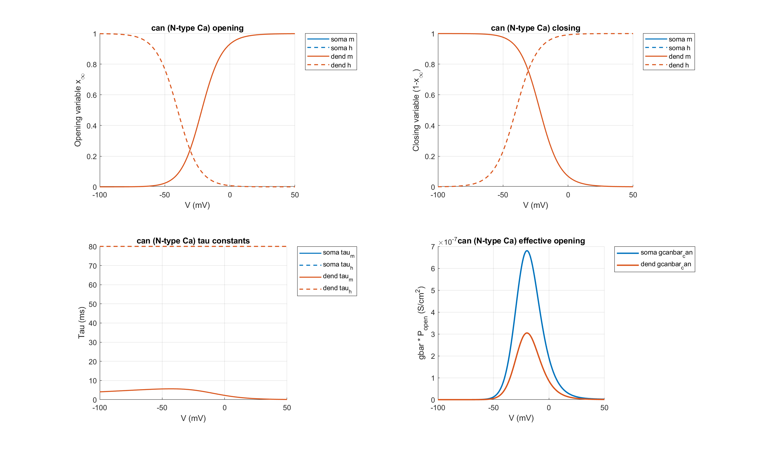
PVBC: can (N-type Ca)

Slide 18
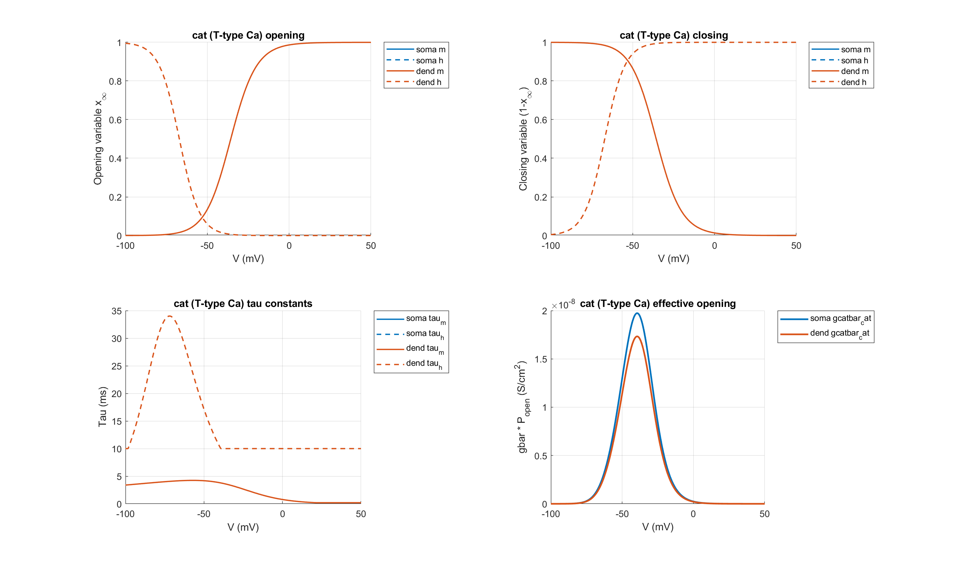
PVBC: cat (T-type Ca)

Slide 19
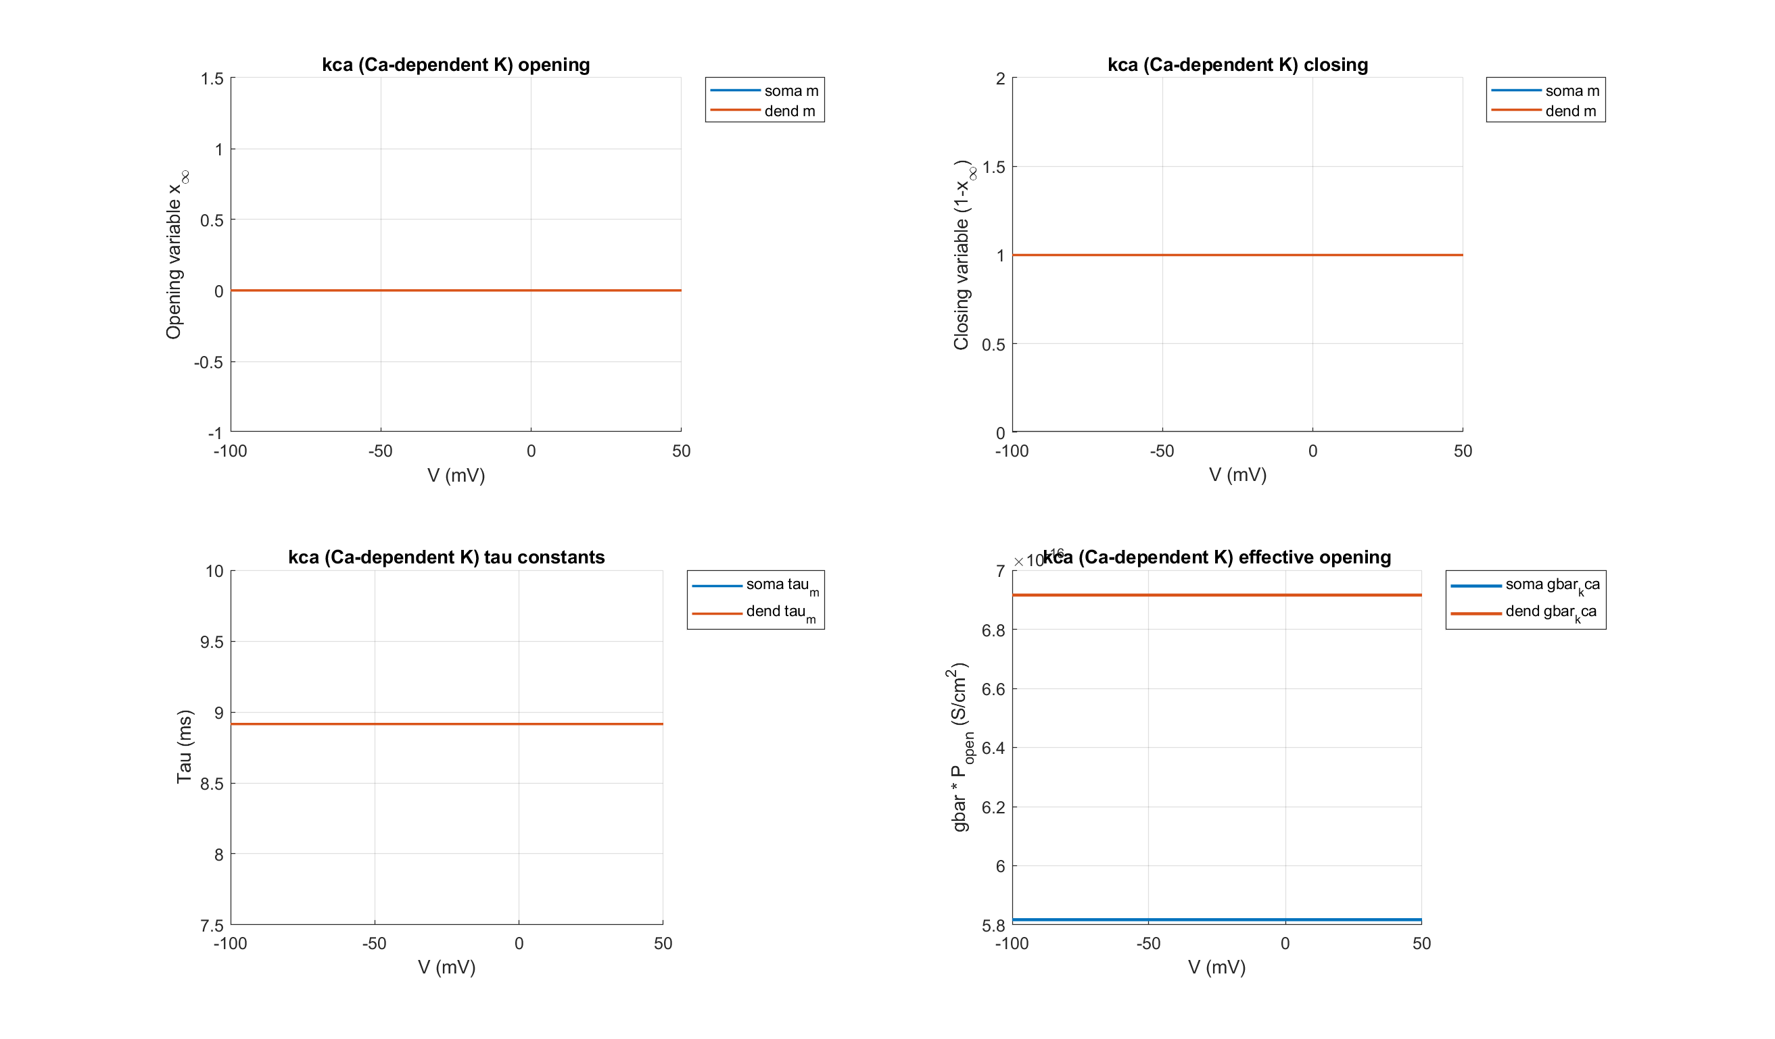
PVBC: kca (Ca-dependent K)

Slide 20
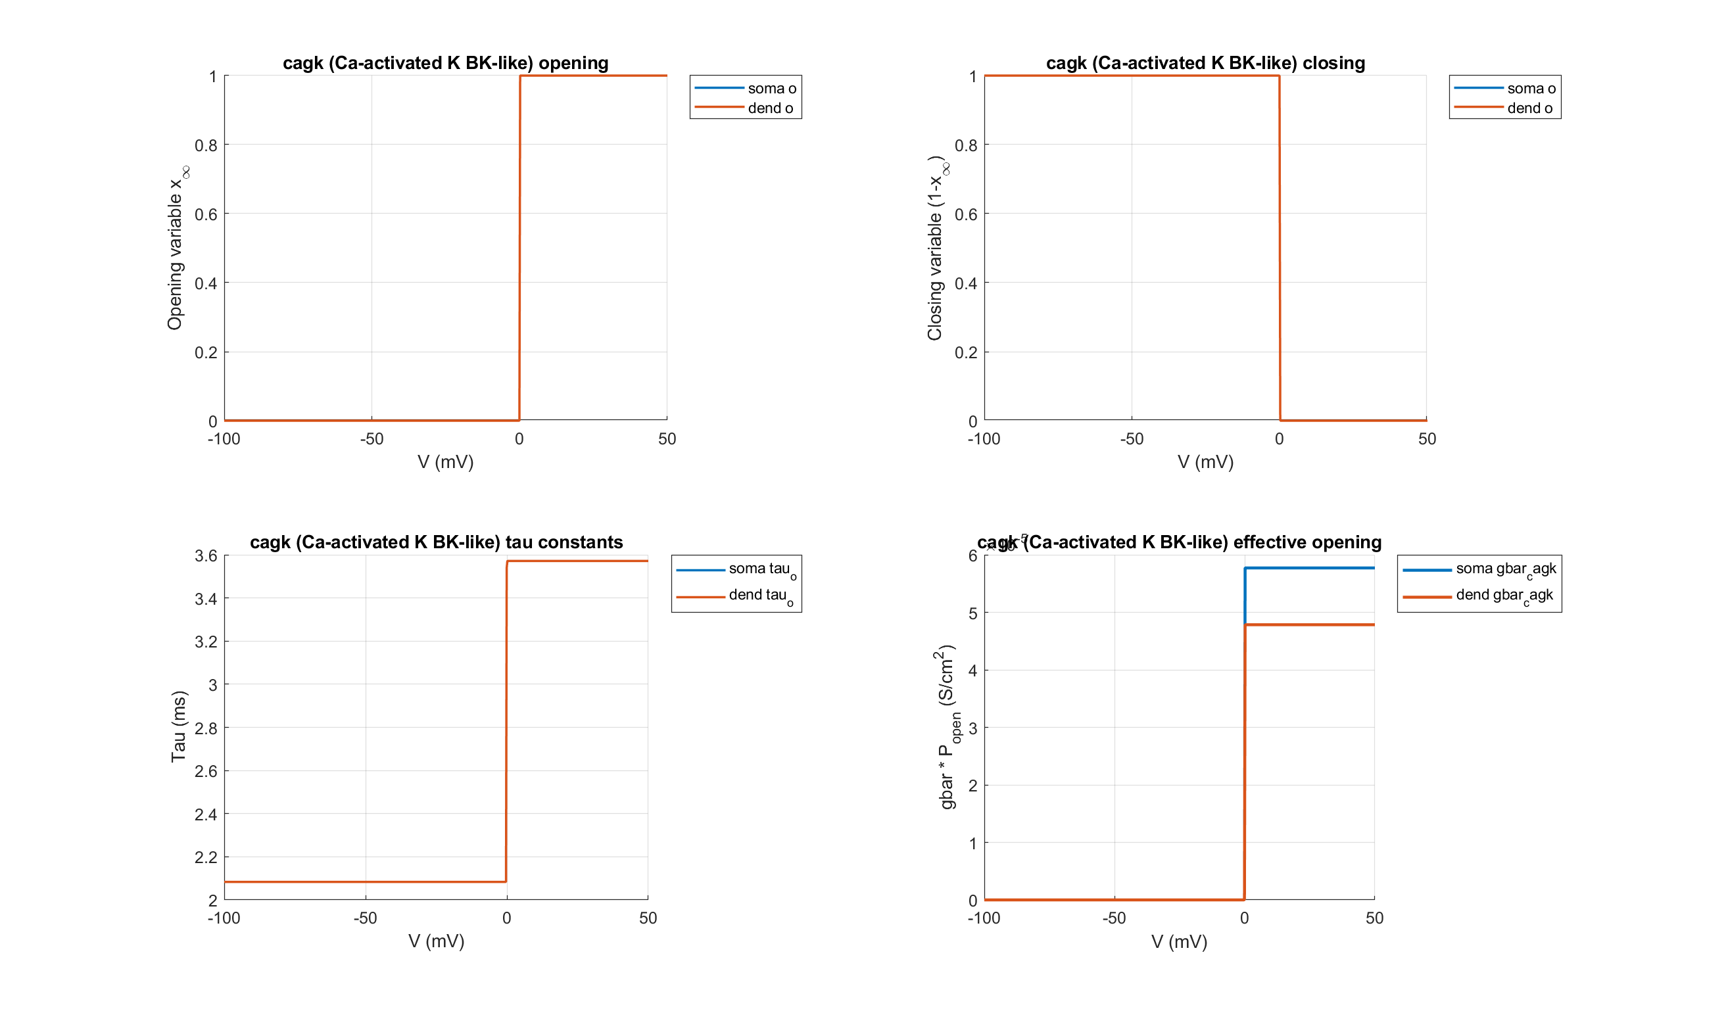
PVBC: cagk (Ca-activated K BK-like)

Slide 21
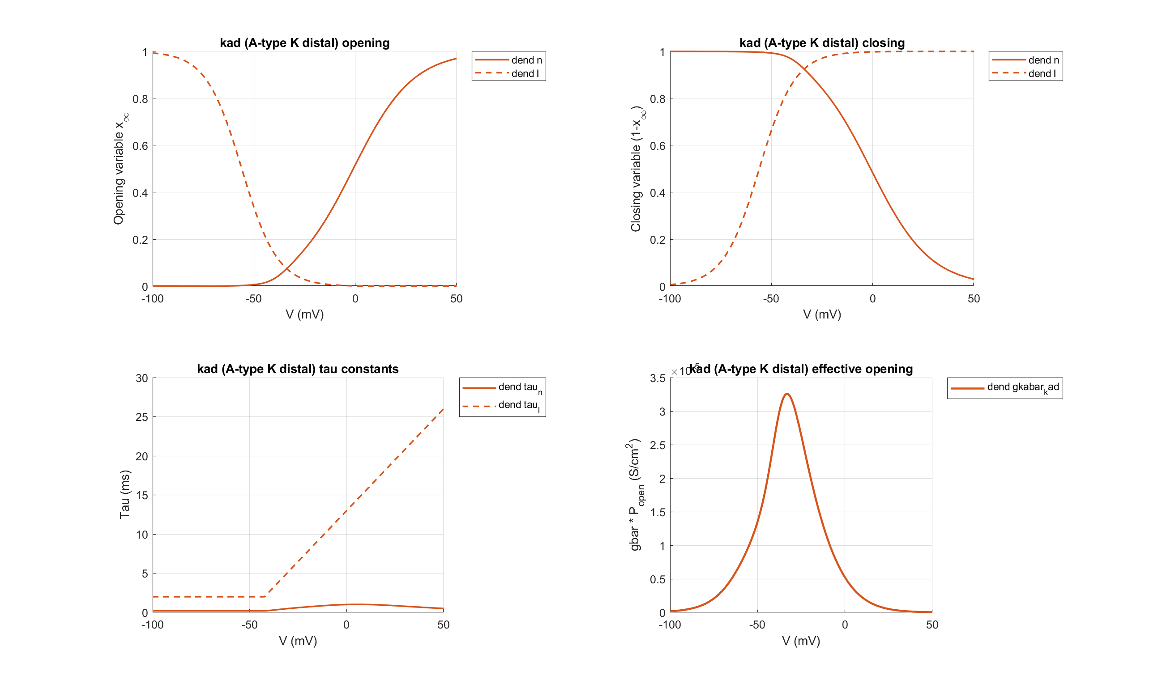
PVBC: kad (A-type K distal)

