Slide 1
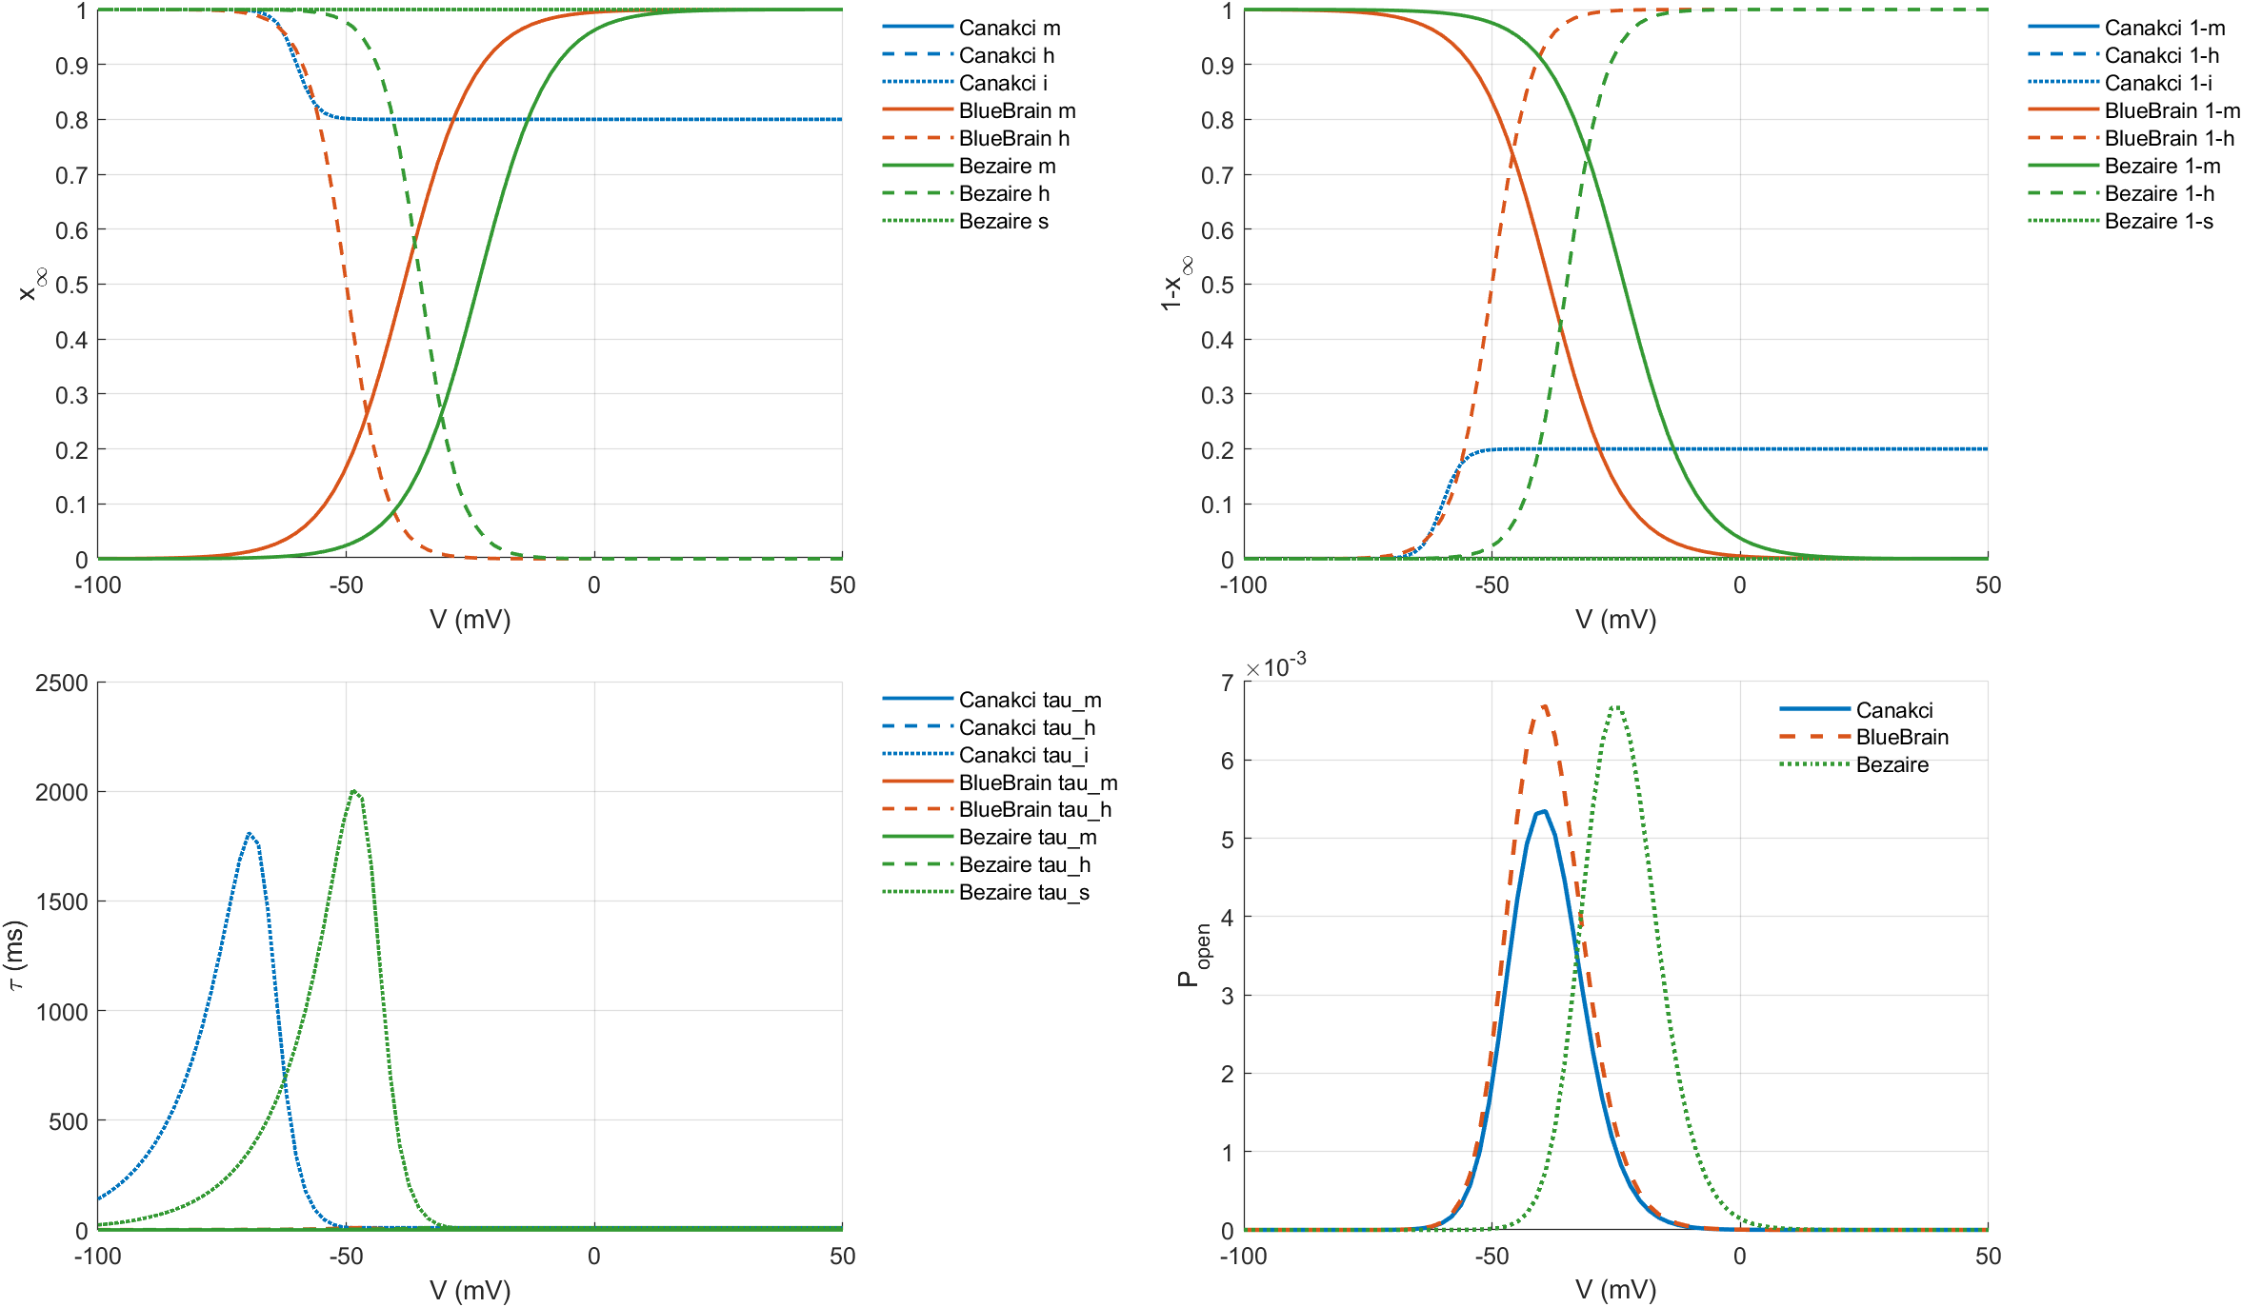
Channel Comparison - PC Na

Slide 2
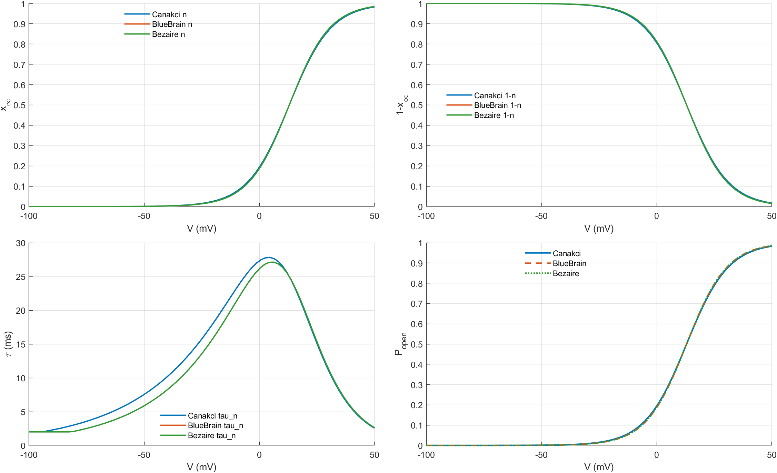
Channel Comparison - PC KDR

Slide 3
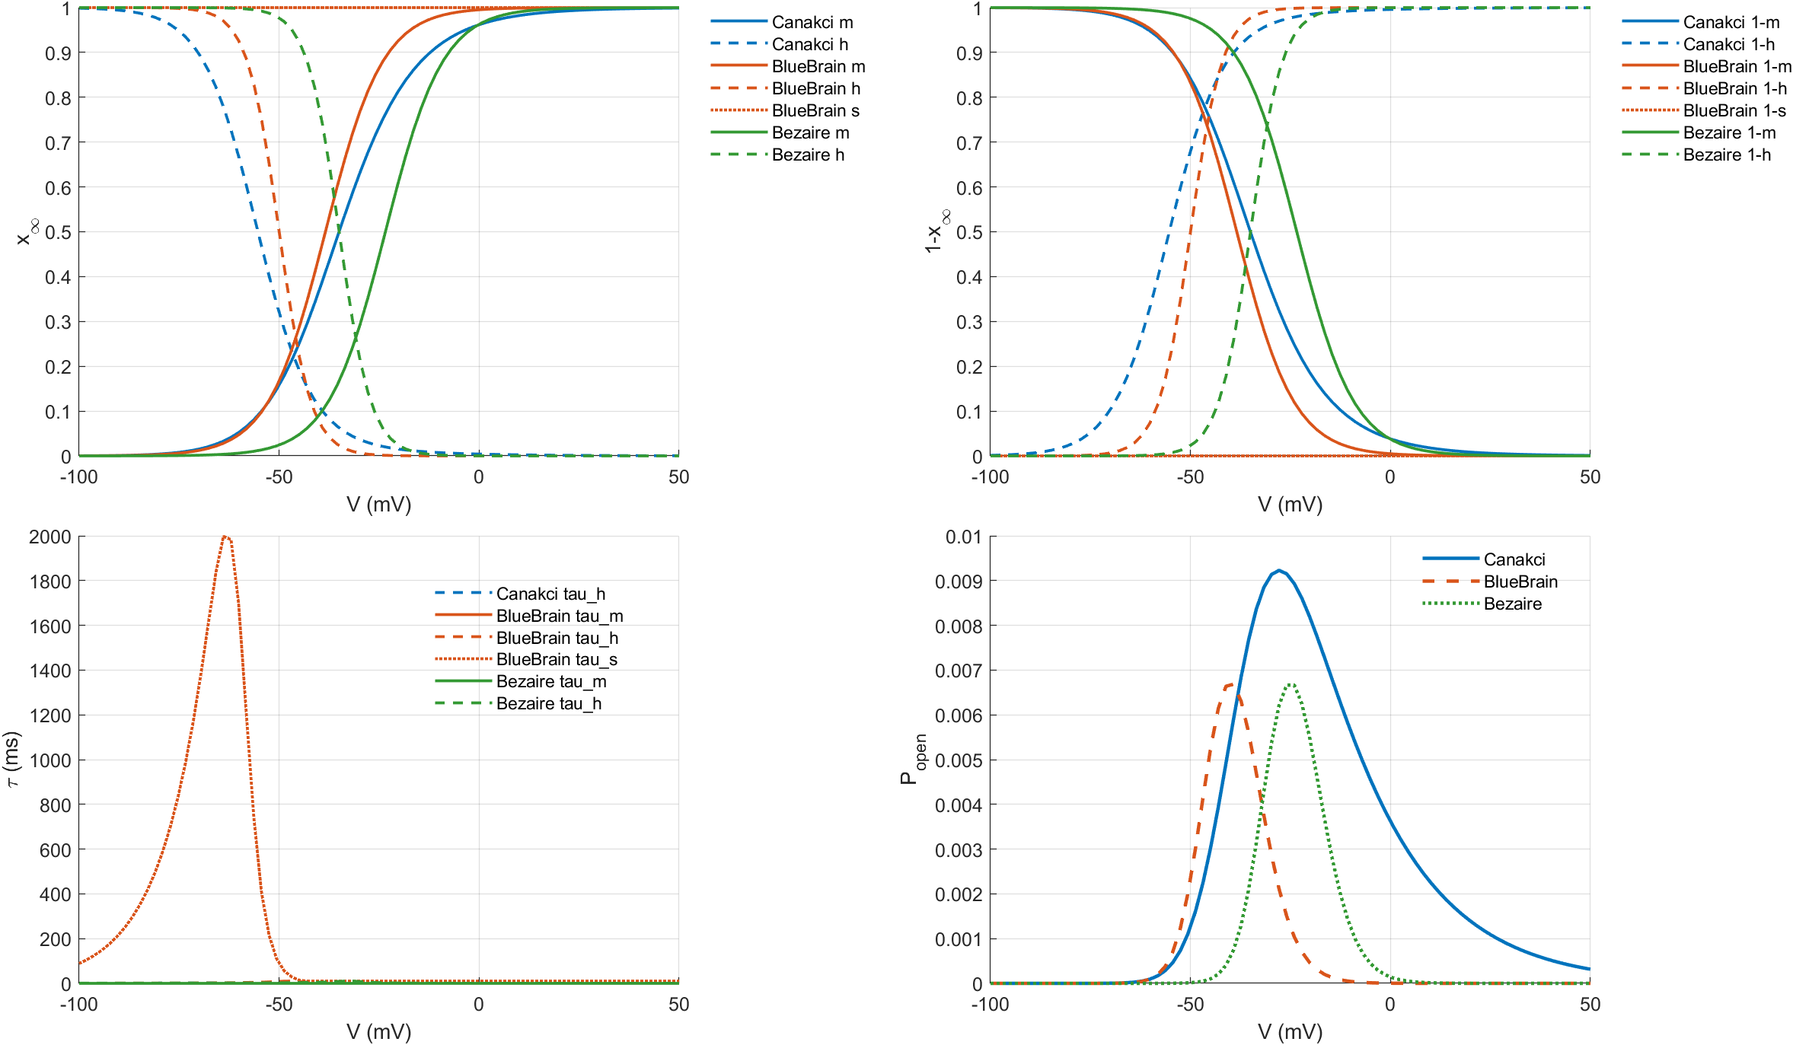
Channel Comparison - PVBC Na

Slide 4
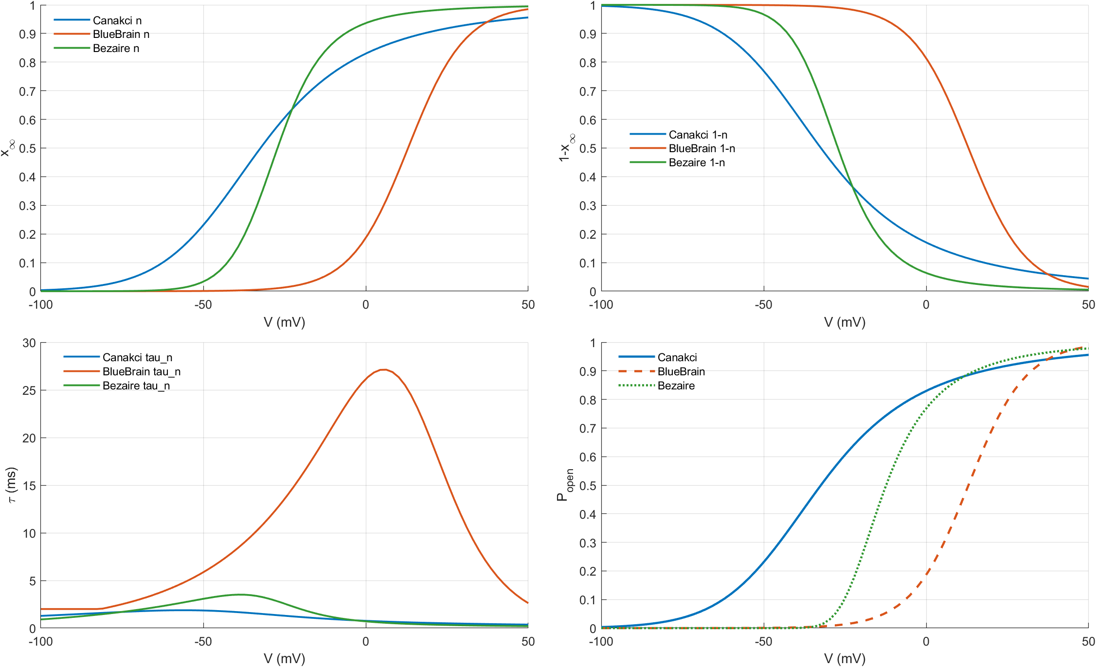
Channel Comparison - PVBC KDR

Slide 5
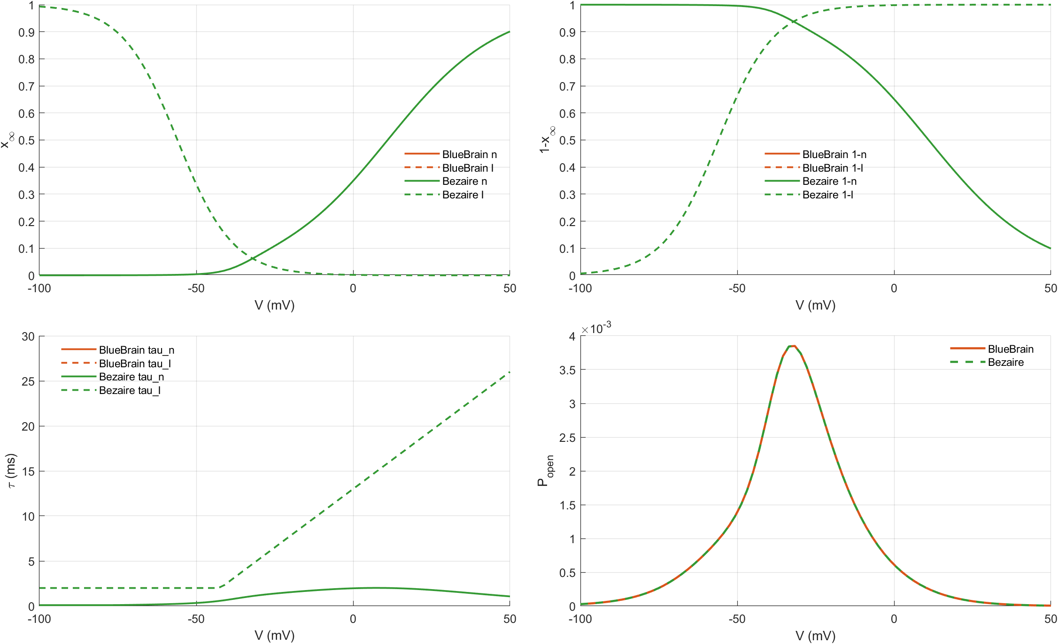
Channel Comparison - PC A-type K

Slide 6
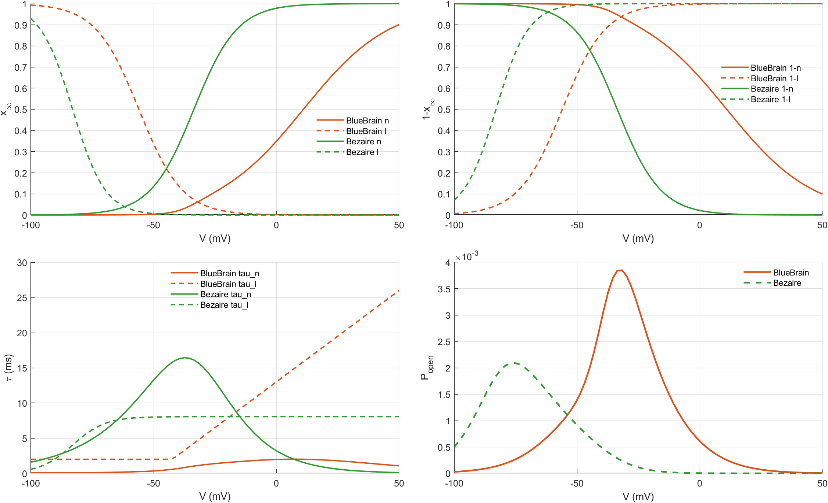
Channel Comparison - PVBC A-type K

Slide 7
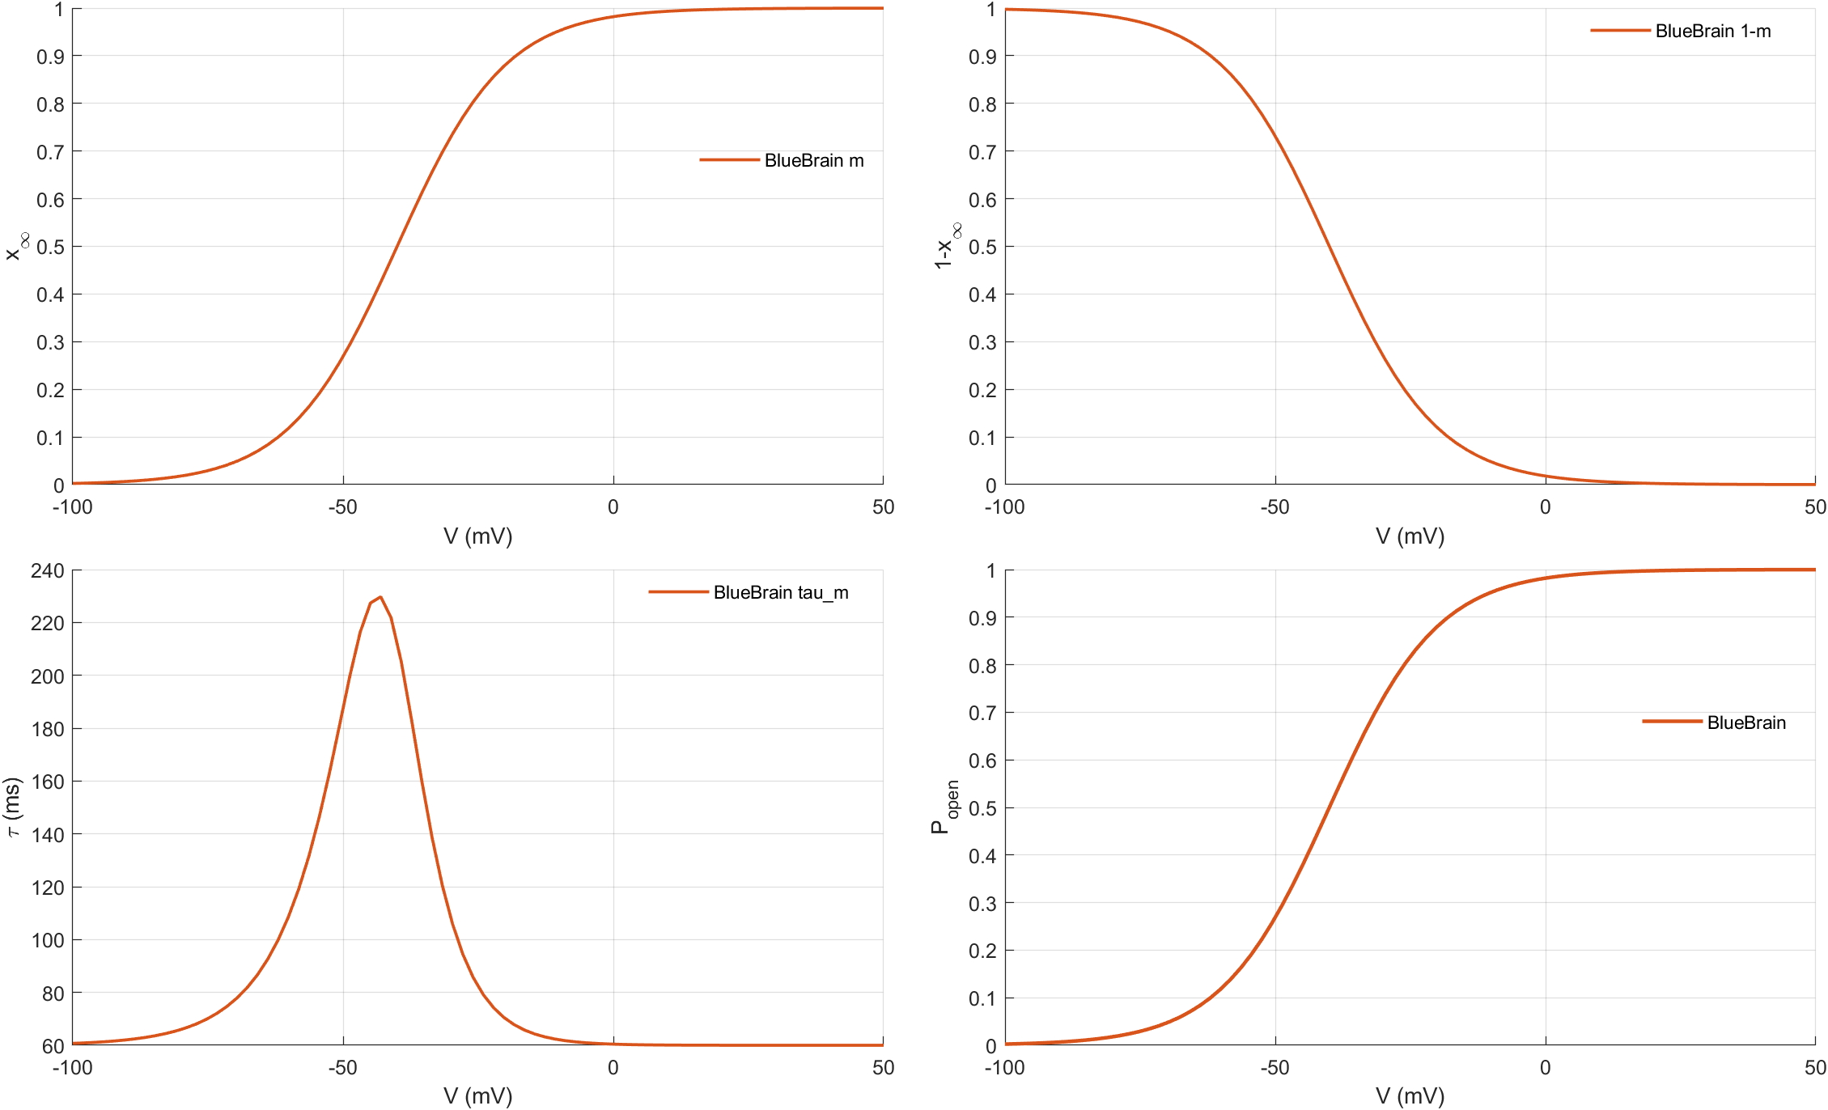
Channel Comparison - BlueBrain PC M-type K

Slide 8
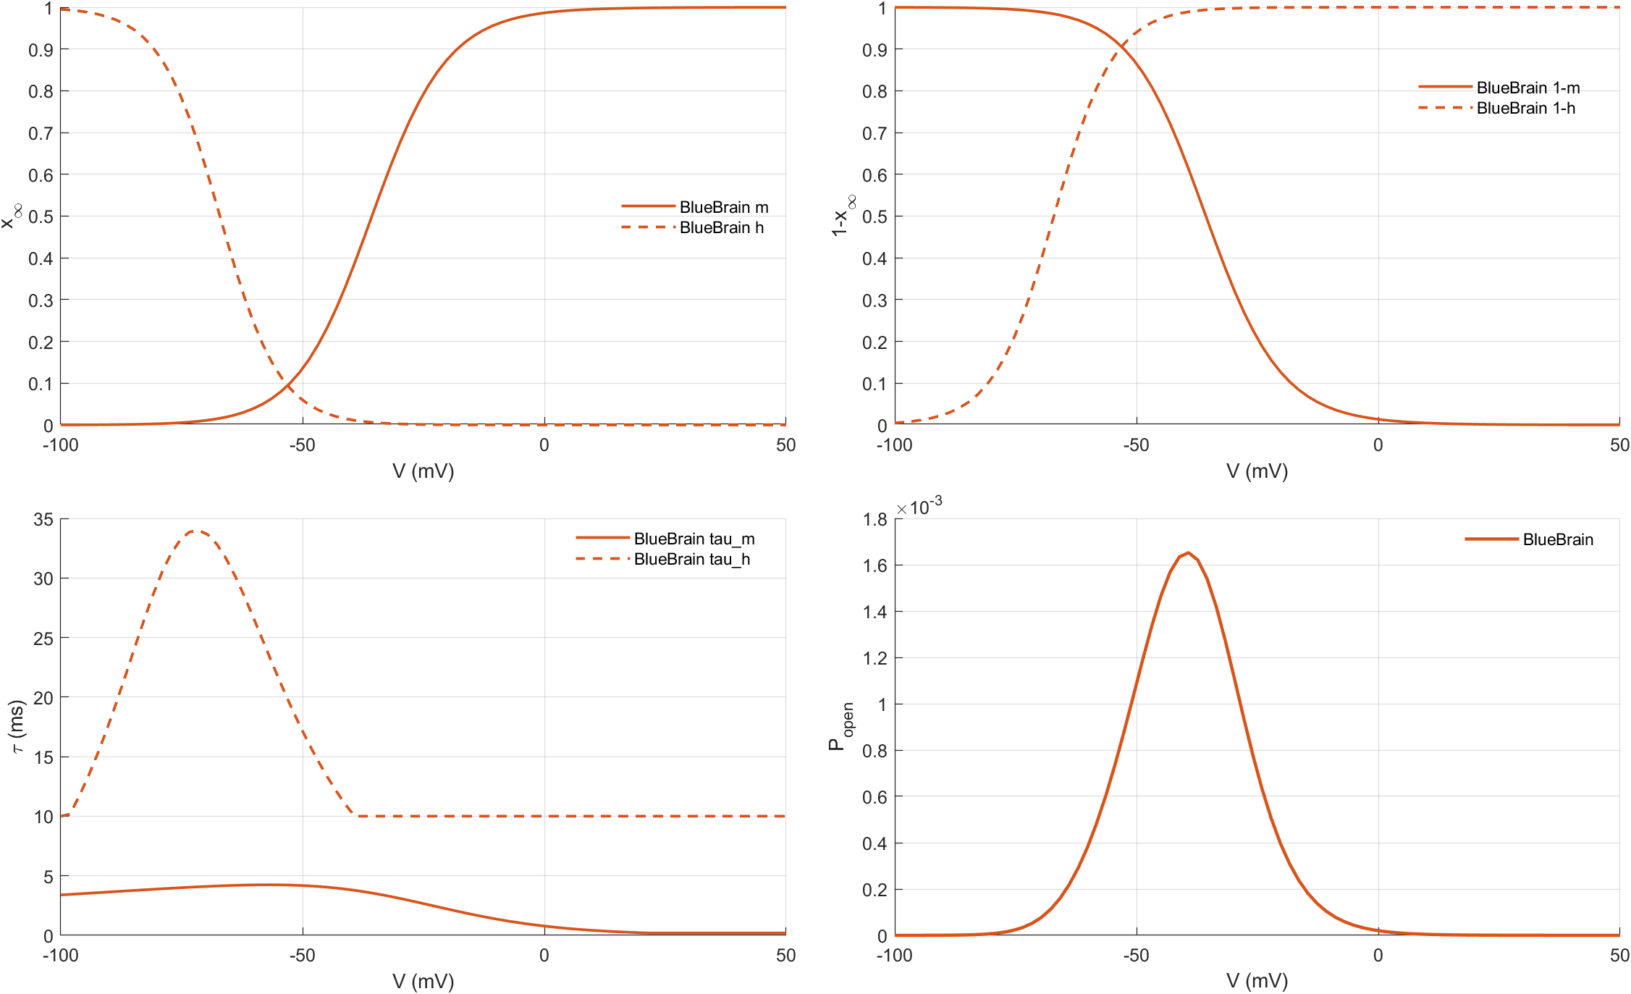
Channel Comparison - BlueBrain PC T-type Ca

Slide 9
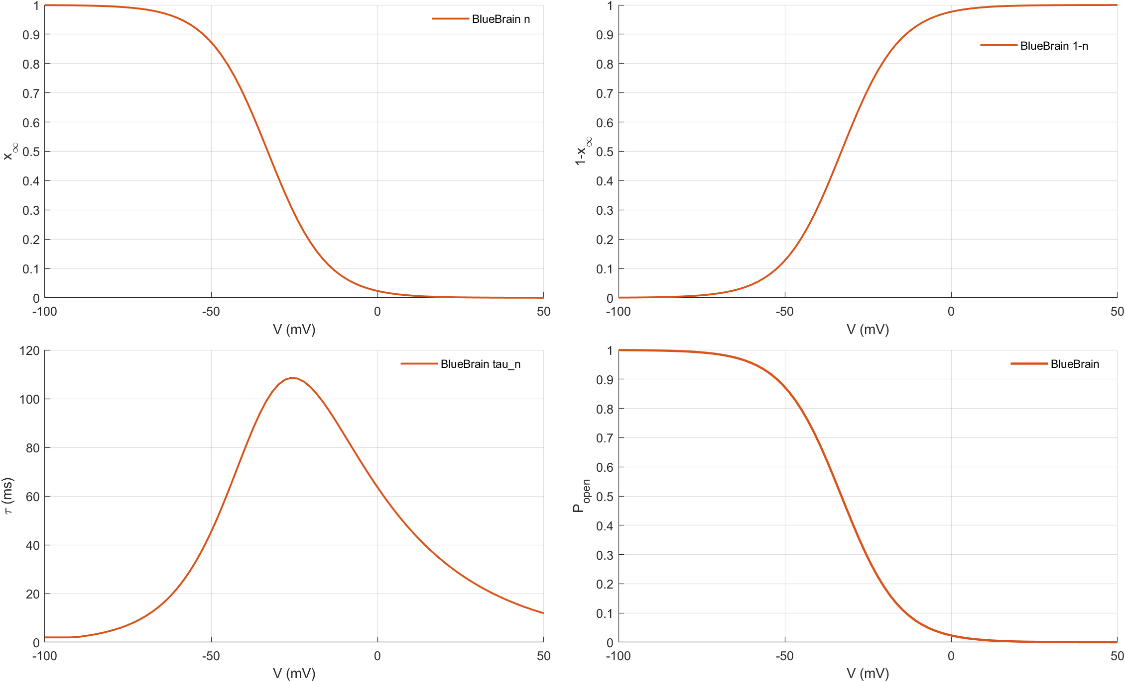
Channel Comparison - BlueBrain PVBC KDB

Slide 10

Channel Comparison - BlueBrain PVBC M-type K

Slide 11
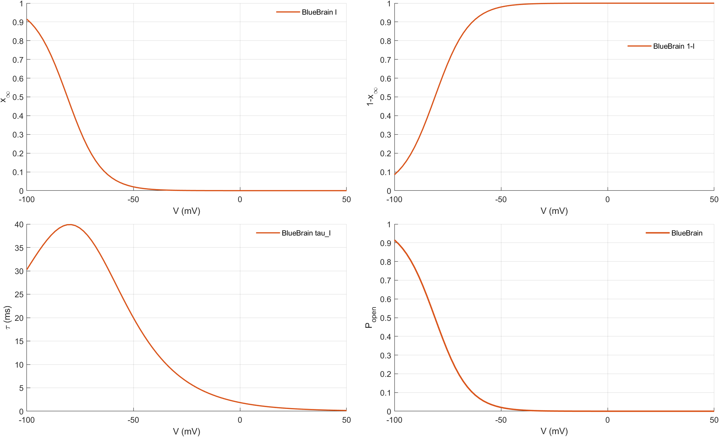
Channel Comparison - BlueBrain PVBC HCN

Slide 12

Channel Comparison - BlueBrain PVBC T-type Ca

Slide 13
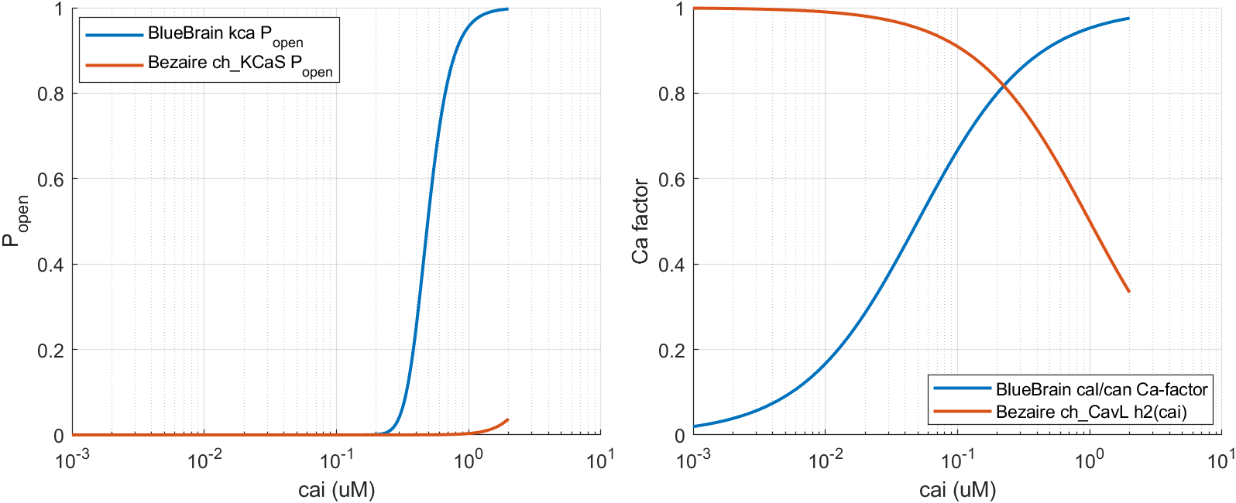
Calcium-dependent channels (cai sweeps only)

Slide 14
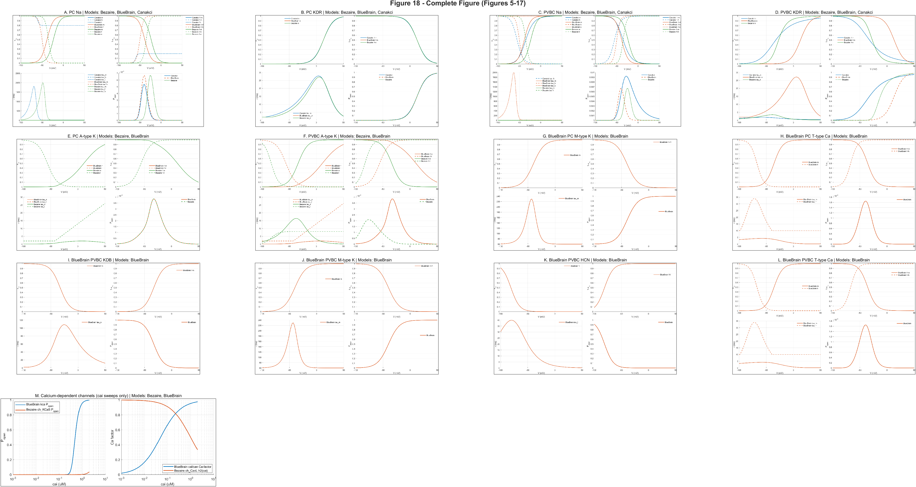
Figure 18 - Complete targeted channel set

