Slide 1

Cybersecurity Plan for AI-Integrated IIoT System
Carlos Granillo | ITAI 3377 Midterm

Slide 2
Smart Factory Overview
AI-driven industrial automation system
Real-time monitoring of machinery health
Uses IIoT sensors + edge computing + cloud AI
Goal: Predict failures and reduce downtime

Slide 3

System Architecture
Sensors → Edge Devices → Cloud Platform
AI models at edge (real-time) and cloud (training)
Dashboard for operators and engineers
Data flows continuously across all layers

Slide 4
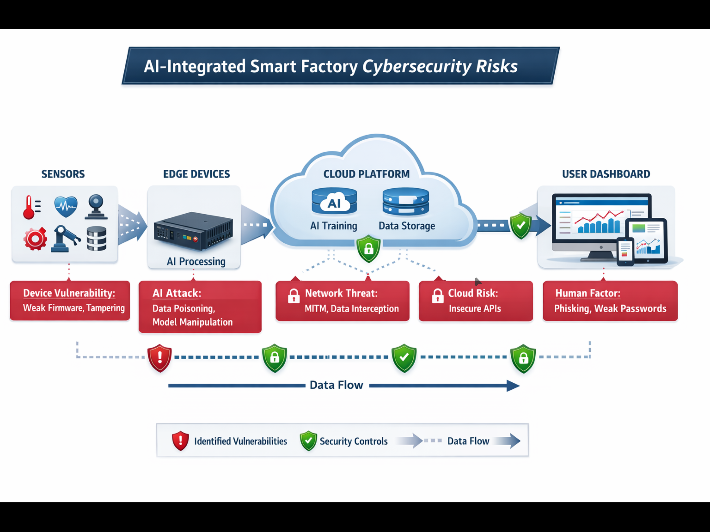

Slide 5

Key Components
Sensors: Temperature, vibration, pressure
Edge Devices: Local processing & filtering
Cloud: Storage, analytics, retraining
Users: Operators via dashboards/mobile apps

Slide 6
Major Vulnerabilities
1. Device Vulnerability (Weak Firmware & Physical Tampering) Many IIoT devices run on outdated or unpatched firmware, which makes them easy targets for attackers. Hackers can exploit known security flaws to gain remote access and take control of the device. If an attacker has physical access, they can also tamper with the hardware, change sensor readings, or install malicious code. This can lead to incorrect data being sent to the system and disrupt normal operations.
2. Network Vulnerability (Man-in-the-Middle Attack – MitM) Data traveling between sensors, edge devices, and the cloud can be intercepted if it is not properly secured. In a Man-in-the-Middle (MitM) attack, an attacker secretly positions themselves between two systems and captures or alters the data being transmitted. This allows them to inject false information, steal sensitive data, or manipulate system behavior without being detected.
3. Application Vulnerability (Insecure APIs) APIs are used to connect different parts of the system, but if they are not properly secured, they can become an entry point for attackers. Weak authentication or poor input validation can allow hackers to send malicious requests, access sensitive data, or control system functions. This could result in unauthorized actions, such as changing machine settings or extracting confidential information.
4. AI Model Vulnerability (Data Poisoning & Manipulation) AI models rely on data to learn and make decisions, so if attackers inject false or misleading data into the system, they can manipulate the model’s behavior. This is known as data poisoning. For example, attackers could alter sensor data so the AI fails to detect equipment issues or generates incorrect predictions. Over time, this can reduce the accuracy and reliability of the entire system.
5. Human Factor Vulnerability (Phishing & Weak Passwords) Human users are often the weakest part of any system. Attackers can use phishing emails or fake login pages to trick users into giving away their credentials. If users also create weak or reused passwords, it becomes even easier for attackers to gain access. Once inside, they can control the system, steal data, or launch further attacks without being noticed.

Slide 7

Threat Example (Attack Path)
Step 1: Phishing attack steals credentials
Step 2: Attacker accesses system dashboard
Step 3: Injects false sensor data
Step 4: AI model produces incorrect predictions

Slide 8

Defense Strategy Overview
1. Device Vulnerability (Weak Firmware & Physical Tampering)
Risk: Attackers exploit outdated firmware or physically access devices to alter behavior.
Defense Measures:
Implement secure boot to ensure only trusted firmware runs
Enforce regular firmware updates and patch management
Use device authentication before allowing network access
Apply physical security controls (locked enclosures, surveillance)
Disable unused ports and services on IIoT devices
2. Network Vulnerability (Man-in-the-Middle Attack – MitM)
Risk: Data interception or manipulation during transmission.
Defense Measures:
Encrypt all data using TLS and VPN tunnels
Implement network segmentation (separate IT and OT networks)
Deploy firewalls and Intrusion Detection/Prevention Systems (IDS/IPS)
Use certificate-based authentication to verify devices
Monitor traffic for anomalies using network monitoring tools
3. Application Vulnerability (Insecure APIs)
Risk: Unauthorized access or malicious API requests.
Defense Measures:
Enforce strong authentication (OAuth 2.0, API keys)
Apply input validation and sanitization
Implement rate limiting to prevent abuse
Use secure API gateways
Conduct regular security testing (e.g., OWASP guidelines)
4. AI Model Vulnerability (Data Poisoning & Manipulation)
Risk: Attackers manipulate training data to alter AI behavior.
Defense Measures:
Validate and sanitize all incoming data sources
Use anomaly detection to identify unusual patterns
Secure the machine learning pipeline (access controls, logging)
Regularly audit and retrain models with trusted datasets
Implement model integrity checks and version control
5. Human Factor Vulnerability (Phishing & Weak Passwords)
Risk: Users unintentionally grant attackers access.
Defense Measures:
Enforce Multi-Factor Authentication (MFA)
Require strong password policies
Conduct security awareness and phishing training
Implement role-based access control (RBAC)
Monitor user activity for suspicious behavior

Slide 9
AI Security Measures
Validate training data sources
Detect anomalies in model predictions
Secure ML pipelines
Regularly retrain and audit models

Slide 10
Implementation Plan Timeline
Week 1: Risk Assessment & Planning
Roles: Security Analyst, Project Manager
Tasks:
Identify vulnerabilities
Define security requirements
Develop mitigation strategy
Tools & Technologies:
Risk assessment frameworks (NIST, ISO 27001)
Threat modeling tools (e.g., Microsoft Threat Modeling Tool)
Documentation tools (Confluence, Google Docs)
Week 2: Network Security & Encryption
Roles: Network Engineer, Cybersecurity Engineer
Tasks:
Configure firewalls
Implement encryption
Segment network
Tools & Technologies:
Firewalls (Cisco ASA, pfSense)
Encryption protocols (TLS, VPN – OpenVPN, IPsec)
Network monitoring tools (Wireshark, Zeek)
IDS/IPS systems (Snort, Suricata)
Week 3: Access Control & AI Protections
Roles: IAM Specialist, AI Engineer
Tasks:
Implement RBAC
Secure AI models
Apply authentication policies
Tools & Technologies:
Identity & Access Management (Okta, Azure AD)
MFA tools (Google Authenticator, Duo)
API security (OAuth 2.0, API Gateway)
ML security tools (TensorFlow Model Analysis, IBM Adversarial Robustness Toolbox)
Week 4: Monitoring & Penetration Testing
Roles: SOC Analyst, Ethical Hacker
Tasks:
Deploy monitoring systems
Conduct penetration testing
Analyze and improve defenses
Tools & Technologies:
SIEM platforms (Splunk, IBM QRadar)
Pen testing tools (Metasploit, Nmap, Burp Suite)
Vulnerability scanners (Nessus, OpenVAS)
Log monitoring tools (ELK Stack)

Slide 11
Penetration Testing
Simulate phishing attack
Test Man-in-the-Middle vulnerability
Attempt AI model poisoning
Evaluate system defenses under attack

Slide 12
Results & Improvements
Phishing revealed need for user training
MitM(Man in the Middle) showed importance of encryption
AI attack required better data validation
Continuous testing is critical for maximizing effectiveness and efficiency.

Slide 13

Key Takeaways
Cybersecurity must cover AI + IIoT layers
Data integrity is as important as network security
Humans are often the weakest link
Defense must be proactive, not reactive

Slide 14
Reflections
This project focused on a smart factory that uses sensors, edge devices, and AI to monitor machines and predict failures. Several vulnerabilities were found, including weak device security, unencrypted networks, insecure APIs, AI model attacks, and human errors like phishing. To fix these issues, a strong defense strategy was created using encryption, multi-factor authentication, network segmentation, and AI data protection. Penetration testing showed that phishing, data interception, and model poisoning are real risks. The results highlighted the need for better user training, stronger encryption, and continuous monitoring to keep the system secure and reliable.

Slide 15

Conclusion
AI-integrated IIoT systems increase efficiency
But introduce new cybersecurity risks
Strong defense strategies reduce vulnerabilities
Ongoing monitoring and updates are essential

