Slide 1
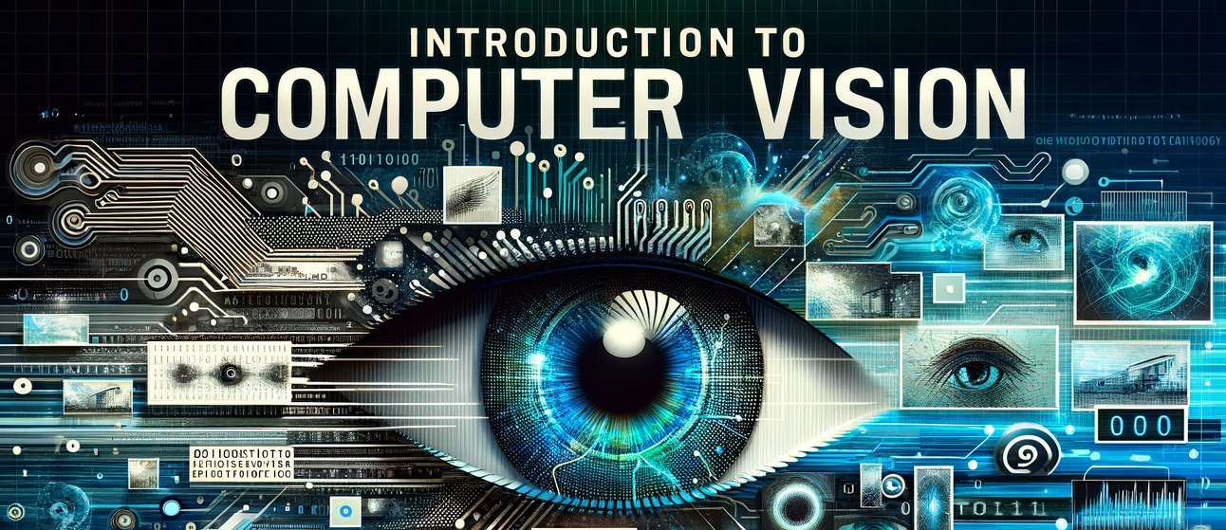
COURSE PORTFOLIO
MADE BY: CARLOS GRANILLO

Slide 2
Modules 1 & 2
In this module, we worked on the introduction of computer vision. It was very important to learn, because we got to understand how crucial this subject really was in the field of Artificial Intelligence.
In addition, we also worked on Exploring the Real-World applications of Computer Vision (CV).
We also got to learn about the History and Timeline of Computer Vision.

Slide 3
Modules 3 & 4
During module 3, we learned about GitHub and how to create an account for when using repositories.
Additionally, we also used the Jupyter Notebook which can be used for coding just like the Google Colab Notebook and all the others.
In module 4, we had a group project that was based on the importance of the amount of pixels and colors within an image to fully understand it.

Slide 4
Modules 5 & 6
In module 5, we learned about Image Classification with SVM.
Image Classification is about the ability of a machine being able to classify different images into different categories.
SVM stands for Support Vector Machine and it is a supervised classification method.
We also got to learn for about TensorFlow and its importance.

Slide 5
Modules 7 & 8
During these modules we had another group assignment about Convolutional Neural Networks (CNNs).
We also had a lab that helped us get a better understanding of how it should be applied. This lab was particularly important to understand because it was a lot of coding and had to be edited in order to run successfully.

Slide 6
Module 9
In module 9, we worked on another group assignment, but this time it was about Object Detection and how there are many different ways it is being used nowadays.
Object Detection is used in our everyday lives and it is now more important to understand than it ever has been before because of the pace technology is advancing at.
Used transfer learning and the Pascal VOC 207 dataset to learn more about applying it on our own.

Slide 7
Module 10
Finally, we got together and worked on the final group project of the semester and it went pretty well.
We got to learn more about object detection and what it means in the world of technology. In addition, we also had to choose a dataset that we had used before and complete it on our own with our partners.
Last but not least, we got to learn more how to make our models run as smoothly as possible and without any errors. By doing so, we would make sure they were always effective and efficient.

Slide 8
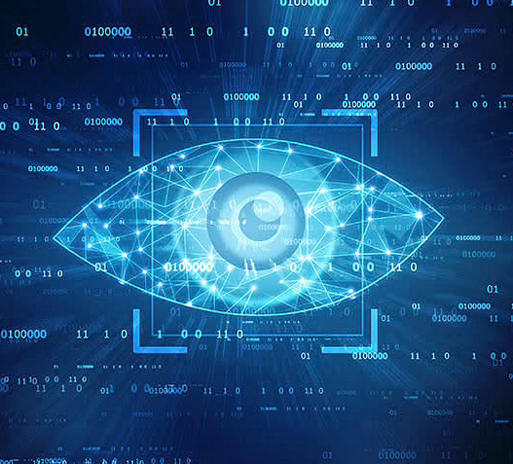
COMPUTER VISION COURSE PORTFOLIO

