Slide 1

King County Housing Market
Flatiron Phase-2 Project
Carlos Govea
ADD YOUR OWN TEXT HERE;)
ADD YOUR OWN TEXT ADD YOUR OWN TEXT ADD YOUR OWN TEXT ADD YOUR OWN TEXT ADD YOUR OWN TEXT ADD YOUR OWN TEXT ADD YOUR OWN TEXT ADD YOUR OWN TEXT ADD YOUR OWN TEXT ADD YOUR OWN TEXT ADD YOUR OWN TEXT ADD YOUR OWN TEXT ADD YOUR OWN TEXT ADD YOUR OWN TEXT ADD YOUR OWN TEXT ADD YOUR OWN TEXT

Slide 2
OBJECTIVE
Investor: Real Estate Firm entering housing marking to provide clients with benchmark appraisals for their home
Maximize home sale negation profits
Identify actionable insights that will provide firm with benchmarks
Build Model to estimate house prices given specific features

Slide 3
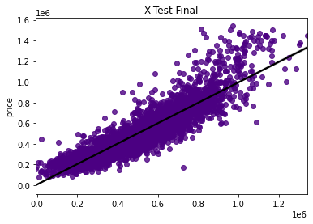
Model Objective
The construction of my model is intended to give a starting price for a home given a specific unit of features
Ex) For a home in zip 98178 with a square footage of 1180 given a grade of 4 will have a starting average price of around $221,900
The Model can predict the price with 82% accuracy based on given features

Slide 4


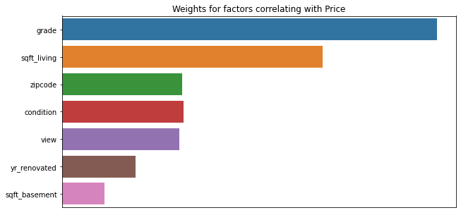
HEADLINE
Price Negotiation Benchmark
Square foot of home Space
Zip code
Grade of home

Slide 5
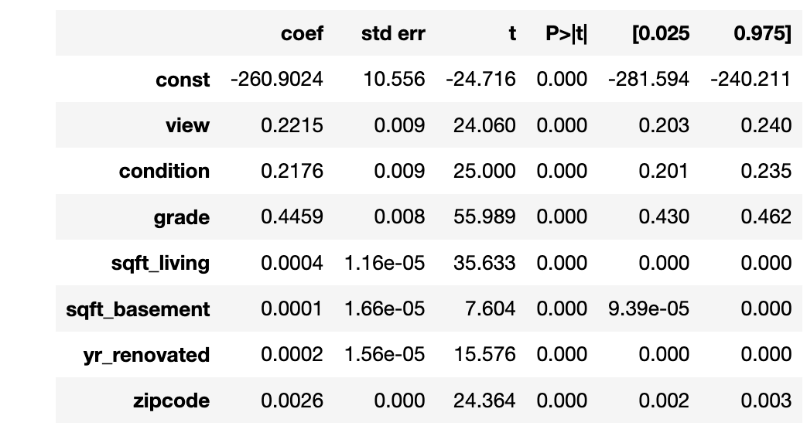
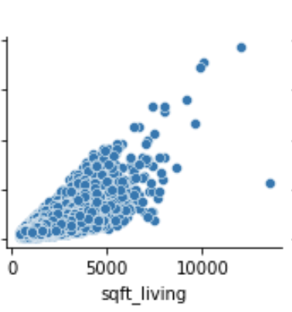
Home Size to Price
Sqft_living – Square footage of living space in the home
For every 1 square footage of living space, the price is increased by 0.04%
The scatter plot represents correlation of living space square footage to price (almost linear)

Slide 6
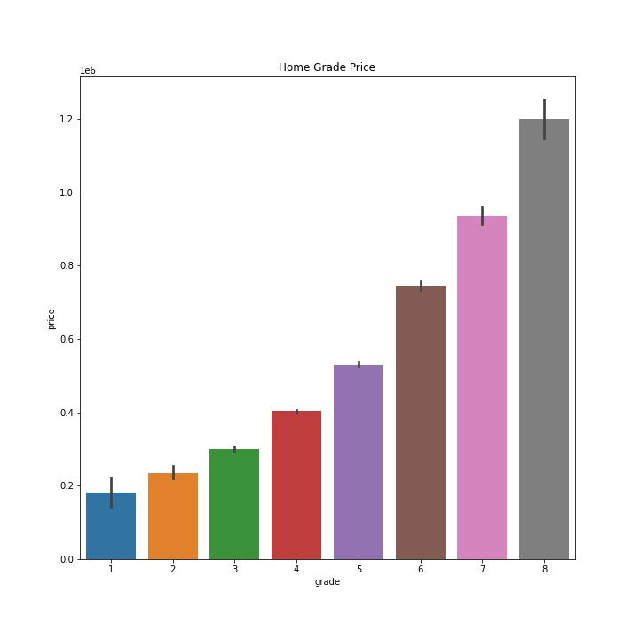
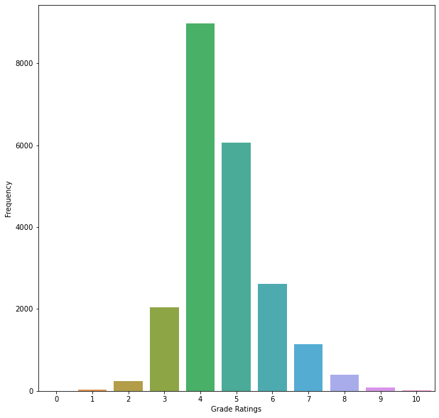
HEADLINE
Grade Effect on Price
The greater the Grade on home the more the price
Distribution of home grades fairly normal which implies their graded diligently

Slide 7
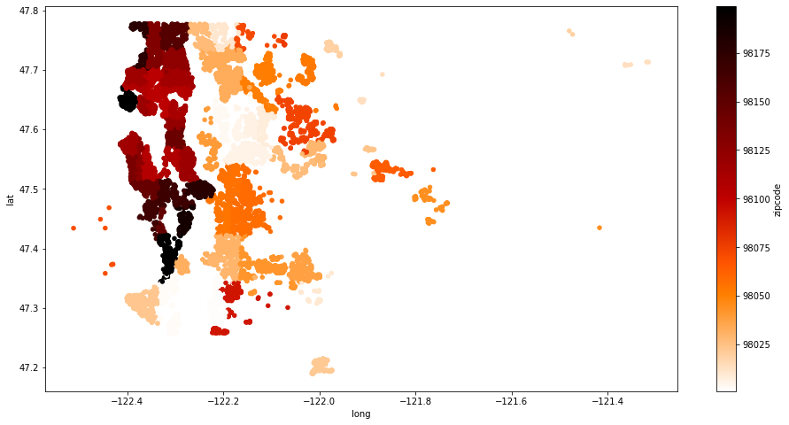
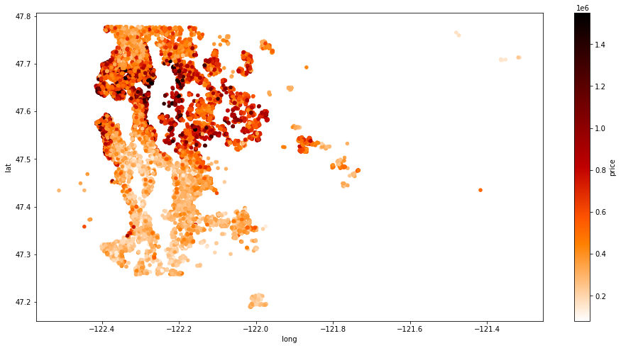
Median Price Per Zip
Area Map with Highest Prices
The areas with the highest priced homes are in the center by the coast
Zip code distribution with most and least dense

Slide 8
HEADLINE
1
CONCLUSION
The Square foot of living home space is largest contributor to price outside of home grade, and zipcode which are also effect the price of homes considerably.
Future changes: Would further liker to improve my model by accounting for specific ranges of prices as have major differences( $100,000 -$500,000 -$1million) or adding school districts as feature

