Slide 1
Week 2 Recap

Slide 2
Data Analysis Process

Slide 3

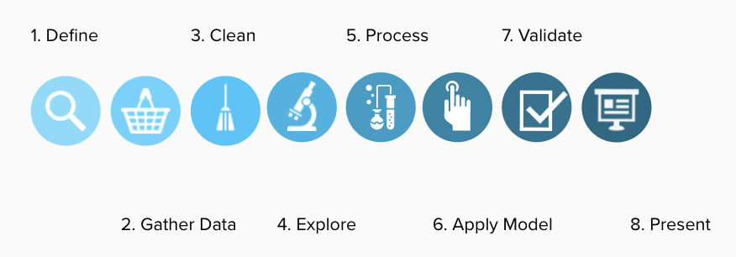
DATA ANALYTICS

Slide 4
Numpy

Slide 5


Python Libraries
There are three ways of load them:
import library_name
import library_name as alias
from library_name import function
How we can use a library in Python?
00

Slide 6
Numpy: what is used for?
Numpy (short for Numerical Python) is a library used to speedup numeric computing
It includes support for multi-dimensional lists and matrices along with a variety of mathematical functions to apply to them.
To use the library use the following library :
import numpy as np
np.sum()
np.mean()
np.__version__ (to check your current version of the library)
00

Slide 7
Numpy additional types of variables
Variable types
We can change the type of a variable using the function np.astype( new_type )
Some new types are:
np.bool_ (boolean)
np.short
np.int_ (integer)
np.double (float)
np.float32
np.float64
00

Slide 8

Numpy arrays: extracting data
# First row of array c
>>>print(c[0])
# First row, second column
>>>print(c[0,1])
# First row, second column, all the slides (:)
>>>print(c[0,1,:])
Numpy arrays also accept ranges to access values
>>>print(c[0:6,:,0:]
0
1
00

Slide 9
Casting lists into numpy arrays
We can cast python lists into numpy arrays as long as all the elements of the list are of the same type. Otherwise numpy will try to cast all the elements to the same type if he can.
lst_lst = [[1,2,3],[4,5,6],[7,8,9]]
d = np.array(lst_lst)
print(d)
[[1 2 3] [4 5 6] [7 8 9]]
How can I access value 5?
00

Slide 10
Pandas

Slide 11
Pandas library
Standard python variables, doesn't include the possibility to load tables of data.
Pandas library was developed to solve this problem. This library includes a new type of object called dataframe or "df" (another convention of the coding community).
Moreover, the Pandas library comes with several methods to deal with this new type of variable.
To use the pandas library use:
import pandas as pd
Pandas library. Why?
00

Slide 12
Pandas library
The primary data structures in Pandas are Series and DataFrames
>>> a = pd.Series(np.random.random(10))
>>> print(a)
>>> colnames = ['Column1','Column2','Column3','Column4','Column5']
>>> df = pd.DataFrame(np.random.random((10,5)), columns=colnames)
>>> df.head(5)
Data Structures
00

Slide 13
The column names of a dataframe can be obtained using:
list ( df.columns )
Elements of a dataframe can be accessed in several ways:
Accessing by column name:
df[ ‘Columname’ ]
It returns a Series
df[ [‘Col1,’Col2’,’Col3’,’Col4’] ]
With implicit index ( every column has an implicit index like a list, while rows have explicit index )
df.iloc[0:5,:]
With explicit name:
df.loc[:,[‘Col1’,’Col2’,’Col3’]]
Pandas library
Slicing dataframes

Slide 14
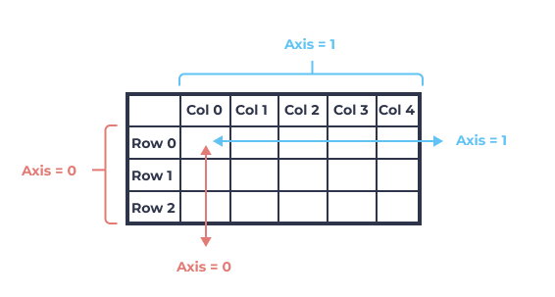
Pandas library
To concatenate the content of two or more files you can use the method: concat()
# Data blending
column_names = file1.columns
data = pd.DataFrame(columns=column_names)
data = pd.concat([data,file1, file2], axis=0)
data.shape
Data blending with Pandas
00

Slide 15
Data types
The main method to convert a column to another data type is: astype()
df[ column_name ].astype(new_type)
Type conversion methods
00

Slide 16
Data types
ALWAYS check for duplicates in your datasets.
They don’t add information
They can bias your model
They increase the time to train a model
Use the method: drop_duplicates()
data.drop_duplicates()
Dropping duplicates
00

Slide 17
Data types
To get a first expiration of your dataframe (df), you can use: df.head()
To have an idea of range of values for each numerical columns use: df.describe()
To get a glimpse of the same for ‘object’ columns use: df[‘colname’].value_counts()
To get unique values: df[‘colnames’].unique()
Exploring the dataframe
00

Slide 18
Pandas wrangling/cleaning
To select a given column name:
df.column_name
df[ list_of_column_names ]
To select a row:
df.iloc[ list_of_row_indexes ]
To select a subset of rows/columns:
df.iloc[ list_if_row_indexes,
list_of_column_indexes ]
Subsetting
00

Slide 19
Pandas wrangling/cleaning
To filters rows/columns based on condition simply insert the condition within the brackets:
df[condition]
To combine several conditions, place each within parentheses and combine them using
& (and)
| (or)
Filters
00

Slide 20
Pandas wrangling/cleaning
To drop columns/rows from a Pandas dataframe, use the method: drop()
For columns:
df.drop(columns=’column_name', inplace=True)
For rows:
df.drop(list_of_row_indexes, inplace=True)
Dropping columns/rows
00

Slide 21
Pandas wrangling/cleaning
Dropping rows doesn’t reset the indexes!!!.
There is a method to reset them: reset_indexes()
https://pandas.pydata.org/pandas-docs/stable/reference/api/pandas.DataFrame.reset_index.html
Indexes
00

Slide 22
Working with columns
In order to find missin_values Pandas provides the methods:
isna()
isnull()
Both methods carry out the analysis column_wise (ie. reports the results for each element of each column)
To know how many missing values are in each column you can “append” the method: sum() to the previous method.
To compute the percentage of missing values....?
Finding missing values
00

Slide 23
Missing values
To achieve this, Pandas provides the method: fillna() to be applied to an specific column of the dataset.
It needs the value to replace the “na” as an argument.
data['median_home_val']= data['median_home_val'].fillna(mean_median_home_value)
With categorical column types, you can get how many values you have of each applying the method: value_counts() to the corresponding column
Filling NA’s
00

Slide 24
Aggregation
The aggregation operation consists in making computations by groups.
To create aggregations you can use df.groupby(column)
To specify the aggregation function append it at the end of the groupby. Ex:
df.groupby(‘gender’).count()
If a list of columns is provided to groupby, then the aggregation will take place in the same hierarchical order of columns. Ex
df.groupby([‘state’,’gender’]).count()
In this last case a “multiindex” dataframe is generated . To prevent this use the option ‘as_index=False’
Aggregation by groups
00

Slide 25
Organising Data Transformation into Pipeline

Slide 26
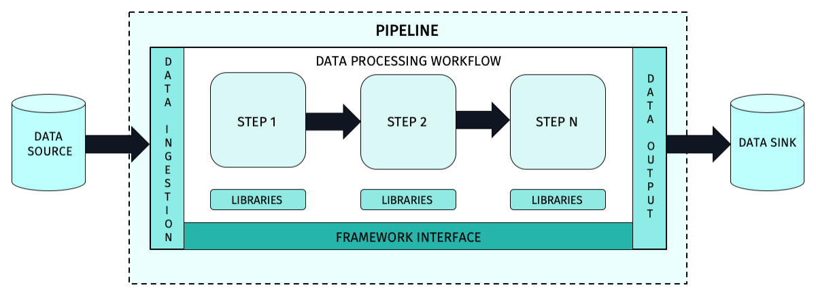
Source:https://developer.here.com/documentation/get-started/dev_guide/shared_content/topics/olp/concepts/pipelines.html

Slide 27
Matplotlib & Seaborn

Slide 28

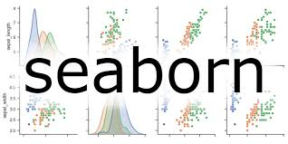

EXPLORATORY DATA ANALYSIS USING MATPLOTLIB AND SEABORN

Slide 29
Exploratory analysis
Creation of almost any kind of plot:
Histograms
Bar charts
Scatter plots
Lines
Pies
surface
Seaborn library needs matplotlib.
Load them as:
import matplotlib.pyplot as plt
import seaborn as sns
%matplotlib inline
https://matplotlib.org/
https://seaborn.pydata.org/
What is the purpose of those libraries?

Slide 30
Barplot -> Bar ( to plot amount for each categorical variable )
Barplot horizontal -> Barh ( the same but exchanging the axis )
Boxplot -> Boxplot ( to plot a boxplot of a numerical variable )
Histogram -> Hist
Pie chart -> Pie
Scatter plot -> scatter ( to plot one symbol of a pair of numerical values )
Line plot -> Plot ( to plot a line connecting observations )
Exploratory analysis
Main types of plots in Matplotlib

Slide 31
Multiple plots in matplotlib are generated using the following functions:
subplot( nrows, ncols, index) (used to change the canvas layout )
subplots( nrows, ncols ) ( returns a figure and a list of axes )
This generate a new canvas containing nrows * ncols plots arranged in nrows and ncolums, unless: add_subplot() is called
The axis of the plot given by index is returned. (The index starts counting from top left and increases to the right and to the bottom ): plt.subplot(2,3,5)
Exploratory analysis
Subplots in Matplotlib
1
2
3
4
5
6

Slide 32
Exploratory analysis
Seaborn is library built in top of matplotlib. Therefore, in order to use seaborn, matplotlib must be imported before.
To use the library:
import matplotlib.pyplot as plt
import seaborn as sns
#%matplotlib inline
Seaborn

Slide 33
Descriptive Statistics Measures

Slide 34
Measures of Frequency
Count, Percent, Frequency
Measures of Central Tendency
Mean, Median, and Mode
Measures of Dispersion or Variation
Range, Variance, Standard Deviation
Measures of Position
* Percentile Ranks, Quartile Ranks

Slide 35
Sampling Vs Population

