Slide 1
Stock market prediction
Capturing trend information with machine learning techniques

Slide 2
Index
Business case
Initial data
Modeling - CCR
Program flow
Conclusions

Slide 3
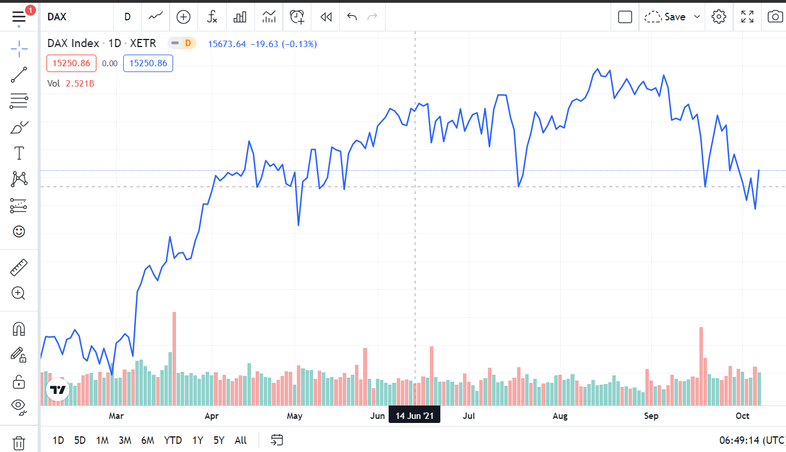
Business case
Hypothesis: it is possible to extract trend information from “snippets” from index data and use it to predict future stock prices.
Field of Technical analysis
Possible users: people who have stocks or want to invest in the stock market with a medium term focus (30 days buy/sell frequency)

Slide 4
2. Initial data
Kaggle dataset with 30+ years of information for 14 indexes:Date, Value, and Volume.
Transformation. For each row:
Pivot day
Snippet size (backwards)
Projection step (forwards)
Get n random days and the relevant information.
Example: if snippet_size=20, for each row we would have 40 data points for price and volume, plus the pivot day price and the projection date price. We use these prices to calculate the percentage increase.
TARGET VALUE: percentage increase or decrease between the pivot date and the projection date.

Slide 5
3. Modeling
Normalisation: minmax for price and volume data.
3 model pipeline:
Clustering: identifying trends with KMeans
Classification: classifying in Good, Bad or Neutral outlooks with Random Forest Classifier or Extra Trees Classifier
Regression: predicting the target value with Light Gradient Boosting Machine or Extra Trees Regressor
R2 SCORE: > 0.75

Slide 6
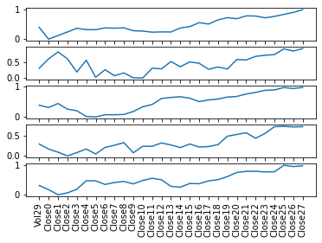
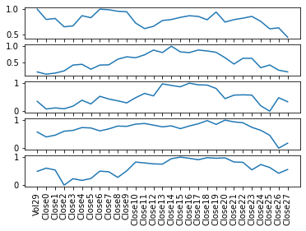
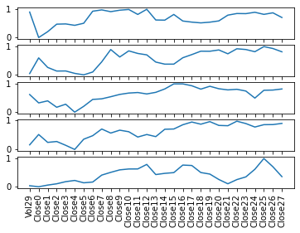
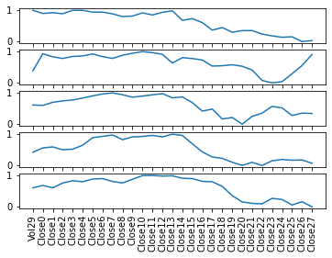
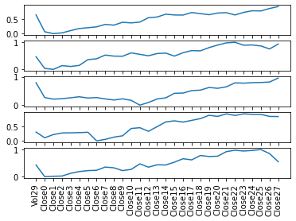
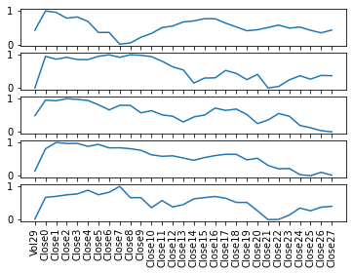
Clustering

Slide 7
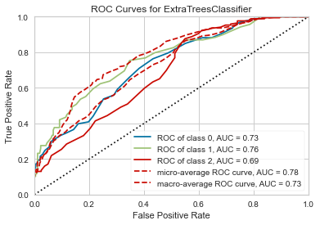
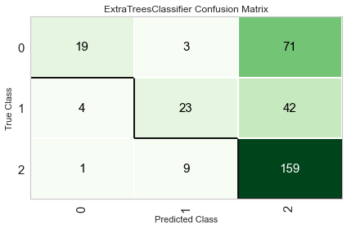
Classification
Labels: good, bad or neutral

Slide 8
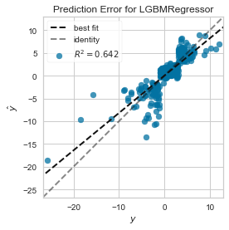
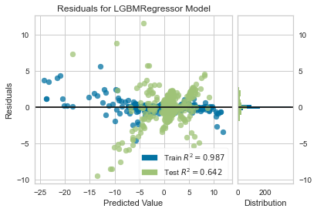
Regression
Baseline - only price and volume information. R2 ~ 40%
With clustering and classification results. R2 ~ 75%

Slide 9
3. Program

Slide 10
4. Conclusions
First conclusion: it seems possible.
Second conclusion: the model’s accuracy can be improved. Possibilities:
Include Moving Average
Trying more advanced techniques such as LSTM Neural Networks
Personal takeaways:
The importance of program flow: optimize and simplify
Getting better API connections (number of connections, dividend, split)
Creating a portfolio management and automatized testing framework.

Slide 11
Thank you!

