Slide 1
Search of trading strategies by grammar-based genetic programming
Carlos Manuel Rodríguez Martínez
Advisor: Alejandro Raúl Hernández Montoya
Universidad Veracruzana
Centro de Investigación en Inteligencia Artificial

Slide 2
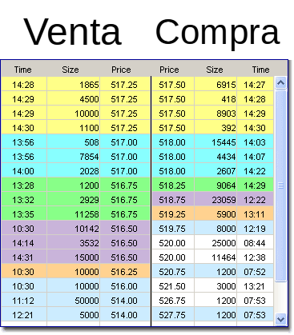

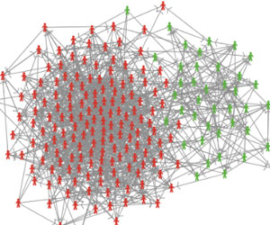
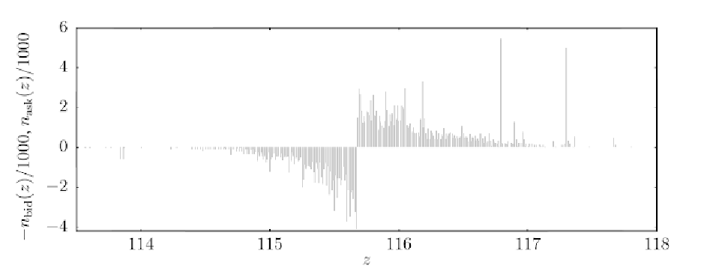
About the stock market

Slide 3
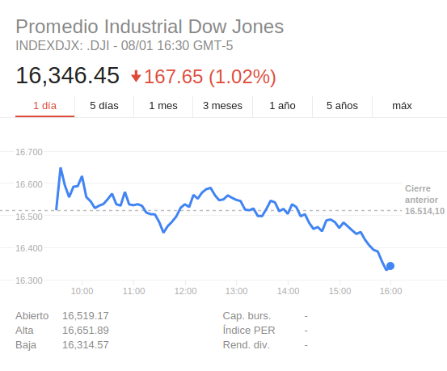
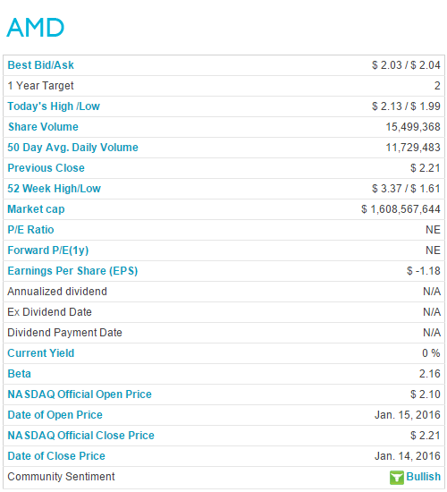
About the stock market

Slide 4
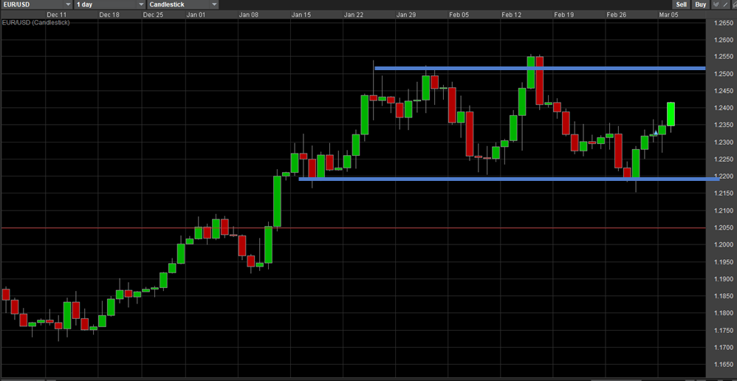
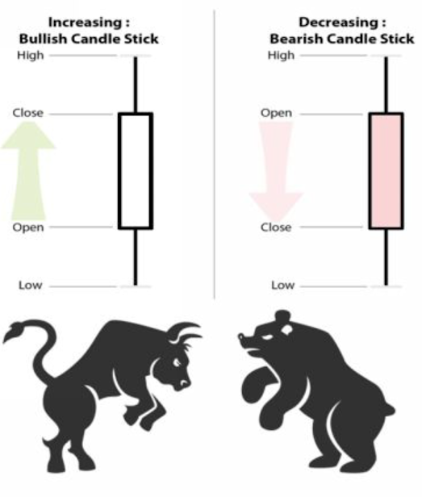
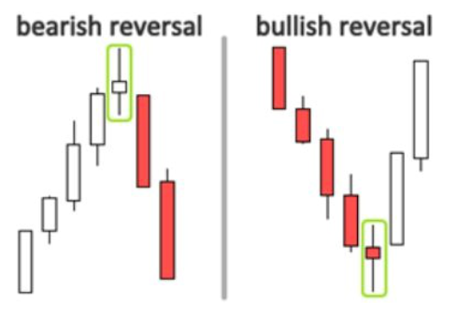
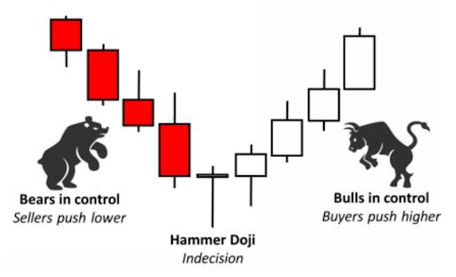
What traders do

Slide 5
Problem formulation
We wish to find a trading strategy that consistently optimizes return on various stocks.
Our search space is made of programs that represent a strategy.
Programs must be encoded in a language that can at least express the most common trading strategies.

Slide 6
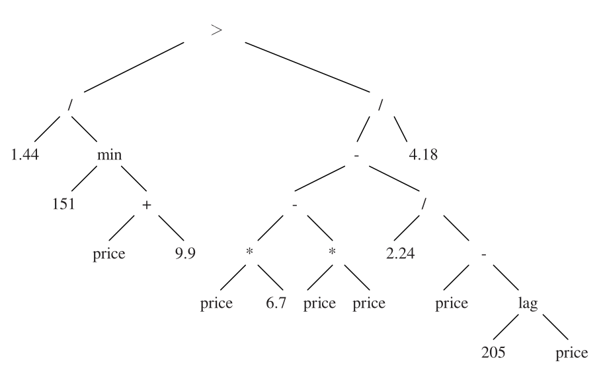
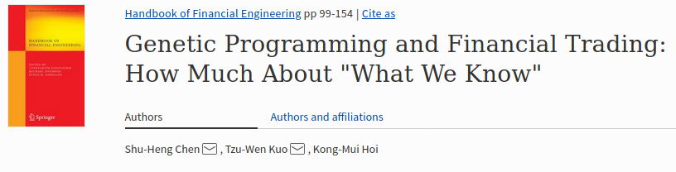
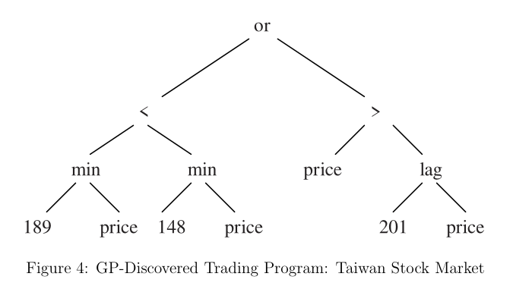
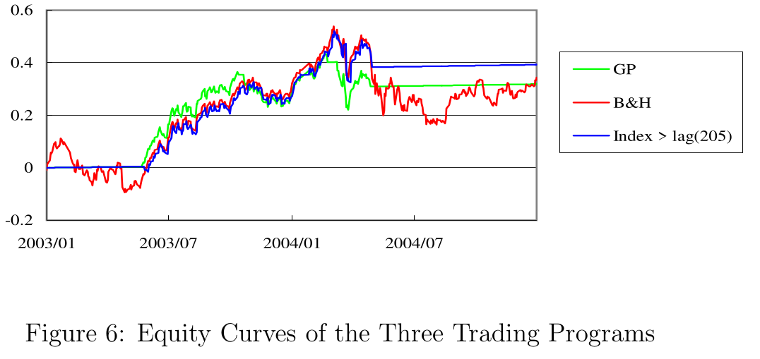
Literature review
Date: 2008

Slide 7
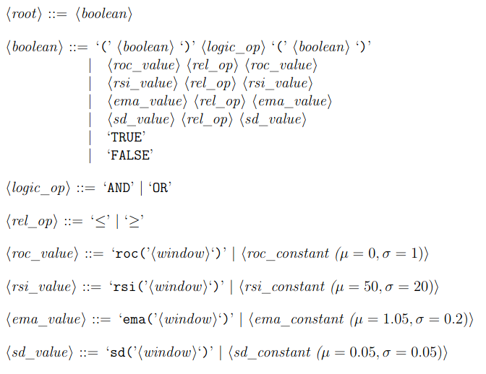

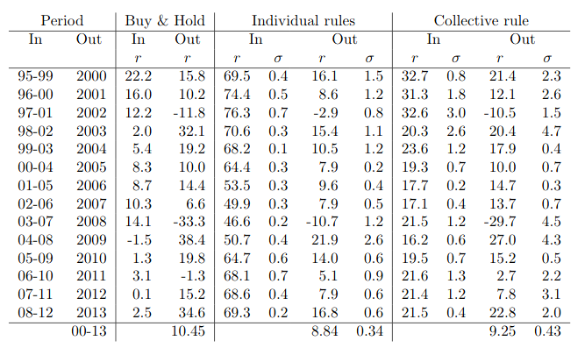
Literature review
Date: 2014
Trained on daily data!!

Slide 8

Informal literature review
https://fabian-kostadinov.github.io/2014/09/01/evolving-trading-strategies-with-genetic-programming-an-overview/
http://www.turingfinance.com/using-genetic-programming-to-evolve-security-analysis-decision-trees/

Slide 9
Proposed methodology
Design a expressive grammar that can express more refined trading decisions.
Include information about market structure and states.
Perform a search over trading strategies using intraday data.

Slide 10
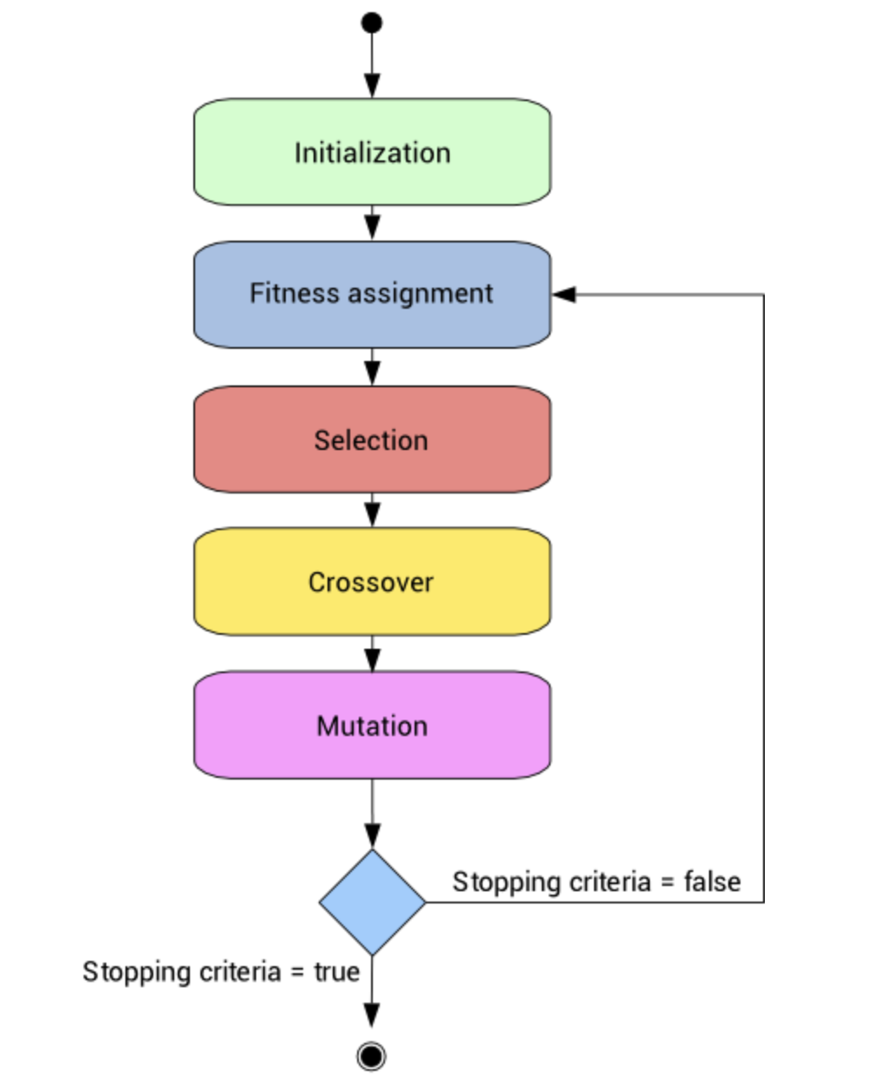
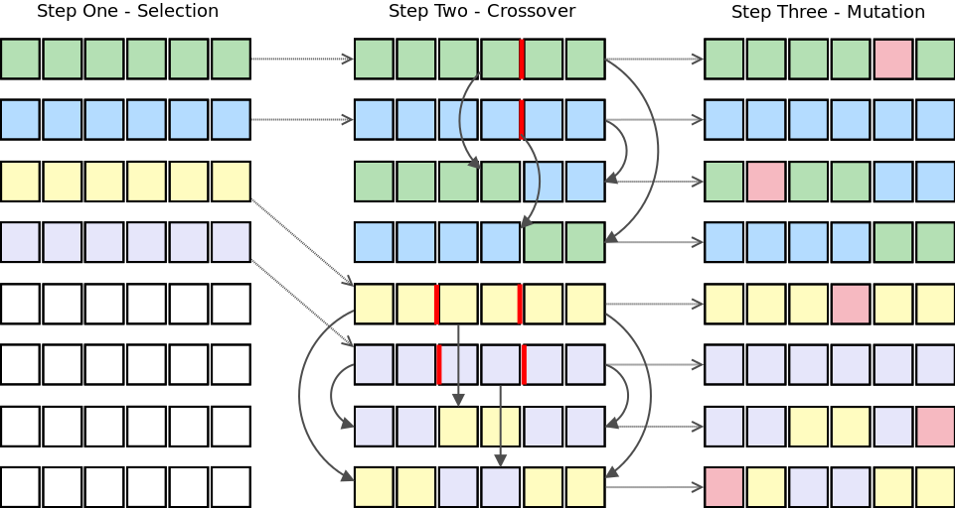
Genetic algorithms

Slide 11
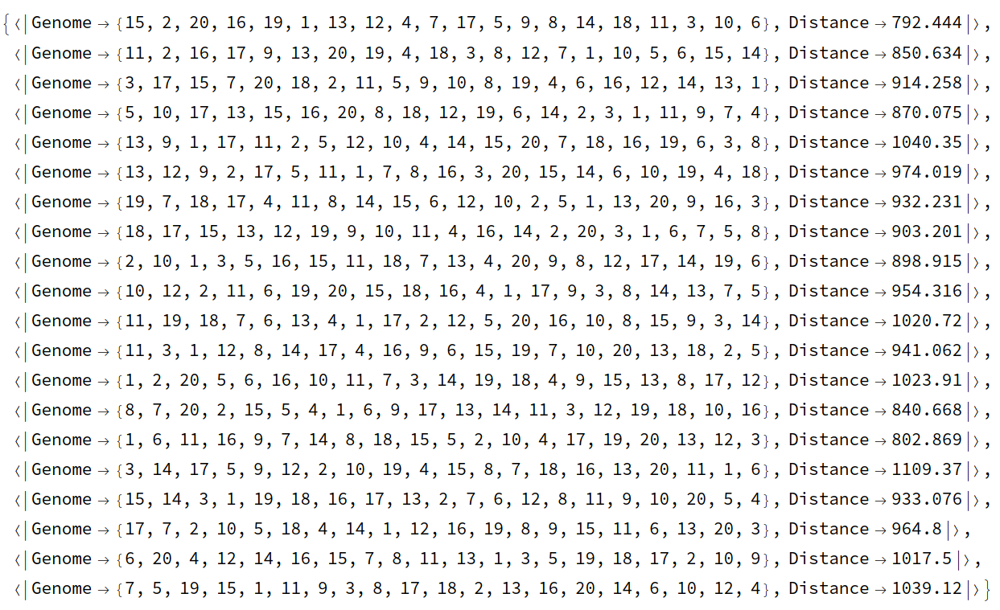
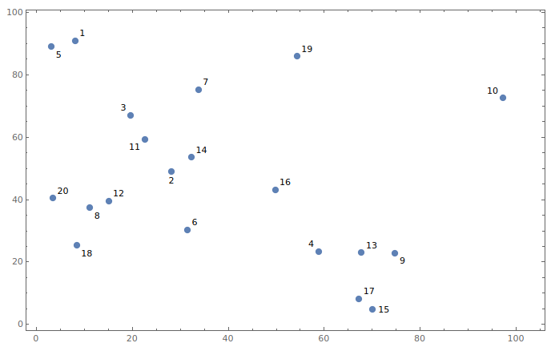
Genetic algorithms
Classic example: The traveling salesman problem
A random population is created

Slide 12

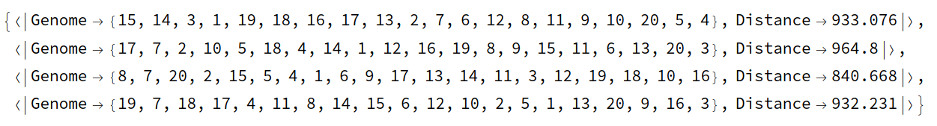
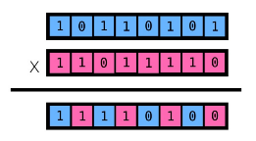
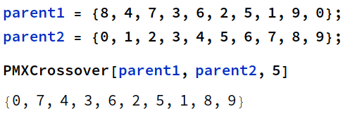
Genetic algorithms
The fitted individuals are selected to reproduce
Reproduction is done through the crossover operation

Slide 13
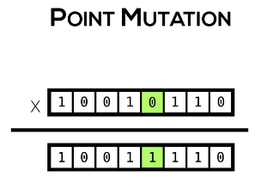
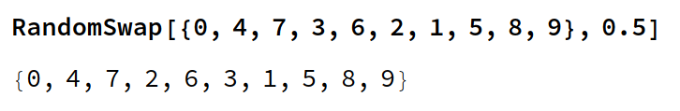
Genetic algorithms
Some individuals experience random mutations
This procedure is repeated n times

Slide 14
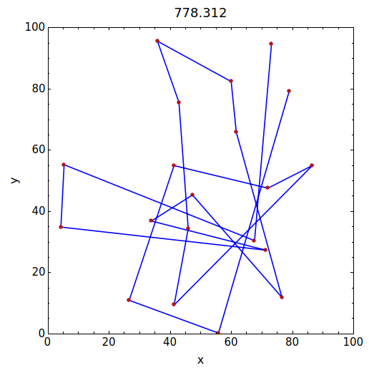
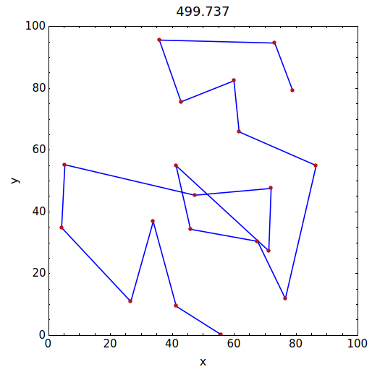
Genetic algorithms
The final solution optimizes distance

Slide 15
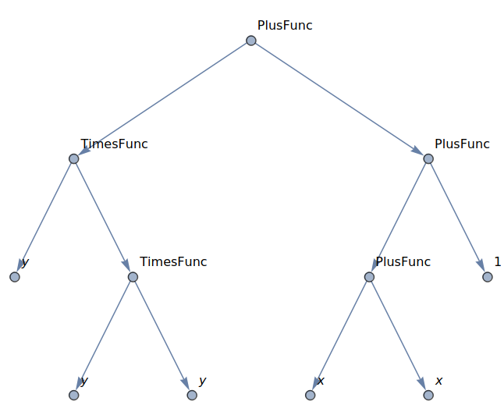

Genetic programming
Analogous to genetic algorithms but optimizes over function space.
Operations are done over a tree structure
Classic example: Symbolic regression
The function set must satisfy the closure property: every function must accept as arguments the other functions and terminals

Slide 16
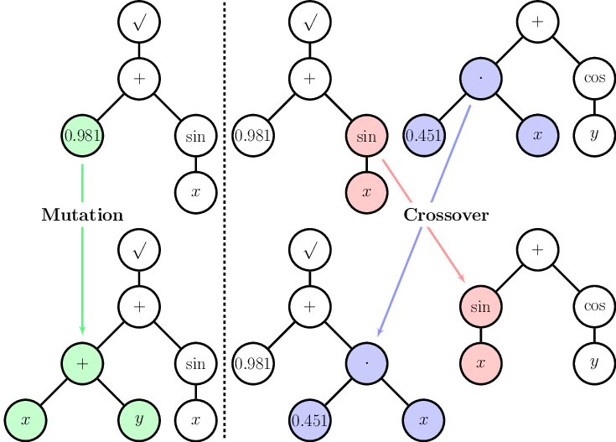
Genetic programming
Source: Quade, Markus & Abel, Markus & Shafi, Kamran & Niven, Robert & Noack, Bernd. (2016). Prediction of Dynamical Systems by Symbolic Regression. Physical Review E. 94. 10.1103/PhysRevE.94.012214.

Slide 17
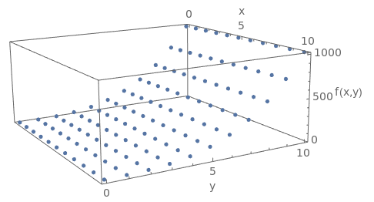
Genetic programming
Sample points to perform a symbolic regression

Slide 18
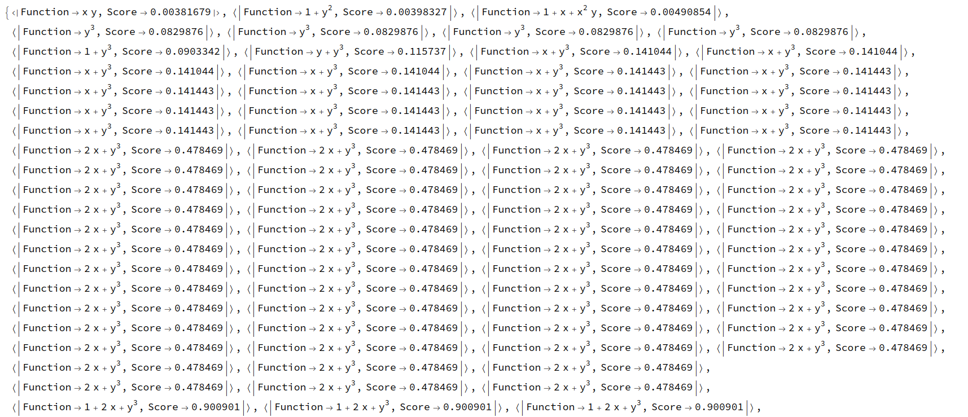
Genetic programming

Slide 19
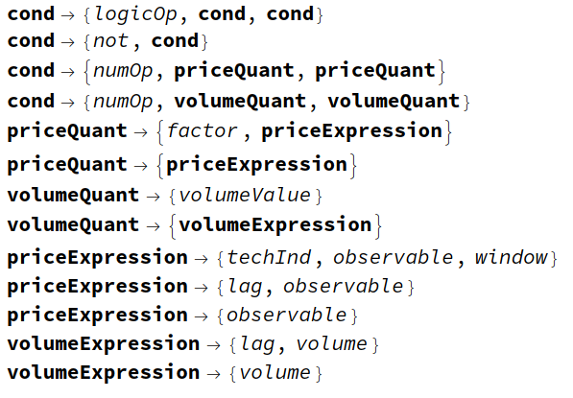
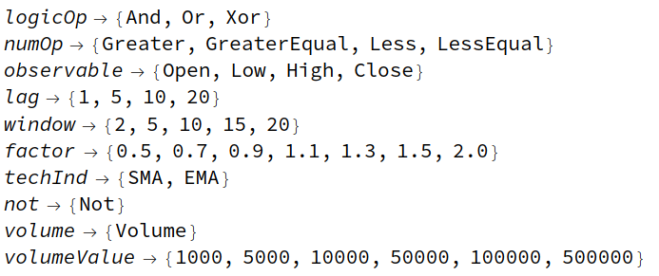
Grammar-based genetic programming
The closure property reduces the diversity of the function set.
A solution is to use a formal grammar that can express trading strategies.
And then we can evolve the population of strategies.

Slide 20
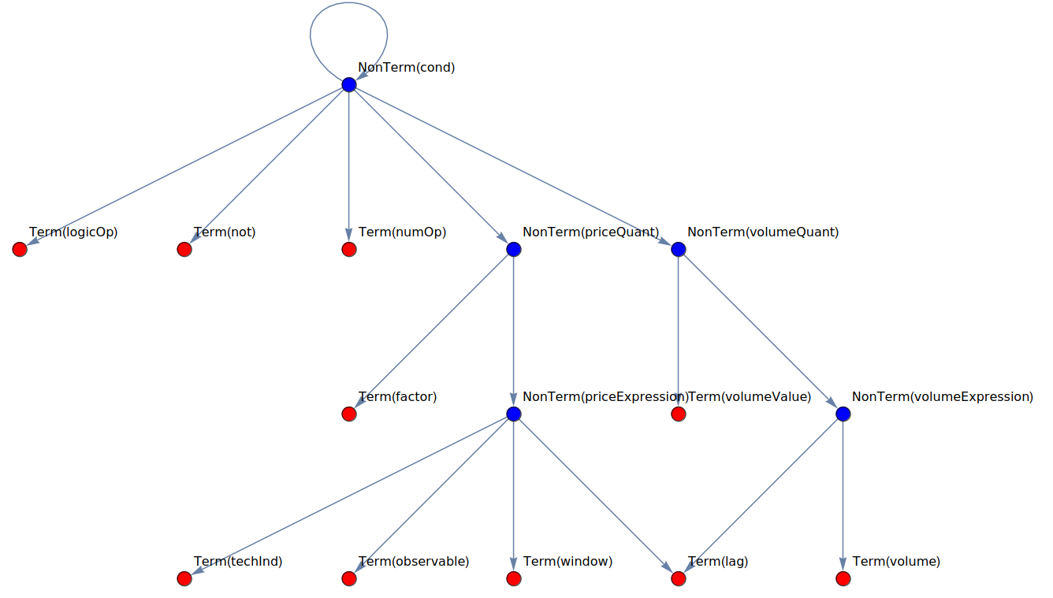
Grammar-based genetic programming

Slide 21
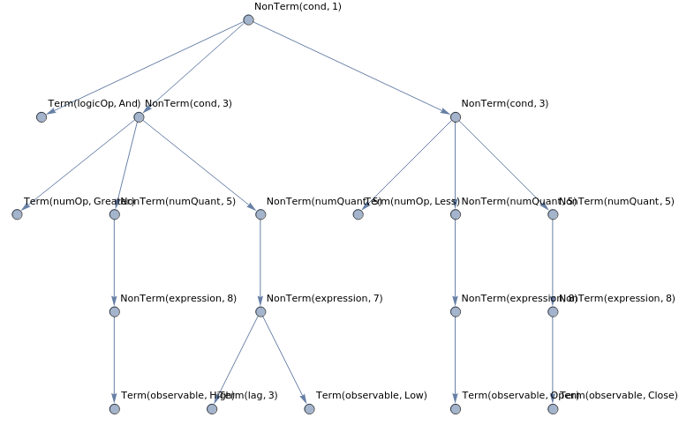
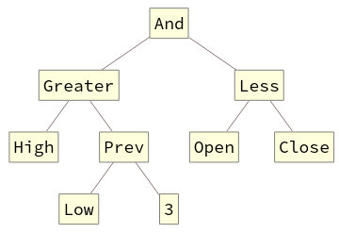
Grammar-based genetic programming
Parse tree
Abstract syntax tree

Slide 22
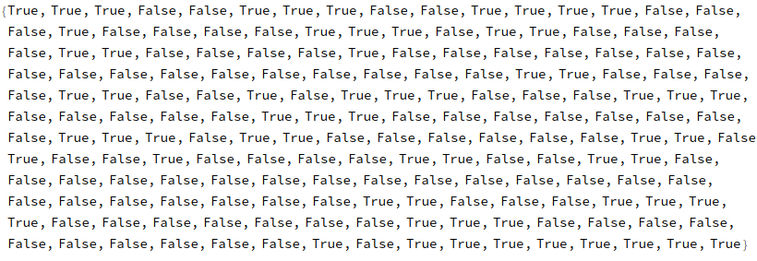
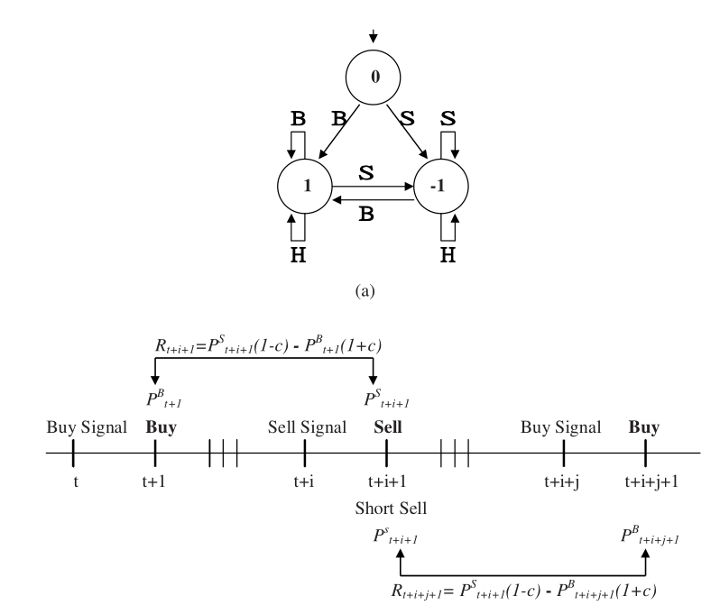
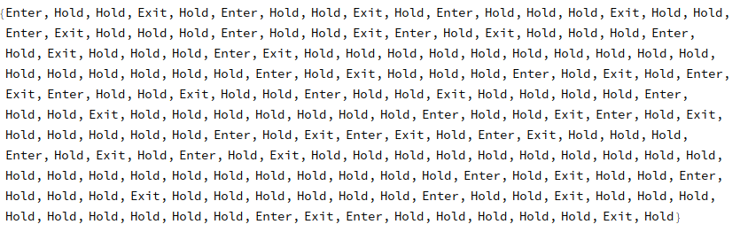
Execution of signals
Example signals:
Processed signals:

Slide 23
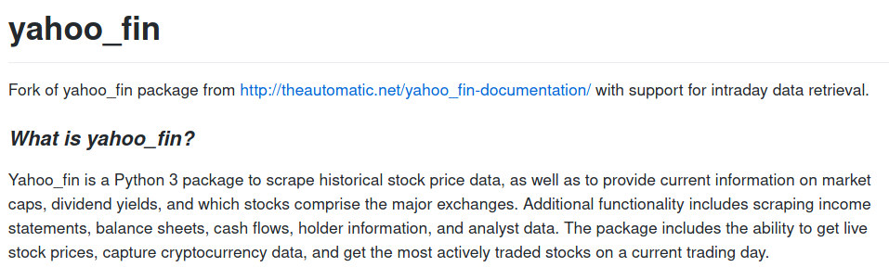
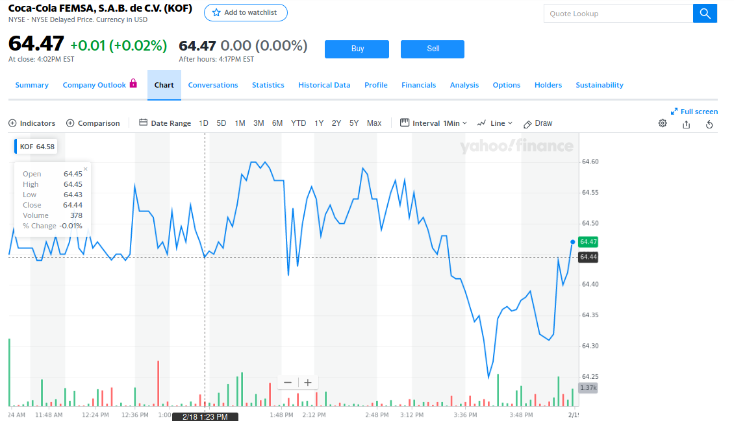
Dataset
Intraday data from the components of IPC was scrapped from Jan/20 to Feb/18. 1 minute frequency.
https://github.com/CarlosManuelRodr/yahoo-fin

Slide 24
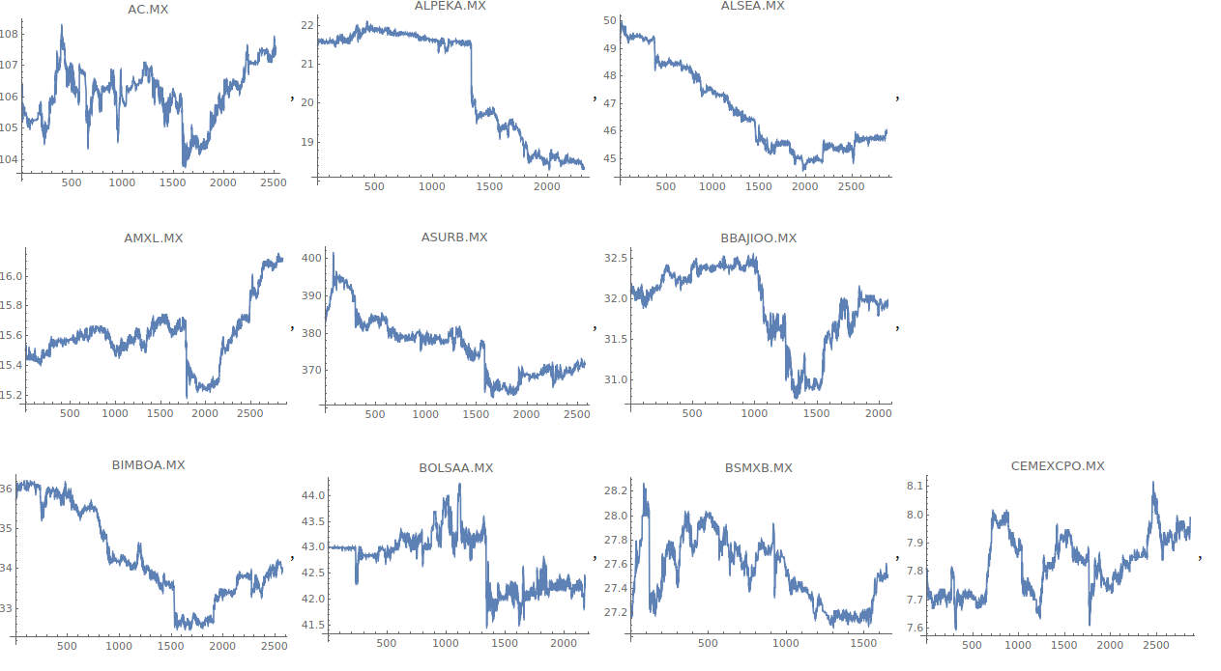
Dataset

