Slide 1
The Effectiveness of Federated Learning in Seismic Interpretation
Carlos Marí · Ghassan AlRegib · OLIVES, Georgia Tech
Notes:
Memorise this opening; look at the audience, not the screen.
'Federated learning promises a shared seismic interpreter that no one has to hand over their data for. Our paper asked whether it actually works. The answer was: not under real geography. Today I want to show you what we have learned since — including where we were wrong.'
TIMING: 15-17 min talk, green light until 5 min remain.

Slide 2
Train together.
Share no data.
Notes:
Sixty seconds of motivation. Seismic data is the asset; it does not leave the company. Federated learning trains one model across partners by exchanging weights, never traces. That is the promise we set out to test.

Slide 3
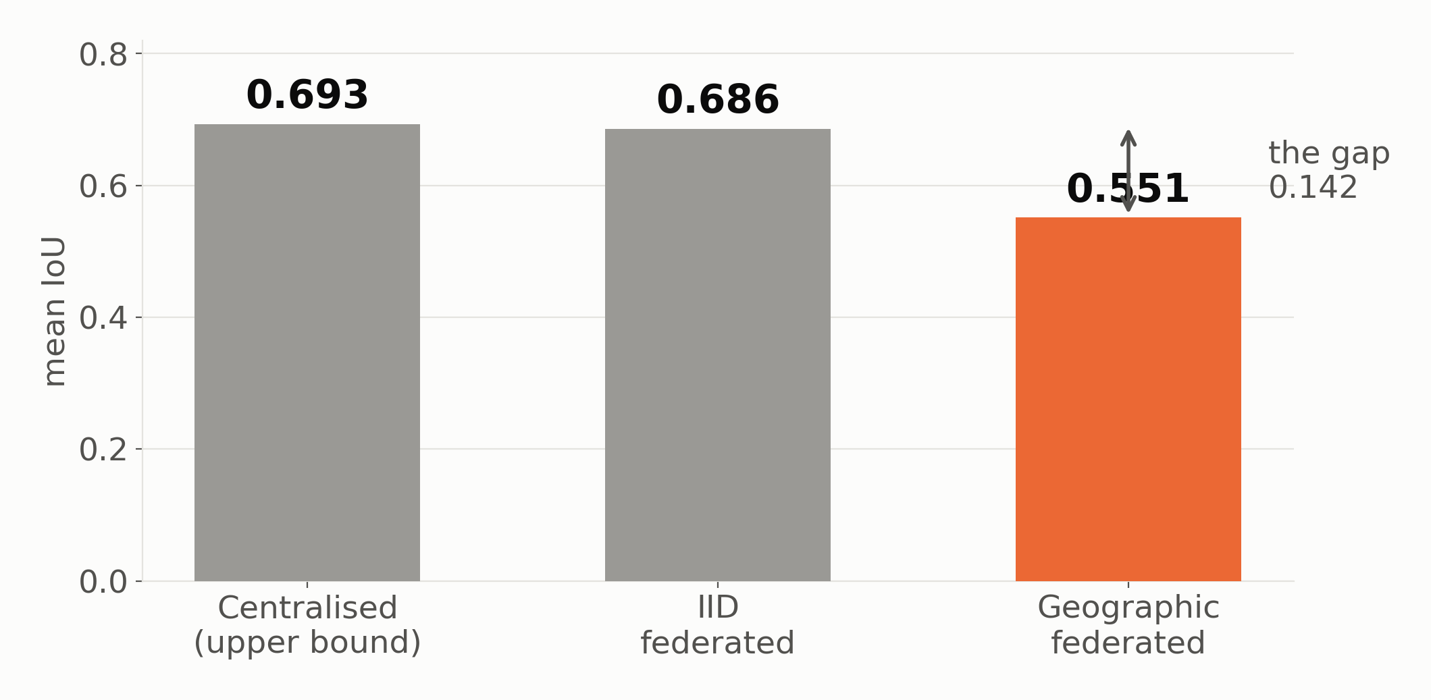
Real partners hold real geography
Shuffled data: federated learning works. Real geography: it does not.
Notes:
The setup that matters. Standard FL benchmarks shuffle data randomly across clients. Real partners each hold a contiguous region, so their facies distributions differ structurally.
Read the chart left to right: centralised is the ceiling at 0.693. Shuffle the data randomly and federated learning essentially matches it — 0.686. Partition it geographically, the way the world actually looks, and it falls to 0.551.
Parihaka and F3, six facies, UNet, up to 20 clients.

Slide 4
One facies went to zero.
Not degraded — absent.
Notes:
This is the paper's sharpest result and worth a pause. Class 5, the rarest facies, reaches exactly 0.0 IoU once you have five or more clients. Not merely poor: the model stops predicting the class at all.
Also worth stating: FedProx and FedBN, the standard fixes for client drift, made things worse — 1 to 12 percent. Plain FedAvg won. That tells you drift is not the problem.

Slide 5
The cause is absence,
not drift.
Notes:
The paper's conclusion. Most clients hold no pixels of the rare facies. Averaging their weights dilutes the few clients that do — so the class is not learned badly, it is erased. That is why drift-correction methods did not help.
This is the hinge of the talk. Everything after this slide is unpublished work asking: can that erasure be undone?

Slide 6
What we found since
Unpublished — submitted five months ago
Notes:
Signpost clearly and slow down here. Everything that follows postdates the submission.

Slide 7
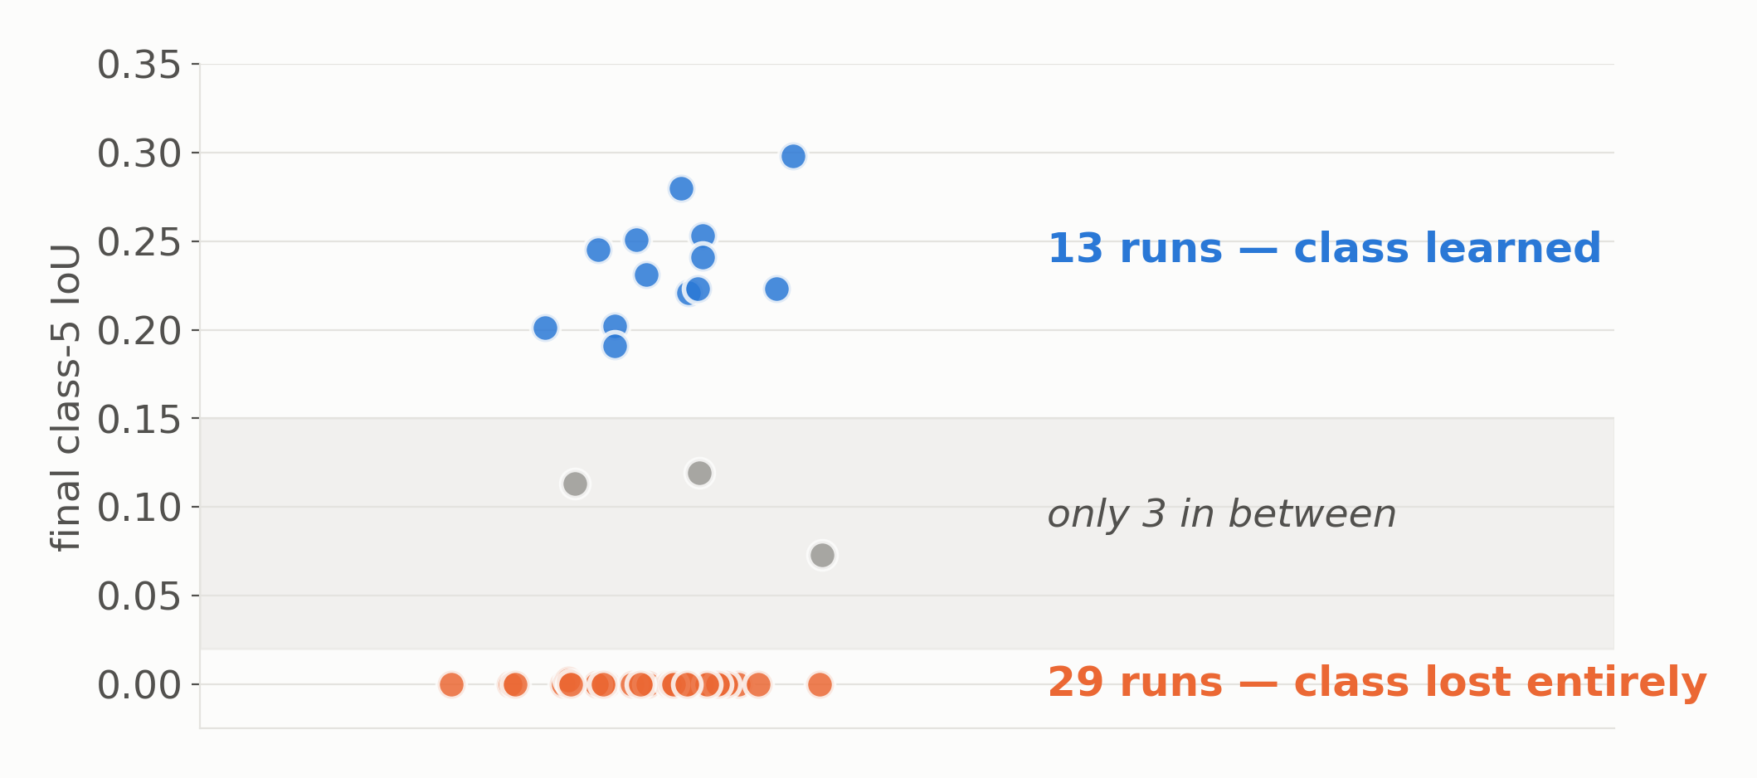
The failure is bimodal, not gradual
Same code, same data, different seed — opposite outcome.
Notes:
Our most interesting finding, and it reframes the problem.
Every dot is one training run — 45 of them. The rare facies either gets learned, around 0.2 to 0.3 IoU, or it collapses to exactly zero. Only three runs land anywhere in between.
This is not ordinary variance; it is two attractors. Same code, same data, different random seed, opposite outcome. Method choice shifts the PROBABILITY of the good basin — it never removes the bad one.
Implication: reporting a single run's number is close to meaningless here.

Slide 8
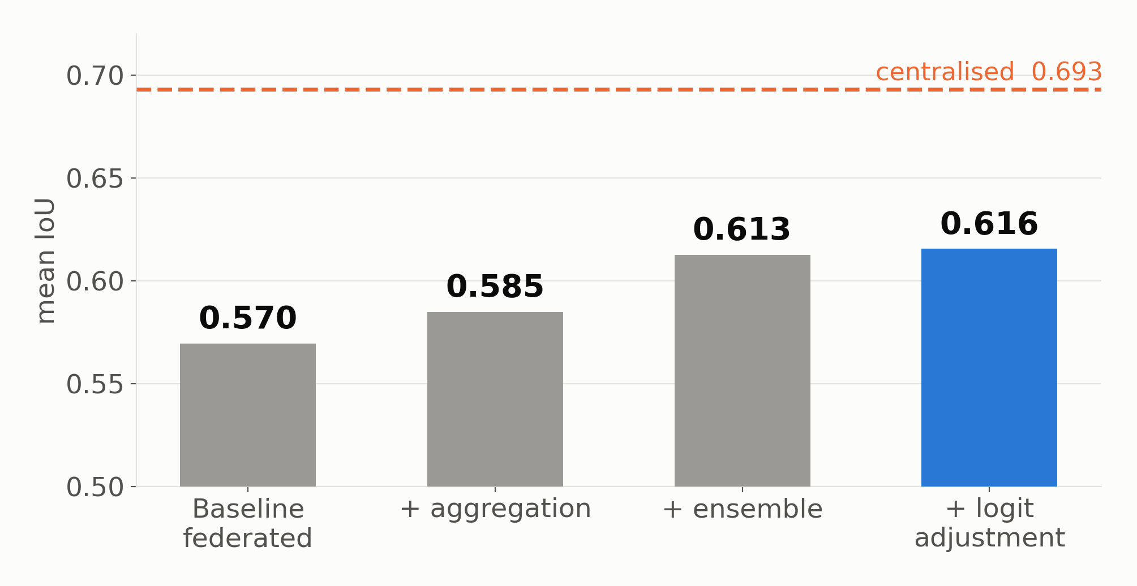
Recovering the gap, step by step
About 39% of the gap to centralised, recovered.
Notes:
Four levers, each isolated, cumulative left to right.
Aggregation: weight clients by how much rare-facies data they hold and how well they have learned it. Ensemble: average several seeds — which works precisely BECAUSE of the bistability we just saw; you are buying lottery tickets. Logit adjustment: a test-time correction, next slide.
Together they close roughly 39 percent of the gap to centralised. Be honest that the ensemble step costs five to ten times the training compute.

Slide 9
Subtract the class prior.
Three lines. No retraining.
Notes:
Logit adjustment — MetaFusion, Chan 2019; Menon 2021. At inference, before the argmax, subtract tau times the log class prior from the logits. Frequent classes are penalised, so rare classes win more pixels.
Three lines of code. No retraining. Works on any checkpoint you already have.

Slide 10
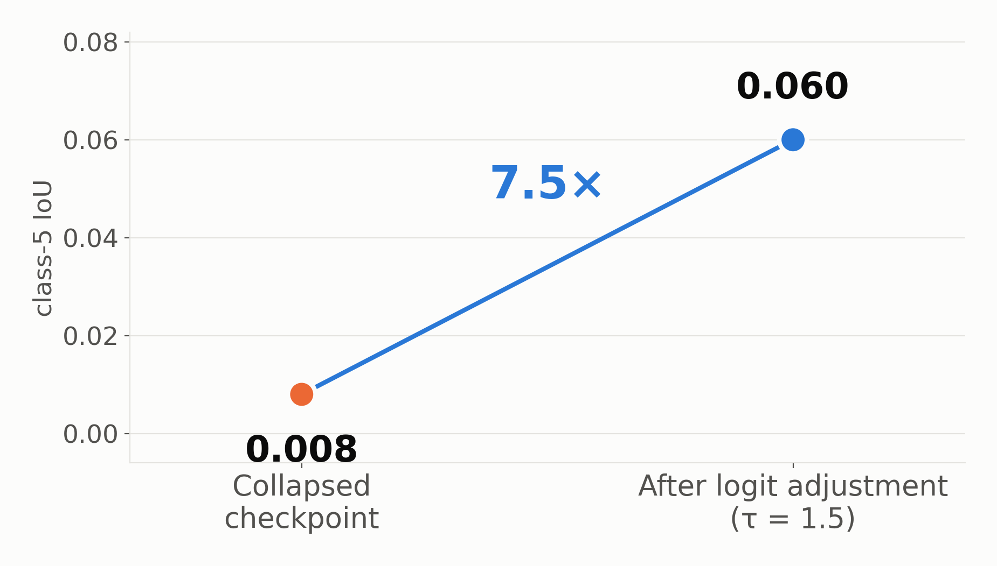
A collapsed facies, brought back
The published failure is partly reversible — for free.
Notes:
THE money slide. Say the numbers slowly, then stop talking for a beat.
This is a checkpoint that had completely lost the rare facies — 0.008 IoU, effectively zero. One line of inference-time arithmetic brings it to 0.060. Seven and a half times. And mean IoU improves slightly at the same time, so it is not a trade.
The headline failure from our paper is partly reversible, at zero training cost.

Slide 11
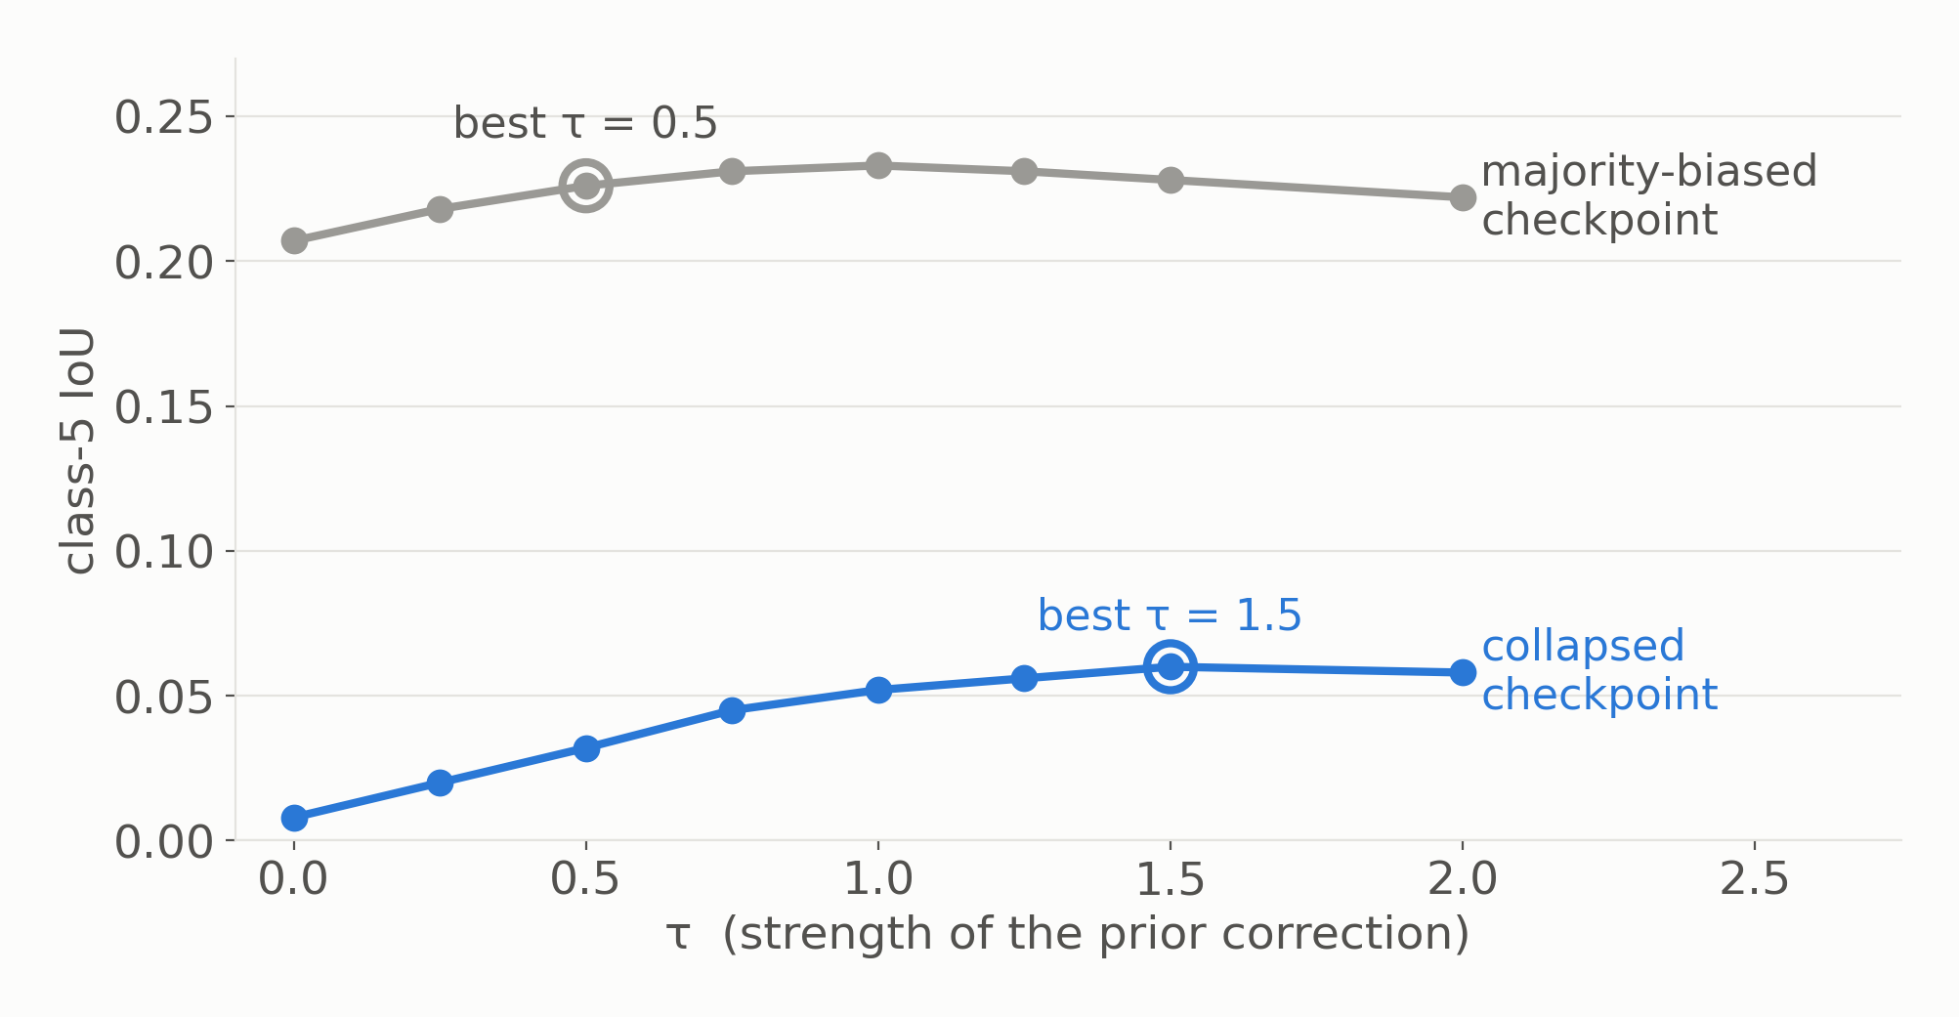
How hard to push depends on the model
Gentle for a healthy model. Aggressive for a collapsed one.
Notes:
Important nuance, and it is what makes this a finding rather than a trick.
Tau is not a constant. On a checkpoint that is merely majority-biased, a gentle correction — tau 0.5 — is best. On a checkpoint where the class has collapsed, you need tau 1.5. Push a healthy model that hard and you damage it.
Practically: pick tau on a single held-out crossline. Essentially free.

Slide 12
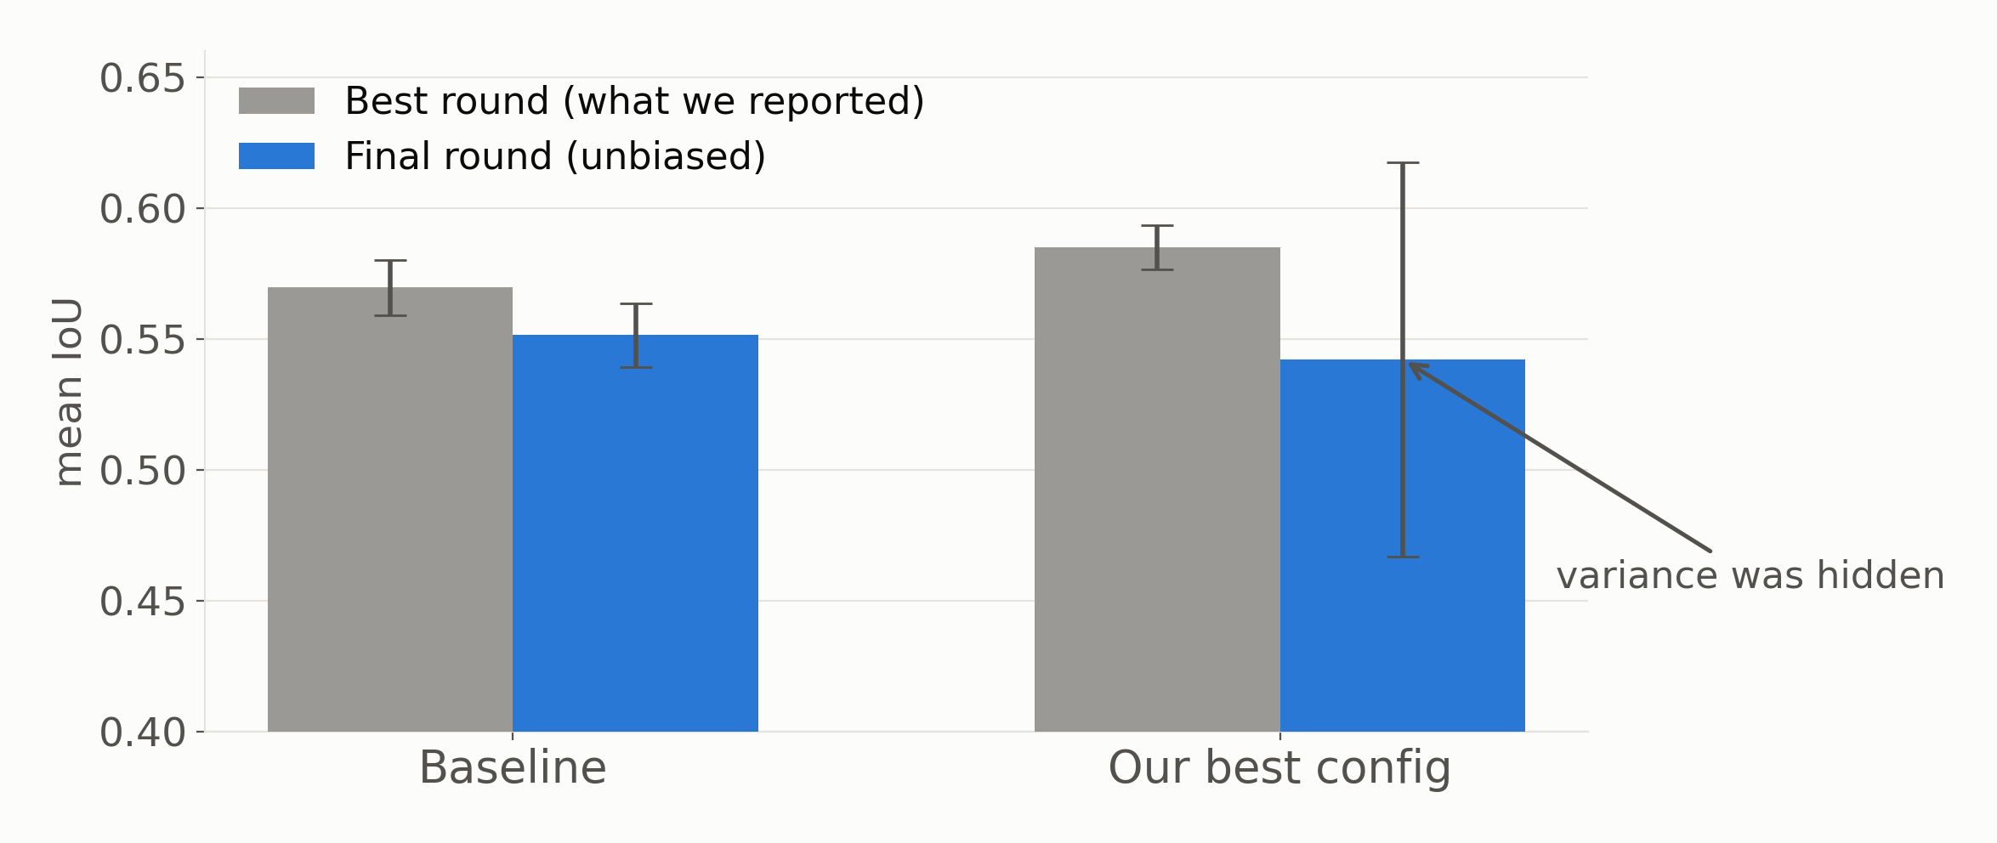
Where we had been fooling ourselves
Our “most stable” configuration was the least stable.
Notes:
Deliberate credibility slide. Volunteering this is far stronger than being asked it in Q&A.
We were saving the best round by test mIoU and reporting that number. That is optimistic — and, worse, unequally so: plus 0.018 for the baseline, plus 0.043 for our own best configuration.
Corrected to final round, two of our claims flip. Our 'most stable' configuration is actually the least stable — one seed ends at 0.39 — and a simpler variant beats it.
Say plainly: this is what the bistability does to anyone who reports a single best number, us included.

Slide 13
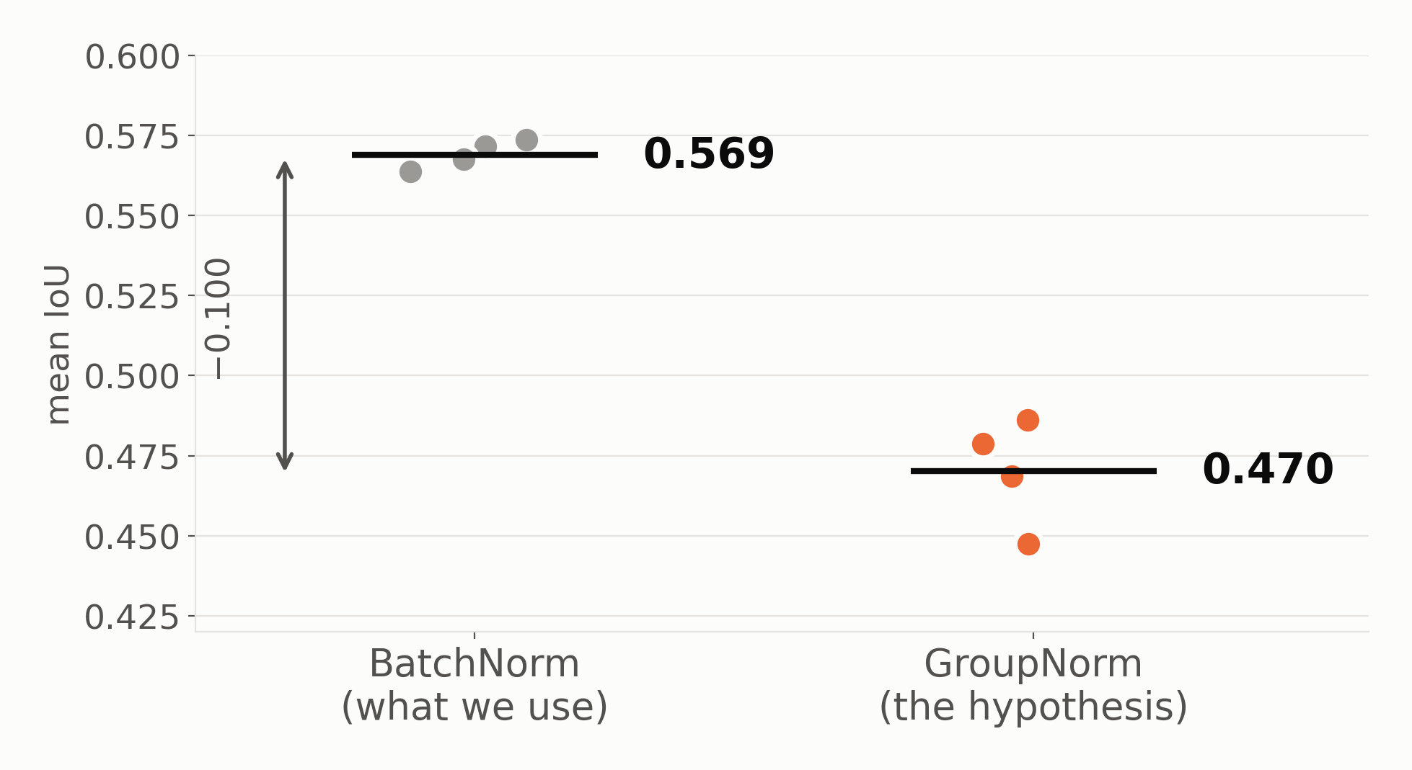
It is not the normalisation
We tested the obvious fix directly. It is not the answer.
Notes:
A negative result, and a useful one — it answers the obvious question about our own paper.
The hypothesis was reasonable: BatchNorm keeps running statistics fitted to each client's own data, and we average them across clients. That is a documented failure mode under non-IID conditions, and it would neatly explain why FedBN did nothing for us.
So we tested it directly — GroupNorm, which has no cross-client statistics, everything else identical. It is a tenth of an IoU WORSE, every seed, no overlap between the two sets. And it does not rescue the rare class either.
Why: our clients all hold slices of one survey, so the low-level statistics — amplitude, texture, frequency — are shared. BatchNorm exploits that. The non-IID-ness here is in WHICH FACIES APPEAR, not in the input distribution. That is the distinction the FL literature does not make.
So: normalisation is not the lever. The absence of data is still the problem.

Slide 14
Three things to take away
Geography breaks federated seismic learning
Rare-class failure is bistable, not noisy
Part of the damage is reversible for free
Notes:
Tell them what you told them.
One: the realistic setting, not the benchmark setting, is where federated learning breaks.
Two: rare-class failure is an attractor problem, not a variance problem — which changes how anyone should report results here.
Three: some of the damage undoes at inference, for free.
Then invite questions.

Slide 15
Thank you
Questions?
Notes:
Anticipated questions:
- 'Which mIoU?' Macro, unweighted, six classes.
- 'Why did FedBN fail?' We tested it directly: GroupNorm is 0.10 IoU worse. Normalisation is not the lever — see that slide.
- 'Did the rare-class aggregation help?' Honestly, no. Against a proper equal-weight control at n=5 it is within noise (0.5695 vs 0.5688).
- 'What does ensembling cost?' 5-10x training. Logit adjustment is free by comparison.
- 'Does this hold on F3?' New results are Parihaka only so far; F3 is next.
- 'How do you pick tau without test data?' A held-out crossline from training.
- 'Is the bistability a bug?' We looked. Same code and data, seed alone flips it — it is the optimisation landscape.

