Slide 1
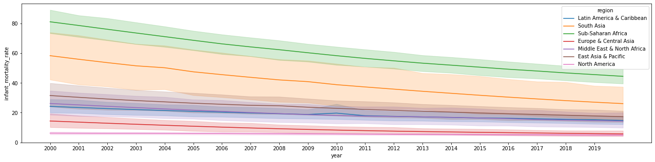
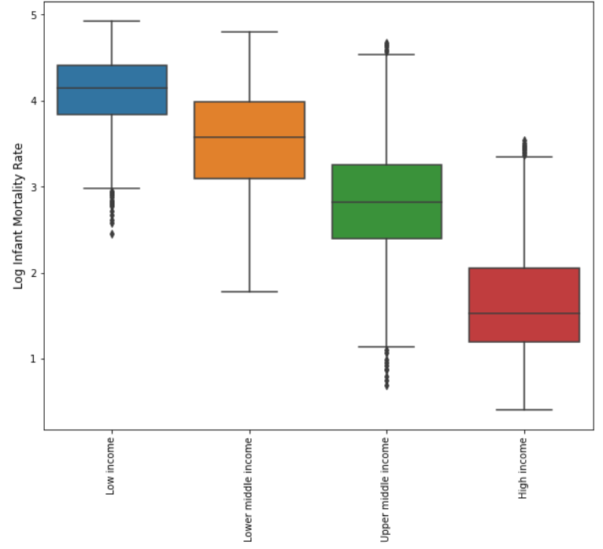
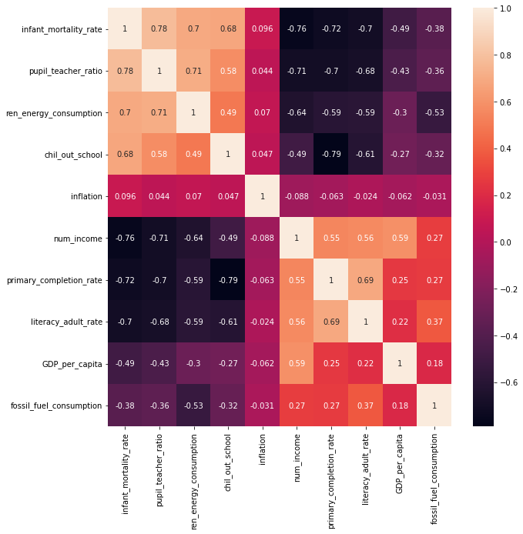
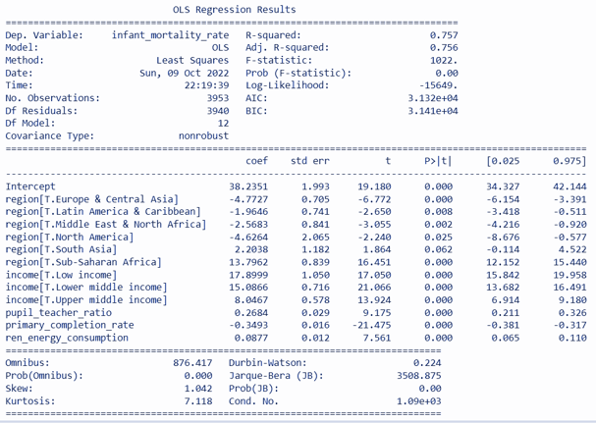
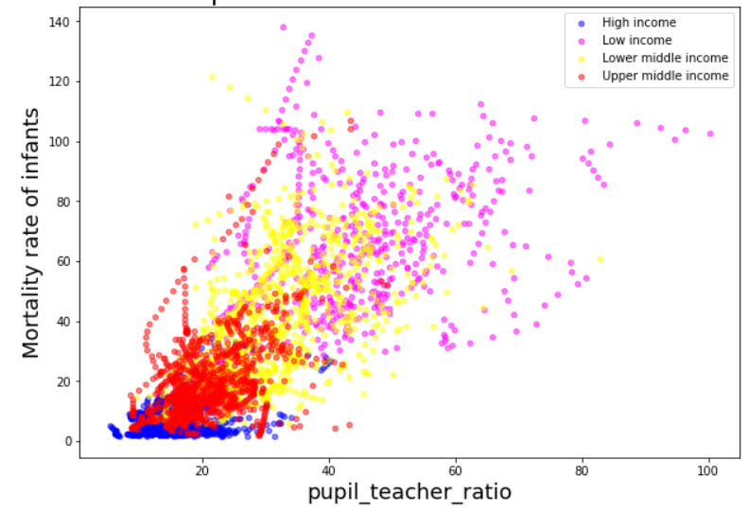
Impact of Economic Growth and Education in Infant Mortality in the 21st Century
Carlos Chávez, Yohana Sandoval, Daniel Durán, Elder Giraldo, Fernán Marsiglia, Juan Álzate, Marta Ordoñez.
Background
Data Analysis
Highlights
Economic growth and education may reflect the effects of other socio-economic variables that may also be related to mortality. For this reason, it is important to conduct comprehensive and interdisciplinary analysis that consider as much information as possible. Such information can be relevant to governmental decision-making on the direction of each country and/or region. This can enable the design and implementation of public policies aligned with the needs of the population and the objectives and goals of sustainable development
Infant Mortality by income
The correlation matrix revealed that:
The most positive correlation about Infant mortality rate is the pupil-teacher ratio [+0.78]
The most negative correlation about Infant mortality rate is income [-0.758]
There is a variant of this model that considers hierarchies between the variables, where it can be said that the value measured (for example, schooling) depends on the country and the year and is not totally independent as assumed in the linear model.
Data
2000------------------21st Century--------------2020
The linear diagram shows a general trend towards the decreasing of the mortality rate through time for all regions. Sub-Saharan Africa and the South of Asia, show higher mortality rates than the other regions.
Infant
Mortality
Rate
Economic variables around the world
Education variables around the world
Correlation Matrix
World Bank Open Data
Data Curation
Merging & EDA
The box plot revealed that there is a clear inverse relationship between income and infant mortality rate
Recommendations
A clear relationship can be observed between infant mortality and the income level of a given country or region. Infant mortality could be seen because of the lack of investment in the field of education, in turn due to lack of capital, corruption, lack of political will or different factors that can influence this decision.
Although, the infant death ratio for each country does not depend exclusively on the number of teachers per certain number of students, governments around the world are encouraged to improve this figure as a sample in addition to greater investment in childhood.
It is proposed to carry out a generalized linear mixed models (GLMMs) that has been seen to be more adequate for the data and the question that this project wanted to solve.
Relationship between pupil-teacher ratio and infant mortality
Model
Acknowledgements
The scatter plot revealed that high and upper-middle-income countries have a low mortality rate, while low and lower-middle-income countries have high mortality rates
Infant mortality is inversely proportional to the income level of the country or region. In turn, the countries or regions with the highest pupil-teacher ratio tend to reduce the cases of infant mortality.

