Slide 1
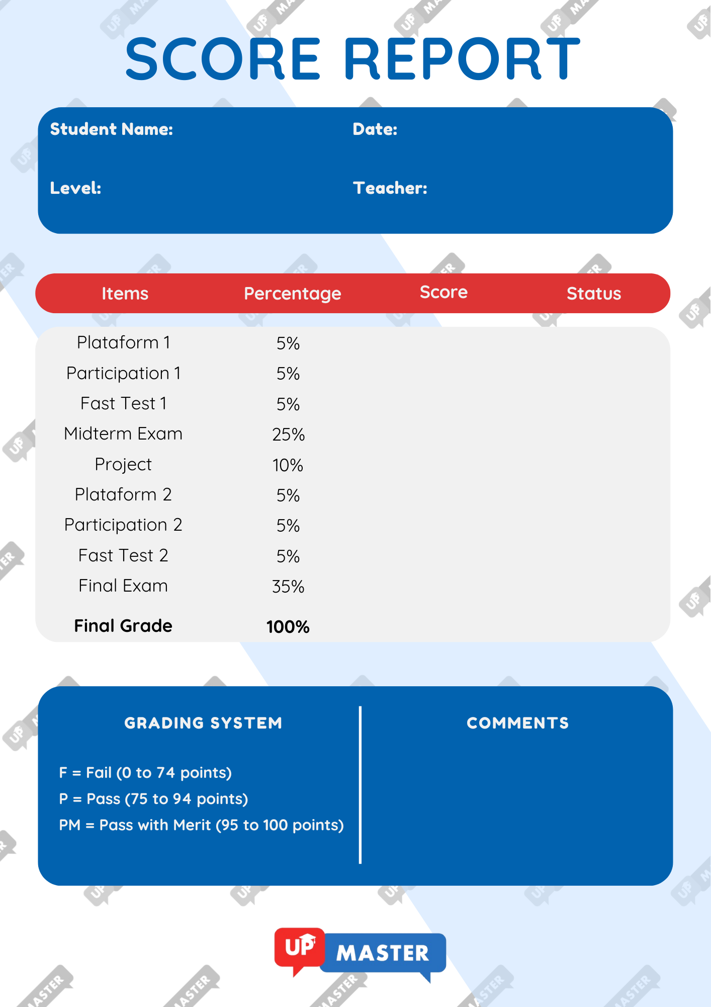
{student}
{date}
{level}
{teacher}
{platform_01} {participation_01} {fast_test_01} {midterm} {project} {platform_02}
{participation_02} {fast_test_02} {final_exam}
{final_grade}
Fail / Pass
{comments}

