Slide 1
MIDTERM – CARLOS OLIVELLA (CEO5302)

Slide 2
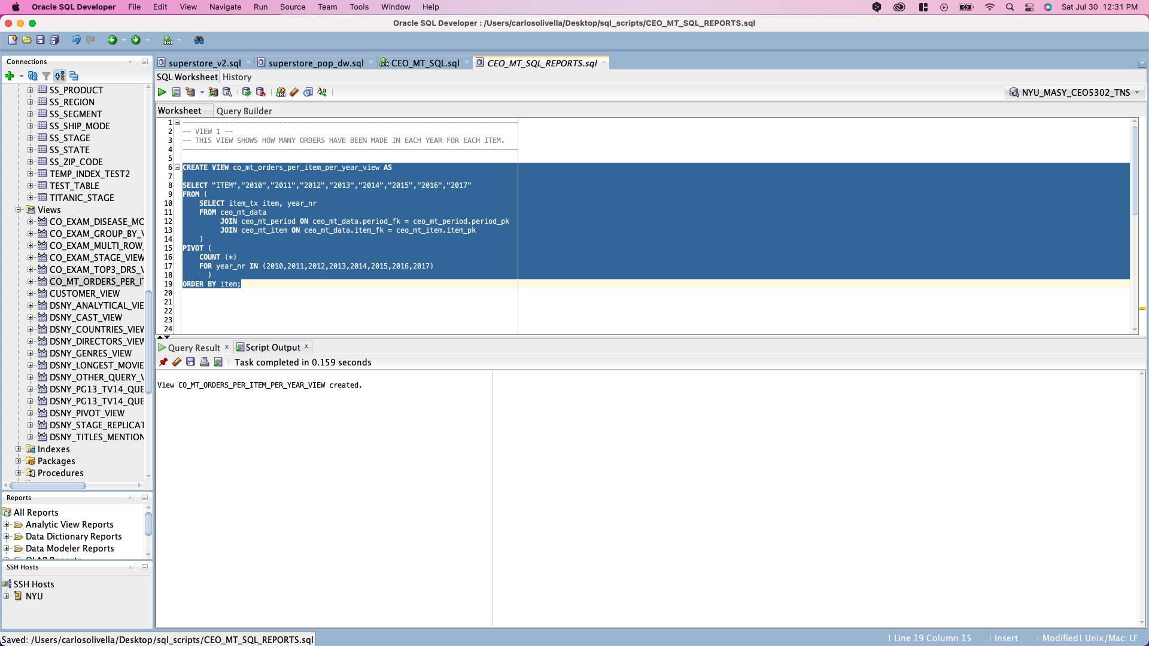

Slide 3
ITEM | 2010 | 2011 | 2012 | 2013 | 2014 | 2015 | 2016 | 2017
Baby Food | 10 | 12 | 8 | 14 | 14 | 12 | 16 | 1
Beverages | 11 | 16 | 14 | 17 | 18 | 9 | 9 | 7
Cereal | 10 | 6 | 13 | 8 | 14 | 13 | 8 | 7
Clothes | 12 | 12 | 14 | 7 | 7 | 14 | 7 | 5
Cosmetics | 10 | 10 | 7 | 8 | 13 | 8 | 11 | 8
Fruits | 12 | 13 | 8 | 10 | 7 | 5 | 10 | 5
Household | 8 | 5 | 11 | 15 | 13 | 9 | 12 | 4
Meat | 9 | 10 | 14 | 9 | 14 | 7 | 9 | 6
Office Supplies | 10 | 11 | 8 | 13 | 12 | 17 | 12 | 6
Personal Care | 17 | 11 | 11 | 13 | 5 | 11 | 12 | 7
Snacks | 15 | 8 | 16 | 15 | 10 | 5 | 6 | 7
Vegetables | 16 | 7 | 17 | 8 | 19 | 13 | 11 | 6

Slide 4
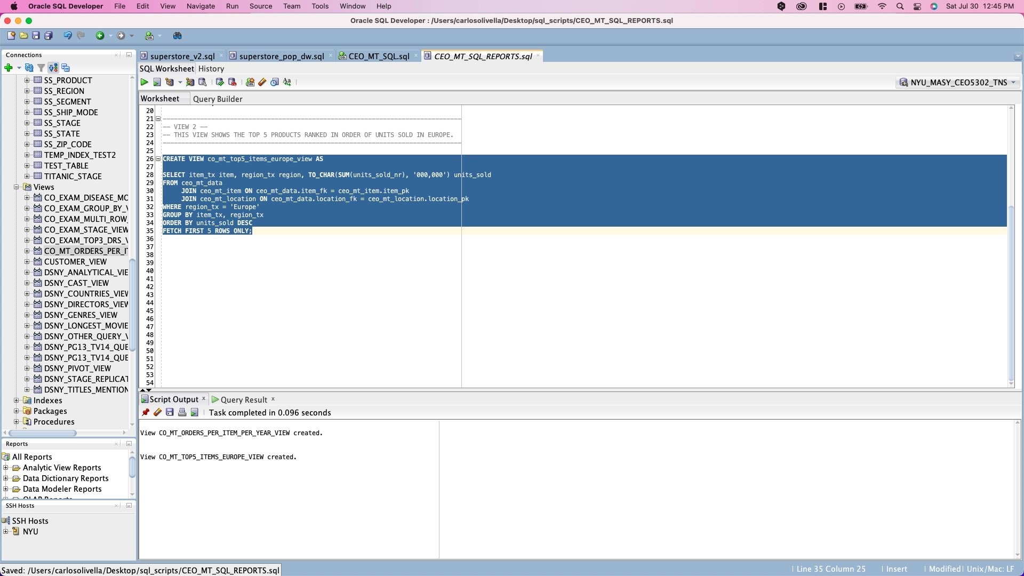

Slide 5
ITEM | REGION | UNITS_SOLD
Office Supplies | Europe | 137,140
Baby Food | Europe | 129,003
Vegetables | Europe | 126,028
Snacks | Europe | 125,661
Beverages | Europe | 124,509

Slide 6
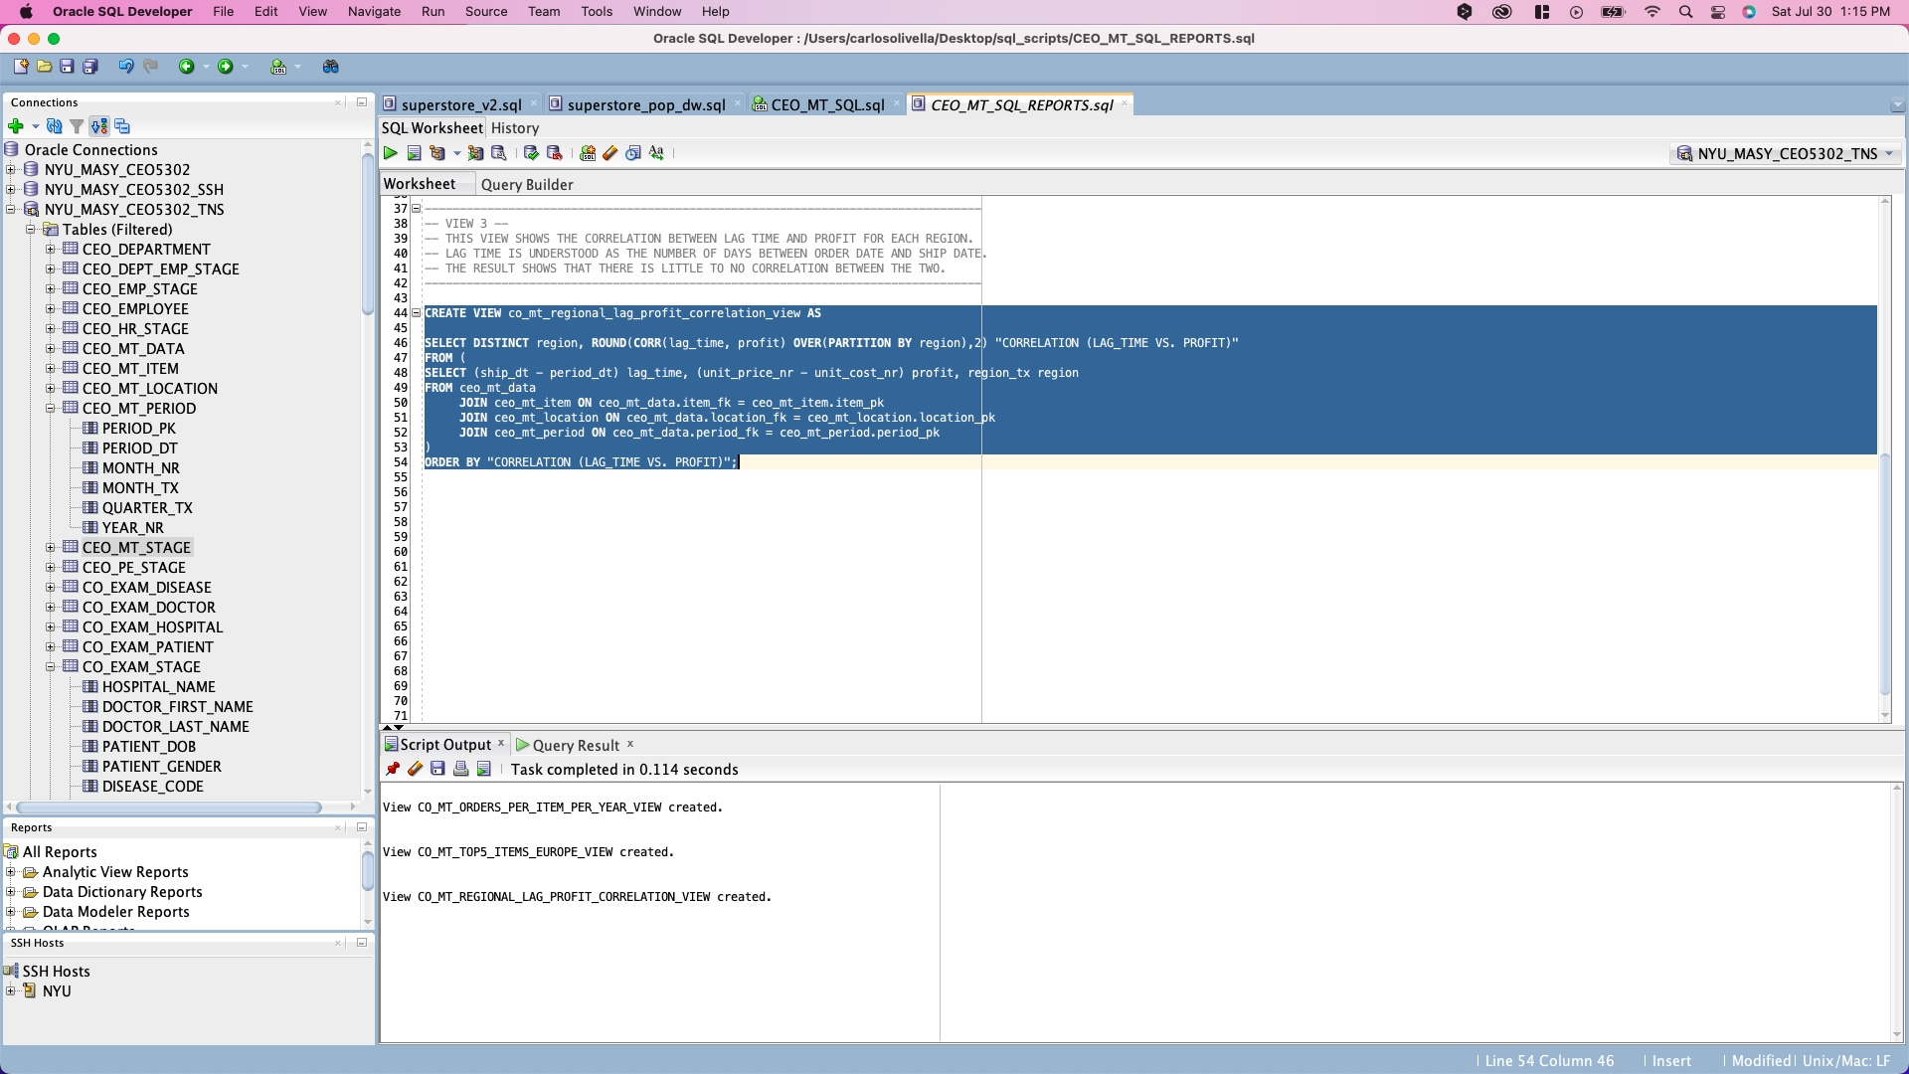

Slide 7
REGION | CORRELATION (LAG_TIME VS. PROFIT)
Central America and the Caribbean | -0.17
Middle East and North Africa | -0.06
Australia and Oceania | -0.04
Europe | -0.04
Asia | -0.02
Sub-Saharan Africa | 0.03
North America | 0.23

Slide 8
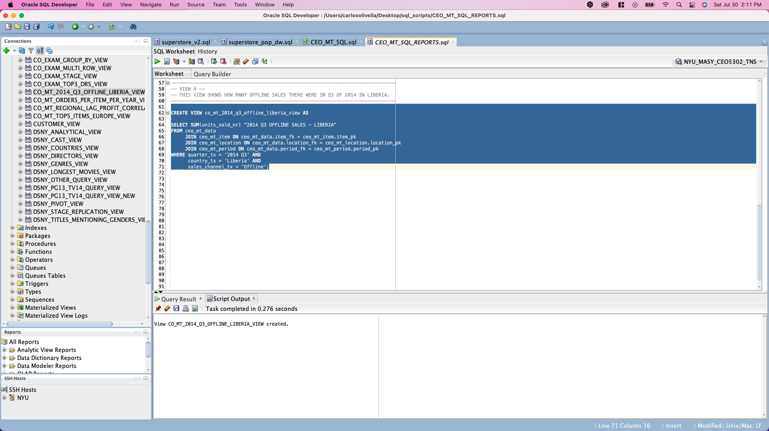

Slide 9
2014 Q3 OFFLINE SALES - LIBERIA
4828

Slide 10
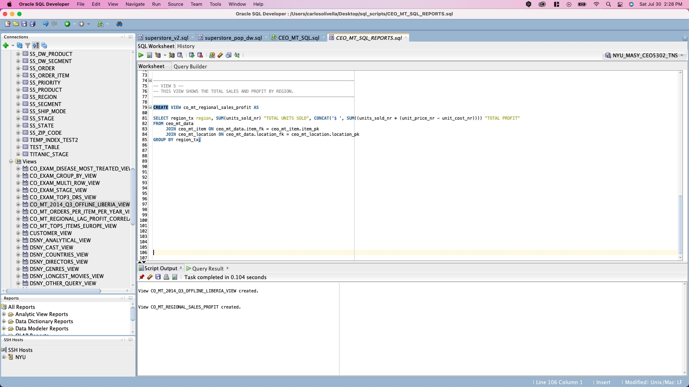

Slide 11
REGION | TOTAL UNITS SOLD | TOTAL PROFIT
Asia | 677524 | $ 50799399.1
Europe | 1285808 | $ 106771968.45
Central America and the Caribbean | 503362 | $ 41336778.21
Australia and Oceania | 417298 | $ 31878420.73
Middle East and North Africa | 682363 | $ 51056993.34
Sub-Saharan Africa | 1386894 | $ 101650992.46
North America | 100739 | $ 7708059.27

