Slide 1

Development of an Embedded Communication Hub for the Acquisition of Sensor Data in a Robotic System
Research Project and Seminar Juan Carlos Reyes Andrade, ICS

Slide 2
Contents
Background:
RTE Networks, IIoT, EtherCAT
Objectives summary
Layered structure of solution
Implementation:
DSMs and RTOS
Results:
Successful EtherCAT transaction
PCB
Conclusions and further work
Questions
2
Notes:
Roadmap: Important to mention:
-Layered structure of the proposal
-Modular, it is not structured programming
-Advantages for further development, debugging, maintenance, structure, understanding.
-Scheduling tables >>
-RTOS scheduling (prioritization-round robin for same priority) -Show at least two state machines:
-Mealy and the Moore SMs + UPPAAL representation
-SOES and the ECAT SM
-RTOS tools used for synchronization of the State Machines -Event Handler
-Different Events and how the information is passed
-PCB 3d >> PCB physical, the PRE-OPERATION-OPERATION
Conclusions:
-Personal growth:
-Working with extense/complex libraries
-Getting to know one of the protocols aimed for open source, hard RT capable
-Summarizing information
-Abstraction and understanding of several resources(only for the standard there are 6 specifications, for ESI is another specification, 2 datasheets MCU+LAN9252 and theory behind the justification)
-Framework, starting point, flexible, understandable, “formal” multitasking approach
-Advantages of using CMSIS-Abstraction layer for multiple RTOS
-Modules depending on further applications
-Response for the Industrial Internet of Things, less gateways, anywhere, anything, anytime
-Response to EDGE computing ---- Neuronal Networks
-In the last years some topics have been open for development -Process data on the edge, standard solutions in low-cost hardware
-CMSIS NN, UNIKERNELS, dockers and unikernels are suited for microcomputers
-Any application over a standardized industrial communication protocol
-Safety applications: CMSIS to multicore mcus, synchronization, redundancy on the programming + FSoE >> opens the gate for certification

Slide 3
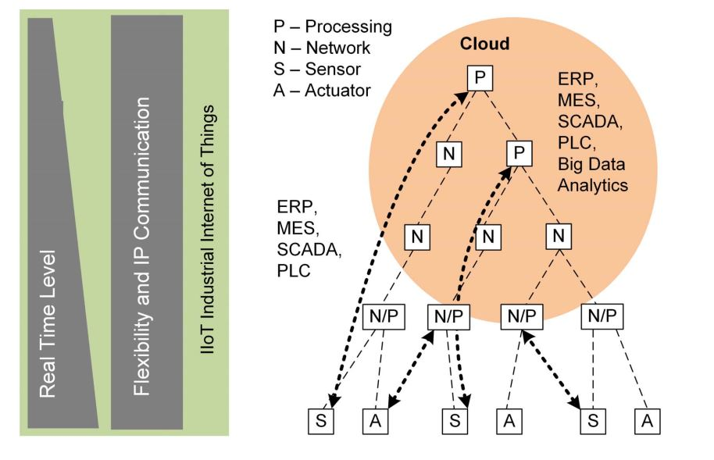
Background: RTE Networks, IIoT
ISO/IEC/IEEE 8802-3:2015, IEC 61158:1999-2000, IEC 61784-Part 2:2008, IEC/IEEE 60802
Interoperability, less gateways
Direct device access through layers, reliable protocols
Industry 4.0 a flexible automation structure. Industrial Internet of Things, source from [SKJ18]
3
Notes:
anywhere, anything, anytime

Slide 4
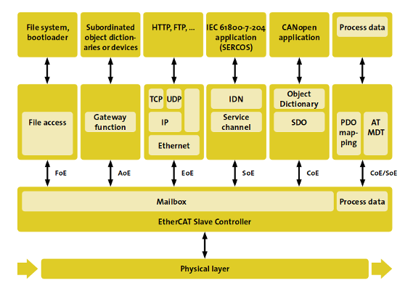
Background: EtherCAT
Open industrial protocol application fields
Industrial: [MGSR20] and [Nor20]
Control loops in robotics: [XJY11] and [DC17]
Real Time Robot Software Platforms: [DC17] and [MHF+20]
Different communication profiles can coexist in the same system. Source from [Bec20b]
4

Slide 5

Objectives summary
“Develop a device using open-source tools to read out sensor data from a robot axis that can be interfaced with an RTE Network.”
Integrating CMSIS-FreeRTOS with SOES library (Open-source tools)
Reading out of axis temperature sensors
Controlling the axis LED Ring (WS2812b)
To design and manufacture a PCB
5

Slide 6
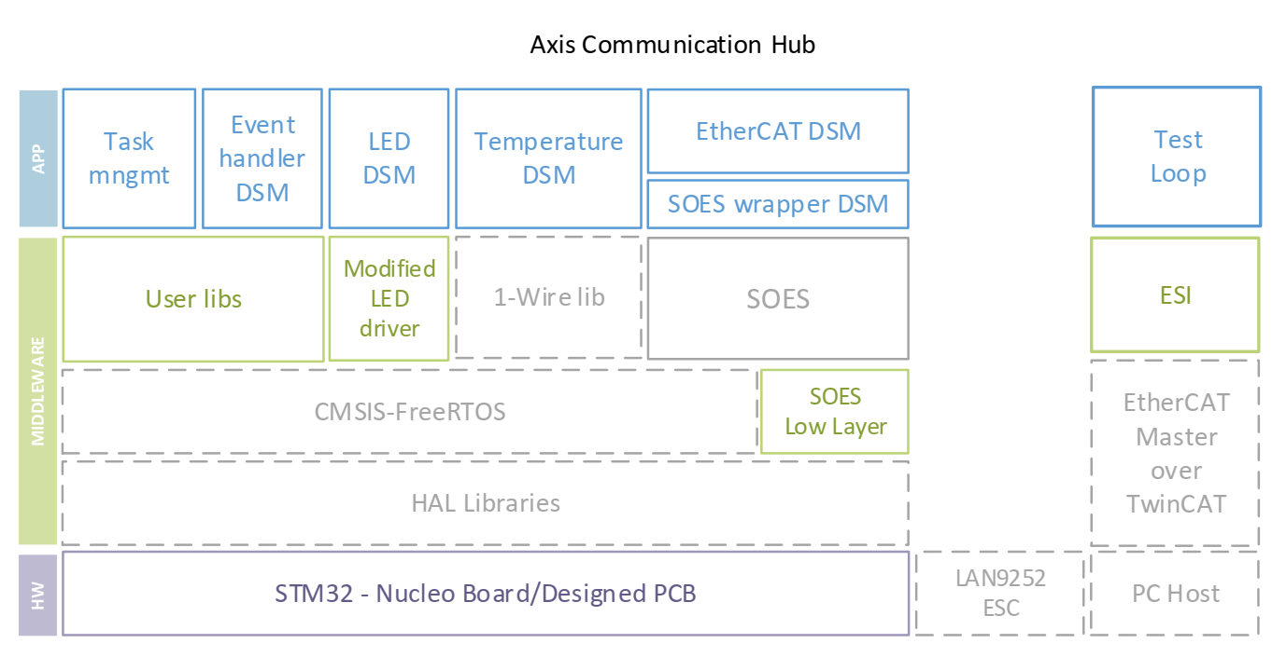
Layered structure of solution
Layered structure of functional blocks: modular, flexible, open source tools
Highlighted the most relevant in this implementation
6
Notes:
LAN9252 is the ESC

Slide 7
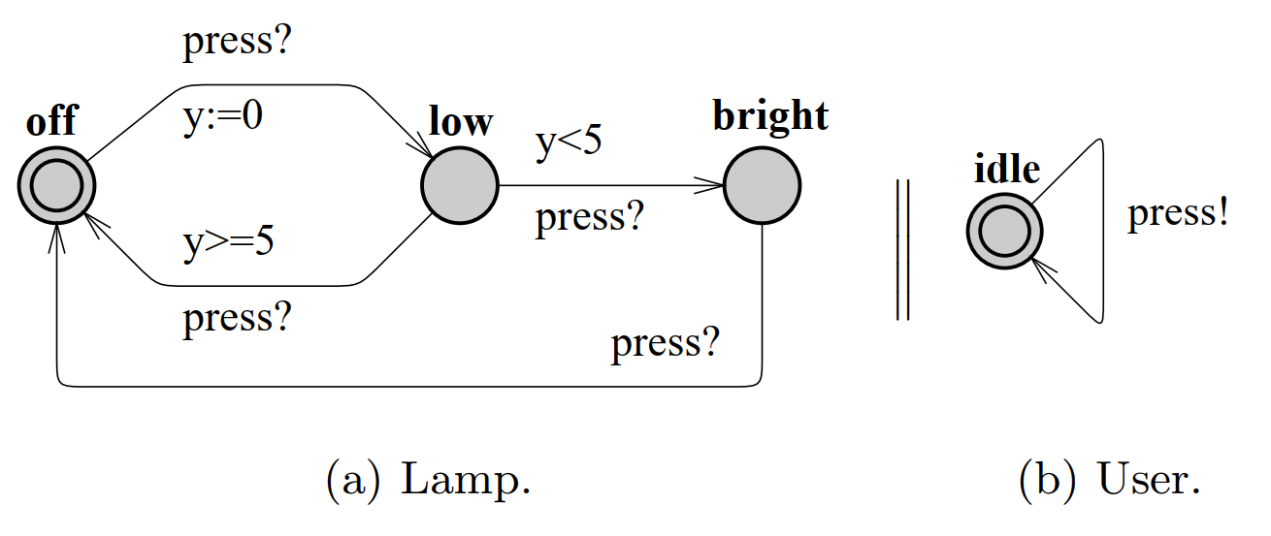
Implementation: background
Each upper functional block as DSM
Considerations:
Moore and Mealy State machine representations.
Synchronization channel as in UPPAAL 4.0.
The lamp example. From [BDL06]
7
Notes:
Moore and Mealy State machine representations:
Mealy: Output/actions dependent on the state and inputs, actions represented on transition
Moore: Outpurs/actions only depend on the state and are represented inside the same state
Timed automaton (pl) – Finite State Machine with extended clock valuations. UPPAAL is software dedicated to verification of RT systems
--Mainly used for verification of the automaton and their safety, liveness or reachability prorperties.
-Synchronization channels are implemented as global variables that are accessible over different timed automaton.
?! Symbols implemented

Slide 8
Layered structure
8

Slide 9
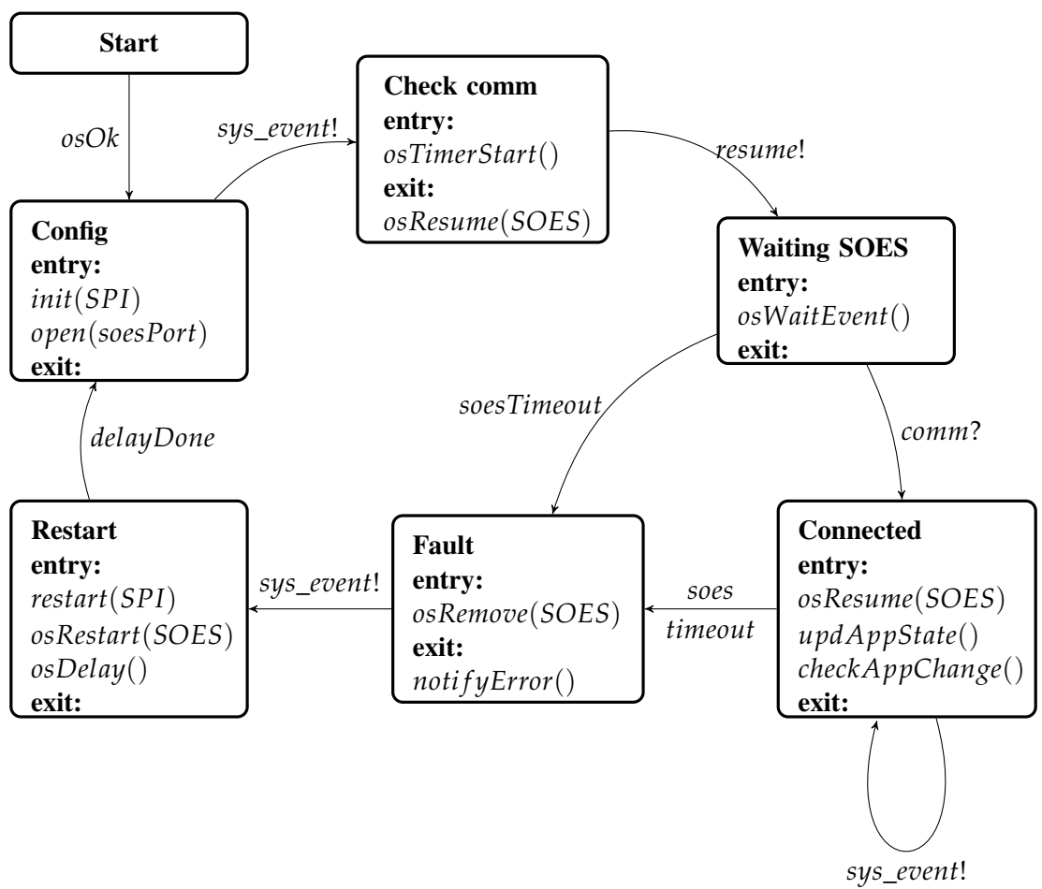
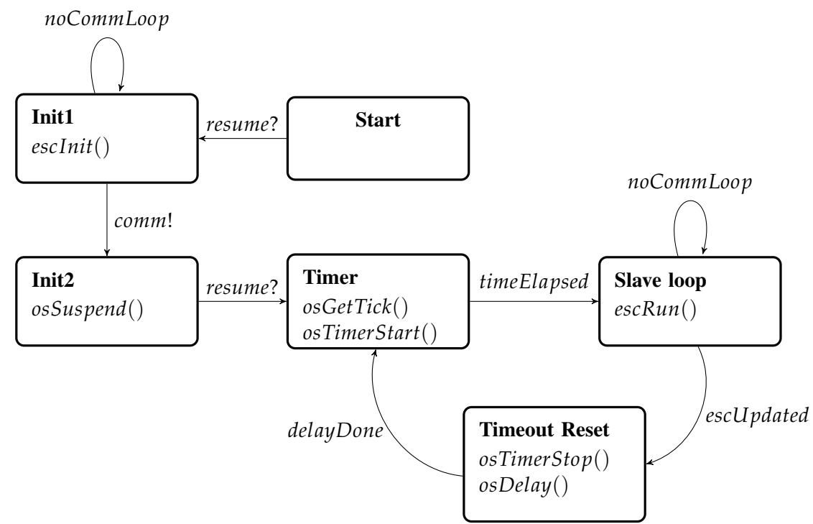
Implementation: DSMs I
SOES implementation
9
Notes:
SOES >> library that only provided an example with LAN9252 and LINUX -SOES app modified to be a very simple SM -SOES synchronization SM -osFunctions, namely Time Management functions provided by OS, virtual timers

Slide 10
Layered structure
10
Notes:
Explain the interaction of the DSMs as functional blocks within the system.
Rather a practical approach in the representation of the State Machines Go directly to the ECAT+SOES

Slide 11
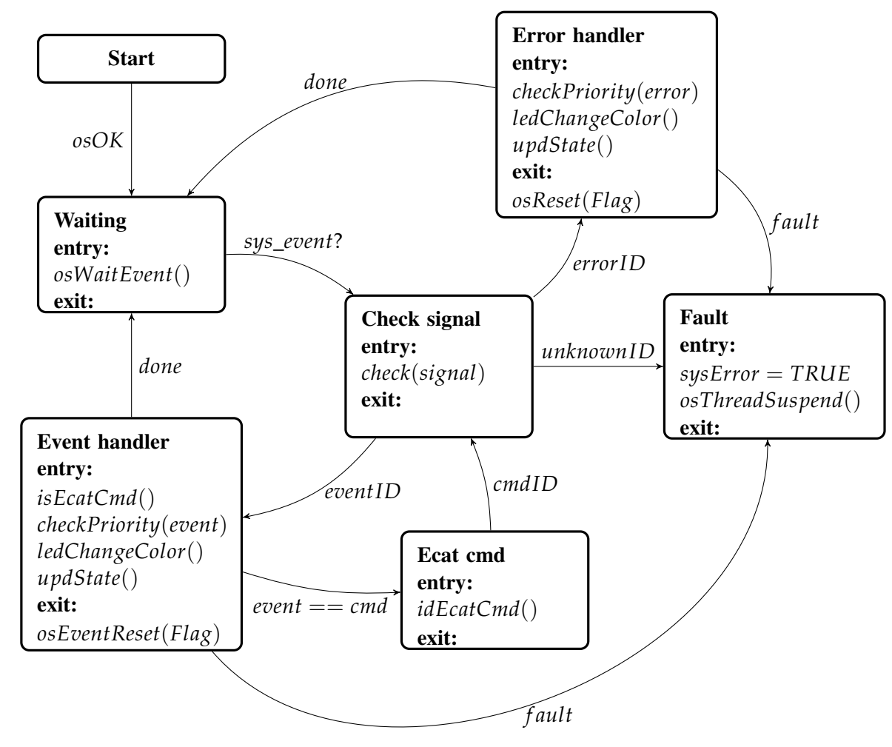
Implementation: Synchronization among DSMs
Flexible and modular
Functions for specific error handling can be added
ECAT command handler foreseen
11
Notes:
Relevant DSM for the handling of events and errors.
The terminate state is not an error but though so for this prototype. Mainly good points are:
-Flexible and modular so specific functions for specific error handling can be added.
-As well as an ECAT command handler

Slide 12
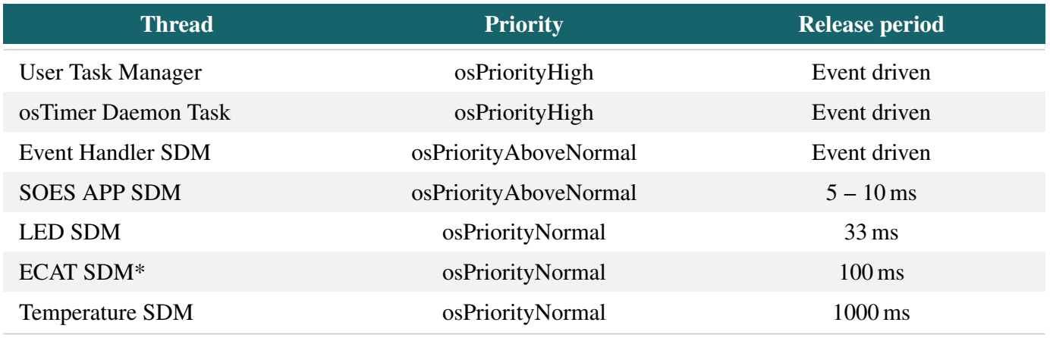
Implementation: RTOS for synchronization and scheduling
Fixed priorities
Pre-emptive priority-based scheduling
Round robin execution for same priority tasks
osThreadX, osEventFlagsX, osTimerX, osWaitX, osMutexX helpful functions, info in [Arm20]
Final priorities’ arrangement for main threads. *ECAT SDM is mainly event driven, nevertheless, in the connected state it has a periodic update.
12

Slide 13
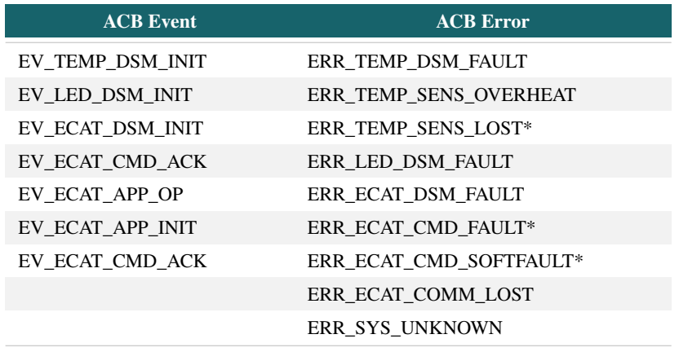
Results: Events and errors handling
Events and errors: Changes are updated within the shared variable through the event handler to notify the LED channels to change the system’s current color
13

Slide 14
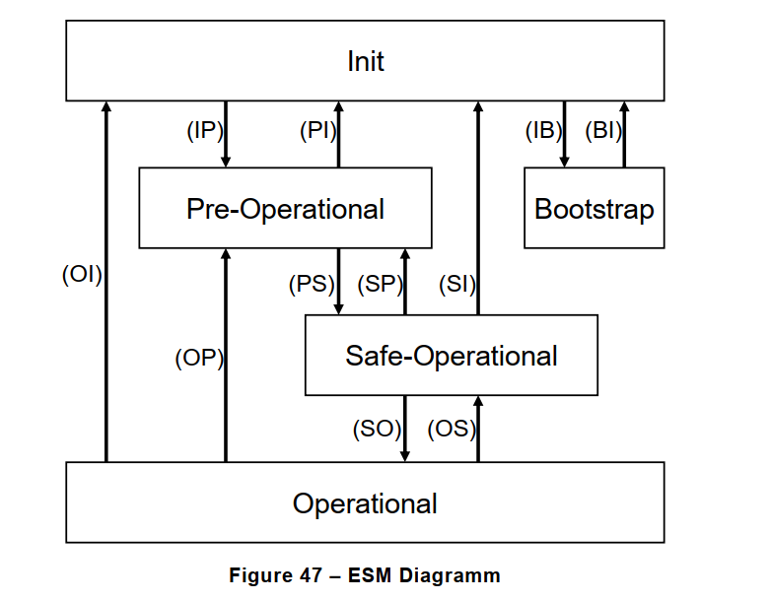
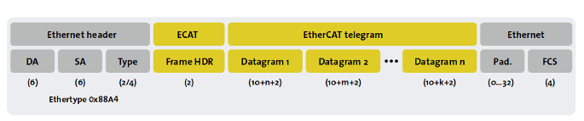
Results: EtherCAT’s protocol overview
AL State Machine
EtherCAT frame within an IEEE 802.3 frame
Reference from [Bec17b]
14
Notes:
Reference: EtherCAT Specification – Part 6, pp 98

Slide 15
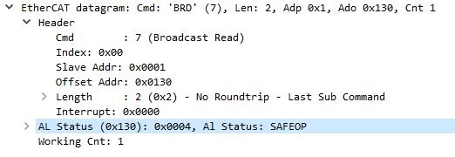
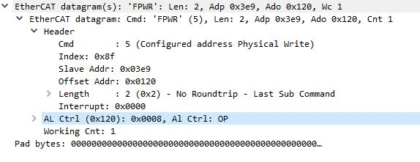
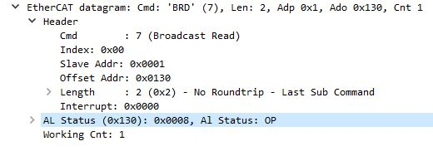
Results: Successful Operational state
Data packets obtained through Wireshark running on Master PC (TwinCAT3)
15

Slide 16
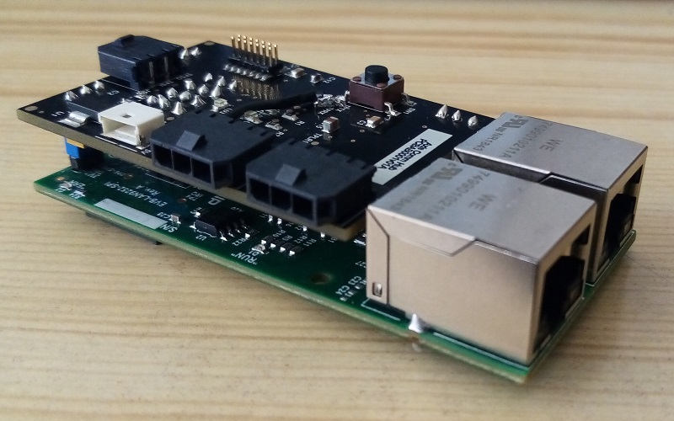
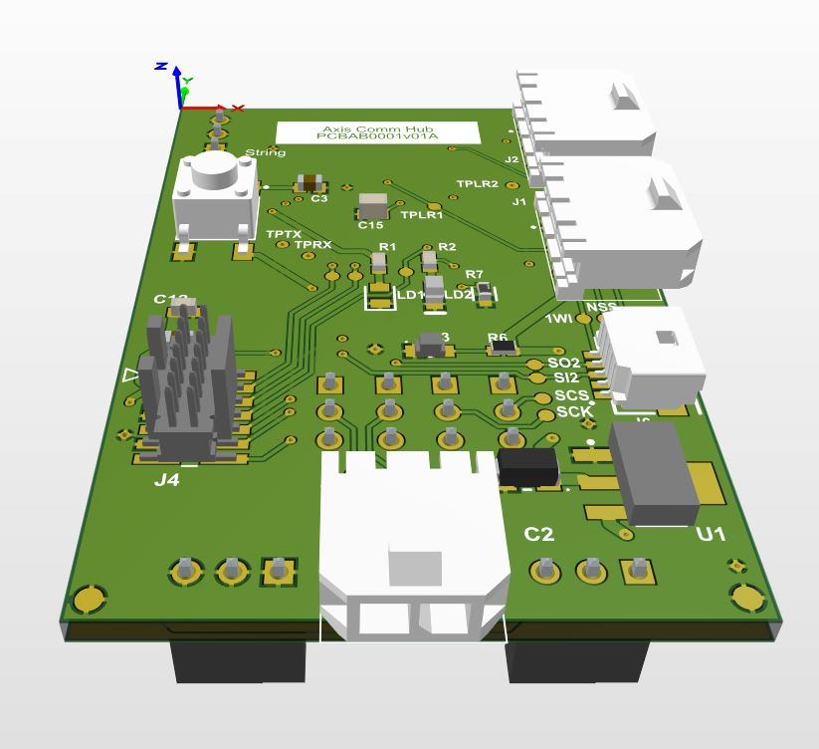
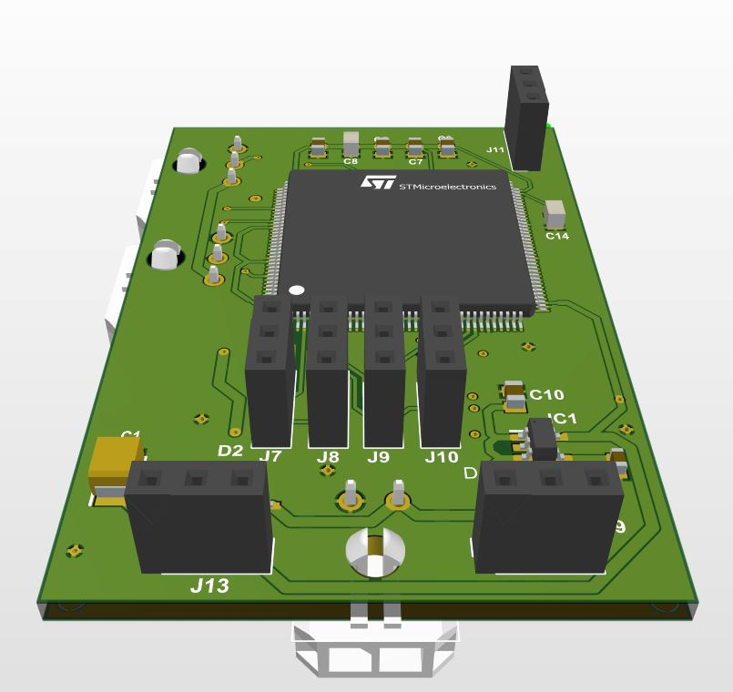
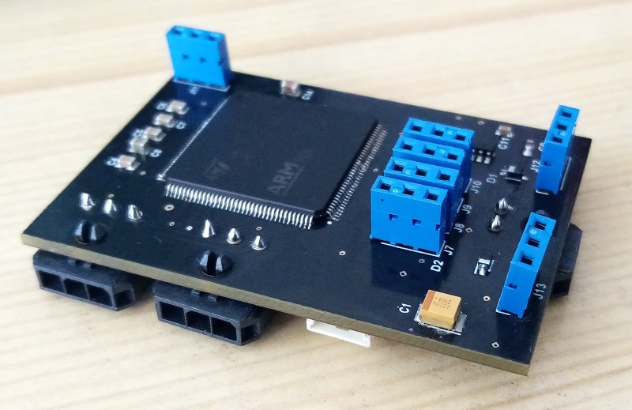
Results: PCB
Altium Designer
4-layered PCB, 38x56mm
3D model
Manufactured PCB
16
Notes:
Comparison with other strategies for reading out data? Interface different protocols → for sure it is a tailored solution
Embedded system --> kits already developed
Why is it not vendor solution but tailored programmed → Because of the Know-How and design experience
Why is it not compatible with Profinet or CAN?
Due to the given compatibility of the Robot ETHERCAT-CAN
EtherCAT is considered within the upcoming TSN Industrial Profile – CAN?
CAN is so far not compatible with the TSN?
Personal experience (advantages STvsMicrochip)

Slide 17
Conclusions and further development
Firmware based on State Machine abstraction of the logic with a deterministic approach, ease the expansion of features and debug process.
CMSIS Abstraction layer for RTOS is an open standardized API, so flexible interoperability with other RTOS is granted, e.g. FreeRTOS and RTX Kernel.
CMSIS package also allows other standardized APIs for example CMSIS NN and CMSIS SVD.
Open industrial protocol for further development of reliable industrial applications.
Modular and flexible firmware + experience in working with open source libraries and standardized documentation.
17
Notes:
The development helped open the doors to new challenges regarding characterization of the firmware performance and capabilities assessment. Furthermore, this device represents development potential, for it could expand functionalities and test compatibility under specific standards, for instance—as the device achieved its goal of establishing a stable connection with a EtherCAT master—features like FoE service for firmware update over the field bus, DC synchronization for hard-real time capabilities and EoE for Ethernet/IP based cloud access can be planned for the future. It could be even candidate for an in-depth dependability analysis, an EtherCAT compliance certification or even FSoE for black channel integration; the previous depending of course on the application, since each of those features would imply different paths that—even when they’re obviously related—the development cannot be mixed neither done at once. Regarding hardware, optimizing the design for integrity of multiple digital signals—asynchronous and synchronous between 5 – 90 Mbit s-1—is also an important point. As to the software for embedded systems, new abstraction layers for RTOS can be explored, since the code uses CMSIS that theoretically provides flexibility to change the underlying RTOS to different ones. The latter would make only sense if, one, the path to follow is to exploit EoE, there are then unikernel projects that basically are tiny linux kernels running on low-cost MPUs; or, two, to explore the safety related functionalities, for which multi-core platforms are appropriate to redundancy approaches—with their related multi-core RTOS. Additionally, also in the sense of embedded systems, more complex architectures can be explored, not because the STM32F4xx MCU is not capable enough, but Texas Instruments MCUs emerged during this project as an interesting alternative, as they sometimes offer more features aiming multi-protocol peripherals, even for those that are currently and commonly integrated through ASICs like IO-LINK or BISS-C interfaces. Finally, it could be summarized that the Research Project achieved the main goal of developing a flexible device for further industrial interfaces.

Slide 18
Further development
FSoE Safety related
Multi core embedded systems for redundancy features >> Multi core RTOS
SoE Hard real time applications 1.5 to 30 us – DC jitter can be reduced to ns.
Dependability analysis of the Firmware + Hardware
Software verification of the State Machines with CMSIS tools and optimization of the Hardware resources and execution times for a better and more formal scheduling [Fed17].
18

Slide 19
References
[SKJ18] S. Schriegel, T. Kobzan, and J. Jasperneite. Investigation on a distributed sdn control plane architecture for heterogeneous time sensitive networks. In 2018 14th IEEE International Workshop on Factory Communication Systems (WFCS), pages 1–10, 2018.
[MGSR20] M. Metaal, R. Guillaume, R. Steinmetz, and A. Rizk. Integrated industrial ethernet networks: Time-sensitive networking over sdn infrastructure for mixed applications. In 2020 IFIP Networking Conference (Networking), pages 803–808, 2020.
[Nor20] M. Norris. A Cannabis Equipment Supplier Turns to Automation to Extract CBD at Commercial Scale. https://www.automationworld.com/home/article/21173096/a-cannabisequipment-supplier-turns-to-automation-to-extract-cbd-at-commercial-scale, August 2020. Last visited: 14/09/2020.
[XJY11] H. Xing, H. Jia, and L. Yanqianga. Motion control system using sercos over ethercat Procedia Engineering, 24:749–753, 12 2011.
[DC17] R. Delgado and B. Choi. Real-time servo control using ethercat master on real-time embedded linux extensions. International Journal of Applied Engineering Research, 12:1179–1185, 11 2017
[MHF+20]C. Mastalli, I. Havoutis, M. Focchi, D. G. Caldwell, and C. Semini. Motion planning for quadrupedal locomotion: Coupled planning, terrain mapping, and whole-body control. IEEE Transactions on Robotics, pages 1–14, 202
19

Slide 20
References
[Bec20b] Beckhoff Automation GmbH. EtherCAT - the Ethernet Fieldbus. https://www.ethercat.org/en/technology.html, January 2020. Last visited: 16/09/2020
[BDL06] G. Behrmann, A. David, and K. Larsen. A tutorial on uppaal 4.0. Department of computer science, Aalborg university, 2006
[Arm20] Arm Ltd. Real-Time Operating System: API and RTX Reference Implementation. https://www.keil.com/pack/doc/CMSIS/RTOS2/html/index.html, April 2020. Last visited: 20/09/2020.
[Bec17b] Beckhoff Automation GmbH. ETG.1000.4 Data Link Layer protocol specification. https://www.beckhoff.com/english/downloadfinder, November 2017. Last visited: 16/09/2020.
[Fed17] D. Fedasyuk, R. Chopey and B. Knysh, "Architecture of a tool for automated testing the worst-case execution time of real-time embedded systems' firmware," 2017 14th International Conference The Experience of Designing and Application of CAD Systems in Microelectronics (CADSM), Lviv, 2017, pp. 278-281, doi: 10.1109/CADSM.2017.7916134.
Reference: https://arm-software.github.io/CMSIS_5/General/html/index.html
20

Slide 21
Questions
9

Slide 22
Dankeschön für Ihre Aufmerksamkeit!
10

Slide 23
Extra information

Slide 24
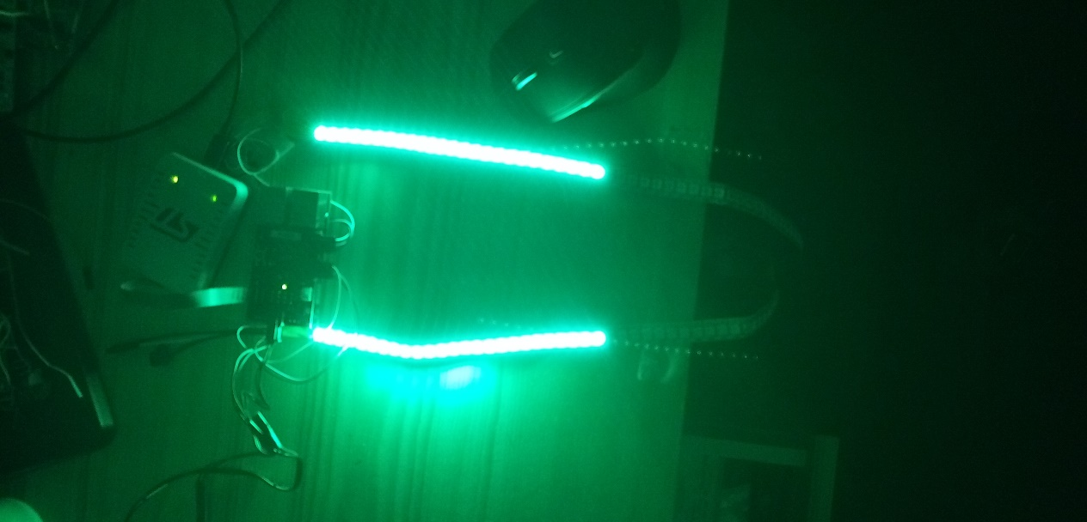
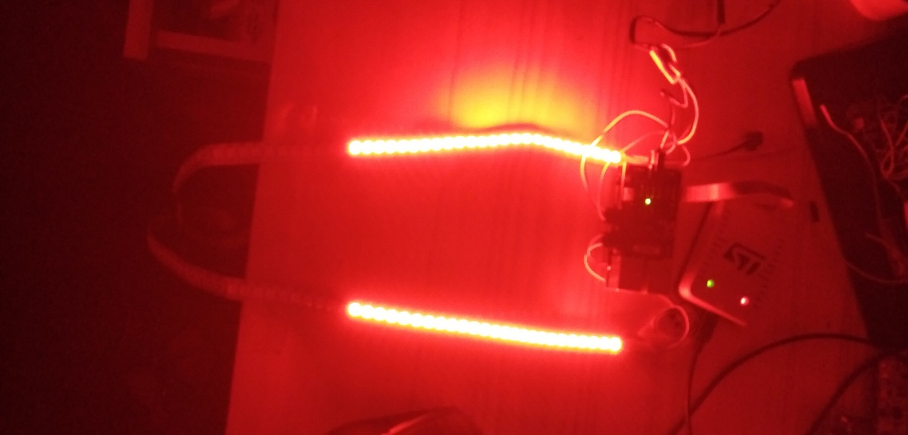
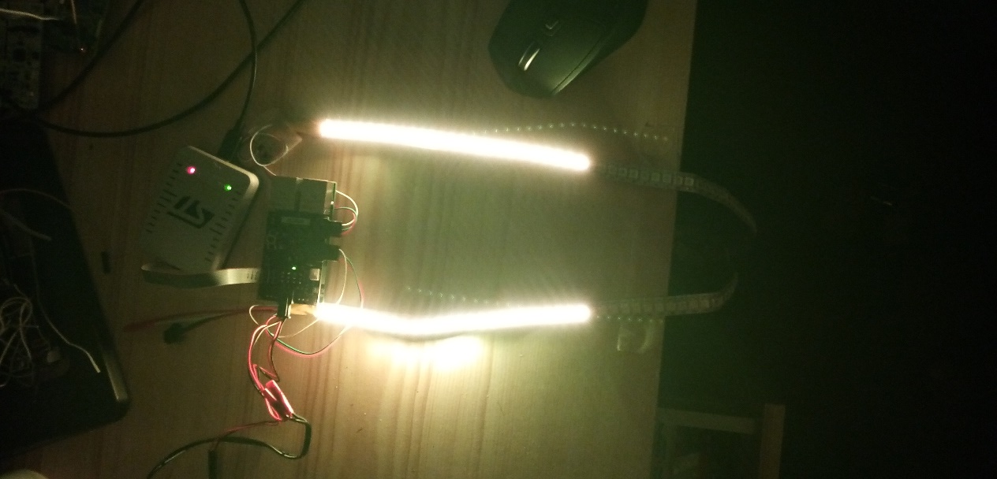
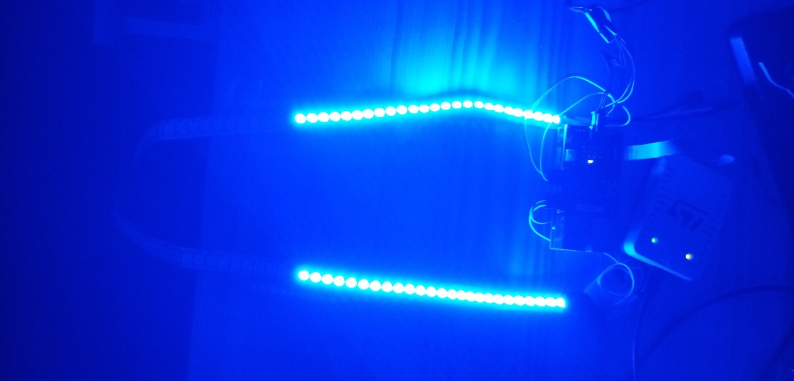
Photos

Slide 25
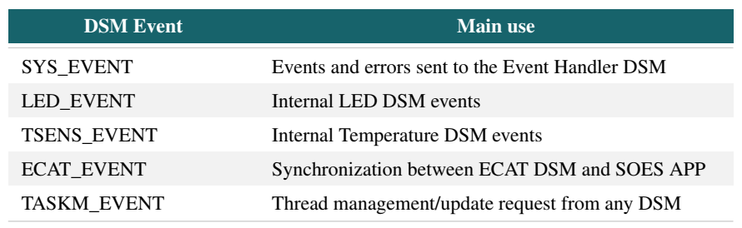
Synchronization with CMSIS-RTOS
Synchronization methods:
EventFlags (extension of ThreadFlags)
Semaphores:
signalling,
multiplex,
rendezvous,
barrier turnstile,
semaphore barrier.

Slide 26
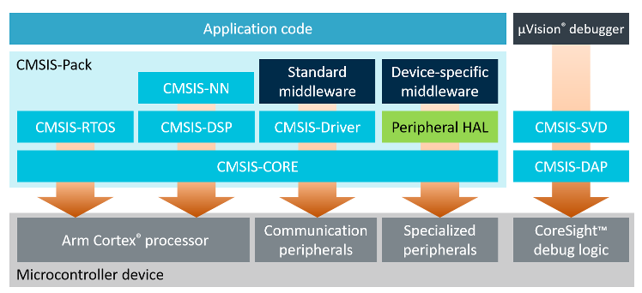
CMSIS Abstraction layer
Simple software interfaces to the processor and peripherals, software re-use, reducing the time to market for new devices
Common approach for RTOS, peripheral and middleware components.
CMSIS-Zone for configuration of multiple processors**
Common API for real-time operating systems along with a reference implementation based on RTX.
Compliant with ANSI C (C99) and C++ (C++03).
Provided free of charge by Arm under the Apache 2.0 License

Slide 27
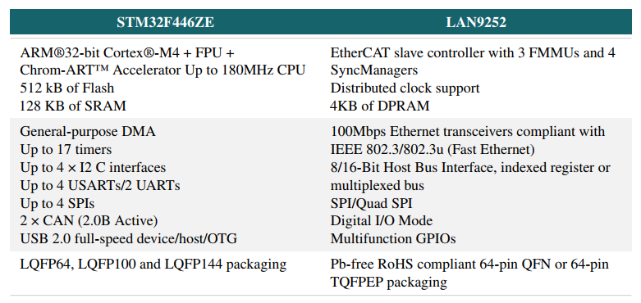
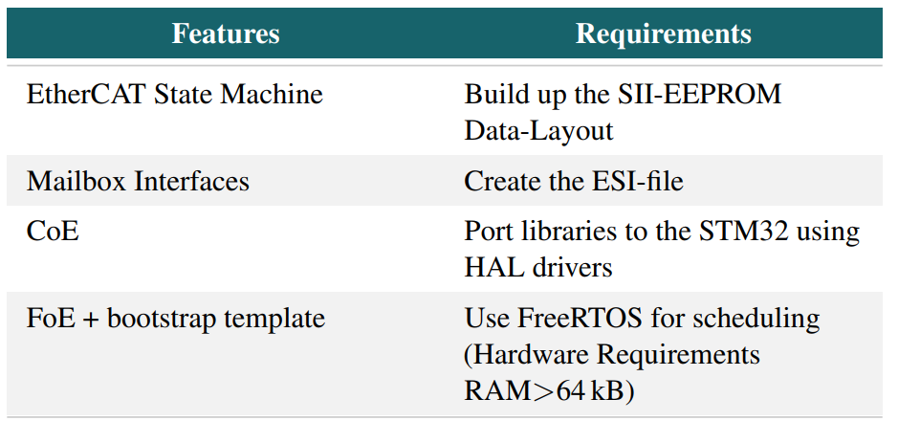
Technical specifications of the hardware

Slide 28
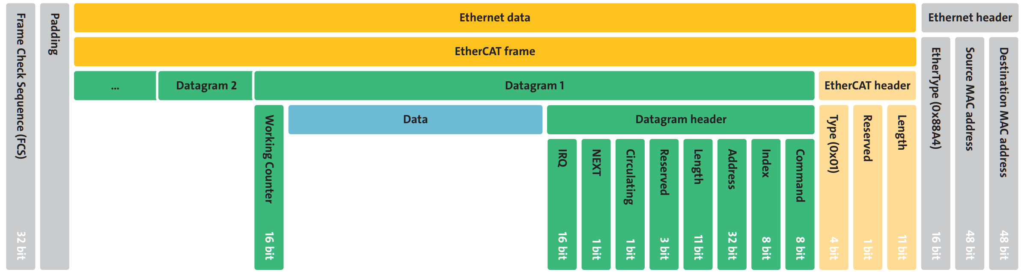
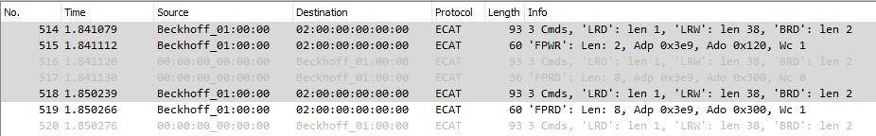
Results: Data frame
Transaction
Ethernet frame (IEEE802.3): 64-1518 Bytes (up to 1522 Bytes if VLAN is used)

Slide 29
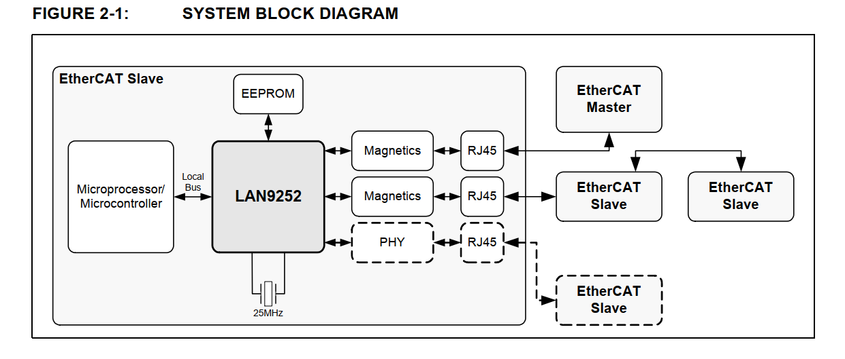
ESC
System Block Diagram: LAN9252 Structure, reference from datasheet

Slide 30
Other relevant tasks within the development
Understanding the EtherCAT protocol specification
Writing the ESI file with snippets from other applications (ET1100 and PIC32 Development boards)
The overall consulting of MCU’s datasheet to proper usage of peripherals (PWM+DMA)
Better understanding of the HAL specification provided by STM32
Constant consulting of CMSIS-RTOS/KEIL project
Understanding the data sheet of LAN9252 to proper configuration and integration with MCU
Integration of the OW open-source library
Relation of

Slide 31
Advantages
From procedural-based 'C' code on small 8-/16-bit microcontrollers to inherently fostering structured code development which is enforced by the RTOS application programming interface (API).
500 bytes of RAM and 5k bytes of code, Flash memory is 512 k and 128 k RAM
The RTOS itself consists of a scheduler which supports round-robin, pre-emptive and co-operative multitasking of program threads, as well as time and memory management services.
Debugging by thread isolation of faults.
pre-emptive priority-based scheduling

Slide 32
Approach for avoiding errors
Avoid dynamic allocation of osObjects as they could lead to memory fragmentation.
Multiple instances of the same code differentiated by arguments during their call, for example, the callback functions of the ostimeouts
Usage of virtual timers
To avoid priority inversion there is only one flag that sets if the temperature is accessible or not.
Nevertheless there are Data exchange objects that can be allocated for a more formal asynchronous method of communication. Message queue and mail queue. Memory pool is the transmission of a pointer. (Zero Copy Mailbox)

Slide 33
Debugging methods
Debugging Methods
It is also possible to monitor the maximum stack memory usage during run time. If you check the "Stack Usage Watermark" option, a pattern (0xCC) is written into each stack space. During runtime, this watermark is used to calculate the maximum memory usage. In Arm Keil MDK, this figure is reported in the threads section of the View - Watch Window - RTX RTOS window.
This section also allows us to select whether the threads are running in privileged or unprivileged mode. The last option allows us to define the processor operating mode for the user threads. If you want an easy life, leave this set to "privileged mode" and you will have full access to all the processor features. However, if you are writing a safety critical or secure application then "unprivileged mode" can be used to prevent thread access to critical processor registers limiting run time errors or attempts at intrusion.
__WEAK uint32_t osRtxErrorNotify

Slide 34
Gantt Chart
Duration: ~4 Months
Official start: 29.04 Final Presentation: 07.09 (Proposal)
12

Slide 35
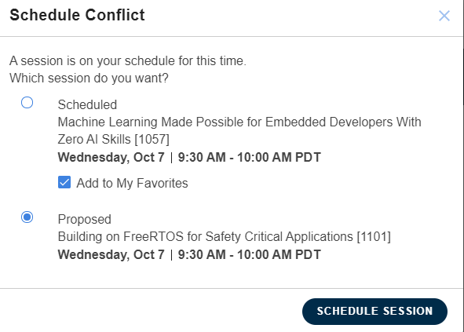
Extra

