Slide 1

Development of an Embedded Communication Hub for the Acquisition of Sensor Data in a Robotic System
Project Thesis Juan Carlos Reyes Andrade, ICS

Slide 2
Contents
Background
RTE Networks
Main goal
Specific goals
Implementation
Results
Conclusion
2
Notes:
Roadmap: Important to mention:
-Layered structure of the proposal
-Modular, it is not structured programming
-Advantages for further development, debugging, maintenance, structure, understanding.
-Scheduling tables >>
-RTOS scheduling (prioritization-round robin for same priority) -Show at least two state machines:
-Mealy and the Moore SMs + UPPAAL representation
-SOES and the ECAT SM
-RTOS tools used for synchronization of the State Machines -Event Handler
-Different Events and how the information is passed
-PCB 3d >> PCB physical, the PRE-OPERATION-OPERATION
Conclusions:
-Personal growth:
-Working with extense/complex libraries
-Getting to know one of the protocols aimed for open source, hard RT capable
-Summarizing information
-Abstraction and understanding of several resources(only for the standard there are 6 specifications, for ESI is another specification, 2 datasheets MCU+LAN9252 and theory behind the justification)
-Framework, starting point, flexible, understandable, “formal” multitasking approach
-Advantages of using CMSIS-Abstraction layer for multiple RTOS
-Modules depending on further applications
-Response for the Industrial Internet of Things, less gateways, anywhere, anything, anytime
-Response to EDGE computing ---- Neuronal Networks
-In the last years some topics have been open for development -Process data on the edge, standard solutions in low-cost hardware
-CMSIS NN, UNIKERNELS, dockers and unikernels are suited for microcomputers
-Any application over a standardized industrial communication protocol
-Safety applications: CMSIS to multicore mcus, synchronization, redundancy on the programming + FSoE >> opens the gate for certification

Slide 3
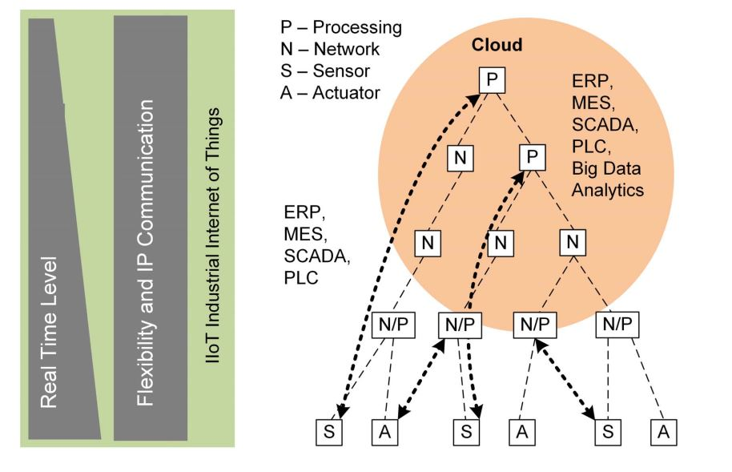
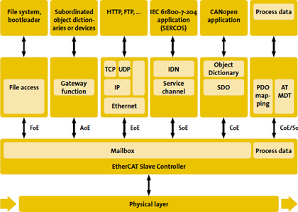
Background
Open industrial protocol
Interoperability through the EtherCAT CPs
The more flexible Industry 4.0 automation structure (directly device access)
3
Notes:
Multiconnectivity: collaborative robots, peripherals sensors and cameras, hmi (touchscreens) any other remote host (interfaces, protocols)*** Difference
IEC61784 part II as an evolution of the field buses
Within ai-ec?** Communication Profiles Families – most of the private profiles/commercial protocols CAN/PROFibus/Powerlink/Profinet/EtherCAT/DeviceNet are addressed
Within the set of data -> Time Sensitive Data -> Data that needs to meet strict time deadlines to ensure the right functionality of the whole system.
The need was already in the industry but it increases as the networks get more complex and diverse and when the market/research offers constantly more and more devices which can or not have RT processing. However, data stream in the network must ensure that the RT Data is not affected by the traffic.
Robots controllers (positions, movements/speeds, time-critical actuators). 3D Cameras.
Rely on RT data.
Within the market and out of it there is already tools that address compatibility with private devices/standards.
----------------
IEC 61158 represents a collection of communication profile families (CPFs), each of them including some communication profiles (CPs), which refers to different and well established commercial protocols. Neither DeviceNet nor CANopen is encompassed by IEC 61158 even though they are two widespread fieldbuses. These two networks rely on the popular CAN.

Slide 4








Background: RT Ethernet Networks
Fieldbuses were included within IEC 61158 (CPFs) 1988-1999
RTEN referenced to IEC61784 part II 2008
Two strategies to ensure RT communication:
TDMA and CIP (Common Industrial Protocol)
TSN Group improves the Data Link and MAC Layer (IEEE802.1Qbv) 2012-2019
Open-source tools offer compatibility → Further development
Licensed RTE Solutions:
Open source tools:
4
Notes:
We have open source tools that now can provide a reliable framework to design on top of them
Usch that they can be tested against the international standards and also with compatibility with the “parivit” vendors.
As history dictates, vendor protected technology have a limit when there are lots of possibilities a non standards.
By 2008 CPF 1: FOUNDATION Fieldbus
CPF 2: CIP
CPF 3: PROFIBUS
CPF 4: P-NET
CPF 5: WorldFIP
CPF 6: INTERBUS
CPF 7: SwiftNet (withdrawn)
CPF 8: CC-Link
CPF 9: HART
CPF 10: Vnet/IP
CPF 11: TCnet
CPF 12: EtherCAT
CPF 13: Ethernet Powerlink
CPF 14: EPA
CPF 15: MODBUS-RTPS
CPF 16: SERCOS^{[5][6]}
DeviceNET and CAN open were not included in IEC 61158
RTEN Started during the early 2000s (evolution of the field buses)
Referenced to IEC61784 part II *** (year?)
Examples are EtherCAT [83], Profinet [84], Ethernet/IP [85], Ethernet, Powerlink [26], and Modbus TCP [86]
2 Technics to ensure RT communication: TDMA (Time Slots to transmit packets) and CIP (Common Industrial Protocol Labeled– HP -> UDP; LP -> TCP)
TSN Group improves initiave that started in 2012 by adding them the AVB Group
Well-known industrial trademarks
User perspective it is unsatisfactory, since it is only a trademark wark. Sometimes the IEC based solutions are not longer compatible with the IEEE 802.3 Ethernet Specification**
Therefore TSN (2012) official attempt to integrate the technologies to an standard, as it happened with classical Ethernet (AVB* in 2003-2005 -> industrial environments)
A set of tools that comply the international standard (mostly improvements within the ISO/OSI layer 2 DATA LINK**).
IEEE802.1Qbv implements a time slot and traffic shapping mechanism
The problem is not a synchronization problem between the EtherCAT and the TSN? Distributed clocks vs GCLs
Ethercat uses TDMA but differs with POWERLINK and Profinet IRR, difference rely within the MAC layer Telegram RT vs maibolxes NRT
Where does EtherCAT live within the OSI model? Is application layer or Network/Transport layer?
What about the PROFINET? If it sticks to ETHERNET, is it easier for it to switch to the new standard?

Slide 5

Main goal
“Develop a device using open-source tools to read out sensor data from a robot axis that can be interfaced with an RTE Network.
The device could be used afterwards as a test platform within an industrial environment to characterize its compatibility with the ongoing IEC/IEEE 60802 TSN Profile for Industrial Automation.”
5

Slide 6
Specific goals
To specify the requirements of the system
Comparison considering the state of the art
To develop the embedded system as a functional EtherCAT Slave Device
Integrating FreeRTOS-CMSIS with SOES (Open-source tools)
Integrating the LAN9252 (SoC over SPI)
Reading out of axis temperature sensors
Controlling the axis LED Ring (WS2812b)
Designing the required user application libraries
To design and manufacture a PCB prototype using Altium Designer
To test and report the system functionality
6
Notes:
Readout of different sensors e.g. IMU (SPI), Encoders (BiSS-C),…

Slide 7
SOES

Slide 8


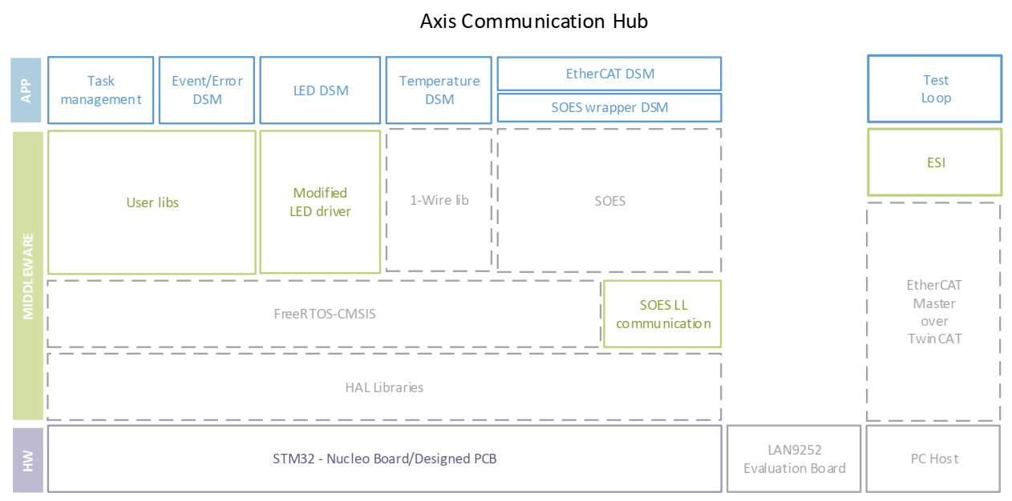
Solution proposal
Final layered structure of functional blocks
7
Notes:
Comparison with other strategies for reading out data? Interface different protocols → for sure it is a tailored solution
Embedded system --> kits already developed
Why is it not vendor solution but tailored programmed → Because of the Know-How and design experience
Why is it not compatible with Profinet or CAN?
Due to the given compatibility of the Robot ETHERCAT-CAN
EtherCAT is considered within the upcoming TSN Industrial Profile – CAN?
CAN is so far not compatible with the TSN?
Personal experience (advantages STvsMicrochip)

Slide 9
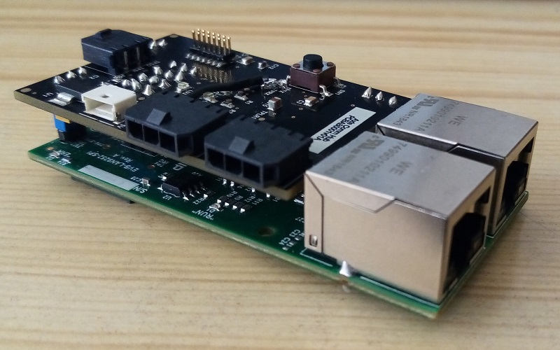
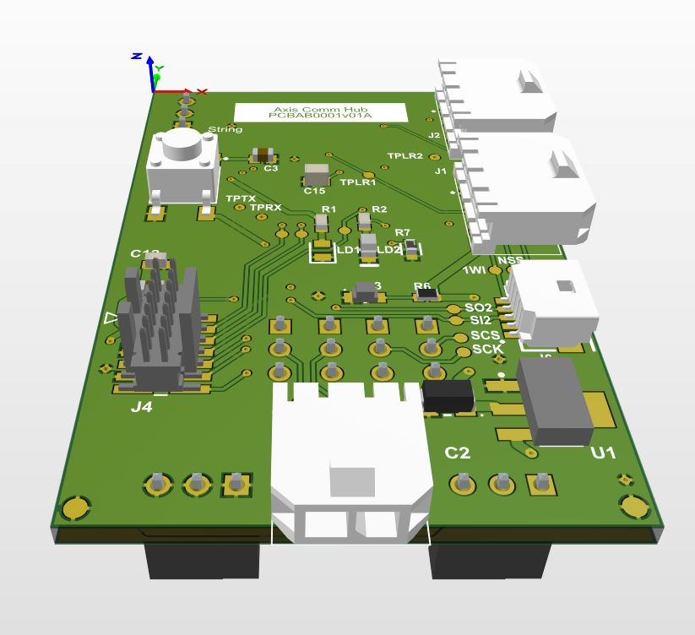
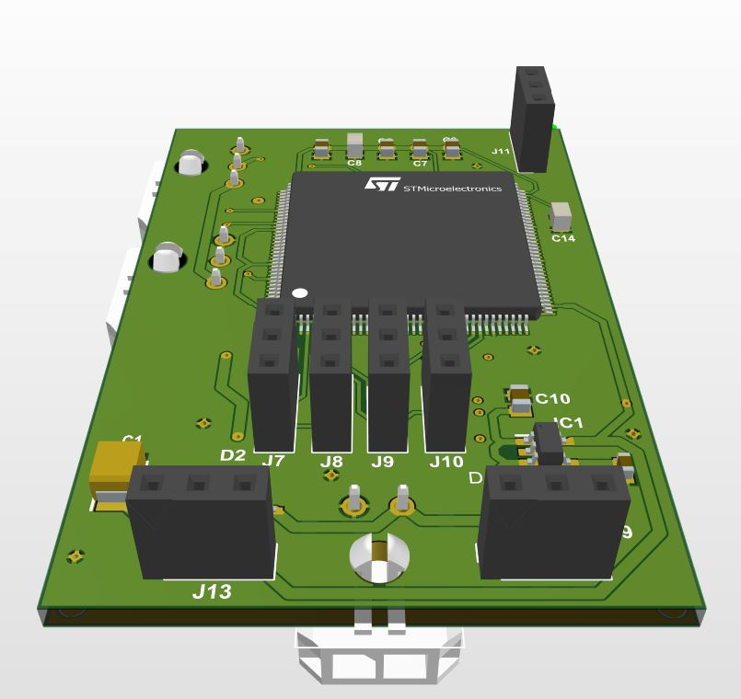
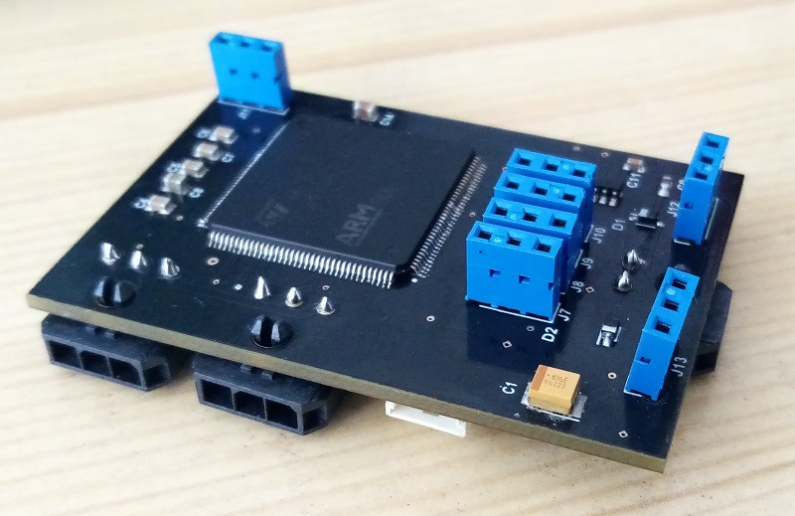
Results
PCB
7
Notes:
Comparison with other strategies for reading out data? Interface different protocols → for sure it is a tailored solution
Embedded system --> kits already developed
Why is it not vendor solution but tailored programmed → Because of the Know-How and design experience
Why is it not compatible with Profinet or CAN?
Due to the given compatibility of the Robot ETHERCAT-CAN
EtherCAT is considered within the upcoming TSN Industrial Profile – CAN?
CAN is so far not compatible with the TSN?
Personal experience (advantages STvsMicrochip)

Slide 10
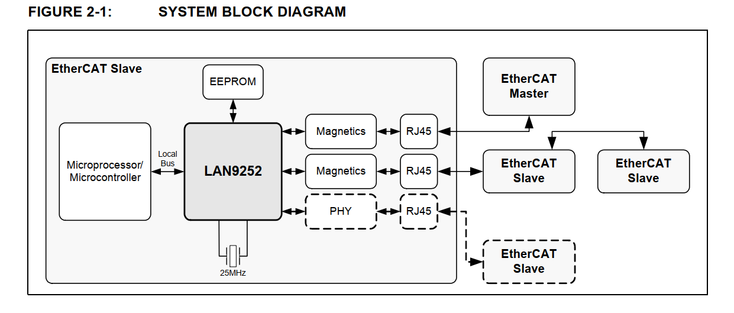
LAN9252 Structure, reference 9, datasheet

Slide 11
Structure

Slide 12
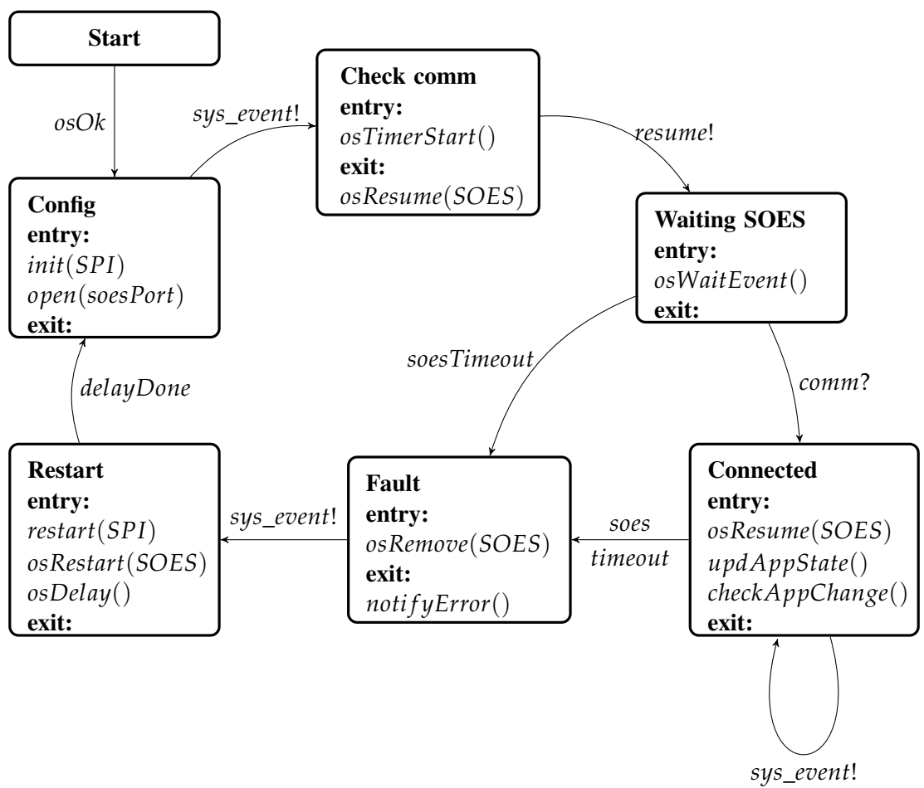
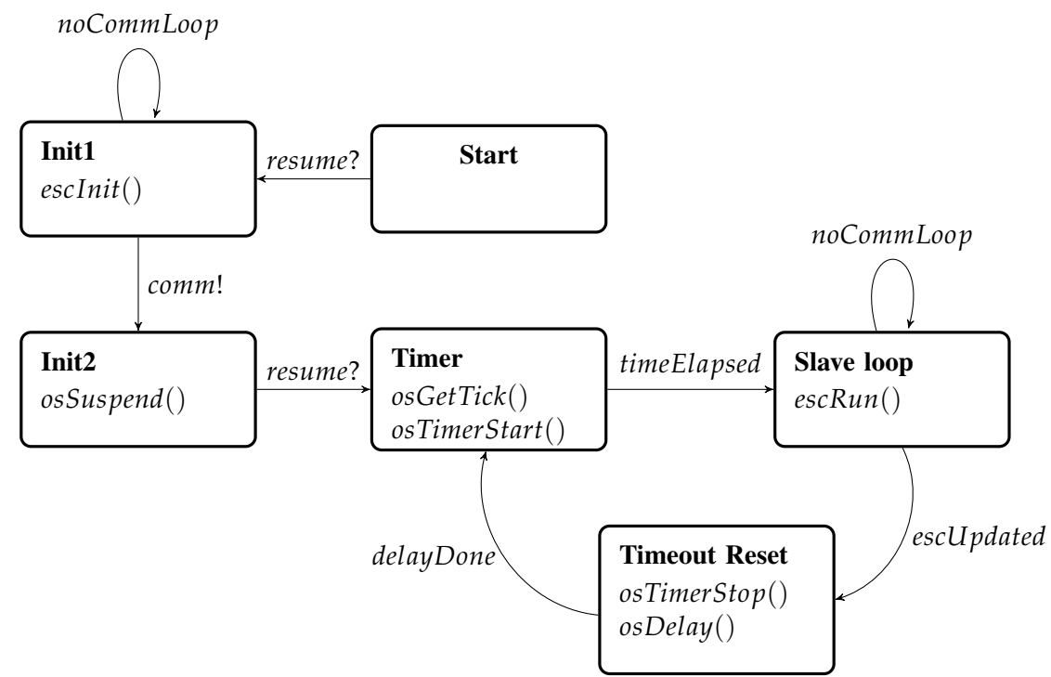
Synchronization/DSMs

Slide 13
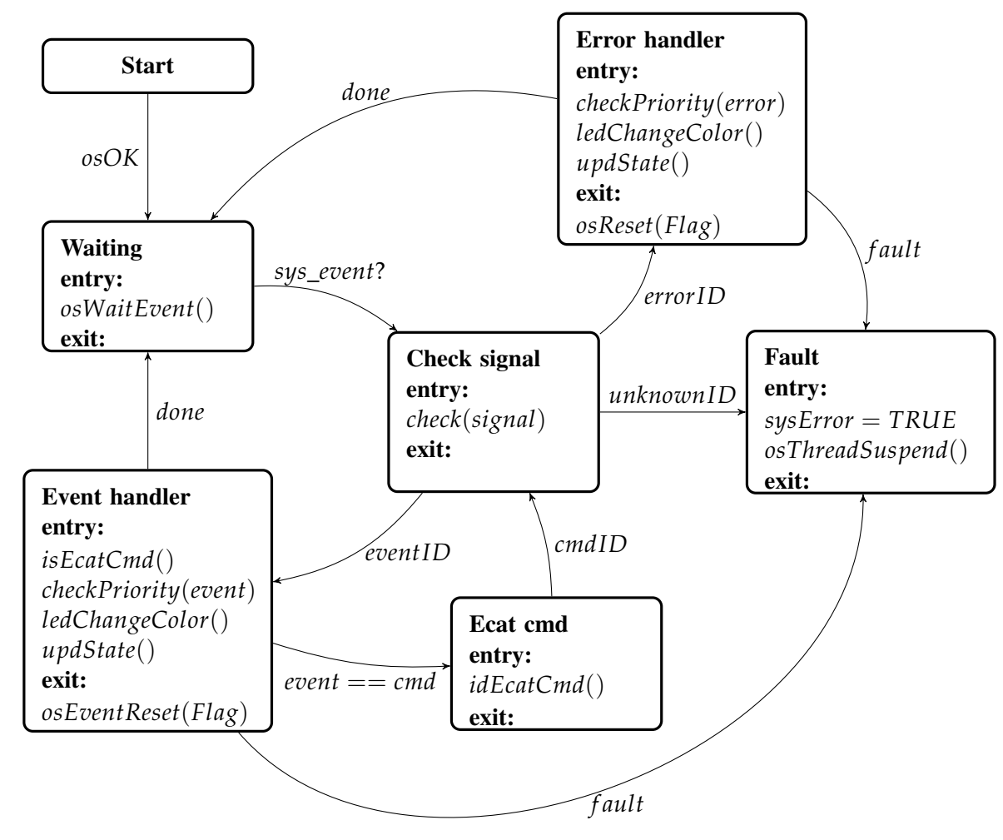
Synchronization/DSMs

Slide 14
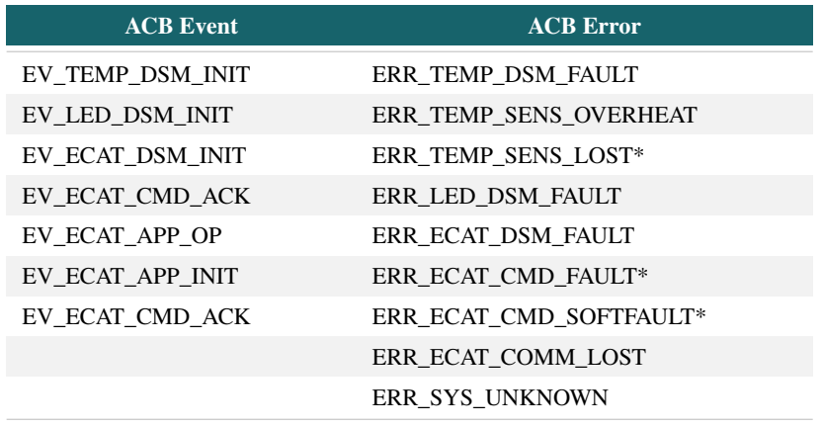
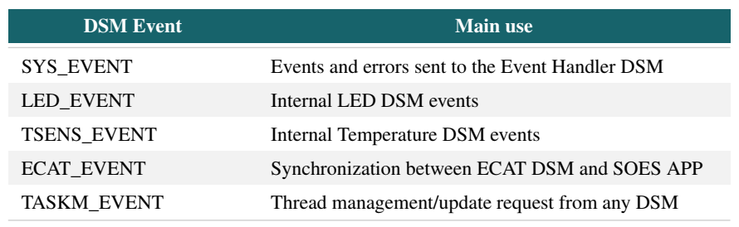
Events/Scheduling

Slide 15
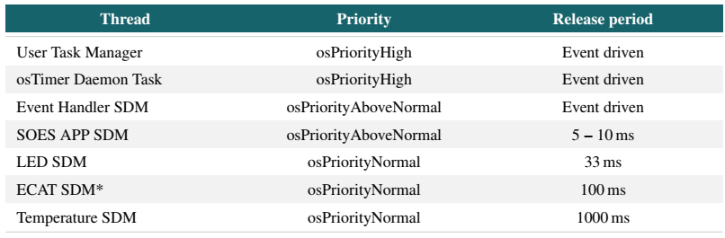
Scheduling

Slide 16
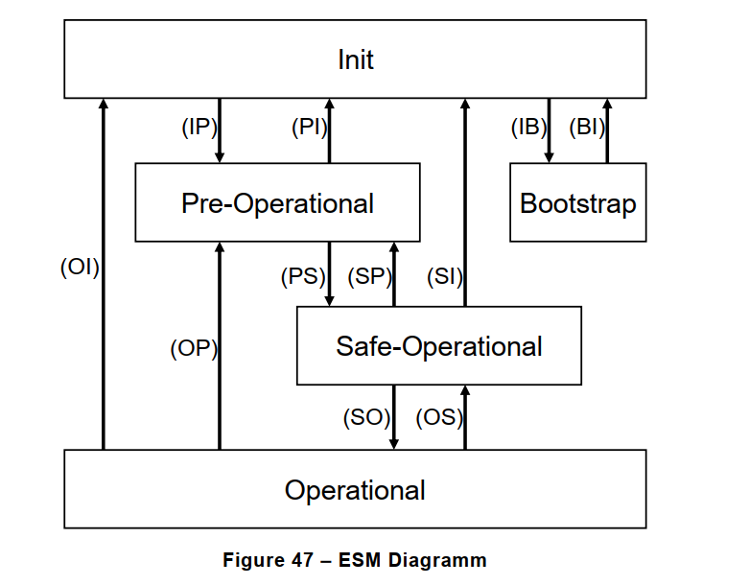
State machine
Reference: EtherCAT Specification – Part 6, pp 98

Slide 17
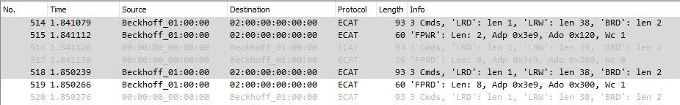
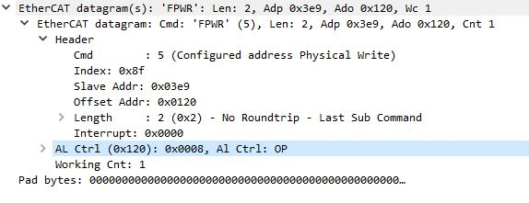
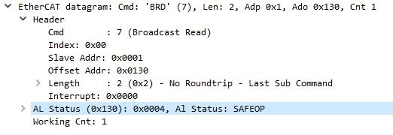
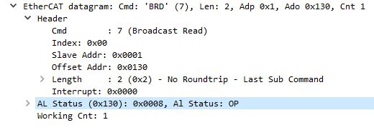
Results
Transaction
7
Notes:
Comparison with other strategies for reading out data? Interface different protocols → for sure it is a tailored solution
Embedded system --> kits already developed
Why is it not vendor solution but tailored programmed → Because of the Know-How and design experience
Why is it not compatible with Profinet or CAN?
Due to the given compatibility of the Robot ETHERCAT-CAN
EtherCAT is considered within the upcoming TSN Industrial Profile – CAN?
CAN is so far not compatible with the TSN?
Personal experience (advantages STvsMicrochip)

Slide 18
Conclusions and further development
Software verification and testing:
8
Notes:
The development helped open the doors to new challenges regarding characterization of the firmware performance and capabilities assessment. Furthermore, this device represents development potential, for it could expand functionalities and test compatibility under specific standards, for instance—as the device achieved its goal of establishing a stable connection with a EtherCAT master—features like FoE service for firmware update over the field bus, DC synchronization for hard-real time capabilities and EoE for Ethernet/IP based cloud access can be planned for the future. It could be even candidate for an in-depth dependability analysis, an EtherCAT compliance certification or even FSoE for black channel integration; the previous depending of course on the application, since each of those features would imply different paths that—even when they’re obviously related—the development cannot be mixed neither done at once. Regarding hardware, optimizing the design for integrity of multiple digital signals—asynchronous and synchronous between 5 – 90 Mbit s-1—is also an important point. As to the software for embedded systems, new abstraction layers for RTOS can be explored, since the code uses CMSIS that theoretically provides flexibility to change the underlying RTOS to different ones. The latter would make only sense if, one, the path to follow is to exploit EoE, there are then unikernel projects that basically are tiny linux kernels running on low-cost MPUs; or, two, to explore the safety related functionalities, for which multi-core platforms are appropriate to redundancy approaches—with their related multi-core RTOS. Additionally, also in the sense of embedded systems, more complex architectures can be explored, not because the STM32F4xx MCU is not capable enough, but Texas Instruments MCUs emerged during this project as an interesting alternative, as they sometimes offer more features aiming multi-protocol peripherals, even for those that are currently and commonly integrated through ASICs like IO-LINK or BISS-C interfaces. Finally, it could be summarized that the Research Project achieved the main goal of developing a flexible device for further industrial interfaces.

Slide 19
Questions
9

Slide 20
Dankeschön für Ihre Aufmerksamkeit!
10

Slide 21
Extra information
11

Slide 22
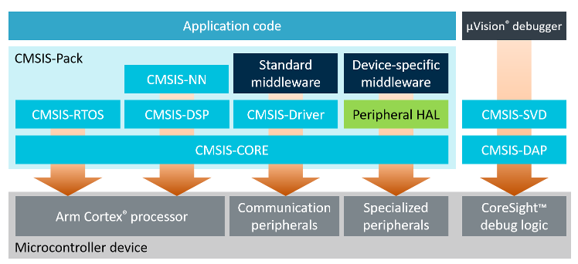
CMSIS Abstraction layer
Simple software interfaces to the processor and peripherals, software re-use, reducing the time to market for new devices
Common approach for RTOS, peripoheral and middleware components.
CMSIS-Zone will simplify system resource and partitioning as it manages the configuration of multiple processors**
Common API for real-time operating systems along with a reference implementation based on RTX. It enables software components that can work across multiple RTOS systems.
Compliant with ANSI C (C99) and C++ (C++03).
provided free of charge by Arm under the Apache 2.0 License

Slide 23
Advantages
From procedural-based 'C' code on small 8-/16-bit microcontrollers to nherently fostering structured code development which is enforced by the RTOS application programming interface (API).
500 bytes of RAM and 5k bytes of code, Flash memory is 512 k and 128 k RAM
The RTOS itself consists of a scheduler which supports round-robin, pre-emptive and co-operative multitasking of program threads, as well as time and memory management services.
Debugging by thread isolation of faults.
pre-emptive priority-based scheduling

Slide 24
Avoid dynamic allocation of osObjects as they could lead to memory fragmentation.
Multiple instances of the same code differentiated by arguments during their call, for example, the callback functions of the ostimeouts
Usage of virtual timers
Synchronization methods with semaphores: signalling, multiplex, rendezvous, barrier turnstile, semaphore barrier
To avoid priority inversion there is only one flag that sets if the temperature is accessible or not.
Nevertheless there are Data exchange objects that can be allocated for a more formal asynchronous method of communication. Message queue and mail queue. Memory pool is the transmission of a pointer. (Zero Copy Mailbox)

Slide 25
Debugging Methods
It is also possible to monitor the maximum stack memory usage during run time. If you check the "Stack Usage Watermark" option, a pattern (0xCC) is written into each stack space. During runtime, this watermark is used to calculate the maximum memory usage. In Arm Keil MDK, this figure is reported in the threads section of the View - Watch Window - RTX RTOS window.
This section also allows us to select whether the threads are running in privileged or unprivileged mode. The last option allows us to define the processor operating mode for the user threads. If you want an easy life, leave this set to "privileged mode" and you will have full access to all the processor features. However, if you are writing a safety critical or secure application then "unprivileged mode" can be used to prevent thread access to critical processor registers limiting run time errors or attempts at intrusion.
__WEAK uint32_t osRtxErrorNotify

Slide 26
Gantt Chart
Duration: ~4 Months
Official start: 29.04 Final Presentation: 07.09 (Proposal)
12

Slide 27
Technical notes
NUCLEO-F446ZE
ARM®32-bit Cortex®-M4 + FPU + Chrom-ART™ Accelerator
Up to 180MHz CPU frequency
512 kB of Flash memory
128 KB of SRAM
General-purpose DMA
Up to 17 timers
Up to 4 × I2 C interfaces (SMBus/PMBus)
Up to 4 USARTs/2 UARTs
Up to 4 SPIs
2 × CAN (2.0B Active)
USB 2.0 full-speed device/host/OTG controller with on-chip PHY
SOES is an EtherCAT slave stack
Address offset based HAL for easy ESC read/write access via any interface
Polling for interrupts
EtherCAT State Machine
Mailbox Interfaces
Protocols
CoE
FoE + bootstrap template
Build up the SII-EEPROM Data-Layout
ESI-file
Port the Libraries to the STM32 using HAL
FreeRTOS: Hardware Requirements >64KB RAM
13

Slide 28
Main topics
Programming of software for embedded systems
STM32 MCUs with ARM architecture
Communication Interfaces (UART, I2C, BiSS, SPI)
Real Time tools (FreeRTOS - CMSIS)
Programming with industrial tools
Integration of an industrial protocol software stack into RTOS (SOES)
RT Ethernet Industrial Protocols (EtherCAT)
External configurations
EtherCAT Host (Beckhoff)
External documentations
TSN Industrial profile specification 2019
14

Slide 29
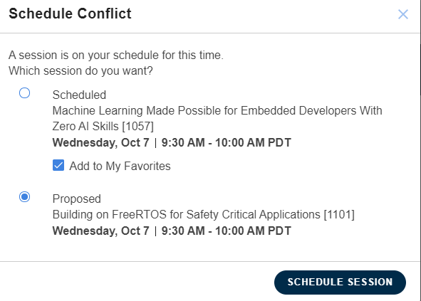
Extra

Slide 30
Referemce: https://arm-software.github.io/CMSIS_5/General/html/index.html
D. Fedasyuk, R. Chopey and B. Knysh, "Architecture of a tool for automated testing the worst-case execution time of real-time embedded systems' firmware," 2017 14th International Conference The Experience of Designing and Application of CAD Systems in Microelectronics (CADSM), Lviv, 2017, pp. 278-281, doi: 10.1109/CADSM.2017.7916134.

