Slide 1
InClass Assignment #7
Carlos Rosario

Slide 2
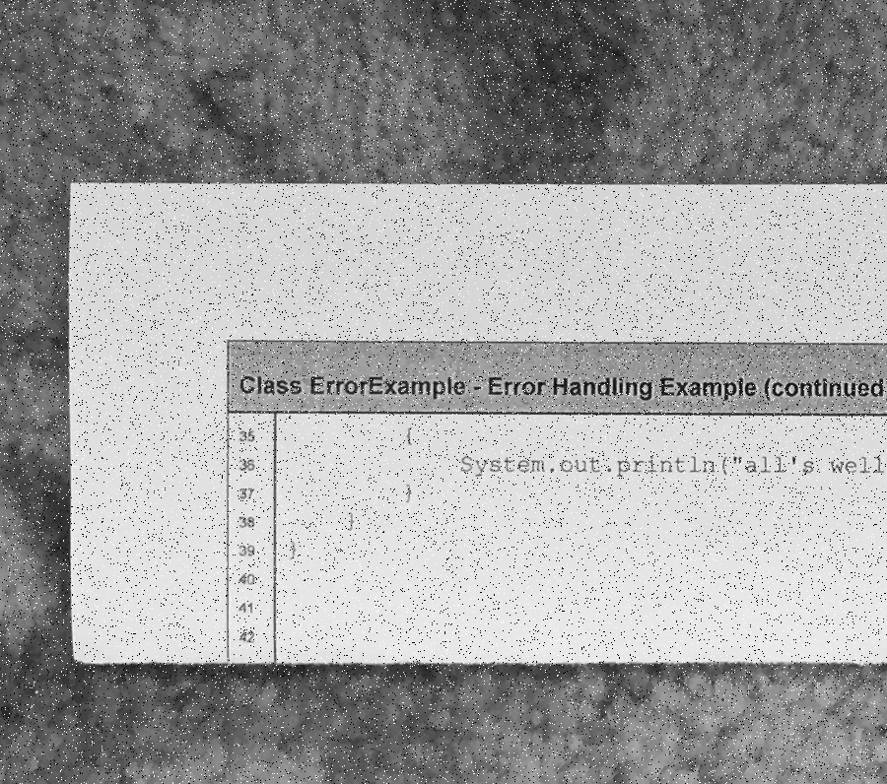
Input Image

Slide 3
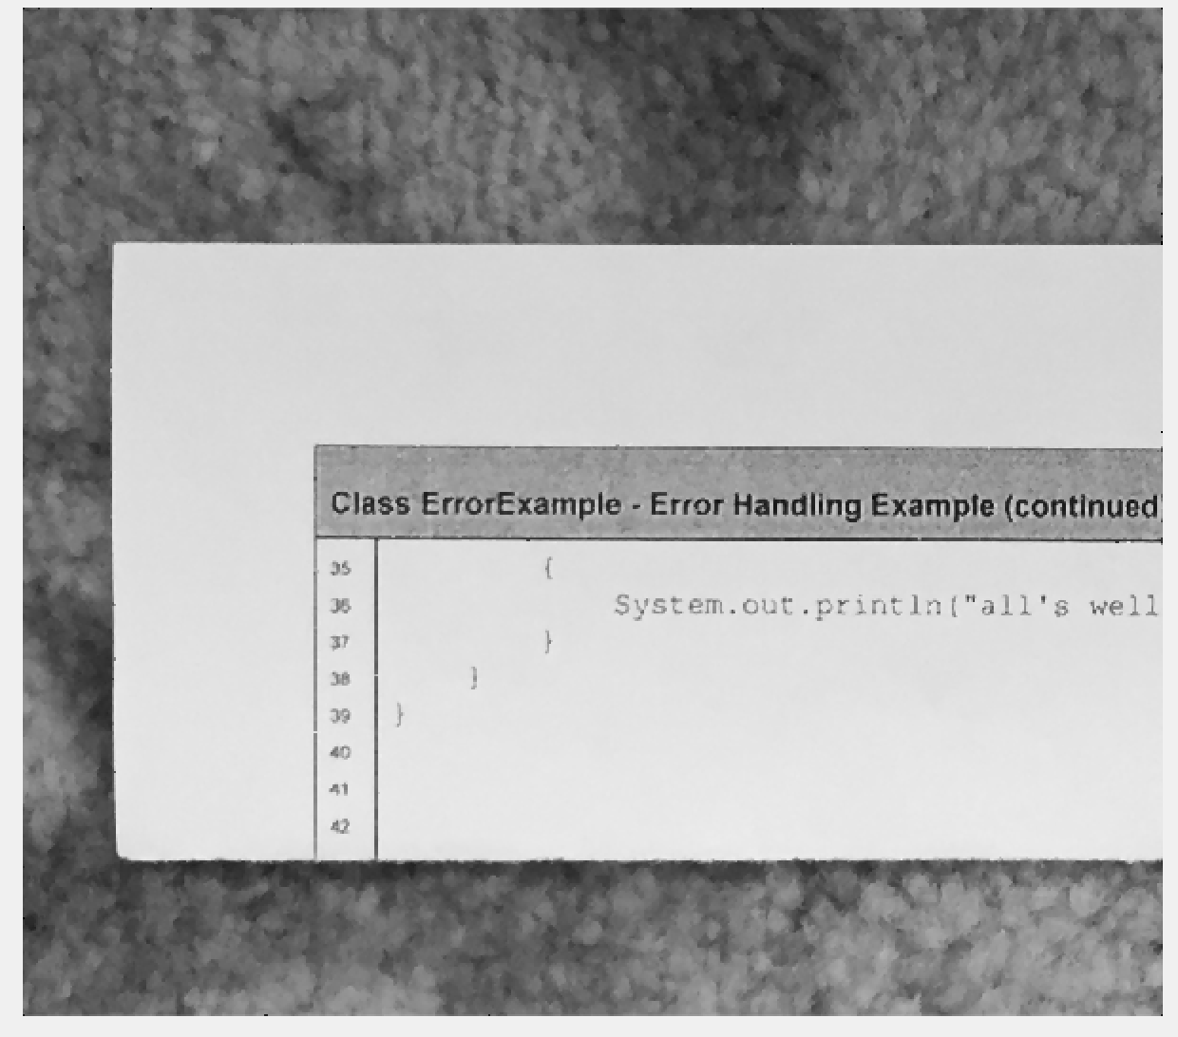
Median Filter output for window size = 3x3

Slide 4
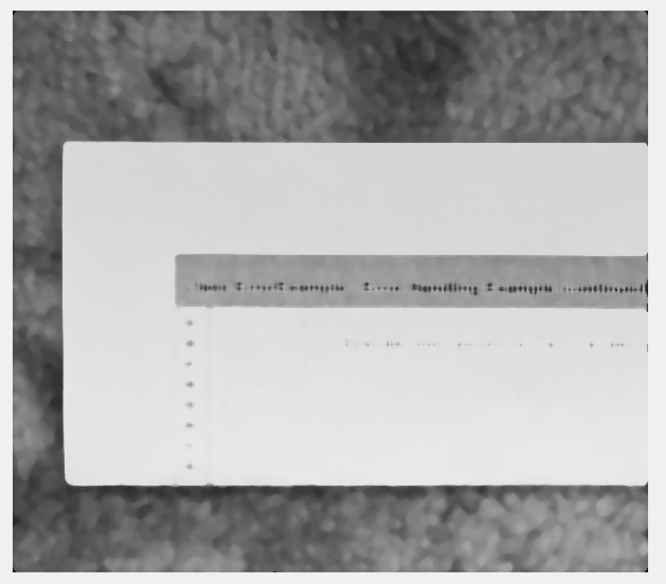
Median Filter output for window size = 11x11

Slide 5

Median Filter output for window size = 31x31

Slide 6
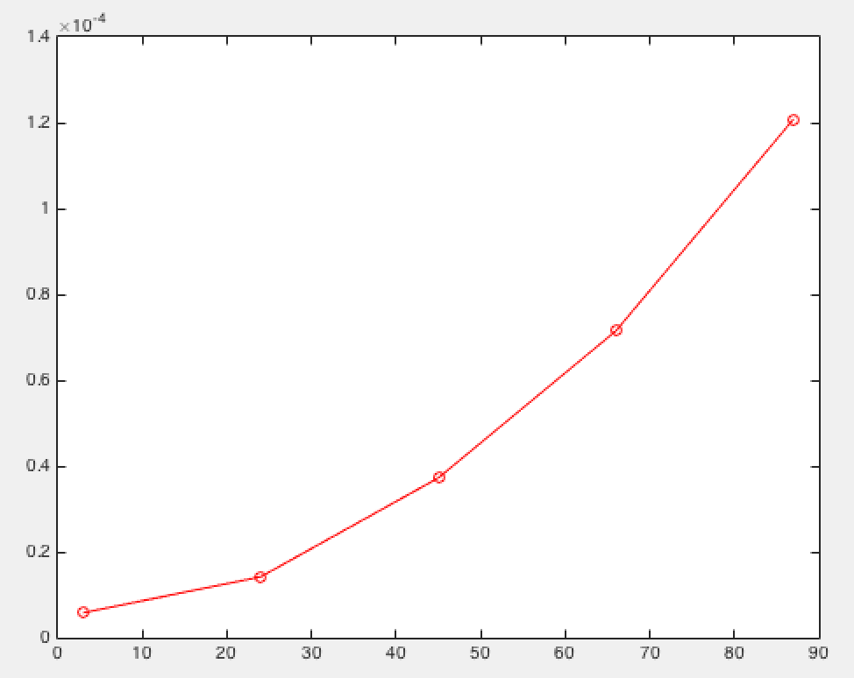
Plot of time for window sizes 3x3, 24x24, 45x45, 66x66, 87x87

