Slide 1
InClass09
Carlos Rosario

Slide 2
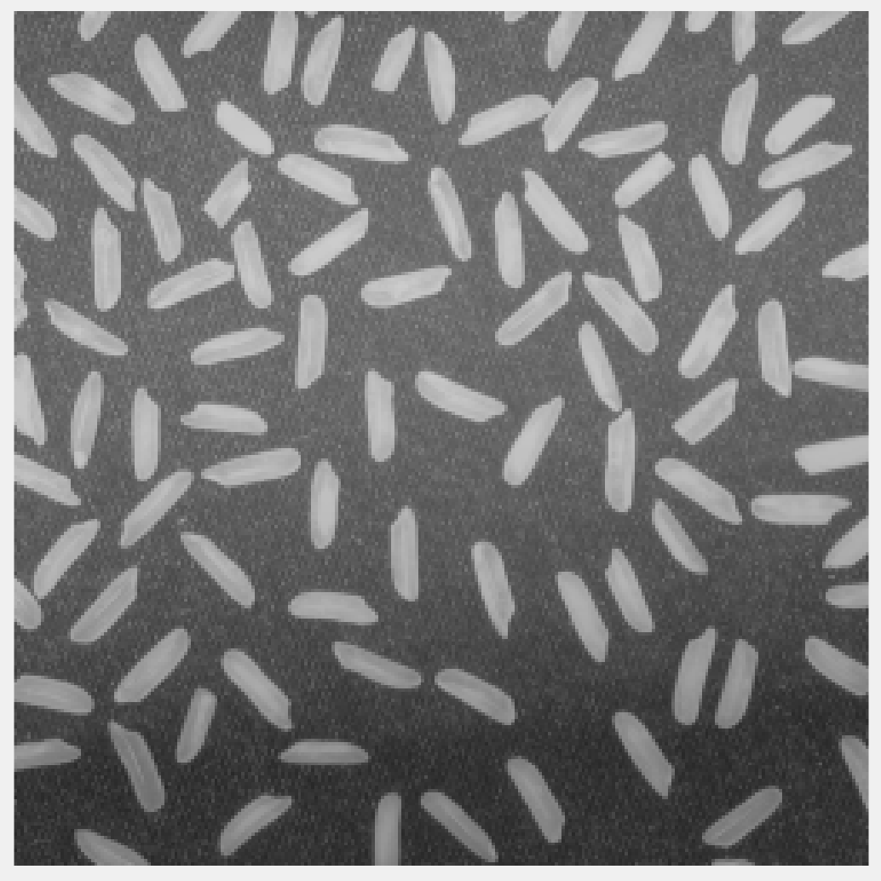
Input Image

Slide 3
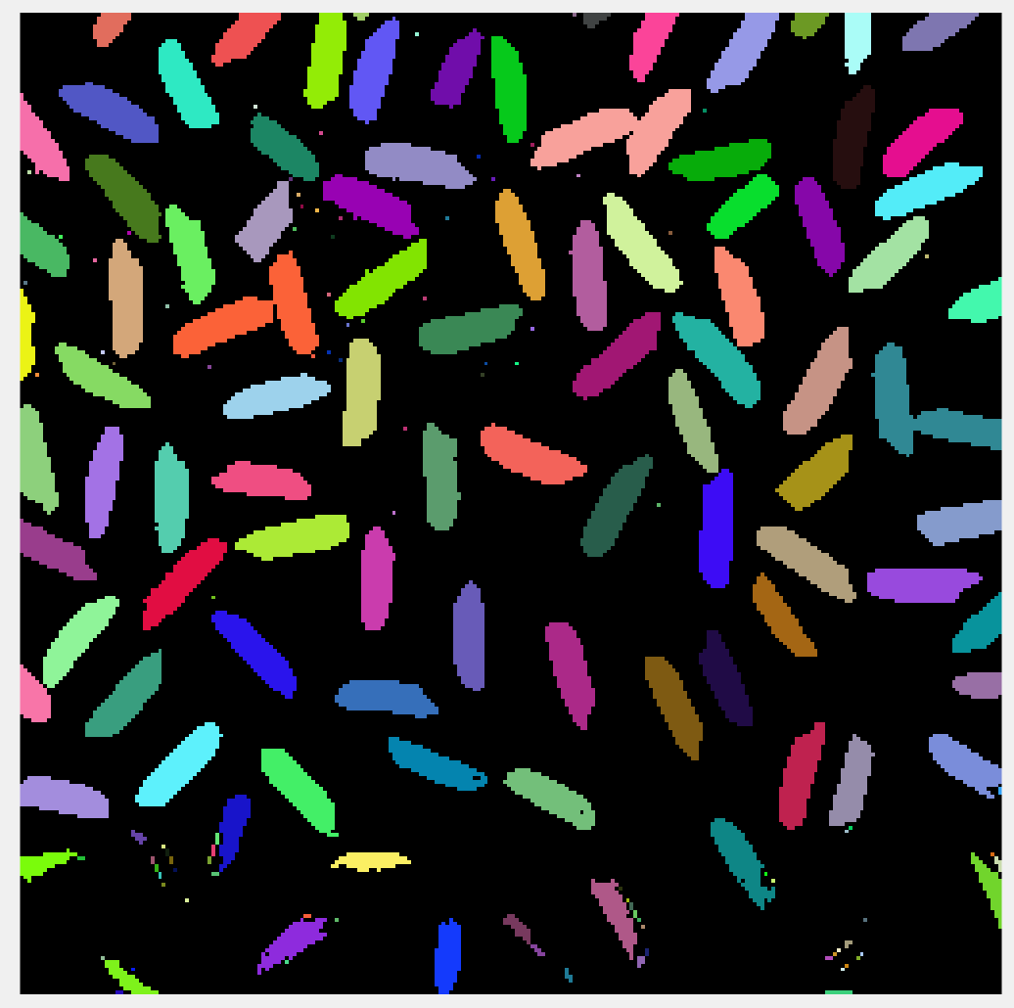
CCL Output

Slide 4
Threshold used to remove noisy regions
I found that a treshold of 5 worked the best to remove the small noisy regions. Anything larger and I started to erode the grains of rice
The treshold works as follows:
If the size of a grain of rice is less than the threshold, then it is labeled 0.
The size of a grain of rice is the total number of label-points (for each label)

Slide 5
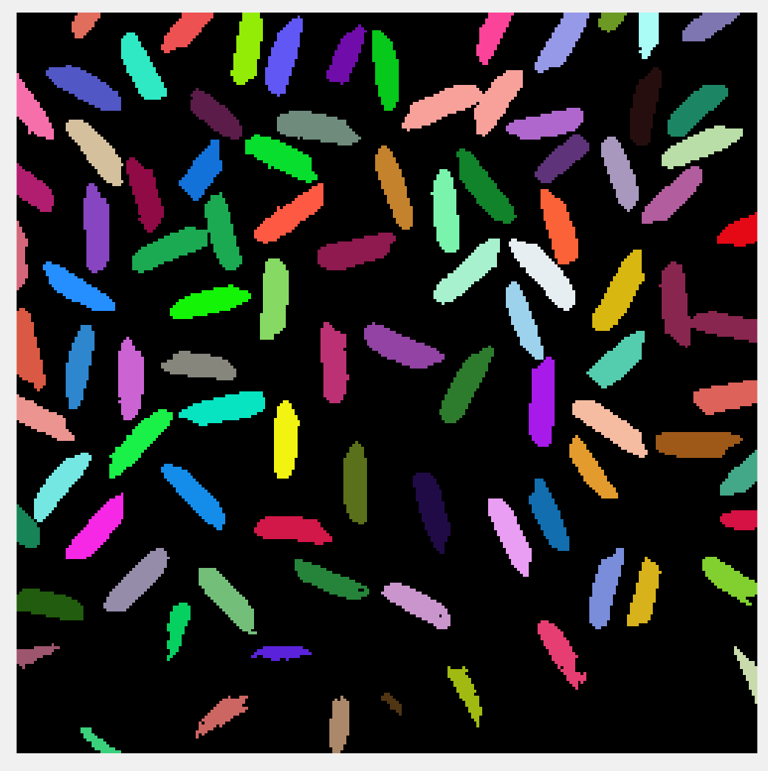
CCL output after small noise/region removal

Slide 6
Number of objects after small region removal
My script reports that there are 94 grains of rice in the image after noise/small region removal.

