Slide 1
InClass 10
Carlos Rosario

Slide 2
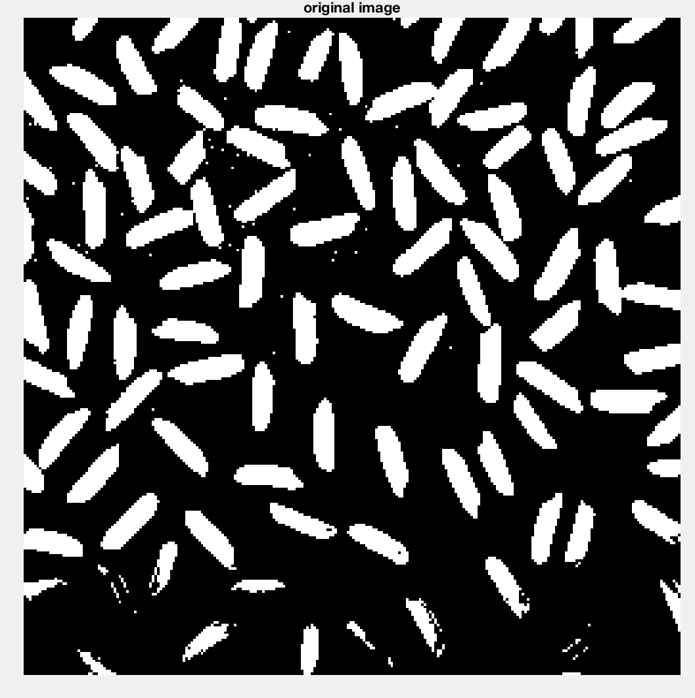
Original image after thresholding

Slide 3
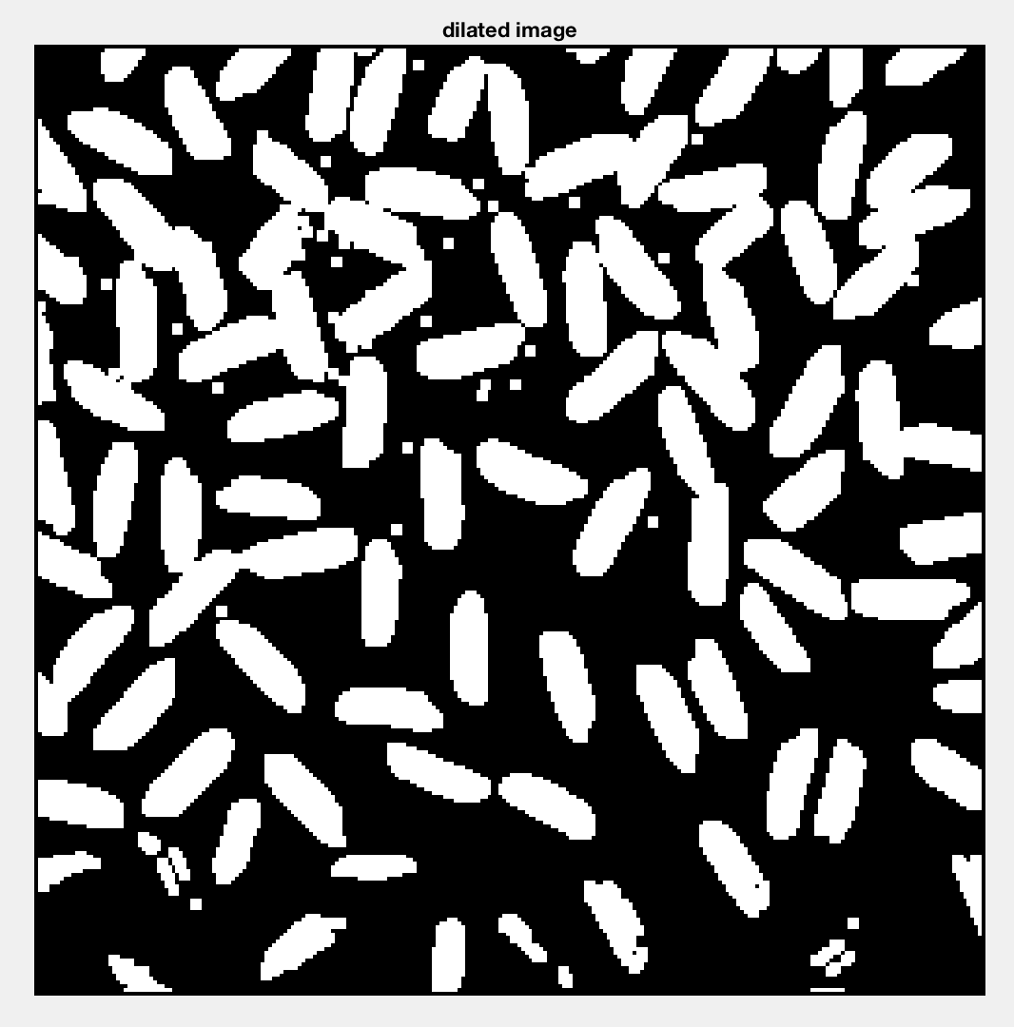
Dilation output using 3x3 structuring element (all 1’s)

Slide 4
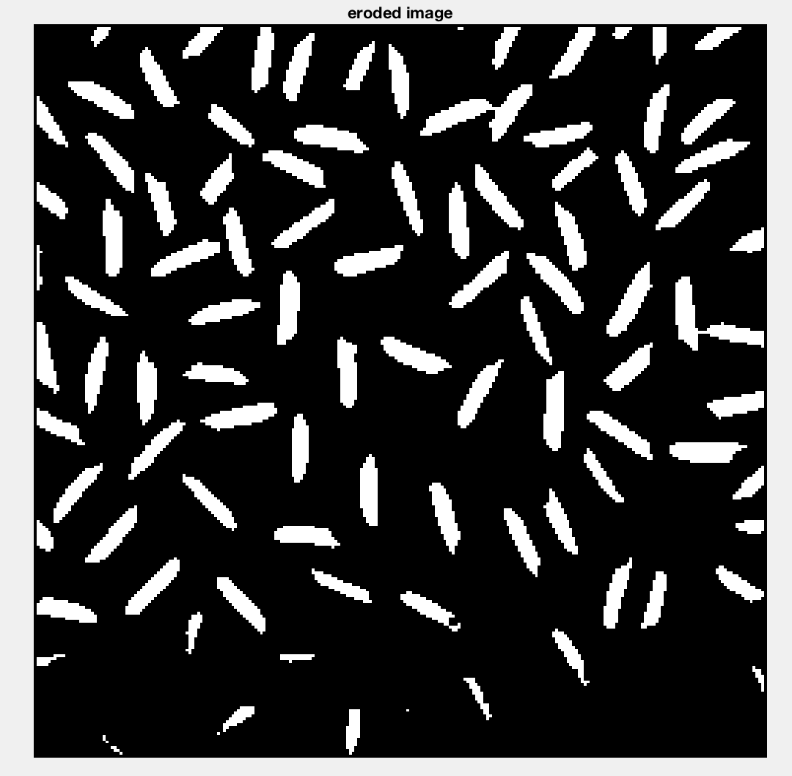
Erosion output using 3x3 structuring element (all 1’s)

Slide 5
Original image after thresholding

Slide 6
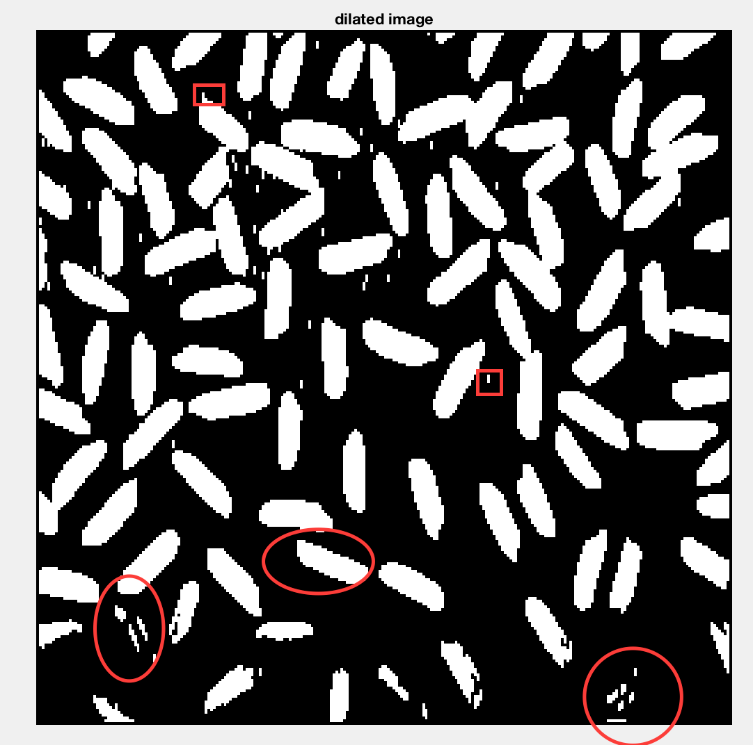
Dilation output using 3x3 structuring element (1 in the centers)
I see the changes happening in vertical direction, i.e the noise and rice grains get thicker but only in a vertical direction.
I can also tell that the rice grains seem to have more jagged edges due to the thickening only happening in one direction.

Slide 7
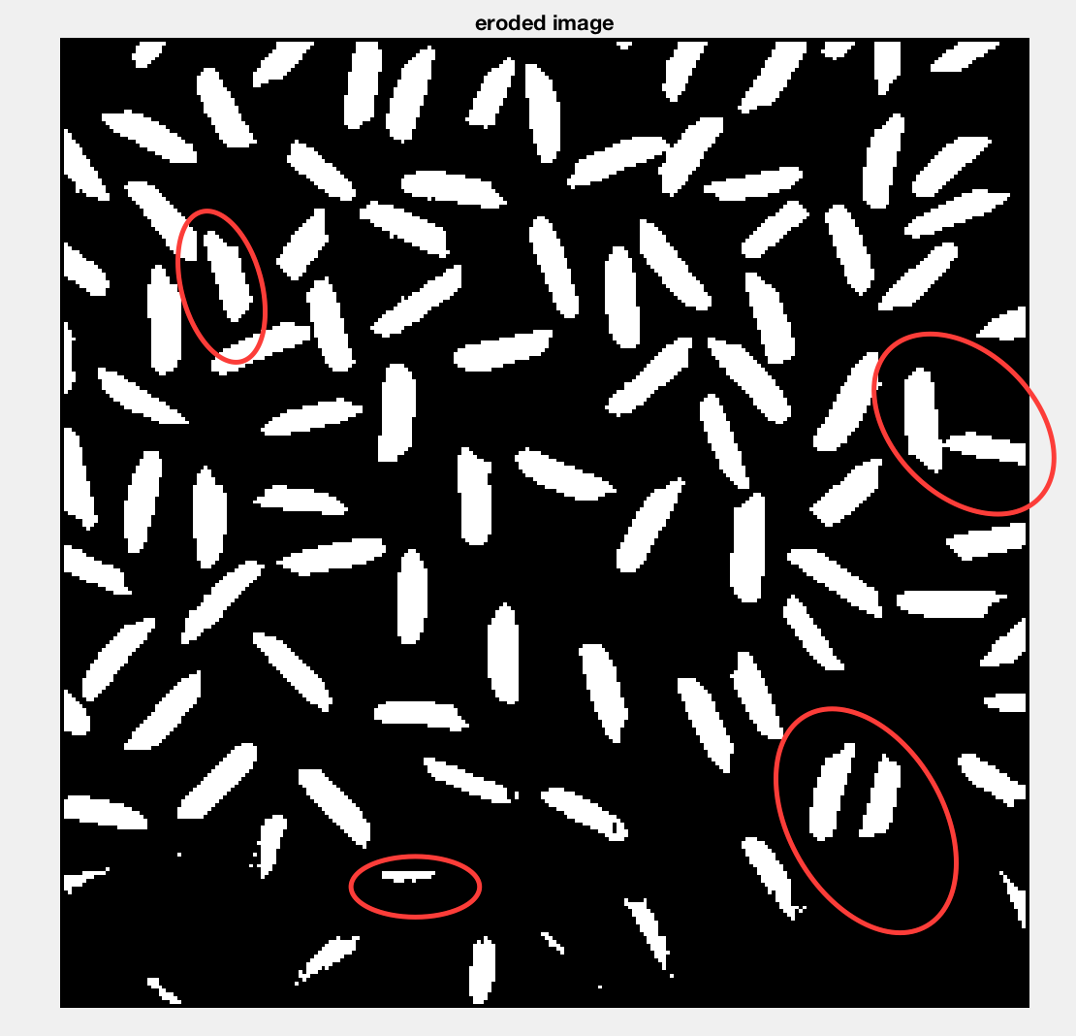
Erosion output using 3x3 structuring element (1 in the centers)
I can also tell that the rice grains seem to have more jagged edges due to the eroding happening along the vertical direction only

Slide 8
Original image after thresholding

Slide 9
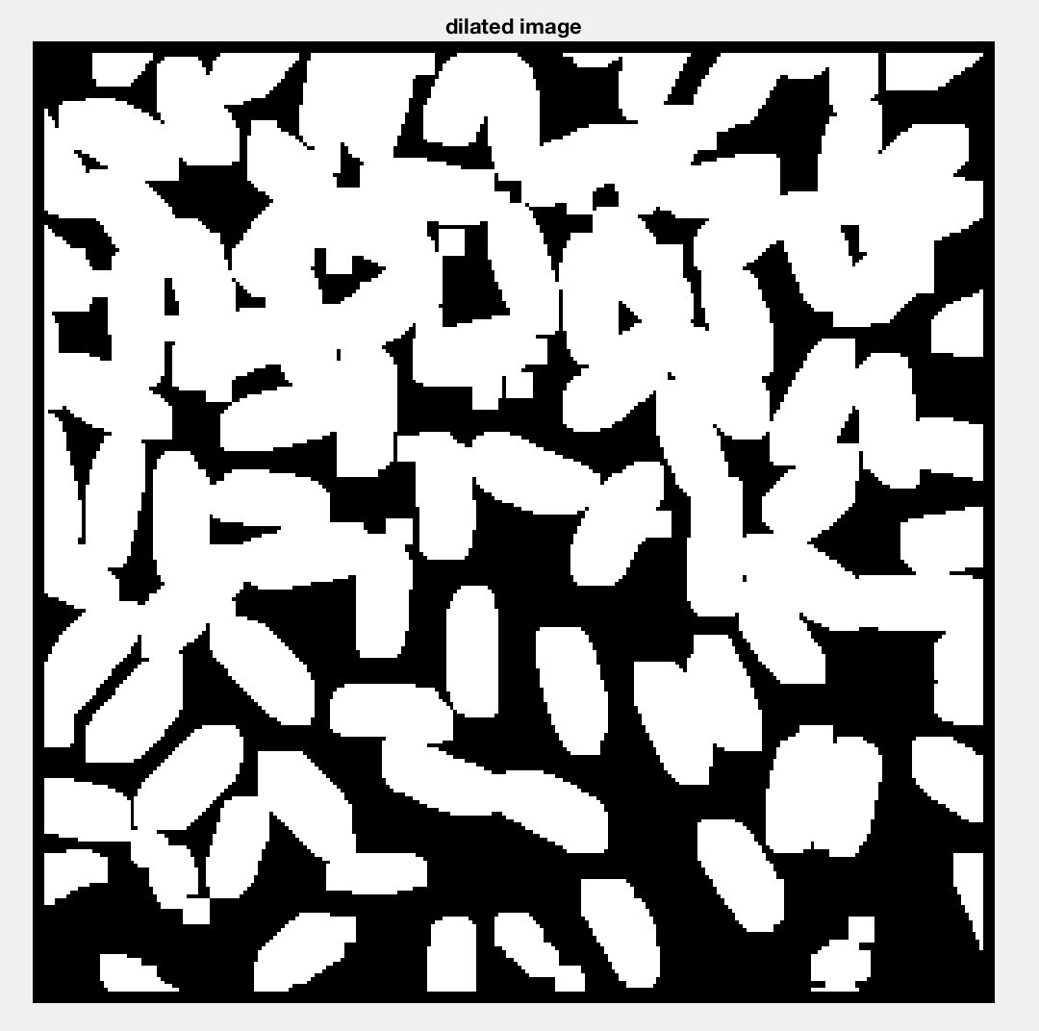
Dilation output using 7x7 structuring element (all 1’s)
Compared to the dilation with 3x3 structuring element, this one is super thick. It looks like the noise has merged with the rice grains in most of the cases.

Slide 10
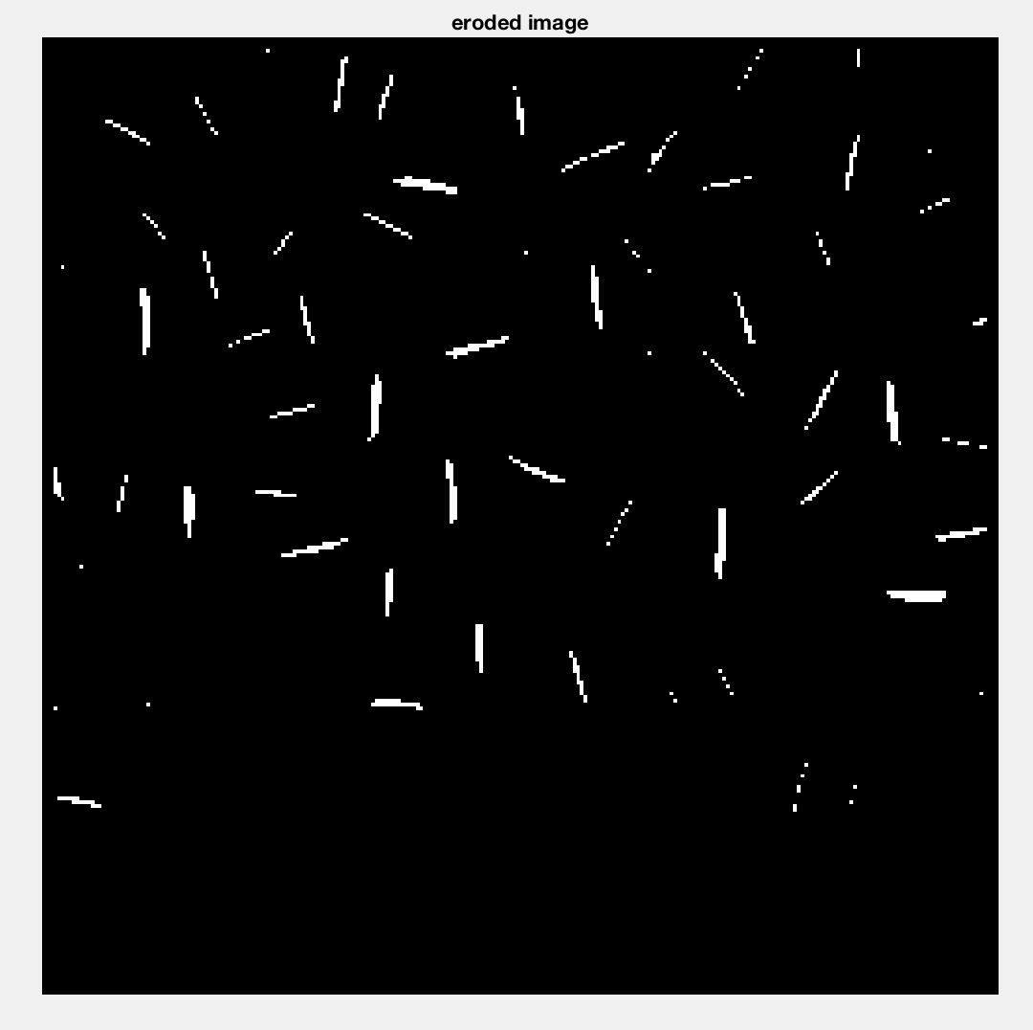
Erosion output using 7x7 structuring element (all 1’s)
Compared to the erosion with 3x3 structuring element, this one is super thin. You can’t even tell that these were rice grains. I think some of the rice grains have even been completely eroded or eroded to a few pixels

