Slide 1
InClass 11
Carlos Rosario

Slide 2
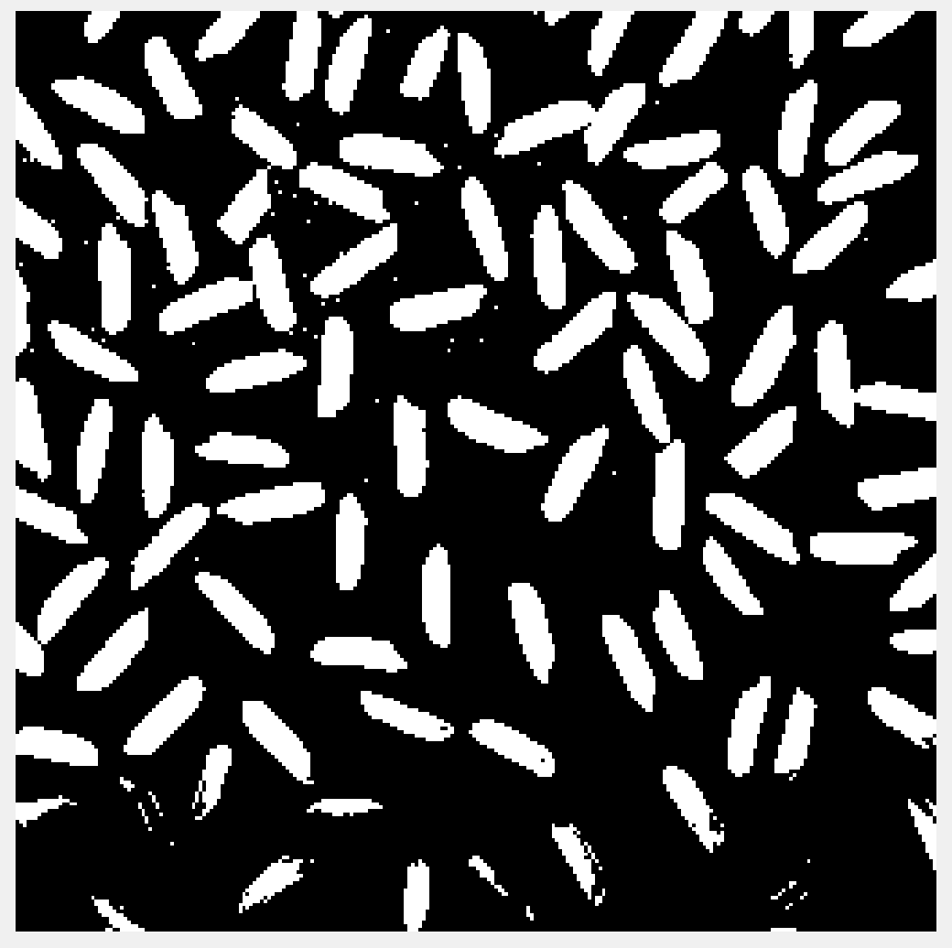
Image after otsu thresholding

Slide 3
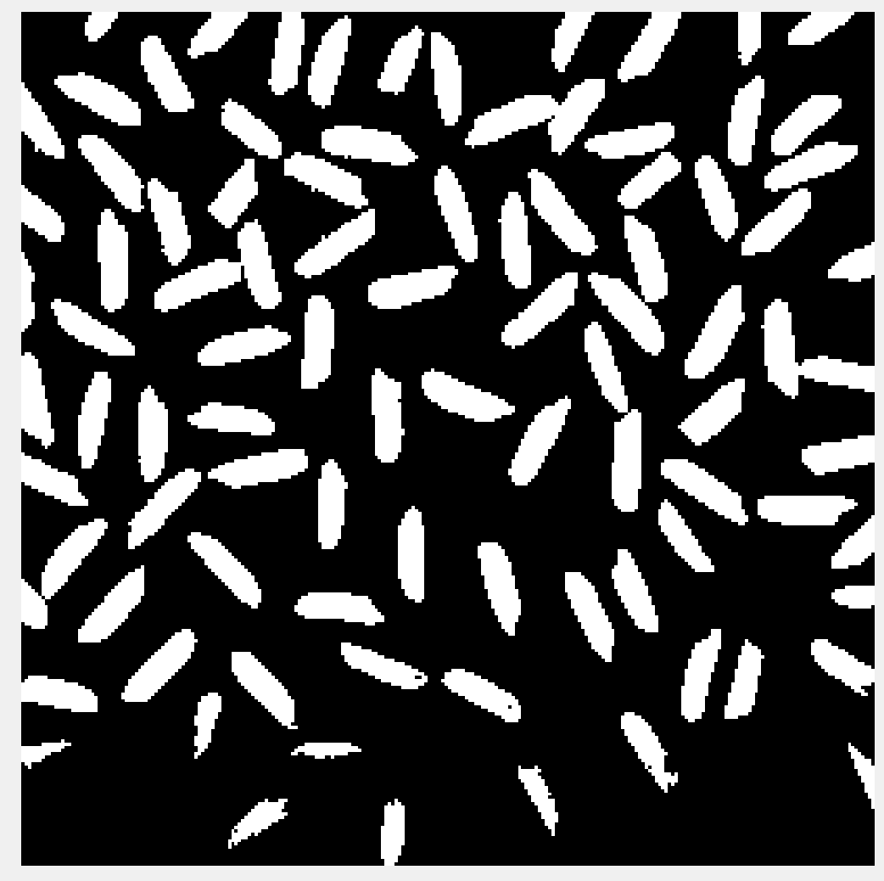
Binary image after small region removal

Slide 4
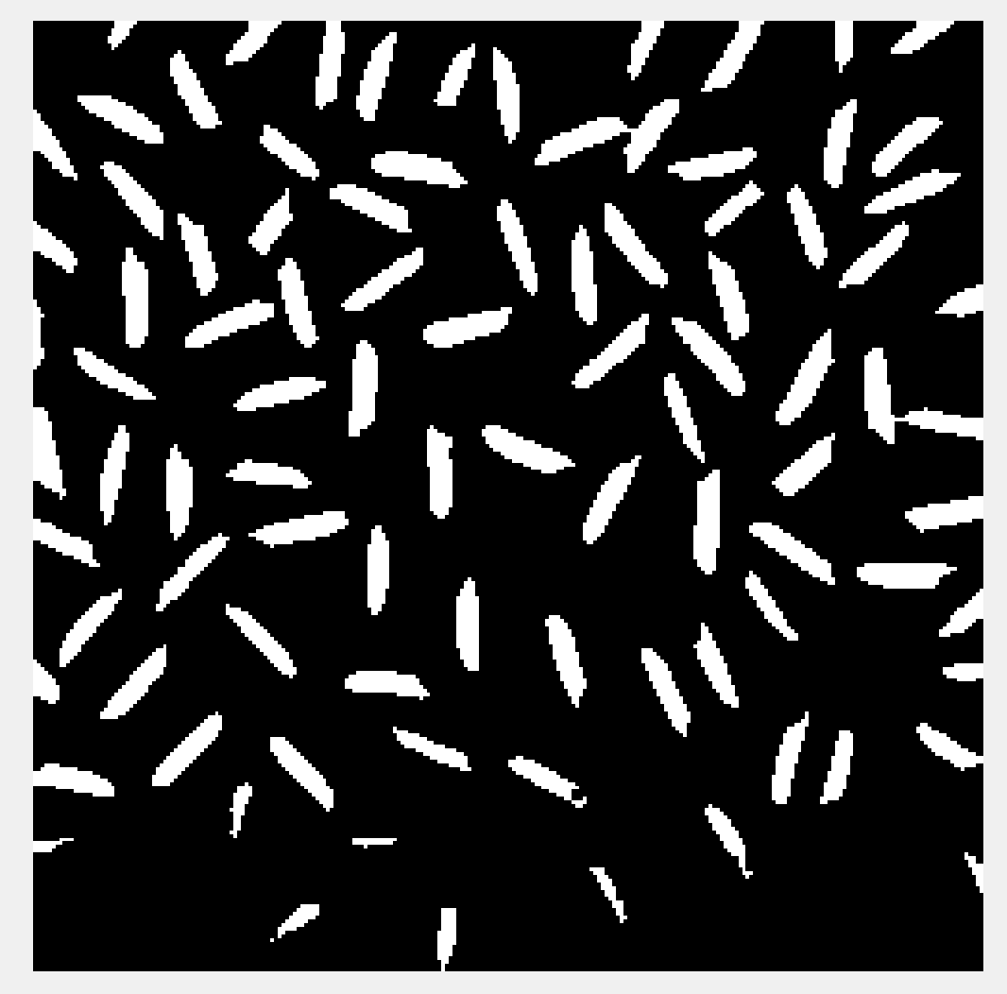
Eroded Image

Slide 5
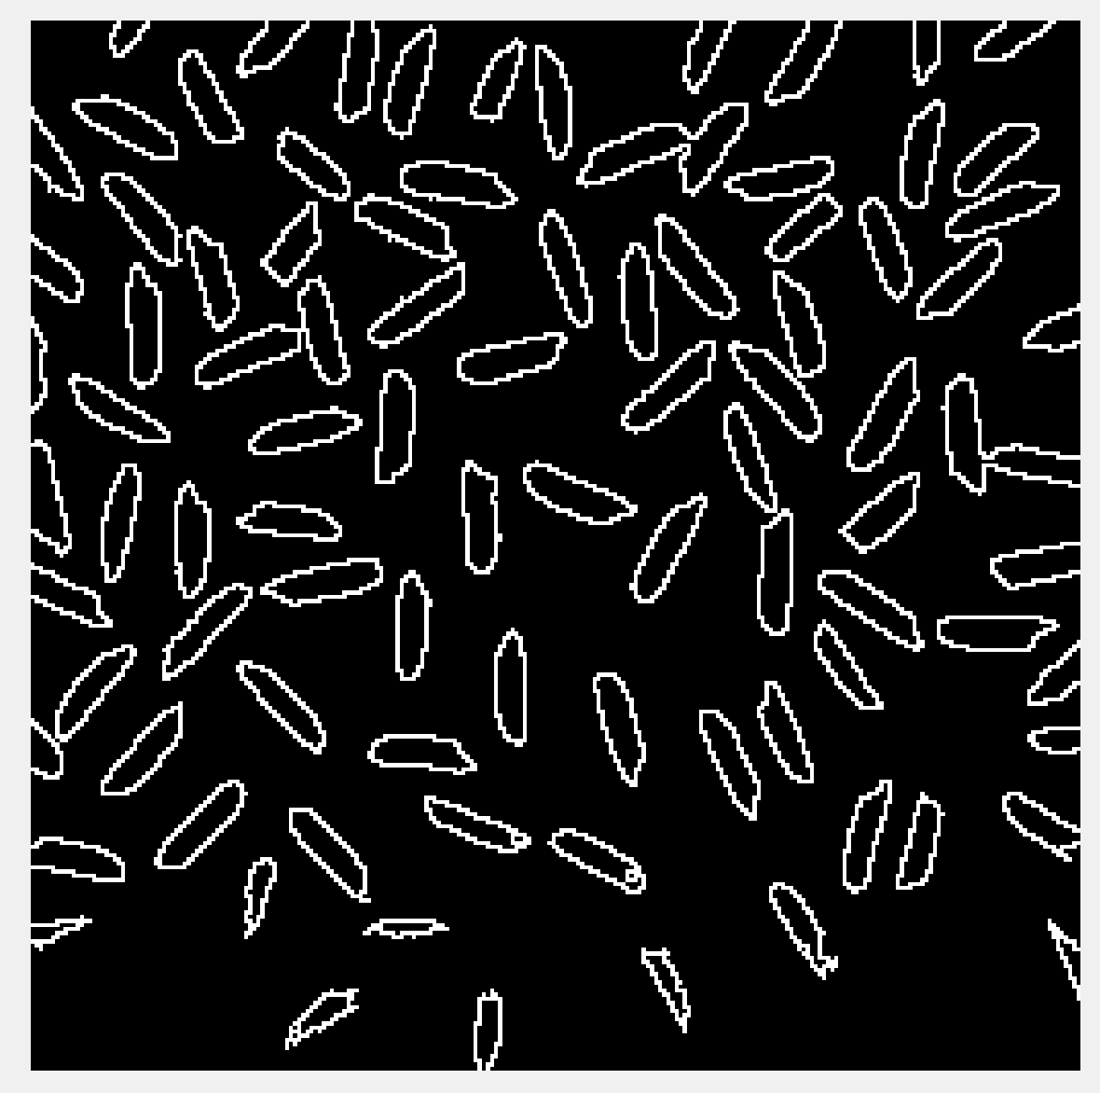
Final boundary image

