Slide 1
InClass Assignment #2
Carlos Rosario

Slide 2
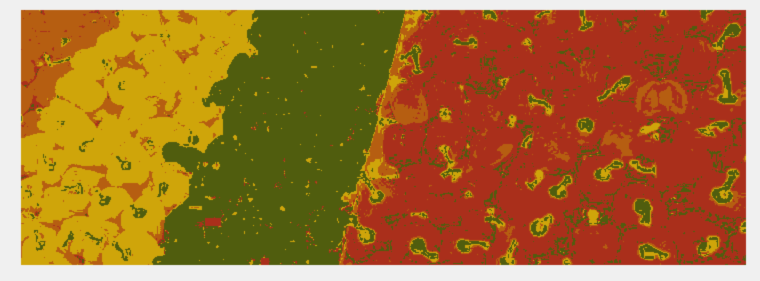
Segmentation Output for N=1

Slide 3
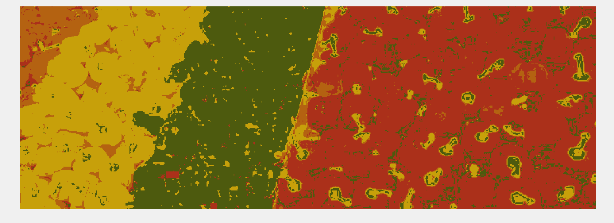
Segmentation Output for N=5

Slide 4
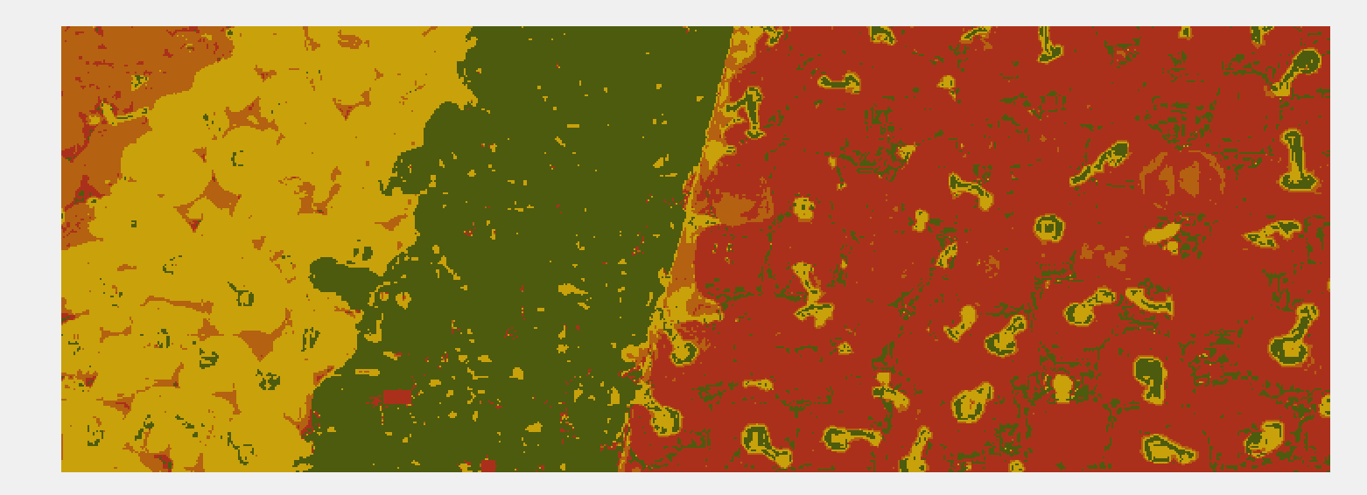
Segmentation Output for N=10

Slide 5
How the segmentation accuracy varies with N
As N gets larger the accuracy of the segmentation tends to increase. I think this makes sense with our intuition because higher N means more data points with which to train our algorithm. I saw the largest accuracy increase (just going off what I could visually see) between N=1 and N=5. The outputs from N=5 and N=10 were very similar.

