Slide 1
InClass #3
Carlos Rosario

Slide 2
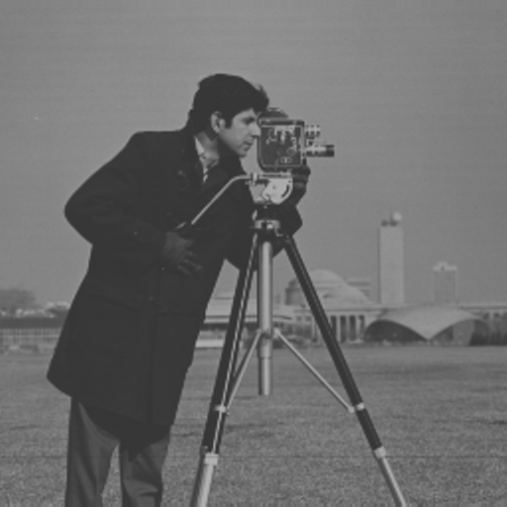
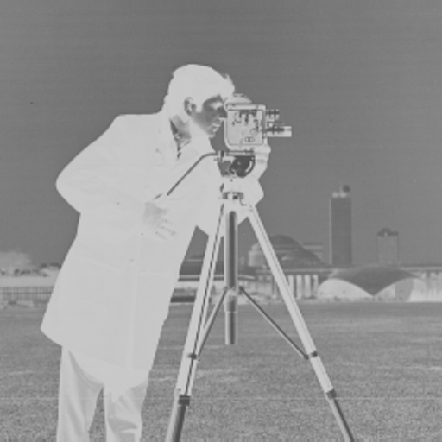
Corrupt1
Corrupted Image
Original Image
Transformation used: inverse
f(x) = 255 - x

Slide 3
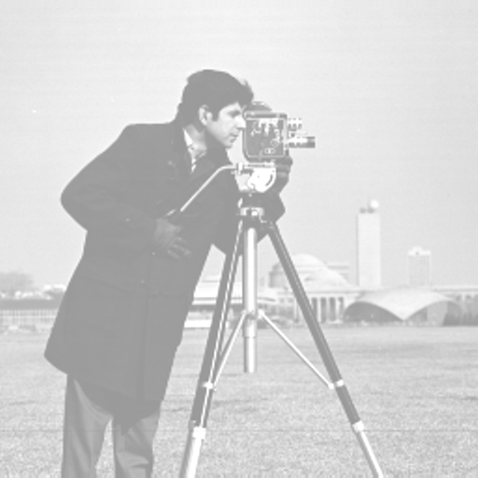
Corrupt2
Corrupted Image
Original Image
Transformation used: add
f(x) = x + 100

Slide 4
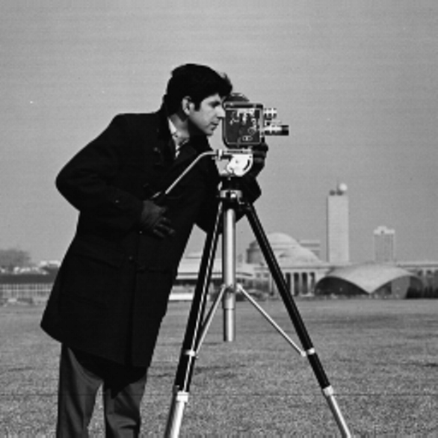
Corrupt3
Corrupted Image
Original Image
Transformation used: linear contrast stretch
f(x) = (255/(orig_max – orig_min) ) * (original – orig_min);
orig_max = 178, orig_min = 50

Slide 5

Corrupt4
Corrupted Image
Original Image
Transformation used: log
f(x) = (255 / log(256) * double(log(original_image) )+1)

