Slide 1
InClass 12
Carlos Rosario

Slide 2

Synthetic Image

Slide 3
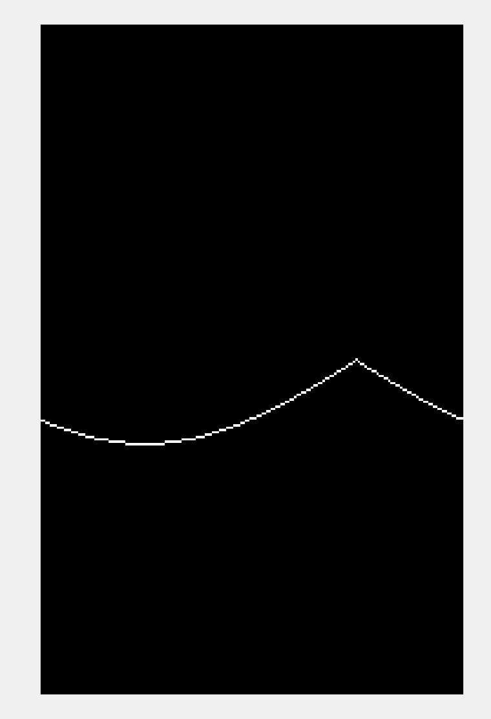
Accumulator array visualization for (25,25)

Slide 4
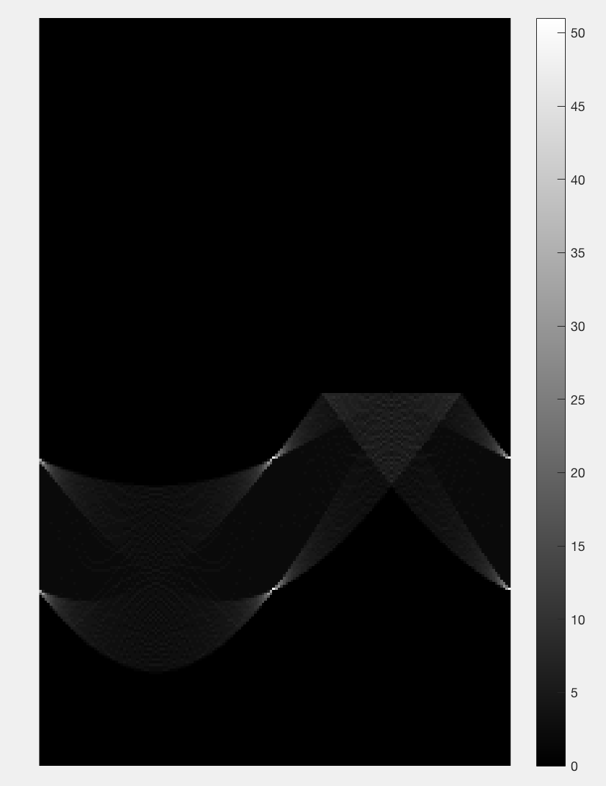
Accumulator array for all edge pixels

Slide 5
Locations in accumulator array with highest votes
These are in (row,column):
(168,90)
(218,90)
(168,180)
(218,180)

Slide 6
Conversions to theta and rho of the locations in the previous slide
(168,90) -> rho = 25, theta = 90
(218,90) -> rho = 75, theta = 90
(168,180) -> rho = -25, theta = 180
(218,180) -> rho = 75, theta = 180
These values do indeed make sense because when you plug in the values for rho and theta you end up with the following four line equations:
Y = 25 (horizontal line at y = 25)
Y = 75 (horizontal line at y = 75)
X = 25 (vertical line at x = 25)
X = 75 (vertical line at x = 75)
Which perfectly describe our original synthetic image.

