Slide 1
InClass Assignment #5
Carlos Rosario

Slide 2
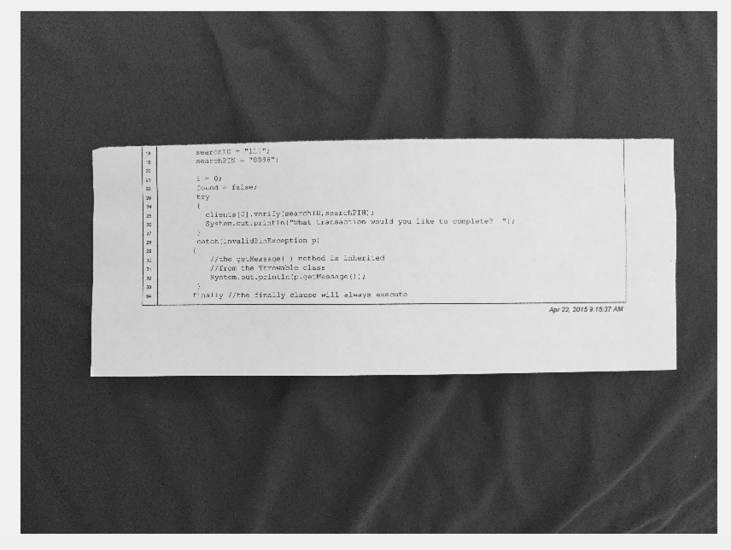
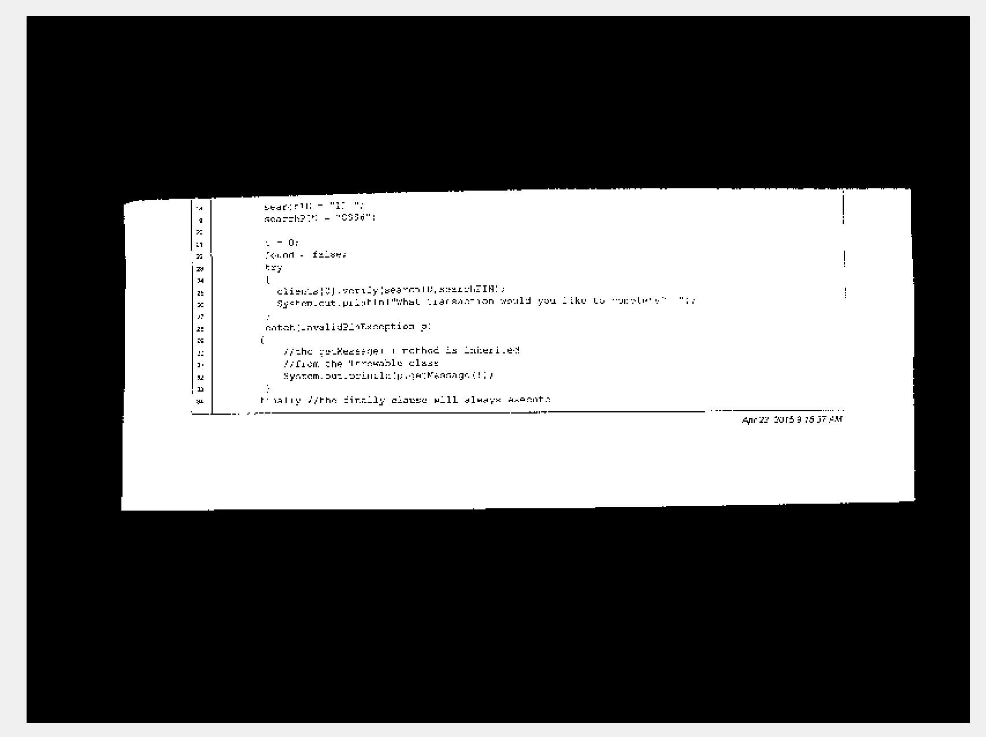
Input image 1 (image1.png) and tresholded output using Otsu’s algorithm

Slide 3
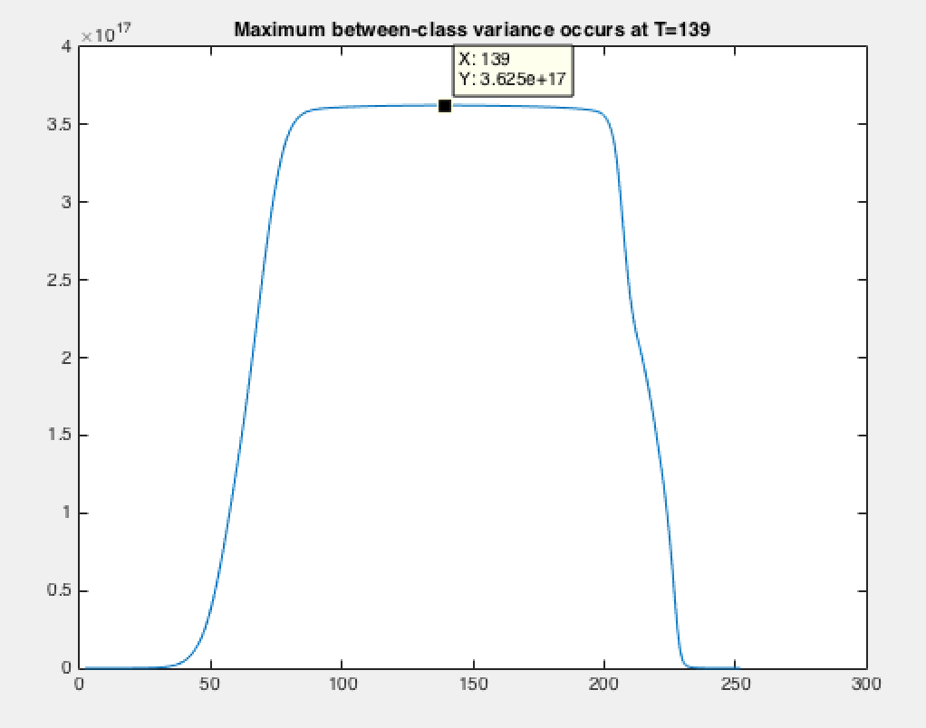
Plot of between-class variance for image1.png after running Otsu’s algorithm

Slide 4
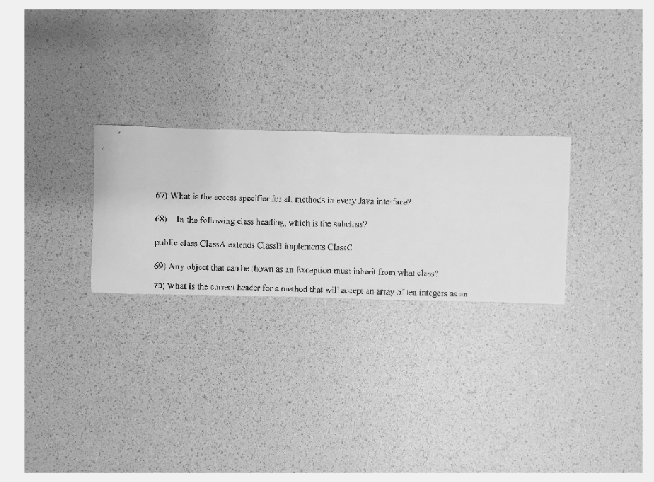
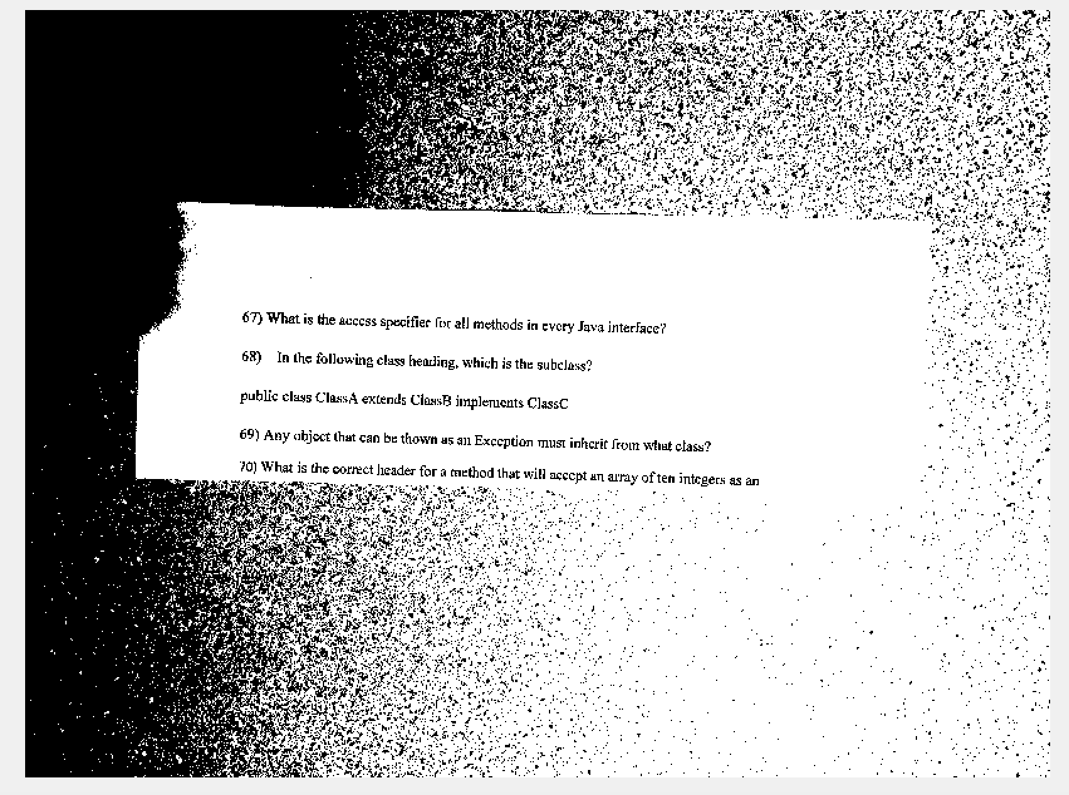
Input image 2 (image2.png) and tresholded output using Otsu’s algorithm

Slide 5
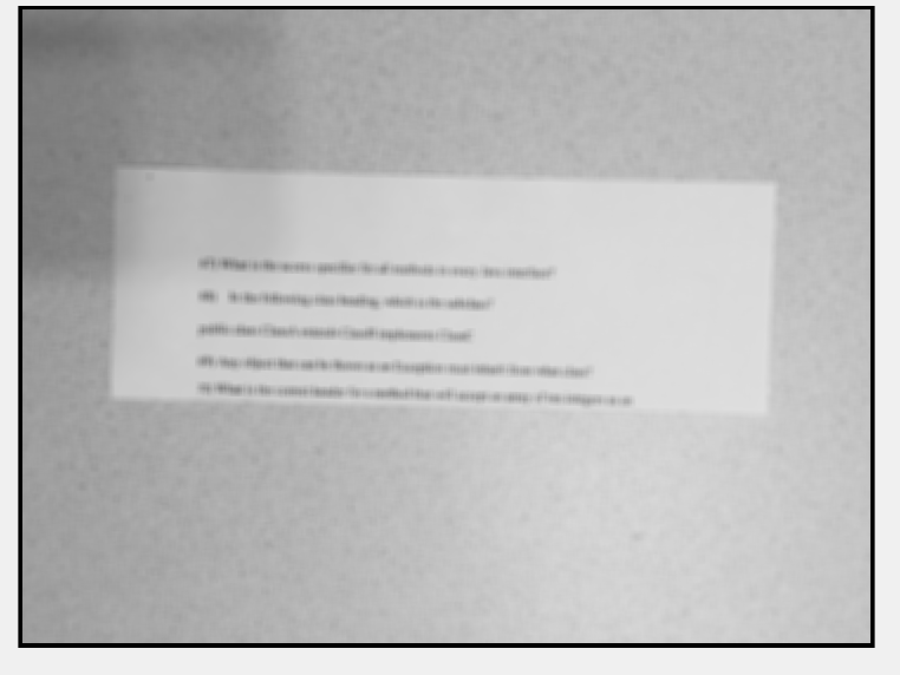
Image2 mean image

Slide 6
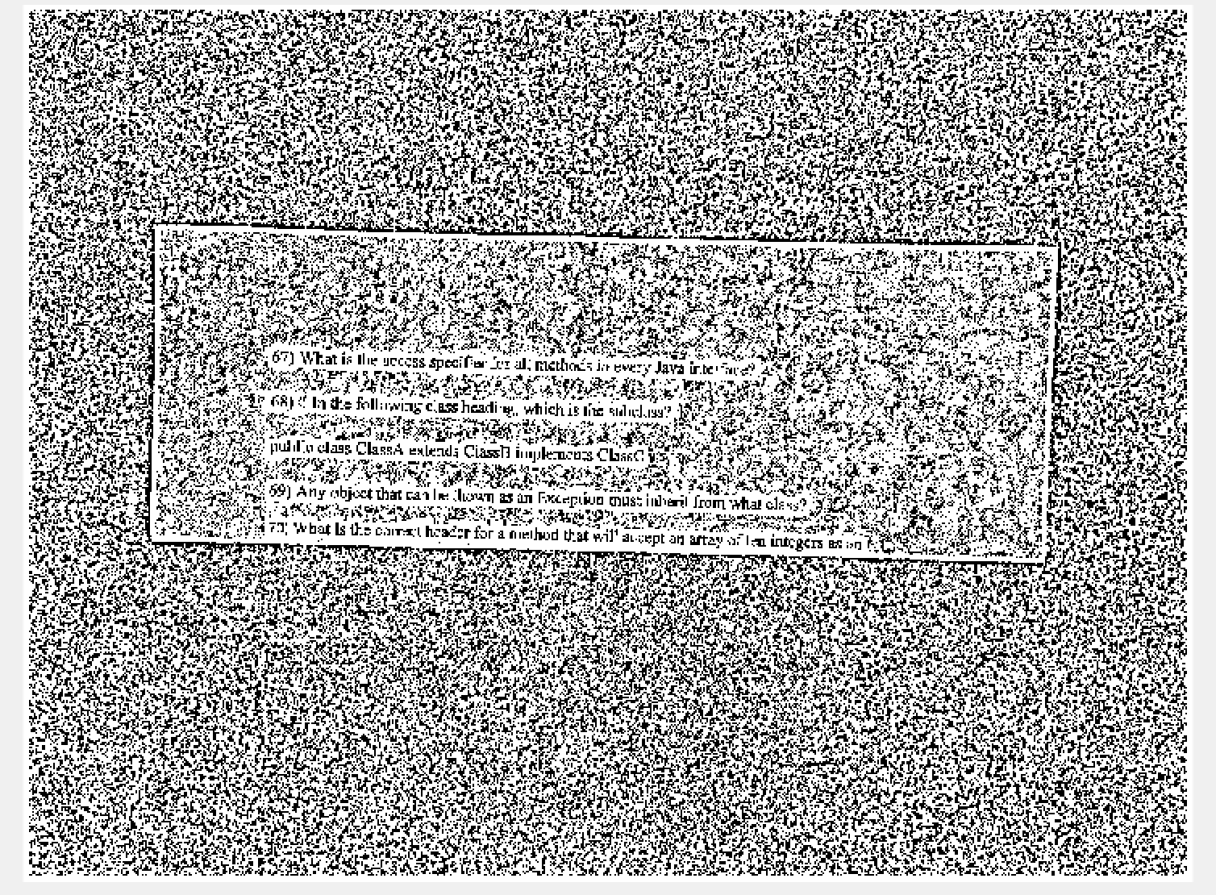
Image 2 treshold output via Local Treshold algorithm; K = 1

Slide 7
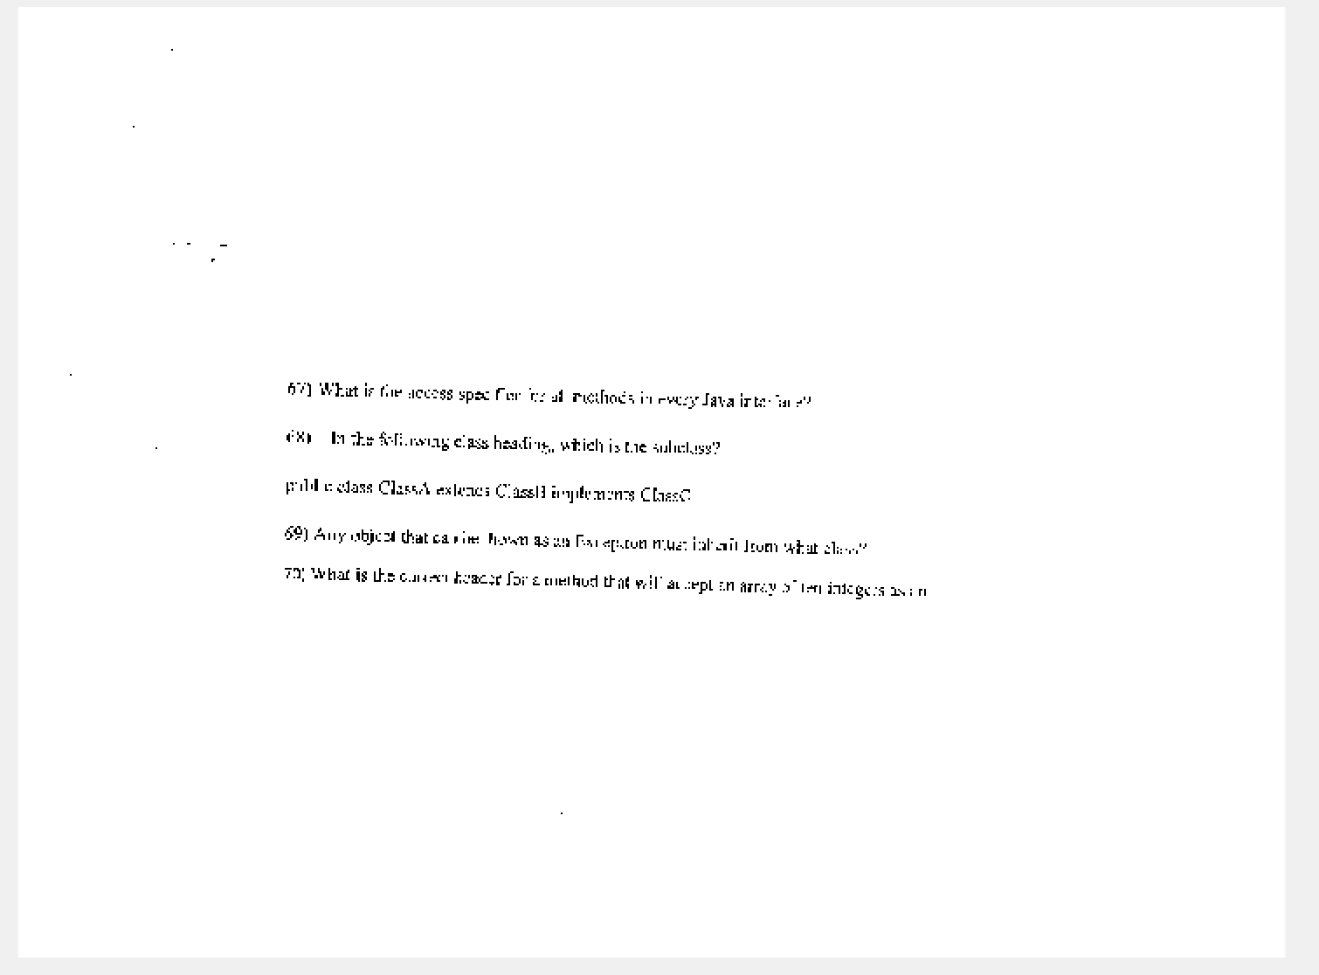
Image 2 treshold output via Local Treshold algorithm; K = .6

Slide 8
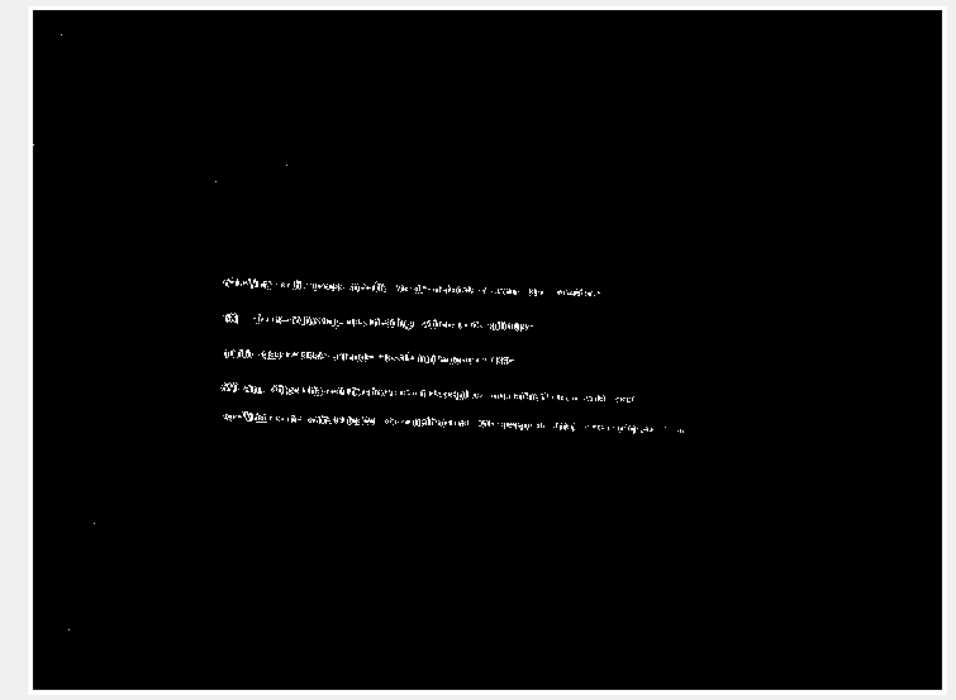
Image 2 treshold output via Local Treshold algorithm; K = 1.2

