Slide 1
Managed Aquifer Recharge as Drought Resilient strategy
Ami Reznik and Ariel Dinar
School of Public Policy, University of California, Riverside
PBPL 273, UCR, February 7

Slide 2
layout
Research Questions
Central Valley Focus Areas
Data Needs and Sources

Slide 3
MAR implementation as a strategy
Is it sustainable, drought resilient?
How is it impacted from different institutions?
What are the interdependencies with other policies?
SGMA
Conservation programs
How much water is available?
What sources to use?
What recharge methods to adopt?
What is farmers’ role?

Slide 4
Institutions for managing the CPR-MAR
Arrangements for storage in the aquifer, operational reservoir
Storage rights
GW master
Inclusion of the urban sector
Water trade in freshwater
Water trade/sale of recycled wastewater

Slide 5
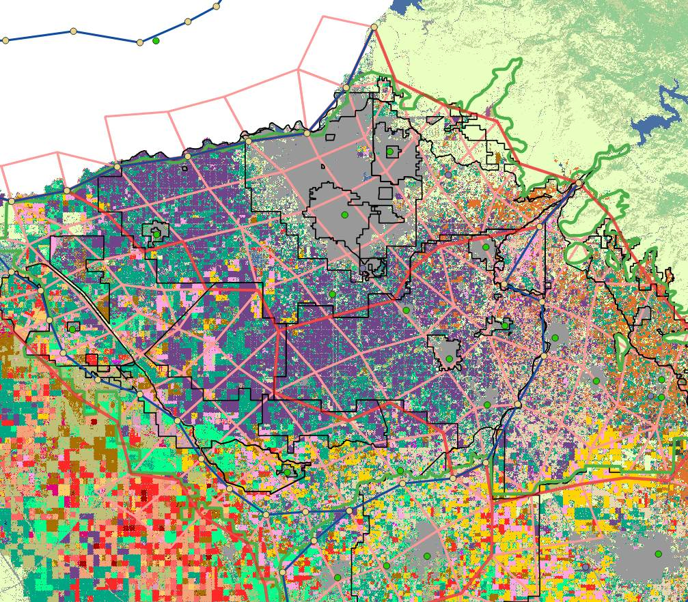
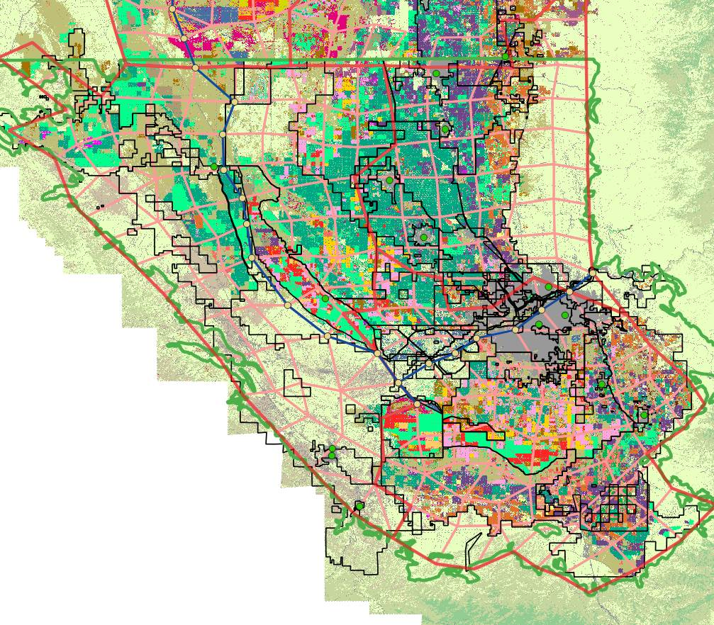
Kings GW Basin Kern GW basin

Slide 6
Data Specification and Sources
Area under main crops [CDL (https://nassgeodata.gmu.edu/CropScape/)].
Soil type under cultivated areas [WSS/GSSURGO (https://websoilsurvey.sc.egov.usda.gov/App/WebSoilSurvey.aspx)].
Land suitability for on-farm recharge [SAGBI/DWR (https://gis.water.ca.gov/app/CADWRLandUseViewer/)]
Weather data e.g., precipitation (recharge), potential evapotranspiration [CIMIS (https://cimis.water.ca.gov/WSNReportCriteria.aspx)]
Boundaries [DWR (https://gis.water.ca.gov/app/boundaries/)]

Slide 7
Additional data
Distances and altitude differences between units of analysis and:
Surface water sources
Groundwater wells
Wastewater treatment facilities

