Slide 1
Installer
Carlos Peña Hernando

Slide 2
What is Application Packaging?
Creation of an executable (or file used by a service) that contains the files, registry and logic to install an application onto a device.
This packages must be prepared and meet the installation requirements for an specific environment

Slide 3
Artifacts
Formats
Multiple files in different locations
Shortcuts
Registry
Runtime engines
.NET registration
Shell integration
ActiveX controls
Databases
Microsoft Windows Installer -> Setup.msi
Legacy executables -> Setup.exe
Windows store .appx
Batch/script files -> Install.vbs, Install.ps1, Install.bat
Loose Files / Raw Files
Add-in /Plug- in -> .dll / .xla /.xlam / .ppam / .dotm, etc…)

Slide 4
Why we need Application Packaging?
Only the simplest applications can work with a simple file copy
Marketing tool
Upgrade and patching features
Digital certificates
Prevents piracy

Slide 5
Windows Installer
Microsoft now provides the Microsoft® Windows® Installer (MSI) service as part of its desktop operating systems
This database-driven service resides on workstations and controls installing, uninstalling, patching, and repairing of software.
Windows Installer technology is divided into two parts that work in combination; these include a client-side installer service (Msiexec.exe) and a Microsoft Software Installation (MSI) package file

Slide 6
MSI Deployment Tasks
Set-up Basics
Custom Actions
Check if the system is suitable for installation for the package in question.
Scan for presence and if necessary install prerequisites and runtimes.
Provide a GUI suitable for input of required settings from the user.
Allow installation in silent mode for corporate use.
purpose built executables (binaries: dll, exe) and scripts capable of making advanced modifications to the system during installation
There are different custom action types: implemented as scripts (JavaScript, VBScript), .NET binaries (C#, VB.NET, DTF,…), PowerShell scripts, etc.
leading causes of deployment errors and failure.

Slide 7



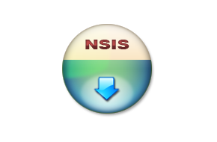


Installer Tools

Slide 8
Wix Toolset
Allows the creation of a binary MSI file from regular text source files
MSI binary is “compiled” from WiX text XML files
Very few significant bugs.
Full integration in Visual Studio, with IntelliSense.
It’s free.
It’s Open Source too. The “community”: https://github.com/wixtoolset.

Slide 9
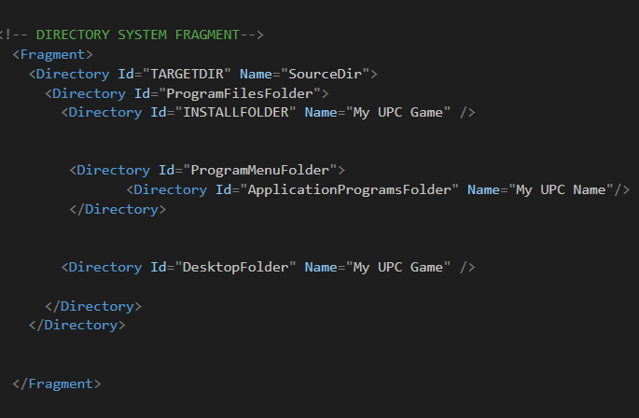
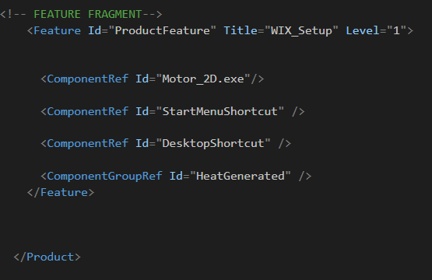
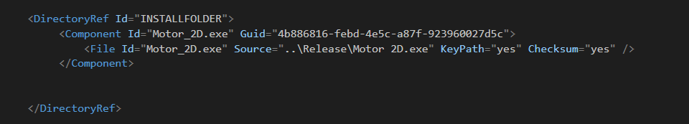
Integration Code

Slide 10
TODO 1: Customize product features + mapping exe project file
You have to add the .exe file of the project by creating a “component” element in the appropriate fragment.
Once created, you must add the required attributes (ID and GUID) and create as your child a “File” element where you have to add your path as an attribute.
You must use the “DirectoryRef” element to reference the folder where you want the .exe file to be copied and use the “ComponentRef” element in the feature section to tell the framework to execute said action.

Slide 11
TODO 2: Add Start Menu Shortcut
You have to add in directory system the “ProgramsMenuFolder” directory and inside it, create the directory where to instantiate the start menu shortcut.
Then, you must create it as a “component” element following the guidelines used in the previous TODO and add as a child the “Shortcut” element where you should indicate the .exe that you want the shortcut to point to.
Finally, use the “ComponentRef” element to notice the framework to execute the instruction.

Slide 12
TODO 3: Add Desktop Shortcut
Do the same as in the previous TODO, with the difference that the folder where the desktop shortcut will be instantiated does not need any extra directory.

Slide 13
TODO 4: Implement control panel icon + exe project icon (shortcuts)
For shortcut icons, you just need to modify shortcut components you created before adding the attribute “Icon” inside Shortcut element.
For control panel icon, you need to import the icon.ico using the “Icon” element and adding a property to work property with the control panel of your computer.

Slide 14
TODO 5: Add UI Dialog theme (installDir)
First, you have to add to the WIX Setup project as a reference the “WixUIExtension” dll provided by Wix Toolset
Once imported, you have to use the external element “UIRef” with the appropriate property to generate the chosen dialog theme (in this case, will use the InstallDir).

Slide 15
TODO 6: Customize UI Dialog theme with bmp files
You have to use the “WixVariable” element to be able to import the path of the bitmap files with the correct ID.

Slide 16
TODO 7: Add Microsoft License into UI Dialog
You need to do the same as previous TODO using “WixVariable” element and import License.rtf file

Slide 17
TODO 8: Uncomment game components (dll, assets, etc)
Uncomment ComponentGroupRef to make enable the game components and dll’s and enjoy the awesome game you have installed!

Slide 18
Signing an Application Packaging
Signing an Application Packaging files is an important thing since you help ensure that tampered files are not installed on end-user computers.
Since we are making use of .msi files for the deployment of applications, the best option is SignTool.exe
we need to install Microsoft Windows SDK to be able to work with SignTool.exe.

Slide 19

Testing Deployment Application on Virtual Machine
This method allows you to simulate a full operating system, isolated from the rest of your machine
Perfect way to test your setup installer to check if it works on different Operating Systems and its previous versions.

Slide 20
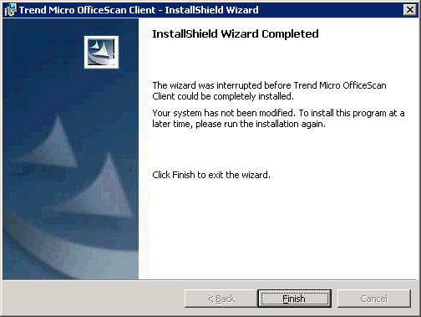
Installation finished!
GitHub account: CarlosUPC
Gmail: carlos_bcn1999@gmail.com

