Slide 1
Multi-Target Code Generation and
Training of Deep Learning Networks
for Autonomous Driving
Carlos Alfredo Yeverino Rodriguez
Masterarbeit
am Lehrstuhl für Software Engineering
RWTH Aachen
Notes:
Good evening,
my name is Carlos Yeverino Rodriguez and I will present my master thesis “Multi-Target Code Generation and Training of Deep Learning Networks for Autonomous Driving”.

Slide 2
Outline
Basics
Motivation
Multi-Target Code Generation for Deep Learning Systems
Tasks and Requirements
Extended Tool Chain
Tool Chain Overview
CNNArch2Caffe2
Generated Product
Demonstration
Conclusion
Notes:
My presentation is divided into 5 parts: Basics, Motivation, then I will look deeper at Multi-Target Code Generation for Deep Learning Systems and afterwards I will show a deep learning application and finally the Conclusions.

Slide 3
Outline
Basics
Motivation
Multi-Target Code Generation for Deep Learning Systems
Tasks and Requirements
Extended Tool Chain
Tool Chain Overview
CNNArch2Caffe2
Generated Product
Demonstration
Conclusion
Notes:
Let us start with some basic concepts to get a better understanding of the following sections.

Slide 4
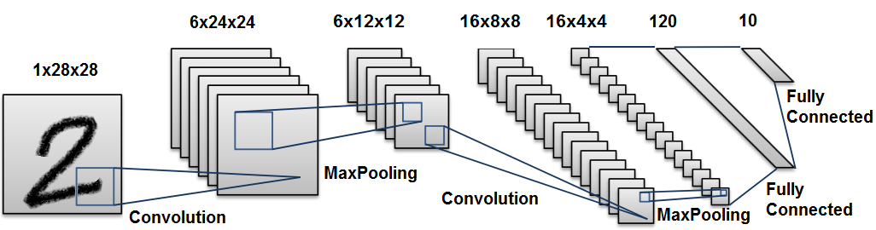
Deep Learning
Learning from data using deep neural networks.
The learning algorithm creates a model from the training dataset.
training dataset consists of samples and target labels.
Convolutional Neural Networks (CNNs) perform especially well on computer vision tasks.
CNNs are composed of pairs of convolutional and pooling layers.
Convolutional layers learn translation invariant features.
Pooling reduces the spatial dimensions, i.e. subsampling.
Notes:
Deep learning is a widely used machine learning technique that makes use of deep neural networks which are built by stacking layers one after another.
There are several application for deep learning such as …image classification
In deep learning and machine learning in general a learning algorithm creates a model…
Convolutional layers learn translation invariant features since a convolution filter is applied across the whole image with some stride.
Pooling makes the image representation smaller without losing too much information, that means, it performs subsampling.
CNNs are therefore models which are invariant to translations and scaling.
This pictures shows a CNN architecture used for implementing the MNIST Classifier. We can observe here the pairs of convolution and max pooling.
The final layer of a CNN would typically be a fully connected layer with a softmax output in the case of multiclass classification.
The ten output units of the final fully connected layer corresponds to the 10 digits.

Slide 5
EmbeddedMontiArc (EMA)
Textual modeling language for Component and Connector (C&C) architectures.
Based on the ADL MontiArc.
Designed for Cyber-Physical Systems.
has features that increase reusability and safety.
Abstract types: Z, Q, C
Strict type system that defines domain and dimensions of types.
Core language of the MontiCAR (Modeling and Testing of Cyber-Physical Architectures) language family.
Notes:
Now I will present EmbeddedMontiArc or EMA for short.
It is based on the Architecture Description Language (ADL) MontiArc developed at this chair.
Cyber-Physical Systems which are characterized by their limited memory and computational power.
Z, Q and C stand for integers, rational numbers and complex numbers respectively.
EMA is employed as the core language of the MontiCAR.
MontiCAR (Modeling and Testing of Cyber-Physical Architectures) is a C&C language with the aim of increasing development efficiency for cyber-physical systems.
Now the question that arises is: how can we integrate Deep Learning into EMA?

Slide 6
EmbeddedMontiArcDeepLearning (EMADL)
Deep learning systems can be modeled with EMADL.
EMADL embeds different DSL to achieve this goal:
EMAM: EMA + MontiMath.
CNNArch
CNNTrain
component MnistClassifier{
ports in Z(0:255)^{1, 28, 28} image,
out Z(0:9) classIndex,
out Q probability;
instance LeNetNetwork<10> net;
instance ArgMax<10> calculateClass;
connect image -> net.image;
connect net.predictions -> calculateClass.inputVector;
connect calculateClass.maxIndex -> classIndex;
connect calculateClass.maxValue -> probability;}
¹
port type
²
³
⁴
⁵
subcomponents
⁶
⁷
⁸
⁹
¹⁰
¹¹
Notes:
…and the answer is EMADL
Within the MontiCAR language family many Domain-Specific Language have been developed such as MontiMath, CNNArch and CNNTrain.
EMAM is the combination of EMA and the mathematical computation language MontiMath.
CNNArch and CNNTrain can be described as CNN languages. CNNArch is used to model CNNs architectures while CNNTrain is employed to specify the training configuration for the modeled CNNs.
This image shows an example of a EMADL model.
It consists of a MNIST Classifier.
Since EMADL is also a Domain-Specific Language that follows the Component&Connector architecture, we need to define the input and output ports of the component.
Furthermore, subcomponents can be created by creating instances such as net and calculateClass. In this section we instantiate the subcomponents LeNet network and ArgMax.
Finally, we define the functional behavior of the component by connecting input and output ports of the components.
In this example, we pass the input image to the input port of the LeNet network subcomponent in order to predict the probability distribution of the classes.
Then, this probability distribution is given to the input port of the ArgMax subcomponent to obtain the corresponding predicted class along with its probability value just to be printed as additional information. These two values are the outputs of the MNIST Classifier.

Slide 7
EmbeddedMontiArcDeepLearning (EMADL)
MnistClassifier
C&C
image: Z(0:255)^{1, 28, 28}
LeNetNetwork
predictions: Q(0:1)^{10}
ArgMax
classIndex: Z(0:9)
probability: Q
Notes:
The presented code in the prevous slide represents the following component.

Slide 8
Outline
Basics
Motivation
Multi-Target Code Generation for Deep Learning Systems
Tasks and Requirements
Extended Tool Chain
Tool Chain Overview
CNNArch2Caffe2
Generated Product
Demonstration
Conclusion
Notes:
Now, let us continue with the question: what is the underlying motivation for this thesis? How can we improve the presented work?

Slide 9
Motivation
There is a wide range of deep learning frameworks. Although most frameworks are similar to certain degrees, each has its unique caracteristics.
Supporting multiple deep learning frameworks can compensate for each one’s shortcomings.
EMADL supported only the deep learning framework MXNet as backend which led to a lack of flexibility.

Slide 10
Outline
Basics
Motivation
Multi-Target Code Generation for Deep Learning Systems
Tasks and Requirements
Extended Tool Chain
Tool Chain Overview
CNNArch2Caffe2
Generated Product
Demonstration
Conclusion
Notes:
This leads me to my next point: Multi-Target Code Generation for Deep Learning Systems.

Slide 11
Tasks and Requirements
Tasks:
Create a Generator Coupling for Multi-target Code Generation.
Extend the EMADL tool chain to support multi-target code generation.
Development of a new deep learning backend-dependent code generator.
Test the extended EMADL tool chain and the developed code generator.
Requirements:
Configurable Mechanism: Implementing a configurable mechanism to allow the user to choose a specific backend for deep learning code generation.
Backend-dependent Code Generation: Generated code must be generated based on the specified backend by the user.
Notes:
The Tasks of this thesis were:
-the creation of a generator coupling for Multi-target Code Generation.
-this implicitly required to extend the previous EMADL tool chain.
-Also, a new deep learning backend-dependent code generator was developed since there was only one before/previously.
-Last but not least, test the extended EMADL tool chain and the developed code generator.
In order to achieve these tasks there were some requirements:
-A configurable mechanism must be implemented to allow the user to choose...
-The generated code must be generated based on the specified backend by the user.

Slide 12
Tasks and Requirements
Requirements (Continuation):
Backend-independent Languages: CNN languages must be backend-independent.
Modularity: Backend-dependent code has to be generated by its corresponding backend-dependent code generator.
New Code Generator: a new code generator has to be developed to enable multi-target code generation.
Notes:
-CNN languages must be backend-independent or in other words generic
-Furtheremore, Modularity must be mantained within the tool chain. That is, backend-dependent code …
-And of course develop a new deep learning code generator to enable multi-target code generation.

Slide 13
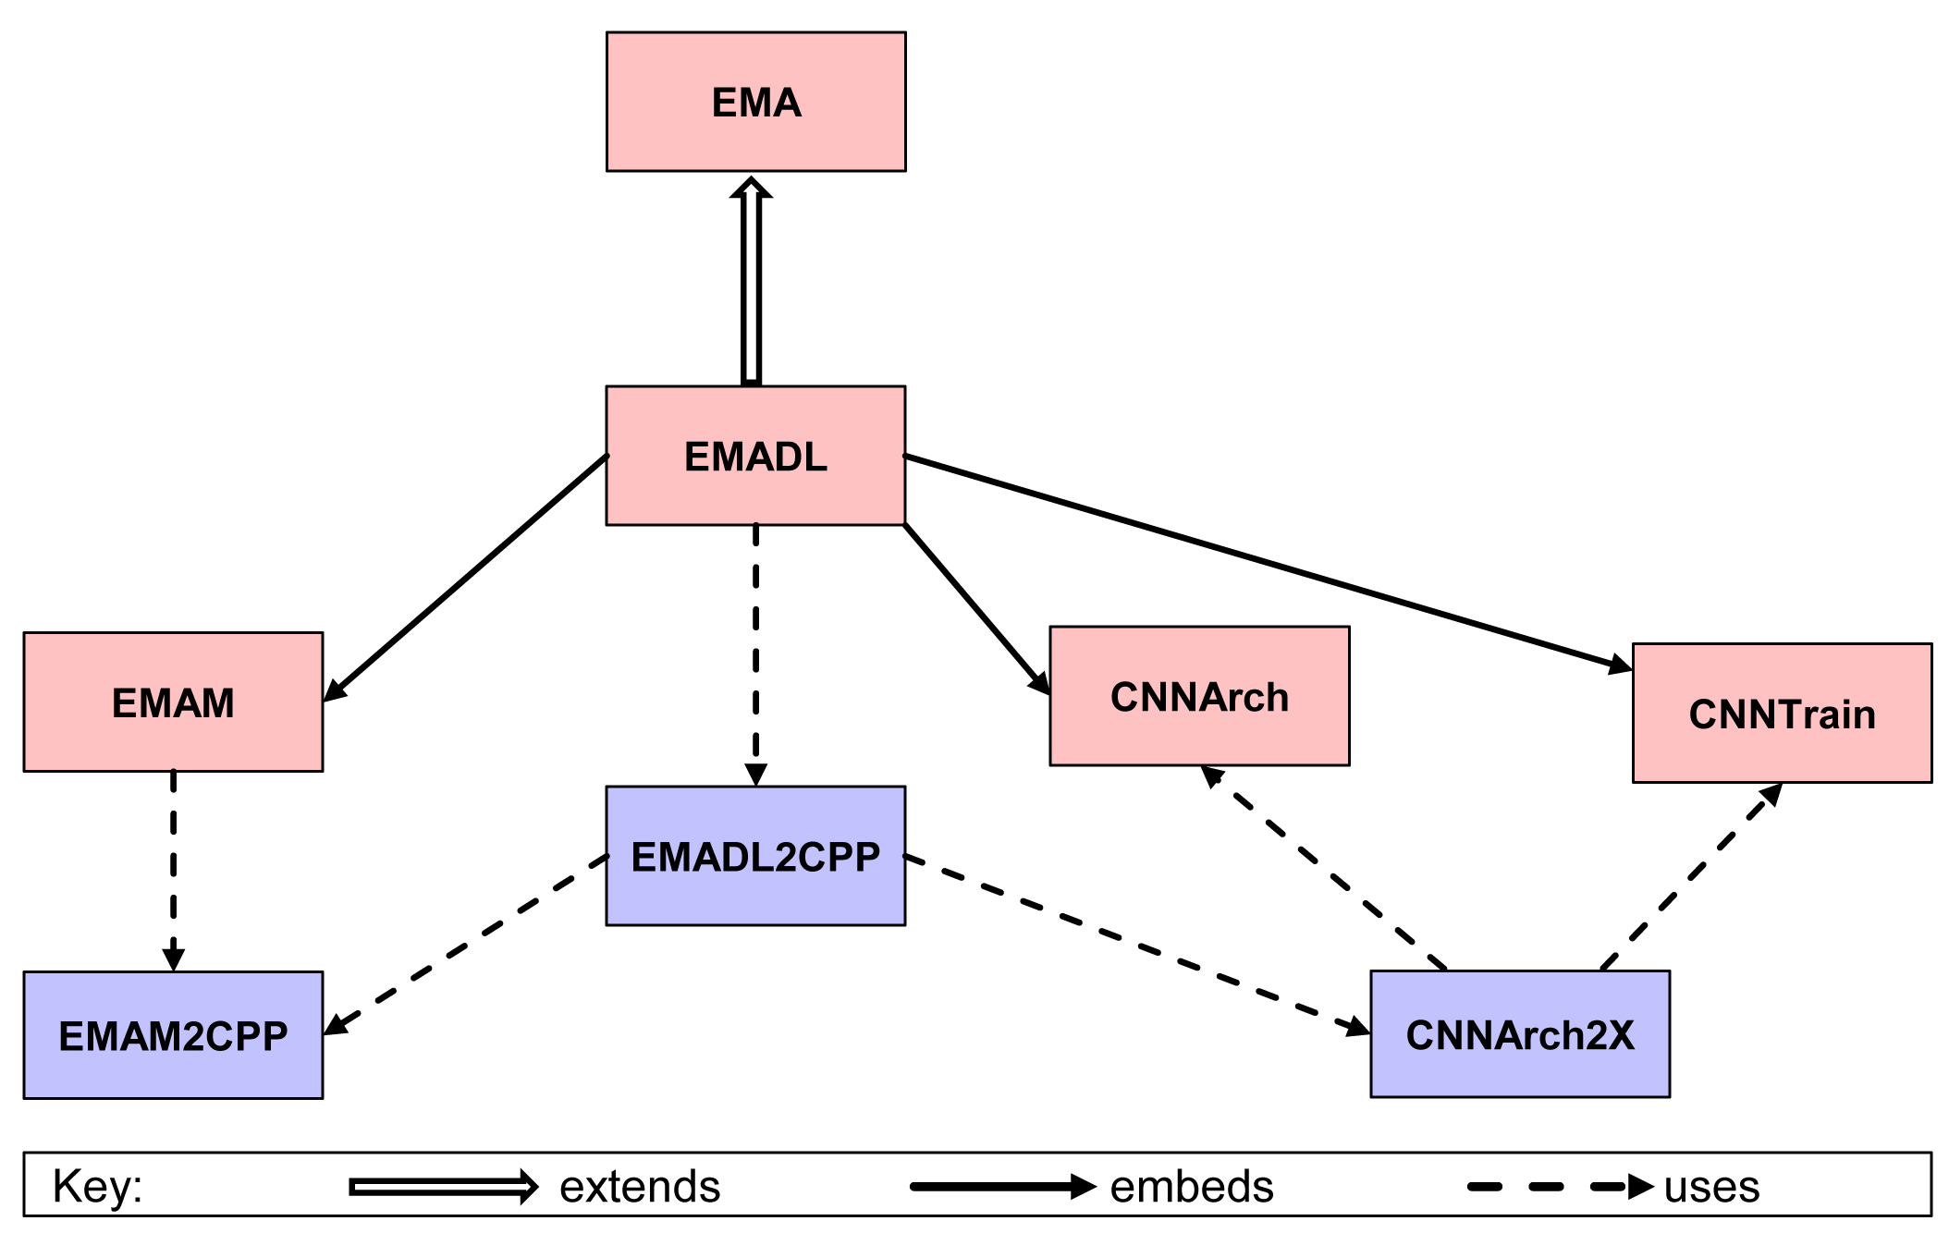
Extended Tool Chain
These requirements led to the following tool chain:
Notes:
These requirements led to the following extended tool chain that supports multi-target code generation.
Here, we can observe the already presented EMA.
EMADL, EMAM, CNNArch and CNNTrain are Domain-Specific languages within the MontiCAR language family.
On the other hand, the blocks with blue background denonte code generators.
The ending 2CPP denotes code generation to the c++ language.
Futhermore, CNNArch2X represents multiple code generators whose names begin with "CNNArch2“.
In the following I will present an overview of this tool chain.

Slide 14
Tool Chain Overview
Languages:
EMAM models mathematical implementations.
CNNArch models CNN architectures by stacking layers one after another. CNNArch files have extension “.cnna”
CNNTrain provides the training configuration for the modeled CNNs. CNNTrain files have extension “.cnnt”
EMADL integrates CNNArch, CNNTrain and MonitMath into EMA in order to enable modeling of deep learning systems. It supports multi-target code generation. EMADL files have extension “.emadl”
Notes:
Within the tool chain we have several Domain-Specific Languages such as EMAM ....CNNArch...CNNTrain
CNNArch and CNNTrain process their own file extension: cnna for CNNArch and cnnt for CNNTrain.
EMADL is used to model complete systems that combine deep learning with regular mathematical computations

Slide 15


Tool Chain Overview
Generators:
CNNArch2Caffe2 generates C++/Python code for the backend Caffe2.
CNNArch2MXNet generates C++/Python code for the framework MXNet.
EMAM2CPP generates C++ code for the mathematical implementations.
EMADL2CPP delegates the code generation to either CNNArch2Caffe2 or CNNArch2MXNet based on the desired backend selected by the user. It uses EMAM2CPP to generate code for mathematical computations.
Notes:
With regard to the code generators, we have the deep learning code generators for Caffe2 and MXNet as well as EMAM2CPP and EMADL2CPP.
Moreover, EMADL2CPP is the code generator used by EMADL.
It delegates the code generation to…

Slide 16
Tool Chain Overview
Textual modeling language for C&C architectures
Modeling language for complete deep learning systems
Modeling language for CNNs
Configuration language for training of deep networks
Mathematical computation language
C++ code generator for EMAM
C++/Python code generator for EMADL
C++/Python code generators for deep learning backends
Notes:
To make a quick recap, we can observe once again the tool chain.
To point out is that EMADL2CPP is the code generator used to create complete deep learning systems.
Furthermore, the configurable mechanism to enable the selection of the desired deep learning backend is implemented in this code generator.

Slide 17
Solution Concept
New Code Generator: The CNNArch2Caffe2 code generator was developed to enrich EMADL with more flexibility.
Modularity: CNNArch2Caffe2 was developed as a separate generator. In this way, CNNArch2Caffe2 generates code for Caffe2 while CNNArch2MXNet generates code for MXNet specifically.
Backend-independent Languages: Code generation performed previously in the CNN languages was removed.
Backend-dependent Code Generation: Java interfaces were introduced in CNNArch and CNNTrain instead so the backend-dependent code generators can implement them to generate code based on the selected backend.
Notes:
Now, I would like to present the solution concept.
As already shown, CNNArch2Caffe2 code generator was developed to enrich ...
CNNArch2Caffe2 was developed as a separate generator to maintain modularity
Furthermore, the code generation performed previously in the CNN languages was removed.
And Java interfaces were introduced in CNNArch and CNNTrain so the backend-dependent code generators

Slide 18
Solution Concept
Configurable Mechanism: EMADL was upgraded to include the design solutions implemented in the CNN languages. A new program argument “backend” or short “b” was added in the EMADL2CPP generator call. An enum type was defined to restrict the accepted values for the argument and create the corresponding instances of the java classes responsible for the code generation based on the specified backend.
Notes:
The program argument “backend” functions as the configurable mechanism to enable multi-target code generation.
An enum type was defined to restrict the accepted values supporting only MXNet and Caffe2.
Based on the “backend” parameter, the corresponding instances of the java classes responsible for the code generation can be created.

Slide 19
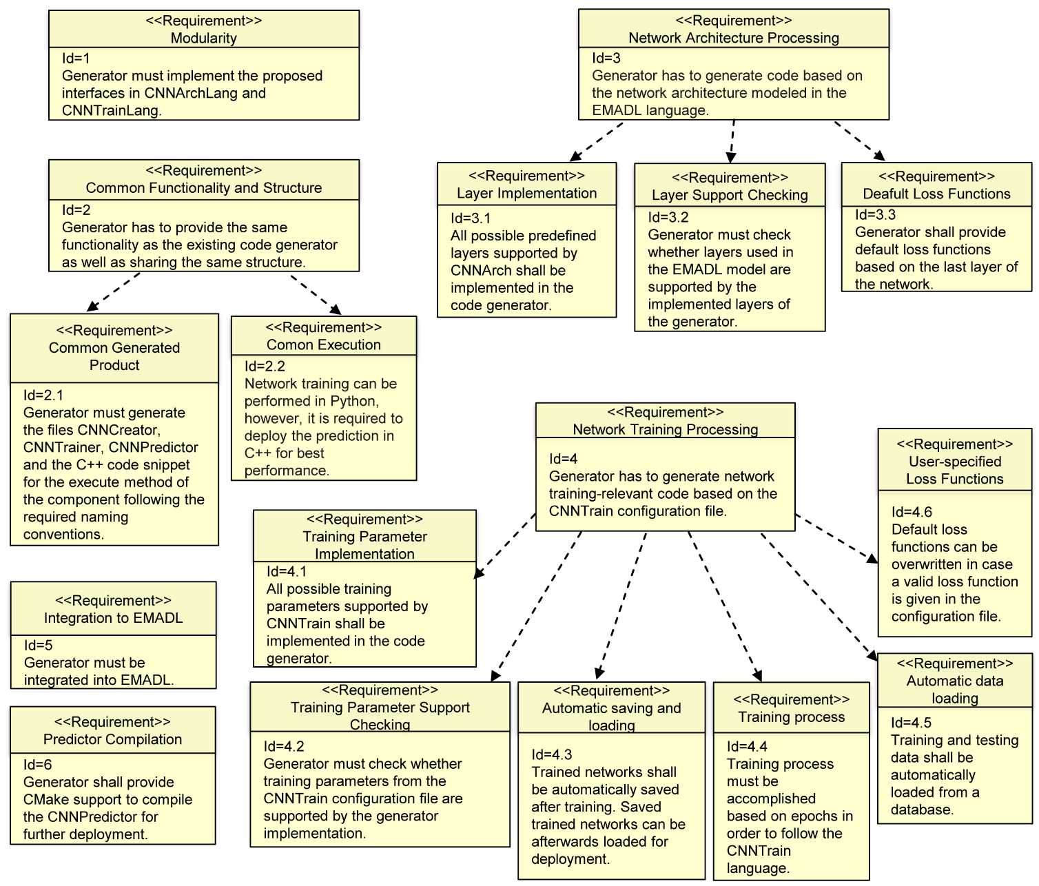
CNNArch2Caffe2
Notes:
With regard to the developed code generator, the following requirements were fulfilled. Some of them were already covered in the previous slides.
To point out is that all CNNArch code generators must have a common functionality and structure so the tool chain can work.
Furthermore, support checkings were implemented to ensure that the employed layers or training parameters are supported by the code generator and the backend.
If a layer is not supported, then the code generation is aborted. On the other hand, if a training parameter is not supported, then it is ignored and replace by a default parameter and value.

Slide 20
Generated Product
Creator
Python code that constructs the CNN architecture obtained from the EMADL model.
It has the necessary functions to train, save and load the modeled network as well as to load the training and test datasets.
Trainer
Python code to train the modeled CNN.
It trains the CNN based on the CNNTrain configuration file and the provided datasets.
Predictor
C++ code for the network deployment.
It loads the trained network and applies it to the input
Notes:
The Generated Product of the tool chain is the following: Creator, Trainer, Predictor, Generated component and Cmake file.
I will describe each file in detail.

Slide 21
Generated Product
Generated component
C++ class which corresponds to the C&C architecture modeled in EMADL.
It uses an instance of the Predictor and functions from the generated auxiliary files to compute the component’s output based on the given input.
CMakeLists.txt
CMake file to compile the generated component.
Notes:
The tool chain process can be described with this workflow.

Slide 22
Tool Chain Process
Deep Learning
Model Creation
Code Generation
Caffe2 Backend
MXNet Backend
Network
Training
Compilation
Deployment

Slide 23
Outline
Basics
Motivation
Multi-Target Code Generation for Deep Learning Systems
Tasks and Requirements
Extended Tool Chain
Tool Chain Overview
CNNArch2Caffe2
Generated Product
Demonstration
Conclusion
Notes:
Now, I would like to present an application as a Demonstration

Slide 24

Demonstration
MNIST Classifier in the Caffe2 backend.
Example application for image classification
LeNet network is trained on the MNIST dataset
Grey scaled images with a resolution of 28x28
50 000 training images and 10 000 test images
Predict the correct class among 10 classes
Notes:
This application consists of a MNIST Classifier

Slide 25
Demonstration
Notes:
This application consists of a MNIST Classifier

Slide 26
Outline
Basics
Motivation
Multi-Target Code Generation for Deep Learning Systems
Tasks and Requirements
Extended Tool Chain
Tool Chain Overview
CNNArch2Caffe2
Generated Product
Demonstration
Autonomous Driving Results
Conclusion
Notes:
Right, let’s continue with the obtained autonomous driving results

Slide 27
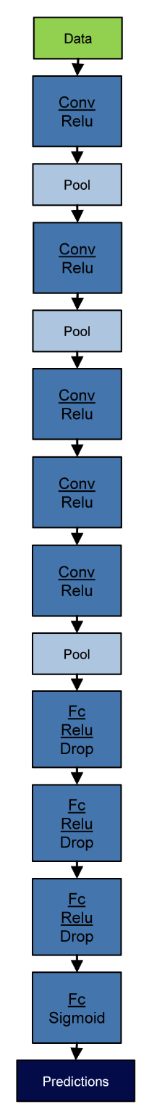
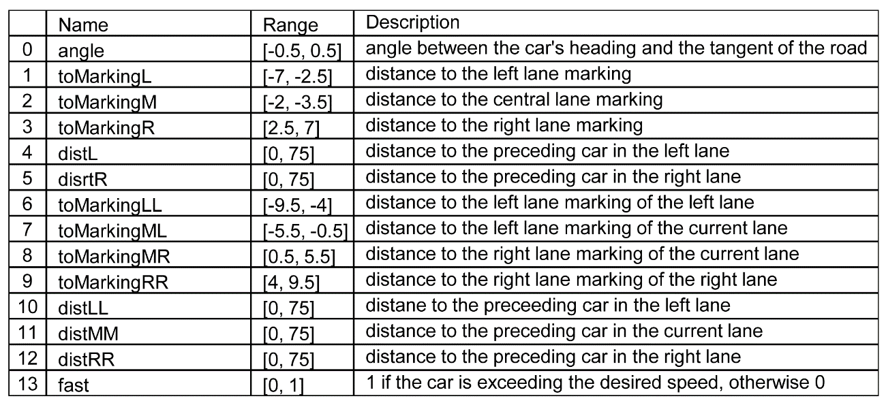
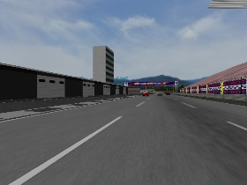
Autonomous Driving Results
Autonomous driving using Direct Perception.
TORCS car race simulator.
DPNet network is trained on the DeepDriving dataset
3-channel images with a resolution of 210x280
387 851 training images and 966 963 test images
Predict the 14 affordance indicators for driving.
Notes:
Direct Perception approach consists in mapping an input image to main affordance indicators of the road and traffic state which can be used for making driving decisions.
DPNet network is trained on modified version of the DeepDriving dataset
The task was to predict the 14 affordance…

Slide 28
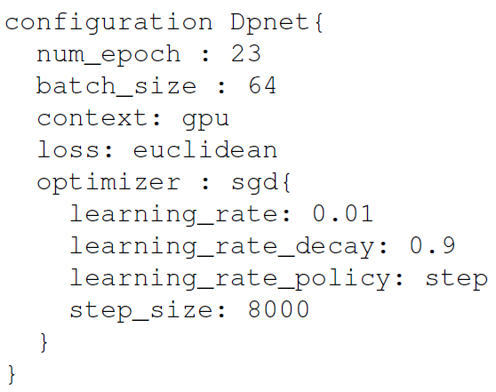
Autonomous Driving Results
DPNet training results:
Notes:
DPNet was trained using this configuration.
training is performed for 23 epochs, which corresponds to almost 140 000 iterations, and using a batch size of 64
The SGD was used with an initial learning rate of 0.01. During training, the learning rate is decreased by a factor of 0.9 (decrease by 10%) every 8000 iterations.
The graph shows how the loss function behaves along the training process. We can observe that the loss function decreases as the number of epochs increases which is expected.
Furthermore, the trained model achieved a good accuracy since the values of the Euclidean loss were below 0.1 in the last 60 000 iterations.

Slide 29
Autonomous Driving Results
DPNet testing results:
Notes:
A test accuracy mean of 0.11 was obtained in the testing phase.
The maximum loss acquired was around 0.31.
The trained model generalizes well since there is only a minor difference between the obtained test accuracy mean and the achieved accuracy obtained in the last thousand iterations of training.

Slide 30
Outline
Basics
Motivation
Multi-Target Code Generation for Deep Learning Systems
Tasks and Requirements
Extended Tool Chain
Tool Chain Overview
CNNArch2Caffe2
Generated Product
Demonstration
Conclusion
Notes:
Finally, just to summarize, let’s quickly look at the main points of my talk

Slide 31
Conclusion
EMADL
EMA with the integration of CNNArch, CNNTrain and EMAM.
It models reusable components for deep learning systems.
EMADL2CPP
Code generator that supports multi-target code generation for deep learning systems.
CNNArch2Caffe2 and CNNArch2MXNet
Python code to construct and train CNNs
C++ code to execute the complete system
The work of this thesis can be served as a basis to introduce additional backends into the tool chain
Notes:
CNNArch and CNNTrain are CNN languages.
EMA with the integration of CNNArch, CNNTrain and EMAM as behavior languages.
basis to introduce additional backends since it provides the necessary requirements to create the code generator as well as how to integrate it into the EMADL tool chain.
That brings me to the end of my presentation, thank you!

