Slide 1
CONNECTING TO HACKATHON CLUSTER
Hackathons and Bootcamps user instructions

Slide 2
INTRODUCTION
About the Cluster:
The hackathon cluster consists of a single CPU-only login node and 10 DGX-1 compute nodes.
NOTE: There is only 1 V100 GPU per instance available to you.
NVIDIA and external users access the cluster via SSH to the login node, using a tool called SFT, which wraps SSH and manages access. Cluster accounts are controlled via a web-based service called Okta.

Slide 3
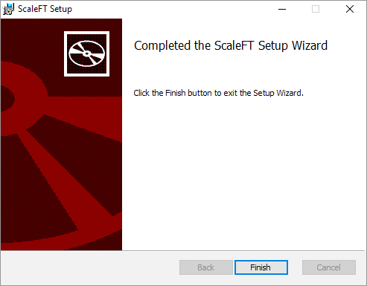
INSTALL OKTA SFT CLIENT
Ubuntu
echo "deb http://pkg.scaleft.com/deb linux main" | sudo tee -a /etc/apt/sources.list
curl -C - https://dist.scaleft.com/pki/scaleft_deb_key.asc | sudo apt-key add -
sudo apt-get update
sudo apt-get install scaleft-client-tools
Windows
Download the client and run the installation MSI.(Click the “Finish” button to exit the Setup Wizard. Installation may also happen in silent mode without any notifications.)
Other operating systems:
Download from the Okta website

