Slide 1
Outlier detection progression to diabetes

Slide 2
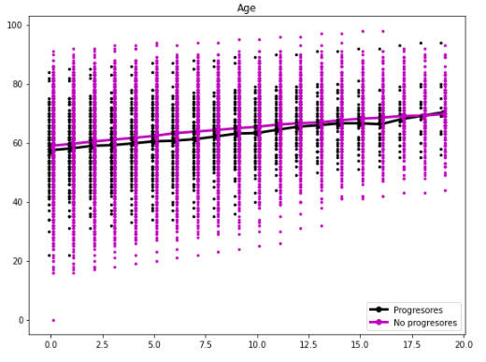
AGE
AGE
No outliers, several nan's
Keep the revisions up to having 40-50 patients
The limit stands for the progesores class

Slide 3
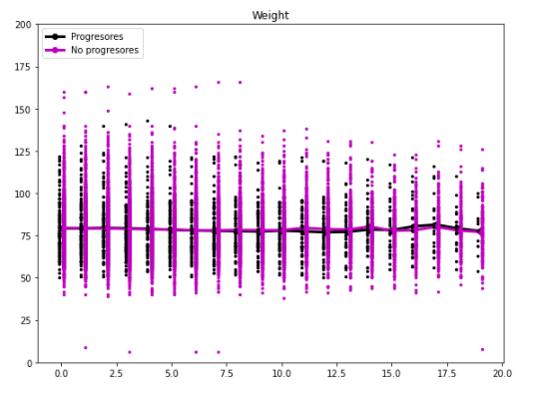
WEIGHT
WEIGHT
Outliers, for values out of [25,200]

Slide 4
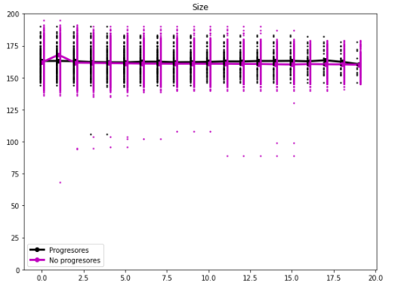
SIZE
SIZE
Outliers for values out of [120,210]

Slide 5
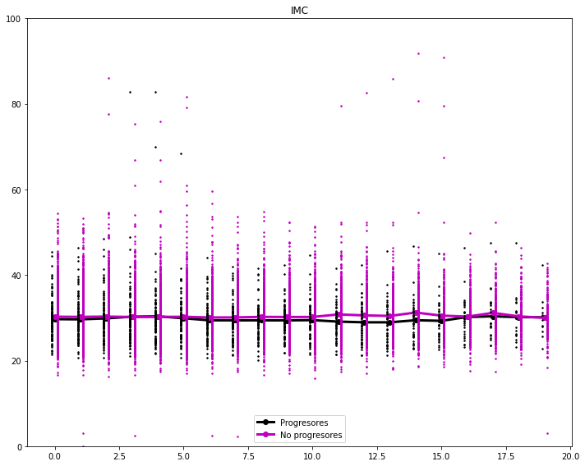
IMC
IMC
Outliers for values out of [10,100]
There are several patients with values between 60 and 100, is that correct. Most of the patients are in the range 18-59

Slide 6
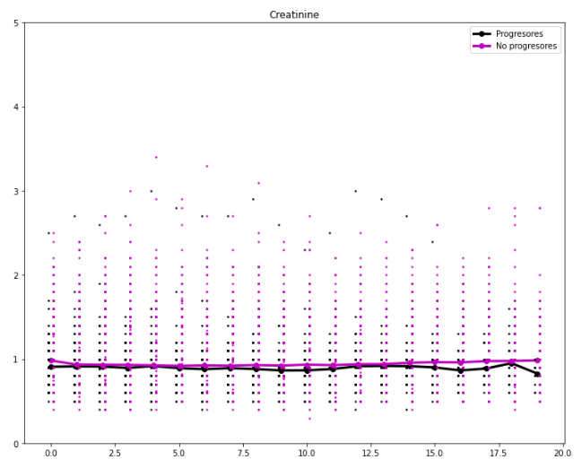
CREATININE
CREATININE
Outliers values out of [0,5]

Slide 7
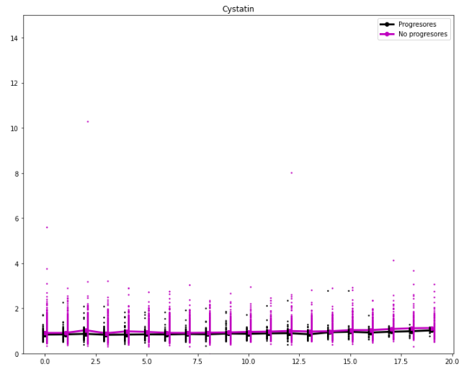
CYSTATIN
CYSTATIN
Outliers values out of [0,6?]
Bunch of patients with values up to 12, consider this as a limit?

Slide 8
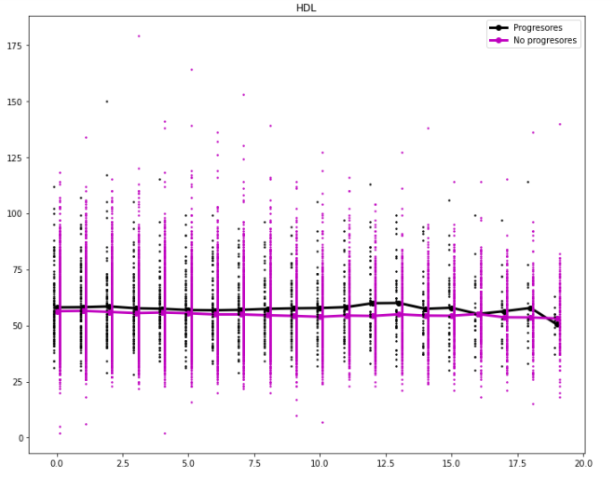
HDL
HDL
Outliers values out of [10,125]
There are some patiens with values near 0 (5,10), and othes with values higher than 125, like 140,175,160

Slide 9
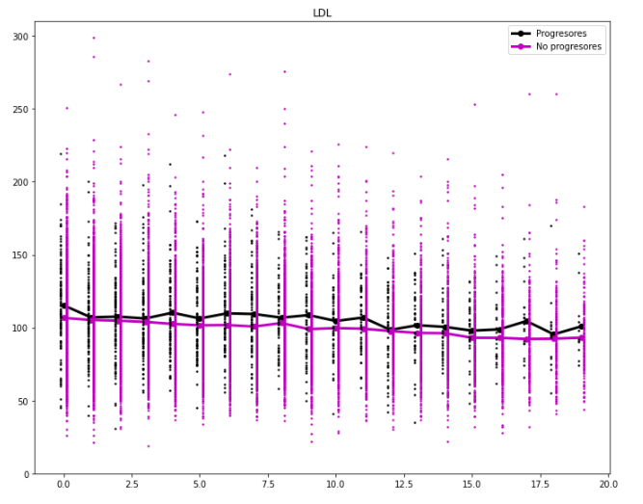
LDL
LDL
outliers values out of [15,300]
most of the values are between 225 and 20

Slide 10
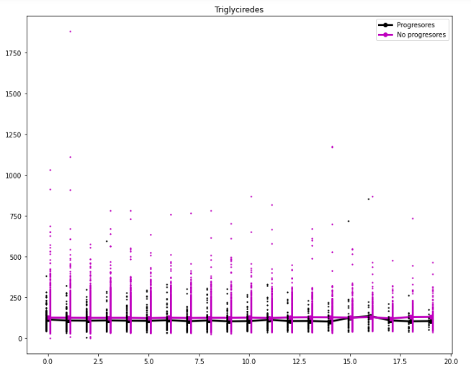
TRIGLYCIREDES
TRIGLYCIREDES
outliers values out of [0,750]?

Slide 11
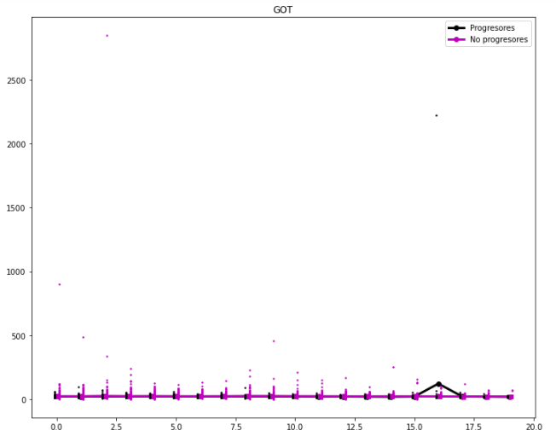
GOT
GOT
outliers values out of [0,150]
a bunch of patients with values higher than 150 up to 500

Slide 12
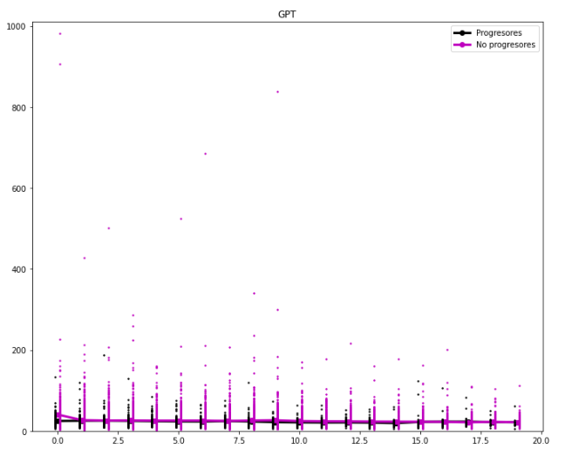
GPT
GPT
outliers values out of [0,250]
a bunch of patients with values between 250 an 400, some even higher up to 1000

Slide 13
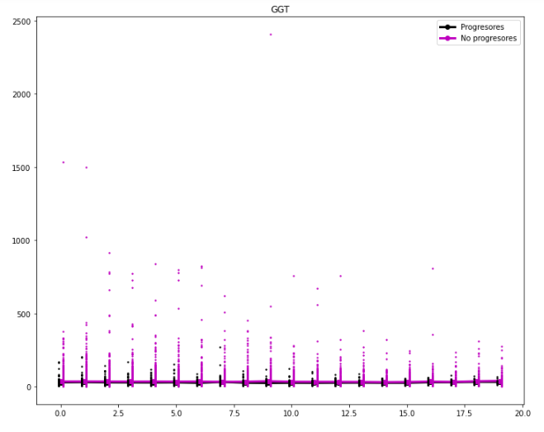
GGT
GGT
outliers values out of [0,1000]
some patiens even higher 1500 up to 2500

Slide 14
IMC
IMC
Outliers for values out of [10,100]
There are several patients with values between 60 and 100, is that correct. Most of the patients are in the range 18-59

Slide 15
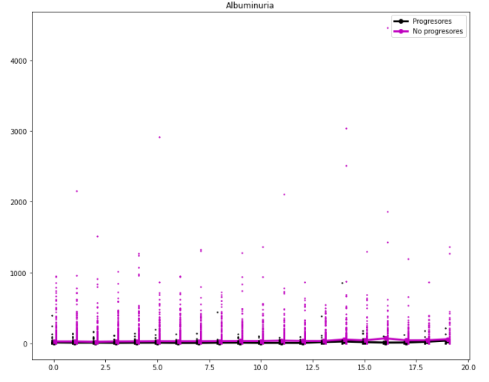
ALBUMINURIA
ALBUMINURIA
outliers values out of [0,1000]
a bunch of patients with values between 1000 and 3000

Slide 16
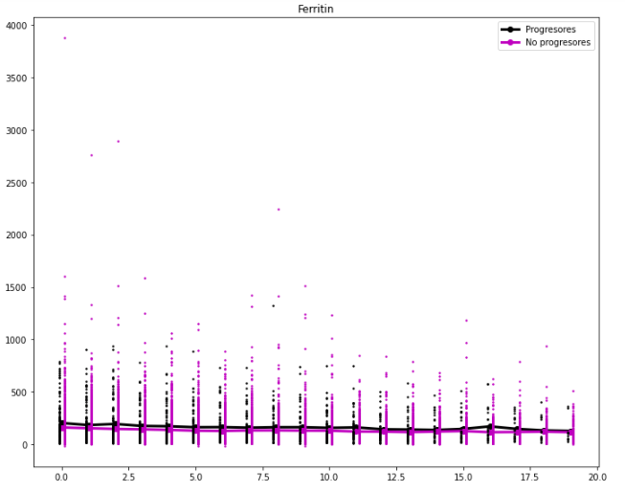
FERRITIN
FERRITIN
outliers values out of [0,1000] or [0,1500]?
some patients even higher up to 3000

Slide 17
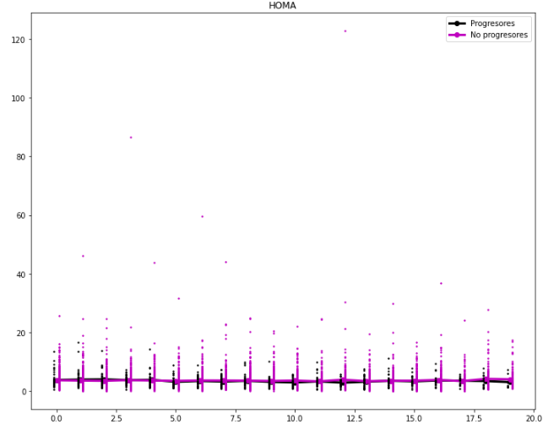
HOMA
HOMA
outliers values out of [0,20]
bunch of patients with values higher than 20, between 20 and 50, some even higher

Slide 18
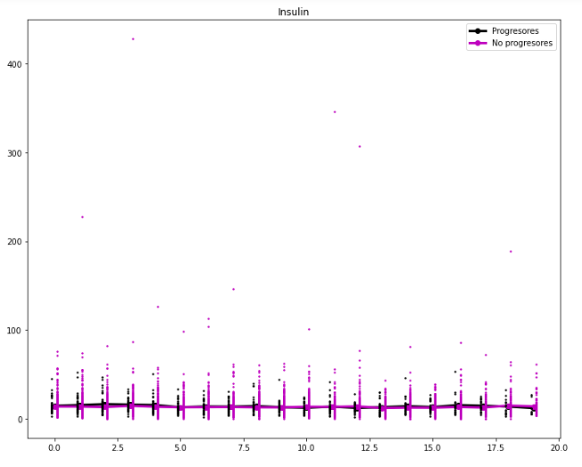
INSULIN
INSULIN
outliers values out of [0,100]
a bunch of patients with values even higher

Slide 19
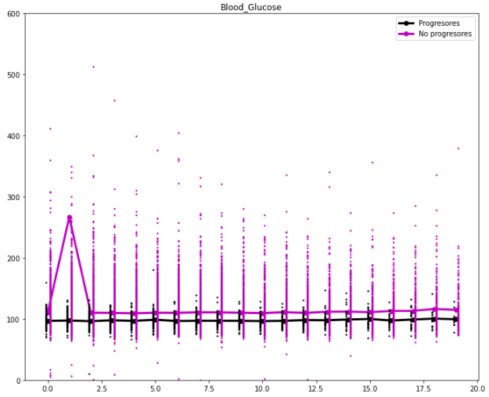
BLOOD GLUCOSE
BLOOD GLUCOSE
outliers values out of [40,400]
a bunch of patients with values between 0 40 (very few) and two with values higheer than 400

Slide 20
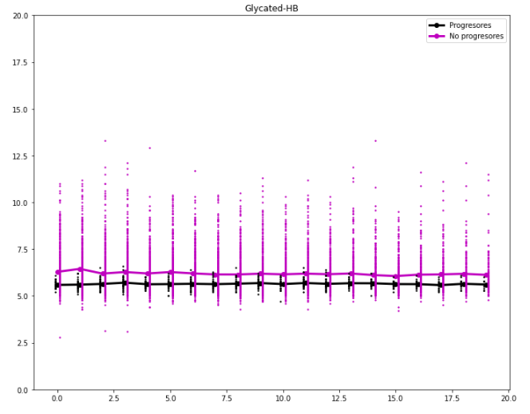
GLYCATED-HB
GLYCATED-HD
outliers values out of [2,15]
some with values higher than 20, but only two

Slide 21
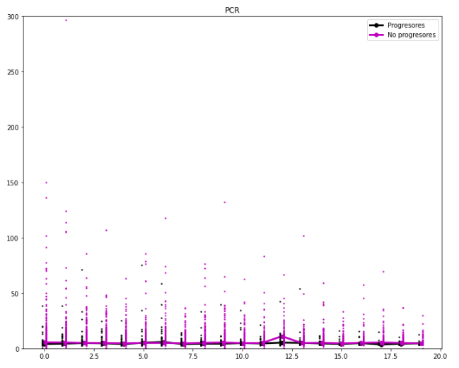
PCR
PCR
outliers values out of [0,200]
a pat with 300

Slide 22
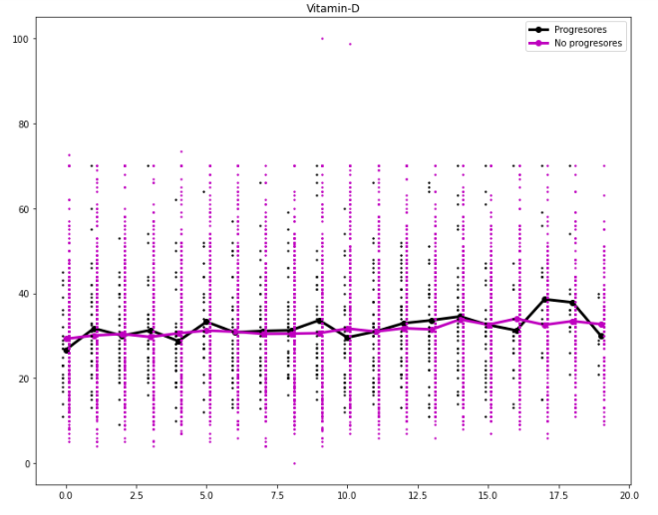
VITAMIN-D
VITAMIN-D
outliers values out of [0,80]
two patients with values 100

Slide 23
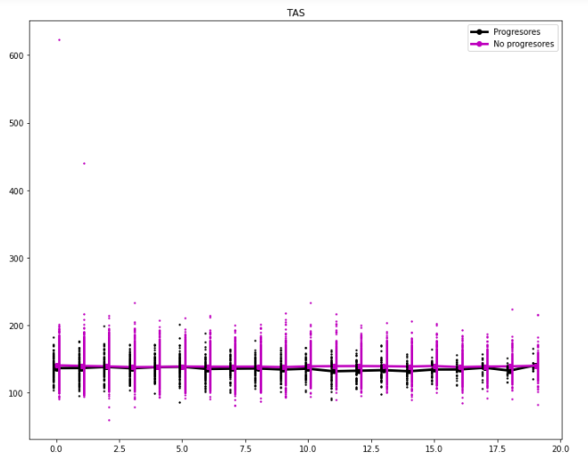
TAS
TAS
outliers values out of [50,250]
two pats with 450 and 610

Slide 24
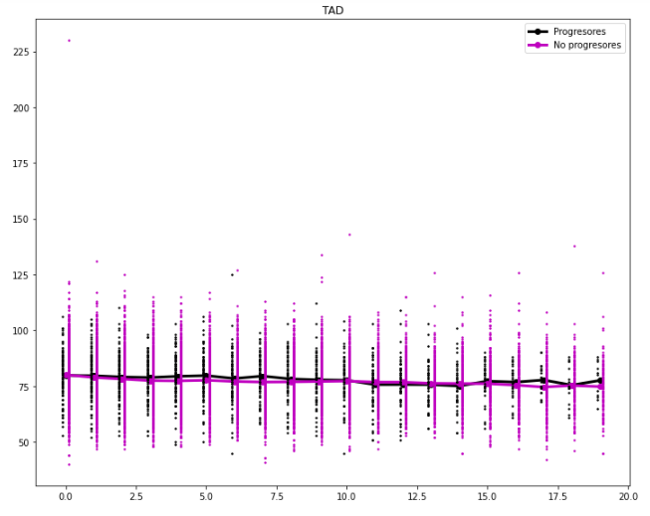
TAD
TAD
outliers values out of [30,150]
one pat with 225

