Slide 1
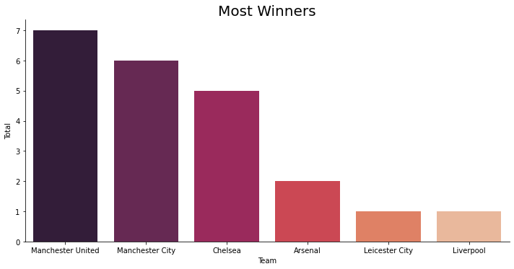


Manchester United has been the team that has won most titles, a total of 7

Slide 2
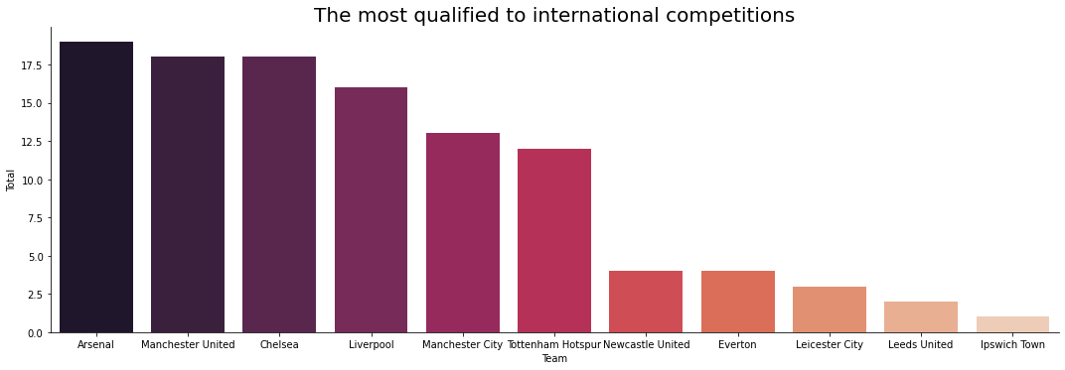

Arsenal is the team that has qualified for international competitions the most times, a total of 19 times

Slide 3
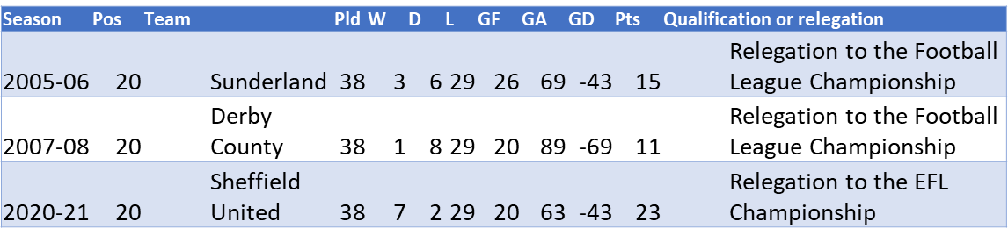



The Most Losers
Derby County has been the team than has won fewest games, a total of 1, in the season 2007-08, also it’s been the team than has made fewest points, a total of 11.
Derby County, Sunderland, Sheffield United, have been the teams that have lost most games, a total of 29 each

Slide 4

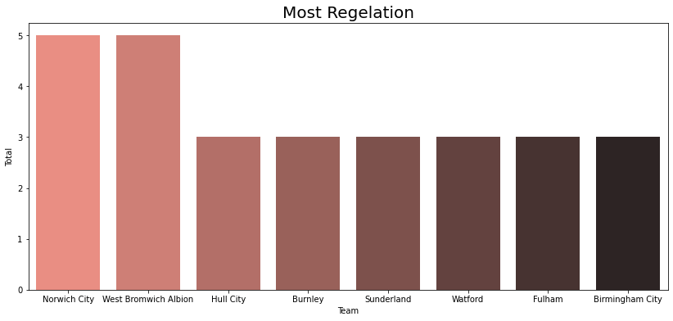


Norwich City and West Bromwich Albion are the teams with the most relegations a total of 5 times each

Slide 5

Records
Manchester City and Liverpool have been the most successful teams getting 32 victories in a season a total 32 games, in the 2017-18, 2018-19 and 2019 – 20 seasons.
Manchester City is the most points team has made in a season a total of 100 points in the 2017-18 season.
Arsenal has been the team that hasn’t lost a match in a season, it was in the 2003 – 04 season.
Manchester United and Leicester City are team that have needed the fewest wins to become champions, a total of 23 games in the 2010 -11 and 2015 – 16 seasons

