Slide 1

A+ Guide to IT Technical Support, 9th Edition
Chapter 11
Optimizing Windows
Notes:
A+ Guide to IT Technical Support, 9th Edition
Chapter 11
Optimizing Windows

Slide 2
Objectives
Solve Windows problems using Windows utilities and tools
Optimize Windows to improve performance
Manually remove software
Notes:
Objectives
Solve Windows problems using Windows utilities and tools
Optimize Windows to improve performance
Manually remove software

Slide 3
Windows Utilities and Tools to Support the OS
This part of the chapter covers:
How Windows works
Windows tools that can be used to see what is really happening to slow Windows down
Notes:
Windows Utilities and Tools to Support the OS
This part of the chapter covers:
How Windows works
Windows tools that can be used to see what is really happening to slow Windows down

Slide 4
What are the Shell and the Kernel?
Shell: portion of an OS that relates to the user and to applications
Provides tools such as File Explorer and the Windows desktop
Made up of subsystems that operate in user mode
Kernel: responsible for interacting with hardware
Known as the “core” of the OS
Has two main components:
HAL (hardware abstraction layer) – layer closest to hardware
Executive services interface – operate between the user mode subsystems and the HAL
Notes:
What is the Shell and the Kernel?
Shell: portion of an OS that relates to the user and to applications
Provides tools such as File Explorer and the Windows desktop
Made up of subsystems that operate in user mode
Kernel: responsible for interacting with hardware
Known as the “core” of the OS
Has two main components:
HAL (hardware abstraction layer) – layer closest to hardware
Executive services interface – operate between the user mode subsystems and the HAL

Slide 5
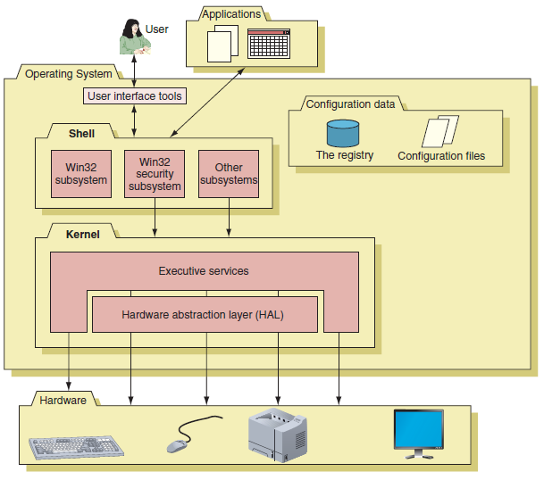
What are the Shell and the Kernel?
Figure 11-1 Inside an operating system, different components perform various functions
Notes:
What is the Shell and the Kernel?

Slide 6
How Windows Manages Applications
Process: a program that is running under the authority of the shell, together with the system resources assigned to it
When a process makes a request for resources to the Win32 subsystem the request is known as a thread
A thread is a single task, such as printing a file that the process requests from the kernel
Sometimes a process is called an instance
A process with more than one thread is called multithreading
Notes:
How Windows Manages Applications
Process: a program that is running under the authority of the shell, together with the system resources assigned to it
When a process makes a request for resources to the Win32 subsystem the request is known as a thread
A thread is a single task, such as printing a file that the process requests from the kernel
Sometimes a process is called an instance

Slide 7
Task Manager
Taskmgr.exe displays applications and processes
Also displays information about memory performance, network activity, and user activity
Several ways to access Task Manager:
Press Ctrl+Alt+Delete
Right click a blank area in the taskbar and select Start Task Manager from shortcut menu
Press Ctrl+Shift+Esc
For Windows 8, press Win+X and click Task Manager
For Windows 7, click Start, enter taskmgr.exe in the search box
Notes:
Task Manager
Taskmgr.exe displays applications and processes
Also displays information about memory performance, network activity, and user activity
Several ways to access Task Manager:
Press Ctrl+Alt+Delete
Right click a blank area in the taskbar and select Start Task Manager from shortcut menu
Press Ctrl+Shift+Esc
For Windows 8, press Win+X and click Task Manager
For Windows 7, click Start, enter taskmgr.exe in the search box

Slide 8
Task Manager
Processes Tab
Shows running processes organized by Apps, Background processes, and Windows processes
Right-click a process, click Go to details to jump to the Details tab
Details tab
Used to end processes
If a process is hung, end the task by selecting it and click End task
Notes:
Task Manager
Processes Tab
Shows running processes organized by Apps, Background processes, and Windows processes
Right-click a process, click Go to details to jump to the Details tab
Details tab
Used to end processes
If a process is hung, end the task by selecting it and click End task

Slide 9
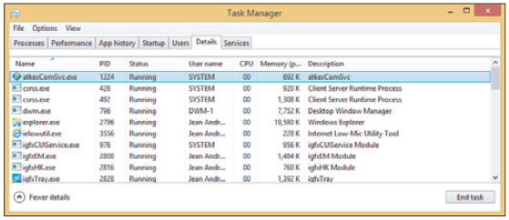
Task Manager
Figure 11-6 Use the Details tab to end a task that is not responding
Notes:
Task Manager

Slide 10
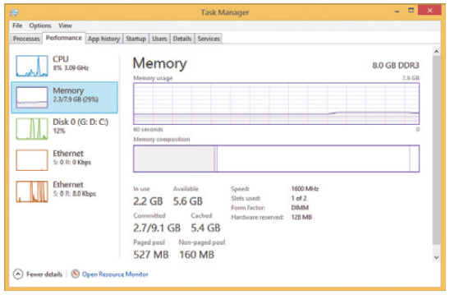
Task Manager
Performance Tab
Allows you to monitor performance of key devices in the system and network connections
Figure 11-8 Use the Performance tab to view system resource usage
Notes:
Task Manager
Performance Tab
Allows you to monitor performance of key devices in the system and network connections

Slide 11
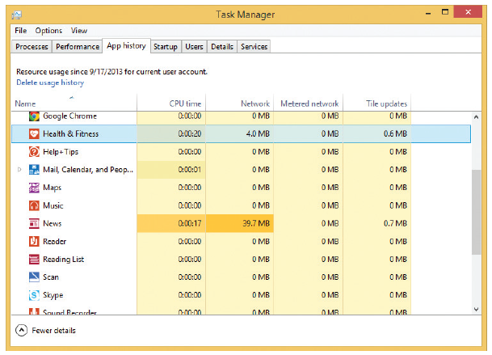
Task Manager
App History Tab
Shows resources that a program is using
Figure 11-10 The App history tab can help you decide if a background program is hogging system resources
Notes:
Task Manager
App History Tab
Shows resources that a program is using

Slide 12
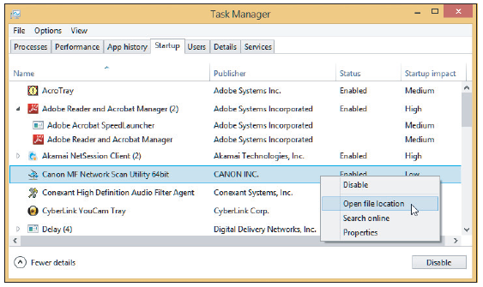
Task Manager
Startup Tab
Used to manage startup items
Figure 11-11 Startup processes are managed on the Startup tab of Task Manager
Notes:
Task Manager
Startup Tab
Used to manage startup items

Slide 13
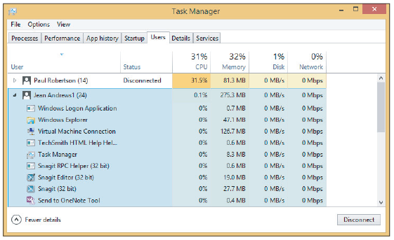
Task Manager
Users Tab
Shows all users currently logged on
Sign out a user to improve performance
Figure 11-12 The Users tab shows system resources used by each signed-in user
Notes:
Task Manager
Users Tab
Shows all users currently logged on
Sign out a user to improve performance

Slide 14
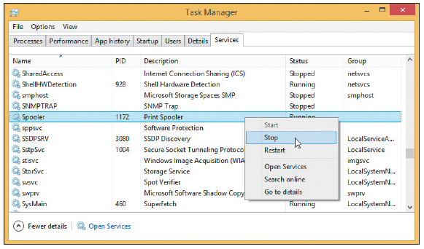
Task Manager
Services Tab
Lists currently installed services with status
Figure 11-13 The Services tab of Task Manager gives the current status of all installed services
Notes:
Task Manager
Services Tab
Lists currently installed services with status

Slide 15
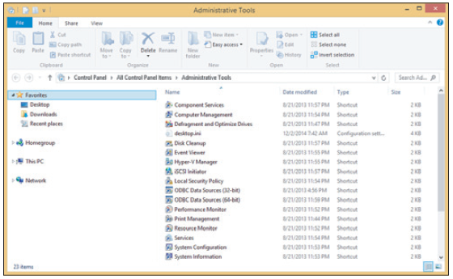
Administrative Tools
Windows Administrative tools can be found in Control Panel
Figure 11-15 Administrative tools in Windows 8 Pro
Notes:
Administrative Tools
Windows Administrative tools can be found in Control Panel

Slide 16
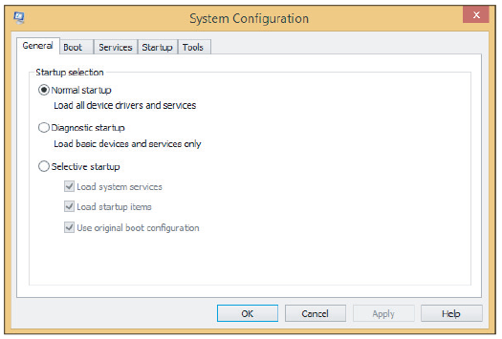
System Configuration
Msconfig.exe
Use to view processes launched at startup and to temporarily disable a process from loading
Figure 11-16 Use the General tab to control how Windows starts
Notes:
System Configuration
Msconfig.exe
Use to view processes launched at startup and to temporarily disable a process from loading

Slide 17
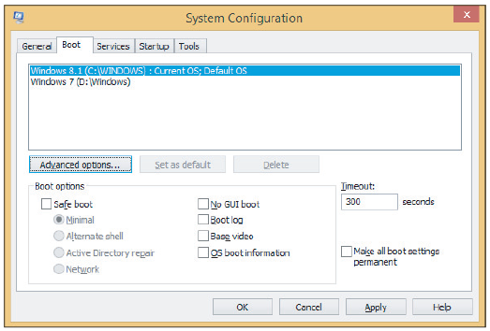
System Configuration
Figure 11-17 Use the Boot tab to control boot settings
Notes:
System Configuration

Slide 18
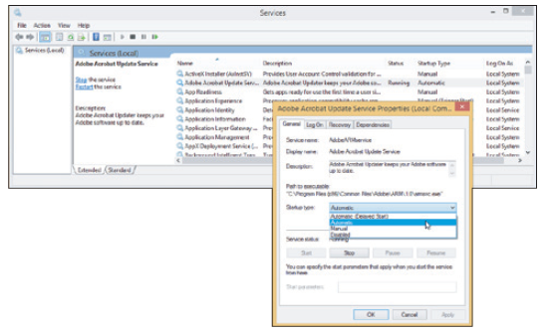
Services Console
Services console is used to control the Windows and third-party services installed
To launch: type services.msc in the search box
Figure 11-21 The Services console is used to manage Windows services
Notes:
Services Console
Services console is used to control the Windows and third-party services installed
To launch: type services.msc in the search box

Slide 19
Services Console
Selecting Properties
Provides more information about a service
Allows stopping or starting a service
Service startup types
Automatic (Delayed Start): starts shortly after startup, after the user logs on
Automatic: starts when Windows loads
Manual: starts as needed
Disabled: cannot be started
Notes:
Services Console
Selecting Properties
Provides more information about a service
Allows stopping or starting a service
Service startup types
Automatic (Delayed Start): starts shortly after startup, after the user logs on
Automatic: starts when Windows loads
Manual: starts as needed
Disabled: cannot be started

Slide 20
Computer Management
Consolidates several Windows administrative tools
Use to manage local PC and other network computers
Administrator authority required
Viewing may allow lesser privileges
Ways to access Computer Management in Windows
Enter compmgmt.msc in Windows Run/search box
Windows 8: press Win+X and click Computer Management
Windows 7: Click Start, right-click Computer, and select Manage
In Control Panel, click Administrative Tools group
Notes:
Computer Management
Consolidates several Windows administrative tools
Use to manage local PC and other network computers
Administrator authority required
Viewing may allow lesser privileges
Ways to access Computer Management in Windows
Enter compmgmt.msc in Windows Run/search box
Windows 8: press Win+X and click Computer Management
Windows 7: Click Start, right-click Computer, and select Manage
In Control Panel, click Administrative Tools group

Slide 21
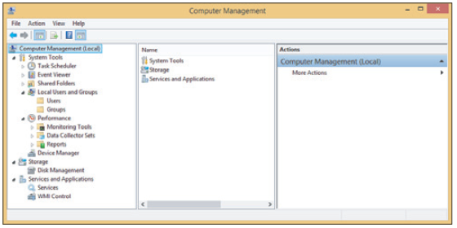
Computer Management
Figure 11-22 Windows Computer Management combines several
administrative tools into a single, easy-to-access window
Notes:
Computer Management
Consolidates several Windows administrative tools
Use to manage local PC and other network computers
Administrator authority required
Viewing may allow lesser privileges
Ways to access Computer Management in Windows
Enter compmgmt.msc in Windows Run/search box
Windows 8: press Win+X and click Computer Management
Windows 7: Click Start, right-click Computer, and select Manage
In Control Panel, click Administrative Tools group

Slide 22
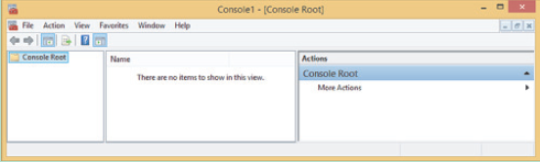
Microsoft Management Console (MMC)
Windows utility to build customized console windows
Console is a single window containing one or more administrative tools
Snap-ins are individual tools in a console
Must be logged in with administrator privileges
Figure 11-23 An empty console
Notes:
Microsoft Management Console (MMC)
Windows utility to build customized console windows
Console is a single window containing one or more administrative tools
Snap-ins are individual tools in a console
Must be logged in with administrator privileges

Slide 23
Event Viewer
Eventvwr.msc
Tool for troubleshooting problems with Windows, applications, and hardware
Also a Computer Management console snap-in
Types of events that are logged:
Critical
Error
Warning
Information
Audit Success
Notes:
Event Viewer
Eventvwr.msc
Tool for troubleshooting problems with Windows, applications, and hardware
Also a Computer Management console snap-in
Types of events that are logged:
Critical
Error
Warning
Information
Audit Success

Slide 24
Event Viewer
Views of logs that are most useful:
Administrator Events log: shows only Warning and Error events intended for administrator
Application log: shows events recorded by an application
Security log: includes successful and unsuccessful logins to a user account
Setup log: events when applications are installed
System log: events triggered by Windows components
Forwarded Events log: receives events recorded on other computers
Notes:
Event Viewer
Views of logs that are most useful:
Administrator Events log: shows only Warning and Error events intended for administrator
Application log: shows events recorded by an application
Security log: includes successful and unsuccessful logins to a user account
Setup log: events when applications are installed
System log: events triggered by Windows components
Forwarded Events log: receives events recorded on other computers

Slide 25
Event Viewer
To create a custom view:
Right-click any log and select Create Custom View
Use Create Custom View box to choose which events to filter
After filters are selected, click OK to name your custom view and click OK
To save the view, right-click it and click Save All Events in Custom View As
In the Save As box, name the file and choose location, click Save
Notes:
Event Viewer
To create a custom view:
Right-click any log and select Create Custom View
Use Create Custom View box to choose which events to filter
After filters are selected, click OK to name your custom view and click OK
To save the view, right-click it and click Save All Events in Custom View As
In the Save As box, name the file and choose location, click Save

Slide 26
Event Viewer
To control the size of a log file, you can clear it
Right-click the log and select Clear Log
To control the maximum size of the log file:
Right-click the log and select Properties
Notes:
Event Viewer
To control the size of a log file, you can clear it
Right-click the log and select Clear Log
To control the maximum size of the log file:
Right-click the log and select Properties

Slide 27
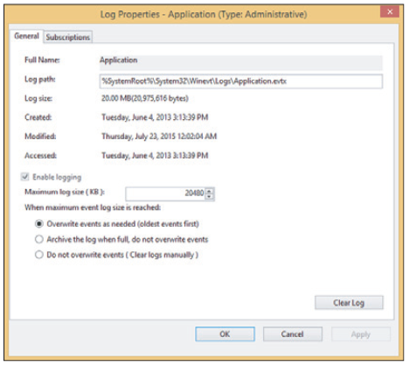
Event Viewer
Figure 11-28 Control the size of a log file and archive events in the log
Notes:
Event Viewer

Slide 28
Print Management
Windows professional and business editions offer the Print Management utility
In the Administrative Tools group of Control Panel
Use it to monitor and manage printer queues for all printers on the network
Each computer on the network that shares a printer to other computers on the network is considered a print server
Notes:
Print Management
Windows professional and business editions offer the Print Management utility
In the Administrative Tools group of Control Panel
Use it to monitor and manage printer queues for all printers on the network
Each computer on the network that shares a printer to other computers on the network is considered a print server

Slide 29
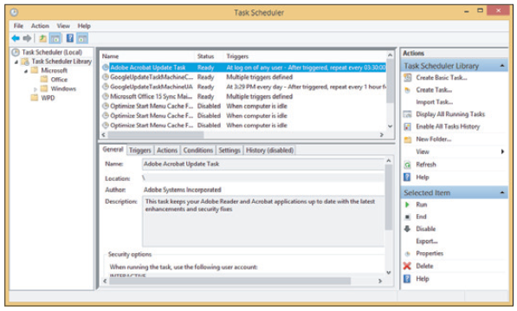
Task Scheduler
Windows Task Scheduler – can be set to launch a task or program at a future time
Figure 11-33
View and manage
tasks from the
Task Scheduler
Window
Notes:
Task Scheduler
Windows Task Scheduler – can be set to launch a task or program at a future time

Slide 30
Windows 7 Performance Monitor
Perfmon.msc or Perfmon.exe (another MMC snap-in)
Can track activity by hardware and software to measure performance
To open Performance Monitor
Enter perfmon.msc in the Windows 8 Run box or the Windows 7 search box
You can also find Performance Monitor in the Administrative Tools group in Control Panel
Notes:
Windows 7 Performance Monitor
Perfmon.msc or Perfmon.exe (another MMC snap-in)
Can track activity by hardware and software to measure performance
To open Performance Monitor
Enter perfmon.msc in the Windows 8 Run box or the Windows 7 search box
You can also find Performance Monitor in the Administrative Tools group in Control Panel

Slide 31
Windows 7 Performance Monitor
Contains hundreds of counters used to examine many aspects of the system
To conserve system resources, only use the counters you really need
To delete a counter:
Select the counter from the list so that it is highlighted and click the red X above the graph
Notes:
Windows 7 Performance Monitor
Contains hundreds of counters used to examine many aspects of the system
To conserve system resources, only use the counters you really need
To delete a counter:
Select the counter from the list so that it is highlighted and click the red X above the graph

Slide 32
The Registry Editor
Difficult problems might require editing or removal of a registry key using the Registry Editor (regedit.exe)
Registry organization
Registry
Database designed with a treelike structure (i.e., hierarchical database)
Contains configuration information for Windows, users, software applications, and installed hardware devices
Registry is built in memory at startup
Windows uses current hardware configuration and information taken from files
Notes:
The Registry Editor
Difficult problems might require editing or removal of a registry key using the Registry Editor (regedit.exe)
Registry organization
Registry
Database designed with a treelike structure (i.e., hierarchical database)
Contains configuration information for Windows, users, software applications, and installed hardware devices
Registry is built in memory at startup
Windows uses current hardware configuration and information taken from files

Slide 33
The Registry Editor
Five files used to build registry are called hives:
SAM (Security Accounts Manager), SECURITY, SOFTWARE, SYSTEM, and DEFAULT hives
Registry organized into five treelike structures (called keys)
Each key can have subkeys
Subkeys can have more subkeys and can be assigned one or more values
Data is organized in registry keys differently than the way it is organized in the hive files
Notes:
The Registry Editor
Five files used to build registry are called hives:
SAM (Security Accounts Manager), SECURITY, SOFTWARE, SYSTEM, and DEFAULT hives
Registry organized into five treelike structures (called keys)
Each key can have subkeys
Subkeys can have more subkeys and can be assigned one or more values
Data is organized in registry keys differently than the way it is organized in the hive files

Slide 34
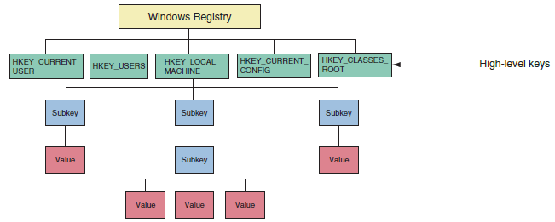
The Registry Editor
Figure 11-37 The Windows registry is logically organized in five keys with subkeys
Notes:
The Registry Editor

Slide 35
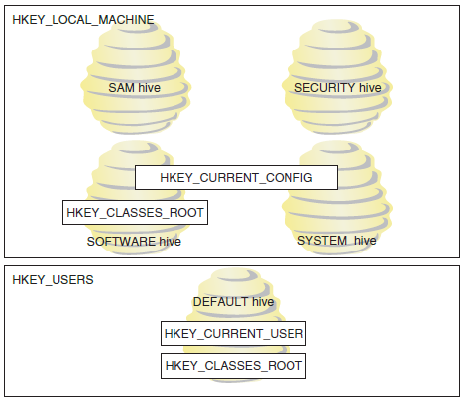
The Registry Editor
Figure 11-38 The relationship between registry keys and hives
Notes:
The Registry Editor

Slide 36
The Registry Editor
Five keys:
HKEY_LOCAL_MACHINE (HKLM)
Contains hardware, software, and security data
HKEY_CURRENT_CONFIG (HKCC)
Used to identify each hardware device
HKEY_CLASSES_ROOT (HKCR)
Used to determine which application opens
HKEY_USERS (HKU)
Contains data about all users
HKEY_CURRENT_USER (HKCU)
Contains data about the current user
Notes:
The Registry Editor
Five keys:
HKEY_LOCAL_MACHINE (HKLM)
Contains hardware, software, and security data
HKEY_CURRENT_CONFIG (HKCC)
Used to identify each hardware device
HKEY_CLASSES_ROOT (HKCR)
Used to determine which application opens
HKEY_USERS (HKU)
Contains data about all users
HKEY_CURRENT_USER (HKCU)
Contains data about the current user

Slide 37
The Registry Editor
Before editing the registry
Back up registry
Use System Protection to create a restore point
Back up a single registry key just before editing the key
Make an extra copy of the C:\Windows\System32\config folder
Back up and restore individual keys you plan to edit
Instead of the whole registry
Edit the registry with Registry Editor (regedit.exe)
Notes:
The Registry Editor
Before editing the registry
Back up registry
Use System Protection to create a restore point
Back up a single registry key just before editing the key
Make an extra copy of the C:\Windows\System32\config folder
Back up and restore individual keys you plan to edit
Instead of the whole registry
Edit the registry with Registry Editor (regedit.exe)

Slide 38
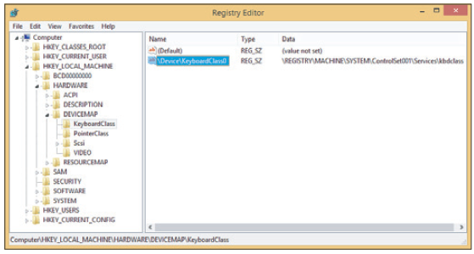
The Registry Editor
Figure 11-39 The Registry Editor showing the five main keys, subkeys, values, and data
Notes:
The Registry Editor

Slide 39
Display Settings and Graphics Software
Use the Display applet in Control Panel to manage display settings
To adjust color depth, click Calibrate color on the Display window
To adjust resolution, click Adjust resolution
Select the highest or recommended resolution
Refresh rate is the number of times a monitor refreshes the screen in one second
To set the rate, click Advanced settings on the Screen Resolution window, click Monitor tab and select the highest value available under Screen refresh rate
Notes:
Display Settings and Graphics Software
Use the Display applet in Control Panel to manage display settings
To adjust color depth, click Calibrate color on the Display window
To adjust resolution, click Adjust resolution
Select the highest or recommended resolution
Refresh rate is the number of times a monitor refreshes the screen in one second
To set the rate, click Advanced settings on the Screen Resolution window, click Monitor tab and select the highest value available under Screen refresh rate

Slide 40
Display Settings and Graphics Software
Use the Display applet in Control Panel to manage display settings (cont’d)
For a dual-monitor setup, use the Screen Resolution window to configure multiple displays
Windows 8 offers a multimonitor taskbar
Option to extend the desktop taskbar across both monitors
Right-click taskbar and click Properties, manage the taskbar for multiple displays on the Taskbar tab
Use the dxdiag.exe command to display information about hardware and diagnose problems with DirectX
Notes:
Display Settings and Graphics Software
Use the Display applet in Control Panel to manage display settings (cont’d)
For a dual-monitor setup, use the Screen Resolution window to configure multiple displays
Windows 8 offers a multimonitor taskbar
Option to extend the desktop taskbar across both monitors
Right-click taskbar and click Properties, manage the taskbar for multiple displays on the Taskbar tab
Use the dxdiag.exe command to display information about hardware and diagnose problems with DirectX

Slide 41
Improving Windows Performance
Assuming Windows is starting with no errors
How to handle errors that keep Windows from actually starting is covered in the chapter “Troubleshooting Windows Startup”
Five steps you can take to improve Windows performance are covered next
Notes:
Improving Windows Performance
Assuming Windows is starting with no errors
How to handle errors that keep Windows from actually starting is covered in the chapter “Troubleshooting Windows Startup”
Five steps you can take to improve Windows performance are covered next

Slide 42
Step 1: Perform Routine Maintenance
Tasks to perform routine maintenance:
Verify critical Windows settings
Clean up, defrag, and check the hard drive
Uninstall software you no longer need
Back up data before applying any fixes
Notes:
Step 1: Perform Routine Maintenance
Tasks to perform routine maintenance:
Verify critical Windows settings
Clean up, defrag, and check the hard drive
Uninstall software you no longer need
Back up data before applying any fixes

Slide 43
Step 2: Clean Windows Startup
Verify startup programs kept to a minimum
Observe a clean boot to set a benchmark for the time it takes to start Windows when only minimum of programs are launched
Time a normal startup and a clean boot
Significant difference: reduce Windows startup to essentials
No improvement indicates problem with hardware or Windows settings (proceed to Step 3)
Notes:
Step 2: Clean Windows Startup
Verify startup programs kept to a minimum
Observe a clean boot to set a benchmark for the time it takes to start Windows when only minimum of programs are launched
Time a normal startup and a clean boot
Significant difference: reduce Windows startup to essentials
No improvement indicates problem with hardware or Windows settings (proceed to Step 3)

Slide 44
Step 2: Clean Windows Startup
Investigate and eliminate startup programs
Open Startup tab and look for a specific program you don’t want
If unsure of its purpose, search the web for information on the program
Temporarily disable it using Windows 8 Task Manager or Windows 7 System Configuration
Task Manager can tell you what processes are currently running
If performance does not improve by disabling services or startup programs, re-enable them
Notes:
Step 2: Clean Windows Startup
Investigate and eliminate startup programs
Open Startup tab and look for a specific program you don’t want
If unsure of its purpose, search the web for information on the program
Temporarily disable it using Windows 8 Task Manager or Windows 7 System Configuration
Task Manager can tell you what processes are currently running
If performance does not improve by disabling services or startup programs, re-enable them

Slide 45
Step 2: Clean Windows Startup
Check for Unwanted Scheduled Tasks
Some applications schedule tasks to check for and download updates and malware sometimes hides as a scheduled task
Best way to uninstall a scheduled task:
Uninstall the software responsible for task
Monitor the Startup Process
Use third-party tools to monitor any changes to startup
Many antivirus programs monitor the startup process and inform you when changes are made
Notes:
Step 2: Clean Windows Startup
Check for Unwanted Scheduled Tasks
Some applications schedule tasks to check for and download updates and malware sometimes hides as a scheduled task
Best way to uninstall a scheduled task:
Uninstall the software responsible for task
Monitor the Startup Process
Use third-party tools to monitor any changes to startup
Many antivirus programs monitor the startup process and inform you when changes are made

Slide 46
Step 3: Check If the Hardware Can Support the OS
If you suspect the processor, hard drive, or memory is a bottleneck
Use Performance Monitor to get more information
Considering upgrading the component if you find it is creating a bottleneck
May also have to consider an upgrade to the OS to solve performance issues
Notes:
Step 3: Check If the Hardware Can Support the OS
If you suspect the processor, hard drive, or memory is a bottleneck
Use Performance Monitor to get more information
Considering upgrading the component if you find it is creating a bottleneck
May also have to consider an upgrade to the OS to solve performance issues

Slide 47
Step 4: Check for a History of Problems
If possible, determine when time problem started
Use the Action Center and Reliability Monitor
Find out what changes were made around the time the problem started
See if other problems occurred
Notes:
Step 4: Check for a History of Problems
If possible, determine when time problem started
Use the Action Center and Reliability Monitor
Find out what changes were made around the time the problem started
See if other problems occurred

Slide 48
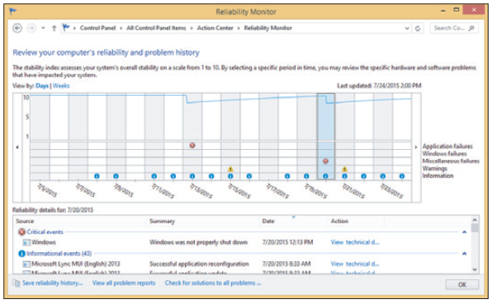
Step 4: Check for a History of Problems
Figure 11-47 Use the Reliability Monitor to search for when a problem began
and what else happened about that time
Notes:
Step 4: Check for a History of Problems

Slide 49
Step 5: Consider Using ReadyBoost
ReadyBoost uses a flash drive or secure digital (SD) memory card to boost hard drive performance
Acts as a buffer to speed up access time
Best for magnetic hard drive running at less than 7200 RPM
Windows automatically tests device qualifications
256 MB to 4 GB with at least 256 MB free space, and run at about 2 MB/sec of throughput
Notes:
Step 5: Consider Using ReadyBoost
ReadyBoost uses a flash drive or secure digital (SD) memory card to boost hard drive performance
Acts as a buffer to speed up access time
Best for magnetic hard drive running at less than 7200 RPM
Windows automatically tests device qualifications
256 MB to 4 GB with at least 256 MB free space, and run at about 2 MB/sec of throughput

Slide 50
Disable the Windows 7 Aero Interface
Aero interface uses memory and computing power
Disable Aero interface to see if performance improves
If performance does improve:
May require memory or video card upgrade
Or just keep Aero disabled
To disable the Aero interface:
Right-click the desktop and select Personalize from the shortcut menu
Scroll down to and click Windows 7 Basic
Notes:
Disable the Windows 7 Aero Interface
Aero interface uses memory and computing power
Disable Aero interface to see if performance improves
If performance does improve:
May require memory or video card upgrade
Or just keep Aero disabled
To disable the Aero interface:
Right-click the desktop and select Personalize from the shortcut menu
Scroll down to and click Windows 7 Basic

Slide 51
Manually Removing Software
Manually uninstall
Programs refusing to uninstall or giving errors when uninstalling
Use as a last resort
Try program’s uninstall routine
Delete the program folders and files
Delete the registry entries used by the software
Remove entries in the Start menu and delete shortcuts
Remove any entries that launch processes at startup
Notes:
Manually Removing Software
Manually uninstall
Programs refusing to uninstall or giving errors when uninstalling
Use as a last resort
Try program’s uninstall routine
Delete the program folders and files
Delete the registry entries used by the software
Remove entries in the Start menu and delete shortcuts
Remove any entries that launch processes at startup

Slide 52
Manually Removing Software
Step 1: First try the uninstall routine
Can be accessed from the Windows Programs and Features window
Windows 8 apps can be uninstalled from Start screen
Step 2: Delete Program files
Look for the program folder in one of these folders:
C:/Program Files
C:/Program Files (x86)
Notes:
Manually Removing Software
Step 1: First try the uninstall routine
Can be accessed from the Windows Programs and Features window
Windows 8 apps can be uninstalled from Start screen
Step 2: Delete Program files
Look for the program folder in one of these folders:
C:/Program Files
C:/Program Files (x86)

Slide 53
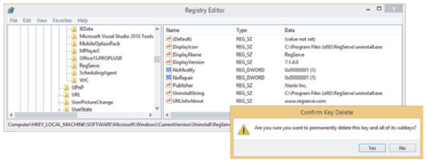
Manually Removing Software
Step 3: Delete Registry entries
Editing the registry can be dangerous – back up first!
Follow steps outlined in the text
Figure 11-53 Select a subkey under the Uninstall key to display its values and data in the right pane
Notes:
Manually Removing Software
Step 3: Delete Registry entries
Editing the registry can be dangerous – back up first!
Follow steps outlined in the text

Slide 54
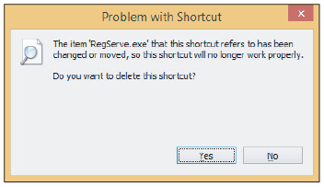
Manually Removing Software
Step 4: Remove Program Shortcuts
Figure 11-54 Delete the program shortcut from the Windows 8 Start screen or Apps screen
Notes:
Manually Removing Software
Step 4: Remove Program Shortcuts

Slide 55
Manually Removing Software
Step 5: Remove Startup Processes
Restart the system and watch for any startup errors about a missing program file
Use System Configuration or Task Manager to find out how the program is set to start
This entry point is called an orphaned entry
You’ll need to delete this startup entry by editing the registry, deleting a shortcut in a startup folder, or disabling a service using the Services console
Notes:
Manually Removing Software
Step 5: Remove Startup Processes
Restart the system and watch for any startup errors about a missing program file
Use System Configuration or Task Manager to find out how the program is set to start
This entry point is called an orphaned entry
You’ll need to delete this startup entry by editing the registry, deleting a shortcut in a startup folder, or disabling a service using the Services console

Slide 56
Summary
Windows OS is made up of two main components: the shell and the kernel
Task Manager lets you view services and other running programs
Tools listed in the Administrative Tools group of Control Panel are used by technicians and developers to support Windows and applications
System Configuration and Task Manager can be used to perform a clean boot, which reduces the boot to essentials
Notes:
Summary
Windows OS is made up of two main components: the shell and the kernel
Task Manager lets you view services and other running programs
Tools listed in the Administrative Tools group of Control Panel are used by technicians and developers to support Windows and applications
System Configuration and Task Manager can be used to perform a clean boot, which reduces the boot to essentials

Slide 57
Summary
The Services console is used to manage Windows and application services
The Computer Management console contains a group of Windows useful tools
Task Scheduler schedules and runs tasks
Performance Monitor uses counters to track activity by hardware and software to evaluate performance
The Registry Editor is used to edit the registry
The Display applet can be used to change screen resolution, refresh rate and adjust color depth
Notes:
Summary
The Services console is used to manage Windows and application services
The Computer Management console contains a group of Windows useful tools
Task Scheduler schedules and runs tasks
Performance Monitor uses counters to track activity by hardware and software to evaluate performance
The Registry Editor is used to edit the registry
The Display applet can be used to change screen resolution, refresh rate and adjust color depth

Slide 58
Summary
Five steps to improve Windows performance:
Routine maintenance, clean Windows startup, check if hardware can support the OS, check for a history of problems, consider using ReadyBoost to improve a slow hard drive’s performance
To manually delete software:
Delete the program files, registry keys, shortcuts to the program on the Start Menu, Apps screen, or Windows 7 All Programs menu, and items in startup folders
Notes:
Summary
Five steps to improve Windows performance:
Routine maintenance, clean Windows startup, check if hardware can support the OS, check for a history of problems, consider using ReadyBoost to improve a slow hard drive’s performance
To manually delete software:
Delete the program files, registry keys, shortcuts to the program on the Start Menu, Apps screen, or Windows 7 All Programs menu, and items in startup folders

