Slide 1

A+ Guide to IT Technical Support, 9th Edition
Chapter 10
Maintaining Windows
Notes:
A+ Guide to IT Technical Support, 9th Edition
Chapter 10
Maintaining Windows

Slide 2
Objectives
Set up and perform scheduled preventive maintenance tasks to keep Windows healthy
Prepare for disaster by keeping good backups of user data and Windows system files
Use commands to manage files and folders and how to use Disk Management to manage hard drives
Notes:
Objectives
Set up and perform scheduled preventive maintenance tasks to keep Windows healthy
Prepare for disaster by keeping good backups of user data and Windows system files
Use commands to manage files and folders and how to use Disk Management to manage hard drives

Slide 3
Scheduled Preventive Maintenance
Preventive maintenance
Alleviates slow computer performance
Some regular tasks to perform
Verifying critical Windows settings
Update drivers and firmware
Patch management
Clean up the hard drive
Checking drive for errors
Move the virtual memory paging file
Notes:
Scheduled Preventive Maintenance
Preventive maintenance
Alleviates slow computer performance
Some regular tasks to perform
Verifying critical Windows settings
Update drivers and firmware
Patch management
Clean up the hard drive
Checking drive for errors
Move the virtual memory paging file

Slide 4
Verify Critical Windows Settings
Three Windows settings are critical for keeping a system protected
Windows Updates - verify updates and service packs are installed
Windows Updates should be configured to automatically allow updating
Antivirus/anti-malware software - should be set to scan regularly and up to date
Network security setting – ensure the security type is set for optimum firewall settings
Notes:
Verify Critical Windows Settings
Three Windows settings are critical for keeping a system protected
Explain importance to users so they do not change the settings
Windows Updates - verify updates and service packs are installed
Windows Updates should be configured to automatically allow updating
Antivirus/anti-malware software - should be set to scan regularly and up to date
Network security setting – ensure the security type is set for optimum firewall settings

Slide 5
Update Drivers and Firmware
A few devices have firmware on the device that can be updated
Called flash firmware
A bad flash can “BRICK” an item
Don’t do it unless totally necessary
To flash the firmware on a controller card:
Download the flash image file from the device manufacturer’s website
Follow instructions on the website or provided with the program.
Notes:
Update Drivers and Firmware
A few devices have firmware on the device that can be updated
Called flash firmware
To flash the firmware on a controller card:
Download the flash image file from the device manufacturer’s website
Click Browse and locate the file
Click Program Flash to begin the firmware update

Slide 6
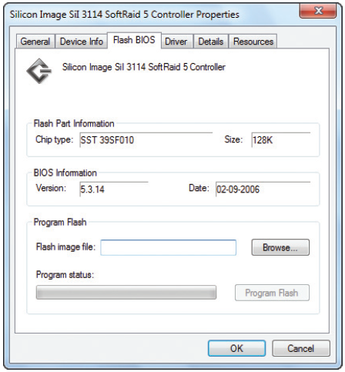
Update Drivers and Firmware
Figure 10-1 Use the device’s properties box to flash the firmware on some devices
Notes:
Update Drivers and Firmware

Slide 7
Patch Management
Guidelines for reading error messages or documentation:
The term x86 refers to 32-bit CPUs and OS’s
The term IA64 refers specifically to 64-bit Intel processors
The term x64 refers to 64-bit Os’s
All CPUs installed in personal computers today are hybrid processors that can process either 32 bits or 64 bits
Notes:
Patch Management
Guidelines for reading error messages or documentation:
The term x86 refers to 32-bit CPUs and OSs
All CPUs installed in personal computers today are hybrid processors that can process either 32 bits or 64 bits
The term IA64 refers specifically to 64-bit Intel processors
The term x64 refers to 64-bit OSs

Slide 8
Clean Up the Hard Drive
Delete unneeded files occasionally
Windows requires about 15% hard drive free space
Uses it for defragmenting drives, burning CDs and DVDs, and other tasks
Ways to improve drive performance and free up space:
Defragmenting the drive
Checking for errors
Compressing folders
Moving files and folders:
To other drives
To the cloud
Notes:
Clean Up the Hard Drive
Delete unneeded files occasionally
Windows requires about 15% hard drive free space
Uses it for defragmenting drives, burning CDs and DVDs, and other tasks
Ways to improve drive performance and free up space:
Defragmenting the drive
Checking for errors
Compressing folders
Moving files and folders to other drives

Slide 9
Directory Structures
User Profile Namespace – when a user logs onto Windows a user profile is created
A collection of user data and settings
Consists of two general items
A user folder – created under the C:\Users folder and contains a group of subfolders collectively called the user profile namespace
Ntuser.dat – file stored in the C:\Users\username folder
Notes:
Directory Structures
User Profile Namespace – when a user logs onto Windows a user profile is created
A collection of user data and settings
Consists of two general items
A user folder – created under the C:\Users folder and contains a group of subfolders collectively called the user profile namespace
Ntuser.dat – file stored in the C:\Users\username folder

Slide 10
Directory Structures
Program Files
C:\Program Files – where Windows stores program files unless you select a different location
In 64-bit versions of Windows:
64-bit program files are stored in C:\Program Files and 32-bit program files are stored in C:\Program Files (x86) folder
Notes:
Directory Structures
Program Files
C:\Program Files – where Windows stores program files unless you select a different location
In 64-bit versions of Windows:
64-bit program files are stored in C:\Program Files and 32-bit program files are stored in C:\Program Files (x86) folder

Slide 11
Directory Structures
Folders for Windows Data
Registry location: C:\Windows\System32\config
Backup of the registry: C:\Windows\System32\config\RegBack
Fonts: C:\Windows\Fonts
Temporary files: C:\Windows\Temp
Offline files: stored in the client-side caching (CSC) folder which is C:\Windows\CSC
Allows users to work with files in the folder when the computer is not connected to a corporate network
Notes:
Directory Structures
Folders for Windows Data
Registry location: C:\Windows\System32\config
Backup of the registry: C:\Windows\System32\config\RegBack
Fonts: C:\Windows\Fonts
Temporary files: C:\Windows\Temp
Offline files: stored in the client-side caching (CSC) folder which is C:\Windows\CSC
Allows users to work with files in the folder when the computer is not connected to a corporate network

Slide 12
Use the Disk Cleanup Utility
Use the Windows Disk Cleanup utility to delete temporary files
To use:
Open Windows Explorer, right-click the volume that Windows is installed on, and select Properties
On the General tab, click Disk Cleanup
To see temporary system files that can also be deleted, click Clean up system files
If even more space is needed click the More Options to see what else could be deleted
Notes:
Use the Disk Cleanup Utility
Use the Windows Disk Cleanup utility to delete temporary files
To use:
Open Windows Explorer, right-click the volume that Windows is installed on, and select Properties
On the General tab, click Disk Cleanup
To see temporary system files that can also be deleted, click Clean up system files
If even more space is needed click the More Options to see what else could be deleted

Slide 13
Defrag the Hard Drive
Defragment: to rearrange fragments or parts of files so each file is stored in contiguous clusters
Two types of hard drives:
Magnetic hard disk drives (HDDs) – contain spinning platters
Windows automatically defrags once a week
If the computer is left on
Solid-state drives (SSDs) – contain flash memory
Has no moving parts so defrag does not improve read/write time
Defragmenting this type of drive is not recommended
Notes:
Defrag the Hard Drive
Defragment: to rearrange fragments or parts of files so each file is stored in contiguous clusters
Two types of hard drives:
Magnetic hard disk drives (HDDs) – contain spinning platters
Windows automatically defrags once a week
Solid-state drives (SSDs) – contain flash memory
Has no moving parts so defrag does not improve read/write time
Defragmenting this type of drive is not recommended

Slide 14
Defrag the Hard Drive
Cluster (also called file allocation unit): group of whole sectors in a file system
Number of sectors in a cluster is fixed
A file is stored in whole clusters
Unused space at end of last cluster is called slack and is wasted free space
As files are written and deleted from a drive, clusters are used, released, and used again
Moving arm of drive may have to move all over a drive to collect all fragments of a file
Slows down performance
Solution is to defragment the drive
Notes:
Defrag the Hard Drive
Cluster (also called file allocation unit): group of whole sectors in a file system
Number of sectors in a cluster is fixed
A file is stored in whole clusters
Unused space at end of last cluster is called slack and is wasted free space
As files are written and deleted from a drive, clusters are used, released, and used again
Moving arm of drive may have to move all over a drive to collect all fragments of a file
Slows down performance
Solution is to defragment the drive

Slide 15
Check the Hard Drive for Errors
Error checking utility: searches for bad sectors on a volume and recovers the data from them if possible
To use the error checking utility:
Right-click the drive and select Properties from the shortcut menu
Click the Tools tab and click Check (Check now in 7/Vista)
In the Error Checking dialog box, click Scan drive (in 7/Vista, check Automatically fix file system errors and Scan for and attempt recovery of bad sectors and Click Start)
Notes:
Check the Hard Drive for Errors
Error checking utility: searches for bad sectors on a volume and recovers the data from them if possible
To use the error checking utility:
Right-click the drive and select Properties from the shortcut menu
Click the Tools tab and click Check (Check now in 7/Vista)
In the Error Checking dialog box, click Scan drive (in 7/Vista, check Automatically fix file system errors and Scan for and attempt recovery of bad sectors and Click Start)

Slide 16
Free Up Space On the Drive
Uninstall software you no longer use
Move data off the drive
Consider moving videos, photos, and other data to an external hard drive or burning them to DVDs, Cloud
Move programs off the drive
Uninstall a program and reinstall it on a second hard drive. External not recommended
Use drive or folder compression
It is not recommended to compress the volume on which Windows is stored
Notes:
Free Up Space On the Drive
Uninstall software you no longer use
Move data off the drive
Consider moving videos, photos, and other data to an external hard drive or burning them to DVDs
Move programs off the drive
Uninstall a program and reinstall it on a second hard drive
Use drive or folder compression
It is not recommended to compress the volume on which Windows is stored

Slide 17
Move the Virtual Memory Paging File
Virtual memory: a file used to enhance the amount of RAM in a system
To save space you can move virtual memory paging file
Pagefile.sys
Hidden file stored in C drive root directory
Move to another partition on the same or different drive
New drive speed should be equal to or greater than existing drive and should have plenty of free space (at least three times the amount of installed RAM)
Notes:
Move the Virtual Memory Paging File
Virtual memory: a file used to enhance the amount of RAM in a system
To save space you can move virtual memory paging file
Pagefile.sys
Hidden file stored in C drive root directory
Move to another partition on the same or different drive
New drive speed should be equal to or greater than existing drive and should have plenty of free space (at least three times the amount of installed RAM)

Slide 18
Backup Procedures
Backup
Extra copy of a data or software file
Use if original file becomes damaged or destroyed
Ways to lose data
System failure, virus, file corruption, or some other problem
Never trust important data to only one media
Notes:
Backup Procedures
Backup
Extra copy of a data or software file
Use if original file becomes damaged or destroyed
Ways to lose data
System failure, virus, file corruption, or some other problem
Never trust important data to only one media

Slide 19
Planning For Disaster Recovery
Decisions to make for a backup and recovery plan
Decide on backup destination
Decide on the backup software
Consider purchasing third-party backup software
Offers more features than Microsoft utility
Decide how simple or complex your backup strategy should be
Large organizations might require backups be documented daily, scheduled at certain times of the day or night, and recovery plans tested regularly
Notes:
Planning For Disaster Recovery
Decisions to make for a backup and recovery plan
Decide on backup destination
Decide on the backup software
Consider purchasing third-party backup software
Offers more features than Microsoft utility
Decide how simple or complex your backup strategy should be
Large organizations might require backups be documented daily, scheduled at certain times of the day or night, and recovery plans tested regularly

Slide 20
Planning For Disaster Recovery
After backup plan is in place, test the recovery plan
Test the recovery process
Erase a file and use the recovery procedures to verify that you can restore the file from backup
Keep backups in a safe place and routinely test them
Should be kept under lock and key
In case of fire, keep backups off-site
Routinely verify backups are good by performing a test recovery of a backed-up file or folder
Notes:
Planning For Disaster Recovery
After backup plan is in place, test the recovery plan
Test the recovery process
Erase a file and use the recovery procedures to verify that you can restore the file from backup
Keep backups in a safe place and routinely test them
Should be kept under lock and key
In case of fire, keep backups off-site
Routinely verify backups are good by performing a test recovery of a backed-up file or folder

Slide 21
Back Up User Data with Windows 8 File History
Windows 8 File History backs up user data stored in several locations, including:
Libraries, user desktop, Internet Explorer favorites, contact folders and offline OneDrive files (for Microsoft accounts)
File History utility is available as a window on the Windows desktop or an app in the Windows 8 interface
For most control, use the window on the desktop
Notes:
Back Up User Data with Windows 8 File History
Windows 8 File History backs up user data stored in several locations, including:
Libraries, user desktop, Internet Explorer favorites, contact folders and offline OneDrive files (for Microsoft accounts)
File History utility is available as a window on the Windows desktop or an app in the Windows 8 interface
For most control, use the window on the desktop

Slide 22
Back Up User Data with Windows 8 File History
To use:
Connect your backup device and open Control Panel in classic view, then click File History
To turn on File History, click Turn on
To manage backups, click Advanced settings
On the Advanced Settings window, set how often backups are made and how long old backups should be kept
You can also view a history of events and clean up old backups to free up space
Notes:
Back Up User Data with Windows 8 File History
To use:
Connect your backup device and open Control Panel in classic view, then click File History
To turn on File History, click Turn on
To manage backups, click Advanced settings
On the Advanced Settings window, set how often backups are made and how long old backups should be kept
You can also view a history of events and clean up old backups to free up space

Slide 23
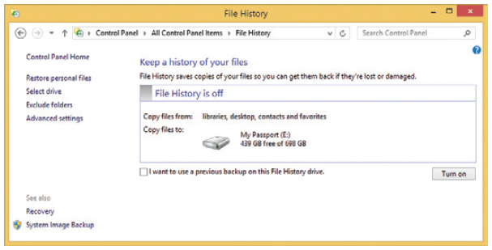
Back Up User Data with Windows 8 File History
Figure 10-8 Turn on and off File History and control its settings
Notes:
Back Up User Data with Windows 8 File History

Slide 24
Back Up User Data with Windows 8 File History
Use File History to Recover a Corrupted or Lost File or Folder
To recover items from File History, click Restore personal files in the File History window
Use left/right arrow keys on either side of the green button at the bottom of the window to select a backup and drill down into a backup to find the file or folder
Select an item and click Restore button
To save in a different location, right-click the Restore button and click Restore to
Notes:
Back Up User Data with Windows 8 File History
Use File History to Recover a Corrupted or Lost File or Folder
To recover items from File History, click Restore personal files in the File History window
Use left/right arrow keys on either side of the green button at the bottom of the window to select a backup and drill down into a backup to find the file or folder
Select an item and click Restore button
To save in a different location, right-click the Restore button and click Restore to

Slide 25
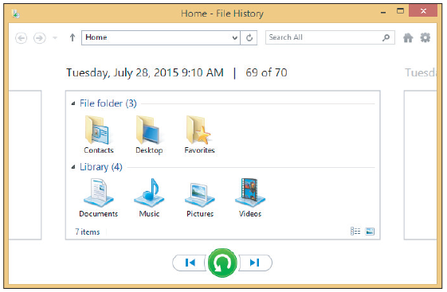
Back Up User Data with Windows 8 File History
Figure 10-9 Drill down into backups to find what you want to restore
Notes:
Back Up User Data with Windows 8 File History

Slide 26
Windows 7: Use Windows 7 Backup and Restore
Back up the Windows Volume
Called the system image
Back up user data
1. Open the Backup and Restore window
2. Select the media to hold the backup
3. In the next box, select Let me choose so you can select the folder to backup, then click Next
4. In the next box, select the libraries and folders you want to back up, click Next to continue
Notes:
Windows 7: Use Windows 7 Backup and Restore
Back up the Windows Volume
Called the system image
Back up user data
1. Open the Backup and Restore window
2. Select the media to hold the backup
3. In the next box, select Let me choose so you can select the folder to backup, then click Next
4. In the next box, select the libraries and folders you want to back up, click Next to continue

Slide 27
Windows 7: Use Windows 7 Backup and Restore
Back up user data (cont’d)
5. Verify the correct folders and libraries are selected
You can also change the frequency in this step
6. Review your backup settings and click Save settings and run backup
Notes:
Windows 7: Use Windows 7 Backup and Restore
Back up user data (cont’d)
1. 5. Verify the correct folders and libraries are selected
You can also change the frequency in this step
6. Review your backup settings and click Save settings and run backup

Slide 28
Windows 7: Use Windows 7 Backup and Restore
Recover Backed Up Items
1. Make the backup media available to computer
2. Open Backup and Restore and click Restore my files
3. Use one of three buttons to locate the file or folder
Follow directions on-screen to restore
To restore a previous version of a file or folder:
1. Copy the corrupted file or folder to a new location
2. Right click the file or folder and select Restore previous version
3. Select the version you want and click Restore
Notes:
Windows 7: Use Windows 7 Backup and Restore
Recover Backed Up Items
1. Make the backup media available to computer
2. Open Backup and Restore and click Restore my files
3. Use one of three buttons to locate the file or folder
Follow directions on-screen to restore
To restore a previous version of a file or folder:
1. Copy the corrupted file or folder to a new location
2. Right click the file or folder and select Restore previous version
3. Select the version you want and click Restore

Slide 29
Back Up Windows System Files
Windows System Protection – automatically backs up system files and stores them at regular intervals
Restore point
Condition at time a snapshot taken
Includes Windows system files
Restore points are taken at least every 24 hours
Can use up to 15 percent of disk space
If disk space gets too low, restore points are no longer made
Can manually create restore point at any time using the System Protection tab of System Properties
Notes:
Back Up Windows System Files
Windows System Protection – automatically backs up system files and stores them at regular intervals
Restore point
Condition at time a snapshot taken
Includes Windows system files
Restore points are taken at least every 24 hours
Can use up to 15 percent of disk space
If disk space gets too low, restore points are no longer made
Can manually create restore point at any time using the System Protection tab of System Properties

Slide 30
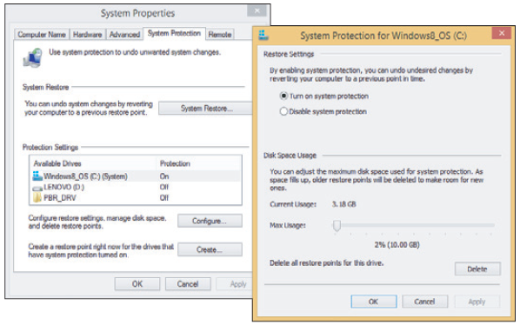
Back Up Windows System Files
Figure 10-14 Make sure System Protection is turned on for the volume on which Windows is installed
Notes:
Back Up Windows System Files

Slide 31
Back Up Windows System Files
Apply a restore point
System Restore restores the system to its condition at the time a restore point is made
User data not altered
Can affect installed software, hardware, user settings, and OS configuration settings
Changes made to settings are lost after restore point is created
Always use most recent restore point capable of fixing the problem
Notes:
Back Up Windows System Files
Apply a restore point
System Restore restores the system to its condition at the time a restore point is made
User data not altered
Can affect installed software, hardware, user settings, and OS configuration settings
Changes made to settings are lost after restore point is created
Always use most recent restore point capable of fixing the problem

Slide 32
Back Up Windows System Files
To return the system to a previous restore point:
Click Start, type rstrui.exe in the Search box and press Enter
System Restore box opens, click Next
Select a restore point and click Next
Windows asks you to confirm, click Finish and respond to warning box
Notes:
Back Up Windows System Files
To return the system to a previous restore point:
Click Start, type rstrui.exe in the Search box and press Enter
System Restore box opens, click Next
Select a restore point and click Next
Windows asks you to confirm, click Finish and respond to warning box

Slide 33
Back Up Windows System Files
Points to remember about system restore
Limitations
System Protection must be turned on
Recovers from errors only if registry somewhat intact
Process cannot remove virus or worm infection
Process might create a new problem
Process might make many changes to a system
Restore points kept in a hidden folder on the hard drive
Viruses and malware sometimes hide in restore points
Can launch System Restore using startup recovery tools
Notes:
Back Up Windows System Files
Points to remember about system restore
Limitations
System Protection must be turned on
Recovers from errors only if registry somewhat intact
Process cannot remove virus or worm infection
Process might create a new problem
Process might make many changes to a system
Restore points kept in a hidden folder on the hard drive
Viruses and malware sometimes hide in restore points
Can launch System Restore using startup recovery tools

Slide 34
Windows 8 Custom Refresh Image
Custom refresh image – an image of the entire Windows volume including the Windows installation
Windows 8 apps, desktop applications, and user settings and data
Best time to create a refresh image:
Right after you’ve installed Windows, hardware, applications, and user accounts
Image is stored in a file named CustomRefresh.wim in the folder you specify
WIM file uses the Windows Imaging File format
Notes:
Windows 8 Custom Refresh Image
Custom refresh image – an image of the entire Windows volume including the Windows installation
Windows 8 apps, desktop applications, and user settings and data
Best time to create a refresh image:
Right after you’ve installed Windows, hardware, applications, and user accounts
Image is stored in a file named CustomRefresh.wim in the folder you specify
WIM file uses the Windows Imaging File format

Slide 35
Windows 8 Custom Refresh Image
Steps to create a Windows 8 custom refresh image:
Open an elevated command prompt window
Press Win+X and click Command Prompt (Admin)
Enter this command, substituting drive and folder:
recimg /createimage D:\MyImage
The image and its location are registered as the active recovery image
The recimg command can also be used to manage refresh images
Notes:
Windows 8 Custom Refresh Image
Steps to create a Windows 8 custom refresh image:
Open an elevated command prompt window
Press Win+X and click Command Prompt (Admin)
Enter this command, substituting drive and folder:
recimg /createimage D:\MyImage
The image and its location are registered as the active recovery image
The recimg command can also be used to manage refresh images

Slide 36
Windows 7: Windows 7 System Image
To create a Windows 7 system image, click Create a system image in the Backup and Restore window and follow directions on screen
Points to keep in mind:
A system image includes the entire drive C: or other drive on which Windows is installed
A system image must always be created on an internal or external hard drive
Don’t depend just on the system image as your backup
Notes:
Windows 7: Windows 7 System Image
To create a Windows 7 system image, click Create a system image in the Backup and Restore window and follow directions on screen
Points to keep in mind:
A system image includes the entire drive C: or other drive on which Windows is installed
A system image must always be created on an internal or external hard drive
Don’t depend just on the system image as your backup

Slide 37
Windows 7: Windows 7 System Image
Points to keep in mind (cont’d):
You can create a system image any time after Windows is installed, and then you can use this image to recover from a failed hard drive
Notes:
Windows 7: Windows 7 System Image
Points to keep in mind (cont’d):
You can create a system image any time after Windows is installed, and then you can use this image to recover from a failed hard drive

Slide 38
Managing Files, Folders, and Storage Devices
This section of the chapter covers:
Managing files and folders using commands in a command prompt window
Managing hard drive partitions and volumes using the Disk Management utility
Notes:
Managing Files, Folders, and Storage Devices
This section of the chapter covers:
Managing files and folders using commands in a command prompt window
Managing hard drive partitions and volumes using the Disk Management utility

Slide 39
How Partitions and File Systems Work
All data is stored on a hard drive in sectors (records)
Each sector on drive is the same size (usually 512 bytes)
Low-level formatting: A process (usually performed at the factory) that electronically creates the hard drive tracks and sectors and tests for bad spots
Size of the sector and total number of sectors determine capacity
Today’s drive capacities are measured in GB (gigabytes) or TB (terabytes)
Notes:
How Partitions and File Systems Work
All data is stored on a hard drive in sectors (records)
Each sector on drive is the same size (usually 512 bytes)
Low-level formatting: A process (usually performed at the factory) that electronically creates the hard drive tracks and sectors and tests for bad spots
Size of the sector and total number of sectors determine capacity
Today’s drive capacities are measured in GB (gigabytes) or TB (terabytes)

Slide 40
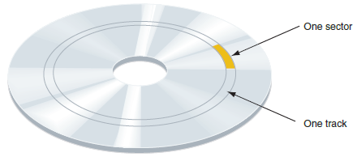
How Partitions and File Systems Work
Figure 10-20 A magnetic hard drive is divided into concentric circles called tracks, and tracks are divided into sectors
Notes:
How Partitions and File Systems Work

Slide 41
How Partitions and File Systems Work
Partitions - hard drives are further divided into one or more partitions (can have up to four in Windows)
Maps of the partitions are kept in a partition table in the first sector of the drive called the Master Boot Record (MBR)
Can have up to three primary partitions (also called volumes)
A fourth partition (called extended partition) can hold one or more volumes called logical drives
Notes:
How Partitions and File Systems Work
Partitions - hard drives are further divided into one or more partitions (can have up to four in Windows)
Maps of the partitions are kept in a partition table in the first sector of the drive called the Master Boot Record (MBR)
Can have up to three primary partitions (also called volumes)
A fourth partition (called extended partition) can hold one or more volumes called logical drives

Slide 42
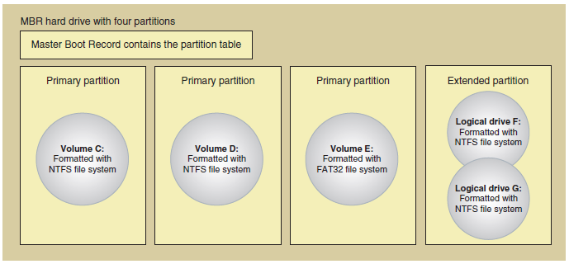
How Partitions and File Systems Work
Figure 10-20 A hard drive with four partitions; the fourth partition is an
extended partition
Notes:
How Partitions and File Systems Work

Slide 43
How Partitions and File Systems Work
Partitions (cont’d)
GPT partitions – the Globally Unique Identifier Partition Table (GUID or GPT) system can support up to 128 partitions
Required for drives larger than 2 TB
Does not use extended partitions or logical volumes
The bootable partition is not called an active partition
First sector in a GPT system contains the protective MBR, which provides information to legacy software that does not support GPT
All partitions are tracked in a single partition table, stored in the GPT header
Notes:
How Partitions and File Systems Work
Partitions (cont’d)
GPT partitions – the Globally Unique Identifier Partition Table (GUID or GPT) system can support up to 128 partitions
Required for drives larger than 2 TB
Does not use extended partitions or logical volumes
The bootable partition is not called an active partition
First sector in a GPT system contains the protective MBR, which provides information to legacy software that does not support GPT
All partitions are tracked in a single partition table, stored in the GPT header

Slide 44
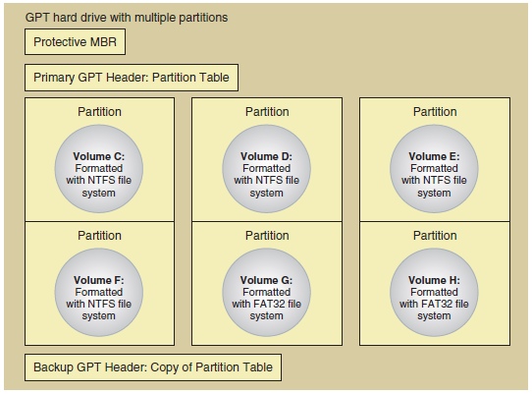
How Partitions and File Systems Work
Figure 10-21 A hard drive using GPT
Notes:
How Partitions and File Systems Work

Slide 45
How Partitions and File Systems Work
File System - before a drive can be used it must be:
Assigned a drive letter (C: or D:)
Formatted using a file system
File system is overall structure an OS uses to name, store, and organize files on a drive
Windows 8/7 supports three types of file systems: NTFS, FAT32, and exFAT
File systems supported by Windows for volumes that don’t hold the Windows installation:
NTFS – uses smaller allocation unit or cluster sizes than FAT32 (more efficient)
Notes:
How Partitions and File Systems Work
File System - before a drive can be used it must be:
Assigned a drive letter (C: or D:)
Formatted using a file system
File system is overall structure an OS uses to name, store, and organize files on a drive
Windows 8/7 supports three types of file systems: NTFS, FAT32, and exFAT
File systems supported by Windows for volumes that don’t hold the Windows installation:
NTFS – uses smaller allocation unit or cluster sizes than FAT32 (more efficient)

Slide 46
How Partitions and File Systems Work
File systems supported by Windows for volumes that don’t hold the Windows installation (cont’d):
ReFS – Resilient File System (ReFS) designed to improve on the NTFS file system by offering better fault tolerance and allowing for better compatibility with virtualization and data redundancy
exFAT – use for large external storage devices to be used with other operating systems
FAT32 – use for small hard drives or USB flash drives
CDFS(Compact Disc File System) and UDF – CDFS is an older file system used by optical discs and is being replaced by UDF (Universal Disc Format)
Notes:
How Partitions and File Systems Work
File systems supported by Windows for volumes that don’t hold the Windows installation (cont’d):
ReFS – Resilient File System (ReFS) designed to improve on the NTFS file system by offering better fault tolerance and allowing for better compatibility with virtualization and data redundancy
exFAT – use for large external storage devices to be used with other operating systems
FAT32 – use for small hard drives or USB flash drives
CDFS(Compact Disc File System) and UDF – CDFS is an older file system used by optical discs and is being replaced by UDF (Universal Disc Format)

Slide 47
How Partitions and File Systems Work
Windows assigns two functions to partitions:
Active partition – the bootable partition that startup UEFI/BIOS turns to when searching for an OS
In GPT system, it is called the EFI System Partition (ESP)
In Windows, the MBR active partition or the ESP System Partition is called the system partition
Boot partition – partition where Windows OS is stored
Notes:
How Partitions and File Systems Work
Windows assigns two functions to partitions:
Active partition – the bootable partition that startup UEFI/BIOS turns to when searching for an OS
In GPT system, it is called the EFI System Partition (ESP)
In Windows, the MBR active partition or the ESP System Partition is called the system partition
Boot partition – partition where Windows OS is stored

Slide 48
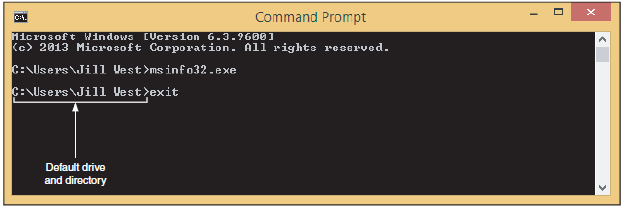
Commands To Manage Files and Folders
Command prompt window
Open by pressing Win+X and click Command Prompt
Can also enter cmd.exe in the search box
Figure 10-24 Use the exit command to close the command prompt window
Notes:
Commands To Manage Files and Folders
Command prompt window
Open by pressing Win+X and click Command Prompt
Can also enter cmd.exe in the search box

Slide 49
Commands to Manage Files and Folders
Windows has two levels of command prompt windows
Standard window – default directory is the currently logged on user’s folder
Commands requiring administrative privileges will not work
Elevated window – requires the user to logon as an administrator
The word “administrator” will appear in the title bar
Default directory will be C:\Windows\system32
Notes:
Commands to Manage Files and Folders
Windows has two levels of command prompt windows
Standard window – default directory is the currently logged on user’s folder
Commands requiring administrative privileges will not work
Elevated window – requires the user to logon as an administrator
The word “administrator” will appear in the title bar
Default directory will be C:\Windows\system32

Slide 50
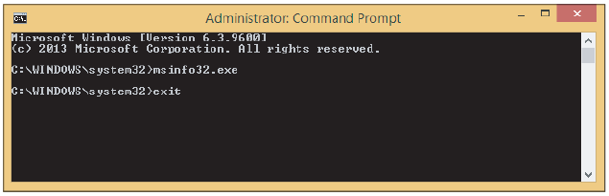
Commands to Manage Files and Folders
Figure 10-25 An elevated command prompt window has administrative privileges
Notes:
Commands to Manage Files and Folders

Slide 51
Commands to Manage Files and Folders
Tips for working in a command prompt window:
Type cls and press Enter to clear the window
Press the up arrow to retrieve the last command
Press the right arrow to retrieve the last command line one character at a time
Press Ctrl+C, Ctrl+Break or Ctrl+Pause to terminate a command before it is finished
Type exit and press Enter to close the window
Notes:
Commands to Manage Files and Folders
Tips for working in a command prompt window:
Type cls and press Enter to clear the window
Press the up arrow to retrieve the last command
Press the right arrow to retrieve the last command line one character at a time
Press Ctrl+C, Ctrl+Break or Ctrl+Pause to terminate a command before it is finished
Type exit and press Enter to close the window

Slide 52
Commands To Manage Files and Folders
File naming conventions
Filename and file extension characters
Letters a through z and numbers 0 through 9
Characters: _ ^ $~ ! # % & – { } ( ) @ ' `
Filename with spaces:
Enclose filename in double quotation marks
Wildcard characters in command lines
Question mark (?): wildcard for one character
Asterisk (*): wildcard for one or more characters
Notes:
Commands To Manage Files and Folders
File naming conventions
Filename and file extension characters
Letters a through z and numbers 0 through 9
Characters: _ ^ $~ ! # % & – { } ( ) @ ' `
Filename with spaces:
Enclose filename in double quotation marks
Wildcard characters in command lines
Question mark (?): wildcard for one character
Asterisk (*): wildcard for one or more characters

Slide 53
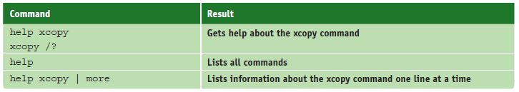
Commands To Manage Files and Folders
help or <command name> /?
Table 10-2 Sample help commands
Notes:
Commands To Manage Files and Folders
help or <command name> /?

Slide 54
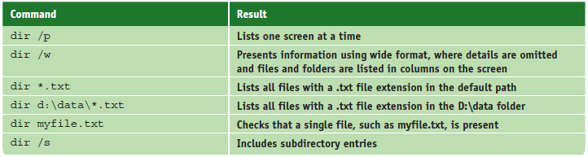
Commands to Manage Files and Folders
dir [<filename>] [/p] [/s] [/w]
List files and directories
Table 10-3 Sample dir commands
Notes:
Commands to Manage Files and Folders
dir [<filename>] [/p] [/s] [/w]
List files and directories

Slide 55
Commands To Manage Files and Folders
md [drive:]path
Creates a subdirectory under a directory
cd [drive:]path or cd..
Changes current default directory
Use .. after CD to move from child directory to its parent directory
rd [drive:]path
Removes a subdirectory
Directory must contain no files
Directory must contain no subdirectories
Directory must not be current directory
Notes:
Commands To Manage Files and Folders
md [drive:]path
Creates a subdirectory under a directory
cd [drive:]path or cd..
Changes current default directory
Use .. after CD to move from child directory to its parent directory
rd [drive:]path
Removes a subdirectory
Directory must contain no files
Directory must contain no subdirectories
Directory must not be current directory

Slide 56
Commands To Manage Files and Folders
del or erase <filename>
Erases files or groups of files
ren <filename1> <filename2>
Renames a file
copy <source> [<destination>] [/v] [/y]
Useful switches or parameters
/v: size of each new file compared to the size of original file
/y: confirmation message does not appear asking to confirm before overwriting a file
Notes:
Commands To Manage Files and Folders
del or erase <filename>
Erases files or groups of files
ren <filename1> <filename2>
Renames a file
copy <source> [<destination>] [/v] [/y]
Useful switches or parameters
/v: size of each new file compared to the size of original file
/y: confirmation message does not appear asking to confirm before overwriting a file

Slide 57
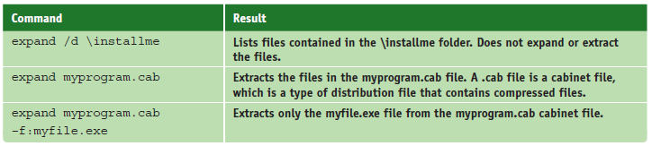
Commands To Manage Files and Folders
recover <filename>
Attempts to recover a file when parts corrupted
expand [/d] <source> [<destination>]
Extracts files from compressed distribution files, which are often used to distribute files for software installations
Table 10-4 Sample expand commands
Notes:
Commands To Manage Files and Folders
recover <filename>
Attempts to recover a file when parts corrupted
expand [/d] <source> [<destination>]
Extracts files from compressed distribution files, which are often used to distribute files for software installations

Slide 58
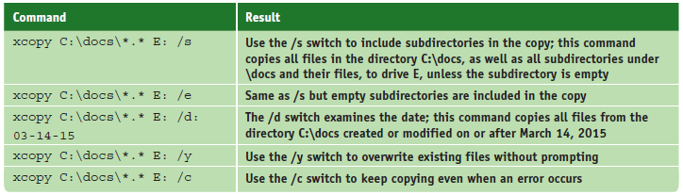
Commands To Manage Files and Folders
xcopy <source> [<destination>] [/s] [/c] [/y] [/d:date]
Table 10-5 Sample Xcopy commands
Notes:
Commands To Manage Files and Folders
xcopy <source> [<destination>] [/s] [/c] [/y] [/d:date]

Slide 59
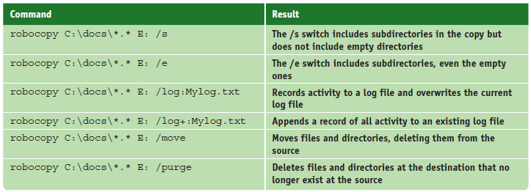
Commands To Manage Files and Folders
robocopy <source> [<destination>] [/s] [/e] [/log:filename] [/log+:filename] [/move] [/purge]
Robust File Copy command
Table 10-6 Sample robocopy commands
Notes:
Commands To Manage Files and Folders
robocopy <source> [<destination>] [/s] [/e] [/log:filename] [/log+:filename] [/move] [/purge]
Robust File Copy command

Slide 60
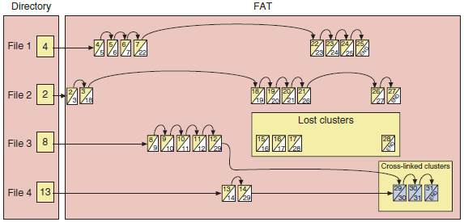
Commands To Manage Files and Folders
chkdsk [drive:] [/f] [/r]
Fixes file system errors
Recovers data from bad sectors
Figure 10-27 Lost and cross-linked clusters
Notes:
Commands To Manage Files and Folders
chkdsk [drive:] [/f] [/r]
Fixes file system errors
Recovers data from bad sectors

Slide 61

Commands To Manage Files and Folders
defrag [drive:] [/C]
Examines a drive for fragmented files
Rewrites fragmented files in contiguous clusters
Table 10-7 Sample defrag commands
Notes:
Commands To Manage Files and Folders
defrag [drive:] [/C]
Examines a drive for fragmented files
Rewrites fragmented files in contiguous clusters

Slide 62
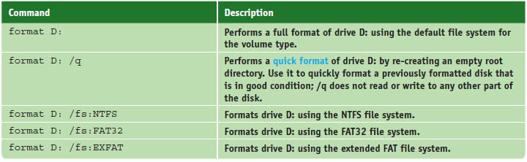
Commands To Manage Files and Folders
format <drive:> [/v:label] [/q] [fs:<filesystem>]
Used to format a hard drive or other storage device
Table 10-8 Sample format commands
Notes:
Commands To Manage Files and Folders
format <drive:> [/v:label] [/q] [fs:<filesystem>]
Used to format a hard drive or other storage device

Slide 63
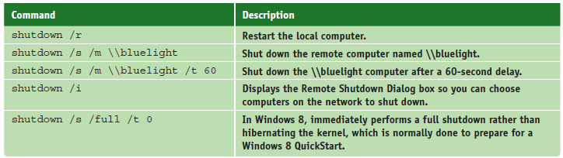
Commands To Manage Files and Folders
shutdown [/m \\computername] [/i] [/r] [/s] [/f] [/t xx]
Shut down the local computer or a remote computer
Figure 10-9 Sample shutdown commands
Notes:
Commands To Manage Files and Folders
shutdown [/m \\computername] [/i] [/r] [/s] [/f] [/t xx]
Shut down the local computer or a remote computer

Slide 64
Commands To Manage Files and Folders
Windows PowerShell – designed to replace the command prompt utility
Users enter commands to be executed
Processes objects called cmdlets
Contains thousands of cmdlets and technicians can program their own cmdlets
To open Windows 8 PowerShell, press Win+X, click Run, type powershell in the Run box, press Enter
Notes:
Commands To Manage Files and Folders
Windows PowerShell – designed to replace the command prompt utility
Users enter commands to be executed
Processes objects called cmdlets
Contains thousands of cmdlets and technicians can program their own cmdlets
To open Windows 8 PowerShell, press Win+X, click Run, type powershell in the Run box, press Enter

Slide 65
Use Disk Management To Manage Hard Drives
Disk Management is the primary tool for managing hard drives
Manage partitions, prepare a new drive for first use, mount a drive, use Windows dynamic disks, or troubleshoot problems with the hard drive
Resize, Create, and Delete Partitions
To open Disk Management, use one of these methods:
Press Win+X and click Disk Management
Press Win+S, type diskmgmt.msc, and press Enter
Notes:
Use Disk Management To Manage Hard Drives
Disk Management is the primary tool for managing hard drives
Manage partitions, prepare a new drive for first use, mount a drive, use Windows dynamic disks, or troubleshoot problems with the hard drive
Resize, Create, and Delete Partitions
To open Disk Management, use one of these methods:
Press Win+X and click Disk Management
Press Win+S, type diskmgmt.msc, and press Enter

Slide 66
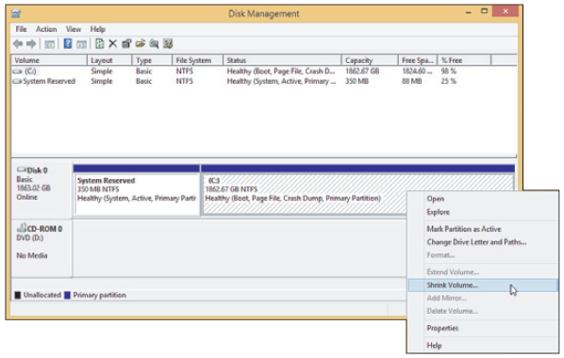
Use Disk Management To Manage Hard Drives
Figure 10-28 Shrink a volume to make room for a new partition
Notes:
Use Disk Management To Manage Hard Drives

Slide 67
Use Disk Management To Manage Hard Drives
Prepare a drive for first use
Step 1: Initialize the Disk
When initialized, Windows identifies the disk as a basic disk, which is a single hard drive that works independently of other hard drives
Step 2: Create a Volume and Format It with a File System
Right-click in the unallocated space, select New Simple Volume from the shortcut menu, and follow directions on-screen
Notes:
Use Disk Management To Manage Hard Drives
Prepare a drive for first use
Step 1: Initialize the Disk
When initialized, Windows identifies the disk as a basic disk, which is a single hard drive that works independently of other hard drives
Step 2: Create a Volume and Format It with a File System
Right-click in the unallocated space, select New Simple Volume from the shortcut menu, and follow directions on-screen

Slide 68
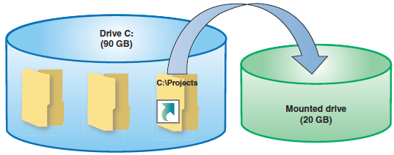
Use Disk Management To Manage Hard Drives
How to Mount a Drive
Mounted drive is a volume accessible by a folder on another volume
Folder has more available space
Mount point: C:\Projects folder
Figure 10-31 The C:\Projects folder is the mount point for the mounted drive
Notes:
Use Disk Management To Manage Hard Drives
How to Mount a Drive
Mounted drive is a volume accessible by a folder on another volume
Folder has more available space
Mount point: C:\Projects folder

Slide 69
Use Disk Management To Manage Hard Drives
Windows Dynamic Disks
Several dynamic disks can work together to collectively present a single dynamic volume
Data to configure each hard drive is stored in a disk management database (resides in last 1 MB of space on each hard drive)
Better reliability, spanning, stripping (RAID 0) to improve performance, mirror two hard drives for fault tolerance (RAID 1) for XP
Notes:
Use Disk Management To Manage Hard Drives
Windows Dynamic Disks
Several dynamic disks can work together to collectively present a single dynamic volume
Data to configure each hard drive is stored in a disk management database (resides in last 1 MB of space on each hard drive)
Better reliability, spanning, stripping (RAID 0) to improve performance, mirror two hard drives for fault tolerance (RAID 1) for XP

Slide 70
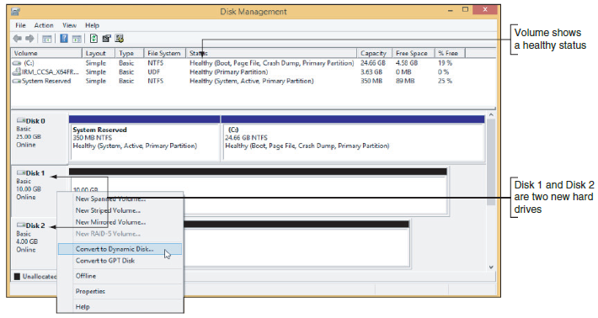
Use Disk Management To Manage Hard Drives
Windows dynamic disks (cont’d.)
Disk Management converts two or more basic disks to dynamic disks
Figure 10-35 Convert a basic disk to a dynamic disk
Notes:
Use Disk Management To Manage Hard Drives
Windows dynamic disks (cont’d.)
Disk Management converts two or more basic disks to dynamic disks

Slide 71
Use Disk Management To Manage Hard Drives
Use Disk Management to Troubleshoot Hard Drive Problems
Drive and volume statuses:
Healthy
Failed
Online
Active
EFI System Partition
Unallocated
Formatting
Basic
Dynamic
Notes:
Use Disk Management To Manage Hard Drives
Use Disk Management to Troubleshoot Hard Drive Problems
Drive and volume statuses:
Healthy
Failed
Online
Active
EFI System Partition
Unallocated
Formatting
Basic
Dynamic

Slide 72
Windows Storage Spaces
With Storage Spaces, you can create a storage pool using any number of internal and external backup drives
Create one or more virtual drives, called spaces, from this pool
Appear as normal drives in File Explorer
Storage spaces is designed for resiliency
Resistance of a configuration against data loss in the event of drive failure
Notes:
Windows Storage Spaces
With Storage Spaces, you can create a storage pool using any number of internal and external backup drives
Create one or more virtual drives, called spaces, from this pool
Appear as normal drives in File Explorer
Storage spaces is designed for resiliency
Resistance of a configuration against data loss in the event of drive failure

Slide 73
Windows Storage Spaces
Storage options:
Simple
Two-way mirroring
Three-way mirroring
Parity
Thin provisioning – a feature that can configure a space to have more virtual storage than the physical drives actually offer
Notes:
Windows Storage Spaces
Storage options:
Simple
Two-way mirroring
Three-way mirroring
Parity
Thin provisioning – a feature that can configure a space to have more virtual storage than the physical drives actually offer

Slide 74
Summary
Regular preventive maintenance improves performance and troubleshooting
Verify Windows settings, defragment hard drives, check drive for errors, reduce startup process to essentials, and free up hard drive space
Windows offers may preventative maintenance tools
Plan for disaster recovery in the event a hard drive fails by performing routine backups of data and system files
Windows 8 File History and Windows 7 Backup and Restore can be used to schedule routine backups of user data files
Notes:
Summary
Regular preventive maintenance improves performance and troubleshooting
Verify Windows settings, defragment hard drives, check drive for errors, reduce startup process to essentials, and free up hard drive space
Windows offers may preventative maintenance tools
Plan for disaster recovery in the event a hard drive fails by performing routine backups of data and system files
Windows 8 File History and Windows 7 Backup and Restore can be used to schedule routine backups of user data files

Slide 75
Summary
System Protection creates restore points
A Windows 8 custom refresh image backs up the entire Windows volume
A hard drive is divided into sectors, blocks, and partitions
The MBR partitioning system requires legacy BIOS and a 32-bit OS
The GPT partitioning system requires UEFI and a 64-bit OS
Notes:
Summary
System Protection creates restore points
A Windows 8 custom refresh image backs up the entire Windows volume
A hard drive is divided into sectors, blocks, and partitions
The MBR partitioning system requires legacy BIOS and a 32-bit OS
The GPT partitioning system requires UEFI and a 64-bit OS

Slide 76
Summary
Commands useful to manage files, folders and storage media include help, dir, del, ren, copy, recover, expand, xcopy, robocopy, MD, CD, RD, chkdsk, defrag, and format
Use Disk Management to manage hard drives and partitions
Windows 8 Storage Spaces is expected to replace the Windows solution for software RAID and can support thin provisioning
Notes:
Summary
Commands useful to manage files, folders and storage media include help, dir, del, ren, copy, recover, expand, xcopy, robocopy, MD, CD, RD, chkdsk, defrag, and format
Use Disk Management to manage hard drives and partitions
Windows 8 Storage Spaces is expected to replace the Windows solution for software RAID and can support thin provisioning

