Slide 1

A+ Guide to IT Technical Support, 9th Edition
Chapter 13
Troubleshooting Windows Startup
Notes:
A+ Guide to IT Technical Support, 9th Edition
Chapter 13
Troubleshooting Windows Startup

Slide 2
Objectives
Describe the boot process from the time you press the power button until the Windows Start screen or desktop loads
Apply appropriate Windows tools to solve Windows startup problems
Troubleshoot Windows startup problems
Notes:
Objectives
Describe the boot process from the time you press the power button until the Windows Start screen or desktop loads
Apply appropriate Windows tools to solve Windows startup problems
Troubleshoot Windows startup problems

Slide 3
Understanding the Boot Process
The better you understand what happens when you first turn on a computer until Windows is loaded
The more likely you will be able to solve a problem when Windows cannot start
Notes:
Understanding the Boot Process
The better you understand what happens when you first turn on a computer until Windows is loaded
The more likely you will be able to solve a problem when Windows cannot start
Begin by noting the differences between a hard boot and a soft boot

Slide 4
Different Ways to Boot
Choosing between a hard boot and a soft boot
Hard boot (cold boot): turning on the power with the on/off switch
Takes more time than a soft boot
Initializes the processor and clears memory
Pressing the power button more than 5 seconds while OS is running will shut down the PC!
Soft boot (warm boot): using the OS to reboot
Initial steps performed by UEFI/UEFI/BIOS in a hard boot don’t happen
To save time use the soft boot to restart
Notes:
Different Ways to Boot
Choosing between a hard boot and a soft boot
Hard boot (cold boot): turning on the power with the on/off switch
Takes more time than a soft boot
Initializes the processor and clears memory
Soft boot (warm boot): using the OS to reboot
Initial steps performed by UEFI/UEFI/BIOS in a hard boot don’t happen
To save time use the soft boot to restart
If a soft boot doesn’t work, use a hard boot

Slide 5
Windows Shutdown and Restart
Windows 8 Fast Startup – feature that speeds up startup by performing a partial hibernation at shutdown
Windows saves the drivers and kernel state in the Windows hibernate file, hiberfil.sys
Reads from this file on the next cold boot
Enabled by default
Can be disabled in the Power Options applet in Control Panel
Notes:
Windows Shutdown and Restart
Windows 8 Fast Startup – feature that speeds up startup by performing a partial hibernation at shutdown
Windows saves the drivers and kernel state in the Windows hibernate file, hiberfil.sys
Reads from this file on the next cold boot
Enabled by default
Can be disabled in the Power Options applet in Control Panel

Slide 6
Power Buttons and Switches on a Computer Case
Power buttons and switches work like this:
Power button in front can be configured as a “soft” power button, causing a Windows restart
The reset button initializes the CPU
Restarts at the beginning of the UEFI/UEFI/BIOS startup
Switch on the rear of the case turns off the power abruptly and is a “hard” power button
Notes:
Power Buttons and Switches on a Computer Case
Power buttons and switches work like this:
Power button in front can be configured as a “soft” power button, causing a Windows restart
The reset button initializes the CPU
Restarts at the beginning of the UEFI/UEFI/BIOS startup
Switch on the rear of the case turns off the power abruptly and is a “hard” power button

Slide 7
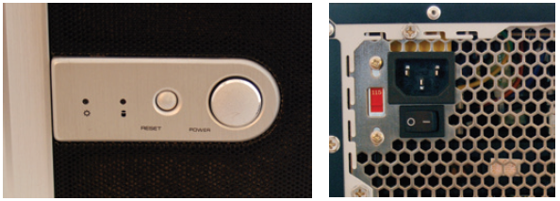
Power Buttons and Switches on a Computer Case
Figure 13-2 This computer case has two power buttons on the front and one power switch on the rear of the case
Notes:
Power Buttons and Switches on a Computer Case

Slide 8
Startup UEFI/UEFI/BIOS Controls The Beginning Of The Boot
Startup UEFI/BIOS: responsible for getting a system up and running
If Secure Boot in UEFI is enabled, UEFI systems run security checks to protect against malware
Stores device drivers and information about Secure Boot on a nonvolatile RAM (NVRAM) chip and in a hidden partition on the hard drive called ESP
UEFI/BIOS searches for and then turns to a boot device to find an OS to launch
Notes:
Startup UEFI/UEFI/BIOS Controls The Beginning Of The Boot
Startup UEFI/BIOS: responsible for getting a system up and running
If Secure Boot in UEFI is enabled, UEFI systems run security checks to protect against malware
Stores device drivers and information about Secure Boot on a nonvolatile RAM (NVRAM) chip and in a hidden partition on the hard drive called ESP
UEFI/BIOS searches for and then turns to a boot device to find an OS to launch

Slide 9
Startup UEFI/UEFI/BIOS Controls The Beginning Of The Boot
A successful boot depends on the hardware, the UEFI/BIOS, and the OS performing without errors
Steps to start a Windows computer are diagrammed in Figures 13-3 and 13-4
Notes:
Startup UEFI/UEFI/BIOS Controls The Beginning Of The Boot
A successful boot depends on the hardware, the UEFI/BIOS, and the OS performing without errors
Steps to start a Windows computer are diagrammed in Figures 13-3 and 13-4

Slide 10
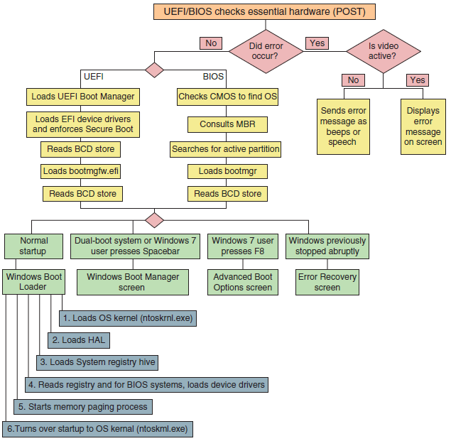
Startup UEFI/UEFI/BIOS Controls The Beginning Of The Boot
Figure 13-3 Steps to booting the computer and loading Windows
Notes:
Startup UEFI/UEFI/BIOS Controls The Beginning Of The Boot

Slide 11
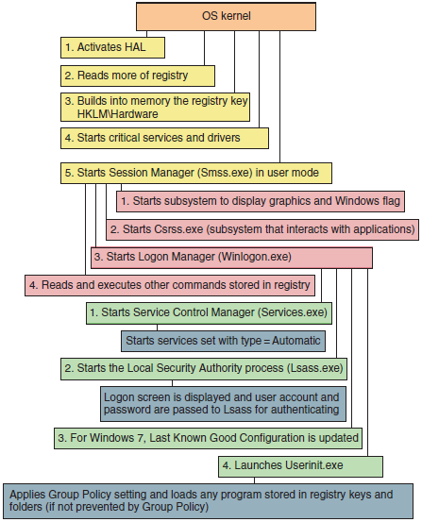
Startup UEFI/UEFI/BIOS Controls The Beginning Of The Boot
Figure 13-4 Steps to complete loading Windows
Notes:
Startup UEFI/UEFI/BIOS Controls The Beginning Of The Boot

Slide 12
Windows 7 Startup
Windows 8 and Windows 7 generally use the same startup processes, with a few differences:
If Windows 7 was previously stopped abruptly or another error occurs, the Windows 7 Error and Recovery screen appears
If the user presses the spacebar near the beginning of Windows startup, the Windows 7 Boot Manager screen appears, which allows you to run Windows Memory Diagnostics
If the user presses F8 at startup, the Windows 7 Advanced Boot Options screen appears
Notes:
Windows 7 Startup
Windows 8 and Windows 7 generally use the same startup processes, with a few differences:
If Windows 7 was previously stopped abruptly or another error occurs, the Windows 7 Error and Recovery screen appears
If the user presses the spacebar near the beginning of Windows startup, the Windows 7 Boot Manager screen appears, which allows you to run Windows Memory Diagnostics
If the user presses F8 at startup, the Windows 7 Advanced Boot Options screen appears

Slide 13
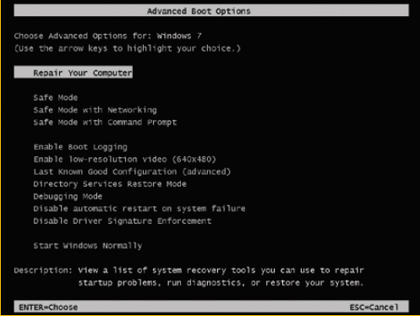
Windows 7 Startup
Figure 13-9 Press F8 during the boot to launch the Windows 7 Advanced Boot Options menu
Notes:
Windows 7 Startup

Slide 14
Tools for Solving Windows Startup Problems
Tools are divided into three groups:
The least invasive and easy solutions
Tools that can affect Windows system files and user settings
Tools to rebuild the Windows installation
Notes:
Tools for Solving Windows Startup Problems
Tools are divided into three groups:
The least invasive and easy solutions
Tools that can affect Windows system files and user settings
Tools to rebuild the Windows installation

Slide 15
What To Do Before a Problem Occurs
While computer is still healthy:
Keep good backups
Create a Windows 8 custom refresh image
Configure Windows 8 to use the F8 key at startup
Give you access to the Advanced Boot Options menu in Windows
Create a recovery drive
Notes:
What To Do Before a Problem Occurs
While computer is still healthy:
Keep good backups
Create a Windows 8 custom refresh image
Configure Windows 8 to use the F8 key at startup
Give you access to the Advanced Boot Options menu in Windows
Create a recovery drive

Slide 16
Create a Recovery Drive
Windows 8 provides two recovery device options:
If the computer has an optical drive, you can boot from the Windows setup DVD and use Windows RE to fix problems
You can use a new Windows 8 tool called a recovery drive
A bootable flash drive
Create the recovery drive before it is needed
Follow steps outlined in the text to create the recovery drive
Notes:
Create a Recovery Drive
Windows 8 provides two recovery device options:
If the computer has an optical drive, you can boot from the Windows setup DVD and use Windows RE to fix problems
You can use a new Windows 8 tool called a recovery drive
A bootable flash drive
Create the recovery drive before it is needed
Follow steps outlined in the text to create the recovery drive

Slide 17
Windows 7: Create a System Repair Disc
Create a system repair disc
You can use it to launch Windows RE
To create:
Click Create a system repair disc in the Windows 7 Backup and Restore window
A repair disc created on one computer can be used on a different computer
Be sure to use a 32-bit disc for a 32-bit installation and a 64-bit disc for a 64-bit Windows installation
Notes:
Windows 7: Create a System Repair Disc
Create a system repair disc
You can use it to launch Windows RE
To create:
Click Create a system repair disc in the Windows 7 Backup and Restore window
A repair disc created on one computer can be used on a different computer
Be sure to use a 32-bit disc for a 32-bit installation and a 64-bit disc for a 64-bit Windows installation

Slide 18
Tools for Least Invasive Solutions
Tools that are easy to use and don’t make major changes to Windows system files:
Windows 8 self-healing feature
Several options on the Windows advanced startup screens
Notes:
Tools for Least Invasive Solutions
Tools that are easy to use and don’t make major changes to Windows system files:
Windows 8 self-healing feature
Several options on the Windows advanced startup screens

Slide 19
Tools for Least Invasive Solutions
Windows 8’s Self-Healing Feature
Automatically launches diagnostics if you restart your computer at least three times within a few minutes
If system hangs while diagnosing and repairing
Try another restart
Windows will launch the Windows Recover Environment (Windows RE)
You can launch Windows RE from the Windows setup DVD or a recovery drive
Notes:
Tools for Least Invasive Solutions
Windows 8’s Self-Healing Feature
Automatically launches diagnostics if you restart your computer at least three times within a few minutes
If system hangs while diagnosing and repairing
Try another restart
Windows will launch the Windows Recover Environment (Windows RE)
You can launch Windows RE from the Windows setup DVD or a recovery drive

Slide 20
Tools for Least Invasive Solutions
Startup Repair
A built-in diagnostic and repair tool in Windows 8/7
Can fix Windows system files without changing Windows settings, user data, or applications
Can be launched:
From the Windows 8 Settings charm
By three or more restarts
By booting from the Windows setup DVD or a recovery drive
Follow steps outlined in text to use startup repair from the Settings charm
Notes:
Tools for Least Invasive Solutions
Startup Repair
A built-in diagnostic and repair tool in Windows 8/7
Can fix Windows system files without changing Windows settings, user data, or applications
Can be launched:
From the Windows 8 Settings charm
By three or more restarts
By booting from the Windows setup DVD or a recovery drive
Follow steps outlined in text to use startup repair from the Settings charm

Slide 21
Change Startup Settings
Startup Settings option on the Advanced options screen is available only when Windows RE is launched from the hard drive
Rather than another media
When you click Startup Settings on the Advanced options screen, click Restart
After restart, another Startup Settings screen appears, which has more options than the first
Press numbers or function keys to launch tools
Windows 7 offers similar tools on Advanced Boot Options screen
Notes:
Change Startup Settings
Startup Settings option on the Advanced options screen is available only when Windows RE is launched from the hard drive
Rather than another media
When you click Startup Settings on the Advanced options screen, click Restart
After restart, another Startup Settings screen appears, which has more options than the first
Press numbers or function keys to launch tools
Windows 7 offers similar tools on Advanced Boot Options screen

Slide 22
Change Startup Settings
Press 1 or F1: Enable Debugging
Moves system boot logs from the failing computer to another computer for evaluation
Press 2 or F2: Enable Boot Logging
Windows loads normally
All files used during load process are recorded
C:\Windows\Ntbtlog.txt
See what did and did not load during the boot
Notes:
Change Startup Settings
Press 1 or F1: Enable Debugging
Moves system boot logs from the failing computer to another computer for evaluation
Press 2 or F2: Enable Boot Logging
Windows loads normally
All files used during load process are recorded
C:\Windows\Ntbtlog.txt
See what did and did not load during the boot

Slide 23
Change Startup Settings
Press 3 or F3: Enable Low-Resolution Video
Used when video setting does not allow screen to display clearly to fix a bad setting
Can also use this option if your video drivers are corrupted and you need to update, roll back, or reinstall the video drivers
Notes:
Change Startup Settings
Press 3 or F3: Enable Low-Resolution Video
Used when video setting does not allow screen to display clearly to fix a bad setting
Can also use this option if your video drivers are corrupted and you need to update, roll back, or reinstall the video drivers

Slide 24
Change Startup Settings
Press 4 or F4: Enable Safe Mode
Things you can do while in safe mode
Launch antivirus software
Open Event Viewer
Run the System File Checker command
Use Device Manager to roll back a driver
Use Memory Diagnostics to verify memory
Use the chkdsk /r command to check for file system errors
Configure Windows for a clean boot on next restart
Perform other troubleshooting tasks
Notes:
Change Startup Settings
Press 4 or F4: Enable Safe Mode
Things you can do while in safe mode
Launch antivirus software
Open Event Viewer
Run the System File Checker command
Use Device Manager to roll back a driver
Use Memory Diagnostics to verify memory
Use the chkdsk /r command to check for file system errors
Configure Windows for a clean boot on next restart
Perform other troubleshooting tasks

Slide 25
Change Startup Settings
Press 5 or F5: Enable Safe Mode with Networking
Use when solving a problem with booting and network access is needed
Also use when the Windows installation files are available on the network
Press 6 or F6: Enable Safe Mode with Command Prompt
Use the sfc /scannow command to verify system files
If problem not solved, launch System Restore
C:\Windows\system32\rstrui.exe
Notes:
Change Startup Settings
Press 5 or F5: Enable Safe Mode with Networking
Use when solving a problem with booting and network access is needed
Also use when the Windows installation files are available on the network
Press 6 or F6: Enable Safe Mode with Command Prompt
Use the sfc /scannow command to verify system files
If problem not solved, launch System Restore
C:\Windows\system32\rstrui.exe

Slide 26
Change Startup Settings
Press 7 or F7: Disable Driver Signature Enforcement
All 64-bit editions of Windows require that kernel-mode drivers be digitally signed
Disabling this option is used by developers who are testing kernel-mode device drivers
Press 8 or F8: Disable Early Launch Anti-Malware Driver
Windows 8 allow antivirus software to launch a driver before any third-party drivers are launch so it can scan drivers for malware
Notes:
Change Startup Settings
Press 7 or F7: Disable Driver Signature Enforcement
All 64-bit editions of Windows require that kernel-mode drivers be digitally signed
Disabling this option is used by developers who are testing kernel-mode device drivers
Press 8 or F8: Disable Early Launch Anti-Malware Driver
Windows 8 allow antivirus software to launch a driver before any third-party drivers are launch so it can scan drivers for malware

Slide 27
Change Startup Settings
Press 9 or F9: Disable Automatic Restart on System
Stop rebooting upon encountering a system failure
Press F10: Return to the Startup Settings Screen
Return to Windows 8 Startup Menu screen
Notes:
Change Startup Settings
Press 9 or F9: Disable Automatic Restart on System
Stop rebooting upon encountering a system failure
Press F10: Return to the Startup Settings Screen
Return to Windows 8 Startup Menu screen

Slide 28
Tools that Can Affect Windows System Files and Settings
These tools include:
System Restore
Several commands that can be executed from a command prompt in Windows RE
Notes:
Tools that Can Affect Windows System Files and Settings
These tools include:
System Restore
Several commands that can be executed from a command prompt in Windows RE

Slide 29
System Restore
You can select System Restore from:
The Windows 8 Advanced options screen
The Windows 7 Advanced Boot Options screen
Within Safe Mode
A command prompt
System Restore can cause a problem of its own
Windows updates and updates to antivirus software can be lost and hardware devices and apps might need to be reinstalled
Won’t help if the file system or registry is corrupted
Notes:
System Restore
You can select System Restore from:
The Windows 8 Advanced options screen
The Windows 7 Advanced Boot Options screen
Within Safe Mode
A command prompt
System Restore can cause a problem of its own
Windows updates and updates to antivirus software can be lost and hardware devices and apps might need to be reinstalled
Won’t help if the file system or registry is corrupted

Slide 30
The Command Prompt Window in Windows RE
Use this when the graphical interface is missing or corrupted
Or if you want to use a specific command to fix a problem when Windows refuses to start
You have administrator privileges and full read and write access to all files on all drives
To access the Windows RE command prompt, follow steps outlined in the text
Notes:
The Command Prompt Window in Windows RE
Use this when the graphical interface is missing or corrupted
Or if you want to use a specific command to fix a problem when Windows refuses to start
You have administrator privileges and full read and write access to all files on all drives
To access the Windows RE command prompt, follow steps outlined in the text

Slide 31
The Command Prompt Window in Windows RE
Manage Data Files and System Files
Use the sfc /scannow command to restore critical Windows system files
Use cd, copy, rename, and delete commands to manage data and system files
Restore registry files using those saved in the RegBack folder
After each fix, reboot the system to see if problem was solved
Use commands in Table 13-2 (see next slide) to restore registry files
Notes:
The Command Prompt Window in Windows RE
Manage Data Files and System Files
Use the sfc /scannow command to restore critical Windows system files
Use cd, copy, rename, and delete commands to manage data and system files
Restore registry files using those saved in the RegBack folder
After each fix, reboot the system to see if problem was solved
Use commands in Table 13-2 (see next slide) to restore registry files

Slide 32
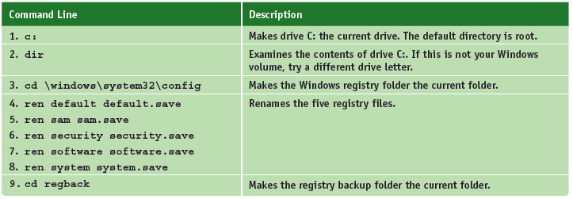
The Command Prompt Window in Windows RE
Table 13-2 Steps to restore the registry files (continues)
Notes:
The Command Prompt Window in Windows RE

Slide 33
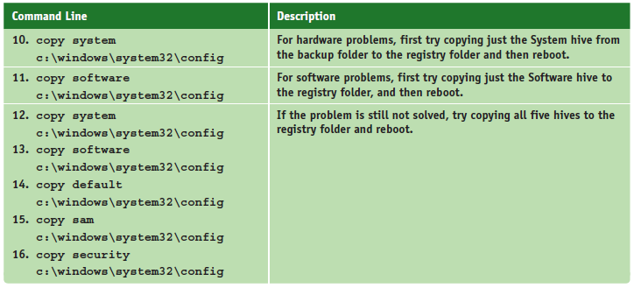
The Command Prompt Window in Windows RE
Table 13-2 Steps to restore the registry files (continued)
Notes:
The Command Prompt Window in Windows RE

Slide 34
The Command Prompt Window in Windows RE
Repair and Manage a Hard Drive
Use chkdsk /r to repair the file system the and format command to reformat a drive
Use diskpart to manage hard drives, partitions, and volumes
Refer to table on the next slide which lists important diskpart commands
Notes:
The Command Prompt Window in Windows RE
Repair and Manage a Hard Drive
Use chkdsk /r to repair the file system the and format command to reformat a drive
Use diskpart to manage hard drives, partitions, and volumes
Refer to table on the next slide which lists important diskpart commands

Slide 35
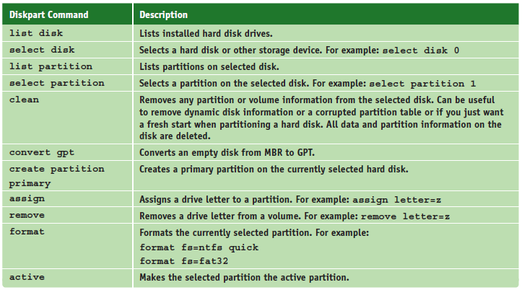
The Command Prompt Window in Windows RE
Table 13-3 Important diskpart commands used at the DISKPART> prompt (continues)
Notes:
The Command Prompt Window in Windows RE

Slide 36
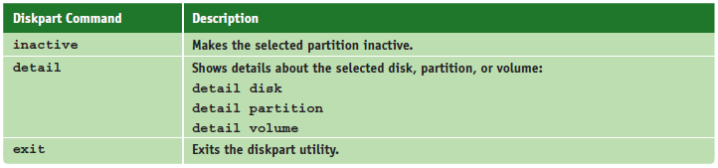
The Command Prompt Window in Windows RE
Table 13-3 Important diskpart commands used at the DISKPART> prompt (continued)
Notes:
The Command Prompt Window in Windows RE

Slide 37
The Command Prompt Window in Windows RE
Enable Networking
Networking is not normally available
Use the wpeinit command to enable networking
Use Bootrec and Bcdedit to Repair the File System and Key Boot Files
Use the bootrec command to repair the BCD and boot sectors
Use the bcdedit command to manually edit the BCD
Use the bootsect command to repair a dual boot system
Notes:
The Command Prompt Window in Windows RE
Enable Networking
Networking is not normally available
Use the wpeinit command to enable networking
Use Bootrec and Bcdedit to Repair the File System and Key Boot Files
Use the bootrec command to repair the BCD and boot sectors
Use the bcdedit command to manually edit the BCD
Use the bootsect command to repair a dual boot system

Slide 38
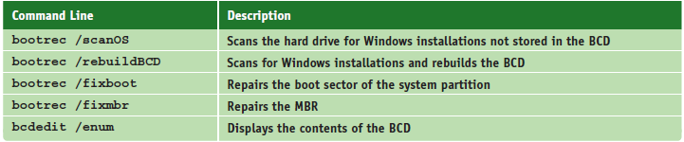
The Command Prompt Window in Windows RE
Table 13-4 Bootrec and bcdedit commands to repair system files and the file system
Notes:
The Command Prompt Window in Windows RE

Slide 39
Tools for Reinstalling Windows
Sometimes Windows is beyond repair and you need to reinstall it
The following startup troubleshooting tools affect the entire Windows installation on a computer
Rather than a few files or settings
Notes:
Tools for Reinstalling Windows
Sometimes Windows is beyond repair and you need to reinstall it
The following startup troubleshooting tools affect the entire Windows installation on a computer
Rather than a few files or settings

Slide 40
OEM Recovery Partition
Laptops and brand-name computers likely have a recovery partition on the hard drive
Contains a copy of the OS build, device drivers, diagnostics programs, and preinstalled applications
Partition might or might not be hidden
To know how to access the recovery tools stored on the recovery partition
See the manufacturer’s website or look for a message at the beginning of the boot
Notes:
OEM Recovery Partition
Laptops and brand-name computers likely have a recovery partition on the hard drive
Contains a copy of the OS build, device drivers, diagnostics programs, and preinstalled applications
Partition might or might not be hidden
To know how to access the recovery tools stored on the recovery partition
See the manufacturer’s website or look for a message at the beginning of the boot

Slide 41
Refresh a Windows 8 Computer
To solve a problem with a corrupted Windows 8 installation you can perform a Windows 8 refresh
Refresh can recover the installation from a custom refresh image that has been designated as:
The active recovery image
A hidden OEM recovery partition on the hard drive
The Windows 8 setup DVD
Unless you are working with a custom refresh image
Windows settings and desktop applications are lost during a refresh
Follow steps outlined in the text to perform a refresh
Notes:
Refresh a Windows 8 Computer
To solve a problem with a corrupted Windows 8 installation you can perform a Windows 8 refresh
Refresh can recover the installation from a custom refresh image that has been designated as:
The active recovery image
A hidden OEM recovery partition on the hard drive
The Windows 8 setup DVD
Unless you are working with a custom refresh image
Windows settings and desktop applications are lost during a refresh
Follow steps outlined in the text to perform a refresh

Slide 42
Reset a Windows 8 Computer
Reset a computer when you are about to give it away, recycle it, or totally want to start over
The Windows volume is formatted and Windows is reinstalled
If an OEM recovery partition is present, the system is reset to its factory state
If no OEM, the Windows setup DVD is requested and is used to reinstall Windows
All user data and settings and installed apps are lost
Follow steps outlined in the text to reset a Windows computer
Notes:
Reset a Windows 8 Computer
Reset a computer when you are about to give it away, recycle it, or totally want to start over
The Windows volume is formatted and Windows is reinstalled
If an OEM recovery partition is present, the system is reset to its factory state
If no OEM, the Windows setup DVD is requested and is used to reinstall Windows
All user data and settings and installed apps are lost
Follow steps outlined in the text to reset a Windows computer

Slide 43
Install Windows Over the Network
You must boot the computer to the network
Where it finds and loads Windows PE on the deployment server
For legacy BIOS system, set the first boot device to be Ethernet
For a UEFI system, look for an advanced setup screen in UEFI setup to enable PXE Support
Computer then boots to the Preboot eXecution Environment (PXE)
PXE searches for a server to provide Windows PE and the deployment image
Notes:
Install Windows Over the Network
You must boot the computer to the network
Where it finds and loads Windows PE on the deployment server
For legacy BIOS system, set the first boot device to be Ethernet
For a UEFI system, look for an advanced setup screen in UEFI setup to enable PXE Support
Computer then boots to the Preboot eXecution Environment (PXE)
PXE searches for a server to provide Windows PE and the deployment image

Slide 44
Troubleshoot Windows Startup
When troubleshooting a startup problem:
Follow procedures to interview the user
Back up important data or verify you have current backups
Research and identify any error messages
Determine what has just changed that might be the source of the problem
When you know the source, decide which tool will be the least invasive to use, yet still fix the problem
Notes:
Troubleshoot Windows Startup
When troubleshooting a startup problem:
Follow procedures to interview the user
Back up important data or verify you have current backups
Research and identify any error messages
Determine what has just changed that might be the source of the problem
When you know the source, decide which tool will be the least invasive to use, yet still fix the problem

Slide 45
Important Data on the Hard Drive
Always start with the question:
“Is there important data on the hard drive not backed up?”
If data is lost or corrupted:
Use Windows tools, third party software, or commercial data recovery services
Use a SATA-to-USB converter kit to temporarily connect a desktop or laptop hard drive to a USB port on a working computer
Use Explorer to copy data to other media
Notes:
Important Data on the Hard Drive
Always start with the question:
“Is there important data on the hard drive not backed up?”
If data is lost or corrupted:
Use Windows tools, third party software, or commercial data recovery services
Use a SATA-to-USB converter kit to temporarily connect a desktop or laptop hard drive to a USB port on a working computer
Use Explorer to copy data to other media

Slide 46
Error Messages and Problems
Hardware errors can present as error messages on a black screen or a blue screen of death (BSOD) stop error
Can be caused by a corrupted registry, a system file that is missing or damaged, a device driver that is missing or damaged, bad memory, or a corrupted or failing hard drive
See Table 13-5 for a list of error messages and what to do about them
Notes:
Error Messages and Problems
Hardware errors can present as error messages on a black screen or a blue screen of death (BSOD) stop error
Can be caused by a corrupted registry, a system file that is missing or damaged, a device driver that is missing or damaged, bad memory, or a corrupted or failing hard drive
See Table 13-5 for a list of error messages and what to do about them

Slide 47
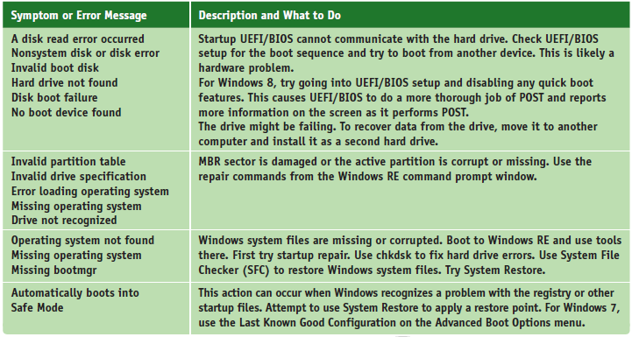
Error Messages and Problems
Table 13-5 Error messages and what to do about them (continues)
Notes:
Error Messages and Problems

Slide 48
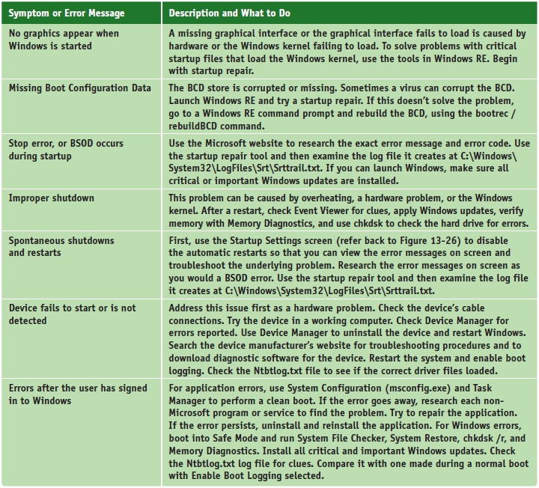
Error Messages and Problems
Table 13-5 Error messages and what to do about them (continued)
Notes:
Error Messages and Problems

Slide 49
Error Messages and Problems
BSOD or Stop Errors
Happen when processes running in kernel mode encounter a problem and Windows must stop the system
Stop errors can occur during or after startup
Follow steps outlined in the text to find out what to do when you get a stop error
Notes:
Error Messages and Problems
BSOD or Stop Errors
Happen when processes running in kernel mode encounter a problem and Windows must stop the system
Stop errors can occur during or after startup
Follow steps outlined in the text to find out what to do when you get a stop error

Slide 50
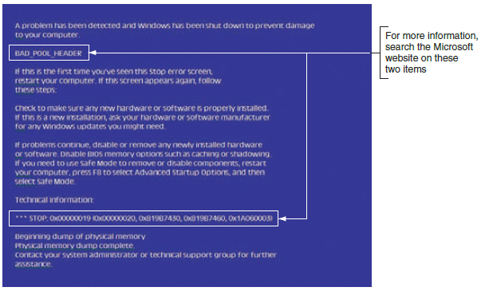
Error Messages and Problems
Figure 13-40 A blue screen of death (BSOD) is definitely not a good sign; time to start troubleshooting
Notes:
Error Messages and Problems

Slide 51
Error Messages and Problems
Dealing with Improper Shutdowns
Most like caused by hardware, such as:
Memory
Motherboard
CPU
Video card
System overheating
Try and check these things:
Check the Event Viewer to see if it has reported a hardware failure
Apply any important or critical Windows updates
Notes:
Error Messages and Problems
Dealing with Improper Shutdowns
Most like caused by hardware, such as:
Memory
Motherboard
CPU
Video card
System overheating
Try and check these things:
Check the Event Viewer to see if it has reported a hardware failure
Apply any important or critical Windows updates

Slide 52
Error Messages and Problems
Dealing with Improper Shutdowns
Try and check these things (cont’d):
Use Memory Diagnostics and chkdsk with the /r parameter to check memory and the hard drive for errors
If you suspect overheating, go into UEFI/BIOS and check the temperature of the CPU (should not exceed 38 degrees C, 100.4 degrees F)
Check for physical damage to the device
Notes:
Error Messages and Problems
Dealing with Improper Shutdowns
Try and check these things (cont’d):
Use Memory Diagnostics and chkdsk with the /r parameter to check memory and the hard drive for errors
If you suspect overheating, go into UEFI/BIOS and check the temperature of the CPU (should not exceed 38 degrees C)
Check for physical damage to the device

Slide 53
Error Messages and Problems
A Device or Service Fails to Start
After identifying a service or device that prevents a normal boot
Boot into Safe Mode and use Device Manager to disable the device (or use the Services console)
Reboot and if the problem goes away, replace the driver or service program file and enable it
If you cannot boot into Safe Mode, open the command prompt window in Windows RE
Backup the registry and use Registry Editor to manually disable the service or driver in the registry
Notes:
Error Messages and Problems
A Device or Service Fails to Start
After identifying a service or device that prevents a normal boot
Boot into Safe Mode and use Device Manager to disable the device (or use the Services console)
Reboot and if the problem goes away, replace the driver or service program file and enable it
If you cannot boot into Safe Mode, open the command prompt window in Windows RE
Backup the registry and use Registry Editor to manually disable the service or driver in the registry

Slide 54
Summary
When a system is turned on, startup UEFI/BIOS takes control to examine hardware components and find an OS to load
Windows startup is managed by the Windows Boot Manager
Before a problem occurs, make sure you have good backups of user data and a Windows 8 custom refresh image or a Windows 7 system image
Windows RE can be started from within Windows, from the Windows setup DVD, or from a recovery drive
Notes:
Summary
When a system is turned on, startup UEFI/BIOS takes control to examine hardware components and find an OS to load
Windows startup is managed by the Windows Boot Manager
Before a problem occurs, make sure you have good backups of user data and a Windows 8 custom refresh image or a Windows 7 system image
Windows RE can be started from within Windows, from the Windows setup DVD, or from a recovery drive

Slide 55
Summary
Tools for startup troubleshooting include startup repair, Memory Diagnostics, System Restore, Safe Mode, enabling boot logging, refresh, reset, and applying a Windows 7 system image
Commands that might be useful when repairing Windows include bootrec, bcdedit, diskpart, chkdsk, and sfc
If a hard drive contains valuable data but will not boot, you might be able to recover data by installing the drive in another system
Notes:
Summary
Tools for startup troubleshooting include startup repair, Memory Diagnostics, System Restore, Safe Mode, enabling boot logging, refresh, reset, and applying a Windows 7 system image
Commands that might be useful when repairing Windows include bootrec, bcdedit, diskpart, chkdsk, and sfc
If a hard drive contains valuable data but will not boot, you might be able to recover data by installing the drive in another system

Slide 56
Summary
Use the web to research stop errors on the error title and error number listed on the blue screen
Improper shutdowns are most likely hardware related
When a device or service causes the system to hang during a normal boot, boot into Safe Mode and disable the device or service
Notes:
Summary
Use the web to research stop errors on the error title and error number listed on the blue screen
Improper shutdowns are most likely hardware related
When a device or service causes the system to hang during a normal boot, boot into Safe Mode and disable the device or service

