Slide 1
INSTALLING LINUX

Slide 2
Linux ubuntu
Today we will be deploying Virtualization on your Desktop & installing Linux Ubuntu.
We will be using “Oracle Virtual Box” a free application as the virtual machine
Virtualization: When one physical machine hosts multiple Operating Systems or activities that are normally done on multiple physical machines.

Slide 3
System requirements
Storage space: Minimum 100GB
Memory: 6GB
Processor: intel i3 or more advanced

Slide 4
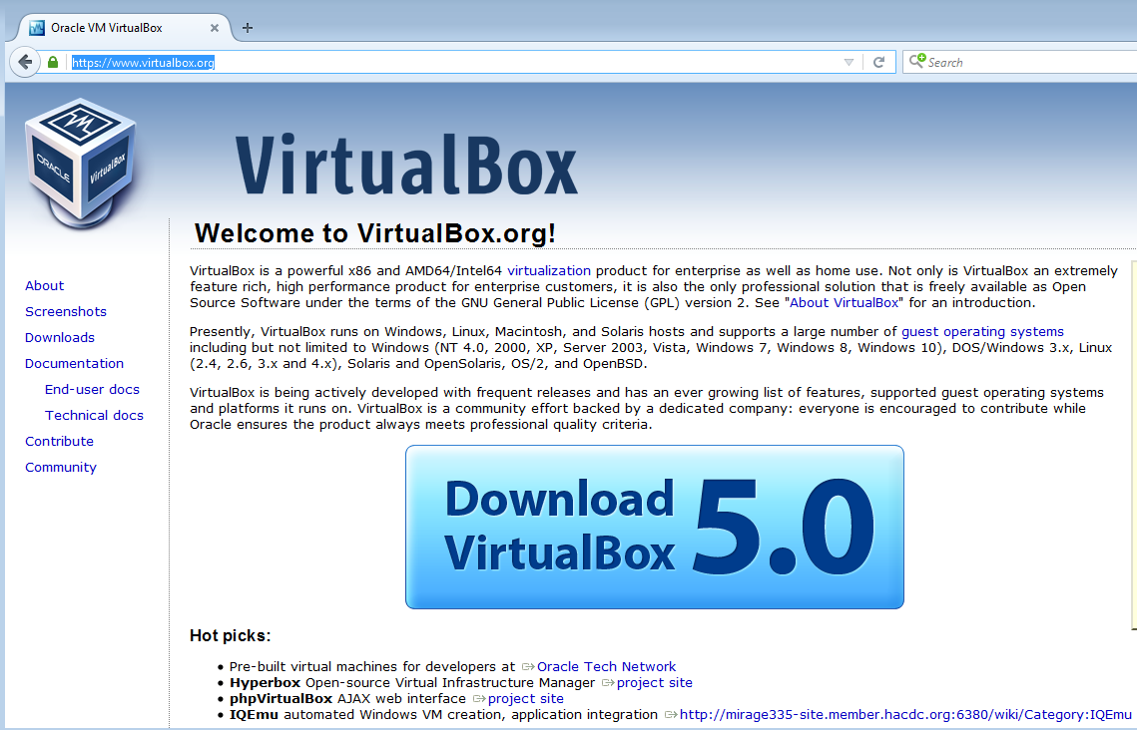
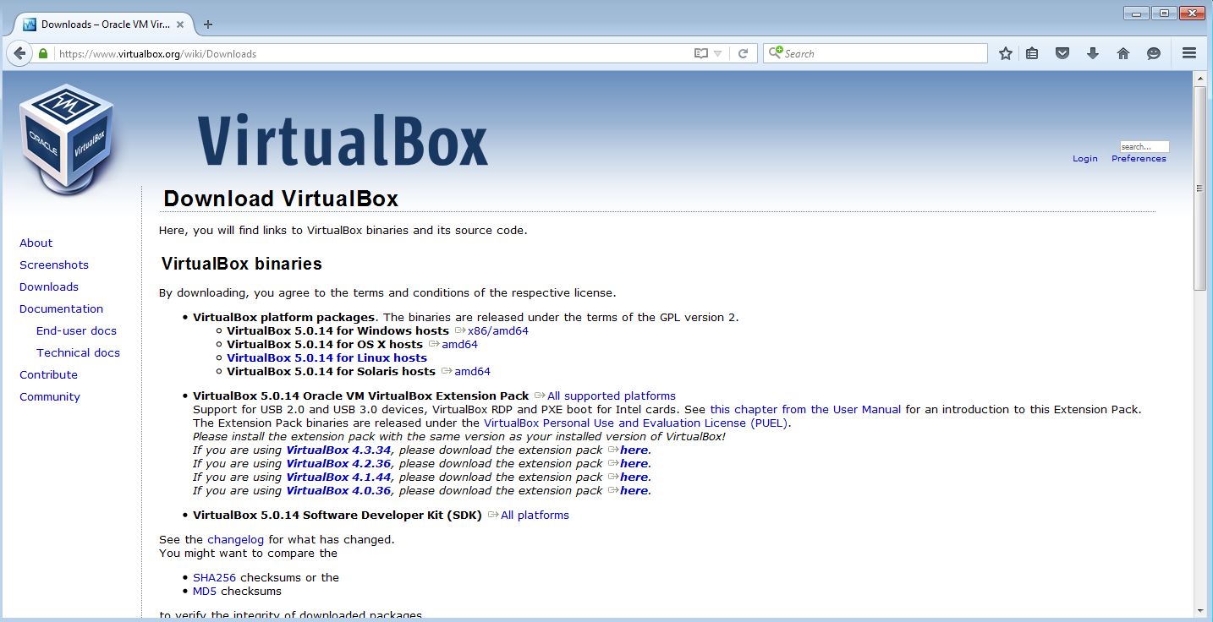
Step 1
Go to :https://www.virtualbox.org
You should be greeted with the screen given on the side top right
Click on the “Download VirtualBox” button (download the latest version they offer) and either save it to your DESKTOP or select “RUN” (if you are using Internet Explorer)
If you do not see that screen, then follow the following step step. Otherwise, go to STEP II: Go to DOWNLOADS on the left pane and then you will see the screen given on the side bottom right
You will need to download the VirtualBox 5.x.x.xx for Windows hosts x86/amd64 to your desktop
Please read each box and then choose all the default settings you are presented with and keep pressing “NEXT” to go to the STEP II

Slide 5
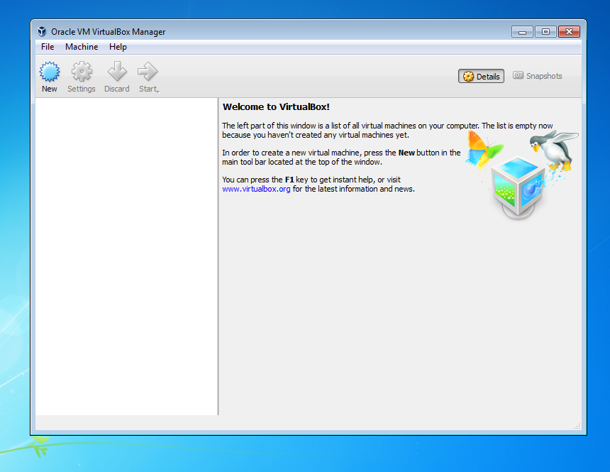
STEP 2
When it is done installing, you will have a screen that looks similar to the screen given on right

Slide 6

Step 3
You will be given a DVD disk with an “ISO” file on it. An ISO is simply a digital file image of a DVD or optical disk and contains the setup files for the Operating System. Place it in your DVD drive.

Slide 7
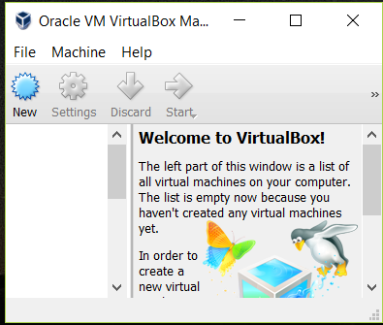
Step 4
Click the blue “NEW” button in Virtual Box Manager

Slide 8
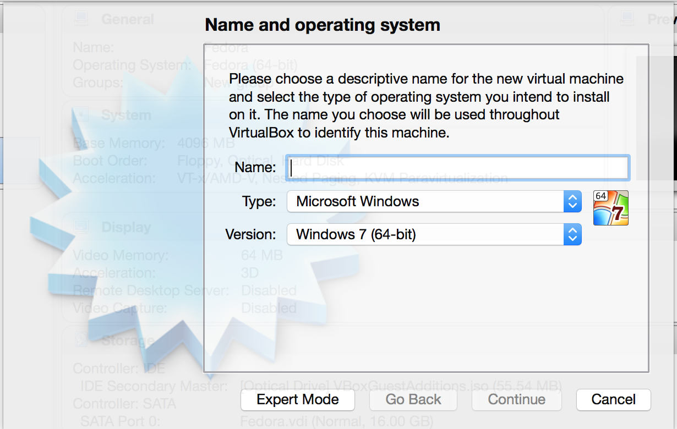
Step 5
Type in the name of the operating system you are installing (ie: Linux Mint, Linux Redhat, Linux Ubuntu etc..)
Choose the type of Operating system (ie: Windows, Linux)
Select Version (64-32 bit)
Click CONTINUE

Slide 9
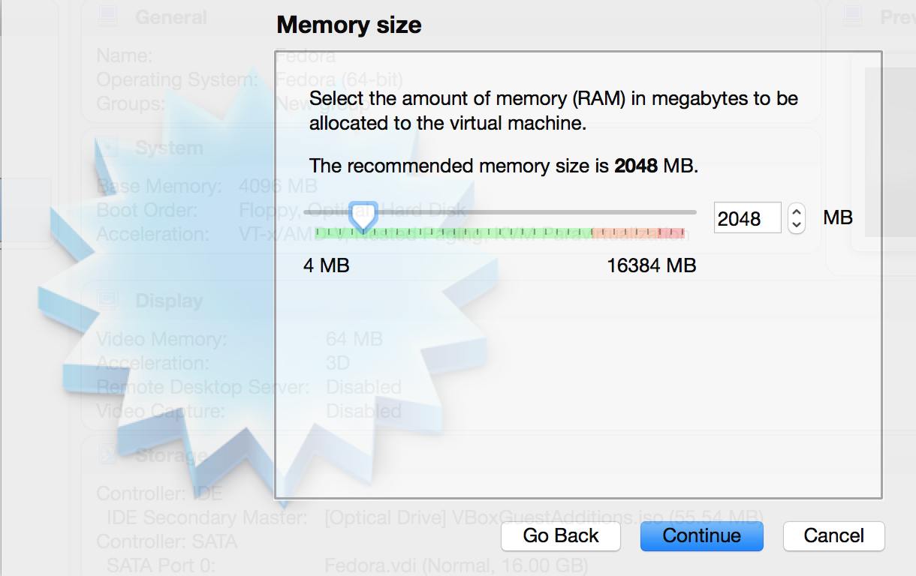
Step 6
Set the memory as needed, using the slide bar
Click continue

Slide 10
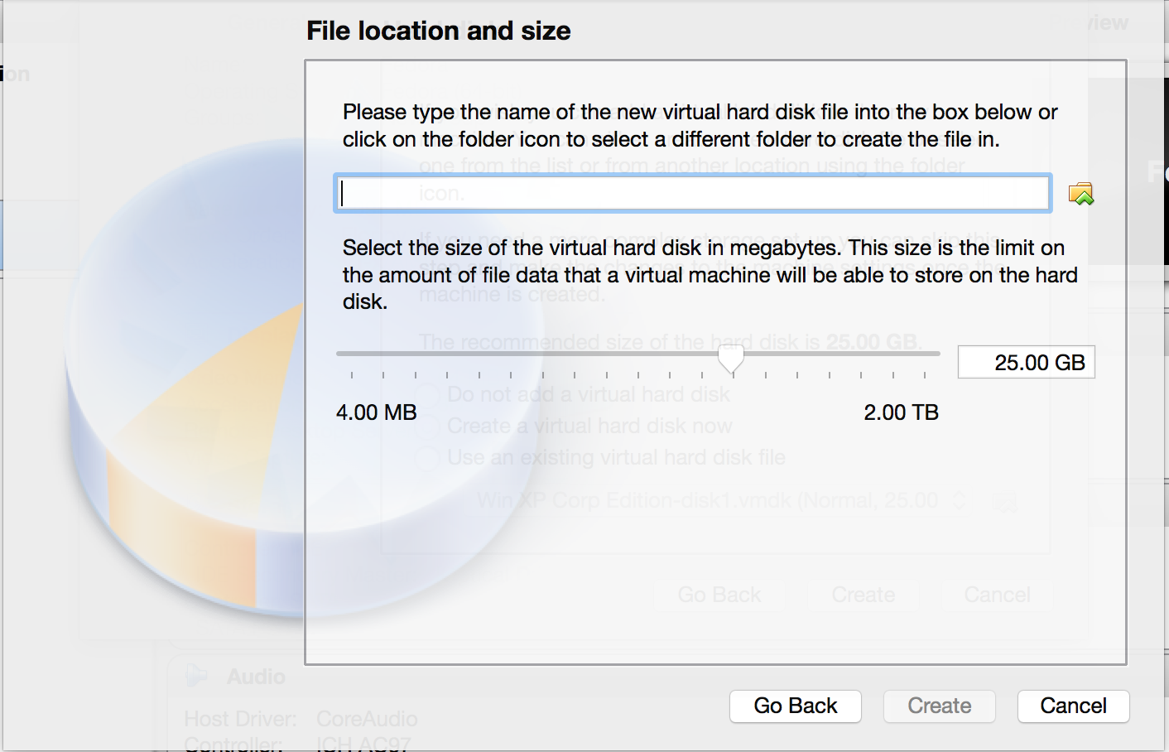
Step 7
Set the File location or name for the new virtual hard disk and size as needed
Click Create

Slide 11
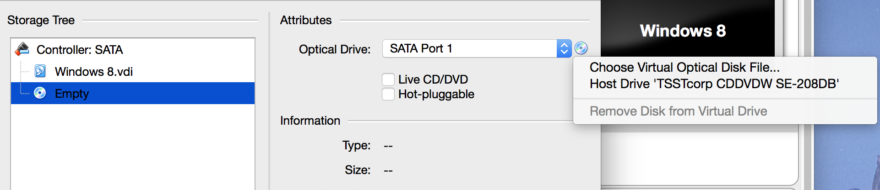
Step 8
On the next screen shown locate and click the Orange “SETTINGS” button
Click Storage
In the storage area, look for a round, DVD symbol and left click in once and click “Host Drive xxxx” (xxxx will be whatever the name of your drive is)

Slide 12
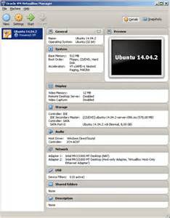
Step 9
Click the Green “START” button. --- Your Operating System will now install

Slide 13
Special thanks to Vasilios “Billy” Pappademetriou for providing us with an outline on how to install Uberstudent.

